Slide 1

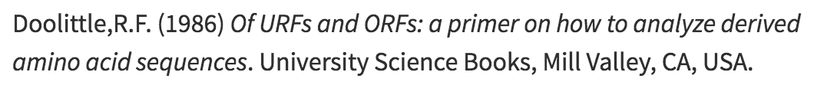

How Can We Compare Sequences ?
The Twilight Zone
%Sequence Identity
Similar Sequence
Similar Structure
Different Sequence
Structure ????
Same 3D Fold
30%
30
Twilight Zone
Length
100

Slide 2
How Can We Compare Sequences ?
The Twilight Zone
Substitution Matrices Work Reasonably Well on Sequences that have more than 30 % identity over more than 100 residues

Slide 3
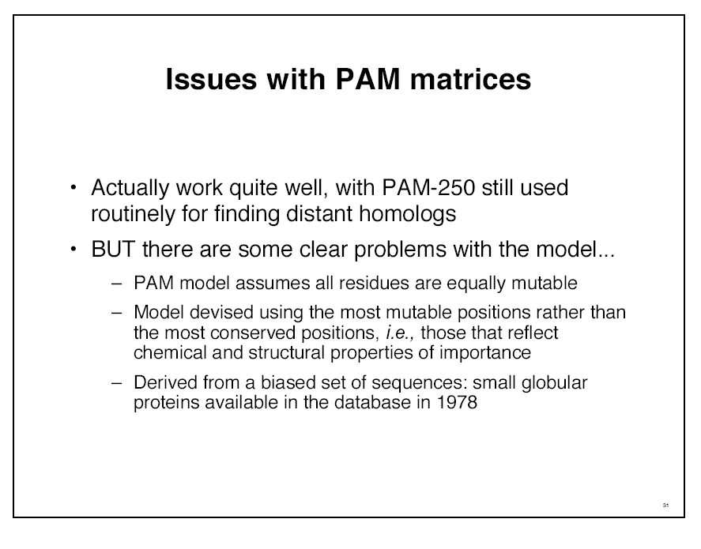

Slide 4
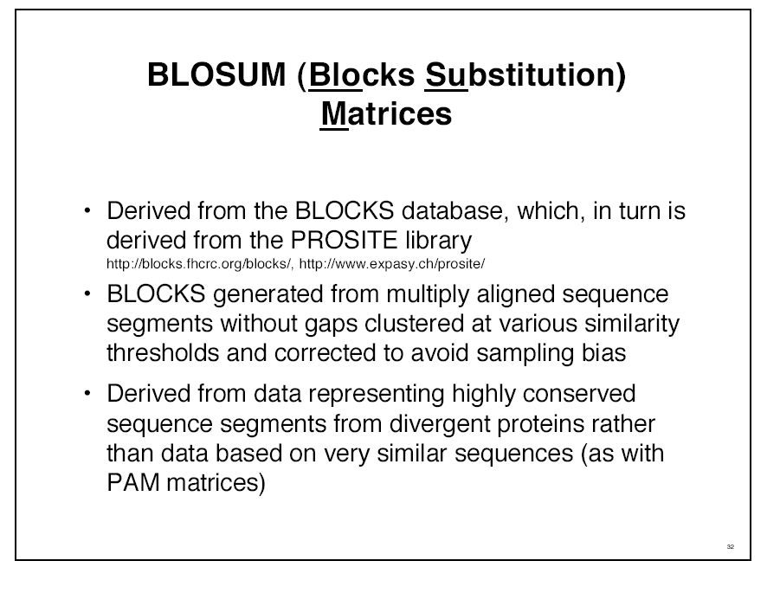

Slide 5
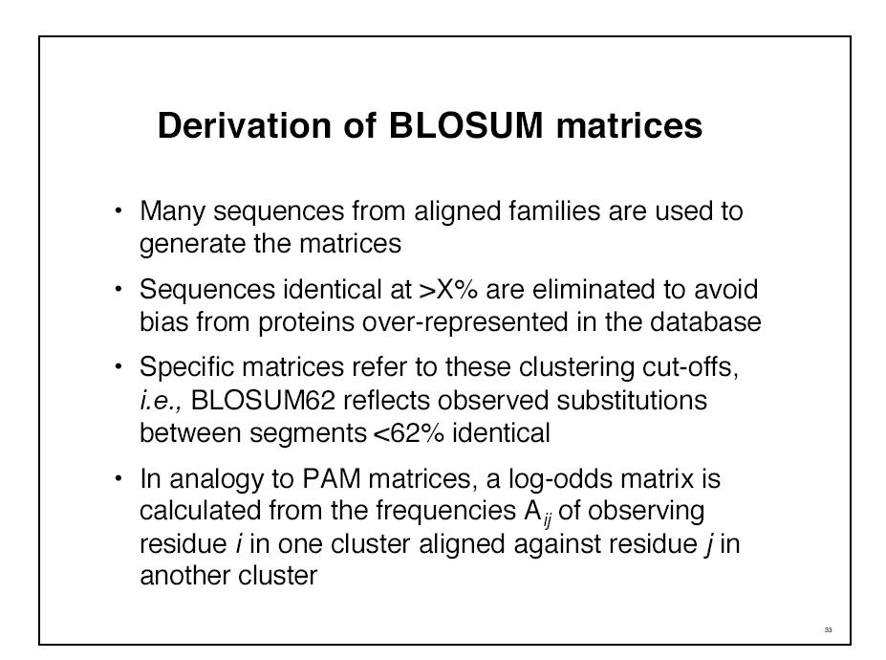

Slide 6
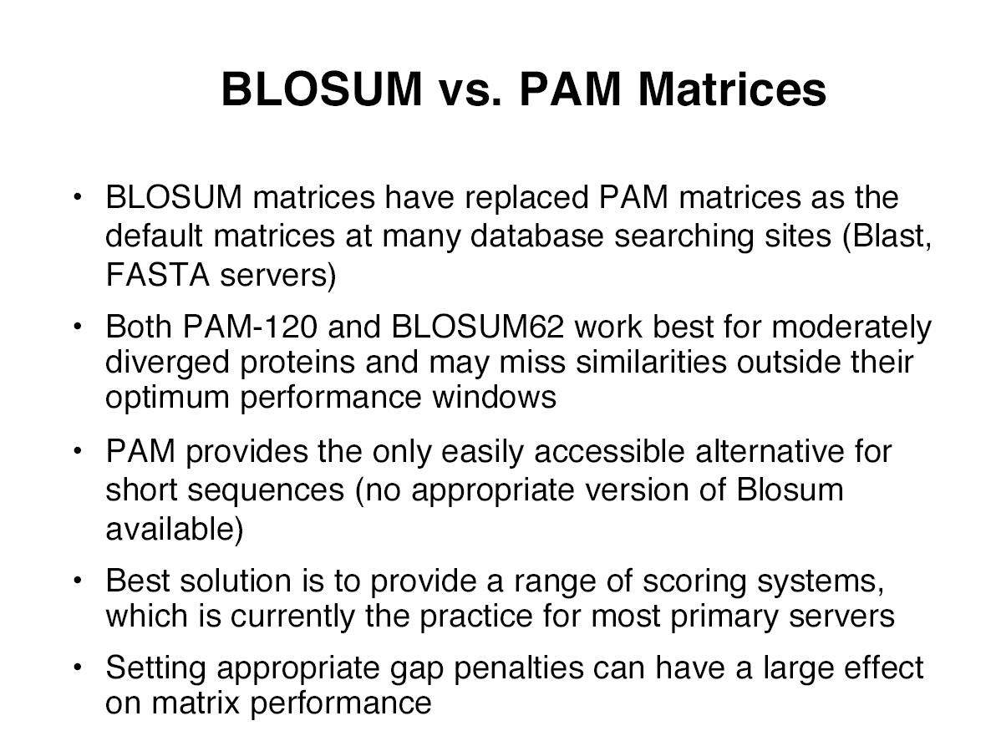

Slide 7
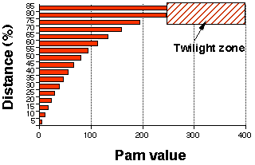
How Can We Compare Sequences ?
Which Matrix Shall I used
The Initial PAM matrix was computed on 80% similar Proteins
It been extrapolated to more distantly related sequences.
Pam 250
Pam 350
Other Matrices Exist:
BLOSUM 42
BLOSUM 62
BLOSUM 62

Slide 8
HOW Can we Align Two Sequences ?
Dot Matrices
Global Alignments
Local Alignment

Slide 9
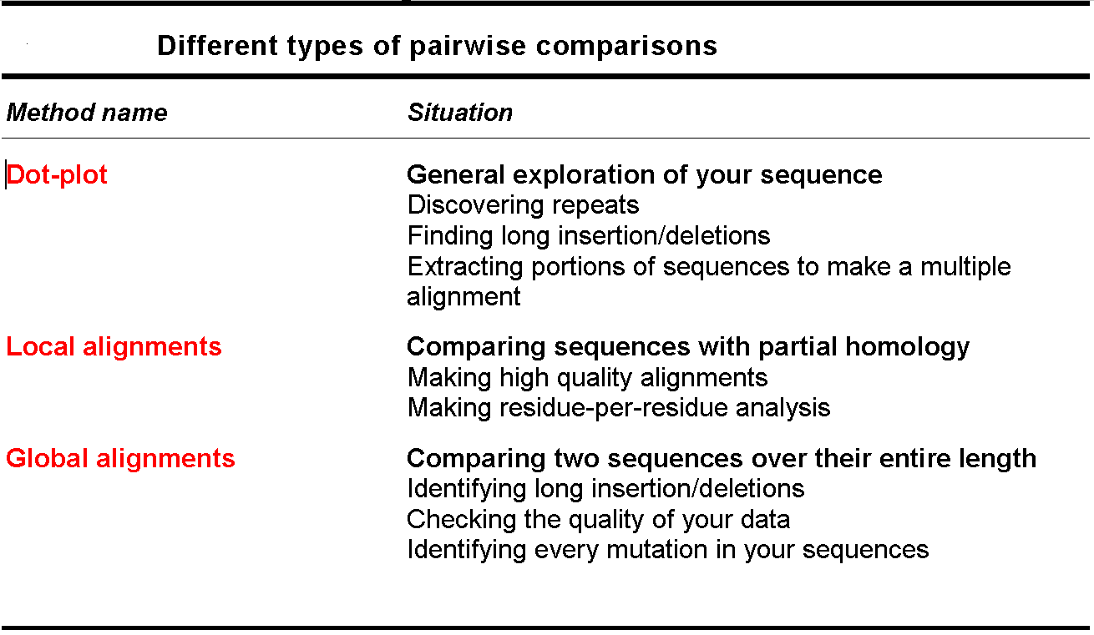

Slide 10
Dot Matrices
QUESTION
What are the elements shared by two sequences ?

Slide 11
Dot Matrices
>Seq1
THEFATCAT
>Seq2
THELASTCAT
T
H
E
F
A
T
C
A
T
T
H
E
F
Window
A
S
T
C
Stringency
A
T

Slide 12
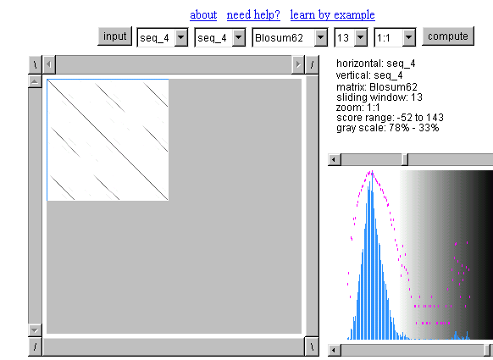

Dot Matrices
Sequences
Window size
Stringency

Slide 13
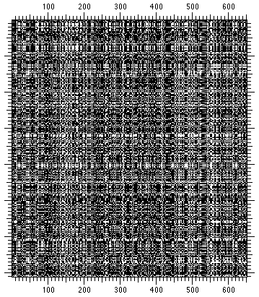
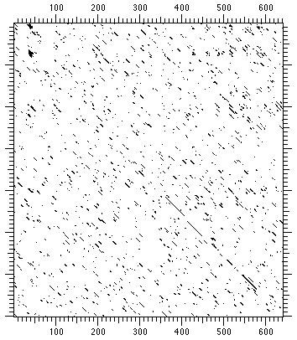
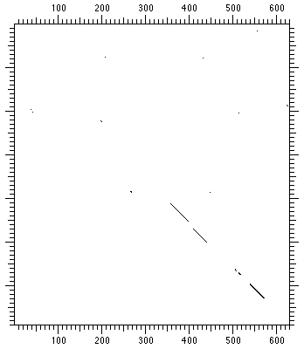
Dot Matrices
Strigency
Window=1
Stringency=1
Window=11
Stringency=7
Window=25
Stringency=15

Slide 14
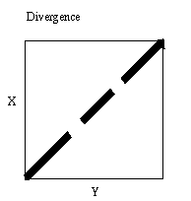
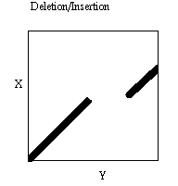
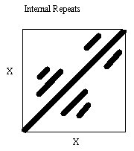
Dot Matrices
x
x
y
y
x

Slide 15
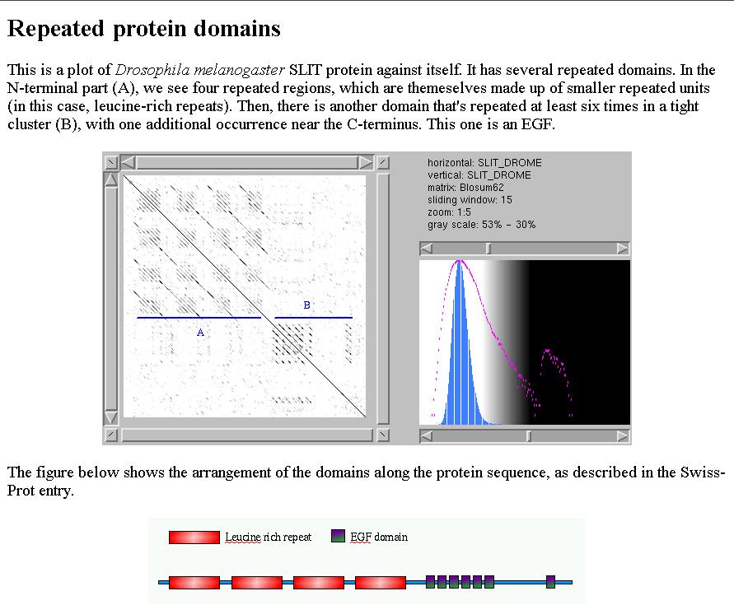
Dot Matrices
http://myhits.isb-sib.ch/cgi-bin/dotlet

Slide 16
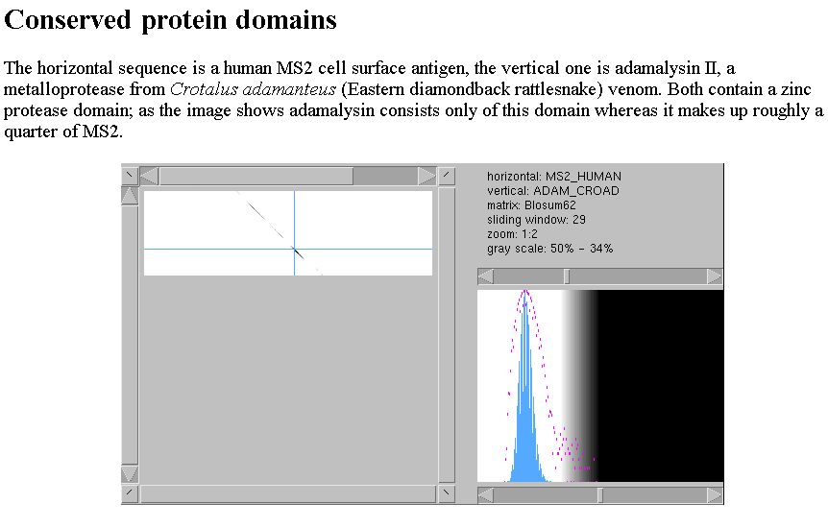
Dot Matrices

Slide 17
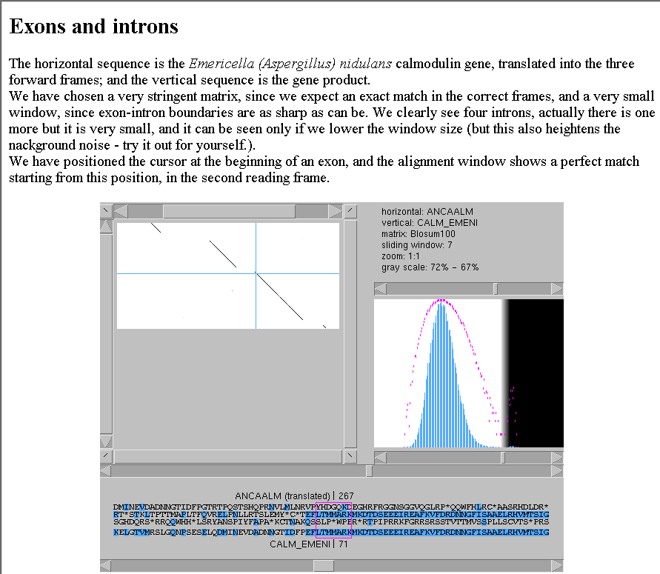
Dot Matrices

Slide 18
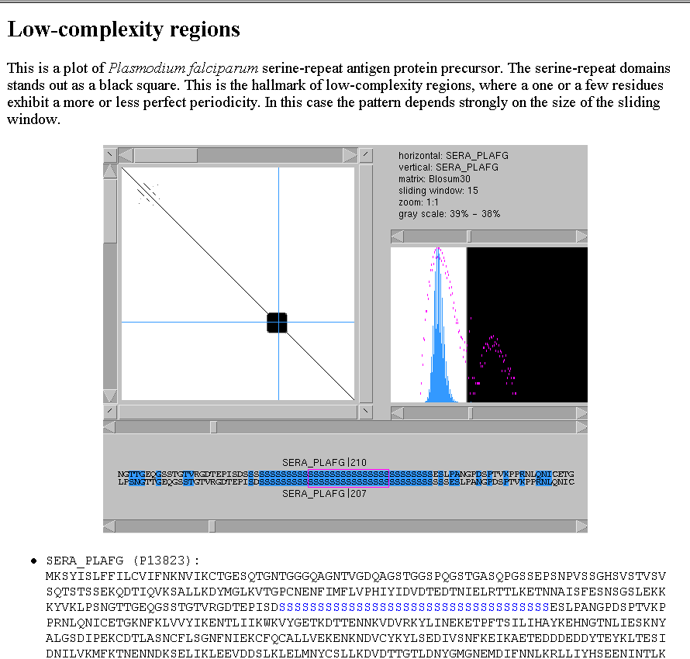
Dot Matrices

Slide 19

Dot Matrices
Limits
-Visual aid
-Best Way to EXPLORE the Sequence Organisation
-Does NOT provide us with an ALIGNMENT
wheat --DPNKPKRAMTSFVFFMSEFRSEFKQKHSKLKSIVEMVKAAGER
| | |||||||| || | ||| ||| | |||| ||||
????? KKDSNAPKRAMTSFMFFSSDFRS----KHSDL-SIVEMSKAAGAA

