Slide 1
Computational approaches to the analysis of RNA-seq data
C. Notredame
Adapted from Haixu Tang,I519 Introduction to Bioinformatics, Fall, 2012

Slide 2
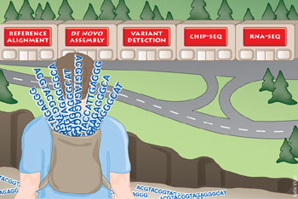
Next-generation gap
http://www.nature.com/nmeth/journal/v6/n11s/full/nmeth.f.268.html

Slide 3
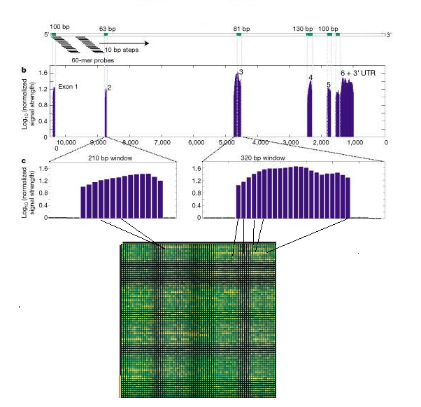
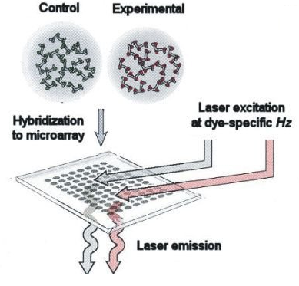
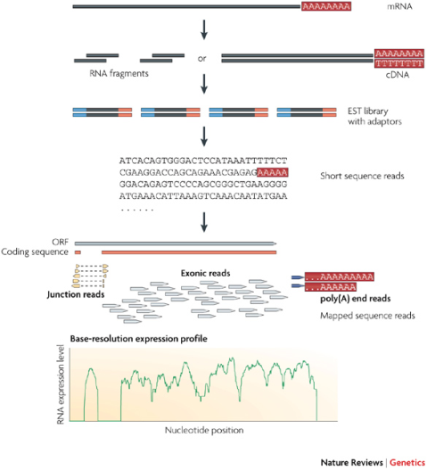
The evolution of transcriptomics
Hybridization-based
RNA-seq is still a technology under active development
1995 P. Brown, et. al.
Gene expression profiling
using spotted cDNA microarray: expression levels of known genes
2002 Affymetrix, whole genome expression profiling using tiling array: identifying and profiling novel genes and splicing variants
2008 many groups, mRNA-seq: direct sequencing of mRNAs using next generation sequencing techniques (NGS)

Slide 4

How RNA-seq works
Sample preparation
Next generation sequencing (NGS)
Data analysis:
Mapping reads
Visualization (Gbrowser)
De novo assembly
Quantification
Figure from Wang et. al, RNA-Seq: a revolutionary tool for transcriptomics, Nat. Rev. Genetics 10, 57-63, 2009).

Slide 5
Next generation sequencing (NGS) techniques
 | 454 Sequencing | Illumina/Solexa | ABI SOLiD
Sequencing Chemistry | Pyrosequencing | Polymerase-based sequence-by-synthesis | Ligation-based sequencing
Amplification approach | Emulsion PCR | Bridge amplification | Emulsion PCR
Paired end (PED) separation | 3 kb | 200-500 bp | 3 kb
Mb per run | 100 Mb | 1300 Mb | 3000 Mb
Time per PED run | <0.5 day | 4 days | 5 days
Read length (update) | 250-400 bp | 35, 75 and 100 bp | 35 and 50 bp
Cost per run | $ 8,438 USD | $ 8,950 USD | $ 17,447 USD
Cost per Mb | $ 84.39 USD | $ 5.97 USD | $ 5.81 USD

Slide 6
RNA-seq vs. microarray
RNA-seq can be used to characterize novel transcripts and splicing variants as well as to profile the expression levels of known transcripts (but hybridization-based techniques are limited to detect transcripts corresponding to known genomic sequences)
RNA-seq has higher resolution than whole genome tiling array analysis
  In principle, mRNA can achieve single-base resolution, where the resolution of tiling array depends on the density of probes
RNA-seq can apply the same experimental protocol to various purposes, whereas specialized arrays need to be designed in these cases
  Detecting single nucleotide polymorphisms (needs SNP array otherwise)
  Mapping exon junctions (needs junction array otherwise)
  Detecting gene fusions (needs gene fusion array otherwise)
Next-generation sequencing (NGS) technologies are now challenging microarrays as the tool of choice for genome analysis.

Slide 7
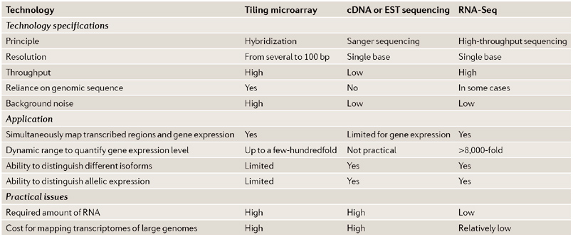
Advantages of RNA-Seq compared with other transcriptomics methods

Slide 8
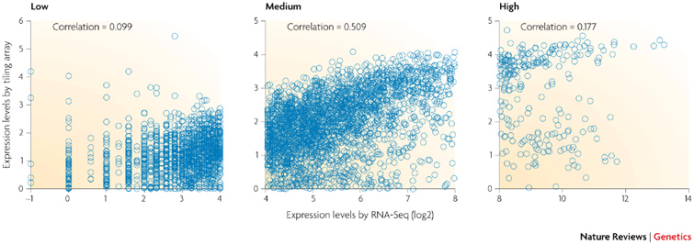
RNA-seq and microarray agree fairly well only for genes with medium levels of expression
Saccharomyces cerevisiae cells grown in nutrient-rich media. Correlation is very low for genes with either low or high expression levels.

Slide 9
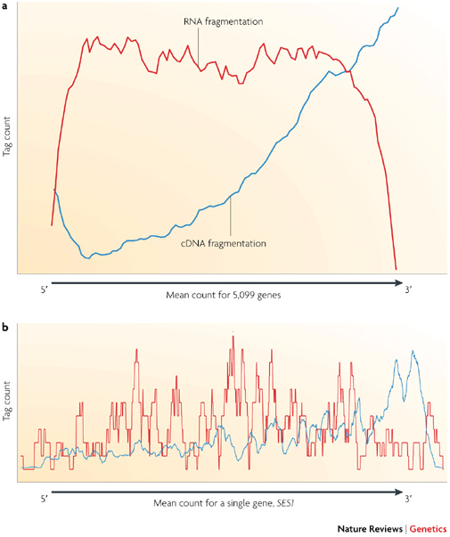
Challenges for RNA-Seq: library construction
Fragmentation of oligo-dT primed cDNA (blue line) is more biased towards the 3' end of the transcript. RNA fragmentation (red line) provides more even coverage along the gene body, but is relatively depleted for both the 5' and 3' ends.
A specific yeast gene, SES1 (seryl-tRNA synthetase)

Slide 10
Library construction
Unlike small RNAs (microRNAs (miRNAs), Piwi-interacting RNAs (piRNAs), short interfering RNAs (siRNAs) and many others), which can be directly sequenced after adaptor ligation, larger RNA molecules must be fragmented into smaller pieces (200–500 bp) to be compatible with most deep-sequencing technologies.
Common fragmentation methods include RNA fragmentation (RNA hydrolysis or nebulization) and cDNA fragmentation (DNase I treatment or sonication).
Each of these methods creates a different bias in the outcome.

Slide 11
Library construction
PCR artefacts
  Many shorts reads that are identical to each other can be obtained from cDNA libraries that have been amplified. These could be a genuine reflection of abundant RNA species, or they could be PCR artefacts.
  Use replicates
Whether or not to prepare strand-specific libraries
  Strand-specific libraries are valuable for transcriptome annotation, especially for regions with overlapping transcription from opposite direction
  strand-specific libraries are currently laborious to produce because they require many steps or direct RNA–RNA ligation, which is inefficient

Slide 12
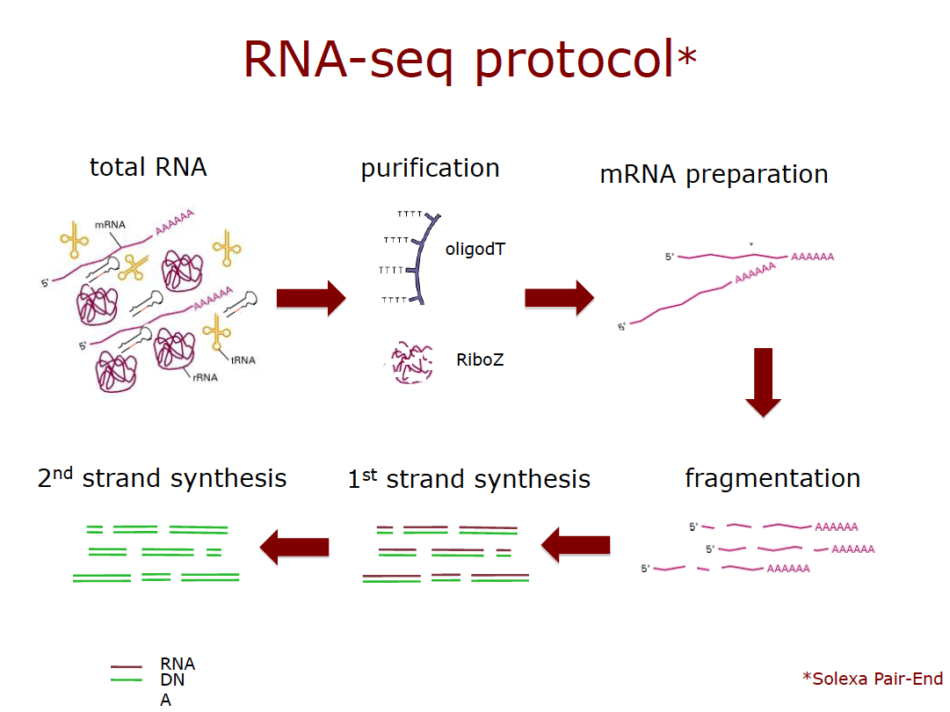

Slide 13
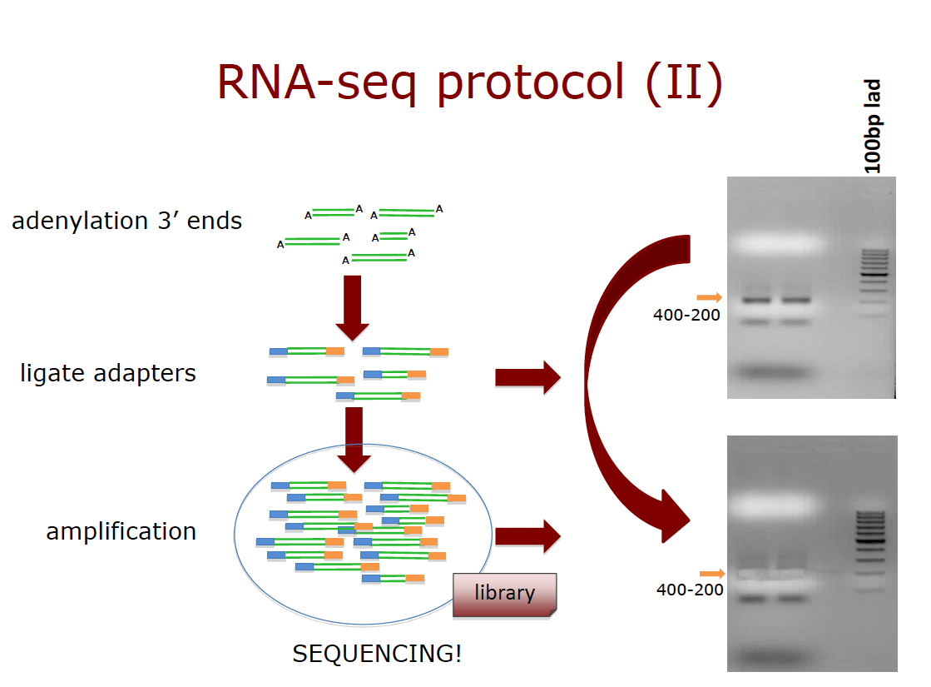

Slide 14
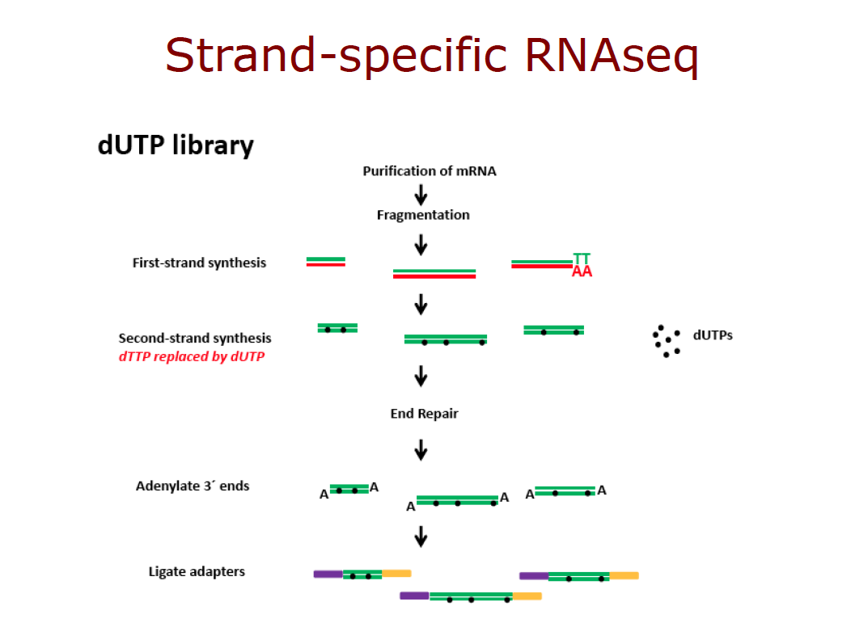

Slide 15
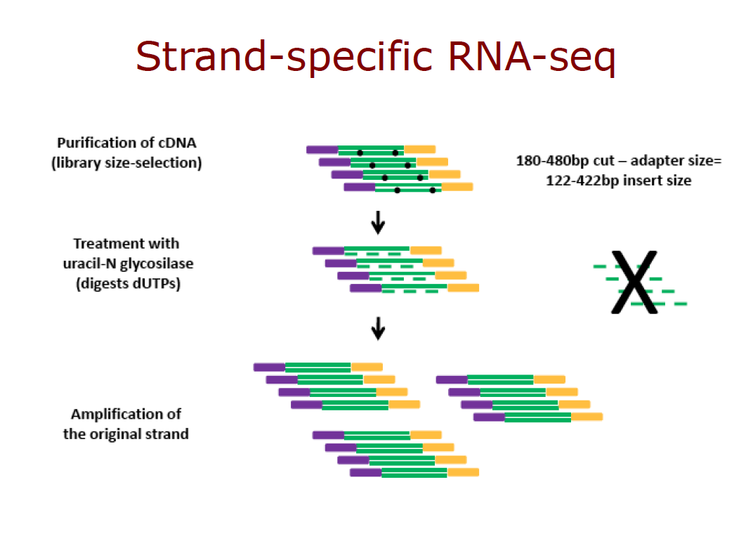
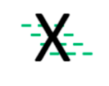

Slide 16
Data analysis for mRNA-seq: key steps
Mapping reads to the reference genome
  Read mapping of 454 sequencers can be done by conventional sequence aligners (BLAST, BLAT, etc)
  Short read aligner needed for Illumina or SOLiD reads
Quantifying the known genes
Prediction of novel transcripts
  Assembly of short reads: comparative vs. de novo
Quantifying splicing variants

Slide 17
Short read aligners
Aligner | Version | Developer | License
BFAST | 0.3.1 | UCLA | Academic
Bowtie | 0.9.8 | Salzberg/UMD | GNUPL
cross_match (CM) | 1.080721 | U. Wash. | Academic
CELL | 2.0 | CLC bio | Commercial
Maq | 0.7.1 | WTSI | GNUPL
Novoalign | 2.00.12 | Novocraft | Academic
RMAP | 0.41 | CSHL | Public
SeqMap | 1.0.12 | Stanford | Academic
Shrimp | 1.1.0 | U. Toronto | Public
SOAP | 2.01 | BGI | Academic
GEM | 1.1 | CRG | Academic
Acknowledgement: Mass Genomics http://www.massgenomics.org/short-read-aligners

Slide 18
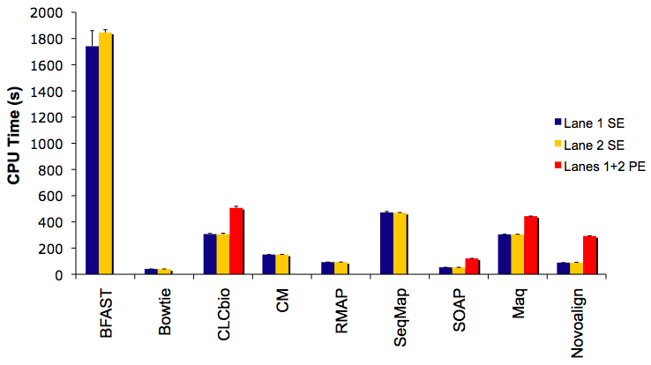
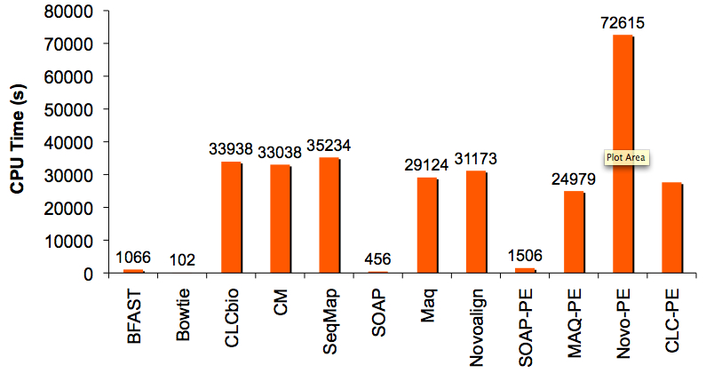
Speed
Trial 1
Trial 2
There were essentially two speed groups. The fastest were BWT-indexing aligners (Bowtie & SOAP) and BFAST, all of which finished in less than 20 minutes. The other aligners (CLCbio, CM, SeqMap, Maq, Novoalign) were comparable in speed to one another and completed in 8-9 hours.
Some data is not shown: SHRiMP is very slow and RMAP is not accurate.
SE: single-end; PE: paired-end
Acknowledgement: Mass Genomics http://www.massgenomics.org/short-read-aligners

Slide 19
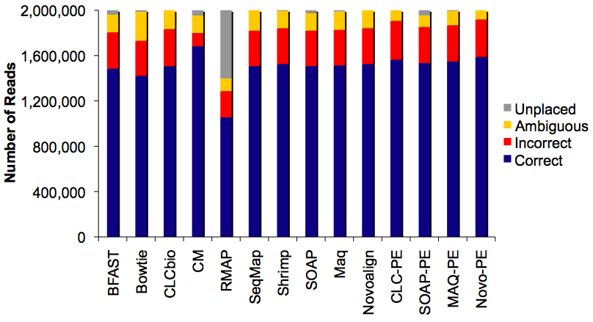
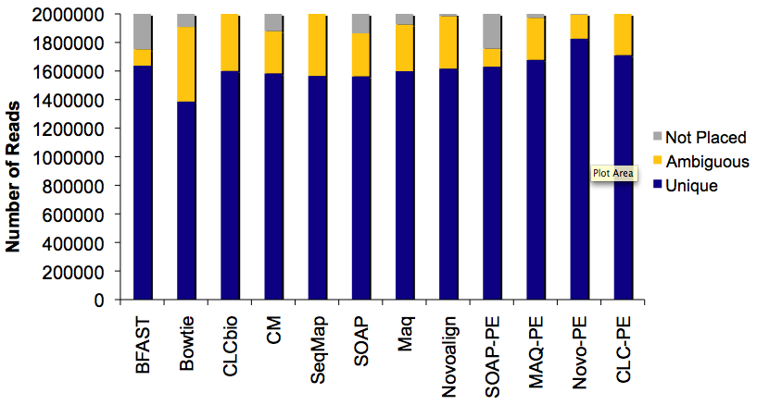
Accuracy
Trial 1
Trial 2
Most aligners placed similar numbers of reads uniquely, yet the numbers of ambiguously-placed or unmapped reads varied widely.
Novoalign in paired-end mode (Novoalign-PE) was the clear winner, though in fairness, it did take at least twice as long to complete as the other aligners.
Acknowledgement: Mass Genomics http://www.massgenomics.org/short-read-aligners

Slide 20
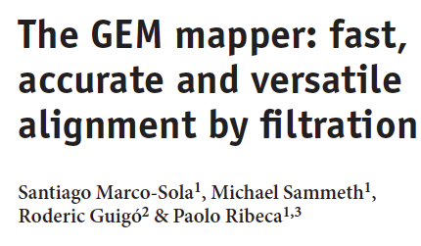
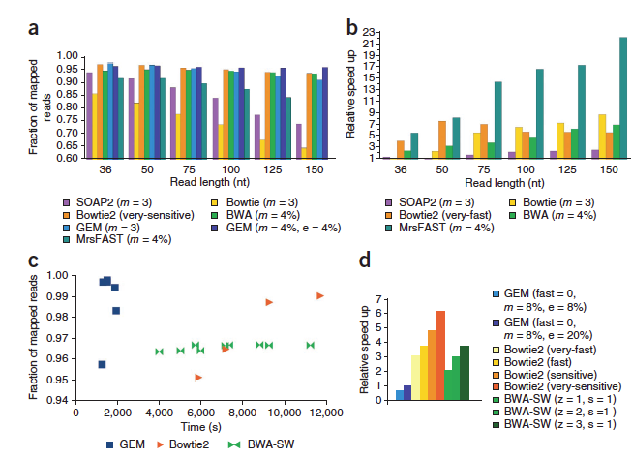
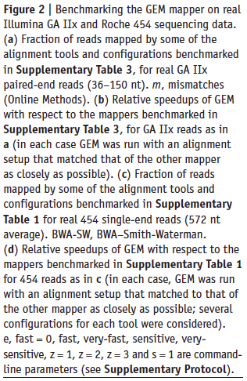

Slide 21
Recommendations
Proven functionality: Maq
  Maq is clearly the most widely used and probably the most publication-proven algorithm
Speed: Bowtie, SOAP and GEM
  The Burrows-Wheeler Transformation indexing aligners have a clear speed advantage. Both have the added benefit of paired-end mode
Sensitivity: Novoalign & cross_match
    Both aligners have algorithmic advantages over programs like Maq. Novoalign allows gaps in single-end mode, and seems better suited to handling mismatches as well. The cross_match program had the best overall sensitivity
Variation detection: SOAP & Novoalign
    Novoalign makes the list because of added sensitivity to substitutions and gaps, which makes it ideal for mining Maq-unplaced reads for variation. SOAP developers have already released a SNP caller (SOAPsnp) and promise an indel caller too
Acknowledgement: Mass Genomics http://www.massgenomics.org/short-read-aligners

Slide 22
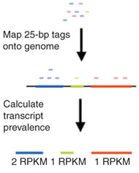
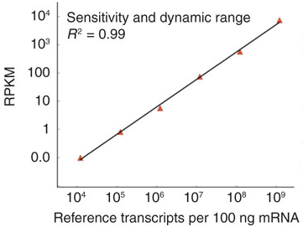
Quantification of known transcripts
The expression levels of known transcripts (exon model) are measured by the number of reads per kilobase of transcript per million mapped reads (RPKM)
Mortazavi, A., Williams, B. A., McCue, K., Schaeffer, L. & Wold, B. Mapping and quantifying mammalian transcriptomes by RNA-Seq. Nature Methods 5, 621–628 (2008).

Slide 23
Lander-Waterman model: foundation of gene expression profiling using mRNA-seq
Consider a shotgun sequencing process in which N reads (of length T) are sampled from a pool of transcripts of total length G. The number of reads mapped to a transcript (with length g and n copies) follows a Poisson distribution with mean α ~ n(g-T)/G × NT/G.
The variation of the number of reads can also be computed based on this model.
For details see: Sharon et. al, RECOMB 2009.

Slide 24
Prediction of novel transcripts: assembling the short reads
Comparative assembly: using an annotated reference genome
  Searching for junctions of annotated exons
  Assembling splice variants
  Finding paired-end (PED) links between exons
De novo assembly: without using a reference genome
  Splicing graph approach: Heber, et. al. ISMB 2002 for EST assembly
  K-mer based approach, working efficiently for short reads (e.g. Velvet, ALLPATH and EULER-ESR)
  Compact representation for alternative splicing variants
  Can also be adapted for comparative assembly & assembly with PED reads

Slide 25
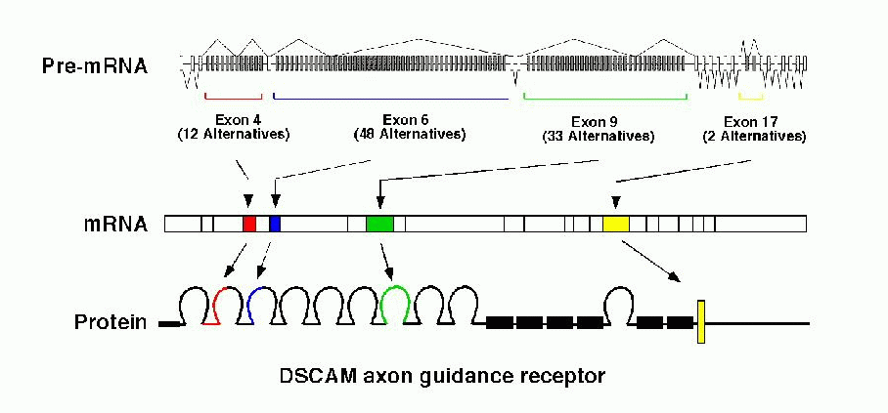
Alternative Splicing (AS)
35% - 60% of human genes show AS
some genes have a huge number of isoforms
(slo >500, neurexin >1000, DSCAM > 38000)
Taken from [Graveley, 2001]

Slide 26
How to assemble multiple alternative spliced transcripts?
In the presence of AS, conventional assembly may be erroneous, ambiguous, or truncated.
truncated
truncated
1
2
3
Overlapping
correct
truncated

Slide 27
Splice graph approach
Replace the problem of finding a list of consensus sequences
with Graph Reconstruction Problem:
Given an set of expressed sequence, find a minimal graph (splicing graph) representing all transcripts as paths.
Heber, et. al. ISMB 2002

Slide 28
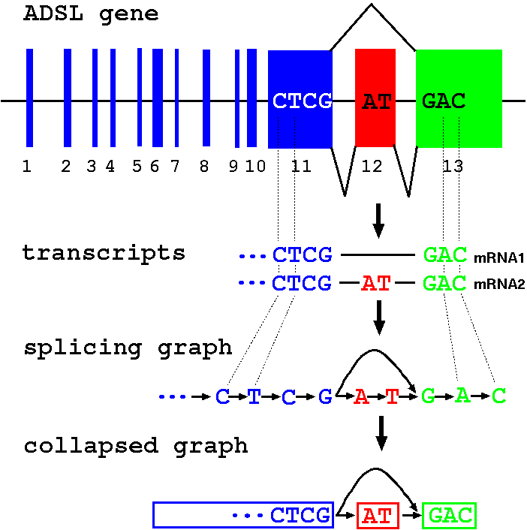
Splicing graphs

Slide 29
Splicing graph construction
If a reference genome is used:
Map reads to the reference genome (short read aligner)
Check alignment (splice sites, quality)
Connect consecutive positions
Build splicing graph
transcript 1
genomic seq.
splicing graph
transcript 2

Slide 30
Splicing graph construction
If a reference genome sequence is not used:
Break sequences into k-mers (20-mers).
Build graph using k-mers as vertices, connect them iff they occur consecutively in a sequence [Pevzner et al., 2001].
Example (3-mers):
Sequences: CTCGATGAC, CTCGGAC
Vertices: {CTC, TCG, CGA, GAT, ATG, TGA, GAC, CGG, GGA}
CGG → GGA
CTC → TCG → CGA → GAT → ATG → TGA → GAC
splicing graph
CTCG → AT → GAC
collapsed splicing graph

Slide 31
Splicing graph and splicing variants
s
A
B
C
D
f
s
A
B
C
D
f
An edge in the splicing graph, called a block, represents a maximal sequence of adjacent exons or exon fragments that always appear together in a given set of splicing variants. Therefore, variants can be represented by sequence of blocks, e.g. {ABCD, C, AD}.
Vertices s and f are included into graph, and are linked to the 5’ and 3’ of each variant, respectively. Each splicing variant corresponds to a directed path that goes from s to t. But note that some paths in the splicing graph do not correspond to real variants, e.g. {ABC, CD}.
Larcroix, et. al. WABI, 2009

Slide 32
Quantifying splicing variants
(Transcriptome reconstruction problem) Given a set of candidate splicing variants S={x₁, …, x_{k}}, and a set of constraints {C₁, …, C_{k}}, each indicating the total abundance of a subset of variants in S, assign the most possible abundance to each variant such at all constraints are satisfied?
In practice, a constraint C_{j}, will reflect the abundance of a block junction j, measured by mRNA-seq reads mapped to the two linked blocks.
Larcroix, et. al. WABI, 2009

Slide 33
Quantifying all splicing variants
For example, in the case of previous slide, constraints can be generated for junctions of blocks {sA=A, AB, BC, CD, sC=Cf=C, Df=D, AD}.
Specifically, for all potential variants in the graph {ABCD, ABC, AD, C, CD}, we have independent constraints of,
ABC+C=C_{Cf}; ABCD+ABC=C_{AB};
C+CD=C_{sC}; AD=C_{AD}
Larcroix, et. al. WABI, 2009

Slide 34
Quantifying known splicing variants
In we known the variants in advance, the same approach can be applied. For example, assuming three known variants in the graph are {ABCD, AD, C}, we have (much simpler) independent constraints of,
C=C_{Cf}; ABCD=C_{AB};
AD=C_{AD}
Larcroix, et. al. WABI, 2009

Slide 35
Integrating mapped PED reads
Given a splicing graph and a set of observed PED reads mapped to block junctions, we first identify all paths (corresponding to potential splicing variants) containing only observed pairs of blocks.
The resulting variants can be used for quantification as indicated in the previous slides.
Larcroix, et. al. WABI, 2009

Slide 36
A probabilistic approach to transcriptome reconstruction
The previous model assumes all observed abundance values in the constraints are accurate. In practice, however, it may not be true due to the noise in the mRNA-seq data. To handle this, a maximum likelihood (ML) model was introduced.
For a gene g, suppose it has m exons with lengths L=[l₁, l₂,..., l_{m}] and n variants with abundances Θ=[θ₁, θ₂,...,θ_{n}]. Consider a set of constraints in which each constraint k has an observed abundance x_{k} reflecting the approximate total abundance of a subset of variants (denoted by c_{ki}, c_{ki}=1 if variant i is included; c_{ki}=0 otherwise).
Jiang and Wong, Bioinformatics, 2009

Slide 37
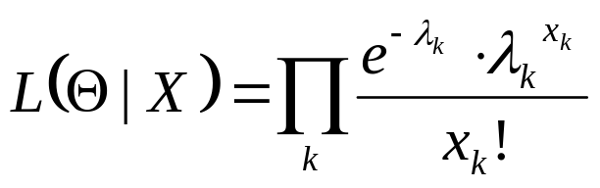
ML model
Based on the previous notation, the expected abundance in constraint k is λ_{k}= Σ_{i}c_{ki}θ_{i}.
The likelihood of observing an abundance λ_{k} for constraint k can be computed by Lander-Waterman’s Poisson model:
The MLE of the abundances of known variants can be computed by maximizing the likelihood function.
The uncertainty of the MLE can be estimated using an important sampling (IP) on the joint distribution.
Jiang and Wong, Bioinformatics, 2009

Slide 38
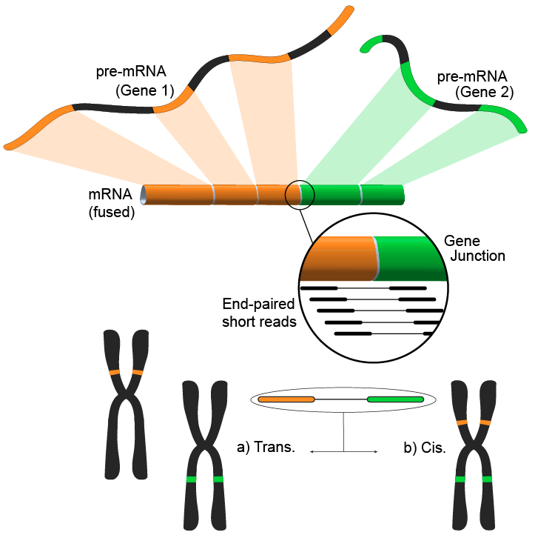
Other applications of mRNA-seq: gene fusion
Following the alignment of the short m-RNA reads to a reference genome, most reads will fall within a single exon, and a smaller but still large set would be expected to map to known exon-exon junctions. The remaining unmapped short reads can then be further analyzed to determine whether they match an exon-exon junction where the exons come from different genes. An alternative approach is using pair-end reads, when potentially a large number of paired reads would map each end to a different exon, giving better coverage of these events. Nonetheless, the end result consists of multiple and potentially novel combinations genes providing an ideal starting point for further validation.
Acknowledgement: Wiki – mRNA-seq

Slide 39
Challenges: mapping reads to reference genome
Sequencing errors and polymorphisms
It is more difficult to map reads that span splice junctions (for complex transcriptomes), due to the presence of extensive alternative splicing and trans-splicing.
Repetitive sequences: a significant portion of sequence reads match multiple locations in the genome
  Obtaining longer sequence reads, or paired-end sequencing strategy, should help alleviate the multi-matching problem.

Slide 40
Challenges: novel splicing variant & quantification
Discovery of novel splicing variants
  Reconstruction of complete splice forms
  Reliability: assignment of a P-value
Quantifying the expression levels of recently duplicated genes
  Equivalent to the problem of quantifying splicing variants, but harder because many isoforms need to be consider simultaneously

Slide 41
Some discoveries from mRNA-Seq
Novel features of eukaryotic gene organization
  Many yeast genes were found to overlap at their 3' ends; 808 pairs of ORFs overlap at their 3' ends (Science 320, 1344–1349, 2008)
  Antisense expression (may be involved in gene regulation) is enriched in the 3' exons of mouse transcripts (Nature Methods 5, 613–619, 2008)
Novel splicing forms
  31,618 known splicing events were confirmed (11% of all known splicing events) and 379 novel splicing events were discovered in human (Biotechniques 45, 81–94, 2008)
Novel transcripts

Slide 42
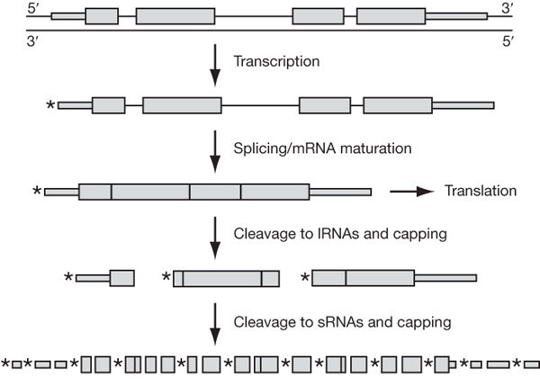
Deeper insights into the complex transcriptomes
Deep sequencing of small RNAs (<200 nucleotides) from human HeLa and HepG2 cells
Individual non-coding RNAs dwarf the number of protein-coding genes, and include classes that are well understood as well as classes for which the nature, extent and functional roles are obscure
A proposed model for the metabolism of genic transcripts into a diversity of long and short RNAs.
Nature 457, 1028-1032, 2009

Slide 43
Another paper of deep sequencing of human transcriptome
50% of the reads mapped to unique genomic locations, of which 80% corresponded to known exons.
66% of the polyadenylated transcriptome mapped to known genes and 34% to nonannotated genomic regions.
On the basis of known transcripts, RNA-Seq can detect 25% more genes than can microarrays.
A global survey of messenger RNA splicing events identified 94,241 splice junctions (4096 of which were previously unidentified) and showed that exon skipping is the most prevalent form of alternative splicing.
Ref: Science, 321(5891):956-60, 2008

Slide 44
Readings
RNA-Seq: a revolutionary tool for transcriptomics, Nature Reviews Genetics 10, 57-63, 2009
Go with microarray or RNA-seq?
  Advantages of next-generation sequencing versus the microarray in epigenetic research,
  Briefings in Functional Genomics and Proteomics 2009 8(3):174-183)
Full-length transcriptome assembly from RNA-Seq data without a reference genome
  Nature Biotechnology Volume: 29, Pages: 644–652 Year published: (2011)
Next-generation transcriptome assembly
  Nature Reviews Genetics 12, 671-682
  This Review summarizes the recent developments in transcriptome assembly approaches — reference-based, de novo and combined strategies

