Slide 1

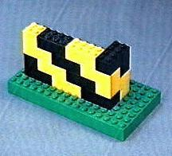
An Introduction to
Multiple Sequence Alignments
Cédric Notredame

Slide 2

chite ---ADKPKRPLSAYMLWLNSARESIKRENPDFK-VTEVAKKGGELWRGLKD
wheat --DPNKPKRAPSAFFVFMGEFREEFKQKNPKNKSVAAVGKAAGERWKSLSE
trybr KKDSNAPKRAMTSFMFFSSDFRS----KHSDLS-IVEMSKAAGAAWKELGP
mouse -----KPKRPRSAYNIYVSESFQ----EAKDDS-AQGKLKLVNEAWKNLSP
***. ::: .: .. . : . . * . *: *
chite AATAKQNYIRALQEYERNGG-
wheat ANKLKGEYNKAIAAYNKGESA
trybr AEKDKERYKREM---------
mouse AKDDRIRYDNEMKSWEEQMAE
* : .* . :

Slide 3
Manguel M, Samaniego F.J.,
Abraham Wald’s Work on Aircraft Suvivability,
J. American Statistical Association. 79, 259-270, (1984)

Slide 4
Why Do We Need Multiple Sequence Alignment ?

Slide 5

How Can I Use A Multiple Sequence Alignment?
chite ---ADKPKRPLSAYMLWLNSARESIKRENPDFK-VTEVAKKGGELWRGLKD
wheat --DPNKPKRAPSAFFVFMGEFREEFKQKNPKNKSVAAVGKAAGERWKSLSE
trybr KKDSNAPKRAMTSFMFFSSDFRS----KHSDLS-IVEMSKAAGAAWKELGP
unknown -----KPKRPRSAYNIYVSESFQ----EAKDDS-AQGKLKLVNEAWKNLSP
***. ::: .: .. . : . . * . *: *
chite AATAKQNYIRALQEYERNGG-
wheat ANKLKGEYNKAIAAYNKGESA
trybr AEKDKERYKREM---------
unknown AKDDRIRYDNEMKSWEEQMAE
* : .* . :
Less Than 30 % id
BUT
Conserved where it MATTERS
Extrapolation Beyond The Twilight Zone
Homology?
SwissProt
Unkown Sequence

Slide 6
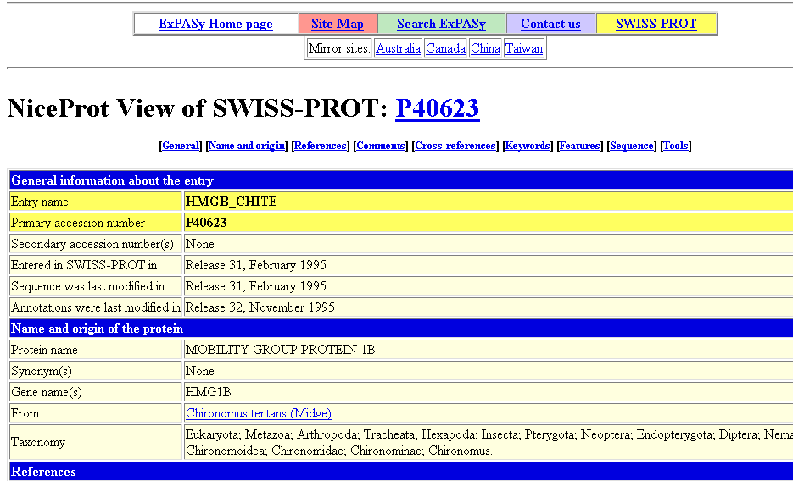
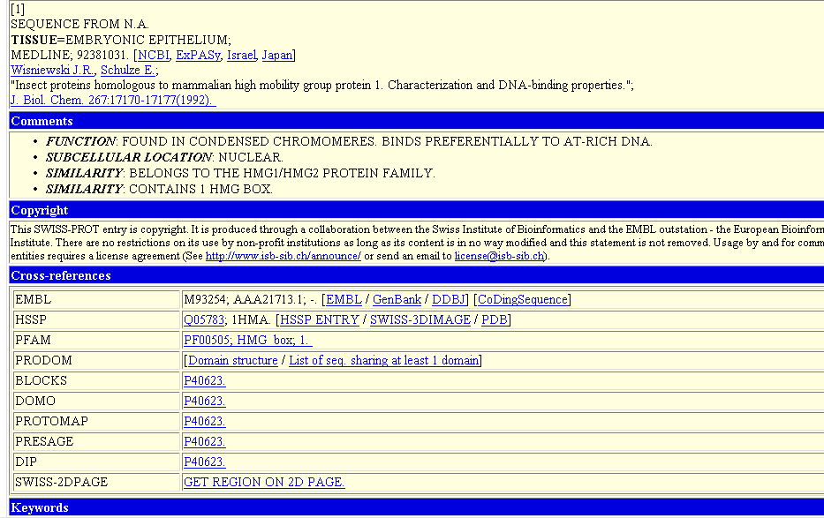
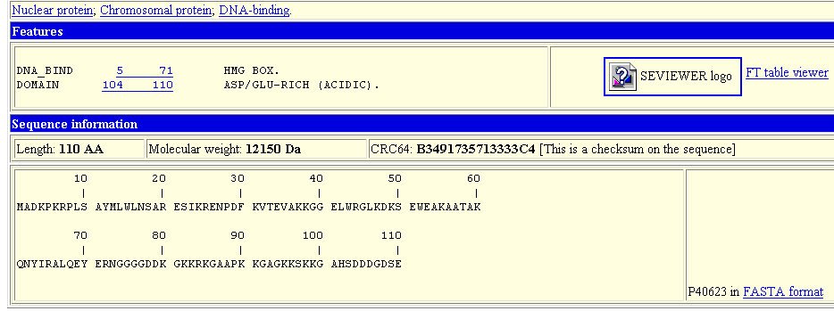

Slide 7
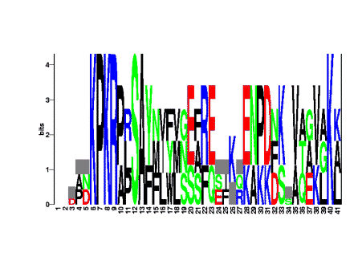
How Can I Use A Multiple Sequence Alignment?
chite ---ADKPKRPLSAYMLWLNSARESIKRENPDFK-VTEVAKKGGELWRGLKD
wheat --DPNKPKRAPSAFFVFMGEFREEFKQKNPKNKSVAAVGKAAGERWKSLSE
trybr KKDSNAPKRAMTSFMFFSSDFRS----KHSDLS-IVEMSKAAGAAWKELGP
mouse -----KPKRPRSAYNIYVSESFQ----EAKDDS-AQGKLKLVNEAWKNLSP
***. ::: .: .. . : . . * . *: *
chite AATAKQNYIRALQEYERNGG-
wheat ANKLKGEYNKAIAAYNKGESA
trybr AEKDKERYKREM---------
mouse AKDDRIRYDNEMKSWEEQMAE
* : .* . :
Extrapolation
Prosite Patterns

Slide 8
How Can I Use A Multiple Sequence Alignment?
chite ---ADKPKRPLSAYMLWLNSARESIKRENPDFK-VTEVAKKGGELWRGLKD
wheat --DPNKPKRAPSAFFVFMGEFREEFKQKNPKNKSVAAVGKAAGERWKSLSE
trybr KKDSNAPKRAMTSFMFFSSDFRS----KHSDLS-IVEMSKAAGAAWKELGP
mouse -----KPKRPRSAYNIYVSESFQ----EAKDDS-AQGKLKLVNEAWKNLSP
***. ::: .: .. . : . . * . *: *
chite AATAKQNYIRALQEYERNGG-
wheat ANKLKGEYNKAIAAYNKGESA
trybr AEKDKERYKREM---------
mouse AKDDRIRYDNEMKSWEEQMAE
* : .* . :
Extrapolation
P-K-R-[PA]-x(1)-[ST]…
Prosite Patterns

Slide 9
How Can I Use A Multiple Sequence Alignment?
chite ---ADKPKRPLSAYMLWLNSARESIKRENPDFK-VTEVAKKGGELWRGLKD
wheat --DPNKPKRAPSAFFVFMGEFREEFKQKNPKNKSVAAVGKAAGERWKSLSE
trybr KKDSNAPKRAMTSFMFFSSDFRS----KHSDLS-IVEMSKAAGAAWKELGP
mouse -----KPKRPRSAYNIYVSESFQ----EAKDDS-AQGKLKLVNEAWKNLSP
***. ::: .: .. . : . . * . *: *
chite AATAKQNYIRALQEYERNGG-
wheat ANKLKGEYNKAIAAYNKGESA
trybr AEKDKERYKREM---------
mouse AKDDRIRYDNEMKSWEEQMAE
* : .* . :
Extrapolation
Prosite Patterns
SwissProt
Uncharacterised Signature
Match?

Slide 10
How Can I Use A Multiple Sequence Alignment?
chite ---ADKPKRPLSAYMLWLNSARESIKRENPDFK-VTEVAKKGGELWRGLKD
wheat --DPNKPKRAPSAFFVFMGEFREEFKQKNPKNKSVAAVGKAAGERWKSLSE
trybr KKDSNAPKRAMTSFMFFSSDFRS----KHSDLS-IVEMSKAAGAAWKELGP
mouse -----KPKRPRSAYNIYVSESFQ----EAKDDS-IQGKLKLVNEAWKNLSP
***. ::: .: .. . : . . * . *: *
chite AATAKQNYIRALQEYERNGG-
wheat ANKLKGEYNKAIAAYNKGESA
trybr AEKDKERYKREM---------
mouse AKDDRIRYDNEMKSWEEQMAE
* : .* . :
L?
K>R
Extrapolation
A
F
D
Prosite Patterns
E
F
G
H
Q
Profiles And HMMs
I
V
L
W
-More Sensitive
-More Specific

Slide 11
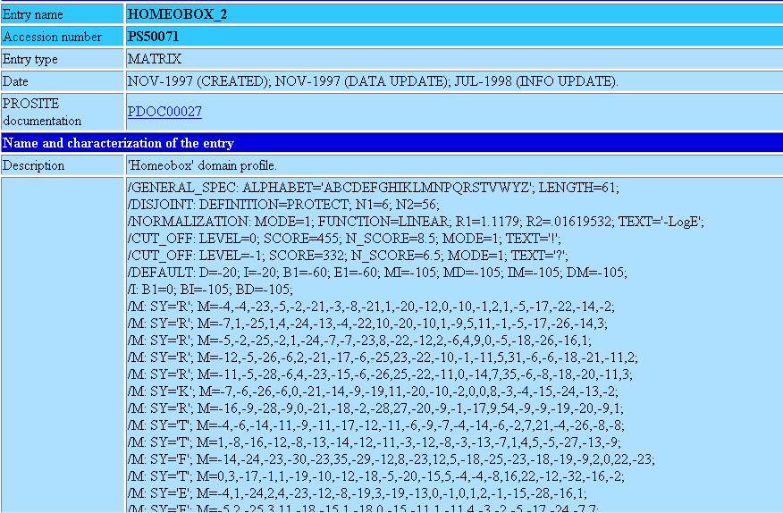
A PROSITE PROFILE
A Substitution Cost For Every Amino Acid, At Every Position

Slide 12
How Can I Use A Multiple Sequence Alignment?
chite ---ADKPKRPLSAYMLWLNSARESIKRENPDFK-VTEVAKKGGELWRGLKD
wheat --DPNKPKRAPSAFFVFMGEFREEFKQKNPKNKSVAAVGKAAGERWKSLSE
trybr KKDSNAPKRAMTSFMFFSSDFRS----KHSDLS-IVEMSKAAGAAWKELGP
mouse -----KPKRPRSAYNIYVSESFQ----EAKDDS-AQGKLKLVNEAWKNLSP
***. ::: .: .. . : . . * . *: *
chite AATAKQNYIRALQEYERNGG-
wheat ANKLKGEYNKAIAAYNKGESA
trybr AEKDKERYKREM---------
mouse AKDDRIRYDNEMKSWEEQMAE
* : .* . :
Extrapolation
chite
wheat
Motifs/Patterns
trybr
Profiles
mouse
-Evolution
-Paralogy/Orthology
Phylogeny

Slide 13
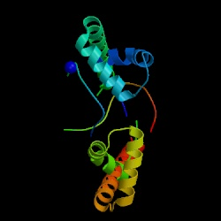
How Can I Use A Multiple Sequence Alignment?
chite ---ADKPKRPLSAYMLWLNSARESIKRENPDFK-VTEVAKKGGELWRGLKD
wheat --DPNKPKRAPSAFFVFMGEFREEFKQKNPKNKSVAAVGKAAGERWKSLSE
trybr KKDSNAPKRAMTSFMFFSSDFRS----KHSDLS-IVEMSKAAGAAWKELGP
mouse -----KPKRPRSAYNIYVSESFQ----EAKDDS-AQGKLKLVNEAWKNLSP
***. ::: .: .. . : . . * . *: *
chite AATAKQNYIRALQEYERNGG-
wheat ANKLKGEYNKAIAAYNKGESA
trybr AEKDKERYKREM---------
mouse AKDDRIRYDNEMKSWEEQMAE
* : .* . :
Extrapolation
Column Constraint
⬄
Evolution Constraint
⬄
Structure Constraint
Motifs/Patterns
Profiles
Phylogeny
Struc. Prediction

Slide 14
How Can I Use A Multiple Sequence Alignment?
chite ---ADKPKRPLSAYMLWLNSARESIKRENPDFK-VTEVAKKGGELWRGLKD
wheat --DPNKPKRAPSAFFVFMGEFREEFKQKNPKNKSVAAVGKAAGERWKSLSE
trybr KKDSNAPKRAMTSFMFFSSDFRS----KHSDLS-IVEMSKAAGAAWKELGP
mouse -----KPKRPRSAYNIYVSESFQ----EAKDDS-AQGKLKLVNEAWKNLSP
***. ::: .: .. . : . . * . *: *
chite AATAKQNYIRALQEYERNGG-
wheat ANKLKGEYNKAIAAYNKGESA
trybr AEKDKERYKREM---------
mouse AKDDRIRYDNEMKSWEEQMAE
* : .* . :
Extrapolation
PsiPred OR PhD For secondary
Structure Prediction:
75% Accurate.
Motifs/Patterns
Profiles
Threading: is improving
but is not yet as good.
Phylogeny
Struc. Prediction

Slide 15


How Can I Use A Multiple Sequence Alignment?
chite ---ADKPKRPLSAYMLWLNSARESIKRENPDFK-VTEVAKKGGELWRGLKD
wheat --DPNKPKRAPSAFFVFMGEFREEFKQKNPKNKSVAAVGKAAGERWKSLSE
trybr KKDSNAPKRAMTSFMFFSSDFRS----KHSDLS-IVEMSKAAGAAWKELGP
mouse -----KPKRPRSAYNIYVSESFQ----EAKDDS-AQGKLKLVNEAWKNLSP
***. ::: .: .. . : . . * . *: *
chite AATAKQNYIRALQEYERNGG-
wheat ANKLKGEYNKAIAAYNKGESA
trybr AEKDKERYKREM---------
mouse AKDDRIRYDNEMKSWEEQMAE
* : .* . :
Automatic Multiple
Sequence Alignment methods
are not always perfect…
You know better…
With your big BRAIN

Slide 16
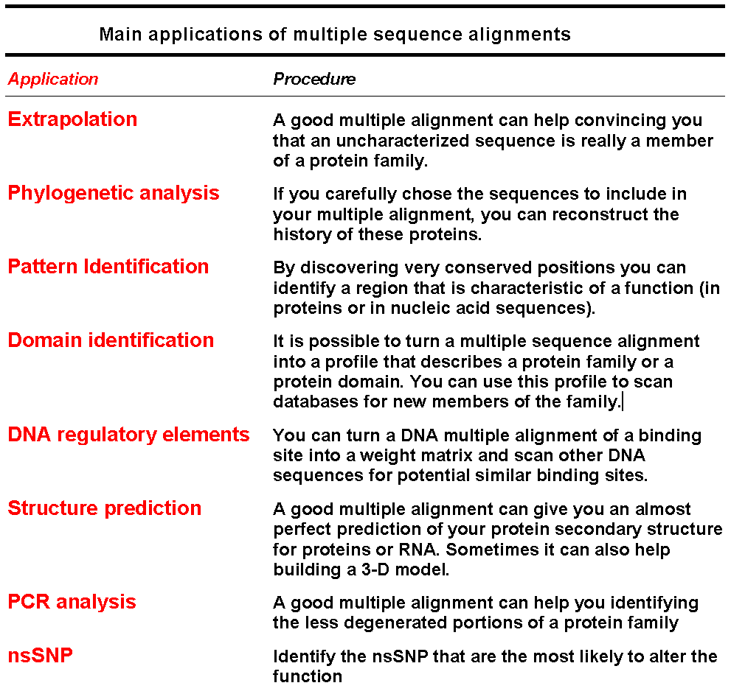

Slide 17


Why Is It Difficult To Compute A multiple Sequence Alignment?
A CROSSROAD PROBLEM
BIOLOGY:
What is A Good Alignment
COMPUTATION
What is THE Good Alignment
chite ---ADKPKRPLSAYMLWLNSARESIKRENPDFK-VTEVAKKGGELWRGLKD
wheat --DPNKPKRAPSAFFVFMGEFREEFKQKNPKNKSVAAVGKAAGERWKSLSE
trybr KKDSNAPKRAMTSFMFFSSDFRS----KHSDLS-IVEMSKAAGAAWKELGP
mouse -----KPKRPRSAYNIYVSESFQ----EAKDDS-AQGKLKLVNEAWKNLSP
***. ::: .: .. . : . . * . *: *

Slide 18
The Biological Problem.
Same as PairWise Alignment Problem
We do NOT know how Sequences Evolve.
We do NOT understand the Relation Between Structures and Sequences.
We would NOT recognize the Correct Alignment if we had it IN FRONT of our eyes…

Slide 19
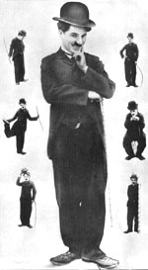
The Biological Problem.
The Charlie Chaplin Paradox

Slide 20
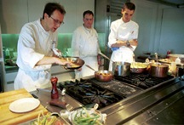


The COMPUTATIONAL Problem.
Producing the Alignment
-A nice set of Sequences
-Substitution Matrix (Blosum)
-Gap Penalties.
-An Evaluation Function
-An Alignment Algorithm
Will It Work
?
GLOBAL Alignment

Slide 21


HOW CAN I ALIGN MANY SEQUENCES
2 Globins =>1 Min

Slide 22

HOW CAN I ALIGN MANY SEQUENCES
3 Globins =>2 hours

Slide 23

HOW CAN I ALIGN MANY SEQUENCES
4 Globins => 10 days

Slide 24

HOW CAN I ALIGN MANY SEQUENCES
5 Globins => 3 years

Slide 25
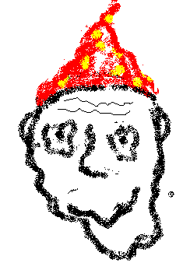
HOW CAN I ALIGN MANY SEQUENCES
!
DHEA
Loaded
6 Globins =>300 years

Slide 26
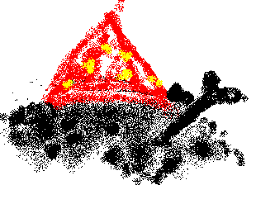
HOW CAN I ALIGN MANY SEQUENCES
7 Globins =>30. 000 years
Solidified Fossil,
Old stuff

Slide 27

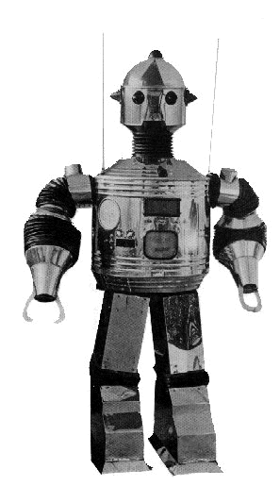
HOW CAN I ALIGN MANY SEQUENCES
8 Globins =>3 Million years

Slide 28
The Progressive Multiple Alignment Algorithm
(Clustal W)

Slide 29
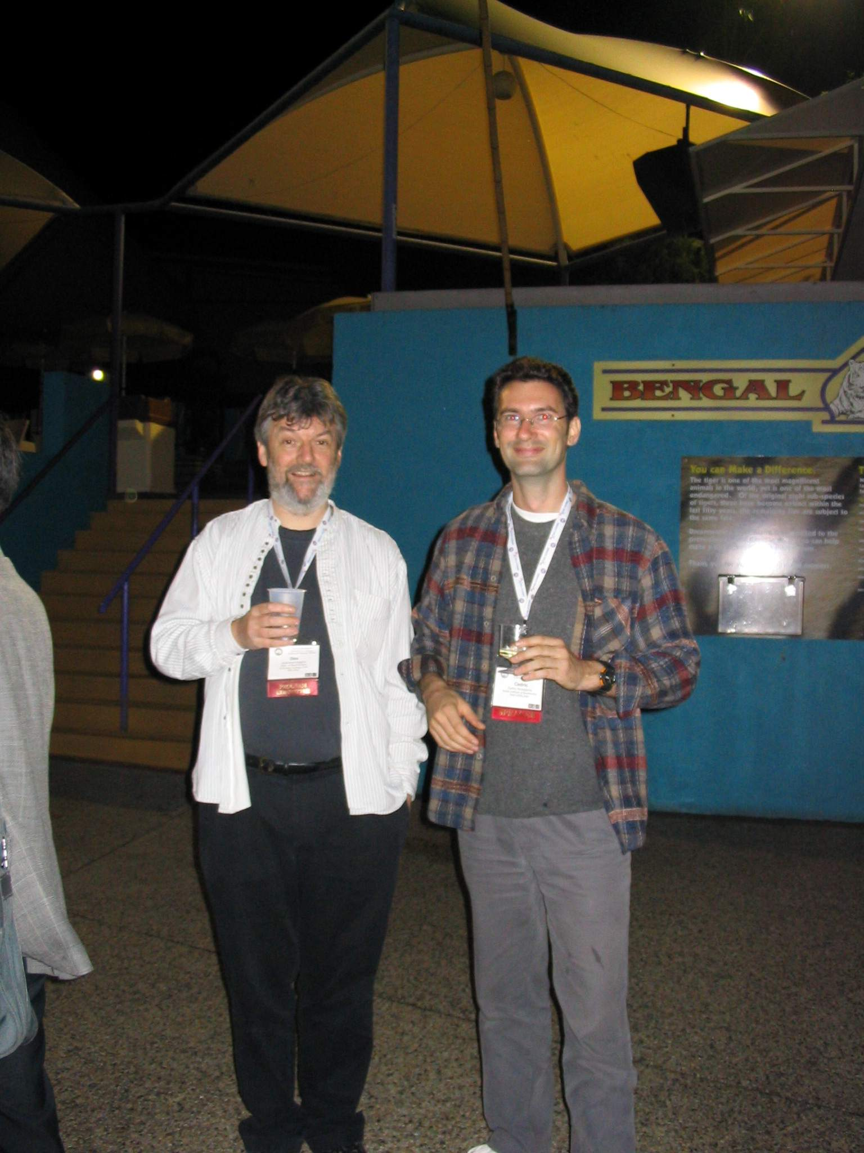

Slide 30
Making An Alignment
Any Exact Method would be TOO SLOW
We will use a Heuristic Algorithm.
Progressive Alignment Algorithm is the most Popular
-ClustalW
-Greedy Heuristic (No Guarranty).
-Fast

Slide 31
Progressive Alignment
Feng and Dolittle, 1988; Taylor 1989
Clustering

Slide 32
Progressive Alignment
Dynamic Programming Using A Substitution Matrix

Slide 33
Progressive Alignment
-Depends on the CHOICE of the sequences.
-Depends on the ORDER of the sequences (Tree).
-Depends on the PARAMETERS:
        Substitution Matrix.
        Penalties (Gop, Gep).
        Sequence Weight.
        Tree making Algorithm.

Slide 34
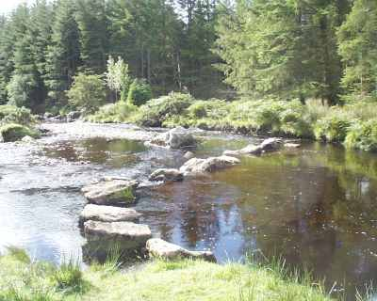
Progressive Alignment
When Does It Work
Works Well When Phylogeny is Dense
No outlayer Sequence.
Image: River Crossing

Slide 35
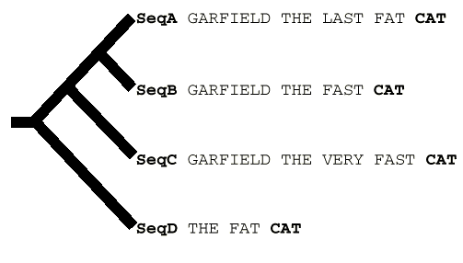
Progressive Alignment
When Doesn’t It Work
CLUSTALW (Score=20, Gop=-1, Gep=0, M=1)
SeqA GARFIELD THE LAST FA-T CAT
SeqB GARFIELD THE FAST CA-T ---
SeqC GARFIELD THE VERY FAST CAT
SeqD -------- THE ---- FA-T CAT
CORRECT (Score=24)
SeqA GARFIELD THE LAST FA-T CAT
SeqB GARFIELD THE FAST ---- CAT
SeqC GARFIELD THE VERY FAST CAT
SeqD -------- THE ---- FA-T CAT

Slide 36
GARFIELD THE LAST FAT CAT
GARFIELD THE LAST FAT CAT
GARFIELD THE FAST CAT ---
GARFIELD THE FAST CAT
GARFIELD THE LAST FA-T CAT
GARFIELD THE FAST CA-T ---
GARFIELD THE VERY FAST CAT
-------- THE ---- FA-T CAT
GARFIELD THE VERY FAST CAT
GARFIELD THE VERY FAST CAT
-------- THE ---- FA-T CAT
THE FAT CAT

