Slide 1

Aligning Sequences
With
T-Coffee
Cédric Notredame
Comparative Bioinformatics Group
Bioinformatics and Genomics Program

Slide 2
T-Coffee and Concistency…
SeqA GARFIELD THE LAST FAT CAT
SeqB GARFIELD THE FAST CAT
SeqC GARFIELD THE VERY FAST CAT
SeqD THE FAT CAT
SeqA GARFIELD THE LAST FA-T CAT
SeqB GARFIELD THE FAST CA-T ---
SeqC GARFIELD THE VERY FAST CAT
SeqD -------- THE ---- FA-T CAT

Slide 3
Consistency: Conflicts and Information
X
Y
W
Z
X
Y
+
X
Z
+
Consistent
OR
Non Consistent
Y
Y
W
Z
W
Z
Y
Y
OR
X
X
X
W
Z
W
Z

Slide 4
T-Coffee and Concistency…
SeqA GARFIELD THE LAST FAT CAT Prim. Weight =88
SeqB GARFIELD THE FAST CAT ---
SeqA GARFIELD THE LAST FA-T CAT Prim. Weight =77
SeqC GARFIELD THE VERY FAST CAT
SeqA GARFIELD THE LAST FAT CAT Prim. Weight =100
SeqD -------- THE ---- FAT CAT
SeqB GARFIELD THE ---- FAST CAT Prim. Weight =100
SeqC GARFIELD THE VERY FAST CAT
SeqC GARFIELD THE VERY FAST CAT Prim. Weight =100
SeqD -------- THE ---- FA-T CAT

Slide 5
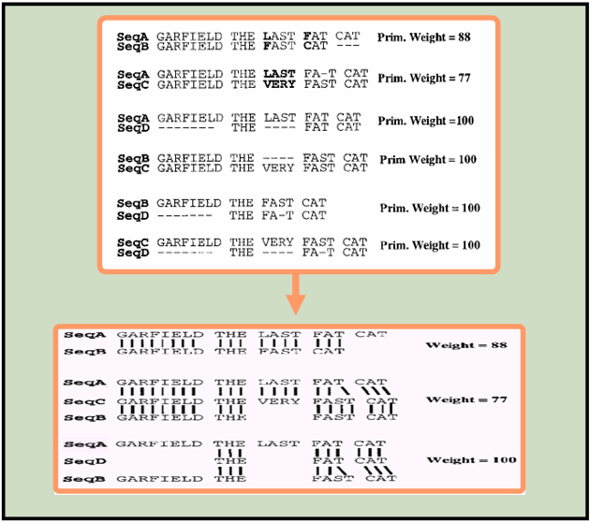
T-Coffee and Concistency…
SeqA GARFIELD THE LAST FAT CAT Prim. Weight =88
SeqB GARFIELD THE FAST CAT ---
SeqA GARFIELD THE LAST FA-T CAT Prim. Weight =77
SeqC GARFIELD THE VERY FAST CAT
SeqA GARFIELD THE LAST FAT CAT Prim. Weight =100
SeqD -------- THE ---- FAT CAT
SeqB GARFIELD THE ---- FAST CAT Prim. Weight =100
SeqC GARFIELD THE VERY FAST CAT
SeqC GARFIELD THE VERY FAST CAT Prim. Weight =100
SeqD -------- THE ---- FA-T CAT
SeqA GARFIELD THE LAST FAT CAT Weight =88
SeqB GARFIELD THE FAST CAT ---
SeqA GARFIELD THE LAST FA-T CAT Weight =77
SeqC GARFIELD THE VERY FAST CAT
SeqB GARFIELD THE ---- FAST CAT
SeqA GARFIELD THE LAST FA-T CAT Weight =100
SeqD -------- THE ---- FA-T CAT
SeqB GARFIELD THE ---- FAST CAT

Slide 6
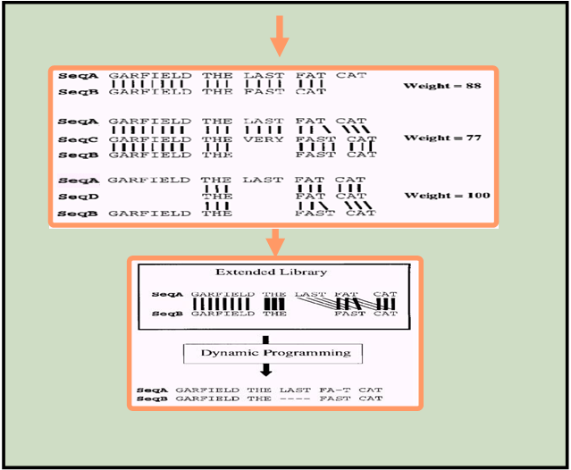
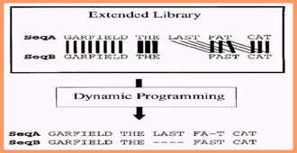
T-Coffee and Concistency…
SeqA GARFIELD THE LAST FAT CAT Weight =88
SeqB GARFIELD THE FAST CAT ---
SeqA GARFIELD THE LAST FA-T CAT Weight =77
SeqC GARFIELD THE VERY FAST CAT
SeqB GARFIELD THE ---- FAST CAT
SeqA GARFIELD THE LAST FA-T CAT Weight =100
SeqD -------- THE ---- FA-T CAT
SeqB GARFIELD THE ---- FAST CAT

Slide 7
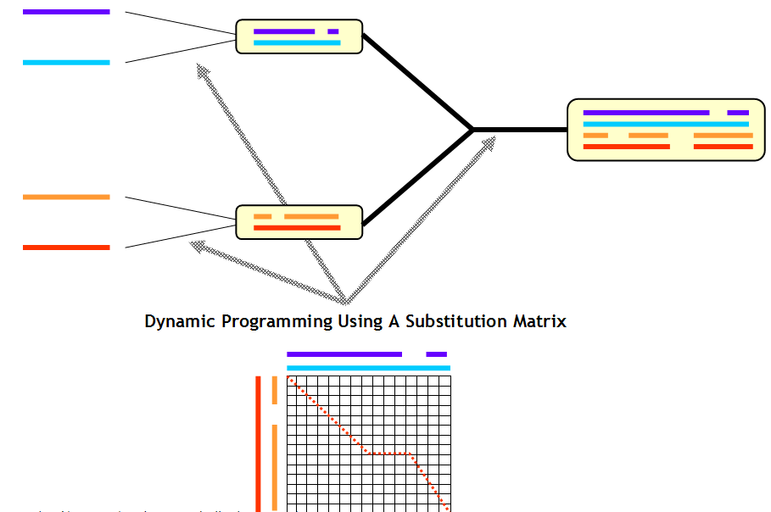
T-Coffee and Concistency…

Slide 8
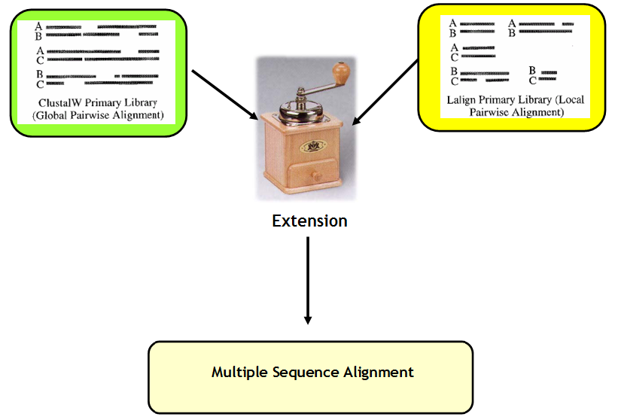
T-Coffee and Concistency…

Slide 9
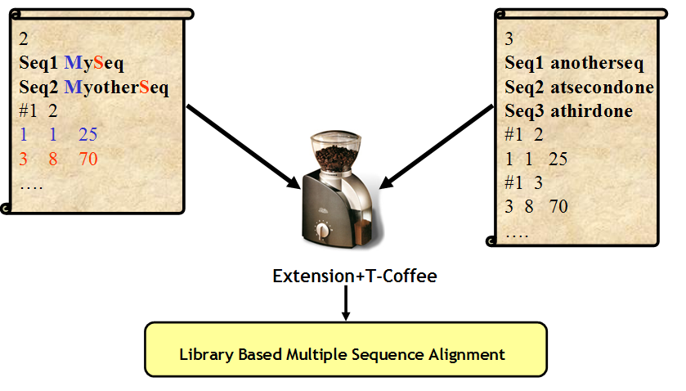
T-Coffee and Concistency…

Slide 10
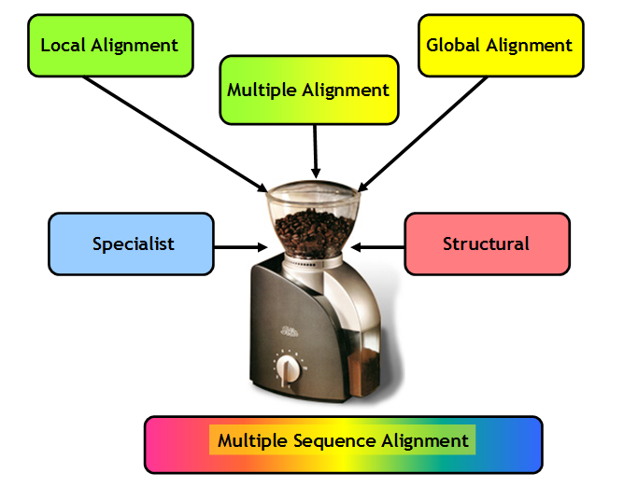
Methods
Scalability
Data

Slide 11
Running T-Coffee over the Web

Slide 12
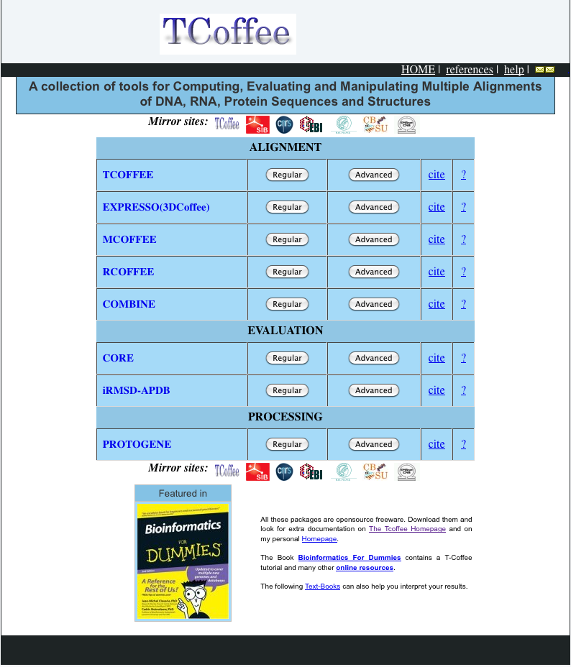
Available Servers and Flavors

Slide 13
Which MSA Method ???

Slide 14
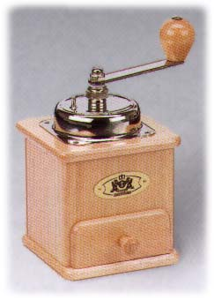
Combining Many MSAs into ONE
ClustalW
MAFFT
T-Coffee
MUSCLE
???????

Slide 15
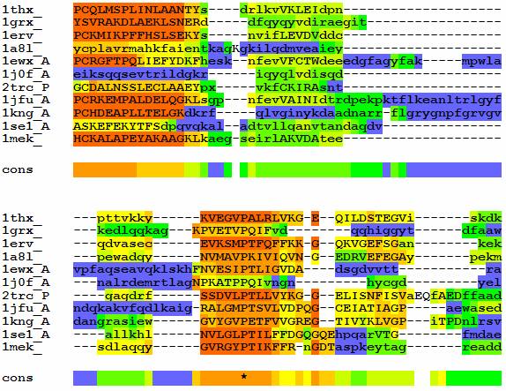
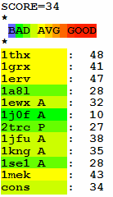
Consistency and Accuracy

Slide 16
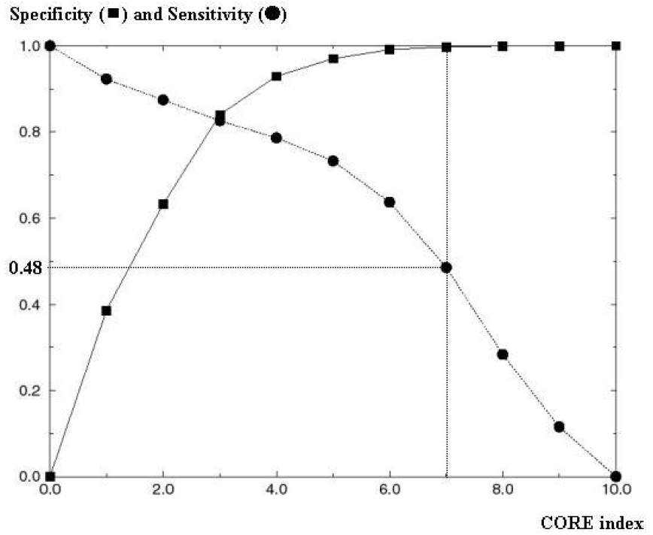
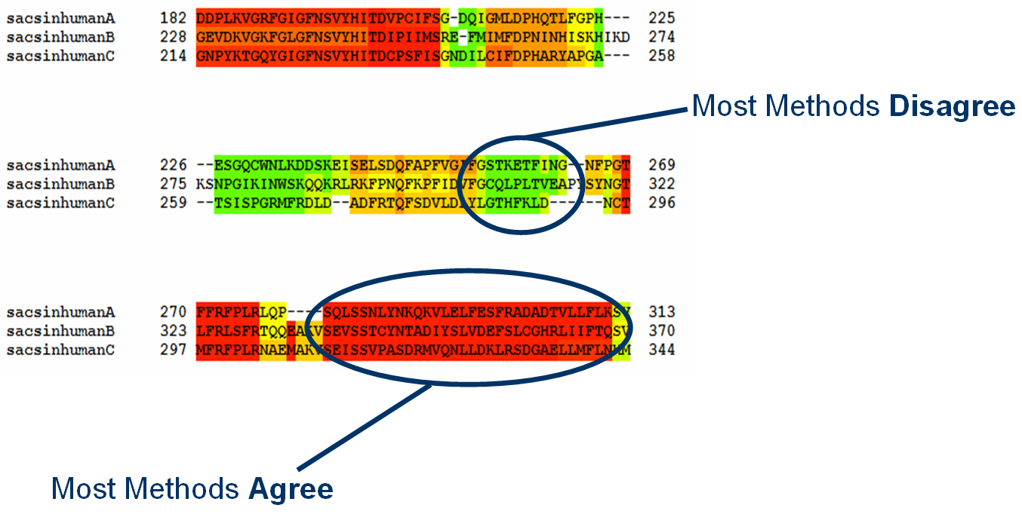
What To Do Without Structures

Slide 17
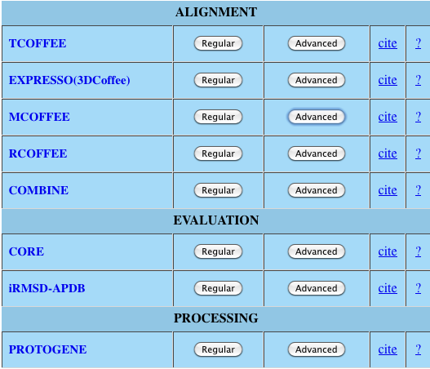
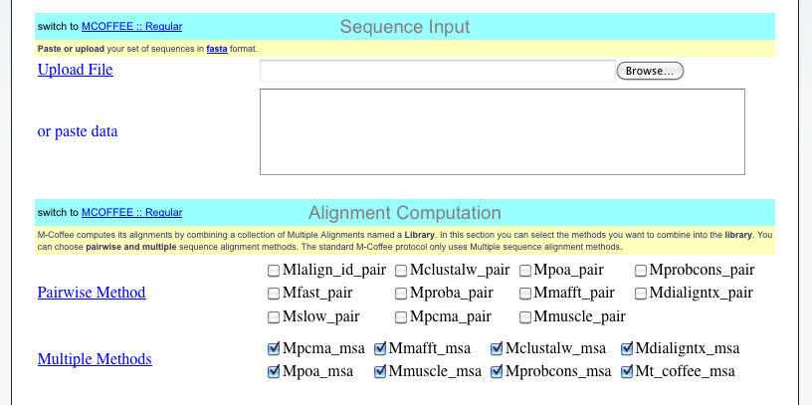
Using the M-Coffee Server

Slide 18
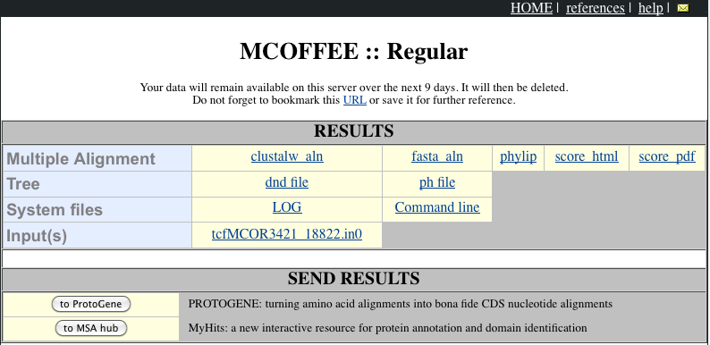
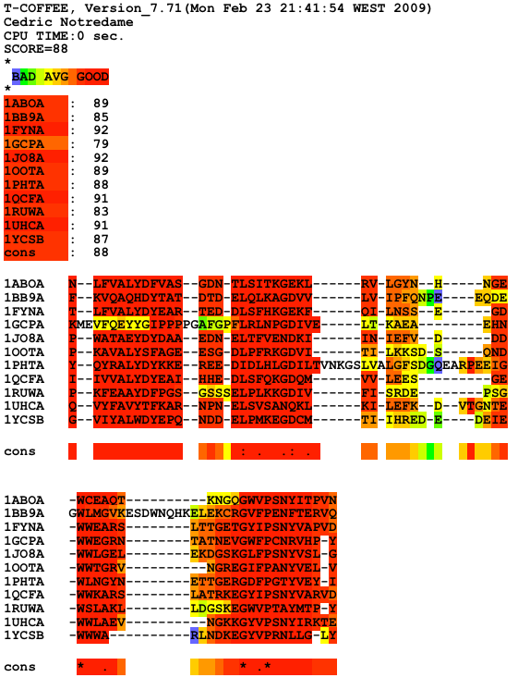
Using the M-Coffee Server

Slide 19
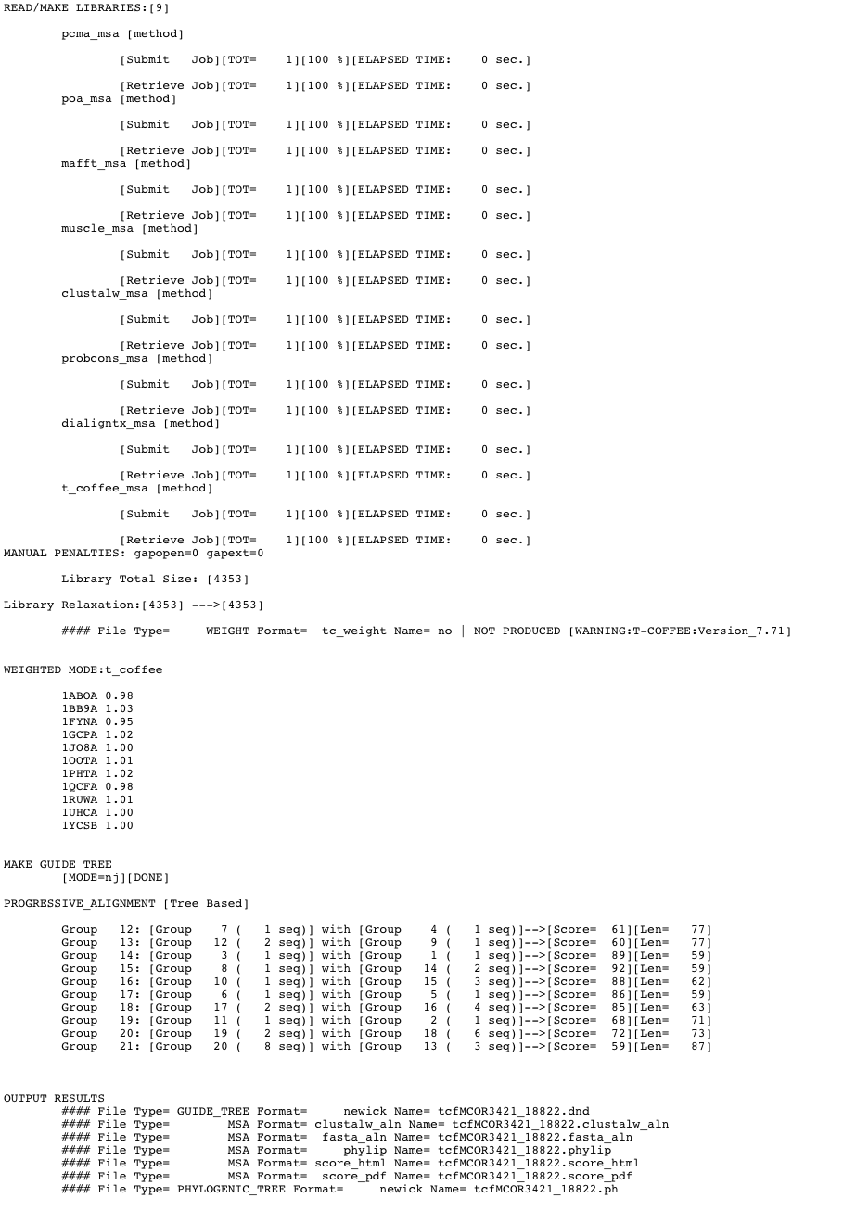

Slide 20
Integrating New Types of Data
Template Based Sequence
Alignments

Slide 21
Templates
Templates
Template
Aligner
TARGET
TARGET
TARGET
Experimental
Data
…
Experimental
Data
…
Template Alignment
Template-Sequence Alignment
Template based Alignment
of the Sequences
Primary Library

Slide 22
Exploring The Template World
Template | Generator | Alignment Method
RNA Structure | Prediction | RNA Aligner
Protein Structure | BLAST vs PDB | 3D Aligner
Profile | BLAST vs NR | Profile/Profile Alignment
Gene Structure | ENSEMBL | Genome Aligner
Promoter | Transfac | Meta-Aligner

Slide 23
Exploring The Template World
Template | Generator | Alignment Method | Mode
RNA Structure | Prediction | RNA Aligner | R-Coffee
Protein Structure | BLAST /PDB | 3D Aligner | 3D-Coffee
Profile | BLAST/NR | Profile/Profile | PSI-Coffee
Gene Structure | ENSEMBL | Genome Aligner | Exoset
Promoter | Transfac | Meta-Aligner | Meta-Coffee

Slide 24
3D-Coffee/Expresso
Incorporating
Structural Information

Slide 25
Expresso: Finding the Right Structure
Sources
BLAST
BLAST
SAP
Templates
Templates
Template Alignment
Source Template Alignment
Remove Templates
Library

Slide 26
PSI-Coffee
Homology Extension

Slide 27
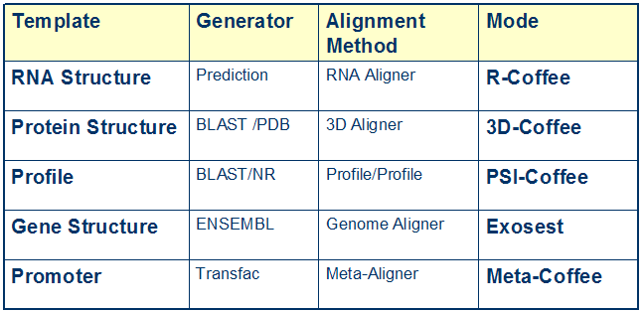
Exploring The Template World

Slide 28
What is Homology Extension ?
-Simple scoring schemes result in alignment ambiguities
L
?
L
L

Slide 29
What is Homology Extension ?
L
L
L
Profile 1
L
L
L
L
L
L
L
L
L
L
I
L
V
L
Profile 2
I
L
L
L

Slide 30
What is Homology Extension ?
L
L
L
Profile 1
L
L
L
L
L
L
L
L
L
L
I
L
V
L
Profile 2
I
L
L
L

Slide 31
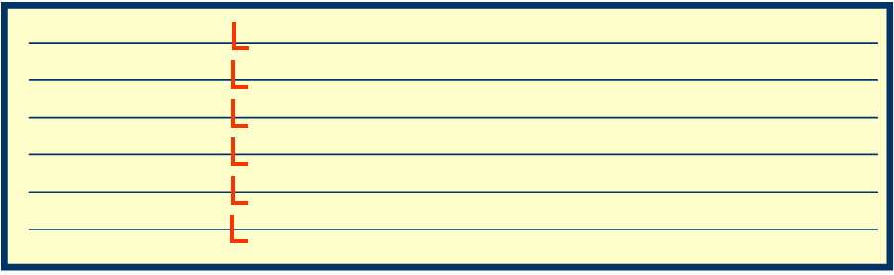
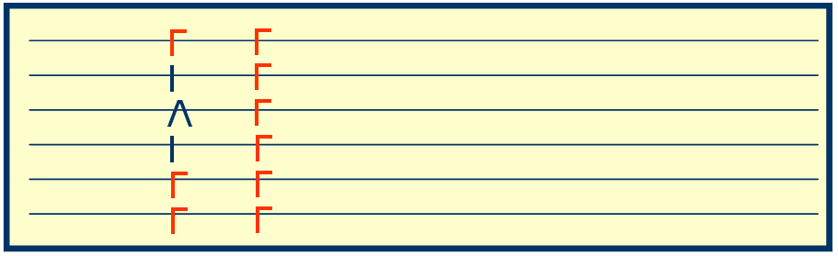
PSI-Coffee: Homology Extension
Sources
BLAST
BLAST
Templates
Profile Aligner
Templates
Template Alignment
Source Template Alignment
Remove Templates
Library

Slide 32
Benchmarks

Slide 33
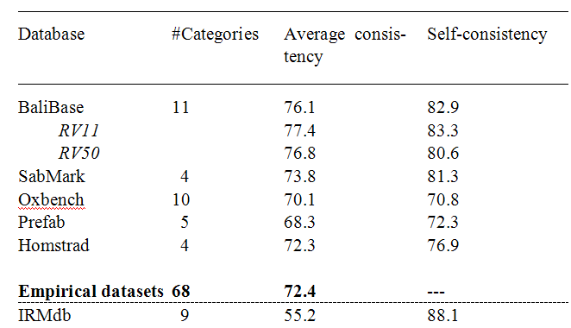
Do Benchmarks All Tell the same story?
Based on

Slide 34
Method | Method | Template | Score | Comment
ClustalW-2 | Progressive | NO | 22.74
PRANK | Gap | NO | 26.18 | Science2008
MAFFT | Iterative | NO | 26.18
Muscle | Iterative | NO | 31.37
ProbCons | Consistency | NO | 40.80
ProbCons | MonoPhasic | NO | 37.53
T-Coffee | Consistency | NO | 42.30
M-Coffe4 | Consistency | NO | 43.60
PSI-Coffee | Consistency | Profile | 53.71
PROMAL | Consistency | Profile | 55.08
PROMAL-3D | Consistency | PDB | 57.60
3D-Coffee | Consistency | PDB | 61.00 | Expresso
Score: fraction of correct columns when compared with a structure based reference (BB11 of BaliBase).

Slide 35
Method | Method | Template | Score | Comment
ClustalW-2 | Progressive | NO | 22.74
PRANK | Gap | NO | 26.18 | Science2008
MAFFT | Iterative | NO | 26.18
Muscle | Iterative | NO | 31.37
ProbCons | Consistency | NO | 40.80
ProbCons | MonoPhasic | NO | 37.53
T-Coffee | Consistency | NO | 42.30
M-Coffe4 | Consistency | NO | 43.60
PSI-Coffee | Consistency | Profile | 53.71
PROMAL | Consistency | Profile | 55.08
PROMAL-3D | Consistency | PDB | 57.60
3D-Coffee | Consistency | PDB | 61.00 | Expresso
Consistency
Score: fraction of correct columns when compared with a structure based reference (BB11 of BaliBase).

Slide 36
Method | Method | Template | Score | Comment
ClustalW-2 | Progressive | NO | 22.74
PRANK | Gap | NO | 26.18 | Science2008
MAFFT | Iterative | NO | 26.18
Muscle | Iterative | NO | 31.37
ProbCons | Consistency | NO | 40.80
ProbCons | MonoPhasic | NO | 37.53
T-Coffee | Consistency | NO | 42.30
M-Coffe4 | Consistency | NO | 43.60
PSI-Coffee | Consistency | Profile | 53.71
PROMAL | Consistency | Profile | 55.08
PROMAL-3D | Consistency | PDB | 57.60
3D-Coffee | Consistency | PDB | 61.00 | Expresso
Homology Extension
Score: fraction of correct columns when compared with a structure based reference (BB11 of BaliBase).

Slide 37
Method | Method | Template | Score | Comment
ClustalW-2 | Progressive | NO | 22.74
PRANK | Gap | NO | 26.18 | Science2008
MAFFT | Iterative | NO | 26.18
Muscle | Iterative | NO | 31.37
ProbCons | Consistency | NO | 40.80
ProbCons | MonoPhasic | NO | 37.53
T-Coffee | Consistency | NO | 42.30
M-Coffe4 | Consistency | NO | 43.60
PSI-Coffee | Consistency | Profile | 53.71
PROMAL | Consistency | Profile | 55.08
PROMAL-3D | Consistency | PDB | 57.60
3D-Coffee | Consistency | PDB | 61.00 | Expresso
Structural Extension
Score: fraction of correct columns when compared with a structure based reference (BB11 of BaliBase).

Slide 38

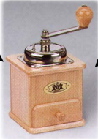

T-Coffee and The World
-Some Templates are obtained with a BLAST
-Queries can be sent to the EBI or the NCBI
-No Need for a Local BLAST installation
BLAST/
SOAP
Users sequences

