Slide 1

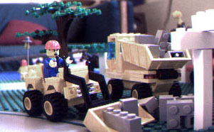
Building the Right Multiple Sequence Alignment.

Slide 2
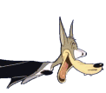
Recognizing The Right Sequences When you Meet Them…

Slide 3

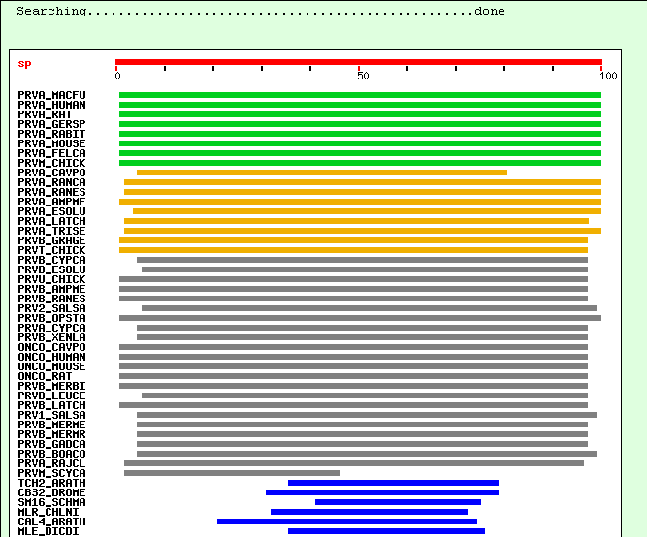
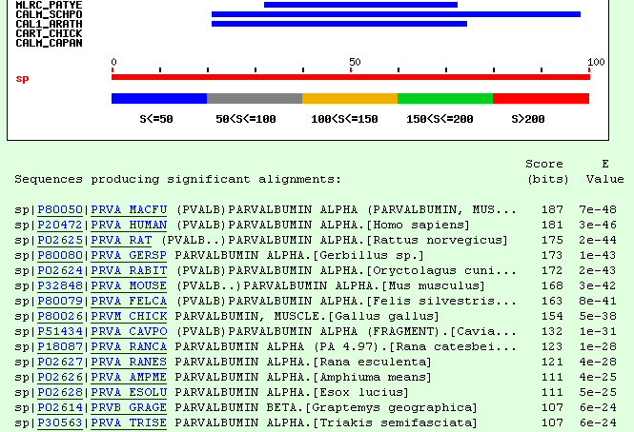
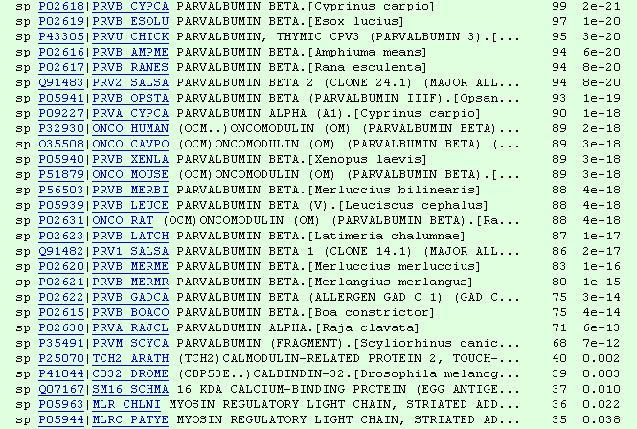
Gathering Sequences: BLAST

Slide 4

Common Mistake:
Sequences Too Closely Related
PRVA_MACFU SMTDLLNAEDIKKAVGAFSAIDSFDHKKFFQMVGLKKKSADDVKKVFHILDKDKSGFIEE
PRVA_HUMAN SMTDLLNAEDIKKAVGAFSATDSFDHKKFFQMVGLKKKSADDVKKVFHMLDKDKSGFIEE
PRVA_GERSP SMTDLLSAEDIKKAIGAFAAADSFDHKKFFQMVGLKKKTPDDVKKVFHILDKDKSGFIEE
PRVA_MOUSE SMTDVLSAEDIKKAIGAFAAADSFDHKKFFQMVGLKKKNPDEVKKVFHILDKDKSGFIEE
PRVA_RAT SMTDLLSAEDIKKAIGAFTAADSFDHKKFFQMVGLKKKSADDVKKVFHILDKDKSGFIEE
PRVA_RABIT AMTELLNAEDIKKAIGAFAAAESFDHKKFFQMVGLKKKSTEDVKKVFHILDKDKSGFIEE
:**::*.*******:***:* :****************..::******:***********
PRVA_MACFU DELGFILKGFSPDARDLSAKETKTLMAAGDKDGDGKIGVDEFSTLVAES
PRVA_HUMAN DELGFILKGFSPDARDLSAKETKMLMAAGDKDGDGKIGVDEFSTLVAES
PRVA_GERSP DELGFILKGFSSDARDLSAKETKTLLAAGDKDGDGKIGVEEFSTLVSES
PRVA_MOUSE DELGSILKGFSSDARDLSAKETKTLLAAGDKDGDGKIGVEEFSTLVAES
PRVA_RAT DELGSILKGFSSDARDLSAKETKTLMAAGDKDGDGKIGVEEFSTLVAES
PRVA_RABIT EELGFILKGFSPDARDLSVKETKTLMAAGDKDGDGKIGADEFSTLVSES
:*** ******.******.**** *:************.:******:**
-IDENTICAL SEQUENCES BRING NO INFORMATION FOR THE MULTIPLE SEQUENCE ALIGNMENT
-MULTIPLE SEQUENCE ALIGNMENTS THRIVE ON DIVERSITY…

Slide 5


Slide 6
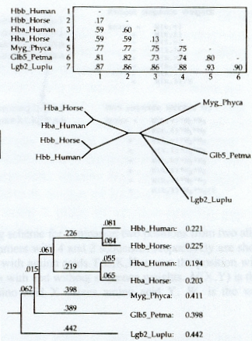
Sequence Weighting Within ClustalW

Slide 7
Selecting Diverse Sequences (Opus II)

Slide 8
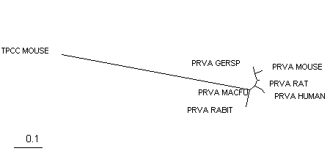
Respect Information!
PRVA_MACFU ------------------------------------------SMTDLLN----AEDIKKA
PRVA_HUMAN ------------------------------------------SMTDLLN----AEDIKKA
PRVA_GERSP ------------------------------------------SMTDLLS----AEDIKKA
PRVA_MOUSE ------------------------------------------SMTDVLS----AEDIKKA
PRVA_RAT ------------------------------------------SMTDLLS----AEDIKKA
PRVA_RABIT ------------------------------------------AMTELLN----AEDIKKA
TPCC_MOUSE MDDIYKAAVEQLTEEQKNEFKAAFDIFVLGAEDGCISTKELGKVMRMLGQNPTPEELQEM
: :*. .*::::
PRVA_MACFU VGAFSAIDS--FDHKKFFQMVG------LKKKSADDVKKVFHILDKDKSGFIEEDELGFI
PRVA_HUMAN VGAFSATDS--FDHKKFFQMVG------LKKKSADDVKKVFHMLDKDKSGFIEEDELGFI
PRVA_GERSP IGAFAAADS--FDHKKFFQMVG------LKKKTPDDVKKVFHILDKDKSGFIEEDELGFI
PRVA_MOUSE IGAFAAADS--FDHKKFFQMVG------LKKKNPDEVKKVFHILDKDKSGFIEEDELGSI
PRVA_RAT IGAFTAADS--FDHKKFFQMVG------LKKKSADDVKKVFHILDKDKSGFIEEDELGSI
PRVA_RABIT IGAFAAAES--FDHKKFFQMVG------LKKKSTEDVKKVFHILDKDKSGFIEEEELGFI
TPCC_MOUSE IDEVDEDGSGTVDFDEFLVMMVRCMKDDSKGKSEEELSDLFRMFDKNADGYIDLDELKMM
This Alignment Is not Informative about the relation Betwwen TPCC MOUSE and the rest of the sequences.
-A better Spread of the Sequences is needed

Slide 9
Selecting Diverse Sequences (Opus II)

Slide 10
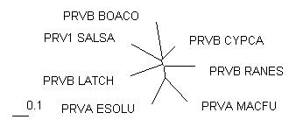
Selecting Diverse Sequences (Opus II)
PRVB_CYPCA -AFAGVLNDADIAAALEACKAADSFNHKAFFAKVGLTSKSADDVKKAFAIIDQDKSGFIE
PRVB_BOACO -AFAGILSDADIAAGLQSCQAADSFSCKTFFAKSGLHSKSKDQLTKVFGVIDRDKSGYIE
PRV1_SALSA MACAHLCKEADIKTALEACKAADTFSFKTFFHTIGFASKSADDVKKAFKVIDQDASGFIE
PRVB_LATCH -AVAKLLAAADVTAALEGCKADDSFNHKVFFQKTGLAKKSNEELEAIFKILDQDKSGFIE
PRVB_RANES -SITDIVSEKDIDAALESVKAAGSFNYKIFFQKVGLAGKSAADAKKVFEILDRDKSGFIE
PRVA_MACFU -SMTDLLNAEDIKKAVGAFSAIDSFDHKKFFQMVGLKKKSADDVKKVFHILDKDKSGFIE
PRVA_ESOLU --AKDLLKADDIKKALDAVKAEGSFNHKKFFALVGLKAMSANDVKKVFKAIDADASGFIE
: *: .: . .* .:*. * ** *: * : * :* * **:**
PRVB_CYPCA EDELKLFLQNFKADARALTDGETKTFLKAGDSDGDGKIGVDEFTALVKA-
PRVB_BOACO EDELKKFLQNFDGKARDLTDKETAEFLKEGDTDGDGKIGVEEFVVLVTKG
PRV1_SALSA VEELKLFLQNFCPKARELTDAETKAFLKAGDADGDGMIGIDEFAVLVKQ-
PRVB_LATCH DEELELFLQNFSAGARTLTKTETETFLKAGDSDGDGKIGVDEFQKLVKA-
PRVB_RANES QDELGLFLQNFRASARVLSDAETSAFLKAGDSDGDGKIGVEEFQALVKA-
PRVA_MACFU EDELGFILKGFSPDARDLSAKETKTLMAAGDKDGDGKIGVDEFSTLVAES
PRVA_ESOLU EEELKFVLKSFAADGRDLTDAETKAFLKAADKDGDGKIGIDEFETLVHEA
:** .*:.* .* *: ** :: .* **** **::** **
-A REASONABLE Model Now Exists.
-Going Further:Remote Homologues.

Slide 11
Aligning Remote Homologues
PRVA_MACFU ------------------------------------------SMTDLLNA----EDIKKA
PRVA_ESOLU -------------------------------------------AKDLLKA----DDIKKA
PRVB_CYPCA ------------------------------------------AFAGVLND----ADIAAA
PRVB_BOACO ------------------------------------------AFAGILSD----ADIAAG
PRV1_SALSA -----------------------------------------MACAHLCKE----ADIKTA
PRVB_LATCH ------------------------------------------AVAKLLAA----ADVTAA
PRVB_RANES ------------------------------------------SITDIVSE----KDIDAA
TPCS_RABIT -TDQQAEARSYLSEEMIAEFKAAFDMFDADGG-GDISVKELGTVMRMLGQTPTKEELDAI
TPCS_PIG -TDQQAEARSYLSEEMIAEFKAAFDMFDADGG-GDISVKELGTVMRMLGQTPTKEELDAI
TPCC_MOUSE MDDIYKAAVEQLTEEQKNEFKAAFDIFVLGAEDGCISTKELGKVMRMLGQNPTPEELQEM
: ::
PRVA_MACFU VGAFSAIDS--FDHKKFFQMVG------LKKKSADDVKKVFHILDKDKSGFIEEDELGFI
PRVA_ESOLU LDAVKAEGS--FNHKKFFALVG------LKAMSANDVKKVFKAIDADASGFIEEEELKFV
PRVB_CYPCA LEACKAADS--FNHKAFFAKVG------LTSKSADDVKKAFAIIDQDKSGFIEEDELKLF
PRVB_BOACO LQSCQAADS--FSCKTFFAKSG------LHSKSKDQLTKVFGVIDRDKSGYIEEDELKKF
PRV1_SALSA LEACKAADT--FSFKTFFHTIG------FASKSADDVKKAFKVIDQDASGFIEVEELKLF
PRVB_LATCH LEGCKADDS--FNHKVFFQKTG------LAKKSNEELEAIFKILDQDKSGFIEDEELELF
PRVB_RANES LESVKAAGS--FNYKIFFQKVG------LAGKSAADAKKVFEILDRDKSGFIEQDELGLF
TPCS_RABIT IEEVDEDGSGTIDFEEFLVMMVRQMKEDAKGKSEEELAECFRIFDRNADGYIDAEELAEI
TPCS_PIG IEEVDEDGSGTIDFEEFLVMMVRQMKEDAKGKSEEELAECFRIFDRNMDGYIDAEELAEI
TPCC_MOUSE IDEVDEDGSGTVDFDEFLVMMVRCMKDDSKGKSEEELSDLFRMFDKNADGYIDLDELKMM
: . .: .. . *: * : * :* : .*:*: :** .
PRVA_MACFU LKGFSPDARDLSAKETKTLMAAGDKDGDGKIGVDEFSTLVAES-
PRVA_ESOLU LKSFAADGRDLTDAETKAFLKAADKDGDGKIGIDEFETLVHEA-
PRVB_CYPCA LQNFKADARALTDGETKTFLKAGDSDGDGKIGVDEFTALVKA--
PRVB_BOACO LQNFDGKARDLTDKETAEFLKEGDTDGDGKIGVEEFVVLVTKG-
PRV1_SALSA LQNFCPKARELTDAETKAFLKAGDADGDGMIGIDEFAVLVKQ--
PRVB_LATCH LQNFSAGARTLTKTETETFLKAGDSDGDGKIGVDEFQKLVKA--
PRVB_RANES LQNFRASARVLSDAETSAFLKAGDSDGDGKIGVEEFQALVKA--
TPCS_RABIT FR---ASGEHVTDEEIESLMKDGDKNNDGRIDFDEFLKMMEGVQ
TPCS_PIG FR---ASGEHVTDEEIESIMKDGDKNNDGRIDFDEFLKMMEGVQ
TPCC_MOUSE LQ---ATGETITEDDIEELMKDGDKNNDGRIDYDEFLEFMKGVE
:: .. :: : :: .* :.** *. :** ::

Slide 12
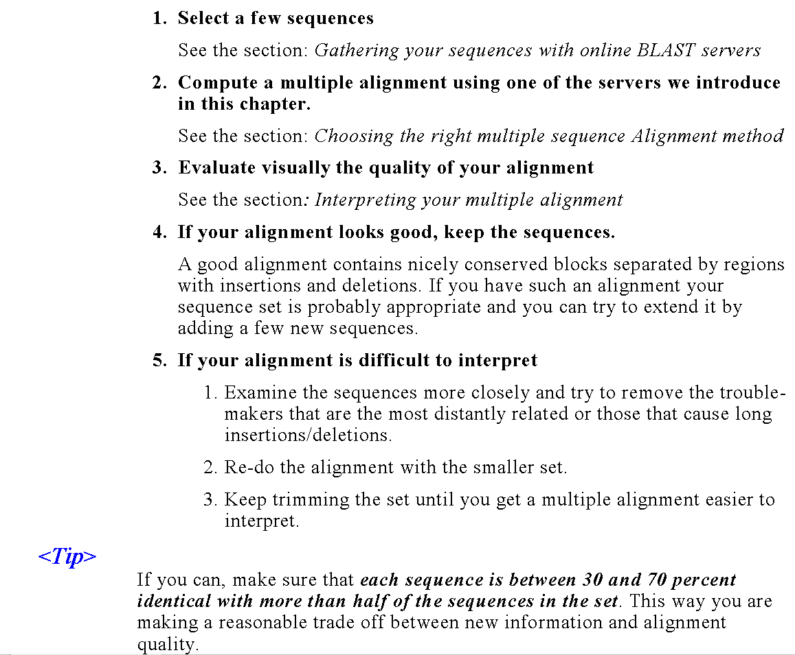
Some
Guidelines
…

Slide 13
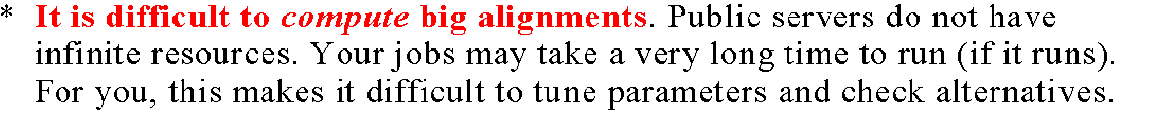
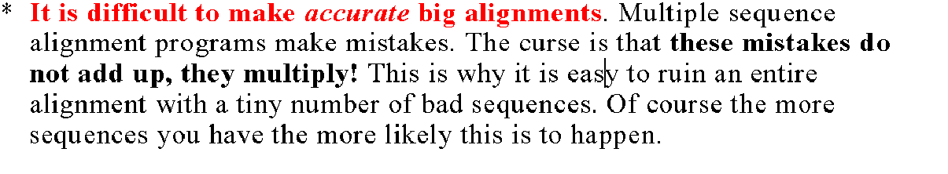
Do Not Use Two Many Sequences…

Slide 14
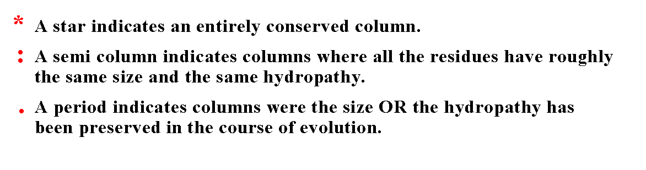
Reading Your Alignment

Slide 15
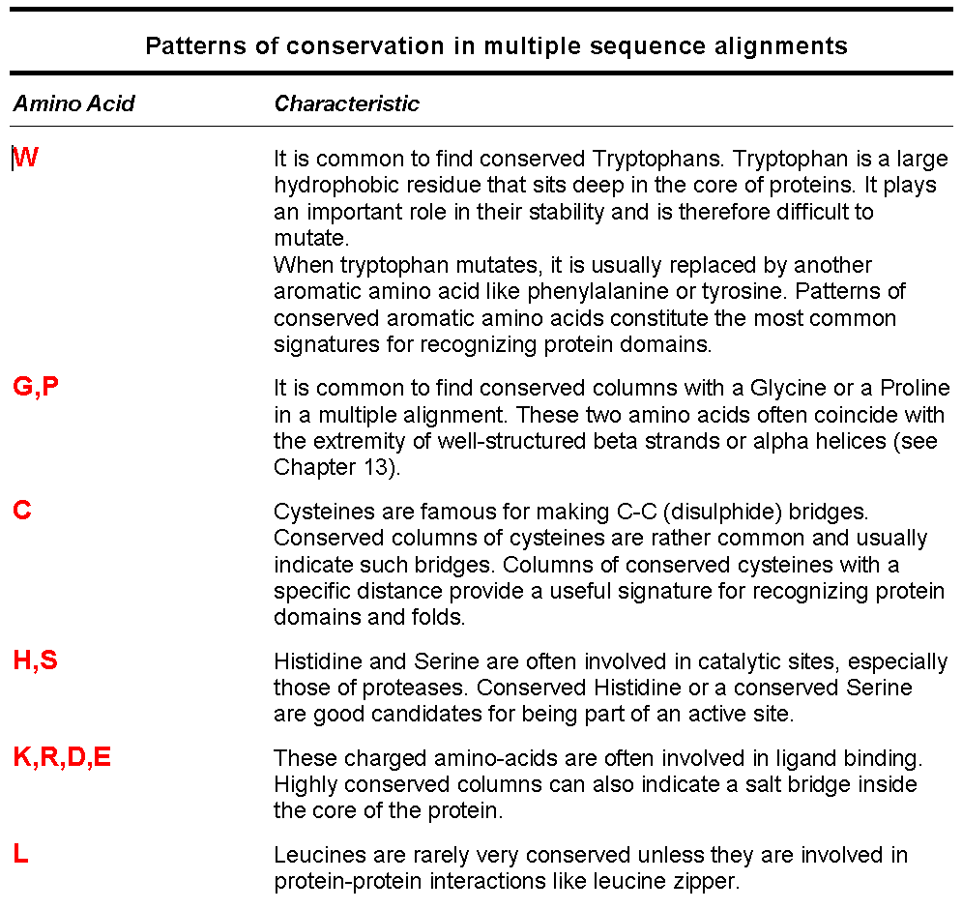
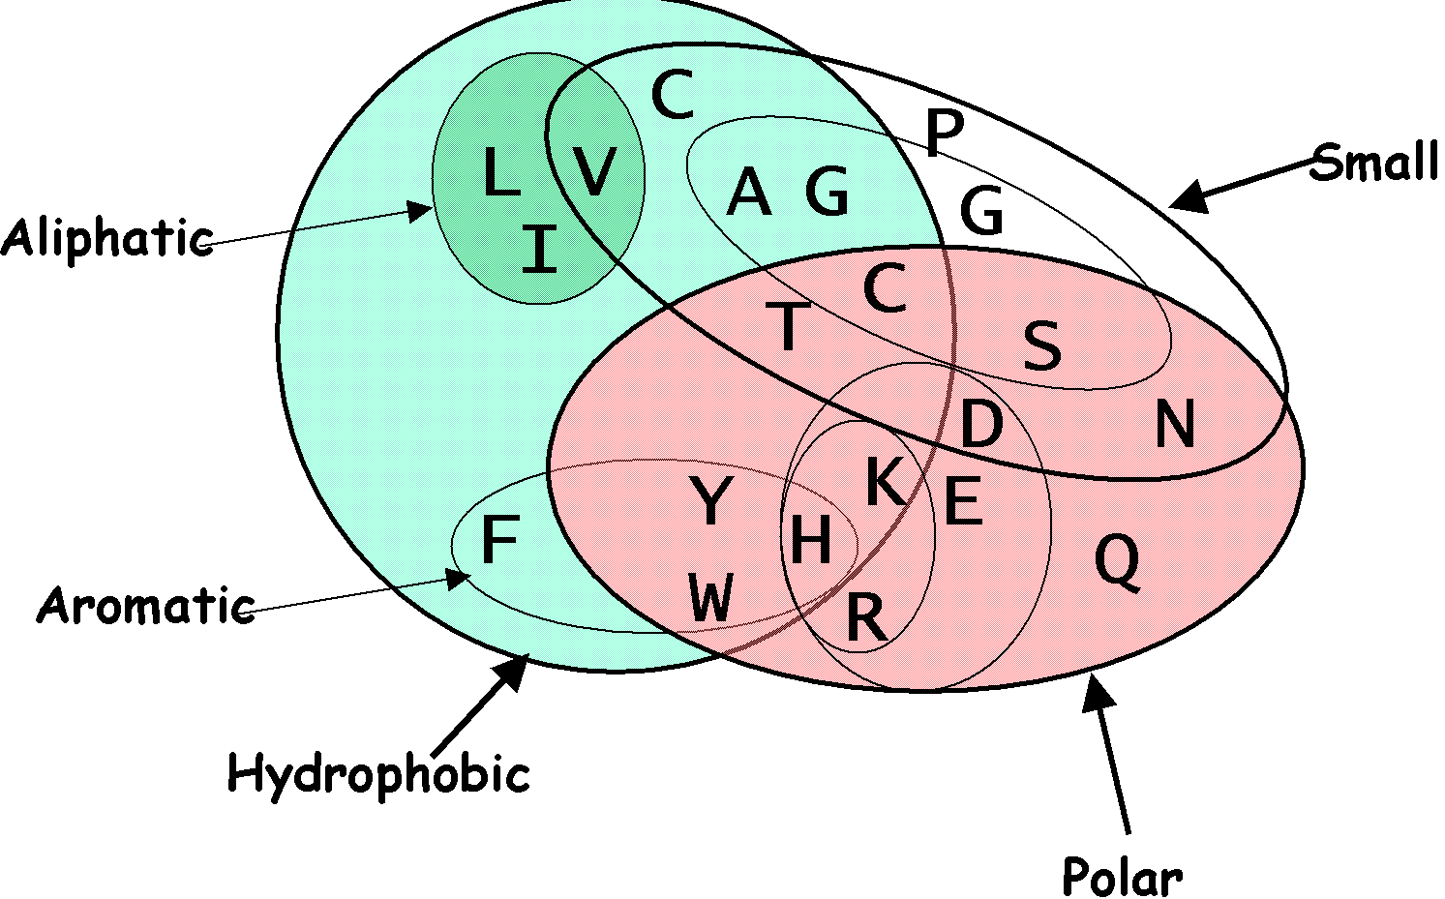

Slide 16

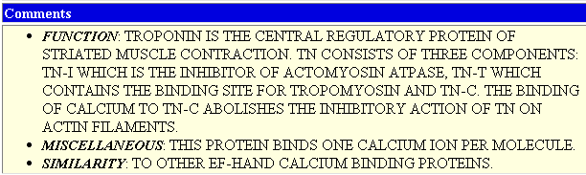
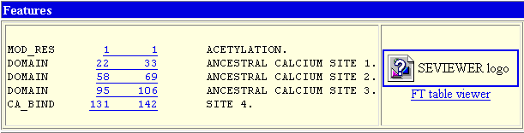

Going Further…
PRVA_MACFU VGAFSAIDS--FDHKKFFQMVG------LKKKSADDVKKVFHILDKDKSGFIEEDELGFI
PRVB_BOACO LQSCQAADS--FSCKTFFAKSG------LHSKSKDQLTKVFGVIDRDKSGYIEEDELKKF
PRV1_SALSA LEACKAADT--FSFKTFFHTIG------FASKSADDVKKAFKVIDQDASGFIEVEELKLF
TPCS_RABIT IEEVDEDGSGTIDFEEFLVMMVRQMKEDAKGKSEEELAECFRIFDRNADGYIDAEELAEI
TPCS_PIG IEEVDEDGSGTIDFEEFLVMMVRQMKEDAKGKSEEELAECFRIFDRNMDGYIDAEELAEI
TPCC_MOUSE IDEVDEDGSGTVDFDEFLVMMVRCMKDDSKGKSEEELSDLFRMFDKNADGYIDLDELKMM
TPC_PATYE SDEMDEEATGRLNCDAWIQLFER---KLKEDLDERELKEAFRVLDKEKKGVIKVDVLRWI
. : .. . :: . : * :* : .* *. : * .
PRVA_MACFU LKGFSPDARDLSAKETKTLMAAGDKDGDGKIGVDEFSTLVAES--
PRVB_BOACO LQNFDGKARDLTDKETAEFLKEGDTDGDGKIGVEEFVVLVTKG--
PRV1_SALSA LQNFCPKARELTDAETKAFLKAGDADGDGMIGIDEFAVLVKQ---
TPCS_RABIT FR---ASGEHVTDEEIESLMKDGDKNNDGRIDFDEFLKMMEGVQ-
TPCS_PIG FR---ASGEHVTDEEIESIMKDGDKNNDGRIDFDEFLKMMEGVQ-
TPCC_MOUSE LQ---ATGETITEDDIEELMKDGDKNNDGRIDYDEFLEFMKGVE-
TPC_PATYE LS---SLGDELTEEEIENMIAETDTDGSGTVDYEEFKCLMMSSDA
: . :: : :: * :..* :. :** ::

Slide 17

WHAT MAKES A GOOD ALIGNMENT…
-THE MORE DIVERGEANT THE SEQUENCES, THE BETTER
-THE FEWER INDELS, THE BETTER
-NICE UNGAPPED BLOCKS SEPARATED WITH INDELS
-DIFFERENT CLASSES OF RESIDUES WITHIN A BLOCK:
      Completely Conserved
      Conserved For Size and Hydropathy
      Conserved For Size or Hydropathy
-THE ULTIMATE EVALUATION IS A MATTER OF PERSONNAL JUDGEMENT AND KNOWLEDGE.

Slide 18
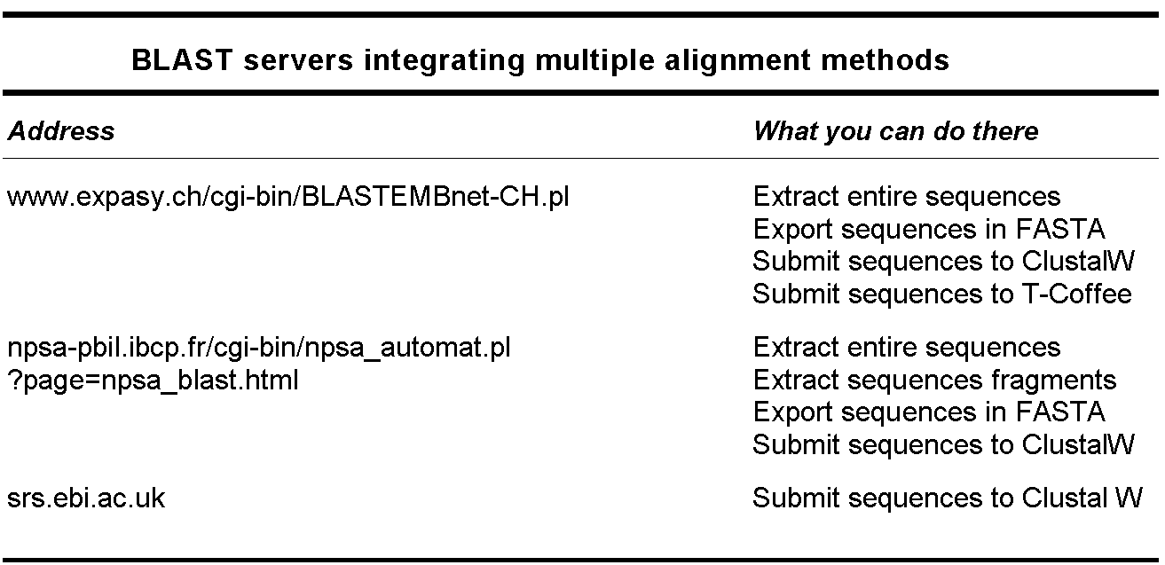

Slide 19
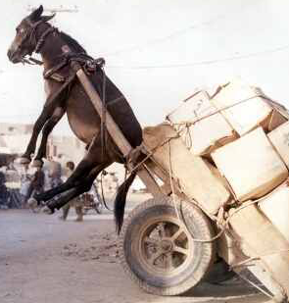
Potential Difficulties

Slide 20
DO NOT OVERTUNE!!!
chite ---ADKPKRPLSAYMLWLNSARESIKRENPDFK-VTEVAKKGGELWRGLKD
wheat --DPNKPKRAPSAFFVFMGEFREEFKQKNPKNKSVAAVGKAAGERWKSLSE
trybr KKDSNAPKRAMTSFMFFSSDFRS----KHSDLS-IVEMSKAAGAAWKELGP
mouse -----KPKRPRSAYNIYVSESFQ----EAKDDS-AQGKLKLVNEAWKNLSP
***. ::: .: .. . : . . * . *: *
chite AATAKQNYIRALQEYERNGG-
wheat ANKLKGEYNKAIAAYNKGESA
trybr AEKDKERYKREM---------
mouse AKDDRIRYDNEMKSWEEQMAE
* : .* . :
DO NOT PLAY WITH PARAMETERS IF YOU KNOW THE ALIGNMENT YOU WANT: MAKE IT YOURSELF!
chite ---ADKPKRPL-SAYMLWLNSARESIKRENPDFK-VTEVAKKGGELWRGLKD
wheat --DPNKPKRAP-SAFFVFMGEFREEFKQKNPKNKSVAAVGKAAGERWKSLSE
trybr KKDSNAPKRAMTSFMFFSSDFRS----KHSDLS-IVEMSKAAGAAWKELGP
mouse -----KPKRPR-SAYNIYVSESFQ----EAKDDS-AQGKLKLVNEAWKNLSP
***. :*: .: .. . : . . * . *: *
chite AATAKQNYIRALQEYERNGG-
wheat ANKLKGEYNKAIAAYNKGESA
trybr AEKDKERYKREM---------
mouse AKDDRIRYDNEMKSWEEQMAE
* : .* . :

Slide 21
TUNING or NOT TUNING!!!
-PARAMETERS TO TUNE USUALLY INCLUDE:
        GOP/ GEP
        MATRIX
        SENSITIVITY Vs SPEED
Substitution Matrices
(Etzold and al. 1993)
Gonnet 61.7 %
Blosum50 59.7 %
Pam250 59.2 %
GOP
GEP
-MOST METHODS ARE TUNED FOR WORKING WELL ON AVERAGE
-PARAMETERS BEHAVIOUR DO NOT NECESSARILY FOLLOW THE THEORY (i.e. Substitution Matrices).
-A GOOD ALIGNMENT IS USUALLY ROBUST(i.e. Changes little).
-TUNE IF YOU WANT TO CONVINCE YOURSELF.

Slide 22
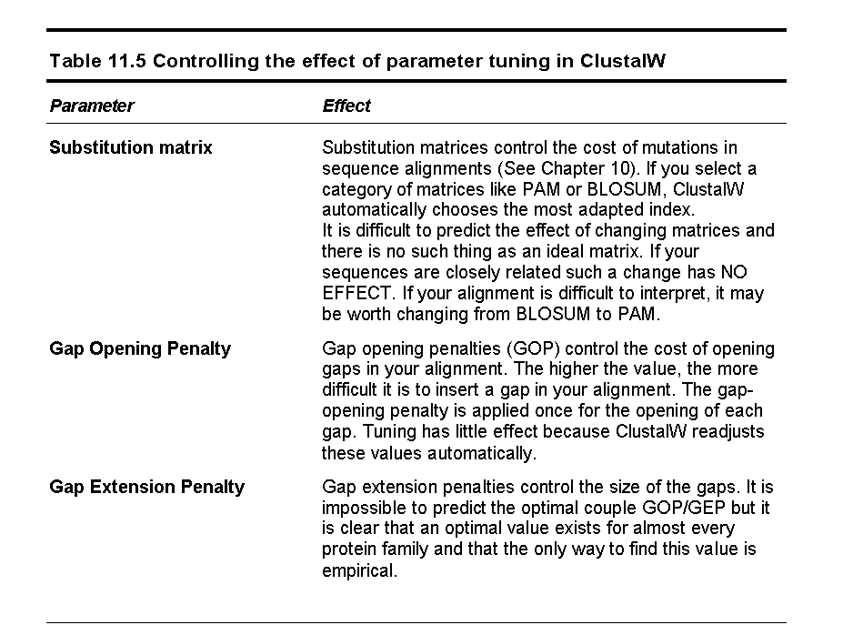

Slide 23
KEEP A BIOLOGICAL PERSPECTIVE
chite ---ADKPKRPLSAYMLWLNSARESIKRENPDFK-VTEVAKKGGELWRGLKD
wheat --DPNKPKRAPSAFFVFMGEFREEFKQKNPKNKSVAAVGKAAGERWKSLSE
trybr KKDSNAPKRAMTSFMFFSSDFRS----KHSDLS-IVEMSKAAGAAWKELGP
mouse -----KPKRPRSAYNIYVSESFQ----EAKDDS-AQGKLKLVNEAWKNLSP
***. ::: .: .. . : . . * . *: *
DIFFERENT PARAMETERS
chite AD--K----PKR-PLYMLWLNS-ARESIKRENPDFK-VT-EVAKKGGELWRGL-
wheat -DPNK----PKRAP-FFVFMGE-FREEFKQKNPKNKSVA-AVGKAAGERWKSLS
trybr -K--KDSNAPKR-AMT-MFFSSDFR-S-KH-S-DLS-IV-EMSKAAGAAWKELG
mouse ----K----PKR-PRYNIYVSESFQEA-K--D-D-S-AQGKL-KLVNEAWKNLS
* *** .:: ::... : * . . . : * . *: *
WRONG ALIGNMENT !!!

Slide 24
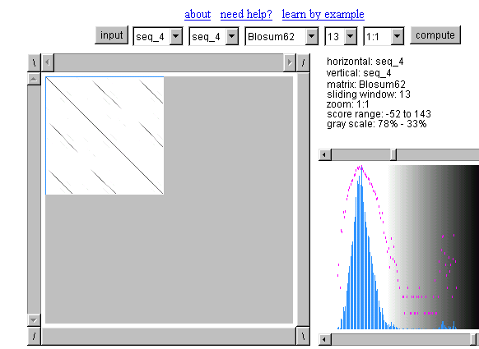

REPEATS
THERE IS A PROBLEM WHEN TWO SEQUENCES DO NOT CONTAIN THE SAME NUMBER OF REPEATS
IT IS THEN BETTER TO MANUALLY EXTRACT THE REPEATS AND TO ALIGN THEM. INDIVIDUAL REPEATS CAN BE RECOGNIZED USING DOTTER

Slide 25
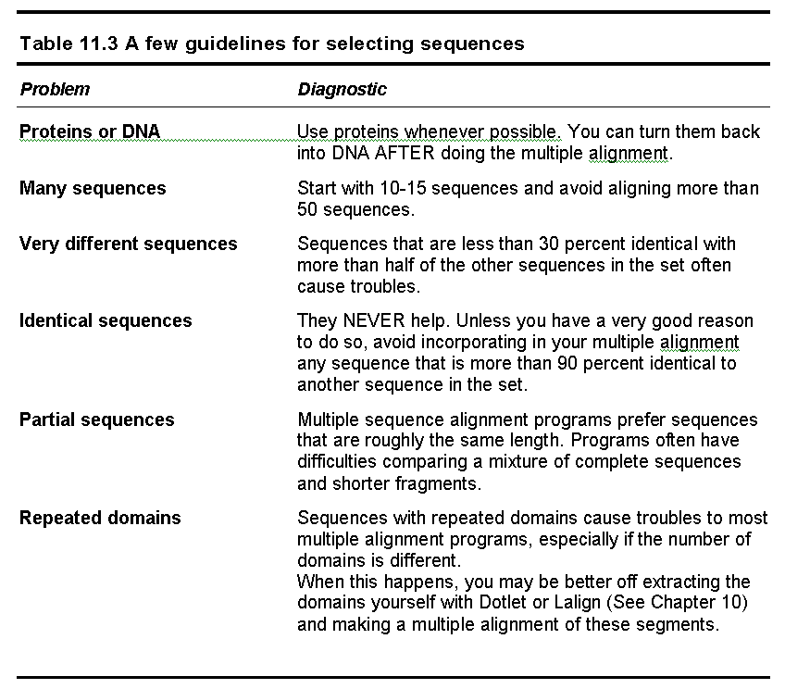

Slide 26
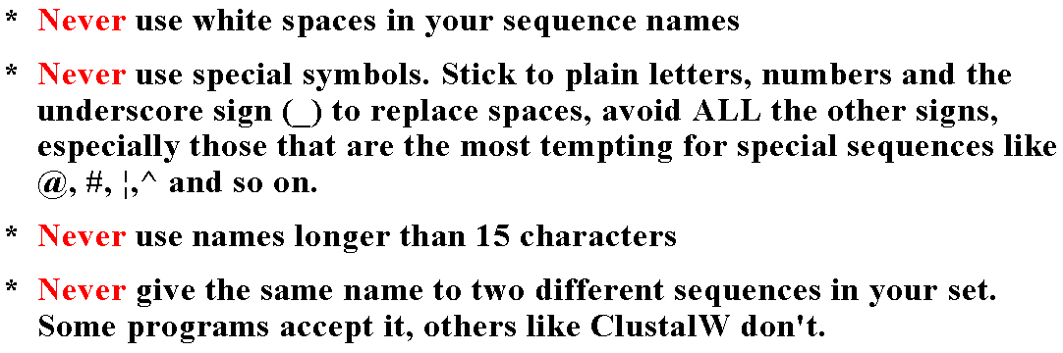
Naming Your Sequences The Right Way

Slide 27
Choosing the right method

Slide 28
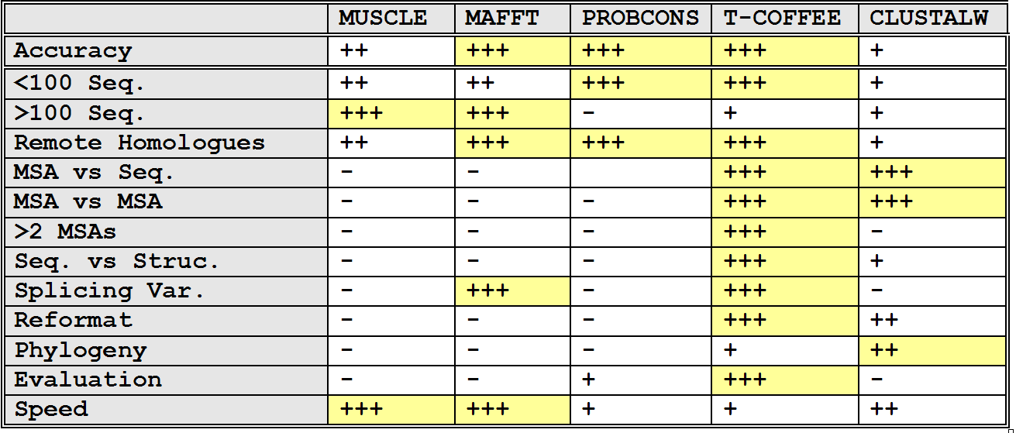
Situation ⬄ Solution

Slide 29
Priority ⬄ Solution
Method Priority | Trees | Profile | 2D –Pred | 3D-Pred | Func-Pred
Accuracy
Speed

Slide 30
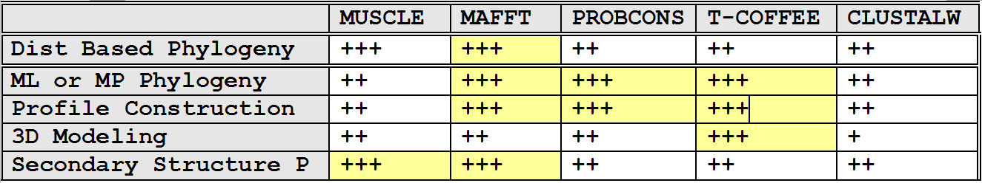
Purpose ⬄ Solution

Slide 31
Conclusion

Slide 32

Multiple Alignment
-The BEST alignment Method:
Your Brain
The Right Data
-The Best Evaluation Procedure:
Experimental Data (SwissProt)
-Choosing The Sequences Well is Important
-Beware of repeated elements

Slide 33
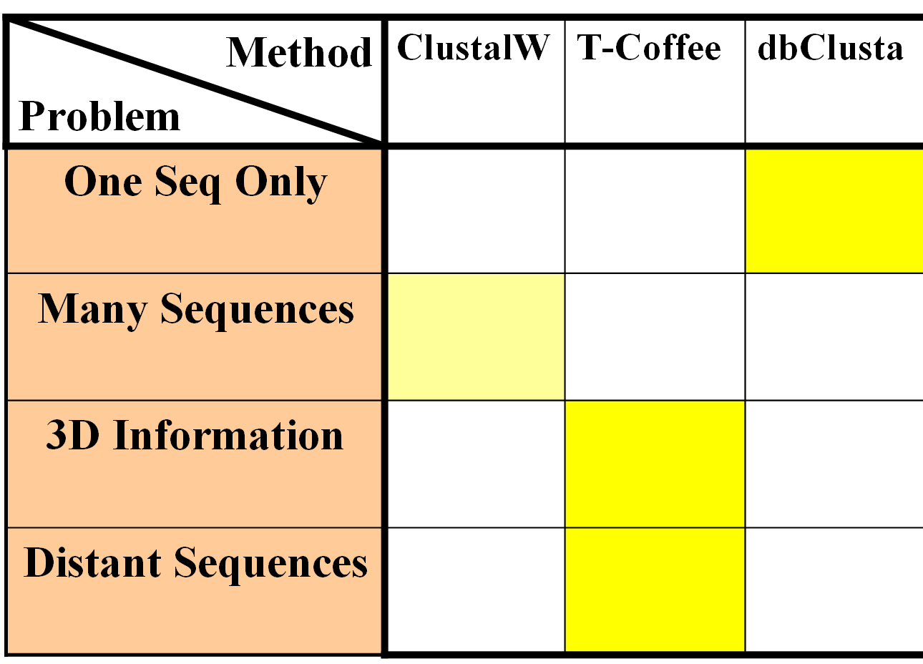
Multiple Alignment
Know Your Problem: What do you want to do with your MSA

Slide 34
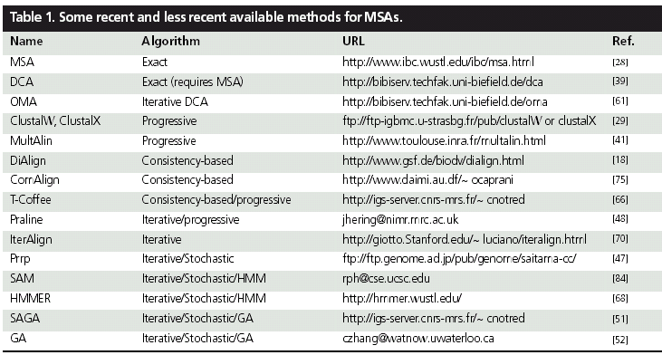
Addresses
MAFFT | Progressive/iterative | www.biophys.kyoto-u.jp/katoh
POA | Progressive/Simultaneous | www.bioinformatics.ucla.edu/poa
MUSCLE | Progressive/Iterative | www.drive5.com/muscle

