Slide 1
T-Coffee tutorial
ACGT Retreat 2012
Jean-François Taly, Ionas Erb and Cedrik Magis

Slide 2
What is T-Coffee ?
Tree based Consistency based Objective Function For AlignmEnt Evaluation
Progressive Alignment
Consistency

Slide 3
Progressive Alignment
Dynamic Programming Using A Substitution Matrix

Slide 4
Progressive Alignment
Depends on the CHOICE of the sequences.
Depends on the ORDER of the sequences (Tree).
Depends on the PARAMETERS:
Substitution Matrix.
Penalties (Gop, Gep).
Sequence Weight.
Tree making Algorithm.

Slide 5
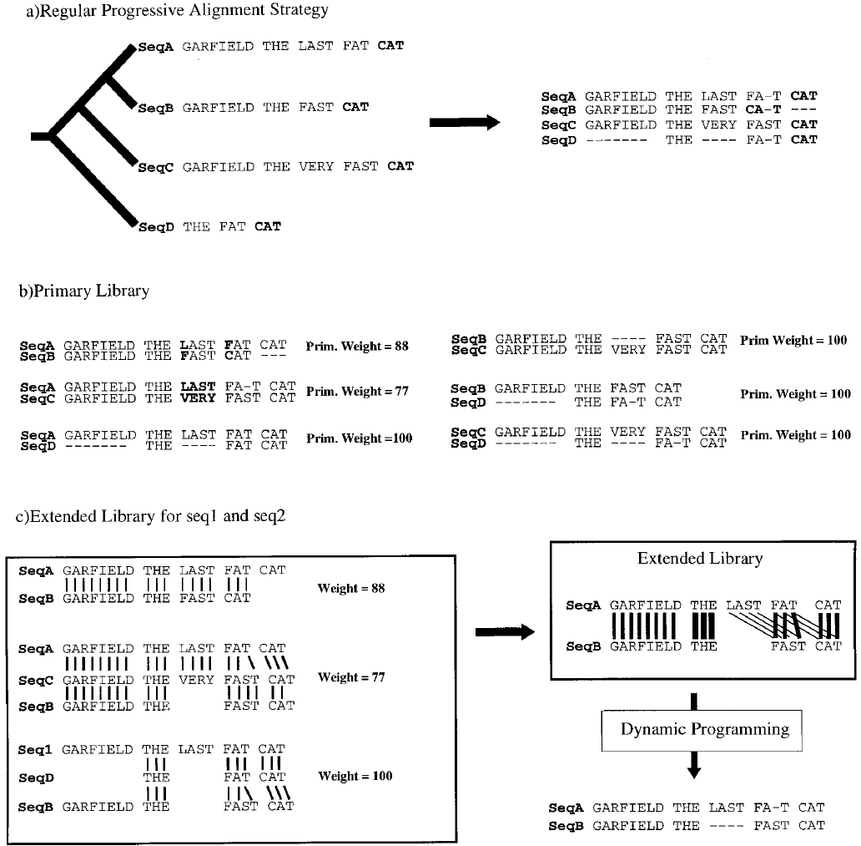
T-Coffee and Consistency… J. Mol. Biol. (2000) 302, 205-217

Slide 6
M-Coffee: T-Coffee and other aligners
Primary libraries can be computed from any third party aligners (pairwise or MSA):
clustalw2
mafft
muscle
probcons
pcma
and many more … type t_coffee for a full list

Slide 7
Template Based Alignment
Very useful in case of weak sequence similarity
wrong libraries will lead to wrong MSAs
Replace the sequence with something more informative:
Profile PSI-Coffee
PDB Structure Expresso
RNA Structure R-Coffee

Slide 8
PSI-Coffee:
Homology extension
Simple scoring schemes result in alignment ambiguities
L
?
L
L

Slide 9
PSI-Coffee:
Use conservation across the protein family
L
L
L
Profile 1
L
L
L
L
L
L
L
L
L
L
I
L
V
L
Profile 2
I
L
L
L

Slide 10
EXPRESSO: Finding automatically the right template structure
Sources
BLAST
PDB
BLAST
PDB
Template
Structural Alignment
(SAP)
Template
Structural Template Alignment
Source & Template Alignment
Library
Remove Templates

Slide 11
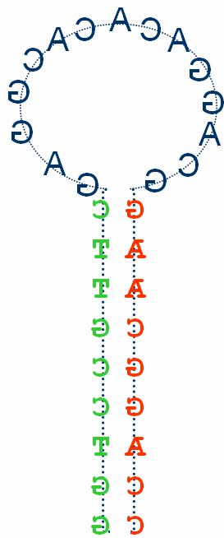
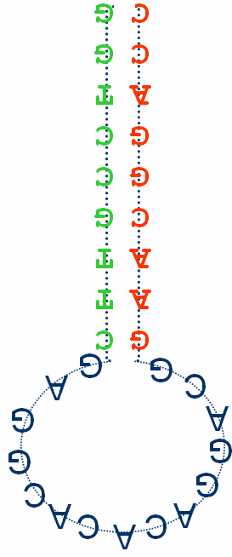
R-Coffee: Embedding RNA Structures Within The T-Coffee Libraries
TC Library
G G Score X
C C Score Y
C
G
C
G
C
G
C
G
The R-extension can be added on the top of any existing method:
Mafft / Muscle / ProbCons
Consan align the RNA sequence and predict secondary structure at the same time
Better libraries but very slow
RNA secondary structures:
Predicted: RNAplFold
Real ones

Slide 12
RNA Sequences
RNAplfold
Consan
or
Mafft / Muscle / ProbCons
Soon! SARA-Coffee:
Like expresso but with RNA structures extracted from the PDB
Carsten Kemena
Giovanni Bussotti
Primary Library
Secondary
Structures
R-Coffee
Extension
R-Coffee Extended
Primary Library
R-Score
Progressive Alignment
Using The R-Score

Slide 13
Pro-Coffee
…gives you a global alignment of homologous regulatory sequences (promoters, enhancers).
uses a dinucleotide substitution matrix derived from TRANSFAC binding site alignments
was optimized on an ortholog finding task with promoter sequences and validated with multi-species ChIP-seq data

Slide 14
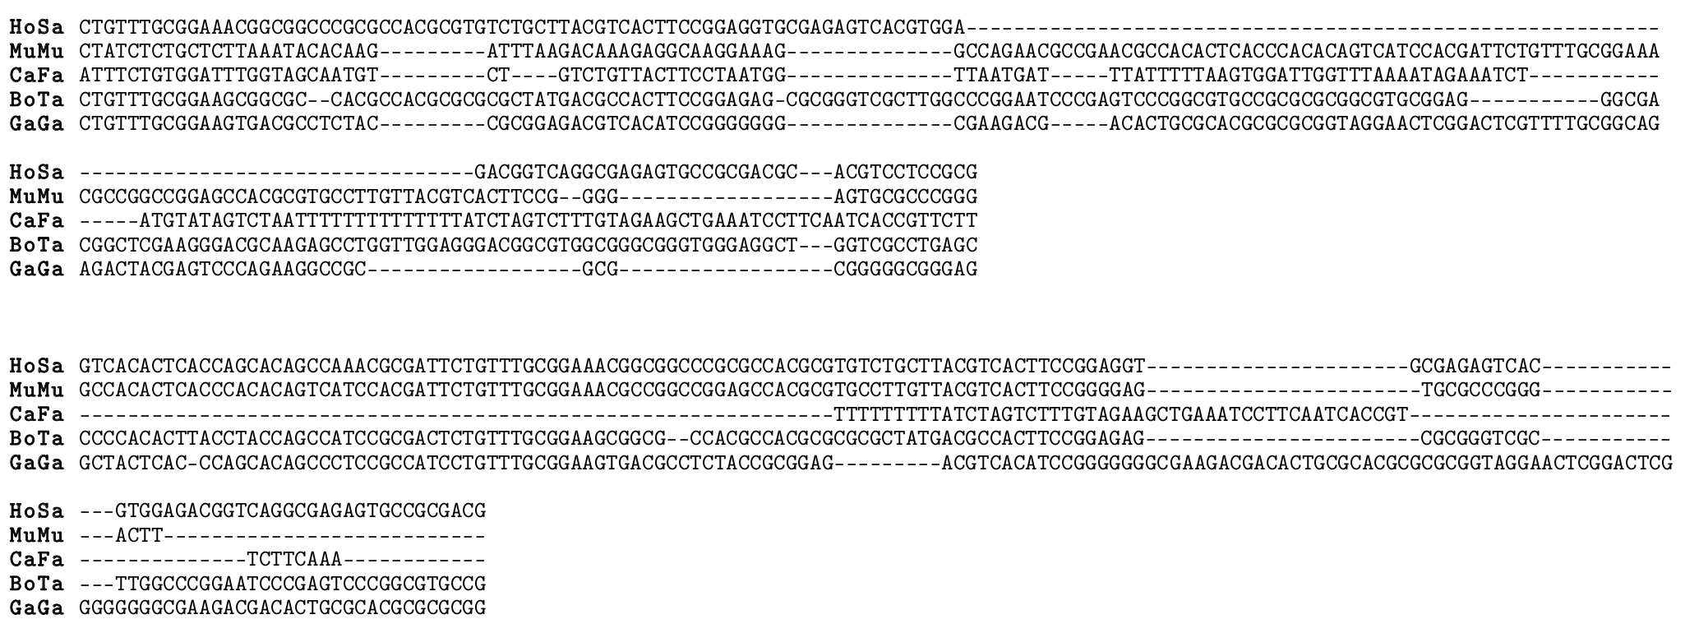
Validation Pro-Coffee
Which alignment is better?

Slide 15
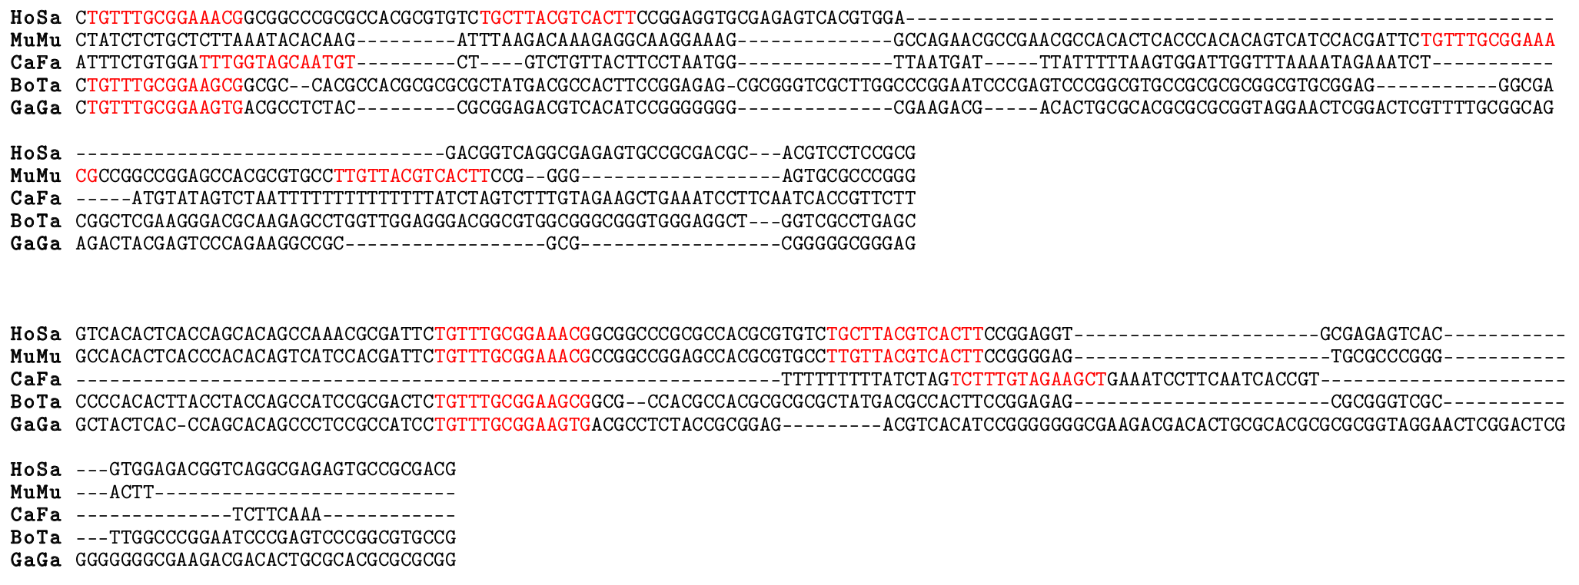
Validation Pro-Coffee
The 2nd one? But can we trust these binding site predictions?

Slide 16
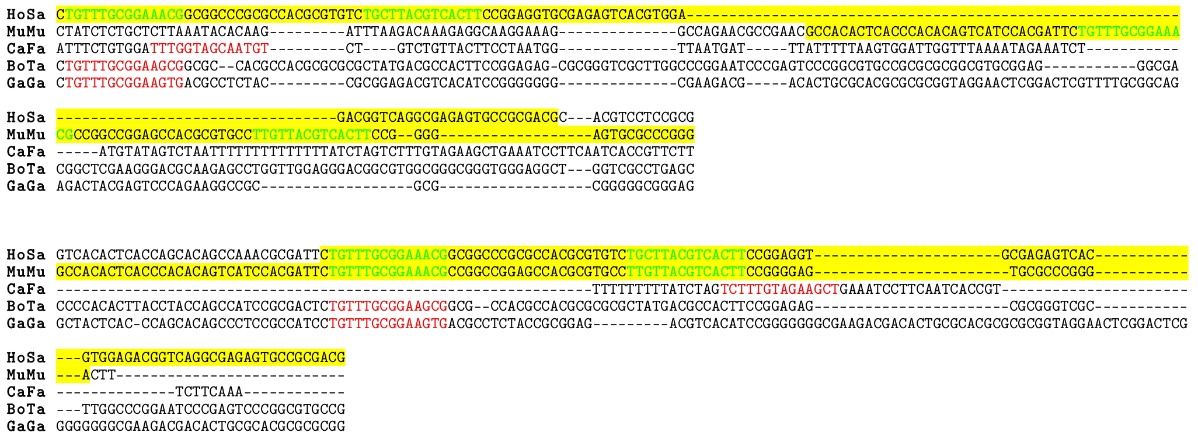
Validation Pro-Coffee
The 2nd one! The green sites are confirmed by ChIP-seq.

Slide 17

Using 3D structure for structural clustering
MSA define equivalences
T-RMSD computes Intramolecular distances
One column = One matrix
One matrix = one tree
Nb columns = support
Magis & al, JMB 2010

Slide 18
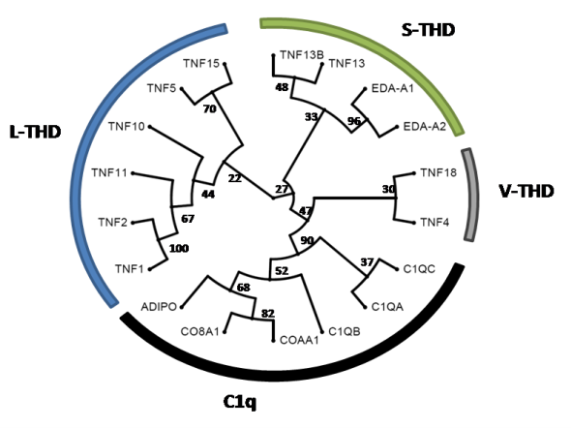
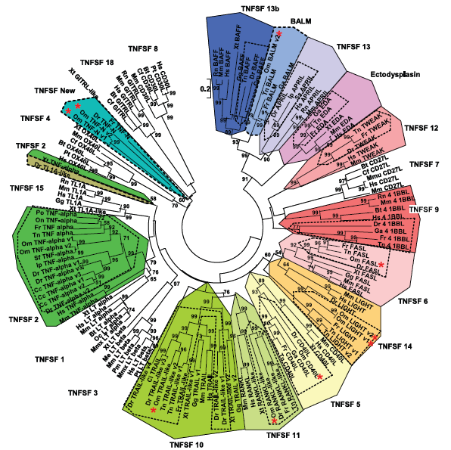
From structural clustering to phylogenetic inference
Structural Tree / PFAM / 3D-Coffee
Magis et al, TIBS (2012, submitted)
Glenney & wiens, Journal of Immunology 2007

Slide 19
Which Flavor?
Fast Alignments
M-Coffee with Fast Aligners: mafft, muscle, kalign
Difficult Protein Alignments
PSI-Coffee
Expresso
Structural clustering
T-RMSD
RNA Alignments
R-Coffee
Promoter Alignments
Pro-Coffee

Slide 20
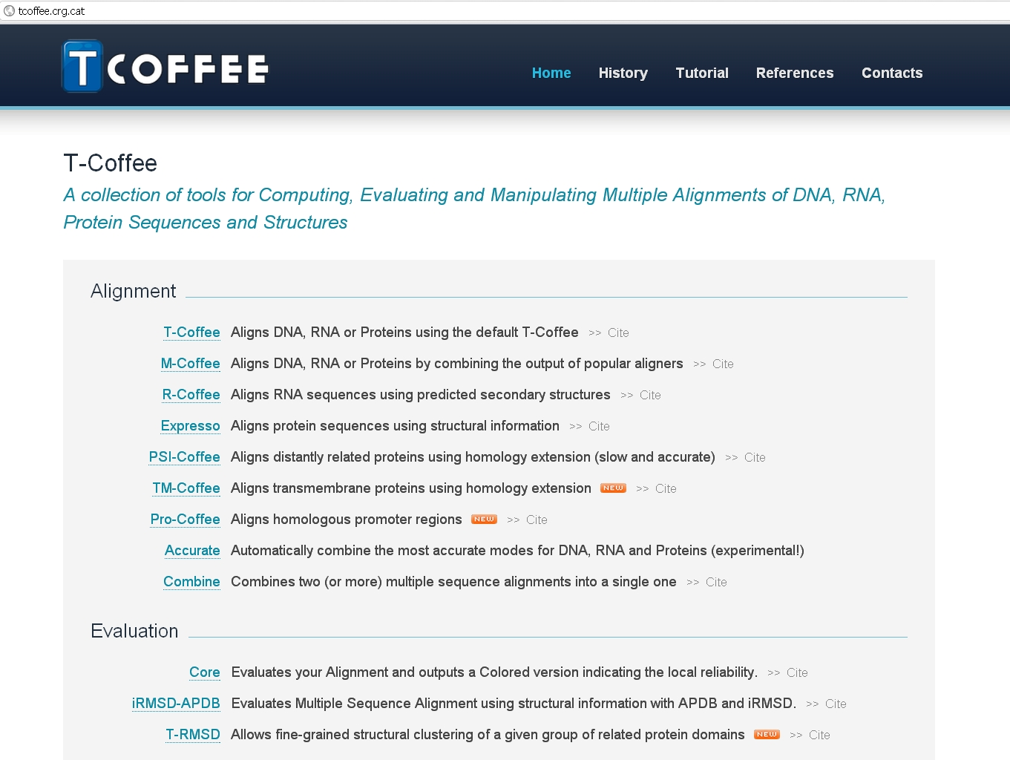
Server: tcoffee.crg.cat Paolo Di Tommaso

Slide 21
Command line structure
t_coffee
-in input_file_name
-method kalign_msa,muscle_msa,mafft_msa
Give the list of methods you want for the computation of the primary libraries
On line documentation: http://www.tcoffee.org/Documentation/t_coffee/t_coffee_tutorial.htm

Slide 22
Command line structure
t_coffee
-in input_file_name
-mode fmcoffee
psicoffee
expresso
mcoffee
T-Coffee special modes
mcoffee
psicoffee
rcoffee
procoffee
On line documentation: http://www.tcoffee.org/Documentation/t_coffee/t_coffee_tutorial.htm

Slide 23
Input/output format
t_coffee
-in input_file_name
-mode expresso
-output output_format
clustal_aln (default)
fasta_aln
phylip_aln
saga_aln
msf_aln
pir_aln
compressed_aln
On line documentation: http://www.tcoffee.org/Documentation/t_coffee/t_coffee_tutorial.htm

Slide 24
T-Coffee “other programs”
t_coffee
-other_pg seq_reformat
aln_compare
strike
irmsd
trmsd
extract_from_pdb
On line documentation: http://www.tcoffee.org/Documentation/t_coffee/t_coffee_tutorial.htm

Slide 25
seq_reformat T-Coffee alignment editing tool
t_coffee
-other_pg seq_reformat
-in input_file_name
-output output_format
-action
+trim _seq_%%90_
On line documentation: http://www.tcoffee.org/Documentation/t_coffee/t_coffee_tutorial.htm

Slide 26
seq_reformat T-Coffee alignment editing tool
t_coffee
-other_pg seq_reformat -help
On line documentation: http://www.tcoffee.org/Documentation/t_coffee/t_coffee_tutorial.htm

Slide 27
T-Coffee & the cache
T-Coffee keeps data in :
~/.t_coffee/cache/
Warning! The cache will accumulate your data and may become very big
Several options :
-cache update
-cache ignore
-cache path

Slide 28
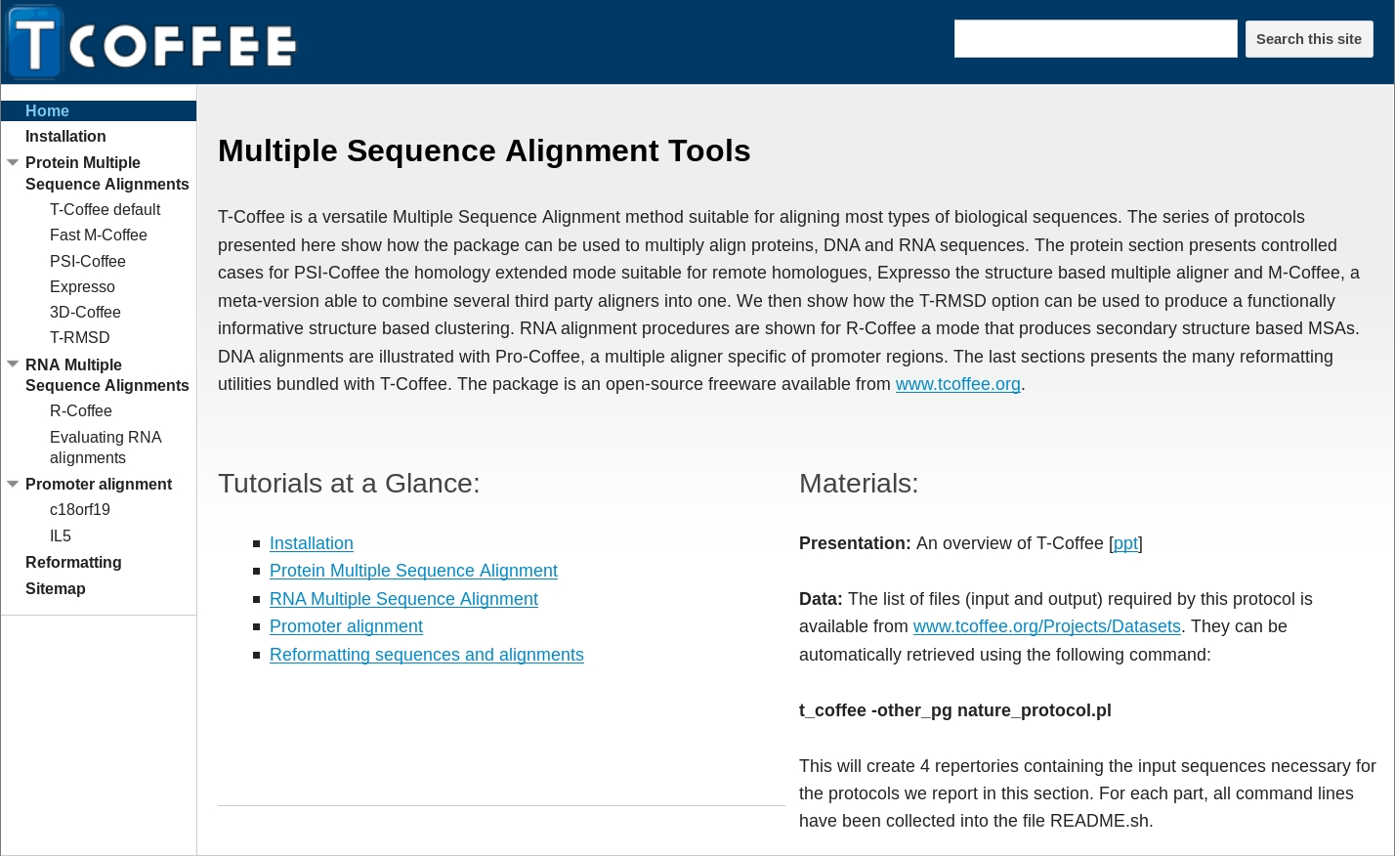
Tutorial web site
https://sites.google.com/site/tcoffeetutorials

Slide 29
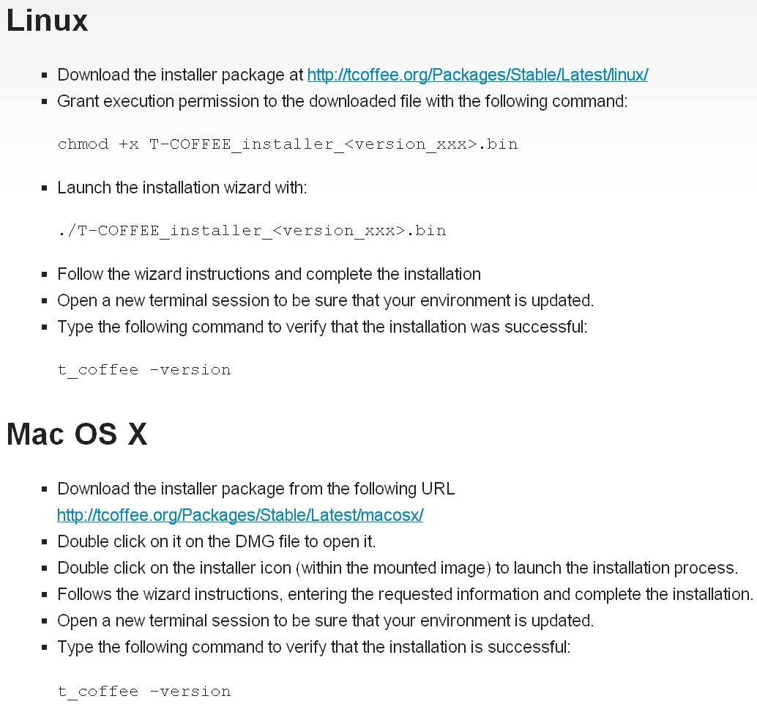
Installation

Slide 30

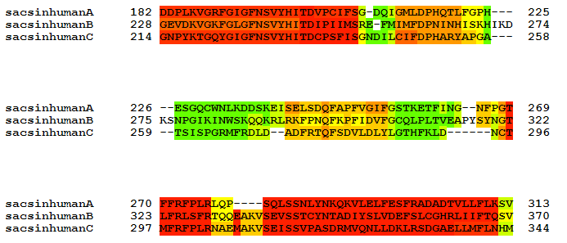
Where to Trust Your Alignments
Most Methods Disagree
Most Methods Agree

Slide 31
Wifi: edenroc
User:gjer5
Password:mm9vq

