Slide 1
RNA folding & ncRNA discovery
I519 Introduction to Bioinformatics, Fall, 2012
Adapted from Haixu Tang

Slide 2
Contents
Non-coding RNAs and their functions
RNA structures
RNA folding
  Nussinov algorithm
  Energy minimization methods
microRNA target identification

Slide 3
RNAs have diverse functions
ncRNAs have important and diverse functional and regulatory roles that impact gene transcription, translation, localization, replication, and degradation
  Protein synthesis (rRNA and tRNA)
  RNA processing (snoRNA)
  Gene regulation
    RNA interference (RNAi)
    Andrew Fire and Craig Mello (2006 Nobel prize)
  DNA-like function
    Virus
  RNA world

Slide 4
Non-coding RNAs
A non-coding RNA (ncRNA) is a functional RNA molecule that is not translated into a protein; small RNA (sRNA) is often used for bacterial ncRNAs.
tRNA (transfer RNA), rRNA (ribosomal RNA), snoRNA (small RNA molecules that guide chemical modifications of other RNAs)
microRNAs (miRNA, μRNA, single-stranded RNA molecules of 21-23 nucleotides in length, regulate gene expression)
siRNAs (short interfering RNA or silencing RNA, double-stranded, 20-25 nucleotides in length, involved in the RNA interference (RNAi) pathway, where it interferes with the expression of a specific gene. )
piRNAs (expressed in animal cells, forms RNA-protein complexes through interactions with Piwi proteins, which have been linked to transcriptional gene silencing of retrotransposons and other genetic elements in germ line cells)
long ncRNAs (non-protein coding transcripts longer than 200 nucleotides)

Slide 5
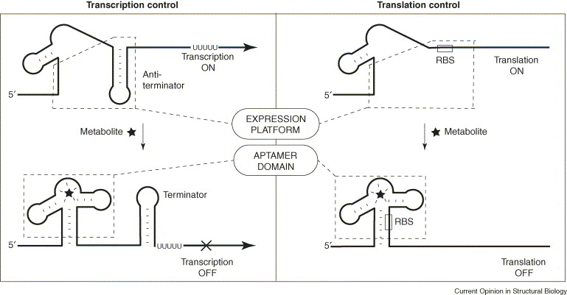
Riboswitch
What’s riboswitch
Riboswitch mechanism
Image source: Curr Opin Struct Biol. 2005, 15(3):342-348
Notes:
What’s a riboswitch?
a part of an mRNA molecule
metabolite sensing
regulates the gene’s activity (expression)
Most riboswitches can be divided roughly into two structural domains: an aptamer [31 and 32] and an expression platform (Figure 1) [26]. The aptamer domain is a highly folded structure that selectively binds to the target metabolite. The expression platform converts metabolite binding events into changes in gene expression by harnessing changes in RNA folding that are brought about by ligand binding.
Common mechanisms of riboswitch gene control. Transcription control involves metabolite binding and stabilization of a specific conformation of the aptamer domain that precludes formation of a competing anti-terminator stem. This allows formation of a terminator stem, which prevents the full-length mRNA from being synthesized. In contrast, control of translation is accomplished by metabolite-induced structural changes that sequester the ribosome-binding site (RBS), thereby preventing the ribosome from binding to the mRNA.
The genes controlled by riboswitches often encode proteins involved in the biosynthesis or transport of the metabolite being sensed [30]. Therefore, the riboswitch is used as a form of feedback inhibition, whereby binding of the metabolite to the riboswitch decreases the expression of the gene products used to make the metabolite.

Slide 6
Structures are more conserved
Structure information is important for alignment (and therefore gene finding)
CGA
GCU
CAA
GUU

Slide 7
Features of RNA
RNA typically produced as a single stranded molecule (unlike DNA)
Strand folds upon itself to form base pairs & secondary structures
Structure conservation is important
RNA sequence analysis is different from DNA sequence

Slide 8
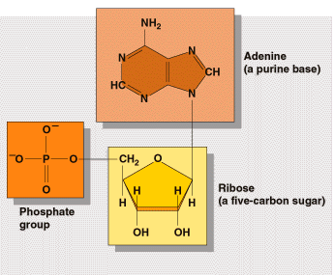
Canonical base pairing
H
N
H
O
N
N
H
N
N
O
H
N
N
N
H
O
H
N
H
N
N
H
N
N
O
N
N
Watson-Crick base pairing
Non-Watson-Crick base pairing G/U (Wobble)

Slide 9
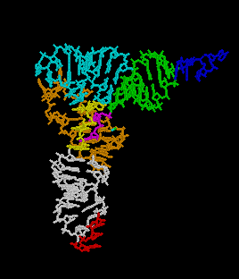
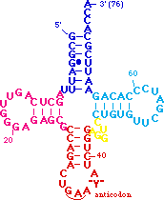
tRNA structure

Slide 10
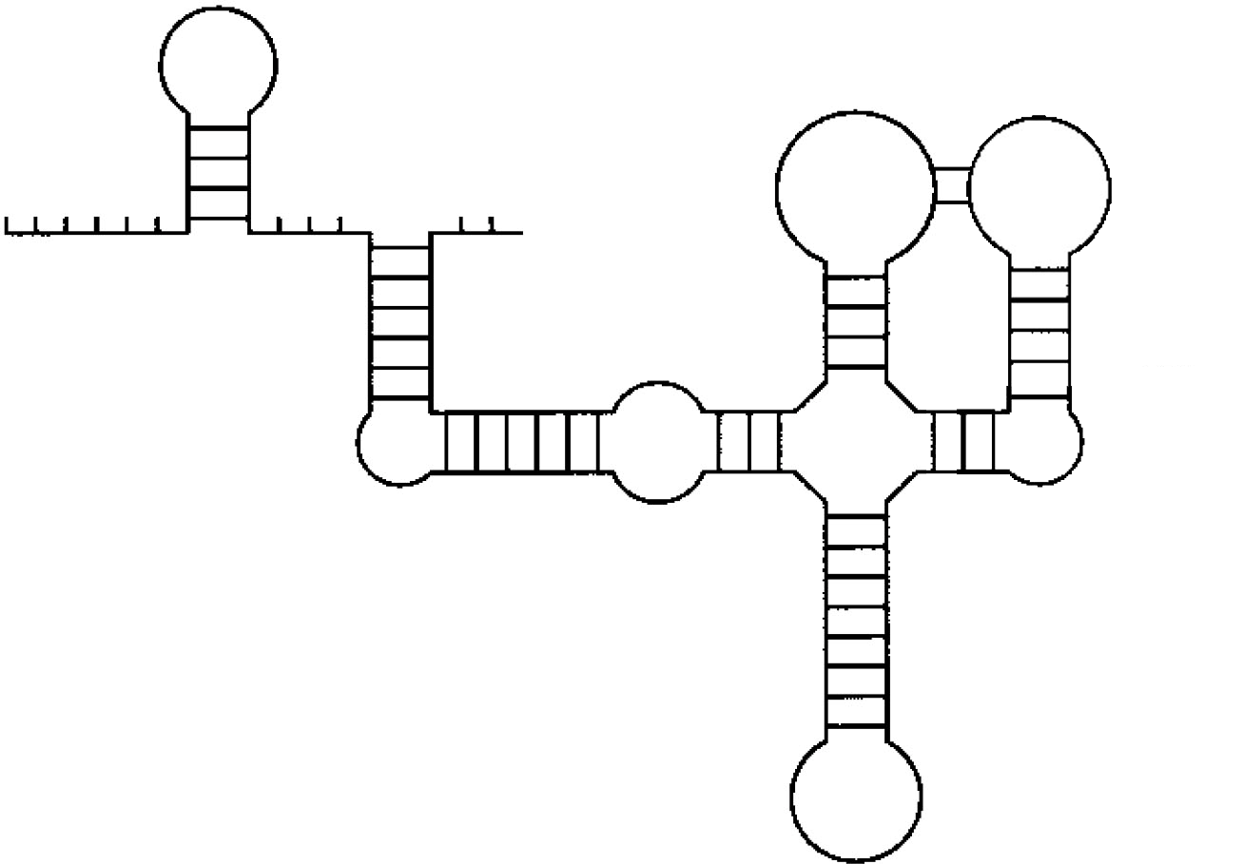
RNA secondary structure
Pseudoknot
Stem
Interior Loop
Single-Stranded
Bulge Loop
Junction (Multiloop)
Hairpin loop

Slide 11
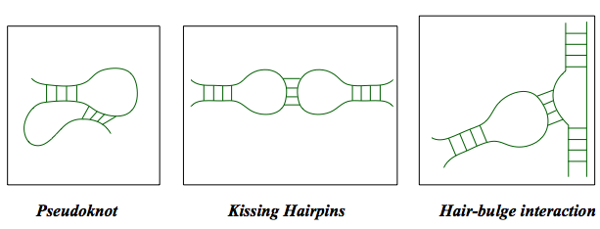
Complex folds

Slide 12
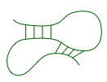

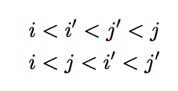
Pseudoknots
i
i
i’
j
j’
j
i’
j’
?

Slide 13
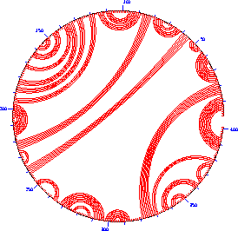
RNA secondary structure representation
2D
Circle plot
Dot plot
Mountain
Parentheses
Tree model
(((…)))..((….))

Slide 14
Main approaches to RNA secondary structure prediction
Energy minimization
  dynamic programming approach
  does not require prior sequence alignment
  require estimation of energy terms contributing to secondary structure
Comparative sequence analysis
  using sequence alignment to find conserved residues and covariant base pairs.
  most trusted
Simultaneous folding and alignment (structural alignment)

Slide 15
Assumptions in energy minimization approaches
Most likely structure similar to energetically most stable structure
Energy associated with any position is only influenced by local sequence and structure
Neglect pseudoknots

Slide 16
Base-pair maximization
Find structure with the most base pairs
  Only consider A-U and G-C and do not distinguish them
Nussinov algorithm (1970s)
  Too simple to be accurate, but stepping-stone for later algorithms

Slide 17
Nussinov algorithm
Problem definition
  Given sequence X=x₁x₂…x_{L,}compute a structure that has maximum (weighted) number of base pairings
How can we solve this problem?
  Remember: RNA folds back to itself!
  S(i,j) is the maximum score when x_{i}..x_{j} folds optimally
  S(1,L)?
  S(i,i)?
S(i,j)
1
i
j
L

Slide 18
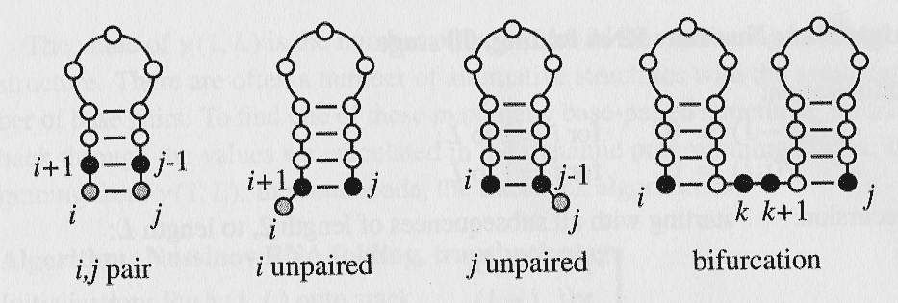
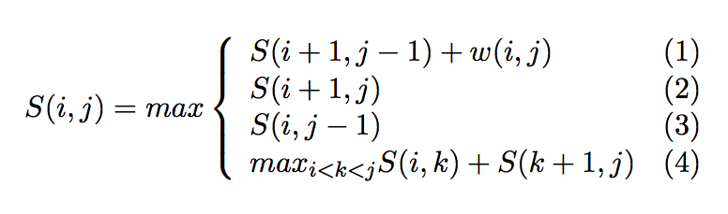
“Grow” from substructures
(1)
(2)
(3)
(4)
1
i
i+1
k
j-1
j
L

Slide 19
Dynamic programming
Compute S(i,j) recursively (dynamic programming)
  Compares a sequence against itself in a dynamic programming matrix
Three steps

Slide 20
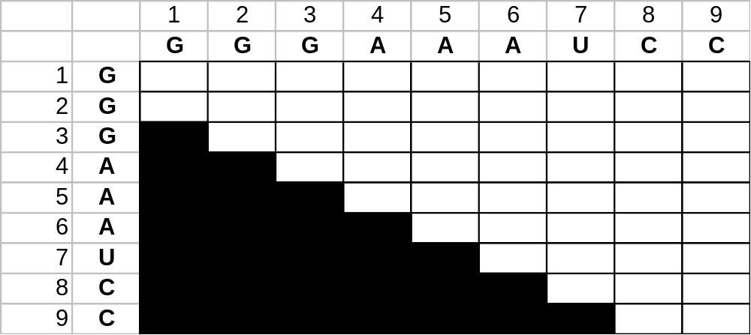
Nussinov RNA Folding Algorithm
Initialization:
  γ(i, i-1) = 0 for I = 2 to L;
  γ(i, i) = 0 for I = 2 to L.
j
i
Image Source: Durbin et al. (2002) “Biological Sequence Analysis”

Slide 21

Nussinov RNA Folding Algorithm
Initialization:
  γ(i, i-1) = 0 for I = 2 to L;
  γ(i, i) = 0 for I = 2 to L.
j
i
Image Source: Durbin et al. (2002) “Biological Sequence Analysis”

Slide 22

Nussinov RNA Folding Algorithm
Initialization:
  γ(i, i-1) = 0 for I = 2 to L;
  γ(i, i) = 0 for I = 2 to L.
j
i
Image Source: Durbin et al. (2002) “Biological Sequence Analysis”

Slide 23
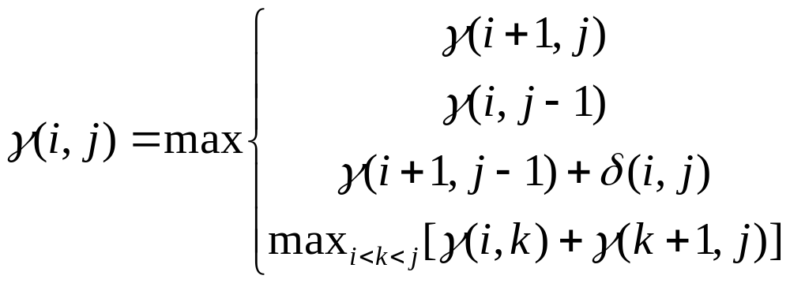
Nussinov RNA Folding Algorithm
Recursive Relation:
For all subsequences from length 2 to length L:
Case 1
Case 2
Case 3
Case 4

Slide 24

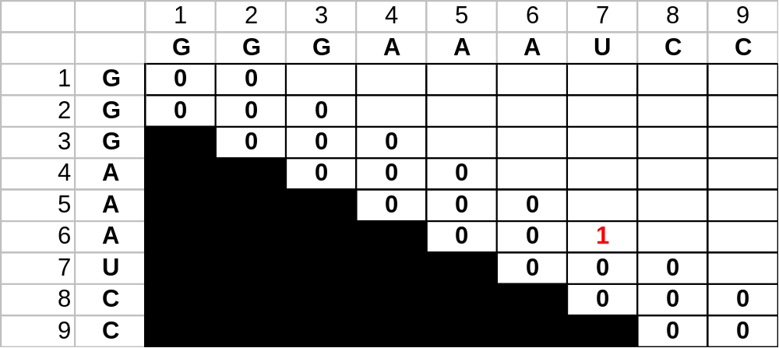
Nussinov RNA Folding Algorithm
j
i
Image Source: Durbin et al. (2002) “Biological Sequence Analysis”

Slide 25
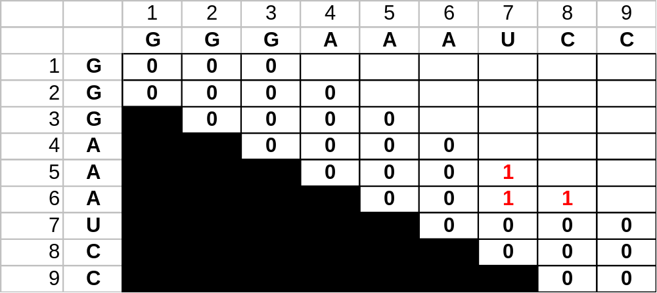
Nussinov RNA Folding Algorithm
j
i
Image Source: Durbin et al. (2002) “Biological Sequence Analysis”

Slide 26
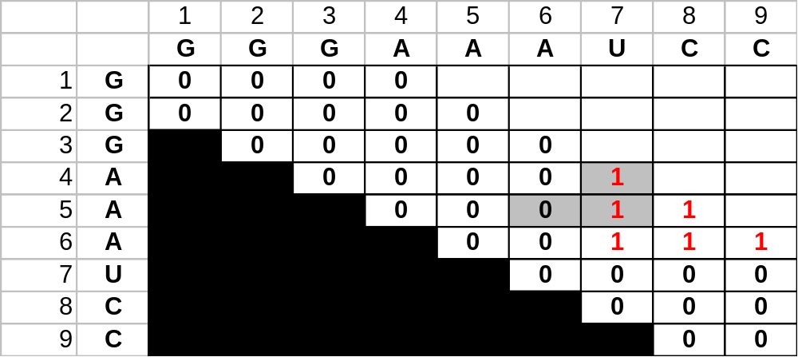
Nussinov RNA Folding Algorithm
j
i
Image Source: Durbin et al. (2002) “Biological Sequence Analysis”

Slide 27
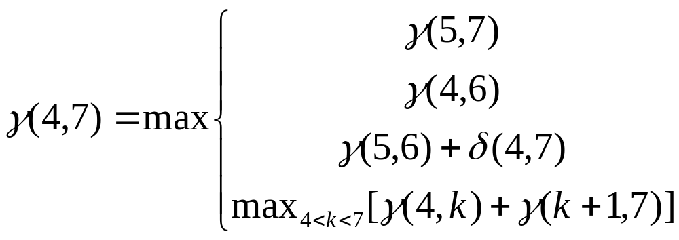
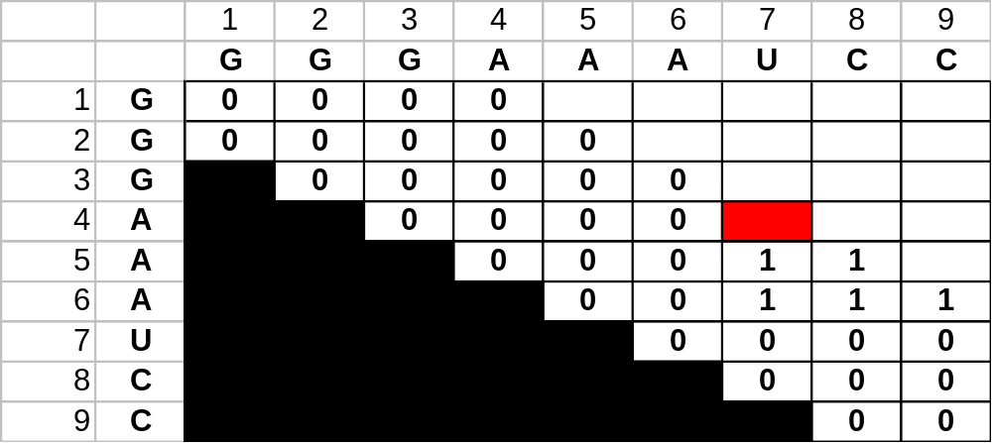
Example Computation
j
i
Image Source: Durbin et al. (2002) “Biological Sequence Analysis”

Slide 28
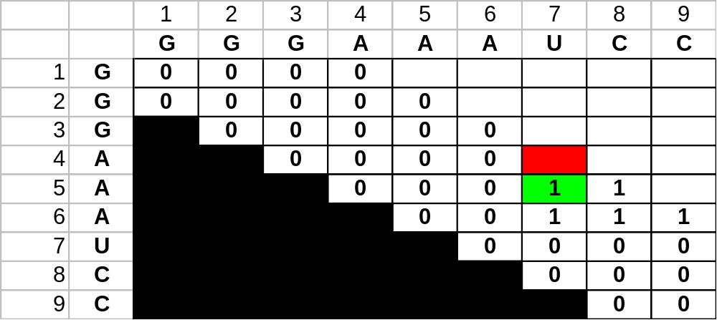
Example Computation
A
i+1
A
U
j
i
A
j
i
Image Source: Durbin et al. (2002) “Biological Sequence Analysis”

Slide 29
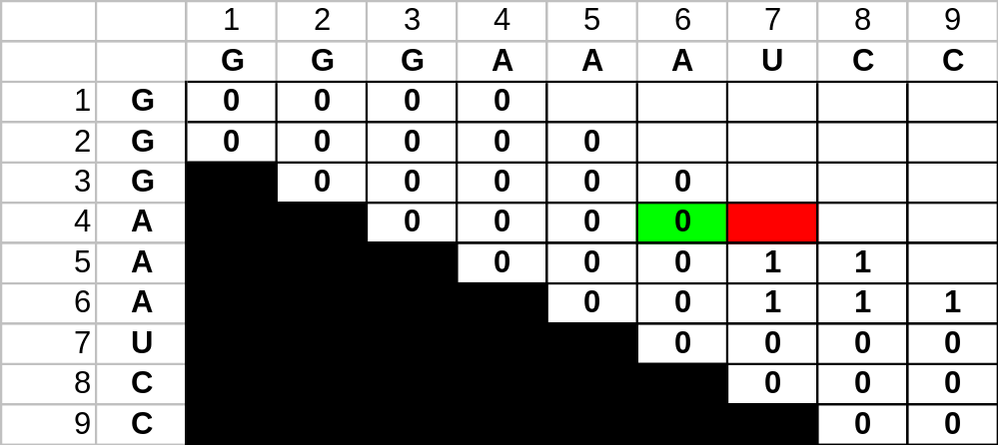
Example Computation
j
i
Image Source: Durbin et al. (2002) “Biological Sequence Analysis”

Slide 30
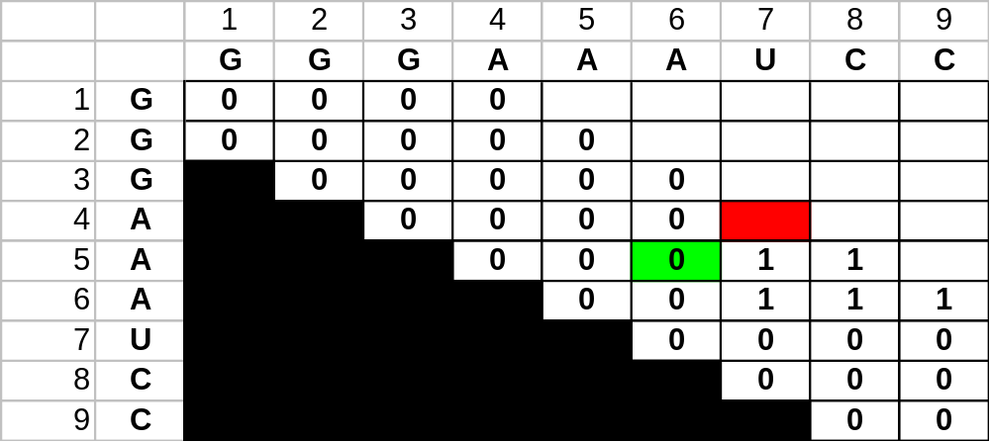
Example Computation
i+1
j-1
A
A
A
U
i
j
j
i
Image Source: Durbin et al. (2002) “Biological Sequence Analysis”

Slide 31
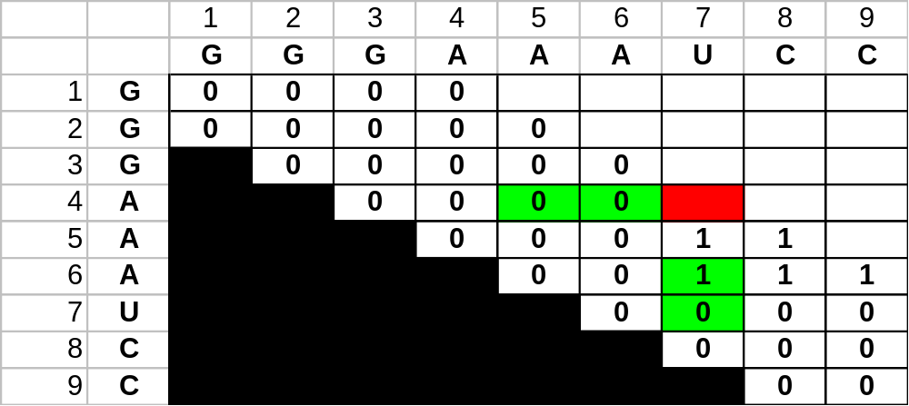
Example Computation
j
i
Image Source: Durbin et al. (2002) “Biological Sequence Analysis”

Slide 32
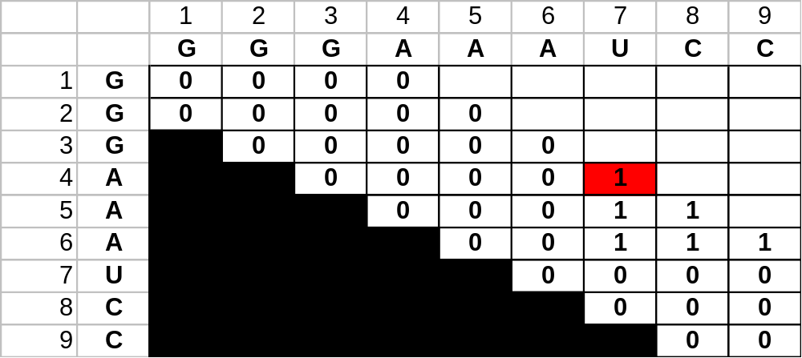
Example Computation
j
i
Image Source: Durbin et al. (2002) “Biological Sequence Analysis”

Slide 33
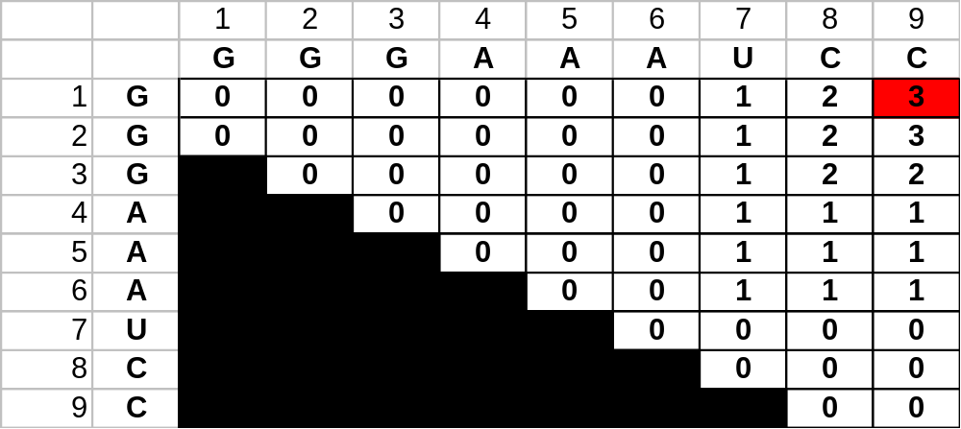
Completed Matrix
j
i
Image Source: Durbin et al. (2002) “Biological Sequence Analysis”

Slide 34
Traceback
value at γ(1, L) is the total base pair count in the maximally base-paired structure
as in other DP, traceback from γ(1, L) is necessary to recover the final secondary structure
pushdown stack is used to deal with bifurcated structures

Slide 35
Traceback Pseudocode
Initialization: Push (1,L) onto stack
Recursion: Repeat until stack is empty:
pop (i, j).
If i >= j continue; // hit diagonal
  else if γ(i+1,j) = γ(i, j) push (i+1,j); // case 1
  else if γ(i, j-1) = γ(i, j) push (i,j-1); // case 2
  else if γ(i+1,j-1)+δ_{i,j} = γ(i, j): // case 3
    record i, j base pair
    push (i+1,j-1);
  else for k=i+1 to j-1:if γ(i, k)+γ(k+1,j)=γ(i, j): // case 4
    push (k+1, j).
    push (i, k).
    break

Slide 36
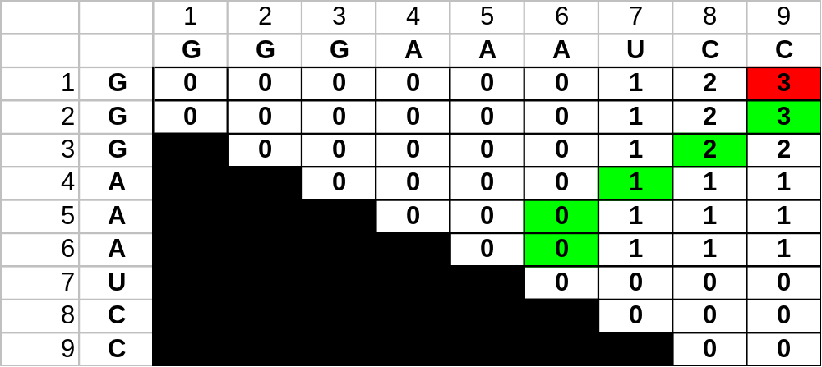
Retrieving the Structure
PAIRS
STACK
(1,9)
CURRENT
j
i
Image Source: Durbin et al. (2002) “Biological Sequence Analysis”

Slide 37
Retrieving the Structure
PAIRS
STACK
(2,9)
CURRENT
(1,9)
j
i
Image Source: Durbin et al. (2002) “Biological Sequence Analysis”

Slide 38
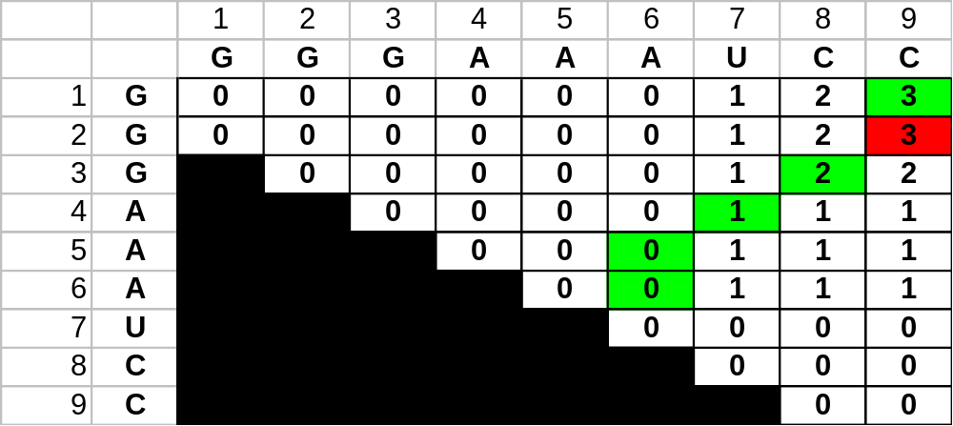
Retrieving the Structure
PAIRS
(2,9)
STACK
(3,8)
CURRENT
(2,9)
G
C
G
j
i
Image Source: Durbin et al. (2002) “Biological Sequence Analysis”

Slide 39
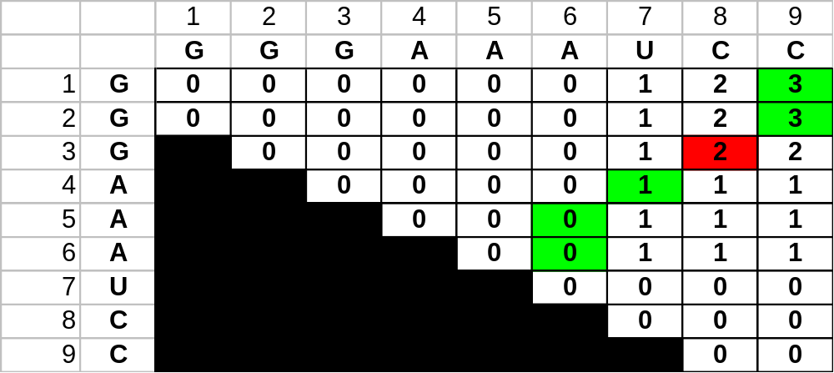
Retrieving the Structure
PAIRS
(2,9)
(3,8)
STACK
(4,7)
CURRENT
(3,8)
G
C
G
C
G
j
i
Image Source: Durbin et al. (2002) “Biological Sequence Analysis”

Slide 40
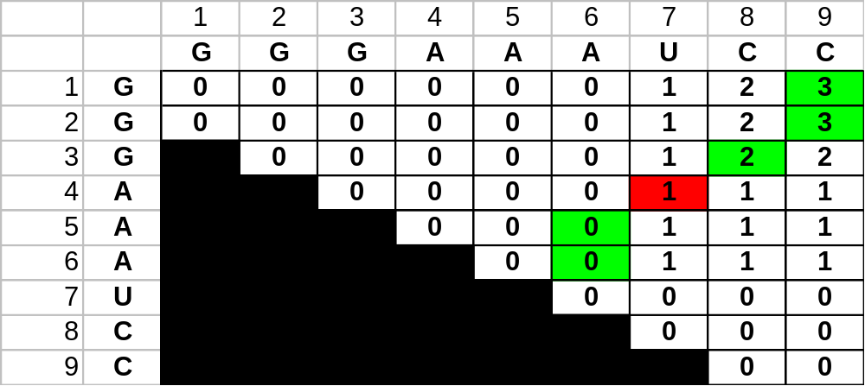
Retrieving the Structure
PAIRS
(2,9)
(3,8)
(4,7)
STACK
(5,6)
CURRENT
(4,7)
A
U
G
C
G
C
G
j
i
Image Source: Durbin et al. (2002) “Biological Sequence Analysis”

Slide 41
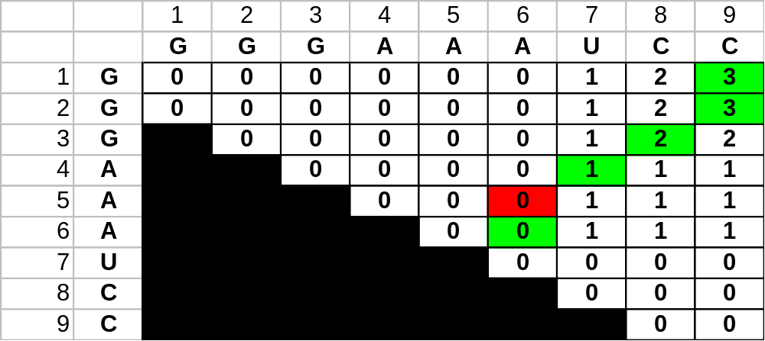
Retrieving the Structure
A
PAIRS
(2,9)
(3,8)
(4,7)
STACK
(6,6)
CURRENT
(5,6)
A
U
G
C
G
C
G
j
i
Image Source: Durbin et al. (2002) “Biological Sequence Analysis”

Slide 42
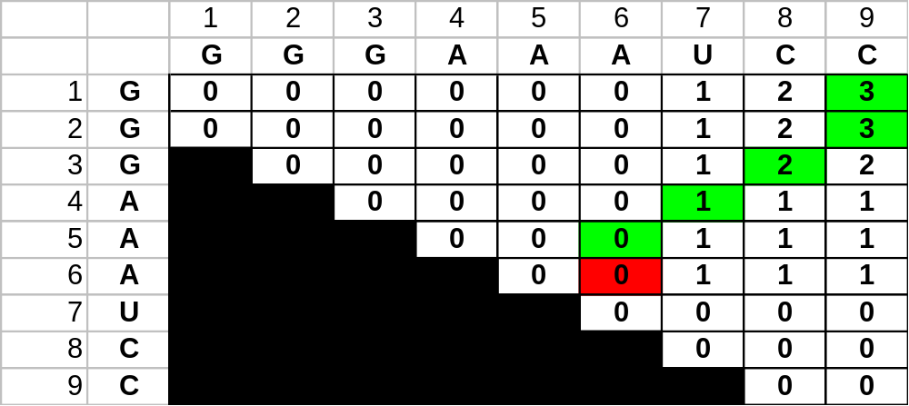
Retrieving the Structure
A
A
PAIRS
(2,9)
(3,8)
(4,7)
STACK
-
CURRENT
(6,6)
A
U
G
C
G
C
G
j
i
Image Source: Durbin et al. (2002) “Biological Sequence Analysis”

Slide 43
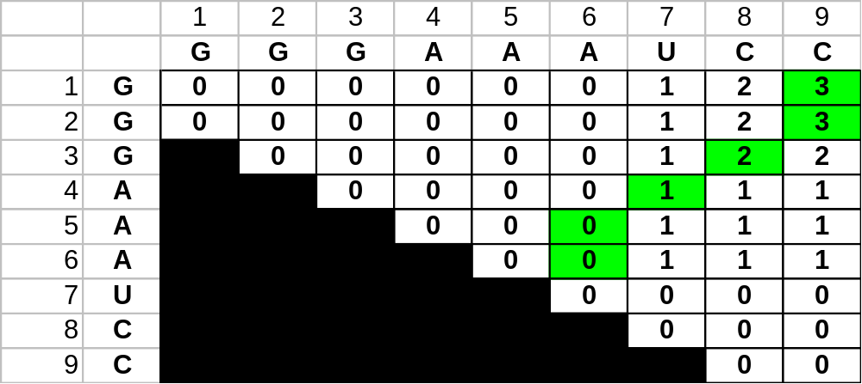
Retrieving the Structure
A
A
A
U
G
C
G
C
G
j
i
Image Source: Durbin et al. (2002) “Biological Sequence Analysis”

Slide 44
Evaluation of Nussinov
unfortunately, while this does maximize the base pairs, it does not create viable secondary structures
in Zuker’s algorithm, the correct structure is assumed to have the lowest equilibrium free energy (ΔG) (Zuker and Stiegler, 1981; Zuker 1989a)

Slide 45
Free energy computation
U U
A A
G C
G C
A
G C
U A
A U
C G
A U
A 3’
A
5’
+5.9 4nt loop
-1.1 mismatch of hairpin
-2.9 stacking
+3.3 1nt bulge
-2.9 stacking
-1.8 stacking
-0.9 stacking
-1.8 stacking
5’ dangling
-2.1 stacking
-0.3
-0.3
ΔG = -4.6 KCAL/MOL

Slide 46
Loop parameters
(from Mfold)
DESTABILIZING ENERGIES BY SIZE OF LOOP
SIZE INTERNAL BULGE HAIRPIN
-------------------------------------------------------
1 . 3.8 .
2 . 2.8 .
3 . 3.2 5.4
4 1.1 3.6 5.6
5 2.1 4.0 5.7
6 1.9 4.4 5.4
.
.
12 2.6 5.1 6.7
13 2.7 5.2 6.8
14 2.8 5.3 6.9
15 2.8 5.4 6.9
Unit: Kcal/mol

Slide 47
Stacking energy
(from Vienna package)
# stack_energies
/* CG GC GU UG AU UA @ */
-2.0 -2.9 -1.9 -1.2 -1.7 -1.8 0
-2.9 -3.4 -2.1 -1.4 -2.1 -2.3 0
-1.9 -2.1 1.5 -.4 -1.0 -1.1 0
-1.2 -1.4 -.4 -.2 -.5 -.8 0
-1.7 -.2 -1.0 -.5 -.9 -.9 0
-1.8 -2.3 -1.1 -.8 -.9 -1.1 0
0 0 0 0 0 0 0

Slide 48
Mfold versus Vienna package
Mfold
  http://frontend.bioinfo.rpi.edu/zukerm/download/
  http://frontend.bioinfo.rpi.edu/applications/mfold/cgi-bin/rna-form1.cgi
  Suboptimal structures
    The correct structure is not necessarily structure with optimal free energy
    Within a certain threshold of the calculated minimum energy
Vienna -- calculate the probability of base pairings
  http://www.tbi.univie.ac.at/RNA/

Slide 49
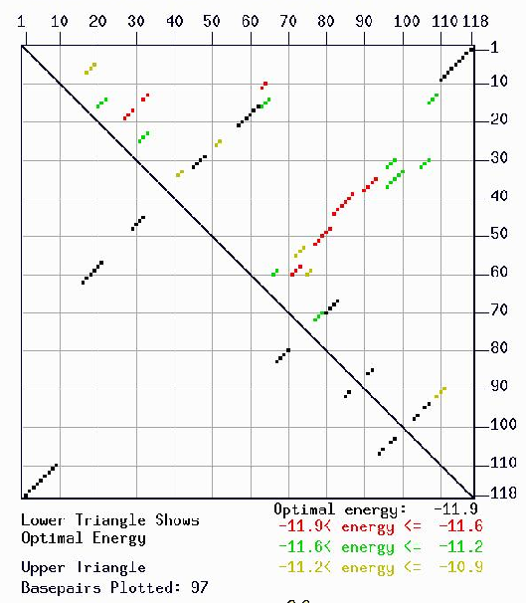
Mfold energy dot plot

Slide 50
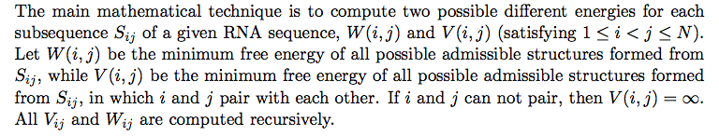
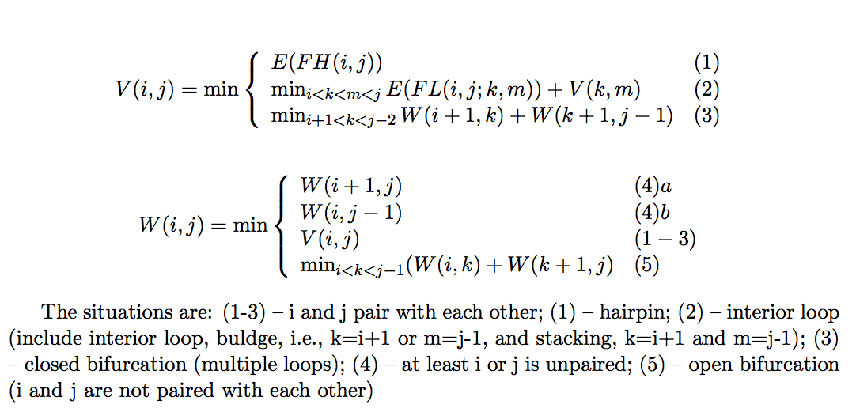
Mfold algorithm
(Zuker & Stiegler, NAR 1981 9(1):133)

Slide 51
A Context Free Grammar
S → AB Nonterminals: S, A, B
A → aAc | a Terminals: a, b, c, d
B → bBd | b
Derivation:
S → AB → aAcB → … → aaaacccB → aaaacccbBd → … → aaaacccbbbbbbddd
Produces all strings a^{i+1}c^{i}b^{j+1}d^{j}, for i, j ≥ 0

Slide 52
The Nussinov Algorithm and Context Free Grammars
CFG
Define the following grammar, with scores:
S → a S u : 3 | u S a : 3
g S c : 2 | c S g : 2
g S u : 1 | u S g : 1
S S : 0 | a S : 0 | c S : 0 | g S : 0 | u S : 0 | ε : 0
Note: ε is the “” string
Then, the Nussinov algorithm finds the optimal parse of a string with this grammar

Slide 53
Example: modeling a stem loop
S → a W₁ u
W₁ → c W₂ g
W₂ → g W₃ c
W₃ → g L c
L → agucg
What if the stem loop can have other letters in place of the ones shown?
AG
U
CG
ACGG
UGCC

Slide 54
Example: modeling a stem loop
S → a W₁ u | g W₁ u
W₁ → c W₂ g
W₂ → g W₃ c | g W₃ u
W₃ → g L c | a L u
L → agucg | agccg | cugugc
More general: Any 4-long stem, 3-5-long loop:
S → aW₁u | gW₁u | gW₁c | cW₁g | uW₁g | uW₁a
W₁ → aW₂u | gW₂u | gW₂c | cW₂g | uW₂g | uW₂a
W₂ → aW₃u | gW₃u | gW₃c | cW₃g | uW₃g | uW₃a
W₃ → aLu | gLu | gLc | cLg | uLg | uLa
L → aL₁ | cL₁ | gL₁ | uL₁
L₁ → aL₂ | cL₂ | gL₂ | uL₂
L₂ → a | c | g | u | aa | … | uu | aaa | … | uuu
AG
U
CG
ACGG
UGCC
AG
C
CG
GCGA
UGCU
CUG
U
CG
GCGA
UGUU

Slide 55
A parse tree: alignment of CFG to sequence
S → a W1 u
W1 → c W2 g
W2 → g W3 c
W3 → g L c
L → agucg
AG
U
CG
ACGG
UGCC
S
W₁
W₂
W₃
L
A C G G A G U G C C C G U

Slide 56
Alignment scores for parses
We can define each rule X → s, where s is a string,
to have a score.
Example:
W → a W’ u: 3 (forms 3 hydrogen bonds)
W → g W’ c: 2 (forms 2 hydrogen bonds)
W → g W’ u: 1 (forms 1 hydrogen bond)
W → x W’ z -1, when (x, z) is not an a/u, g/c, g/u pair
Questions:
How do we best align a CFG to a sequence: DP
How do we set the parameters: Stochastic CFGs.

Slide 57
The Nussinov Algorithm
Initialization:
F(i, i-1) = 0; for i = 2 to N
F(i, i) = 0; for i = 1 to N S → a | c | g | u
Iteration:
For i = 2 to N:
For i = 1 to N – l
j = i + L – 1
F(i+1, j -1) + s(x_{i}, x_{j}) S → a S u | …
F(i, j) = max
max{ i ≤ k < j } F(i, k) + F(k+1, j) S → S S
Termination:
Best structure is given by F(1, N)

Slide 58
Stochastic Context Free Grammars
In an analogy to HMMs, we can assign probabilities to transitions:
Given grammar
X₁ → s₁₁ | … | s_{in}
…
X_{m} → s_{m1} | … | s_{mn}
Can assign probability to each rule, s.t.
P(X_{i} → s_{i1}) + … + P(X_{i} → s_{in}) = 1

Slide 59
Computational Problems
Calculate an optimal alignment of a sequence and a SCFG
  (DECODING)
Calculate Prob[ sequence | grammar ]
  (EVALUATION)
Given a set of sequences, estimate parameters of a SCFG
  (LEARNING)

Slide 60
Normal Forms for CFGs
Chomsky Normal Form:
X → YZ
X → a
All productions are either to 2 nonterminals, or to 1 terminal
Theorem (technical)
Every CFG has an equivalent one in Chomsky Normal Form
(That is, the grammar in normal form produces exactly the same set of strings)

Slide 61
Example of converting a CFG to C.N.F.
S
A
B
C
S → ABC
A → Aa | a
B → Bb | b
C → CAc | c
Converting:
S → AS’
S’ → BC
A → AA | a
B → BB | b
C → DC’ | c
C’ → c
D → CA
A
a
B
b
C
A
c
a
B
b
c
a
S
b
A
S’
A
A
B
C
a
a
B
B
D
C’
B
B
b
C
A
c
b
b
c
a

Slide 62
Another example
S → ABC
A → C | aA
B → bB | b
C → cCd | c
Converting:
S → AS’
S’ → BC
A → C’C’’ | c | A’A
A’ → a
B → B’B | b
B’ → b
C → C’C’’ | c
C’ → c
C’’ → CD
D → d

Slide 63
Decoding: the CYK algorithm
Given x = x₁....x_{N}, and a SCFG G,
Find the most likely parse of x
(the most likely alignment of G to x)
Dynamic programming variable:
γ(i, j, V): likelihood of the most likely parse of x_{i}…x_{j},
rooted at nonterminal V
Then,
γ(1, N, S): likelihood of the most likely parse of x by the grammar

Slide 64
The CYK algorithm (Cocke-Younger-Kasami)
Initialization:
For i = 1 to N, any nonterminal V,
γ(i, i, V) = log P(V → x_{i})
Iteration:
For i = 1 to N-1
For j = i+1 to N
For any nonterminal V,
γ(i, j, V) = max_{X}max_{Y}max_{i≤k<j} γ(i,k,X) + γ(k+1,j,Y) + log P(V→XY)
Termination:
log P(x | θ, π*) = γ(1, N, S)
Where π* is the optimal parse tree (if traced back appropriately from above)

Slide 65
A SCFG for predicting RNA structure
S → a S | c S | g S | u S | ε
→ S a | S c | S g | S u
→ a S u | c S g | g S u | u S g | g S c | u S a
→ SS
Adjust the probability parameters to reflect bond strength etc
No distinction between non-paired bases, bulges, loops
Can modify to model these events
  L: loop nonterminal
  H: hairpin nonterminal
  B: bulge nonterminal
  etc

Slide 66
CYK for RNA folding
Initialization:
γ(i, i-1) = log P(ε)
Iteration:
For i = 1 to N
For j = i to N
γ(i+1, j–1) + log P(x_{i} S x_{j})
γ(i, j–1) + log P(S x_{i})
γ(i, j) = max
γ(i+1, j) + log P(x_{i} S)
max_{i < k < j} γ(i, k) + γ(k+1, j) + log P(S S)

Slide 67
Evaluation
Recall HMMs:
Forward: f_{l}(i) = P(x₁…x_{i}, π_{i} = l)
Backward: b_{k}(i) = P(x_{i+1}…x_{N} | π_{i} = k)
Then,
P(x) = Σ_{k} f_{k}(N) a_{k0} = Σ_{l} a_{0l} e_{l}(x₁) b_{l}(1)
Analogue in SCFGs:
Inside: a(i, j, V) = P(x_{i}…x_{j} is generated by nonterminal V)
Outside: b(i, j, V) = P(x, excluding x_{i}…x_{j} is generated by S and the excluded part is rooted at V)

Slide 68
The Inside Algorithm
To compute
a(i, j, V) = P(x_{i}…x_{j}, produced by V)
a(i, j, v) = Σ_{X} Σ_{Y} Σ_{k} a(i, k, X) a(k+1, j, Y) P(V → XY)
V
X
Y
i
k
k+1
j

Slide 69
Algorithm: Inside
Initialization:
For i = 1 to N, V a nonterminal,
a(i, i, V) = P(V → x_{i})
Iteration:
For i = 1 to N-1
For j = i+1 to N
For V a nonterminal
a(i, j, V) = Σ_{X} Σ_{Y} Σ_{k} a(i, k, X) a(k+1, j, X) P(V → XY)
Termination:
P(x | θ) = a(1, N, S)

Slide 70
The Outside Algorithm
b(i, j, V) = Prob(x₁…x_{i-1}, x_{j+1}…x_{N}, where the “gap” is rooted at V)
Given that V is the right-hand-side nonterminal of a production,
b(i, j, V) = Σ_{X} Σ_{Y} Σ_{k<i} a(k, i-1, X) b(k, j, Y) P(Y → XV)
Y
X
V
k
i
j

Slide 71
Algorithm: Outside
Initialization:
b(1, N, S) = 1
For any other V, b(1, N, V) = 0
Iteration:
For i = 1 to N-1
For j = N down to i
For V a nonterminal
b(i, j, V) = Σ_{X} Σ_{Y} Σ_{k<i} a(k, i-1, X) b(k, j, Y) P(Y → XV) +
Σ_{X} Σ_{Y} Σ_{k<i} a(j+1, k, X) b(i, k, Y) P(Y → VX)
Termination:
It is true for any i, that:
P(x | θ) = Σ_{X} b(i, i, X) P(X → x_{i})

Slide 72
Learning for SCFGs
We can now estimate
c(V) = expected number of times V is used in the parse of x₁….x_{N}
1
c(V) = –––––––– Σ_{1≤i≤N}Σ_{i≤j≤N} a(i, j, V) b(i, j, v)
P(x | θ)
1
c(V→XY) = –––––––– Σ_{1≤i≤N}Σ_{i<j≤N} Σ_{i≤k<j} b(i,j,V) a(i,k,X) a(k+1,j,Y) P(V→XY)
P(x | θ)

Slide 73
Learning for SCFGs
Then, we can re-estimate the parameters with EM, by:
c(V→XY)
P^{new}(V→XY) = ––––––––––––
c(V)
c(V → a) Σ_{i: xi = a} b(i, i, V) P(V → a)
P^{new}(V → a) = –––––––––– = ------------------------------------------
c(V) Σ_{1≤i≤N}Σ_{i<j≤N} a(i, j, V) b(i, j, V)

Slide 74
Summary: SCFG and HMM algorithms
GOAL HMM algorithm SCFG algorithm
Optimal parse Viterbi CYK
Estimation Forward Inside
Backward Outside
Learning EM: Fw/Bck EM: Ins/Outs
Memory Complexity O(N K) O(N² K)
Time Complexity O(N K²) O(N³ K³)
Where K: # of states in the HMM
# of nonterminals in the SCFG

Slide 75
Methods for inferring RNA fold
Experimental:
  Crystallography
  NMR
Computational
  Fold prediction (Nussinov, Zuker, SCFGs)
  Multiple Alignment

Slide 76
Multiple alignment and RNA folding
Given K homologous aligned RNA sequences:
Human aagacuucggaucuggcgacaccc
Mouse uacacuucggaugacaccaaagug
Worm aggucuucggcacgggcaccauuc
Fly ccaacuucggauuuugcuaccaua
Orc aagccuucggagcgggcguaacuc
If i^{th} and j^{th} positions are always base paired and covary, then they are likely to be paired

Slide 77



Mutual information
: frequency of a base in column i
: joint (pairwise) frequency of a base pair between columns i and j
Information ranges from 0 and ? bits
If i and j are uncorrelated (independent), mutual information is 0

Slide 78
Mutual information
f_{ab}(i,j)
M_{ij} = Σ_{a,b∈{a,c,g,u}}f_{ab}(i,j) log₂––––––––––
f_{a}(i) f_{b}(j)
Where f_{ab}(i,j) is the # of times the pair a, b are in positions i, j
Given a multiple alignment, can infer structure that maximizes the sum of mutual information, by DP
In practice:
Get multiple alignment
Find covarying bases – deduce structure
Improve multiple alignment (by hand)
Go to 2
A manual EM process!!

Slide 79
Inferring structure by comparative sequence analysis
Need a multiple sequence alignment as input
Requires sequences be similar enough (so that they can be initially aligned)
Sequences should be dissimilar enough for covarying substitutions to be detected
“Given an accurate multiple alignment, a large number of sequences, and sufficient sequence diversity, comparative analysis alone is sufficient to produce accurate structure predictions” (Gutell RR et al. Curr Opin Struct Biol 2002, 12:301-310)

Slide 80
RNA variations
Variations in RNA sequence maintain base-pairing patterns for secondary structures (conserved patterns of base-pairing)
When a nucleotide in one base changes, the base it pairs to must also change to maintain the same structure
Such variation is referred to as covariation.
CGA
GCU
CAA
GUU

Slide 81
If neglect covariation
In usual alignment algorithms they are doubly penalized
…GA…UC…
…GA…UC…
…GA…UC…
…GC…GC…
…GA…UA…

Slide 82
Covariance measurements
Mutual information (desirable for large datasets)
  Most common measurement
  Used in CM (Covariance Model) for structure prediction
Covariance score (better for small datasets)

Slide 83
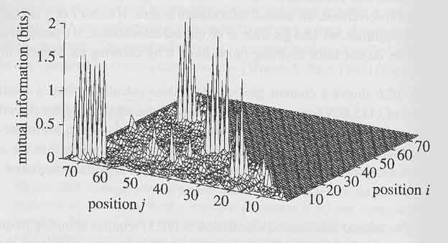
Mutual information plot

Slide 84
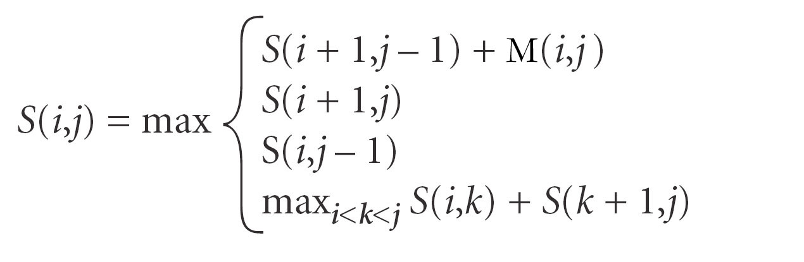
Structure prediction using MI
S(i,j) = Score at indices i and j; M(i,j) is the mutual information between i and j
The goal is to maximize the total mutual information of input RNA
The recursion is just like the one in Nussinov Algorithm, just to replace w(i,j) (1 or 0) with the mutual information M(i,j)

Slide 85
Covariance-like score
RNAalifold
  Hofacker et al. JMB 2002, 319:1059-1066
Desirable for small datasets
Combination of covariance score and thermodynamics energy

Slide 86
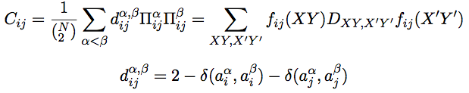
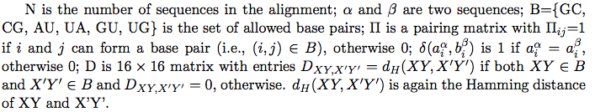
Covariance-like score calculation
The score between two columns i and j of an input multiple alignment is computed as following:

Slide 87
Covariance model
A formal covariance model, CM, devised by Eddy and Durbin
  A probabilistic model
  ≈ A Stochastic Context-Free Grammer
  Generalized HMM model
A CM is like a sequence profile, but it scores a combination of sequence consensus and RNA secondary structure consensus
Provides very accurate results
Very slow and unsuitable for searching large genomes

Slide 88
CM training algorithm
Unaligned sequence
alignment
Multiple alignment
EM
Covariance model
Parameter re-estimation
Modeling construction

Slide 89
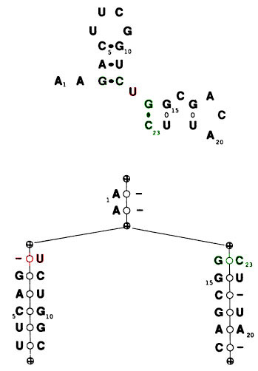
Binary tree representation of RNA secondary structure
Representation of RNA structure using Binary tree
Nodes represent
  Base pair if two bases are shown
  Loop if base and “gap” (dash) are shown
Pseudoknots still not represented
Tree does not permit varying sequences
  Mismatches
  Insertions & Deletions
Images – Eddy et al.

Slide 90
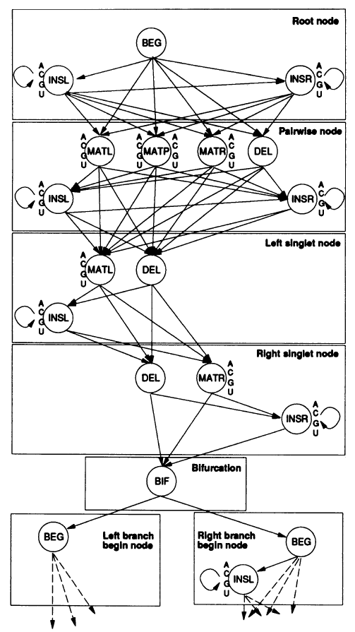
Overall CM architecture
  MATP emits pairs of bases: modeling of base pairing
  BIF allows multiple helices (bifurcation)

Slide 91
Covariance model drawbacks
Needs to be well trained (large datasets)
Not suitable for searches of large RNA
  Structural complexity of large RNA cannot be modeled
  Runtime
  Memory requirements

Slide 92
ncRNA gene finding
De novo ncRNA gene finding
  Folding energy
  Number of sub-optimal RNA structures
Homology ncRNA gene searching
  Sequence-based
  Structure-based
  Sequence and structure-based

Slide 93
Rfam & Infernal
Rfam 9.1 contains 1379 families (December 2008)
Rfam 10.0 contains 1446 families (January 2010)
Rfam is a collection of multiple sequence alignments and covariance models covering many common non-coding RNA families
Infernal searches Rfam covariance models (CMs) in genomes or other DNA sequence databases for homologs to known structural RNA families
http://rfam.janelia.org/

Slide 94
An example of Rfam families
TPP (a riboswitch; THI element)
  RF00059
  is a riboswitch that directly binds to TPP (active form of VB, thiamin pyrophosphate) to regulate gene expression through a variety of mechanisms in archaea, bacteria and eukaryotes

Slide 95
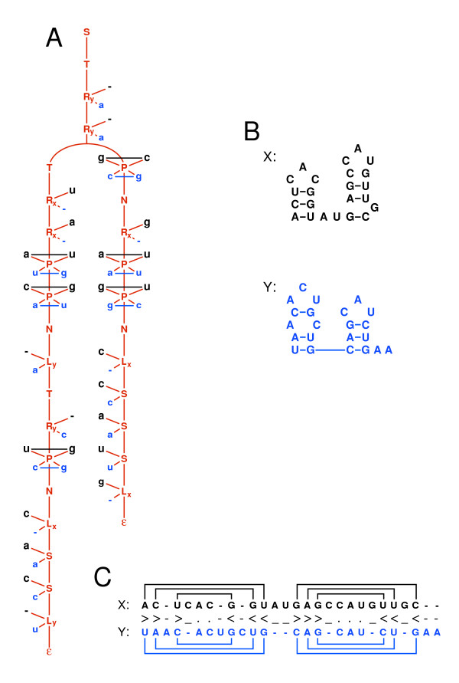
Simultaneous structure prediction and alignment of ncRNAs
The grammar emits two correlated sequences, x and y
http://www.biomedcentral.com/1471-2105/7/400

Slide 96
References
How Do RNA Folding Algorithms Work? Eddy. Nature Biotechnology, 22:1457-1458, 2004 (a short nice review)
Biological Sequence Analysis: Probabilistic models of proteins and nucleic acids. Durbin, Eddy, Krogh and Mitchison. 1998 Chapter 10, pages 260-297
Secondary Structure Prediction for Aligned RNA Sequences. Hofacker et al. JMB, 319:1059-1066, 2002 (RNAalifold; covariance-like score calculation)
Optimal Computer Folding of Large RNA Sequences Using Thermodynamics and Auxiliary Information. Zuker and Stiegler. NAR, 9(1):133-148, 1981 (Mfold)
A computational pipeline for high throughput discovery of cis-regulatory noncoding RNAs in Bacteria, PLoS CB 3(7):e126
  Riboswitches in Eubacteria Sense the Second Messenger Cyclic Di-GMP, Science, 321:411 – 413, 2008
  Identification of 22 candidate structured RNAs in bacteria using the CMfinder comparative genomics pipeline, Nucl. Acids Res. (2007) 35 (14): 4809-4819.
  CMfinder—a covariance model based RNA motif finding algorithm. Bioinformatics 2006;22:445-452

Slide 97
Understanding the transcriptome through RNA structure
'RNA structurome’
Genome-wide measurements of RNA structure by high-throughput sequencing
Nat Rev Genet. 2011 Aug 18;12(9):641-55

