Slide 1
VARIANT CALLING
INTRODUCTION METHODS ZOOM ON GATK
Cedric Notredame
Adapted from Yannick Boursin

Slide 2
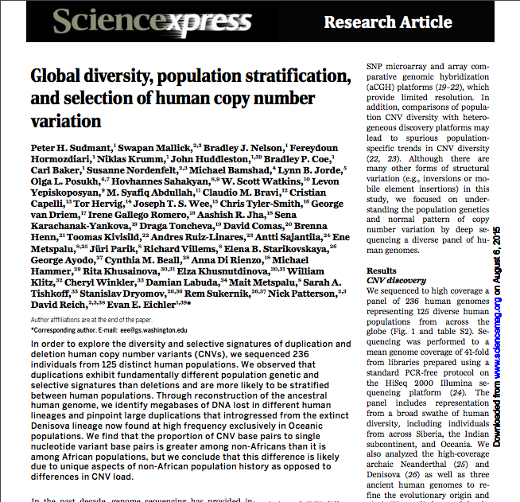

Slide 3
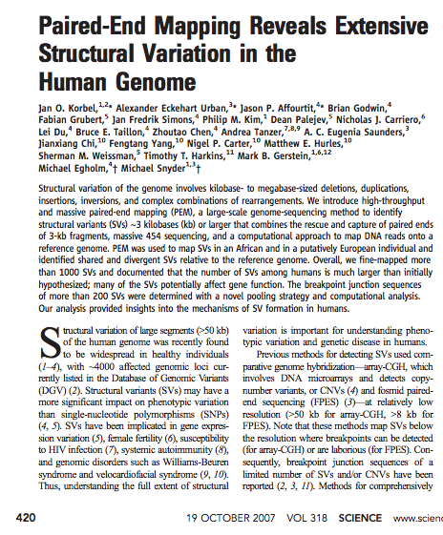
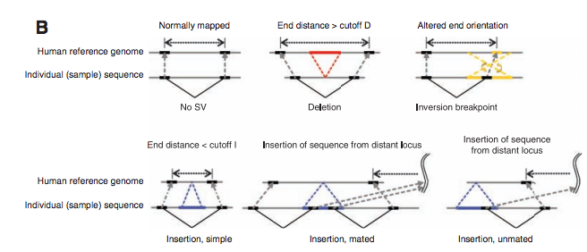

Slide 4
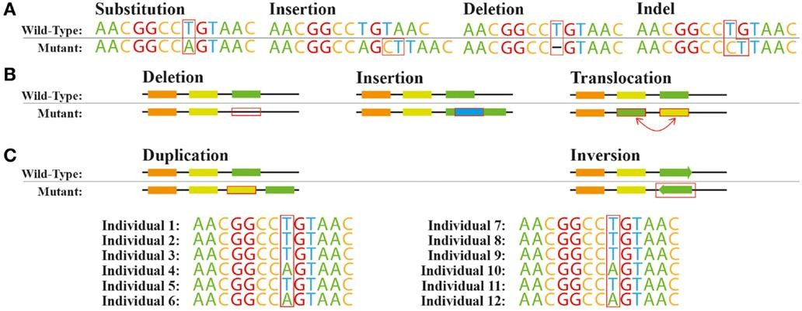
Genetic variations
Variations at the (A) nucleotide level and
(B) structural level. (C) Single nucleotide polymorphism (SNP) across a population. DOI: 10.3389/fbioe.2015.00013

Slide 5
Terminology
Polymorphism: stated regarding a population
Variant: said of anything that is different regarding a reference
Beware: SNP not equal SNV.
InDel : Insertion – Deletion. Used by bioinformaticians to designate either an insertion or a deletion
In practice: people (even us) often use the term SNP when they talk about SNVs.
Process of extracting information about genomic variants
is called “Variant Calling”

Slide 6
Why would variant calling be complicated ?
Identify true genetic variations and discard false positives.
False positive variations may arise from any step of the previous analysis:
> PCR artefacts
> Sequencing artefacts / errors / quality
> Alignment
> Realignment, Recalibration
> Any other step, even the most insignificant might add it’s layer of dust

Slide 7
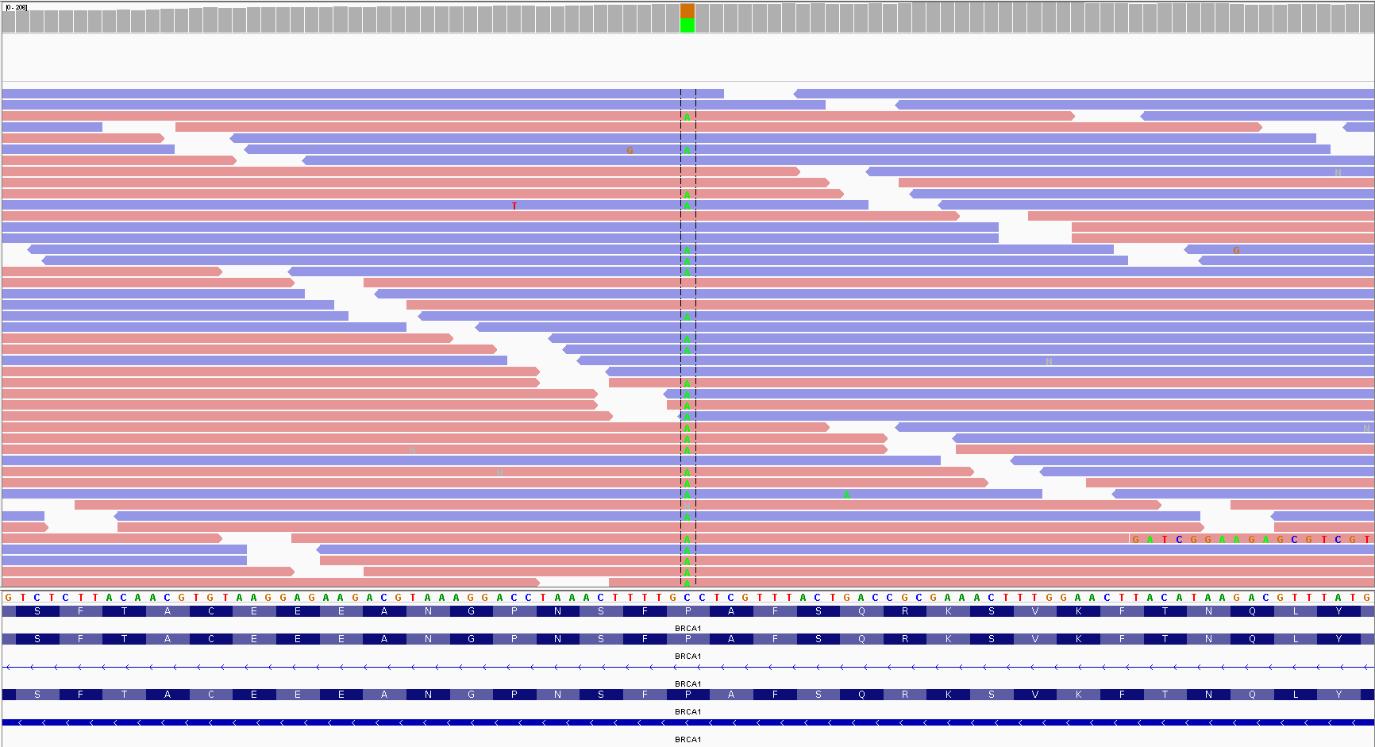
Naïve approach
What are we trying to do with Variant Calling (VC) ?
A BRCA1 SNV from an ovary cancer sample viewed on IGV

Slide 8
Naïve approach
Advantages
> Convenient for the “trust what I see” consortium
> Adds some visual context to your variant
Disadvantages
> Too much time and data
> Reproducibility
> For large genomes, recognized as a risk factor for major depression
Keep that to check variants found in silico

Slide 9
In silico approach
Use software called “Variant Callers”
Advantages
> Relatively automatic
> Gives some methodological background to your study
Disadvantages
> Can be computationally intensive
> Potentially complex algorithms leading to incomplete comprehension of results (may give you some headaches)
> No “one caller fits all” approach

Slide 10

ZOOMING ON A FEW ALGORITHMS
8

Slide 11
Calling variant bound to reference: Heuristic approach
Find all variations
Various filters *
* Base quality, mapping quality, depth, variant depth, context, strand bias, other sample presenting the variation, …
Test for significance (Fisher’s exact test)
Discard variant
Keep variant

Slide 12
Heuristic p-value: the Varscan2 example
Get the reference reads and the alternate reads
Compute coverage at position
Use baseline errors to compute expected alternate
erroneous read counts
Compute t-test to compare expectation with observation
Though this is a very naïve approach, it is widely used and has the advantage of having easily understood results. Some publication talk about Varscan2 being the best variant caller.

Slide 13
Calling variant bound to reference: the Broad Institute contributions
Broad Institute
> IGV (Integrative Genomics Viewer)
> http://www.tumorportal.org
> GATK
> (hail – Post-calling variant analysis – In progress)
MuTecT (Somatic Cancer Variant Caller)
GISTIC (MCR)
MutSig (Identify driver mutations)

Slide 14
Calling variant bound to reference: lets get back to GATK
GATK: The Genome Analysis Toolkit
> 2985 citations (24th October 2016)
> Collection of many tools
> Developed by the Broad Institute
> TCGA, 1000 Genome, …
> GATK isn’t a variant caller, GATK-HC and GATK-UG are
> GATK-UG is deprecated and should not be used anymore
> GATK-HC should not be used for somatic variant calling
GATK-HC : GATK-HaplotypeCaller
GATK-UG : GATK-UnifiedGenotyper

Slide 15
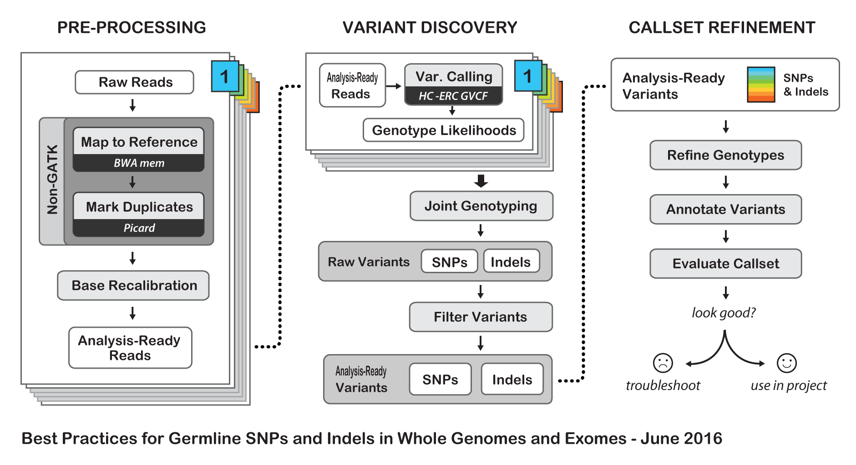
The GATK Best Practices

Slide 16
When should you use GATK-HC
You would like to find DNA / RNA variants in a constitutional context with a reference genome.
You have computational resources (complete GATK workflow duration: approx. 1 days / 8 cores / 16gb RAM / sample
You are aware and cool with the fact that sometimes, when you check in alignment file, you see something looking like a variant that was not called by GATK (look at bamOutput)
You like that the people who wrote the software answer you and mostly keep the math away from you.

Slide 17
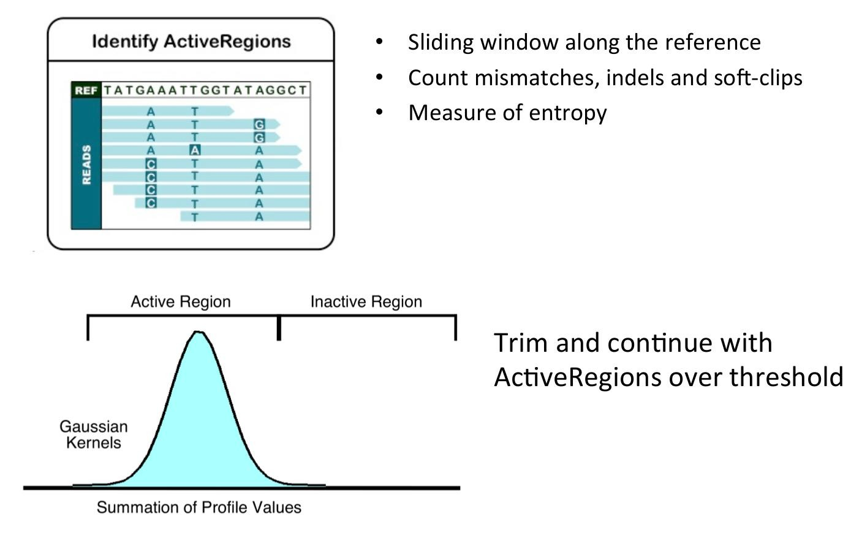
How does GATK-HC works: step 1
https://software.broadinstitute.org/gatk/events/slides/1604/presentations/

Slide 18
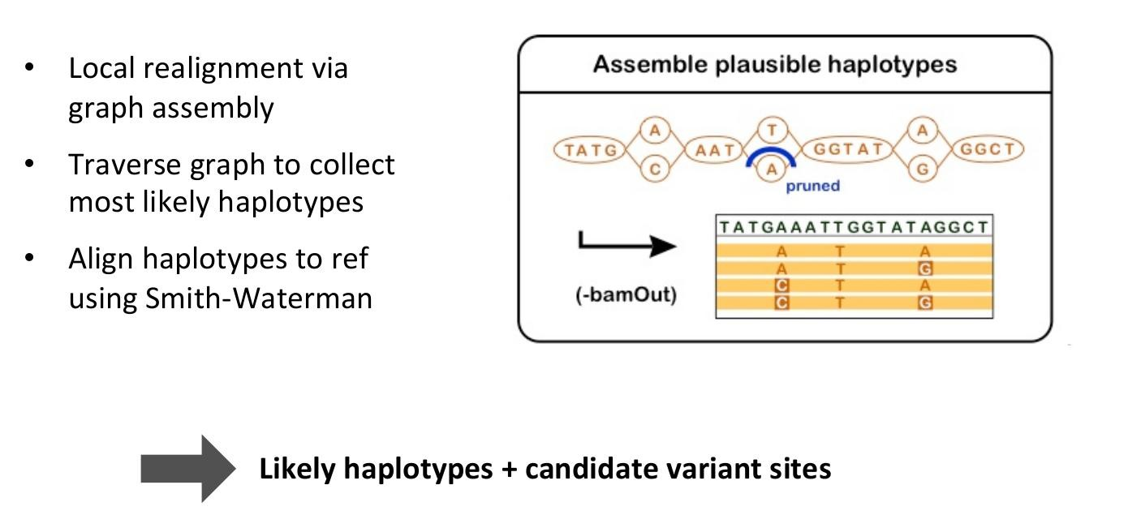
How does GATK-HC works: step 2

Slide 19
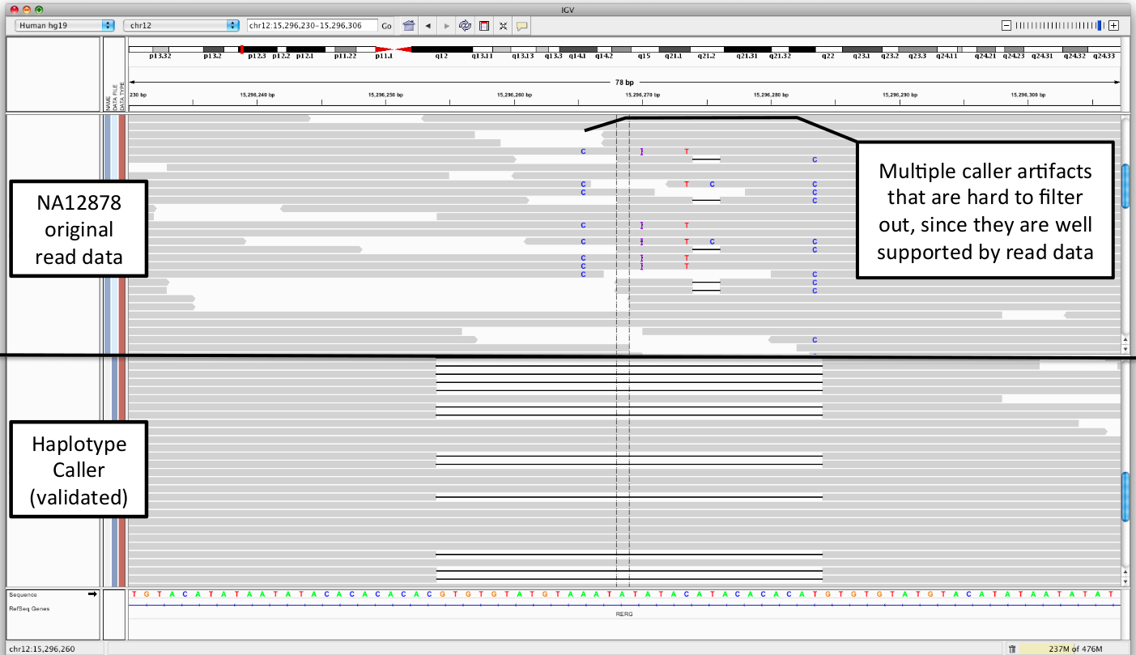
How does GATK-HC works: step 2

Slide 20
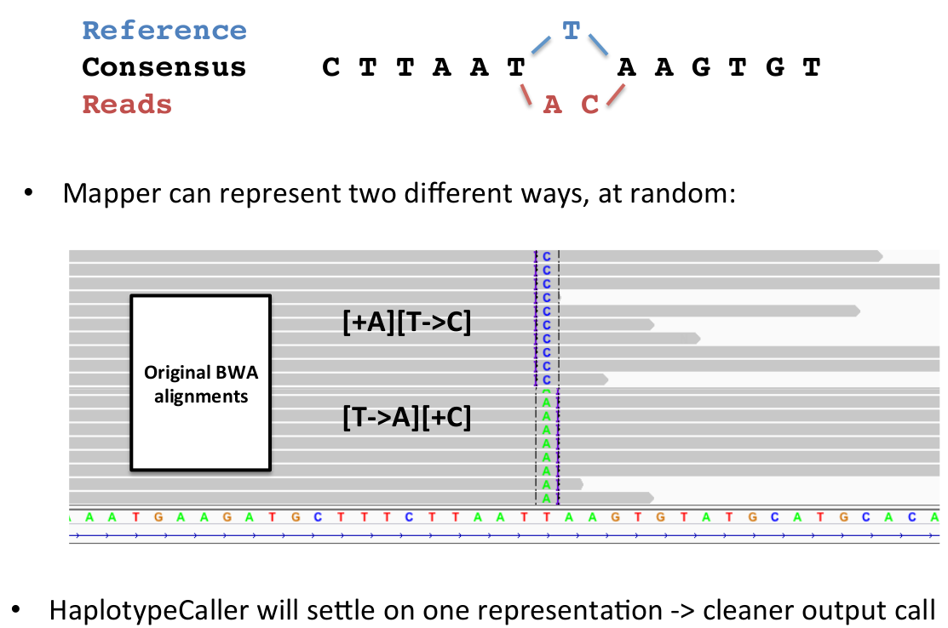
How does GATK-HC works: step 2

Slide 21
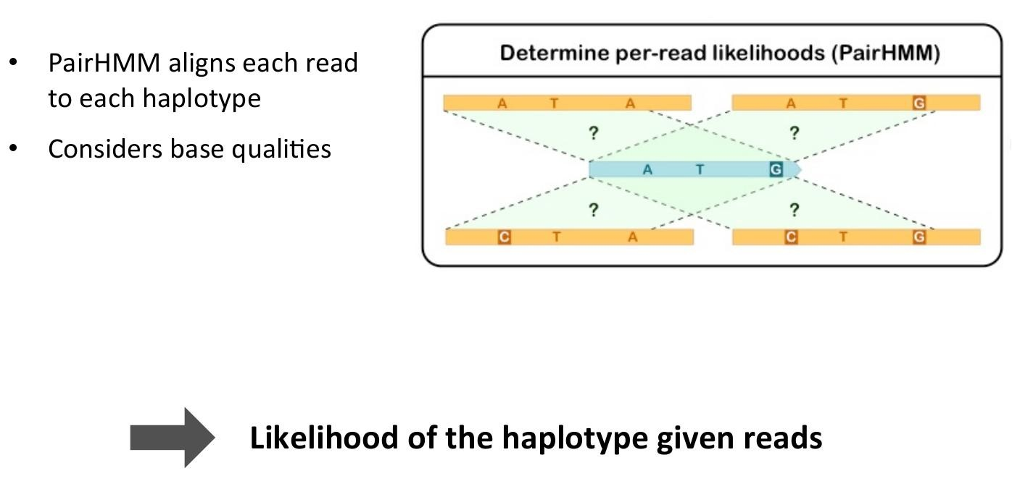
How does GATK-HC works: step 3

Slide 22
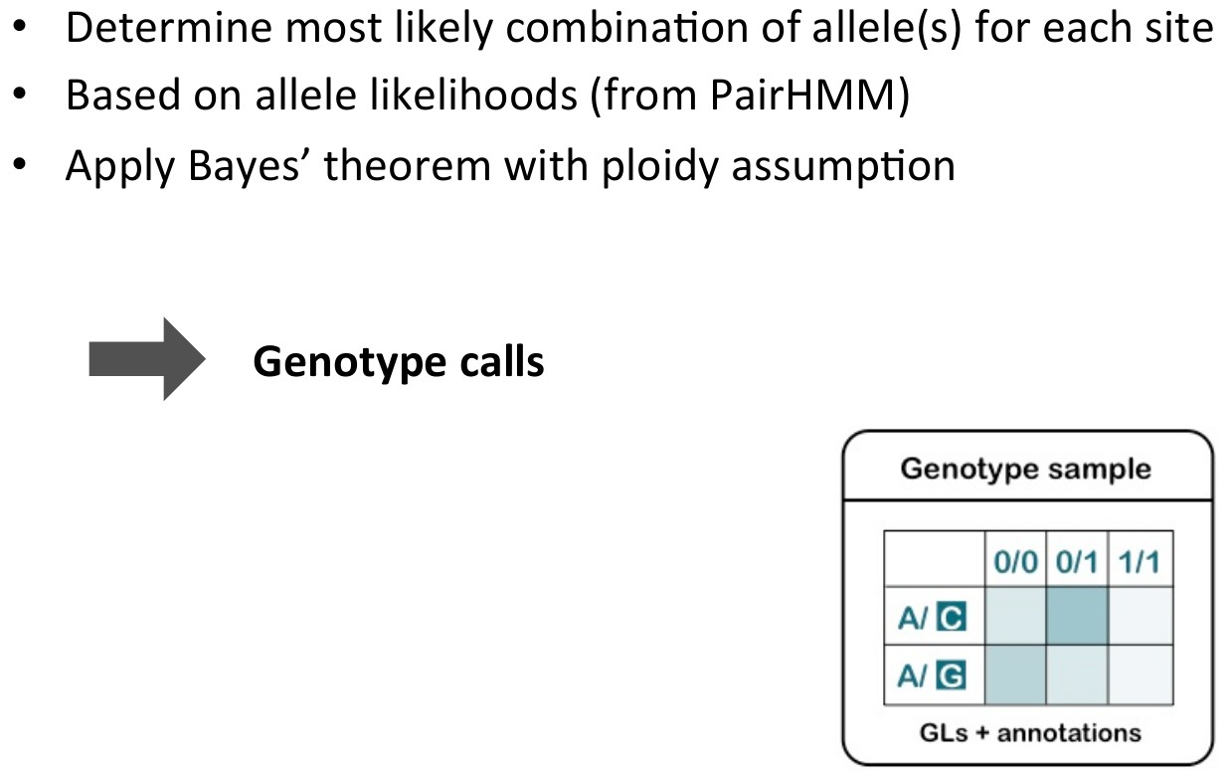
How does GATK-HC works: step 4

Slide 23
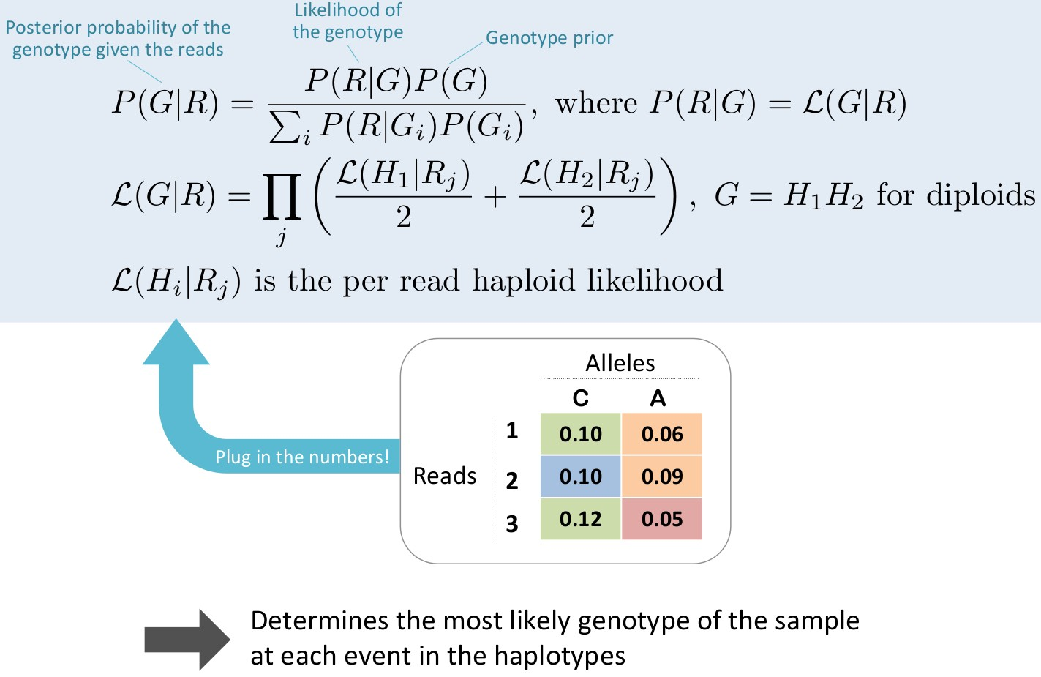
How does GATK-HC works: step 4
Awful Bayesian math that is here for reference

Slide 24
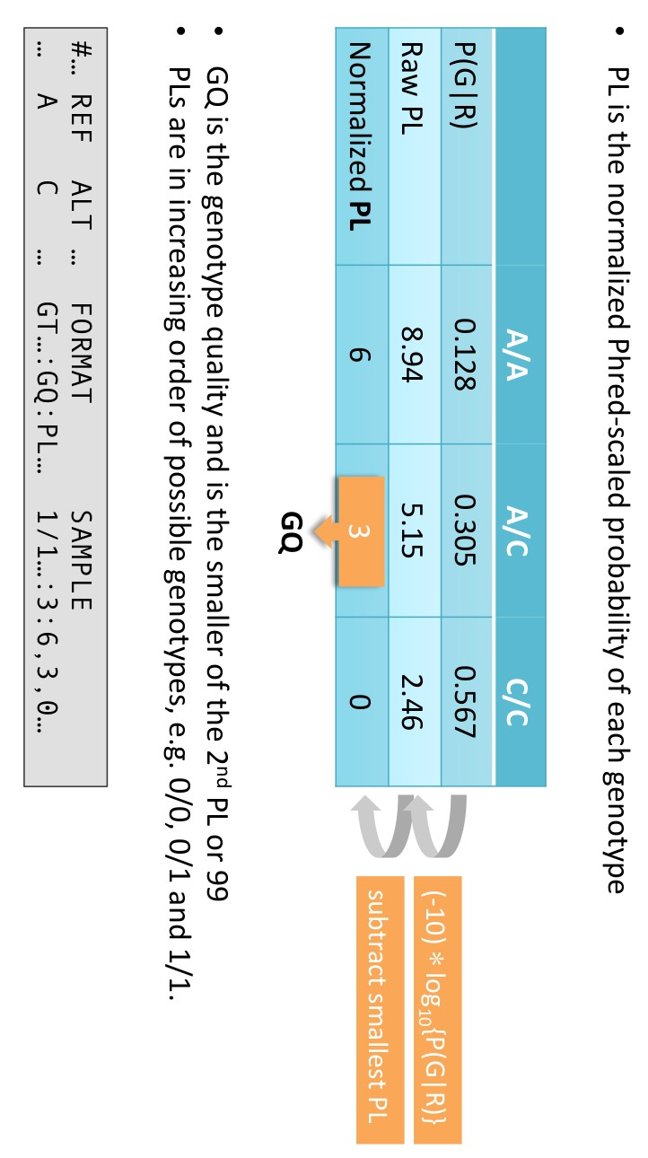
Only few people know what this “PL” is all about
Variant Calling – Yannick Boursin
22

Slide 25
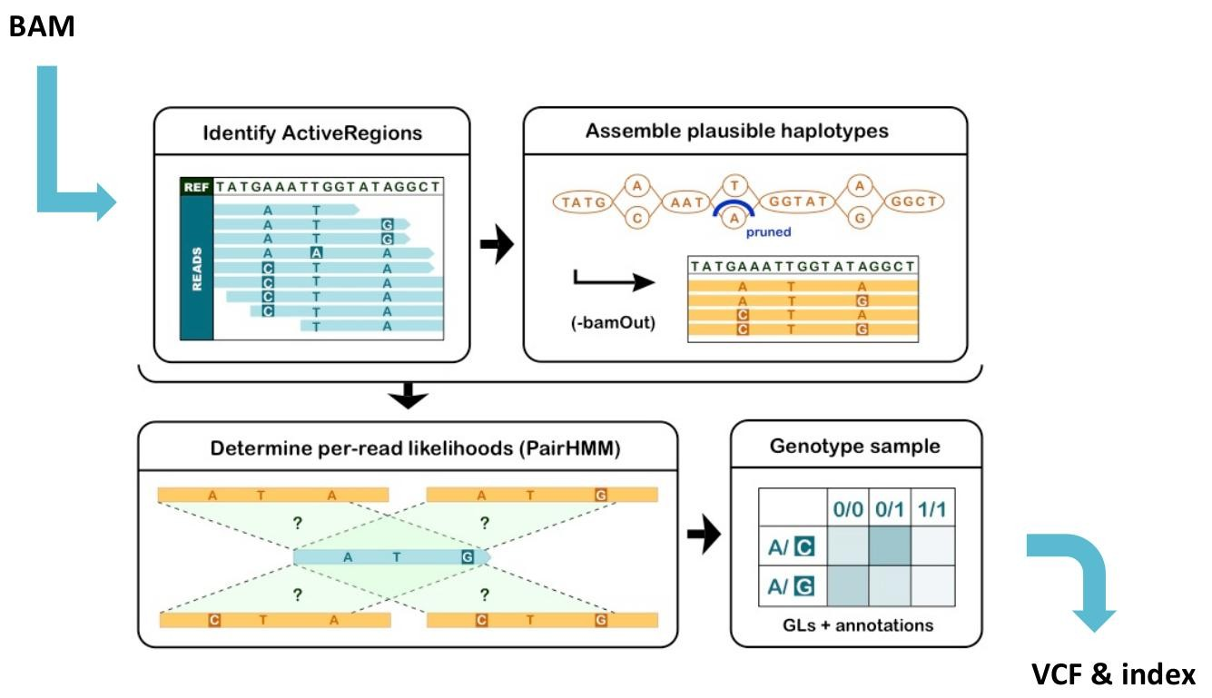
How does GATK-HC works: summary
https://software.broadinstitute.org/gatk/events/slides/1604/presentations/

Slide 26
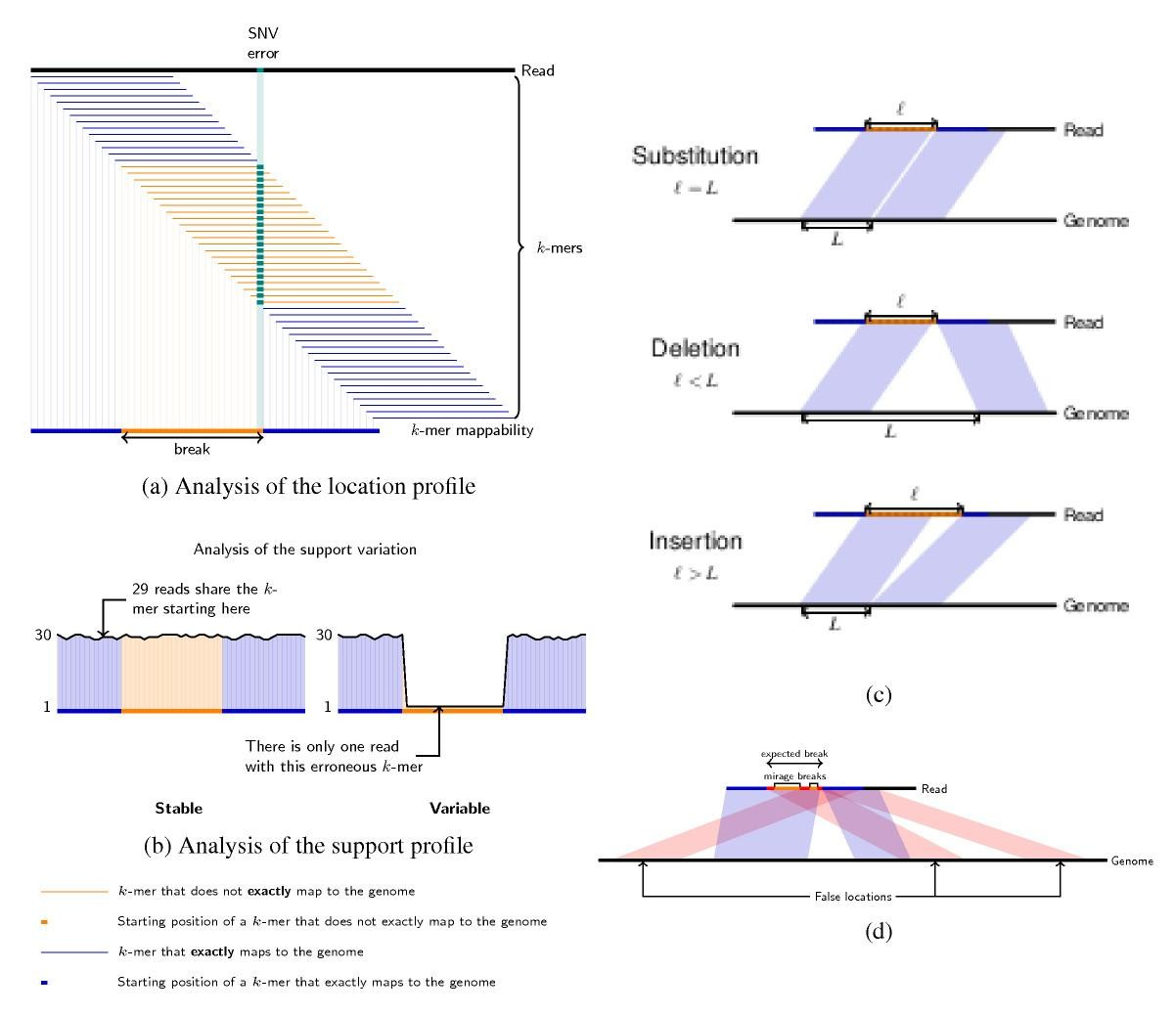
Calling variants in RNA-Seq bound to reference: the k-mer approach
Used by CraC
Advantage: one method to do everything, so you do not accumulate errors. CraC performs the mapping and SNV, InDels, Fusion and splice junctions for each reads

Slide 27
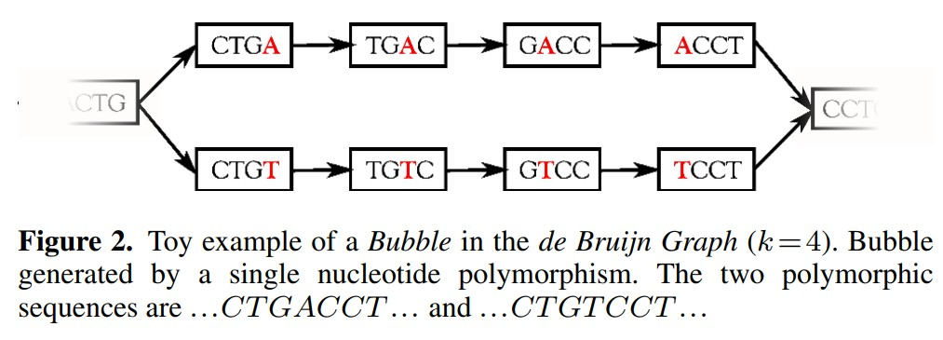
How to discover variants without reference
Two methods:
> Perform de-novo assembly, then map the reads back on the assembly and call variants accordingly.
> Use de Bruijn graphs to model the reads then look for “bubbles”
DiscoSNP++
12
DOI: 10.1093/nar/gku1187

Slide 28
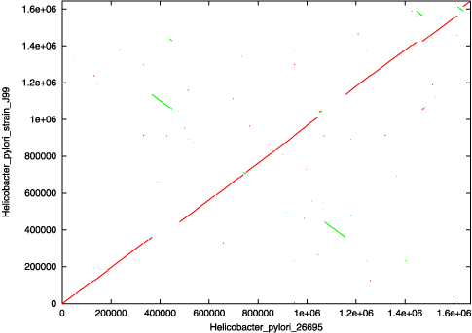
Calling variants from assemblies
First align assemblies using nucmer from Mummer
Second use show-snps to get snps from the alignment
If I may, I strongly discourage you from doing that. If you only got some assembly (e.g. 454 – newbler), ask for the reads …

Slide 29
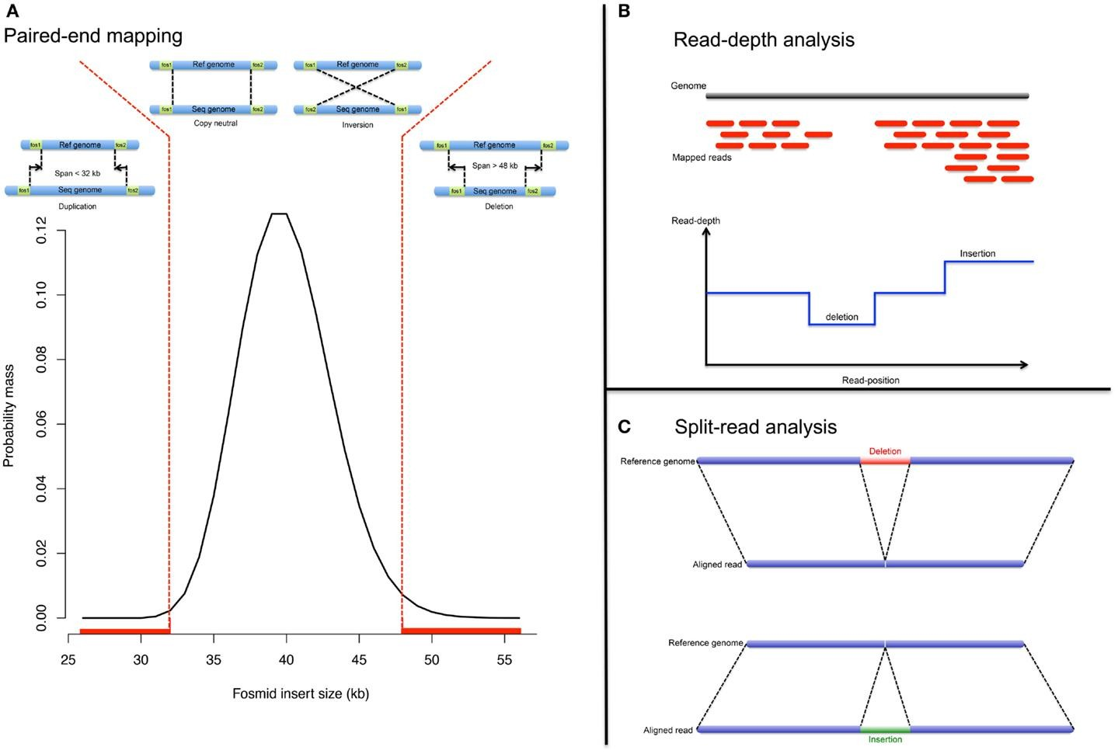
Calling InDels ?
● Read depth
Reference: ATTACGAGACATTACG
● Read pairs
Split Reads
The growing importance of CNVs: new insights for detection and clinical interpretation –
Frontiers in genetics 2013

Slide 30
How to find the right caller with no reference genome ?
RADSeq (Yvan Le Bras - Mercredi)
Small reads
Stacks
Preferably long
reads
DiscoSnp++
TP
Experimental Design
Metagenomics
MaryGold
Phenotype difference in population
Cortex
Reference-free SNP detection: dealing with the data deluge - BMC Genomics 2014

Slide 31
How to find the right caller for your aligned data ?
GATK HC*, GATK UG,
VarScan2, samtools, varDict, Platypus, Freebayes …
Constitutive study
* Note: GATK HC
engine uses de- novo assembly and a hidden Markov model
Experimental Design
Somatic study
MuTecT2*, VarScan2, Strelka, SomaticSniper
…
Trios
GATK HC* (mirTrios)*,
VarScan2, Scalpel …
Type of algorithm for SNV calling: Heuristic, Statistical Model, Assembly-based

Slide 32
How to find the right caller for your aligned data ?
Include specific InDels algorithms
pindel, Scalpel, softsearch, …
* Note: GATK HC
engine uses de- novo assembly and a hidden Markov model
Experimental Design
Large cohorts (+1000)
Reveel
GATK HC*,
samtools, CraC
RNA-Seq
Type of algorithm for SNV calling: Heuristic, Statistical Model, Assembly-based, k-mer algorithm for InDel calling: Read depth, Pairs, Split reads, Assembly-based

Slide 33
How to find the right caller for your aligned data ?
The provided list is just a snapshot: there are many other variant callers.
Advise n°1: check bibliography. Has anyone conducted the same experiment ? If someone did, what tool did they use ?
Advise n°2: check if the tool is available to you. Will you get some support would you need it ? Is it on Galaxy ?
> E.g.: ABSOLUTE (estimation of ploidy and subclonality).
This tool is a mess, though everyone wants to use it.

Slide 34
VARIANT CALLER OUTPUTS
32

Slide 35
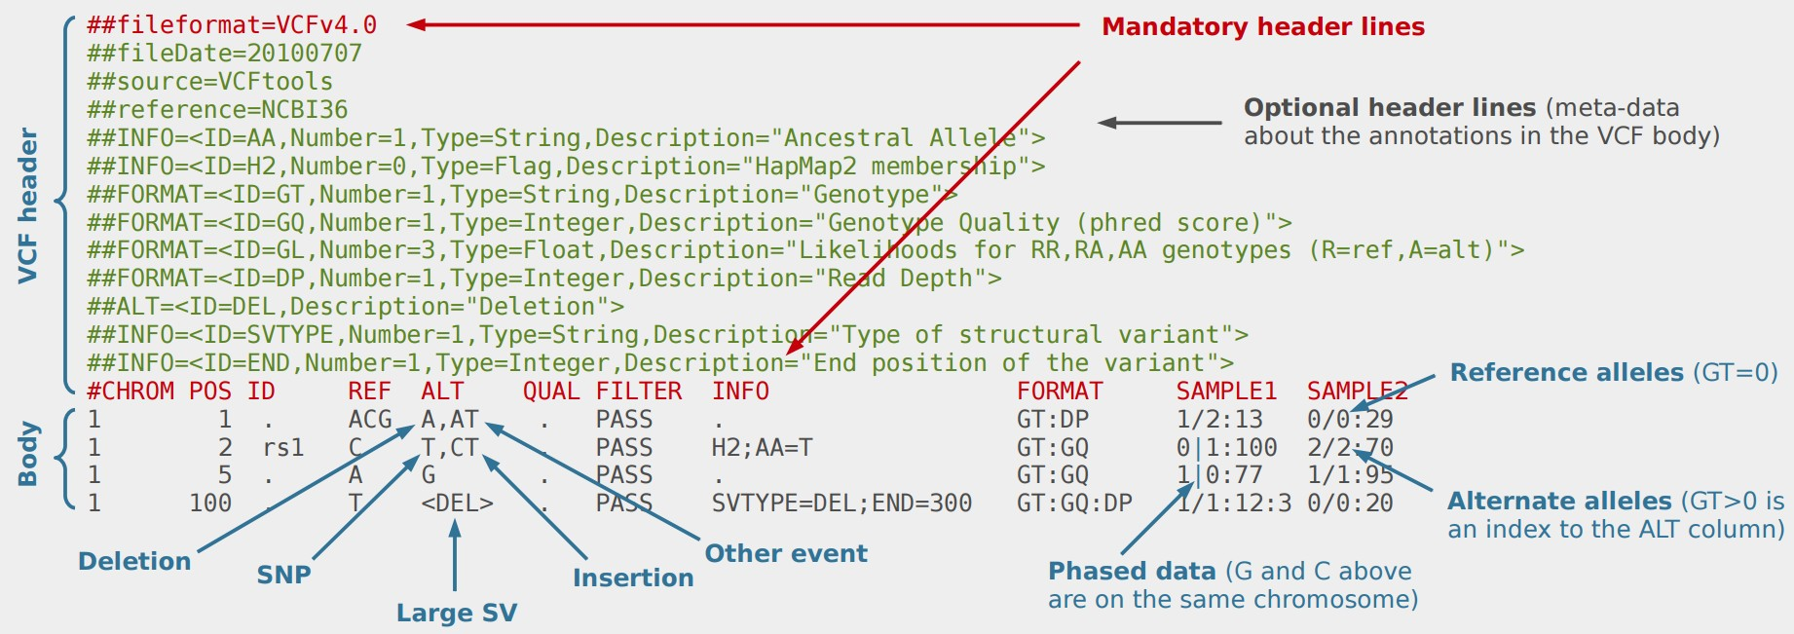
What variant callers outputs: VCF & gVCF
A sample VCF file (http://vcftools.sourceforge.net/VCF-poster.pdf)

Slide 36
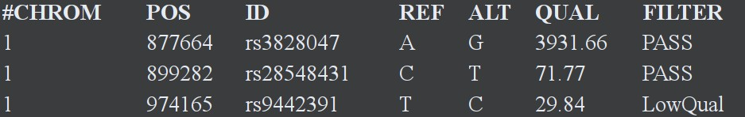
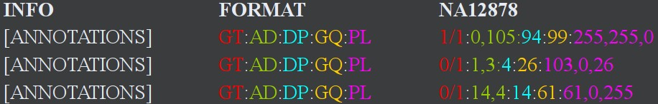
What variant callers outputs: VCF & gVCF
and why researchers are almost never happy about it
Field | What it is | Field | What it is
GT | Genotype | GQ | Genotype Quality
AD | Allelic Depth | PL | Phred-scaled Likelihood
DP | Global Depth

Slide 37
What variant callers outputs: VCF & gVCF
and why researchers are almost never happy about it
Column | What the hell it is
CHROM | Chromosome number
POS | Genomic position
ID | Database ID if any (default: ‘.’)
REF | Reference allele (namely, the 0 allele, as in “patient 0”)
ALT | Alternate allele (if multiple, comma-separated, each gets a number in order).
QUAL | Phred-scaled quality score (complicated in HaplotypeCaller)
FILTER | PASS (may be any value there, it is supposed to help you filtering)

Slide 38
What variant callers outputs: VCF & gVCF
and why researchers are almost never happy about it
Column | What the hell it is
INFO | Place for any position wide information (like GD quality info, variant genomic effect, cosmic count …)
FORMAT | Works with the next column (sample, here NA12878 is the sample id) and defines the order in which the data is going to be displayed
NA12878 | Sample-dependent data.

Slide 39
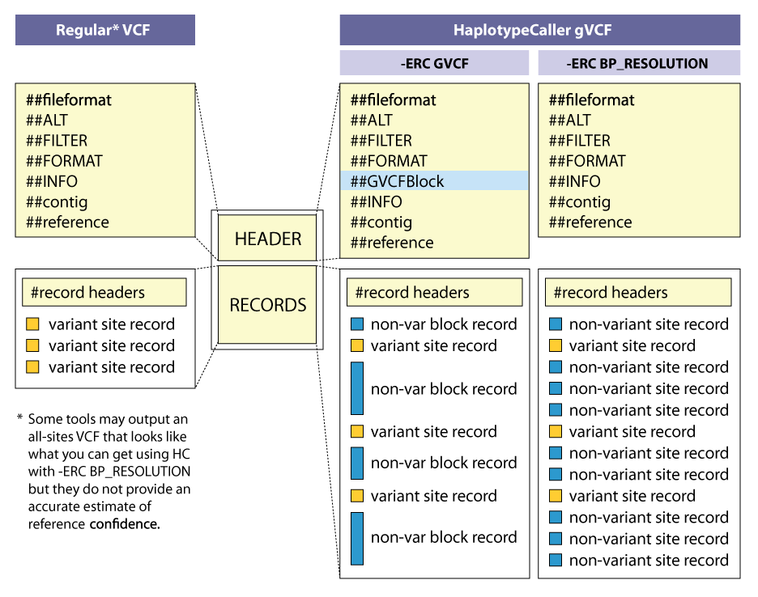
What variant callers outputs: VCF & gVCF
gVCF : Genomic VCF
Contains info about every regions.
Useful when calling variants on cohorts
How do you know you can compare a specific genomic region in a cohort ? Maybe you say there is no variation whereas the region has just not been sequenced.
Get rid of some computational costs and improve quality.

Slide 40
What variant callers outputs: VCF & gVCF
Each variant caller has its own output format, though it is generally VCF compliant.
VCF is very flexible
VCF is complicated to read
Any kind of variation can be stored in VCF
Documentation: https://samtools.github.io/hts- specs/VCFv4.2.pdf
Getting out of it: use specific tools to get tables or
views out of VCFs

Slide 41
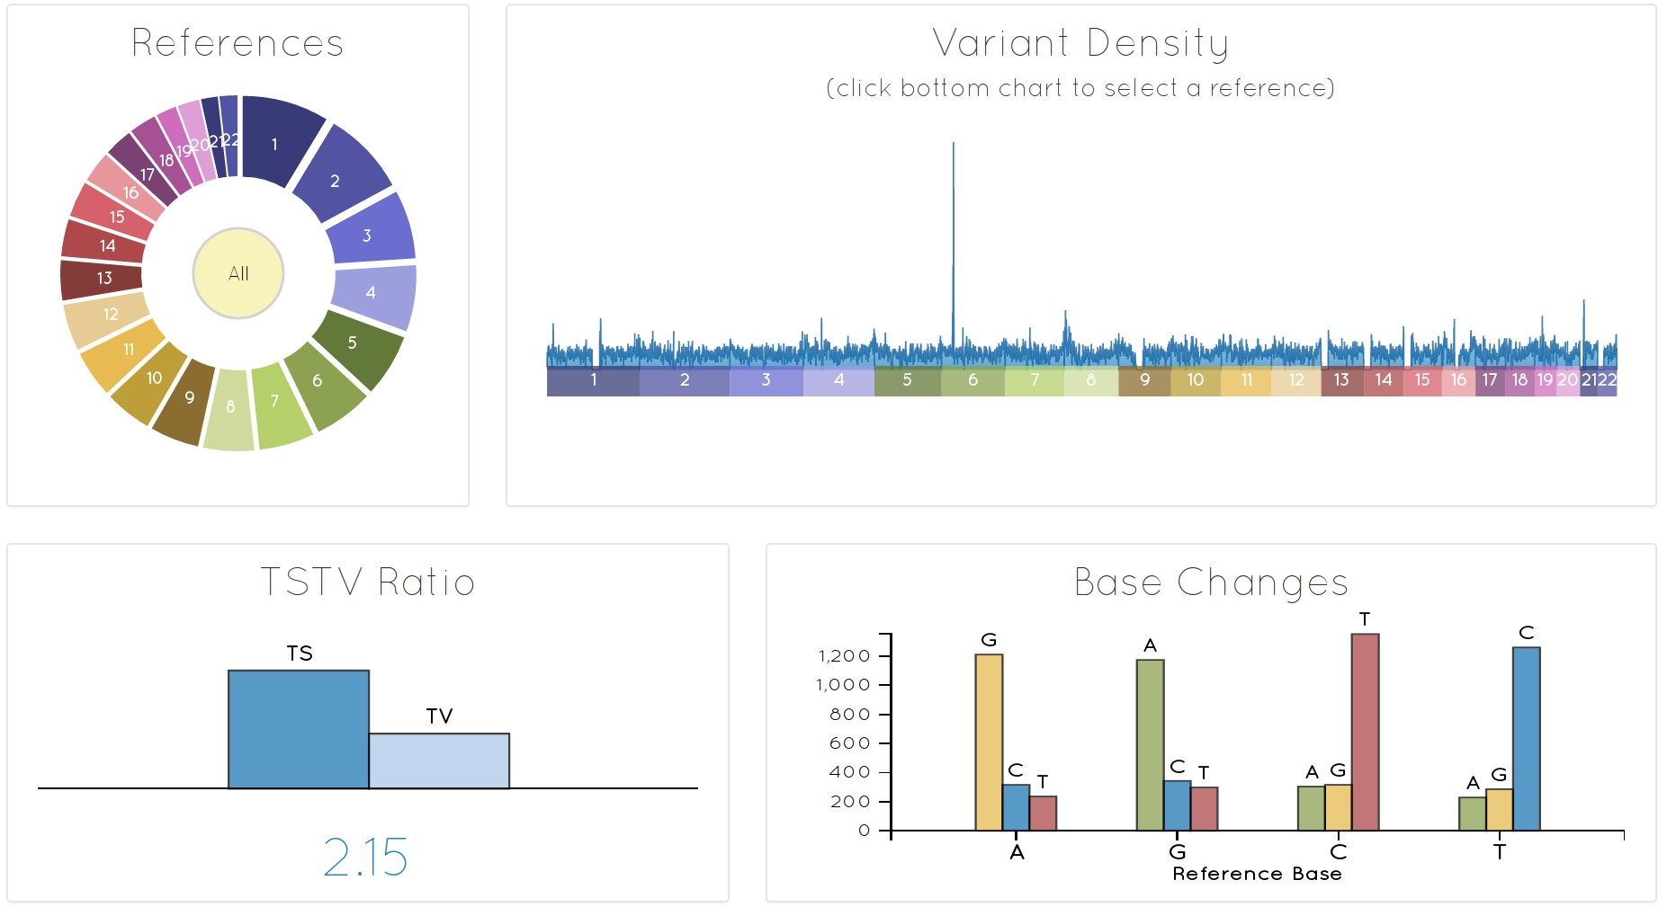
Looking at VCF files ?
http://vcf.iobio.io

Slide 42
Looking at VCF files ?
With some learning: Gemini
> http://dx.doi.org/10.1371/journal.pcbi.1003153
> https://gemini.readthedocs.io
Learning way more: R with VcfR
> http://dx.doi.org/10.1101/041277
Galaxy
> vcftools, bcftools, tabix, vcflib
> pyVCF, pySam

Slide 44
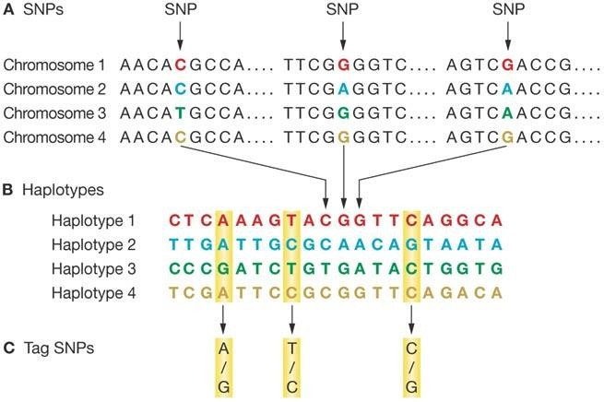
Haplotype ?
SNPs in
population
Genetic linkage Linkage Disequilibrium
Genotypes
The effect of HapMap on cardiovascular research and clinical practice - Nature Clinical
Practice Cardiovascular Medicine (2007)

Slide 45
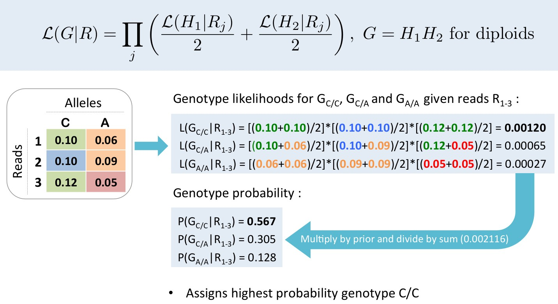
How does GATK-HC works: step 4

