Slide 1
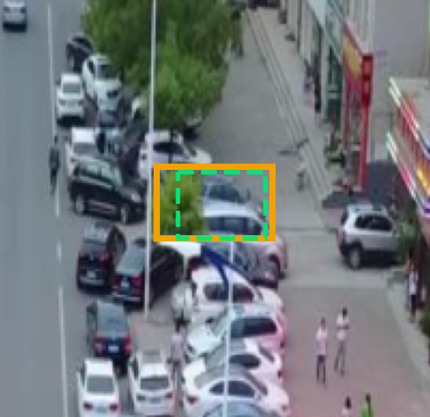
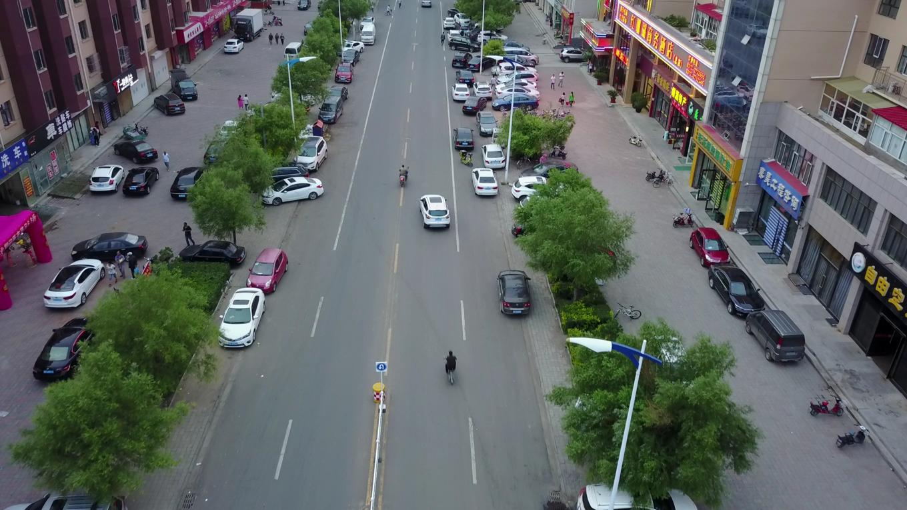
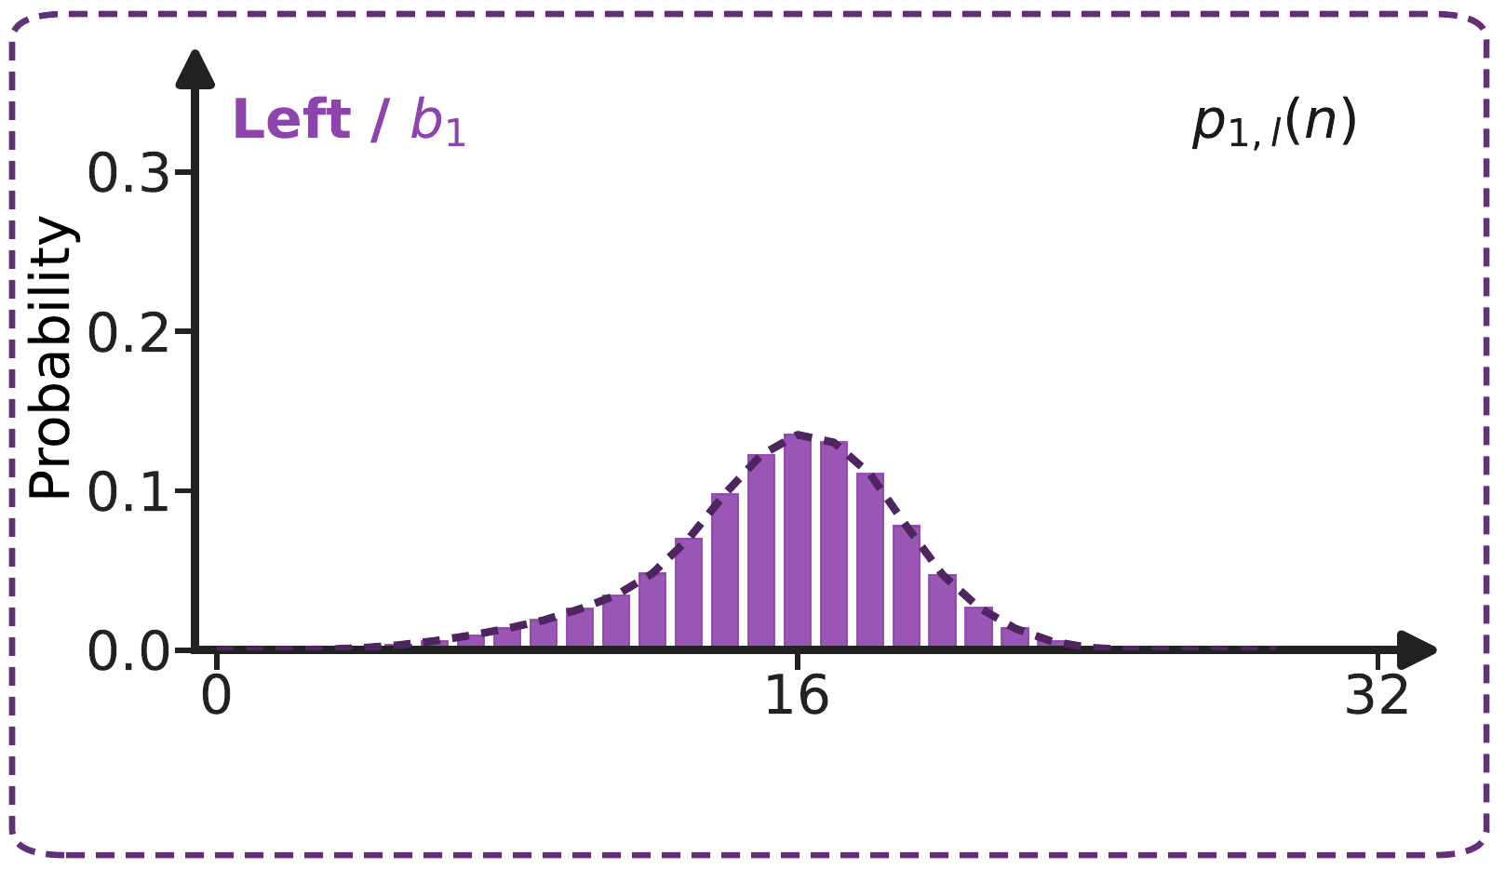
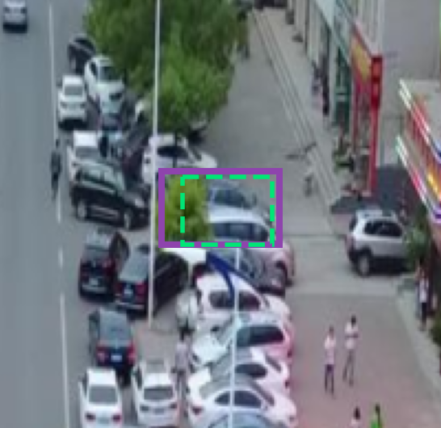


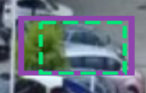
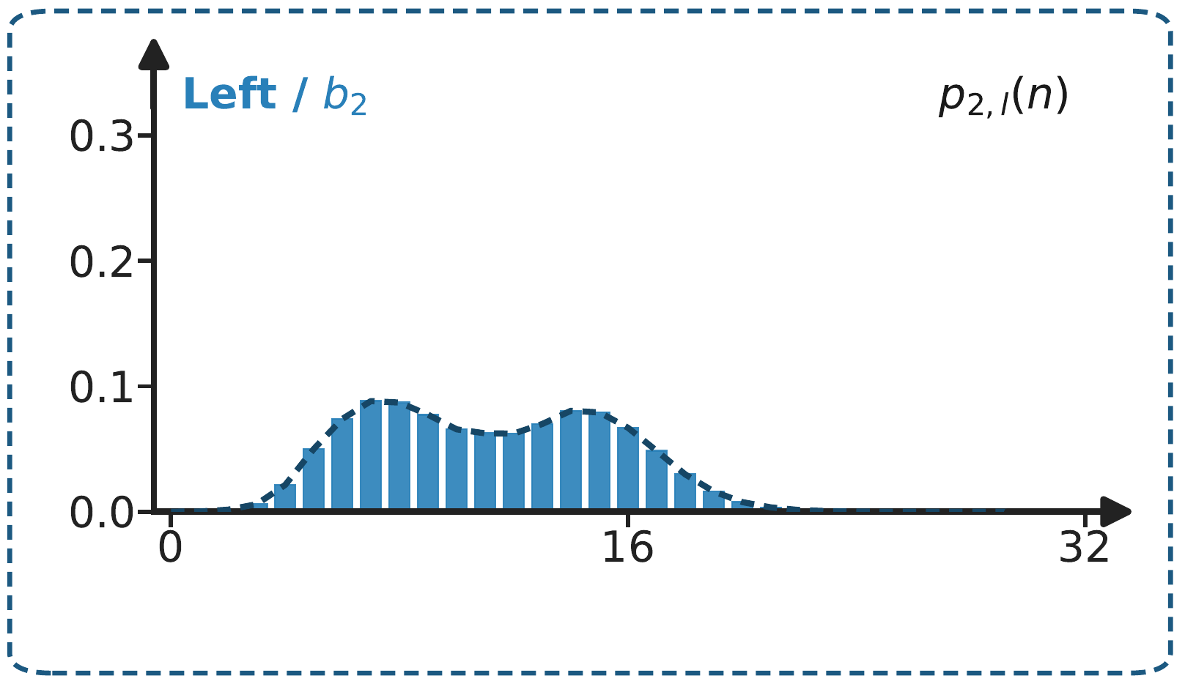



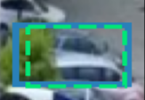
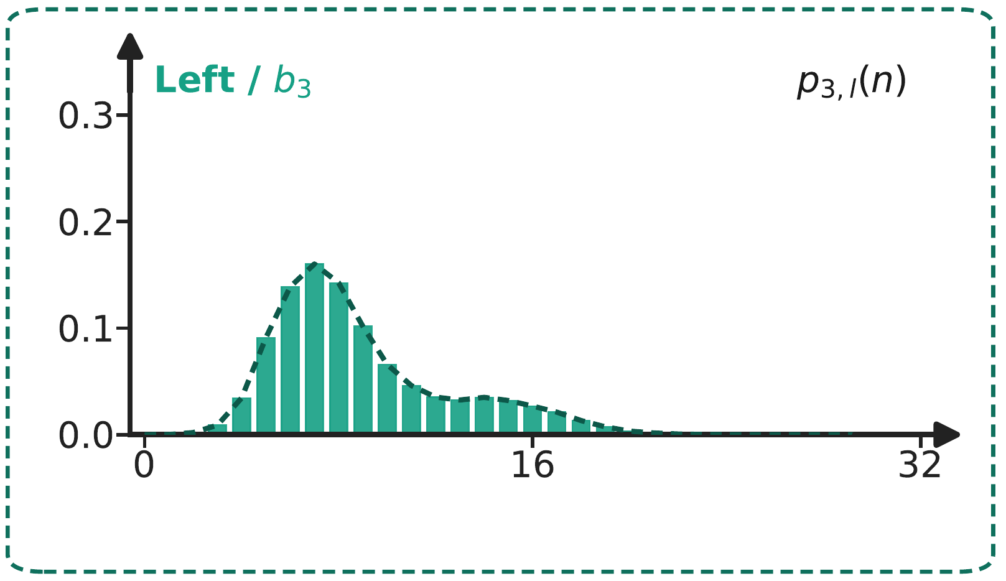
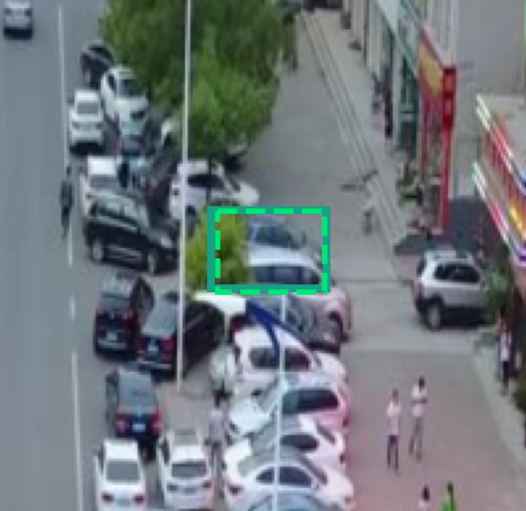



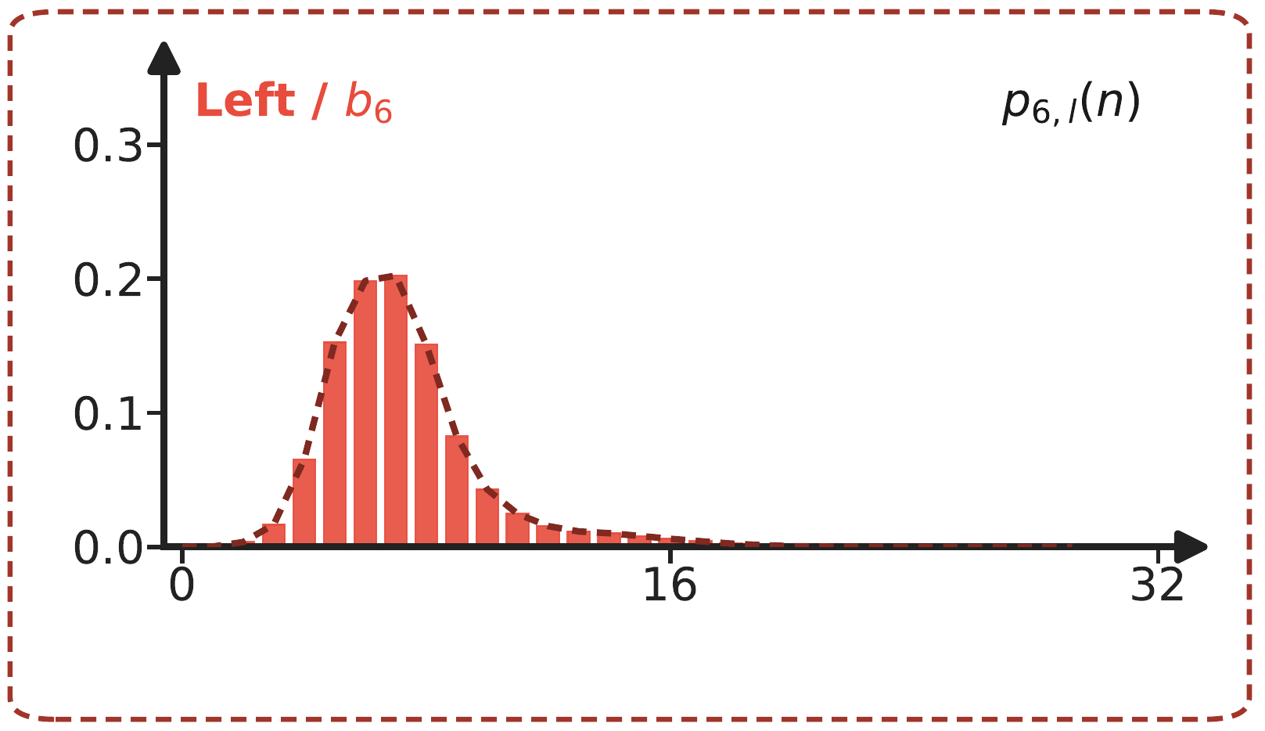




Initial box
b₀
Initial box
prediction
Refined distributions
b₀
Input
DDO
Adaptive scale r_{i}
b₁
Backbone
Encoder
Decoder 1
FDR Head
Integral
Edge
offsets
Box Decoder
Adaptive W(n)
b₀
h₁
LQE + Entropy
Class logits
h₁
Queries
Logit Residual
CLC
b₀
DDO
Adaptive scale r_{i}
b₂
b₁
Decoder 2
FDR Head
Integral
Edge
offsets
Box Decoder
Adaptive W(n)
b₀
h₂
LQE + Entropy
Class logits
h₂
Queries
Logit Residual
CLC
b₀
DDO
Adaptive scale r_{i}
b₃
b₂
Decoder 3
FDR Head
Integral
Edge
offsets
Box Decoder
Adaptive W(n)
b₀
h₃
LQE + Entropy
Class logits
h₃
Layer 4
Queries
Logit Residual
⋮
⋮
⋮
b₀
Layer 5
Adaptive scale r_{i}
DDO
b₆
b₅
Decoder 6
FDR Head
Integral
Edge
offsets
Box Decoder
From layer 5
Adaptive W(n)
b₀
h₆
All layers
LQE + Entropy
Class logits
h₆
GT
FRD
Fisher FGL
FR-LSD
Training and inference
Final detections
Training only
Notes:
Overview of FALCON. Sources: Codes/configs/v22/hdq_auto_v22_imgsz1024_v2.yml; Codes/src/zoo/dfine/dfine_decoder.py:274-326,421-535,995-1030; dfine_criterion.py:167-395; dfine_utils.py:119-142; postprocessor.py:42-64; FALCON_manuscript.docx Sections 3.1-3.5. Layers 1, 2, 3 and 6 are shown, with 4-5 omitted. Every decoder reads shared encoder features and previous query content; previous decoded boxes provide attention references. Initial b0 also depends on the encoder reference. FDR Heads summarize feature and cumulative-logit residuals. Histograms schematically visualize the probabilities associated with each layer's edge logits; actual consumers perform their own softmax and temperature scaling. DDO and Integral operate at every layer in training and inference. Box Decoder uses b0, four integrated edge offsets, and the DDO scale. Class projection is implicit on the Class logits arrows. LQE takes class logits plus corner logits; shallow readout is training-only and layer 6 is also used for inference. LQE output paths and postprocessing are omitted. CLC arrows denote adjacent-pair loss inputs, not gradient direction or a forward transform; layer 3 and layer 6 are not a direct pair. FRD combines Fisher FGL at all layers with final-to-shallow FR-LSD. Matching, teacher-score/IoU weighting, gradient stops, shared memory paths, FM peak and adjacent Hellinger losses, auxiliary and denoising branches are omitted for clarity. Histograms and supplied photos are illustrative, not measured layer-specific predictions. W(n) uses the manuscript's Adaptive label by author request; this terminology is an explicit exception to code alignment. DDO connections continue to depict the current implemented decoding-scale path.
参考来源：配置文件 Codes/configs/v22/hdq_auto_v22_imgsz1024_v2.yml；代码文件 Codes/src/zoo/dfine/dfine_decoder.py 第 274–326、421–535、995–1030 行；dfine_criterion.py 第 167–395 行；
dfine_utils.py 第 119–142 行；postprocessor.py 第 42–64 行；论文手稿 FALCON_manuscript.docx 第 3.1–3.5 节。
图中展示了第 1、2、3、6 层，省略了第 4、5 层。每个解码器读取共享编码器特征与上一轮查询向量；前序解码得到的框作为注意力参考。初始框 \(\boldsymbol{b}_0\) 同样依赖编码器参考特征。FDR 头用于汇总特征与累积对数残差。
直方图为示意图，用于可视化各层边界对数概率；实际模块会自行执行 Softmax 与温度缩放。 DDO 与积分模块在训练、推理阶段的每一层均生效。框解码器基于初始框\(\boldsymbol{b}_0\)、4 个积分边界偏移量以及 DDO 缩放系数进行计算。
类别投影隐含在类别对数概率箭头中。 LQE 模块输入为类别对数概率与角点对数概率；浅层读出模块仅用于训练，第 6 层同时参与推理。LQE 的输出通路与后处理流程未在图中画出。
CLC 箭头代表相邻成对损失的输入，不代表梯度方向或前向变换；第 3 层与第 6 层并非直接配对。FRD 融合所有层的 Fisher FGL 损失，以及深层到浅层的 FR-LSD 损失。
为简洁起见，图中省略匹配策略、教师分数 / 交并比加权、梯度截断、共享内存通路、FM 峰值与相邻海林格损失、辅助分支与去噪分支。
直方图与配图仅作示意，并非各层真实预测结果。 应作者要求，\(W(n)\) 采用手稿中的自适应标签命名；
该术语是一处明确的特例，不与代码命名保持一致。DDO 连线描绘当前已实现的解码缩放通路。

Slide 2





















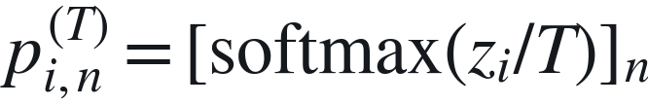
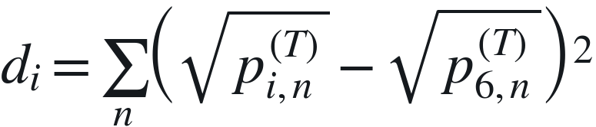


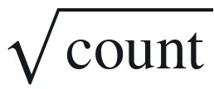
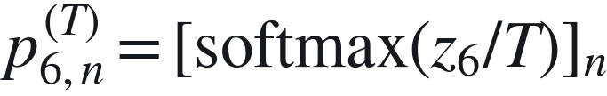

Fisher–Rao Distribution Loss
(a) Fisher FGL
GT supervision · layers 1–6
W(n) ≤ d_{GT} ≤ W(n+1)
GT box
+ initial b₀
GT edge encoding
Two-bin GT target
Interpolated
cross-entropy
Weighted FGL
$d_{GT}$
t_{n}
t_{n+1}
×
$L_{Fisher FGL}^{\left(i\right)}$
W(n)
W(n+1)
n
n+1
Mean of the four-edge
loss over matched boxes
Matched z_{i}
i = 1, …, 6
$p_{i}=softmax\left(z_{i}\right)$
Entropy reweighting
$η_{i}×{IoU}_{i}$
$η_{i}=1+0.35 H\left(p_{i}\right)/log33$
$IoU\left(b_{i},GT\right)$
(b) FR-LSD
Layer 6 teaches layers 1–5
$Student z_{i}$
$i=1,…,5$
$p_{i,n}^{\left(T\right)}={\left[softmax\left(z_{i}/T\right)\right]}_{n}$
Squared Hellinger
distance
Quality weighting
& group balance
di=n​pi,nT−p6,nT2
$×T^{2}$
$Group means$
$\sqrt{count}$
$Teacher z_{6}$
$Final layer$
$p_{6,n}^{\left(T\right)}={\left[softmax\left(z_{6}/T\right)\right]}_{n}$
L_{FR-LSD}^{(i)}
IoU / confidence
Notes:
FRD v8. All computation arrows are solid; no training/inference distinction is encoded by line style. The final weighted sum is documented in the caption, not drawn as a separate bar. Two dark-purple modules highlight the FALCON changes: entropy-reweighted FGL and squared-Hellinger FR-LSD. D-FINE FGL and GO-LSD/DDF inheritance follows local D-FINE PDF sections 4.1 and 4.2, equations 5 and 6. Current FALCON code takes precedence over manuscript section 3.5. Upper branch consumes matched cumulative logits directly for interpolated CE; ordinary softmax is used for entropy only. eta=1+0.35*detach(clip(H/log33,0,1)); IoU weights and GT targets are detached. GT d_GT denotes encoded relative edge coordinate, not raw pixel distance; fixed reg_scale/up. Lower branch T=5, final teacher detached, squared-root probability distance without 1/2, T squared scaling, matched student IoU/unmatched final corrected class confidence weights detached. Group means are weighted by square-root group counts. Ordinary layer ranges are FGL 1–6 and FR-LSD 1–5 with teacher 6. The main diagram depicts the ordinary detection branch. N_m refers only to num_boxes_go. Denoising FGL uses dn_num_boxes=num_boxes*dn_num_group, with fallback 1 when nonpositive. Denoising FR-LSD reuses ordinary-group balancing coefficients; its own group loss means use denoising masks. L_FRD groups loss_fgl and loss_ddf including applicable auxiliary and denoising terms, no additional criterion loss key. All histograms are illustrative, not measured. Full details and code citations in accompanying caption. Combined v4: all subscripts are native editable italic, non-bold runs, including converted Unicode subscript characters. FRD retains the v8 palette. CLC/DDO/LQE use saturated bright accent fills. No computation or geometry has changed; shared canvas is 185 x 121 mm with no stretching. Combined v5: only CLC innovation fill changes to #2784D5. All key-module text is white. Innovation borders use darker colors in the same hue family. Italic non-bold subscripts and all geometry, computation and scope labels remain unchanged.
Combined v6: layer index i follows the actual v14 r_i label; p_i denotes ordinary softmax(z_i), p_i^T denotes temperature softmax. Initial reference b_0 and its w_0,h_0 use subscripts. LQE class logits s_i=ClassHead_i(h_i). Shared W(n) is retained to match code; v14 Adaptive W(n) remains a documented main-figure label conflict.
v7 user-requested finishing changes: diagram label Adaptive W(n); all mathematical text uses 9 pt base size, with 6.75 pt superscripts/subscripts. Computational graph unchanged. The Adaptive W(n) label follows the overview terminology; actual code still shares the project and dynamically modulates r_i.

Slide 3






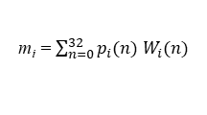






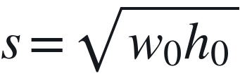




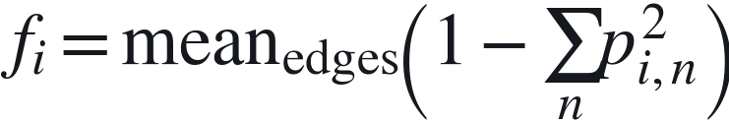
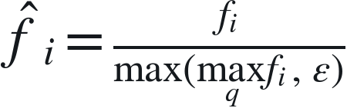



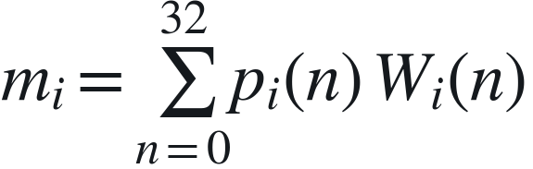





Decoder Distribution Optimizer (DDO)
Adaptive decoding scale (i = 1, …, 6)
Initial box b₀
w₀, h₀
Box-scale adaptation
$s=\sqrt{w_{0}h_{0}}$
Scale modulation
$r_{base}=4 clip\left(0.05/\left(s+ε\right), 0.6, 1.8\right)$
$r_{i}=r_{base}$
$× \left(1+0.15 {\hat{f}}_{i}\right)$
Adaptive scale
$r_{i}∈R^{B×Q}$
Distribution flatness
One scale per
query shared by
four edges
$Edge logits$
$z_{i}$
$p_{i}=$
$softmax\left(z_{i}\right)$
fi=meanedges​1−n​pi,n2
${\hat{f}}_{i}=\frac{f_{i}}{max\left(\max_{q}f_{i}, ε\right)}$
$Initial b_{0}$
Decoding context
$\left(b_{0},r_{i}\right)$
Adaptive W(n)
33-bin projection
$\left(p_{i},W\right)$
Integral
Edge offsets m_{i}
Box Decoder
$m_{i}=\sum_{n=0}^{32}{p_{i}}\left(n\right) W_{i}\left(n\right)$
$decode\left(b_{0},m_{i},r_{i}\right)$
$b_{i}$
Notes:
Decoder Distribution Optimizer. dfine_decoder.py:428-535; dfine_utils.py:119-142; config:55-70. b0 is fixed initial prediction, detached at decoder line456. w0,h0 clamp_min(1e-6); epsilon=1e-6. Scale uses r0=4, s_ref=.05, clamp [.6,1.8]. Flatness averages 4 edges, detaches, divides by per-image current-layer max across queries clamped to 1e-6. The normalization denominator clamps the per-image query maximum by epsilon=1e-6. Current queries can include DN during training. Both branches modify rs passed to distance2bbox. Shared W is generated before the layer loop from fixed reg_scale and up; it is not regenerated by DDO. The lower panel is context outside DDO, not new DDO submodules. Integral consumes p as shown mathematically; the actual Integral receives logits and internally softmaxes them. One scale per query shared across four edges, not six-layer aggregation. No independent learnable DDO parameters. All 6 layers in training and current eval. Main v14 inputs b0 and distribution, output adaptive scale to Box Decoder are preserved. Manuscript curvature wording and v14 Adaptive W label differ from code; do not redraw W as instance-adaptive. v2: filled dots on the arrows are explicit computational input junctions. The Integral junction bundles (p_l,W) and does not add them; the Box Decoder junction bundles (b0,r_l), while m_l remains a separate input. DDO does not modify W. Both added branches join at exact midpoints of their host arrows. v3: innovation fills use lighter component colors and dark text. The top-right dimension badge and footer have been removed. Essential layer ranges or scalar broadcasting are expressed within the computational diagram. Computational formulas and input/output dependencies are unchanged. Combined v4: all subscripts are native editable italic, non-bold runs, including converted Unicode subscript characters. FRD retains the v8 palette. CLC/DDO/LQE use saturated bright accent fills. No computation or geometry has changed; shared canvas is 185 x 121 mm with no stretching. Combined v5: only CLC innovation fill changes to #2784D5. All key-module text is white. Innovation borders use darker colors in the same hue family. Italic non-bold subscripts and all geometry, computation and scope labels remain unchanged.
Combined v6: layer index i follows the actual v14 r_i label; p_i denotes ordinary softmax(z_i), p_i^T denotes temperature softmax. Initial reference b_0 and its w_0,h_0 use subscripts. LQE class logits s_i=ClassHead_i(h_i). Shared W(n) is retained to match code; v14 Adaptive W(n) remains a documented main-figure label conflict.
v7 user-requested finishing changes: diagram label Adaptive W(n); all mathematical text uses 9 pt base size, with 6.75 pt superscripts/subscripts. Computational graph unchanged. The Adaptive W(n) label follows the overview terminology; actual code still shares the project and dynamically modulates r_i.

Slide 4








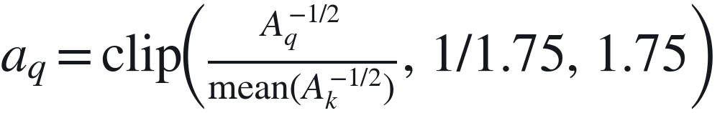



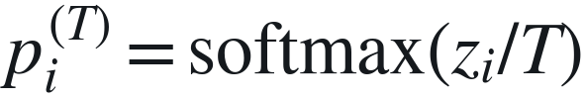
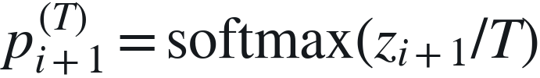
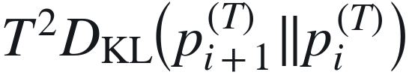
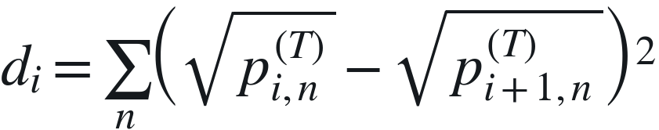

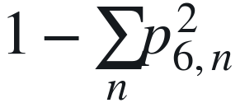
Cross-Layer Consistency
GT box area
A = w × h
Scale weighting
Layer-pair weighting
$a_{q}=clip​\left(\frac{A_{q}^{−1/2}}{mean\left(A_{k}^{−1/2}\right)}, 1/1.75, 1.75\right)$
α_{i} = 1 + 0.35(5 − i)
(a) Adjacent-layer consistency (i = 1, …, 5)
a_{q} α_{i}
$Shallow logits$
$z_{i}$
Matched queries
Adjacent KL
Weighted pair mean
p_{i} = softmax(z_{i})
$T^{2}D_{KL}​\left(p_{i+1}^{\left(T\right)}‖p_{i}^{\left(T\right)}\right)$
1.25 L_{KL}
$p_{i}^{\left(T\right)}=softmax\left(z_{i}/T\right)$
a_{q} α_{i}
$p_{i+1}^{\left(T\right)}=softmax\left(z_{i+1}/T\right)$
$Deep logits$
$z_{i+1}$
Squared Hellinger
Weighted pair mean
T = 1.5
di=n​pi,nT−pi+1,nT2
0.15 L_{H}
(b) Final-layer peakiness
a_{q}
Matched final
logits z₆
$p_{6}=softmax\left(z_{6}\right)$
Peakiness penalty
Weighted edge sum / N
1−n​p6,n2
0.05 L_{peak}
Notes:
Cross-Layer Consistency. Current six-layer configuration: hdq_auto_v22_imgsz1024_v2.yml:73-86. Code: dfine_criterion.py:281-396,463-482,505-521. p is shallow and q is detached deeper target. KL is KL(q||p), multiplied by T^2; adjacent squared Hellinger has neither 1/2 nor T^2. Both use T=1.5 and all five neighboring pairs. GT area and the cross-layer matching union determine detached area weights. The final-layer peak term uses T=1. N is num_boxes_go; pair terms sum matched edges / N then average five pairs. Loss outputs are separate dictionary entries, not a forward prediction. Only ordinary detection queries; no DN invocation. FM losses are grouped with CLC according to manuscript Sec.3.5 and ablations. v14 shows adjacent inputs and omits GT weights, FM terms and loss outputs. All internal solid arrows mean computational dependency, not inference scope. See accompanying caption for exact clamps and reductions. v2 layout: a_q and alpha_l are defined in the top strip and reused by same-symbol local weight input ports. These are symbolic references to the same weights, not independent calculations or learnable parameters. The two (p,q) exits both carry the same probability pair. No long weight bus and no crossing paths. v3: innovation fills use lighter component colors and dark text. The top-right dimension badge and footer have been removed. Essential layer ranges or scalar broadcasting are expressed within the computational diagram. Computational formulas and input/output dependencies are unchanged. Combined v4: all subscripts are native editable italic, non-bold runs, including converted Unicode subscript characters. FRD retains the v8 palette. CLC/DDO/LQE use saturated bright accent fills. No computation or geometry has changed; shared canvas is 185 x 121 mm with no stretching. Combined v5: only CLC innovation fill changes to #2784D5. All key-module text is white. Innovation borders use darker colors in the same hue family. Italic non-bold subscripts and all geometry, computation and scope labels remain unchanged.
Combined v6: layer index i follows the actual v14 r_i label; p_i denotes ordinary softmax(z_i), p_i^T denotes temperature softmax. Initial reference b_0 and its w_0,h_0 use subscripts. LQE class logits s_i=ClassHead_i(h_i). Shared W(n) is retained to match code; v14 Adaptive W(n) remains a documented main-figure label conflict.
v7 user-requested finishing changes: diagram label Adaptive W(n); all mathematical text uses 9 pt base size, with 6.75 pt superscripts/subscripts. Computational graph unchanged. The Adaptive W(n) label follows the overview terminology; actual code still shares the project and dynamically modulates r_i.

Slide 5




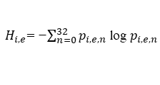


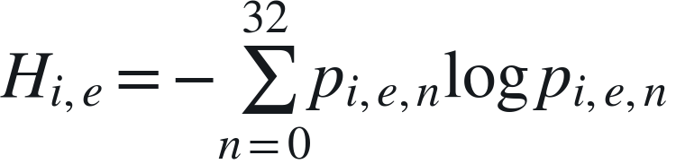




Localization Quality Estimator (LQE)
Distribution-based quality correction
Top-k statistics
Top-4 per edge + their mean
Quality MLP
Class logits
4 × 5 = 20 features
20 → 64 → 1
$s_{i}={ClassHead}_{i}\left(h_{i}\right)$
$Edge logits$
$z_{i}$
$p_{i}=softmax\left(z_{i}\right)$
+
$Scalar q_{i}$
+
Broadcast to
all classes
Edge entropy
$H_{i,e}=−\sum_{n=0}^{32}{p_{i,e,n}}logp_{i,e,n}$
Entropy MLP
Corrected logits
5 → 64 → 1
$s_{i}^{′}=s_{i}+q_{i}$
$\left[H_{i,1},H_{i,2},H_{i,3},H_{i,4},{\overset{‾}{H}}_{i}\right]$
Notes:
Localization Quality Estimator. dfine_decoder.py:298-326,377-381,521-524. The top-k path is inherited from D-FINE; the entropy path is the FALCON addition. All distributions are from current cumulative logits with 4 edges and 33 bins. top4+their mean on each edge =>20 features; MLP20->64->1. Entropy on each edge and mean =>5 features; MLP5->64->1. Both MLPs have one ReLU hidden layer and zero-initialized final affine layer at construction. Entropy is computed in float32 after clamping p to 1e-8, uses natural log and no /log33 or detach. Quality output B,Q,1 broadcasts over C classification logits. It is not class probability; sigmoid occurs in downstream losses/postprocess as applicable. Each decoder layer has its own LQE module parameters. Training computes layers1-6; current eval only layer6. No constrained monotonic relation between entropy and score. v14 input edges preserved; it omits LQE outputs. New output here is code-derived. Auxiliary FR-LSD teacher confidence comes from final corrected logits, described in caption rather than an extra forward arrow. v3 compact layout: panel height 685 units. Both class arrows are 120 units and both quality vertical arrows are 135 units. q_l is one scalar per query, broadcast across all classes. v3: innovation fills use lighter component colors and dark text. The top-right dimension badge and footer have been removed. Essential layer ranges or scalar broadcasting are expressed within the computational diagram. Computational formulas and input/output dependencies are unchanged. Combined v4: all subscripts are native editable italic, non-bold runs, including converted Unicode subscript characters. FRD retains the v8 palette. CLC/DDO/LQE use saturated bright accent fills. No computation or geometry has changed; shared canvas is 185 x 121 mm with no stretching. Combined v5: only CLC innovation fill changes to #2784D5. All key-module text is white. Innovation borders use darker colors in the same hue family. Italic non-bold subscripts and all geometry, computation and scope labels remain unchanged.
Combined v6: layer index i follows the actual v14 r_i label; p_i denotes ordinary softmax(z_i), p_i^T denotes temperature softmax. Initial reference b_0 and its w_0,h_0 use subscripts. LQE class logits s_i=ClassHead_i(h_i). Shared W(n) is retained to match code; v14 Adaptive W(n) remains a documented main-figure label conflict.
v7 user-requested finishing changes: diagram label Adaptive W(n); all mathematical text uses 9 pt base size, with 6.75 pt superscripts/subscripts. Computational graph unchanged. The Adaptive W(n) label follows the overview terminology; actual code still shares the project and dynamically modulates r_i.

