Slide 1


CaTSCAN: Calculating Typed Subgraph Counts Analytically for Networks
Christian Beth, Mattis thor Straten, Felix Rodriguez Rasmussen,
Mohammad Matin Najafi, Reynold Cheng, Matthias Renz
Christian Beth, Kiel University European Conference on Machine Learning and Principles and Practice of Knowledge Discovery in Databases (ECML PKDD) September 7-11, 2026, Naples, Italy

Slide 2
What are the Building Blocks of a Network?

Slide 3
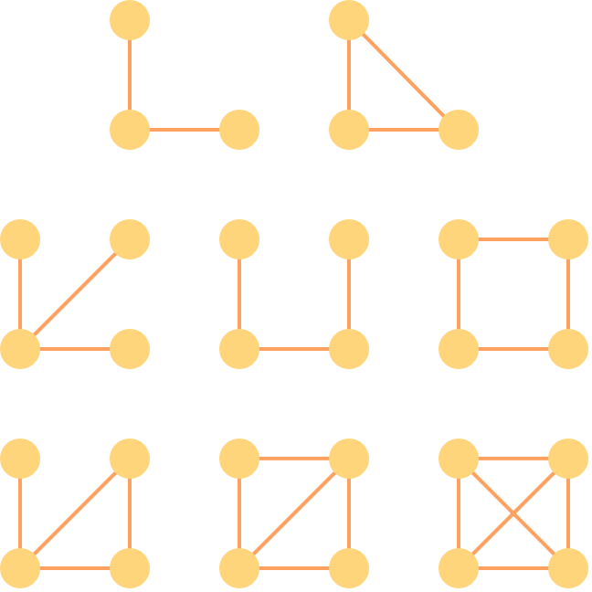
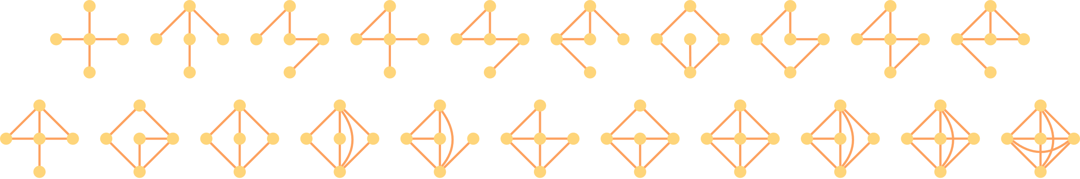
(Untyped) Graphlets
3 nodes:
How many of these building blocks are in the network?
4 nodes:
5 nodes:

Slide 4
Heterogeneous Information Networks (HINs)

Slide 5
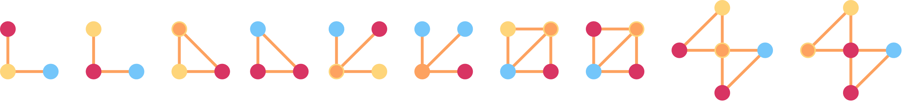
Typed Graphlets
…

Slide 6
Contributions of CaTSCAN
First solution for typed 5-node graphlet counting in HINs
Out-speeds state-of-the-art for typed 4-node graphlet counting approaches by 1 - 4 orders of magnitude
Counts typed 5-node graphlets faster than state-of-the-art counts typed 4-node graphlets
Code: https://github.com/c-beth/CaTSCAN

Slide 7
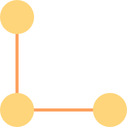
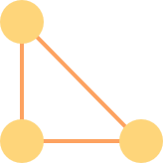


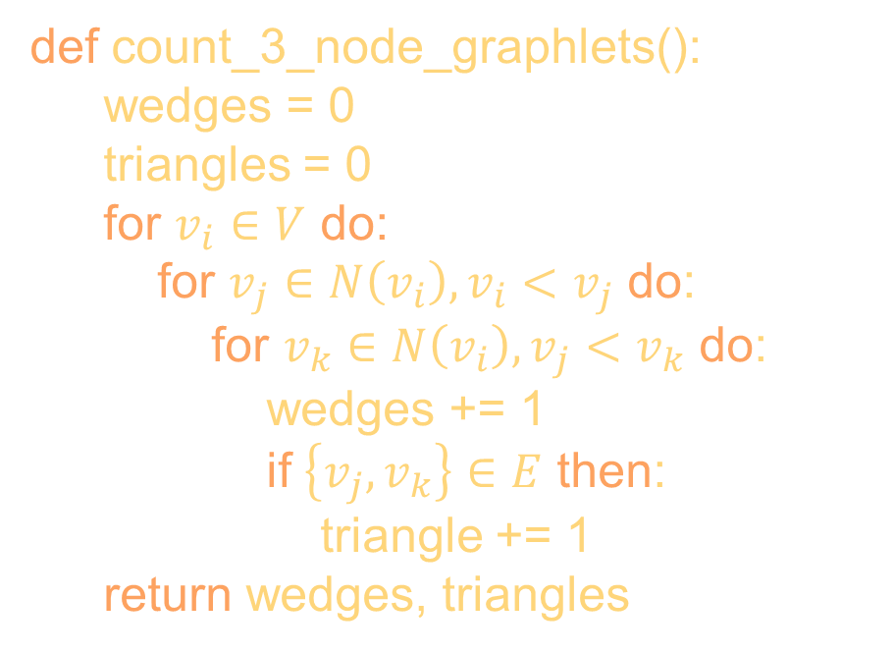


Counting (Untyped) Graphlets
def count_3_node_graphlets():
wedges = 0
triangles = 0
for $v_{i}∈V$ do:
for $v_{j}∈N\left(v_{i}\right),v_{i}<v_{j}$ do:
for $v_{k}∈N\left(v_{i}\right), v_{j}<v_{k}$ do:
wedges += 1
if $\left\{v_{j}, v_{k}\right\}∈E$ then:
triangle += 1
return wedges, triangles
$$v_{k}$$
Enumeration touches every. single. instance…
$$v_{j}$$
$$v_{k}$$
$$v_{i}$$

Slide 8
Why Enumerating is a Bad Idea…
Graphs of interest are large: millions of nodes and edges
Combinatorial explosion: trillions (10¹²), or even quintillions (10¹⁸) of graphlet instances
Matching a subgraph is related to the subgraph isomorphism problem, which is NP-complete :(

Slide 9
The Ideas that Count
Don’t count – calculate!
Combine counts of smaller graphlets for larger graphlets
Degree-ordered edge orientation for faster enumeration in DAG
impossible in DAG
?
only check these

Slide 10
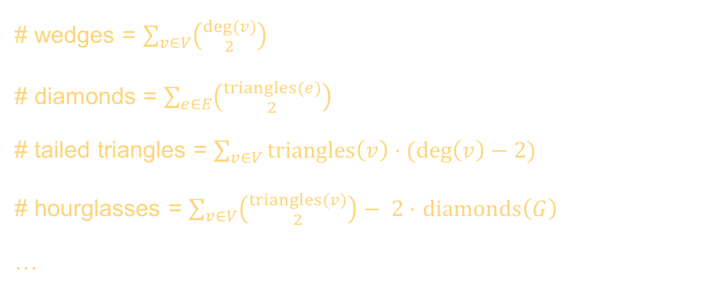
Calculate with Combinatorics (Untyped)
# wedges = $\sum_{v∈V}{\left({deg⁡(v) \atop 2}\right)}$
# diamonds = $\sum_{e∈E}{\left({triangles(e) \atop 2}\right)}$
# tailed triangles = $\sum_{v∈V}{triangles\left(v\right)⋅(\deg\left(v\right)−2)}$
# hourglasses = $\sum_{v∈V}{\left({triangles⁡(v) \atop 2}\right)}− 2⋅$ $diamonds\left(G\right)$
…

Slide 11
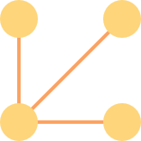



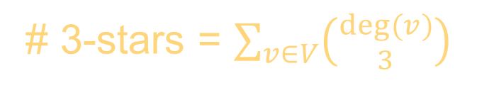




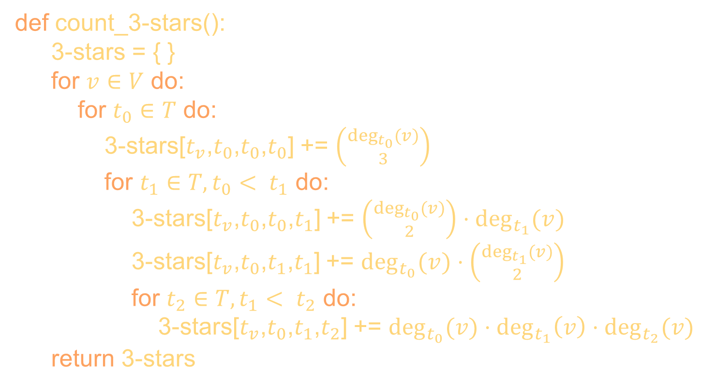









Preserving the Types
$$t_{0}$$
$$t_{0}$$
$$t_{0}$$
$$t_{0}$$
$$t_{1}$$
$$t_{1}$$
def count_3-stars():
3-stars = { }
for $v∈V$ do:
for $t_{0}∈T$ do:
3-stars[$t_{v}$,$t_{0}$,$t_{0}$,$t_{0}$] += $\left({\deg_{t_{0}}{(}v) \atop 3}\right)$
for $t_{1}∈T, t_{0}< t_{1}$ do:
3-stars[$t_{v}$,$t_{0}$,$t_{0}$,$t_{1}$] += $\left({\deg_{t_{0}}{(}v) \atop 2}\right)⋅\deg_{t_{1}}{(v)}$
3-stars[$t_{v}$,$t_{0}$,$t_{1}$,$t_{1}$] += $\deg_{t_{0}}{(v)}⋅\left({\deg_{t_{1}}{(}v) \atop 2}\right)$
for $t_{2}∈T, t_{1}< t_{2}$ do:
3-stars[$t_{v}$,$t_{0}$,$t_{1}$,$t_{2}$] += $\deg_{t_{0}}{(v)}⋅\deg_{t_{1}}\left(v\right)⋅\deg_{t_{2}}{(v)}$
return 3-stars
$$t_{0}$$
$$t_{0}$$
There are 28 more… see our paper [5] and appendix [6]
$$t_{v}$$
$$t_{v}$$
$$t_{v}$$
$$t_{v}$$
$$t_{1}$$
$$t_{2}$$
$$t_{1}$$
$$t_{0}$$
# 3-stars = $\sum_{v∈V}{\left({deg⁡(v) \atop 3}\right)}$

Slide 12
Experiments
Dataset | Nodes | Edges | Types | 3-Node Instances* | 4-Node Instances* | 5-Node Instances*
webkb-wisc | 265 | 459 | 5 | 10³ | 10⁵ | 10⁷
cora | 2.7k | 5.3k | 7 | 10⁴ | 10⁶ | 10⁷
political-retweets | 18.5k | 48k | 2 | 10⁶ | 10⁸ | 10¹⁰
DBLP4areas | 15.6k | 51.4k | 4 | 10⁶ | 10⁸ | 10¹⁰
visualize-us | 595k | 3.2M | 3 | 10¹⁰ | 10¹⁵ | 10¹⁸
Telecom | 170k | 8.9M | 4 | 10⁹ | 10¹² | 10¹⁶
DBLPfull | 10.5M | 29.9M | 3 | 10¹⁰ | 10¹⁴ | 10¹⁷
orkut | 11.8M | 176M | 2 | 10¹¹ | 10¹⁴ | 10¹⁷
*(OoM)

Slide 13
Experiments
Dataset | Nodes | Edges | Types
webkb-wisc | 265 | 459 | 5
cora | 2.7k | 5.3k | 7
political-retweets | 18.5k | 48k | 2
DBLP4areas | 15.6k | 51.4k | 4
visualize-us | 595k | 3.2M | 3
Telecom | 170k | 8.9M | 4
DBLPfull | 10.5M | 29.9M | 3
orkut | 11.8M | 176M | 2
Benchmarks
ESCAPE [1] (untyped)
PGD [2] (untyped, only 3-, 4-node)
TG [3] (only 3-, 4-node)
GC [4] (simpler problem)
CaTSCAN [5] (this work)

Slide 14
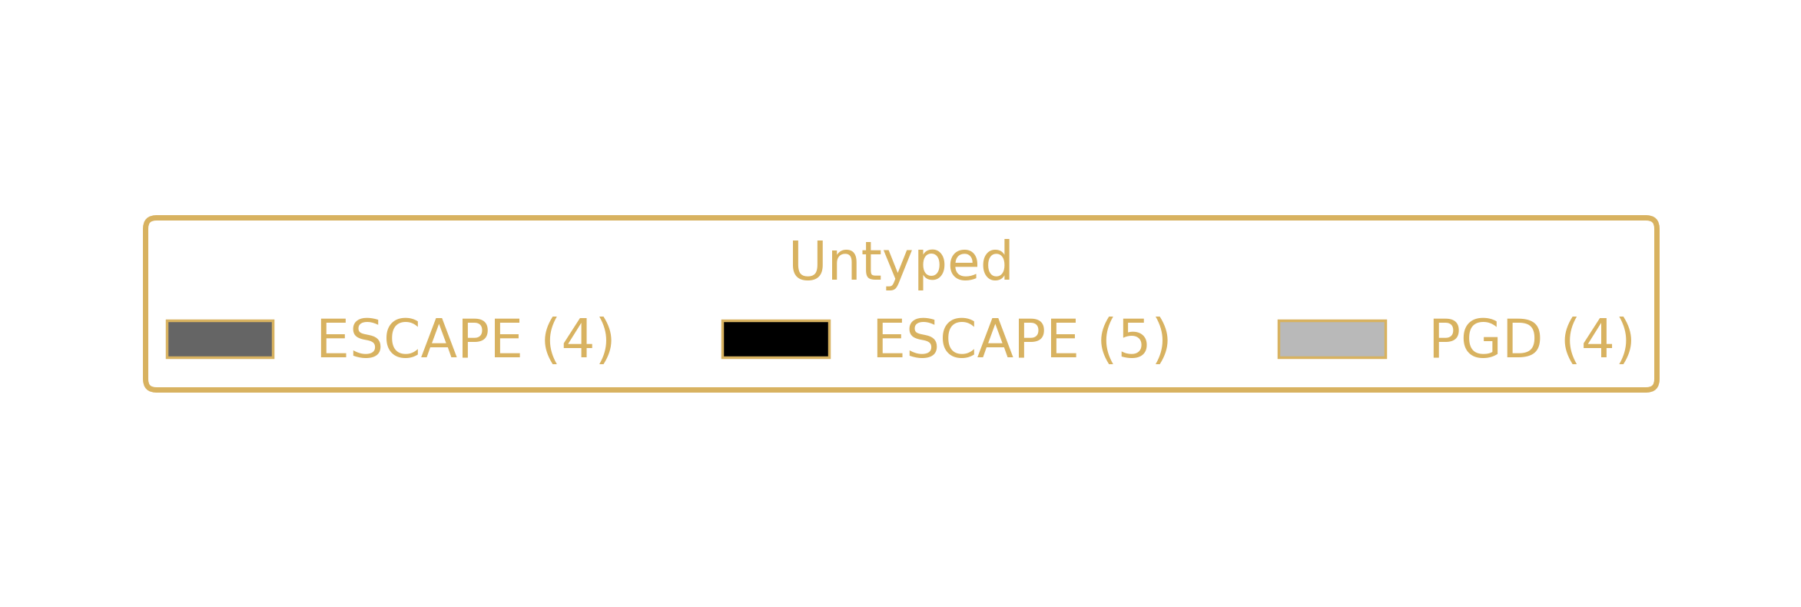
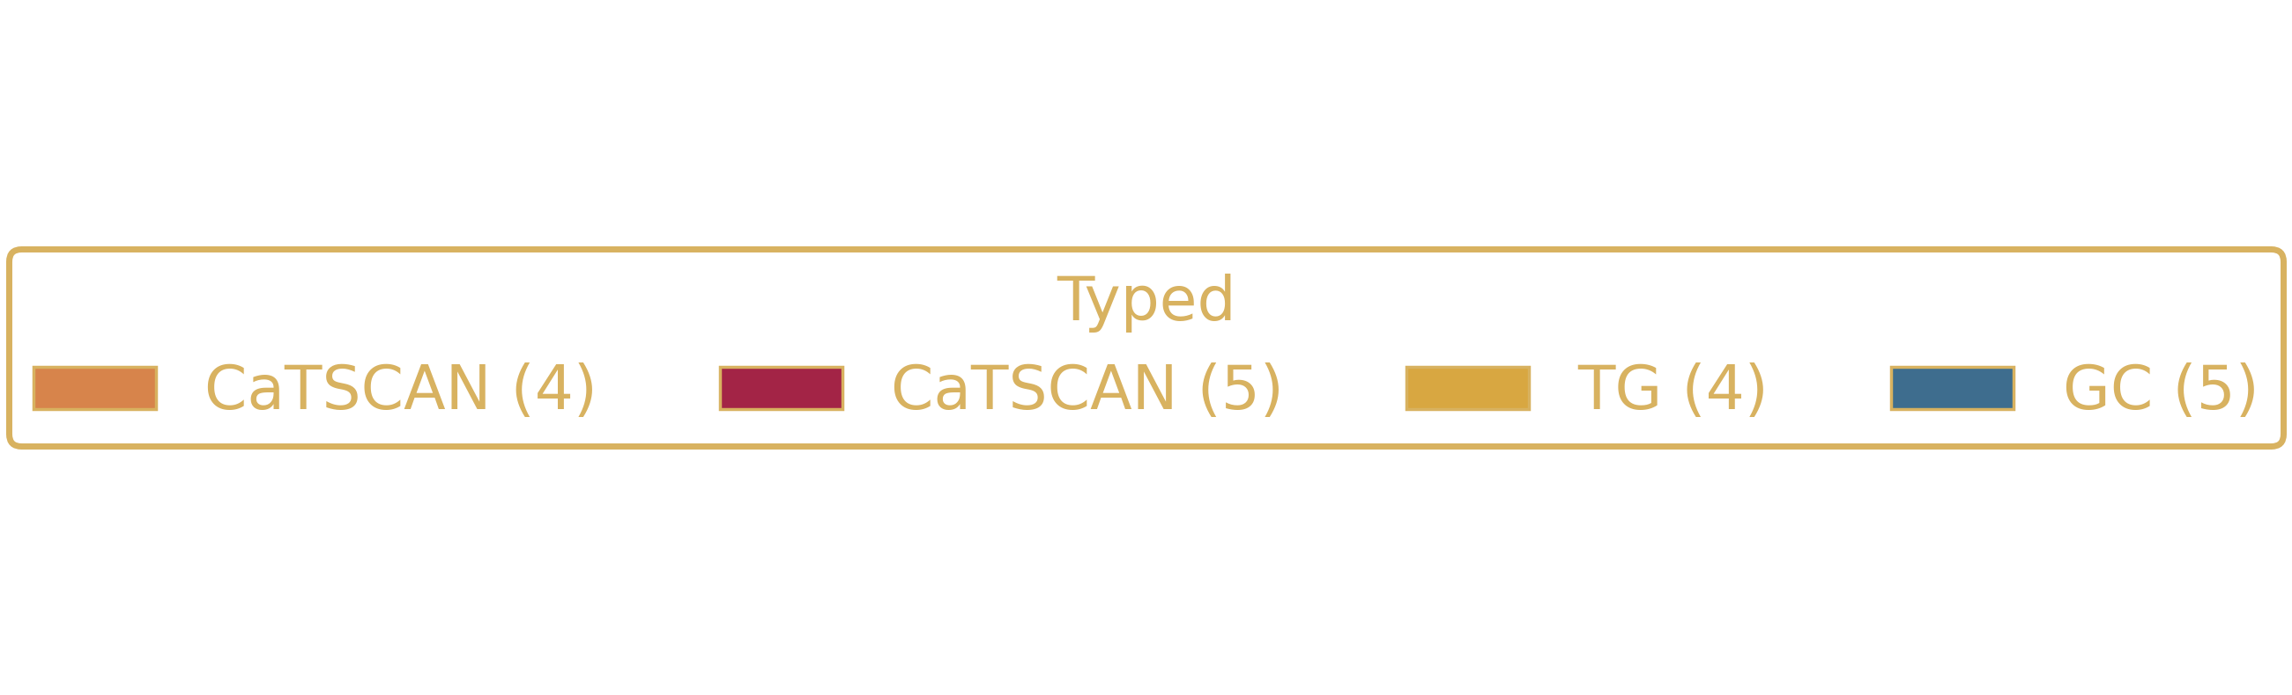
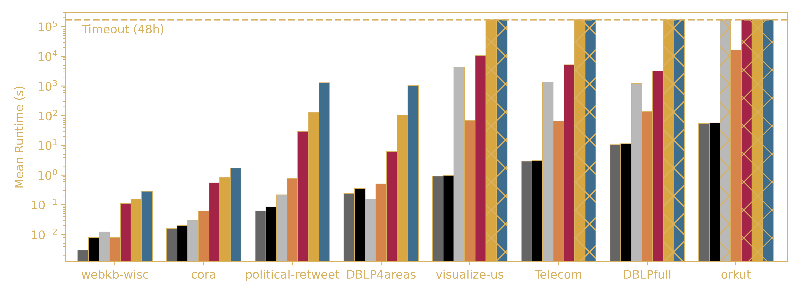
Only Untyped Counts Faster

Slide 15

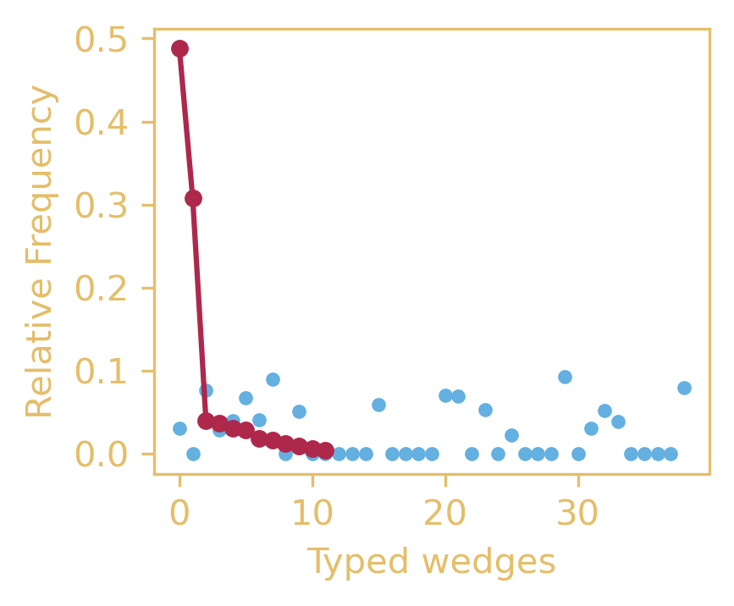
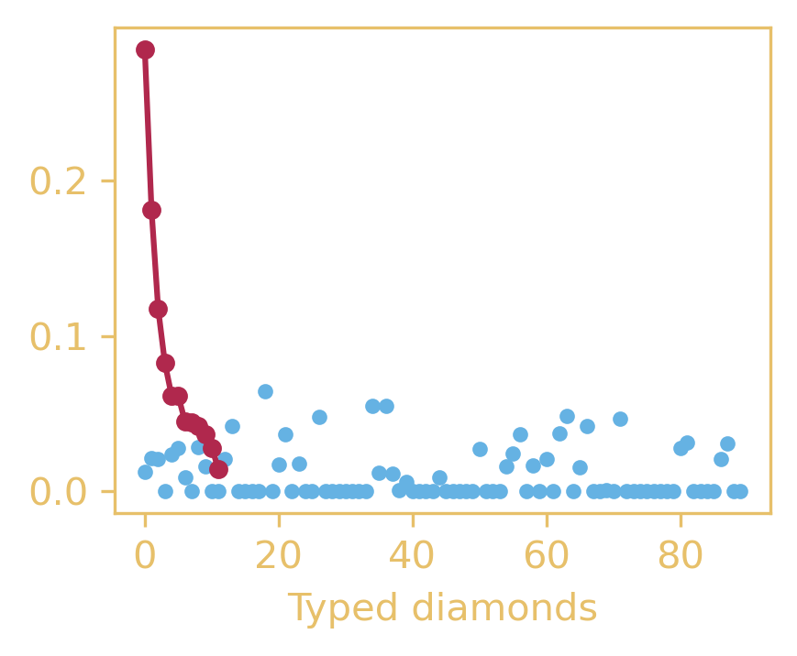
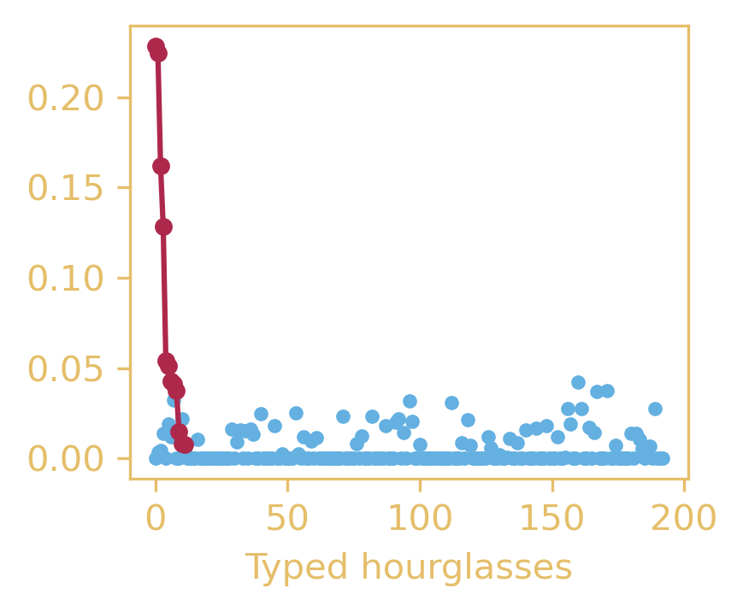
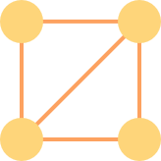
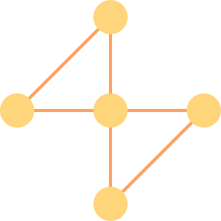
Typed Counts are More Informative
DBLP4areas: randomly shuffle the types (100 runs)
Observed (true) frequencies are systematic, not random.

Slide 16
Future Work
Got ideas? → Talk to me! :)
Consider types on edges, including
direction
multi-edges
Parallel and distributed solution
work in progress

Slide 17
Conclusion
CaTSCAN counts typed 5-node graphlets in HINs
Orders of magnitude faster than existing approaches
Only untyped counting is faster…
… but typed counts are more informative
Don’t count – Calculate!

Slide 18

Conclusion
christianbeth.com
CaTSCAN counts typed 5-node graphlets in HINs
Orders of magnitude faster than existing approaches
Only untyped counting is faster…
… but typed counts are more informative
Don’t count – Calculate!
Speaker: Christian Beth

Slide 19


Special Thanks
Mattis thor Straten (CAU)
Felix Rodriguez Rasmussen (CAU)
Matin Najafi (HKU)
Prof. Reynold Cheng (HKU)
Prof. Matthias Renz (CAU)

Slide 20
References
[1] Pinar, A., Seshadhri, C., Vishal, V.: “ESCAPE: Efficiently counting all 5-vertex subgraphs”. In: Proceedings of the 26th international conference on world wide web. pp. 1431–1440 (2017)
[2] Ahmed, N.K., Neville, J., Rossi, R.A., Duffield, N.: “Efficient graphlet counting for large networks”. In: 2015 IEEE International Conference on Data Mining. pp. 1–10. IEEE (2015)
[3] Rossi, R.A., Ahmed, N.K., Carranza, A., Arbour, D., Rao, A., Kim, S., Koh, E.: “Heterogeneous graphlets”. In: ACM Transactions on Knowledge Discovery from Data (TKDD) 15(1), 1–43 (2020)
[4] Gu, S., Johnson, J., Faisal, F.E., Milenković, T.: “From homogeneous to heterogeneous network alignment via colored graphlets”. In: Scientific reports 8(1), 1–16 (2018)
[5] Beth, C., thor Straten, M., Rodriguez Rasmussen, F., Najafi, M.M., Cheng, R., Renz, M.: “CaTSCAN: Calculating Typed Subgraph Counts Analytically for Networks”. In: Machine Learning and Knowledge Discovery in Databases. Research Track. ECML PKDD 2026 (in press)
[6] Beth, C., thor Straten, M., Rodriguez Rasmussen, F., Najafi, M.M., Cheng, R., Renz, M.: Supplementary Appendix for the Paper “CaTSCAN: Calculating Typed Subgraph Counts Analytically for Networks”. https://zenodo.org/records/20664518

