Slide 1
Distilling Crude EHR Data
Alex Milinovich
Data Ninja
milinoa@ccf.org
Quantitative Health Sciences - Cleveland Clinic

Slide 2
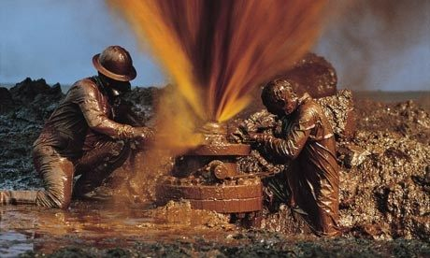
What it’s like to be a data analyst
Data
Data
Data
Data
Data
Data
Data
Data
Data
Data
Data
Data
Data
Analyst
Analyst
EMR
https://qph.ec.quoracdn.net/main-qimg-fffae69f5ee7c5831b5730a47477ba7b-c

Slide 3
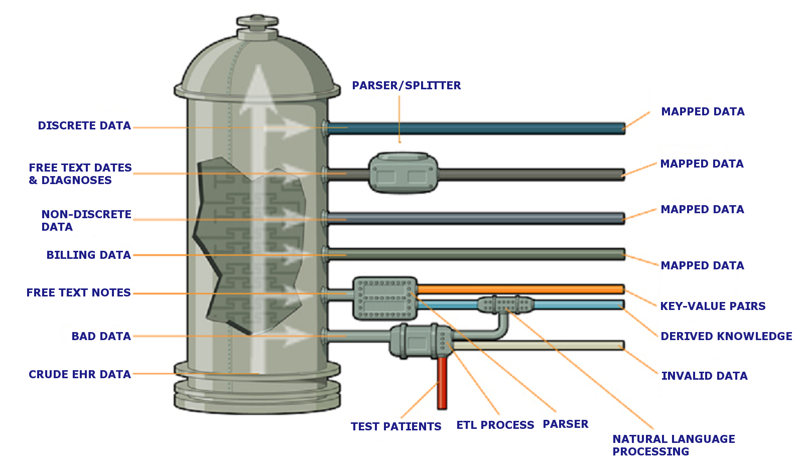
QHS Data Refinery

Slide 4
Clinical Data Transformation
Extract, Transform & Load (ETL)
Epic
Billing
Anesthesia
KP (PROs)
Non-Clinical (e.g. Death data)
Outcomes
Data Warehouse

Slide 5
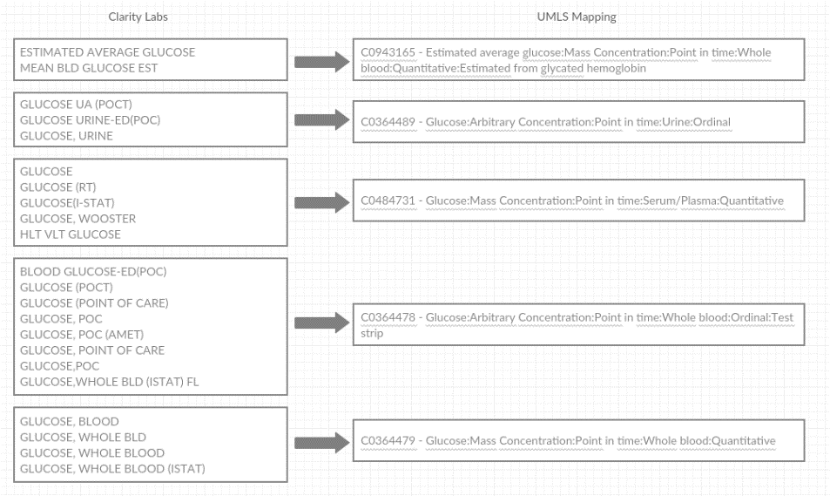
Clinical Data Transformation
Map terms to Unified Medical Language System (UMLS) identifiers

Slide 6
Clinical Data Transformation
Map terms to Unified Medical Language System (UMLS) identifiers
REFERENCE_UNIT
mg/dl
mgdl
mg/dl (calc)
mg/dl fasting
mg/dl adult
m/dl
mg/dl
C0439269 - mg/dL
Providers
Physician_Key - PAUL A MASCI
PRIM_SURG_CODE - MASCI P
PRIMARY_SURGEON - V83
PROV_ID - MASCI, PAUL A
CC005036 –
MASCI, PAUL A
DX_ID
Type II or unspecified type diabetes mellitus without mention of complication, not stated as uncontrolled
DM W/O COMPLICATION TYPE II
TYPE 2 DIABETES MELLITUS WITHOUT COMPLICATIONS
DIABETES MELLITUS
DM (DIABETES MELLITUS)
C0375113 -
Diabetes mellitus without mention of complication, type II or unspecified type, not stated as uncontrolled
ICD9 = 250.00

Slide 7
Clinical Data Transformation
Combine tables
Diagnoses
28 different data sources
Billing (back to 1989)
Free text medication history dates parsed
Free text admission/complaint/optime diagnoses mapped
Surgeries
OpTime + ORIS (back to 1991)
Other disparate tables including billing data
Test patients removed
9,000 patients marked as test patients (via FYI flag)
10,000+ additional test patients identified
Test, companies, research studies, “do not schedule”
185 tables contribute to the warehouse
<5% of raw data is coded variables
Only 9% of columns in warehouse end up being uncoded
Load into data warehouse
Admissions
Allergies
Appointments
Current Medications
Diagnoses
Encounters
Flowsheets
Identities + Identities History
Medications
Notes
Patients
Procedures
Results
Social History
Surgeries
Surgical History
Universal Charge Line

Slide 8
Clinical Data Transformation
Data Volumes
6.8 million terms mapped to UMLS concepts
>35 billion individual data points
5.8 billion flowsheets
1.7 billion lab results
1.5 billion diagnoses
>150 million notes
500,000 custom UMLS concepts
>100,000 abbreviations
200 million blood pressures
150 million heart rates

Slide 9
UMLS Atoms (aka synonyms)
Combines disparate medical vocabularies into single terms
C0085580 = Essential Hypertension
Vocabulary | Code | Description
CCS | 7.1.1 | Essential hypertension
CCS | 98 | Essential hypertension
ICD10CM | I10 | Essential (primary) hypertension
ICD9CM | 401 | Essential hypertension
ICD9CM | 401.9 | Hypertension NOS
ICD9CM | 401.9 | Unspecified essential hypertension
NCI | C3478 | Essential Hypertension
SNOMEDCT_US | 155296003 | Essential hypertension
SNOMEDCT_US | 194757006 | Essential hypertension
SNOMEDCT_US | 194760004 | Essential hypertension NOS
SNOMEDCT_US | 59621000 | Essential hypertension
SNOMEDCT_US | 59621000 | Idiopathic hypertension
SNOMEDCT_US | 59621000 | Primary hypertension
SNOMEDCT_US | 59621000 | Primary hypertension, NOS
SNOMEDCT_US | 59621000 | Systemic primary arterial hypertension

Slide 10
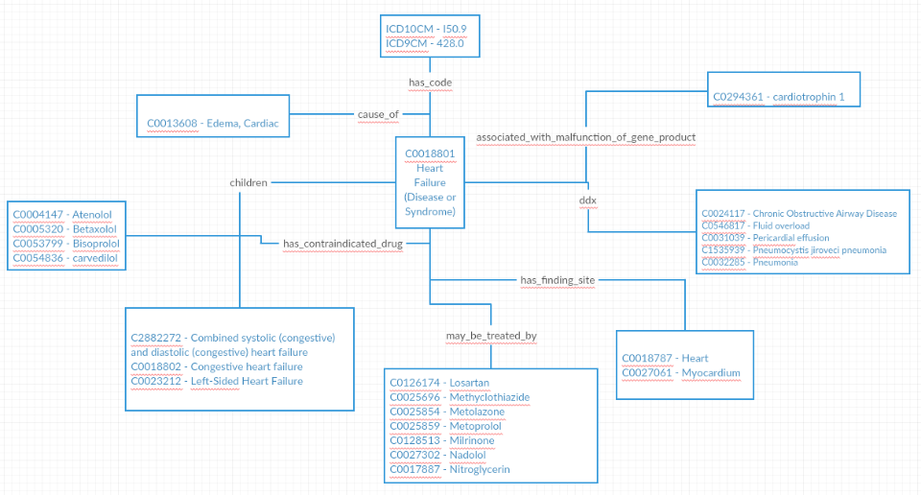
UMLS Relationships
Adds relationships/hierarchies

Slide 11
UMLS Hierarchies
ConceptID | ConceptDescription | Position
C2880081 | International Classification of Diseases, 10th Edition, Clinical Modification | 0
C0263660 | Musculoskeletal and connective tissue disorders | 1
C0162323 | Polyarthritis | 2
C0018099 | Gout | 3
C0149896 | Primary gout | 4
C0837798 | Idiopathic gout, ankle and foot | 5
C2889675 | Idiopathic gout, right ankle and foot | XXX
ConceptID | ConceptDescription | VocabularyAbbreviation | Position | PathNumber
C2880081 | International Classification of Diseases, 10th Edition, Clinical Modification | ICD10CM | 0 | 23
C0263660 | Musculoskeletal and connective tissue disorders | ICD10CM | 1 | 23
C0162323 | Polyarthritis | ICD10CM | 2 | 23
C1137112 | ICD-9-CM | ICD9CM | 0 | 21
C0178237 | diseases and injuries | ICD9CM | 1 | 21
C0342105 | Endocrine, nutritional, metabolic and immunity disorders | ICD9CM | 2 | 21
C0178259 | OTHER METABOLIC AND IMMUNITY DISORDERS | ICD9CM | 3 | 21
C2720507 | SNOMED CT Concept (SNOMED RT+CTV3) | SNOMEDCT_US | 0 | 31
C0037088 | Signs and Symptoms | SNOMEDCT_US | 1 | 31
C0012634 | Disease | SNOMEDCT_US | 2 | 31
C0025517 | Metabolic Diseases | SNOMEDCT_US | 3 | 31
C0034139 | Purine-Pyrimidine Metabolism, Inborn Errors | SNOMEDCT_US | 4 | 31
C0268104 | Disorder of purine metabolism | SNOMEDCT_US | 5 | 31

Slide 12
UMLS – Sample Population
Diabetic patients on a GLP-1 medication with an HbA1c > 10
Diabetics = C0011847 - Diabetes
Get all “child” concepts
2,666 different diagnoses
147 ICD9 codes
792 ICD10 codes
GLP-1 = C2916791 - Glucagon-like Peptide-1 (GLP-1) Agonists [MoA]
Get all concepts that have an active ingredient or are a tradename of
69 different medications
HbA1c = C0366781 - Hemoglobin A1c/Hemoglobin.total:Mass Fraction:Point in time:Whole blood:Quantitative
15 different labs in Epic map to this ConceptID

Slide 13
Sample Population Query – UMLS (581 chars w/o comments)
SELECT
p.PatientID
FROM Patients AS p
WHERE
EXISTS (SELECT 1 FROM Diagnoses AS d
WHERE d.PatientID = p.PatientID
AND d.ConceptID IN (
SELECT ccc.ConceptID
FROM UMLS.dbo.ChildConceptsCLR('C0011847', 'same_as,isa,classified_as', 1) AS ccc))
AND EXISTS
(SELECT 1 FROM Medications AS M
WHERE M.PatientID = p.PatientID
AND M.ConceptID IN (
SELECT mssdf.ConceptID FROM UMLS.dbo.MedicationSuperSearchDoseForm('C2916791', 2 /*Oral - 2 if solution*/, 1 /*Injectable*/, 1 /*Transdermal*/, 1 /*Topical*/, 1 /*Inhalable*/, 1 /*Vaginal*/ , 1 /*Rectal*/, 1 /*Powder*/) AS mssdf ))
AND EXISTS
(SELECT 1 FROM Results AS r WHERE r.PatientID = p.PatientID AND r.ConceptID = 'C0366781' AND r.OrderNumericValue > 10)

Slide 14
Sample Population Query – Clarity (6,175 chars w/o comments)
SELECT p.PAT_ID FROM PATIENT AS p
WHERE --Exclude test patients (still doesn't account for unmarked test patients) NOT EXISTS (SELECT 1 FROM PATIENT_3 AS p1 WHERE p1.PAT_ID = p.PAT_ID AND p1.IS_TEST_PAT_YN = 'Y')
AND
--Have to join 1.9 billion row ORDER_RESULTS with 950+ million ORDER_PROC because ORDER_RESULTS.PAT_ID is deprecated
EXISTS (SELECT 1 FROM ORDER_RESULTS AS [or] INNER JOIN ORDER_PROC AS op ON [or].ORDER_PROC_ID = op.ORDER_PROC_ID WHERE op.PAT_ID = p.PAT_ID AND [or].COMPONENT_ID IN (SELECT cc.COMPONENT_ID FROM CLARITY_COMPONENT AS cc WHERE cc.NAME LIKE '%A1C%' OR cc.EXTERNAL_NAME LIKE '%A1C%' OR cc.COMMON_NAME LIKE '%A1C%' OR cc.BASE_NAME like '%A1C%') AND [or].ORD_NUM_VALUE > 10) AND
EXISTS (SELECT 1 FROM ORDER_MED AS om WHERE om.PAT_ID = p.PAT_ID AND om.MEDICATION_ID IN (SELECT cm.MEDICATION_ID FROM Staging.dbo.CLARITY_MEDICATION cm LEFT OUTER JOIN Staging.dbo.ZC_PHARM_CLASS zpc ON cm.PHARM_CLASS_C = zpc.PHARM_CLASS_C LEFT OUTER JOIN Staging.dbo.ZC_PHARM_SUBCLASS zps ON cm.PHARM_SUBCLASS_C = zps.PHARM_SUBCLASS_C WHERE zpc.NAME LIKE '%GLP-1%' OR zps.NAME LIKE '%GLP-1%'))
--Check for diabetes diagnosis (doesn't include billing, ORIS, free text admit dx, free text Optime dx, free text ER complaint)
AND ( EXISTS (SELECT 1 FROM PAT_ENC_DX AS ped WHERE ped.PAT_ID = p.PAT_ID AND ped.DX_ID IN (SELECT eci.DX_ID FROM EDG_CURRENT_ICD9 AS eci WHERE eci.CODE LIKE '250%' UNION ALL SELECT eci.DX_ID FROM EDG_CURRENT_ICD10 AS eci WHERE eci.CODE LIKE 'E1[01]%')) OR EXISTS (SELECT 1 FROM HSP_ADMIT_DIAG AS had WHERE had.PAT_ID = p.PAT_ID AND had.DX_ID IN (SELECT eci.DX_ID FROM EDG_CURRENT_ICD9 AS eci WHERE eci.CODE LIKE '250%' UNION ALL SELECT eci.DX_ID FROM EDG_CURRENT_ICD10 AS eci WHERE eci.CODE LIKE 'E1[01]%')) OR EXISTS (SELECT 1 FROM MEDICAL_HX AS mh WHERE mh.PAT_ID = p.PAT_ID AND mh.DX_ID IN (SELECT eci.DX_ID FROM EDG_CURRENT_ICD9 AS eci WHERE eci.CODE LIKE '250%' UNION ALL SELECT eci.DX_ID FROM EDG_CURRENT_ICD10 AS eci WHERE eci.CODE LIKE 'E1[01]%')) OR EXISTS (SELECT 1 FROM CLM_DIAGNOSIS AS cd INNER JOIN PAT_ENC AS pe ON cd.CLAIM_ID = pe.CLAIM_ID WHERE pe.PAT_ID = p.PAT_ID AND cd.DX_ID IN (SELECT eci.DX_ID FROM EDG_CURRENT_ICD9 AS eci WHERE eci.CODE LIKE '250%' UNION ALL SELECT eci.DX_ID FROM EDG_CURRENT_ICD10 AS eci WHERE eci.CODE LIKE 'E1[01]%')) OR EXISTS (SELECT 1 FROM CLM_OTHER_DXS AS cod INNER JOIN PAT_ENC AS pe ON cod.CLAIM_ID = pe.CLAIM_ID WHERE pe.PAT_ID = p.PAT_ID AND cod.OTHER_DX_ID IN (SELECT eci.DX_ID FROM EDG_CURRENT_ICD9 AS eci WHERE eci.CODE LIKE '250%' UNION ALL SELECT eci.DX_ID FROM EDG_CURRENT_ICD10 AS eci WHERE eci.CODE LIKE 'E1[01]%')) OR EXISTS (SELECT 1 FROM FOL_DIAGNOSIS AS fd INNER JOIN FOL_INFO AS fi ON fd.FOL_ID = fi.FOL_ID WHERE fi.PATIENT_ID = p.PAT_ID AND fd.DIAGNOSIS_ID IN (SELECT eci.DX_ID FROM EDG_CURRENT_ICD9 AS eci WHERE eci.CODE LIKE '250%' UNION ALL SELECT eci.DX_ID FROM EDG_CURRENT_ICD10 AS eci WHERE eci.CODE LIKE 'E1[01]%')) OR EXISTS (SELECT 1 FROM HH_PAT_IP_DX AS hpid WHERE hpid.PAT_ID = p.PAT_ID AND hpid.INPATIENT_DX_ID IN (SELECT eci.DX_ID FROM EDG_CURRENT_ICD9 AS eci WHERE eci.CODE LIKE '250%' UNION ALL SELECT eci.DX_ID FROM EDG_CURRENT_ICD10 AS eci WHERE eci.CODE LIKE 'E1[01]%')) OR EXISTS (SELECT 1 FROM HSP_ACCT_ADMIT_DX AS haad INNER JOIN HSP_ACCT_PAT_CSN AS hapc ON haad.HSP_ACCOUNT_ID = hapc.HSP_ACCOUNT_ID WHERE hapc.PAT_ID = p.PAT_ID AND haad.ADMIT_DX_ID IN (SELECT eci.DX_ID FROM EDG_CURRENT_ICD9 AS eci WHERE eci.CODE LIKE '250%' UNION ALL SELECT eci.DX_ID FROM EDG_CURRENT_ICD10 AS eci WHERE eci.CODE LIKE 'E1[01]%')) OR EXISTS (SELECT 1 FROM HSP_ACCT_DX_LIST AS haad INNER JOIN HSP_ACCT_PAT_CSN AS hapc ON haad.HSP_ACCOUNT_ID = hapc.HSP_ACCOUNT_ID WHERE hapc.PAT_ID = p.PAT_ID AND haad.DX_ID IN (SELECT eci.DX_ID FROM EDG_CURRENT_ICD9 AS eci WHERE eci.CODE LIKE '250%' UNION ALL SELECT eci.DX_ID FROM EDG_CURRENT_ICD10 AS eci WHERE eci.CODE LIKE 'E1[01]%')) OR EXISTS (SELECT 1 FROM HSP_ACCT_ECDDX_ALT AS haad INNER JOIN HSP_ACCT_PAT_CSN AS hapc ON haad.ACCT_ID = hapc.HSP_ACCOUNT_ID WHERE hapc.PAT_ID = p.PAT_ID AND haad.ECD_DX_ALT_ID IN (SELECT eci.DX_ID FROM EDG_CURRENT_ICD9 AS eci WHERE eci.CODE LIKE '250%' UNION ALL SELECT eci.DX_ID FROM EDG_CURRENT_ICD10 AS eci WHERE eci.CODE LIKE 'E1[01]%')) OR EXISTS (SELECT 1 FROM HSP_ACCT_EXTINJ_CD AS haad INNER JOIN HSP_ACCT_PAT_CSN AS hapc ON haad.HSP_ACCOUNT_ID = hapc.HSP_ACCOUNT_ID WHERE hapc.PAT_ID = p.PAT_ID AND haad.EXT_INJURY_DX_ID IN (SELECT eci.DX_ID FROM EDG_CURRENT_ICD9 AS eci WHERE eci.CODE LIKE '250%' UNION ALL SELECT eci.DX_ID FROM EDG_CURRENT_ICD10 AS eci WHERE eci.CODE LIKE 'E1[01]%')) OR EXISTS (SELECT 1 FROM HSP_ACCT_FINDX_ALT AS haad INNER JOIN HSP_ACCT_PAT_CSN AS hapc ON haad.ACCT_ID = hapc.HSP_ACCOUNT_ID WHERE hapc.PAT_ID = p.PAT_ID AND haad.FIN_DX_ALT_ID IN (SELECT eci.DX_ID FROM EDG_CURRENT_ICD9 AS eci WHERE eci.CODE LIKE '250%' UNION ALL SELECT eci.DX_ID FROM EDG_CURRENT_ICD10 AS eci WHERE eci.CODE LIKE 'E1[01]%')) OR EXISTS (SELECT 1 FROM HSP_TX_DIAG AS haad INNER JOIN HSP_ACCT_PAT_CSN AS hapc ON haad.HSP_ACCOUNT_ID = hapc.HSP_ACCOUNT_ID WHERE hapc.PAT_ID = p.PAT_ID AND haad.DX_ID IN (SELECT eci.DX_ID FROM EDG_CURRENT_ICD9 AS eci WHERE eci.CODE LIKE '250%' UNION ALL SELECT eci.DX_ID FROM EDG_CURRENT_ICD10 AS eci WHERE eci.CODE LIKE 'E1[01]%')) OR EXISTS (SELECT 1 FROM OR_CASE_DX_CODE AS ocdc INNER JOIN OR_CASE AS oc ON ocdc.OR_CASE_ID = oc.OR_CASE_ID WHERE oc.PAT_ID = p.PAT_ID AND ocdc.DX_ID IN (SELECT eci.DX_ID FROM EDG_CURRENT_ICD9 AS eci WHERE eci.CODE LIKE '250%' UNION ALL SELECT eci.DX_ID FROM EDG_CURRENT_ICD10 AS eci WHERE eci.CODE LIKE 'E1[01]%')) OR EXISTS (SELECT 1 FROM OR_LOG_DIAG_CODES AS ocdc INNER JOIN OR_LOG AS ol ON ocdc.LOG_ID = ol.LOG_ID WHERE ol.PAT_ID = p.PAT_ID AND ocdc.DX_CODES_ID IN (SELECT eci.DX_ID FROM EDG_CURRENT_ICD9 AS eci WHERE eci.CODE LIKE '250%' UNION ALL SELECT eci.DX_ID FROM EDG_CURRENT_ICD10 AS eci WHERE eci.CODE LIKE 'E1[01]%')) OR EXISTS (SELECT 1 FROM PROBLEM_LIST AS pl WHERE pl.PAT_ID = p.PAT_ID AND pl.DX_ID IN (SELECT eci.DX_ID FROM EDG_CURRENT_ICD9 AS eci WHERE eci.CODE LIKE '250%' UNION ALL SELECT eci.DX_ID FROM EDG_CURRENT_ICD10 AS eci WHERE eci.CODE LIKE 'E1[01]%')) OR EXISTS (SELECT 1 FROM UNIV_CHG_LN_DX AS ucld INNER JOIN CLARITY_UCL AS cu ON ucld.UCL_ID = cu.UCL_ID WHERE cu.PATIENT_ID = p.PAT_ID AND ucld.DIAGNOSIS_ID IN (SELECT eci.DX_ID FROM EDG_CURRENT_ICD9 AS eci WHERE eci.CODE LIKE '250%' UNION ALL SELECT eci.DX_ID FROM EDG_CURRENT_ICD10 AS eci WHERE eci.CODE LIKE 'E1[01]%')))

Slide 15
Sample Population Query – EDV
???
Didn’t know you could make Clarity more difficult to understand

Slide 16
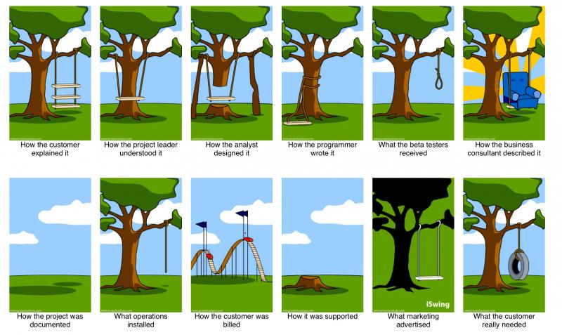
EDV

Slide 17
Other integrated data
Patient-Level
Charge-level billing data
ARKS/PHDS (intraop anesthesia)
Blood & ICU data marts
HealthQuest
Critical care transport log
Polysmith (sleep studies)
Provation (GI scope studies)
Cancer staging
Death indices
SSDI (through 2013)
Ohio Death Index (through 2017)
Addressed truncation of SSN since 2015 via probabilistic matching
In progress
Florida death index
National death index monthly updates – via Enterprise analytics
Working with external auditor as of February 2019
Key-value pair parsed free-text notes/reports
Coding
Various ICD9/ICD10 crosswalks – CMS, CCF, AHRQ, UMLS
CMS ICD10 to DRG
Compiled list of >100,000 abbreviations & acronyms
GPRO, HEIDS, NLM, NQF, USHIK value sets
Census & Wikipedia lists of common first and last names for test patient identification
10 million unique patient addresses geocoded
6.5 million patients
150,000 geocoded healthcare facilities
213,000 patients with facility address
Block group-level American Community Survey data
Direct import/export of REDCap data

Slide 18
Benefits
More robust and inclusive population definitions
Both with use of UMLS and combination of data sources
Don’t need lists of codes/medication names anymore
More accurate data
Test patients removed
Erroneous orders removed
Proper labs identified
Bad data removed
Patient address 1 – "FASHION POLICE!!! POPPED COLLARS- Okay unless you are a member the Jersey Shore, no one (including them) should be doing this, and especially men over 14… This was a fad of the early 80's and made a very quick return in the early 2000's, and as fast as it came back and it left. So, to the gentlemen (and significant others of these guys popping collars). Please be reminded, "THIS FAD IS OVER, like yesterday!"
Live query exploration
Faster completion of projects
10-100x faster than using Clarity
By 1 person
60,000 queries in 4 years
>1,000 data requests completed in 4 years
Faster updating of project data
E.g. No need to add new medications to classes
Human readable table & column names
Including department names
Limited need to join tables

Slide 19
Publications/Highlights
A Milinovich, MW Kattan. Extracting and utilizing electronic health data from Epic for research. Annals of Translational Medicine. February 2018.
Co-authored 30 publications utilizing the outcomes data warehouse
Countless publications based off populations/extracted data
Readmissions prediction model
No show prediction model

Slide 20
How do we do it?
Intro to the data coordinator

Slide 21
How do we do it?
SQL Server Integration Services (SSIS) ETL packages automatically generated
Source to Staging
Staging to Data Warehouse
Automatic mapping processes run
Coded & non-coded data
Patient matching
Full refresh of primary data weekly
~8 hours to stage data
4 hours data pull (100GB/hour)
4 hours index rebuilds
~10 hours to load to data warehouse
Includes index rebuilds
~5 hours for diagnoses (28 data sources)

Slide 22
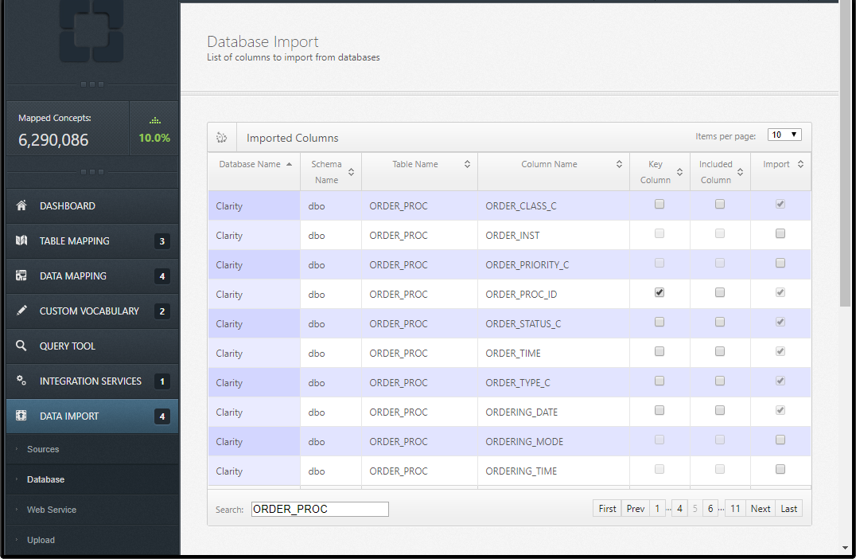

Slide 23
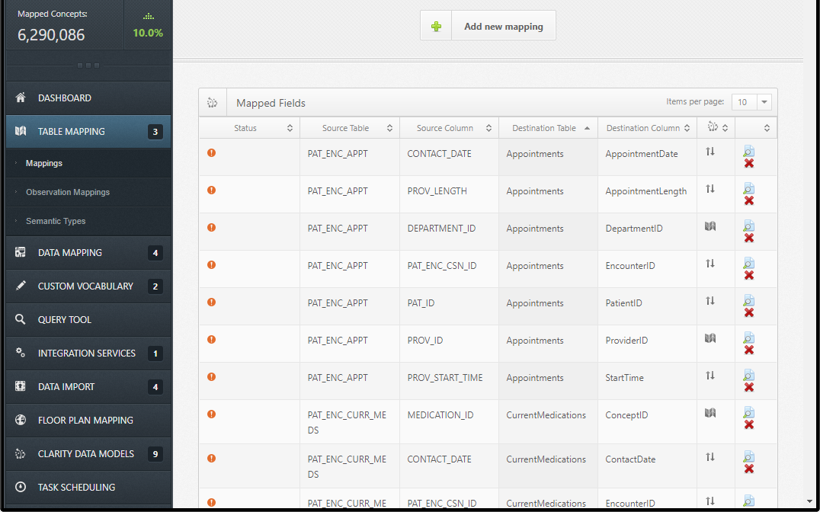

Slide 24
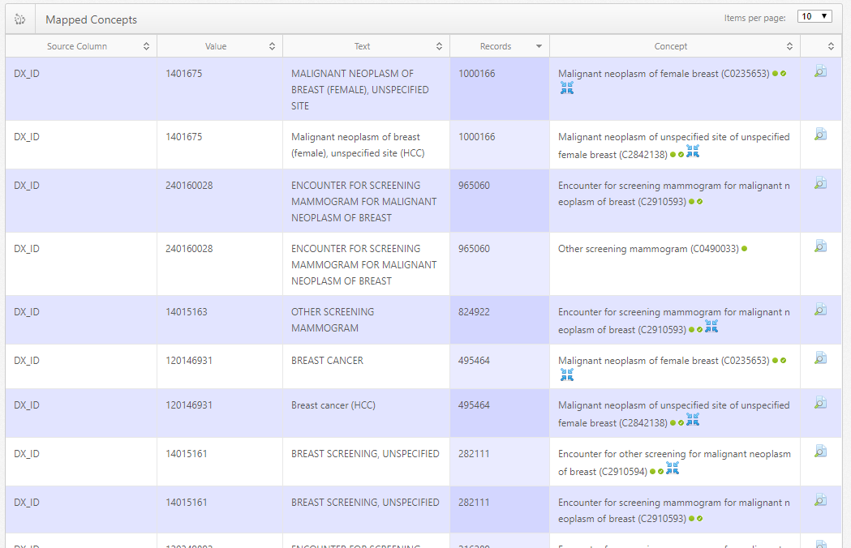

Slide 25
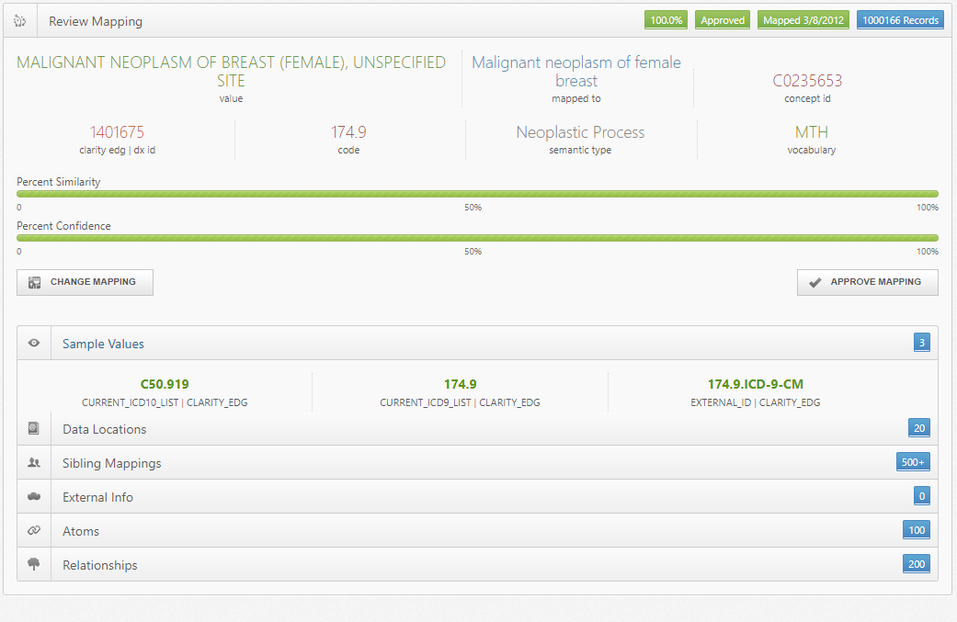

Slide 26
Geocoding

Slide 27
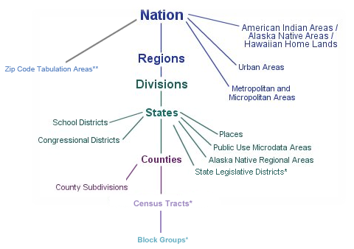
Geocoding
What is geocoding?
Census geographic hierarchy
Taking an address & mapping it to a latitude & longitude
Can then find the Geographic Identifier (GEOID) to tie to other data sources

Slide 28
Census geographic hierarchy
Street Segment
Lat/Long
Additional granularity

Slide 29
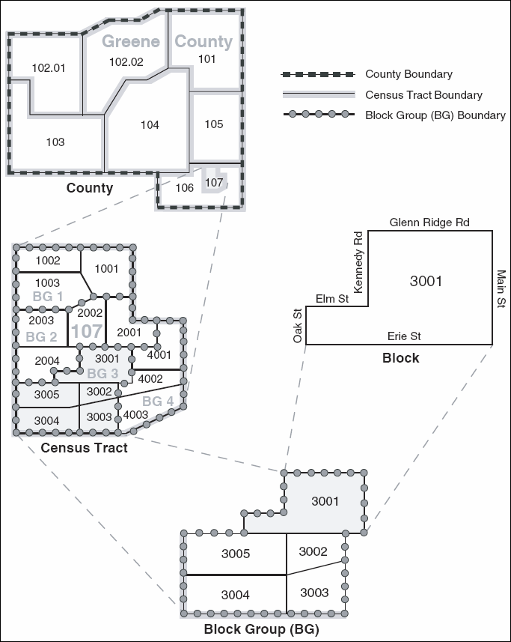

Slide 30
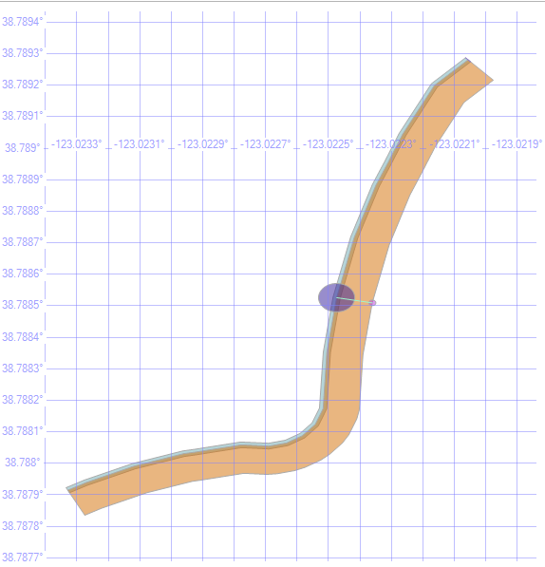
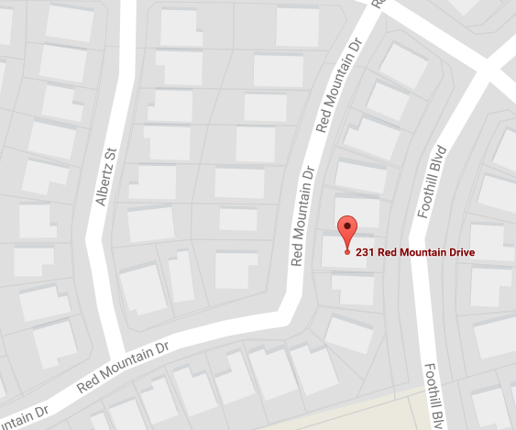
Geocoding
Census TIGER/LINE data are free
231 Red Mountain Dr, Cloverdale, CA 95425
Google Maps
72 foot difference
Not bad for only having start & end addresses

Slide 31
Geocoding
What can we do with it?
Get block-level American Community Survey data
Distance calculations
Combine with EPA and weather data
Identify patients living in healthcare facilities

Slide 32
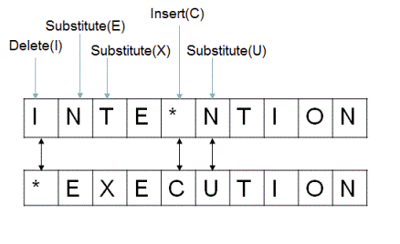
Similarity Calculations
Match patients across multiple systems
Match providers across multiple systems
Match uncoded data to coded data
Match misspelled address to correct addresses
Validate coded terms
Helpful when terms are coded to less succinct codes or obsolete codes
Utilize
Levenshtein edit distance
Jaccard similarity coefficient
Jaro-Winkler distance
Longest common subsequence algorithms
Simple edit distance
http://www.ideserve.co.in/learn/img/editDistance_0.gif

Slide 33
Leveraging Regular Expressions for Information Extraction

Slide 34
Regular Expressions
“A sequence of characters that define a search pattern”
Match any letter from A-Z
([A-Za-z])
Match at least 2 spaces and a capital letter preceded by a period
(?<=\.)\s{2,}(?=[A-Z])
Overly complicated key + value pair extraction
(?<=^|([\w\()\.\-\s]+[\s]{1}[\w\.\()\-/#]+|[\w\()\.\-/#]+){2,})(?<![0-9\s]+)(?:\s*(?:[:])\s*)([A-Za-z0-9\/:\s%,\.\-]+(?<!:))(?:[\s]|$|\|)

Slide 35
Note Parsing
Tons of useful information in notes & order results
Information not recorded anywhere else discretely
Legacy & other systems only import data into Epic as notes
>40 million free text order results
>150 million free text notes
Want to pull out key + value pairs

Slide 36
Note Parsing Example
Section | ObservationName | ObservationValue
 | PROCEDURE REASON | Limb ischemia
RESULT | Observation | COLOR AND DUPLEX DOPPLER ANALYSIS BILATERAL LOWER EXTREMITIES ARTERIAL
Technique | Technique | Color and duplex Doppler analysis of the arteries of the lower extremities was performed.
Technique | Limitations to the exam | None
Findings | Findings | Aorta and common iliac arteries not visualized
Findings | Observation | RIGHT LOWER EXTREMITY: (cm/sec)
RIGHT LOWER EXTREMITY | Right external iliac artery | 113
RIGHT LOWER EXTREMITY | Right common femoral artery | 125
RIGHT LOWER EXTREMITY | Right profunda femoris artery | 86
RIGHT LOWER EXTREMITY | Discussion | Nonvisualization of the SFA with the exception of a small segment visualized in the midportion.
RIGHT LOWER EXTREMITY | Discussion | Delayed upstroke low resistance type flow in the right profunda femoris artery.
RIGHT LOWER EXTREMITY | Discussion | A portion of the mid right SFA is visualized.
RIGHT LOWER EXTREMITY | Discussion | Delayed upstroke low resistance in the right popliteal artery suggesting reconstitution from collaterals .
RIGHT LOWER EXTREMITY | Discussion | Similar delayed upstroke noted this was to present to the right posterior tibial artery which is seen patent to the distal leg and the left anterior tibial artery which is also seen patent to the distal leg.
RIGHT LOWER EXTREMITY | Discussion | Right peroneal artery cannot be visualized.
PROCEDURE REASON: Limb ischemia
RESULT:
COLOR AND DUPLEX DOPPLER ANALYSIS BILATERAL LOWER EXTREMITIES ARTERIAL
Technique: Color and duplex Doppler analysis of the arteries of the lower
extremities was performed.
Limitations to the exam: None
Findings:
Aorta and common iliac arteries not visualized
RIGHT LOWER EXTREMITY: (cm/sec)
Right external iliac artery: 113
Right common femoral artery: 125
Right profunda femoris artery: 86
Discussion: Nonvisualization of the SFA with the exception of a small
segment visualized in the midportion. Delayed upstroke low resistance
type flow in the right profunda femoris artery. A portion of the mid
right SFA is visualized. Delayed upstroke low resistance in the right
popliteal artery suggesting reconstitution from collaterals . Similar
delayed upstroke noted this was to present to the right posterior tibial
artery which is seen patent to the distal leg and the left anterior
tibial artery which is also seen patent to the distal leg. Right peroneal
artery cannot be visualized

Slide 37
Note Parsing
What can we parse?
Note parser is generic enough for any note or procedure type
Some tweaking needed for very specific procedures
What have we parsed so far?
EKGs
Echos
Surgical pathology results
Pulse volume recording/dopplers
Mammographies
Endoscopies
Cardiac caths
Colonoscopies
PFTs
Sleep studies
ABI/TBIs
GI imaging
Renal scans
Autopsies
Mohs surgeries
POP-Q
LVEFs

Slide 38
Leveraging Natural Language Processing for Information Extraction

Slide 39
What is natural language processing?
Interaction between human language and computers
Turns plain text into annotated & meaningful data (ideally)
Rich set of tools available many programming languages – R, python, Java
Trained via various machine learning techniques using pre-annotated data
Can be trained on generic or domain specific text
OpenNLP uses maximum entropy & perceptron classification

Slide 40

NLP Functions
Dependency Annotation
“Dr. Acula prescribed 2.5 mg of Zofran for the patient.”

Slide 41
What can we do with it?
Phrase chunking
[Dr. Acula] {NP} [prescribed] {VP} [2.5 mg [of] {PP} [Zofran] {NP} [for] {PP} [the patient.] {NP} ] {NP}
Named entity recognition
Dr. Acula = PERSON
Prescribed = ACTIVITY
Zofran = MEDICATION
Polarity/negation
“Patient did not have cancer” = No cancer
Conditionality
“If pain gets worse, give patient fentanyl.” = Conditional statement

Slide 42
What can we do with it?
Temporal annotation
“Last March, patient was seen in the ED for chest pain”
“Last March” = temporal phrase
“6/1/2017” = note date aka reference date
“March 2016” = calculated temporal date
3/1/2016 – 3/31/2016 = calculated temporal range
“3/31/2016” = calculated discrete date
Event happened by at least the last day of the month

Slide 43
What can we do with it?
Dictionary lookup
Pre-defined dictionary of medical terms based on the Unified Medical Language System (UMLS)
“Dr. Acula prescribed 2.5 mg of Zofran for emesis.”
UmlsConcept - “emesis”
codingScheme="ICD10CM"
code=“R11.10"
cui="C0042963"
tui="T184" (Sign or Symptom)
preferredText=“Vomiting"
UmlsConcept - “Zofran”
codingScheme="RXNORM"
code="66981"
cui="C0206046"
tui="T121“ (Pharmacologic Substance)
preferredText="Zofran"

Slide 44
What can we do with it?
Additional Annotators
Negation
“Patient does not have colon cancer.”
Colon cancer = negative
“She didn’t have nausea, vomiting or diarrhea.”
Nausea = negative
Vomiting = negative
Diarrhea = negative
Conditionality
“If patient has hypoglycemia, give them D50.”
Hypoglycemia = conditional
Measurements
“Patient’s ejection fraction is 35%.”
Measure name = ejection fraction
Measure value = 35%
History of
“She has a history of afib.”
Atrial fibrillation = historical

Slide 45
What have we done with it?
Parse medication SIGs
Stage Crohn’s patients at each visit
Calculate dates of diagnosis
Determine H. pylori test result
Extract cause of death
Map free-text admission diagnoses
Categorize pseudo-categorical data
Identify hypoglycemic events
Extract cardiac MRI indications & findings

Slide 46
Conclusion
With a combination of all these processes, massive time and $$$ are achieved
Live query exploration can be done while sitting with potential clients
Data issues are handled proactively
Query performance can be optimized

