Slide 1

Classification of Signals with Common Variable Dependent Tones Occurring at Random Harmonics Using Machine Learning
Christopher Bell

Slide 2
Outline
Motivation
Signal Model
Overview of Convolutional Neural Network (CNN) Architectures
Results

Slide 3
Motivation

Slide 4
Motivation
The goal of this project is to develop a machine learning (ML) algorithm to classify signals with common variable dependent tones
Secondary goal is to determine if time domain or frequency domain-based convolution neural networks (CNNs) are more efficient
The presence of large numbers of overlapping tones makes classification of source mechanisms difficult
Typically requires an experienced analyst and can not always be performed simultaneously with data collection
Examples of datasets with common variable dependent tones and harmonics include:
Strucutureborne vibration data from rotating machinery
Airborne noise data from drones
Underwater acoustic data from ships or mammals
The use of machine learning algorithms to classify frequency spectra has been a significant area of study
Machinery health faults (Sourza et. al. 2021)
Detection of drones (Taha & Shoufan 2019)
This specific project uses structureborne vibration data from rotating machinery
All source mechanisms are functions of shaft rate

Slide 5
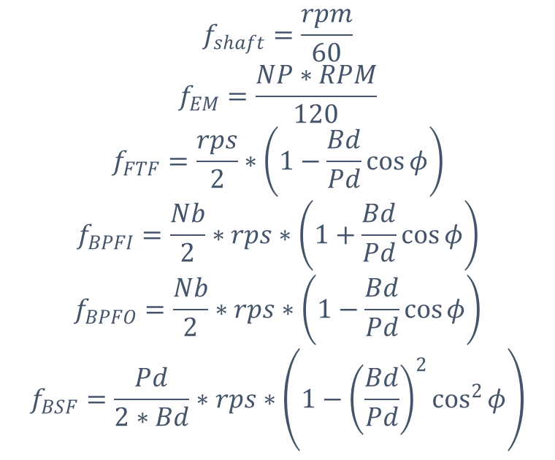
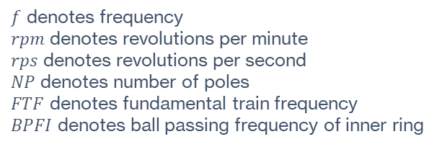
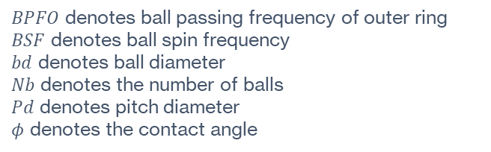
Motivation
$f$ denotes frequency
$rpm$ denotes revolutions per minute
$rps$ denotes revolutions per second
$NP$ denotes number of poles
$FTF$ denotes fundamental train frequency
$BPFI$ denotes ball passing frequency of inner ring
$BPFO$ denotes ball passing frequency of outer ring
$BSF$ denotes ball spin frequency
$bd$ denotes ball diameter
$Nb$ denotes the number of balls
$Pd$ denotes pitch diameter
$φ$ denotes the contact angle
$$f_{shaft}=\frac{rpm}{60}$$
$$f_{EM}=\frac{NP∗RPM}{120}$$
$$f_{FTF}=\frac{rps}{2}∗\left(1−\frac{Bd}{Pd}\cos{φ}\right)$$
$$f_{BPFI}=\frac{Nb}{2}∗rps∗\left(1+\frac{Bd}{Pd}\cos{φ}\right)$$
$$f_{BPFO}=\frac{Nb}{2}∗rps∗\left(1−\frac{Bd}{Pd}\cos{φ}\right)$$
$$f_{BSF}=\frac{Pd}{2∗Bd}∗rps∗\left(1−{\left(\frac{Bd}{Pd}\right)}^{2}\cos^{2}{φ}\right)$$
$$rpm=2400, NP = 4, bd=4 inches, Nb=12, Pd=2 inches, φ=30 degrees$$

Slide 6
Signal Model

Slide 7
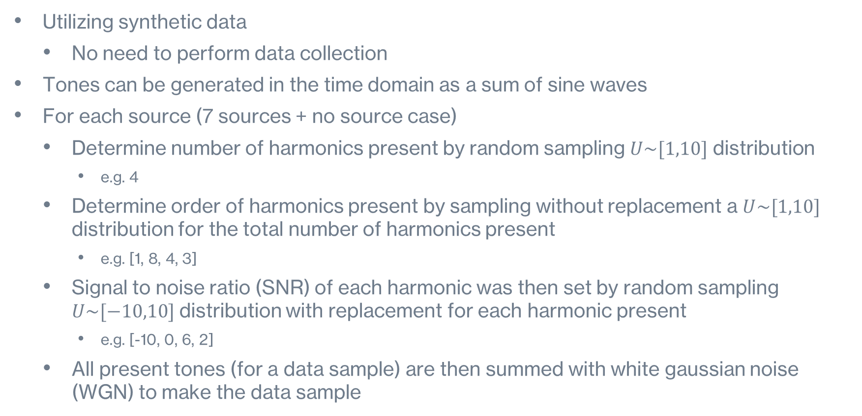
Signal Model
Utilizing synthetic data
No need to perform data collection
Tones can be generated in the time domain as a sum of sine waves
For each source (7 sources + no source case)
Determine number of harmonics present by random sampling $U\sim [1,10]$ distribution
e.g. 4
Determine order of harmonics present by sampling without replacement a $U\sim [1,10]$ distribution for the total number of harmonics present
e.g. [1, 8, 4, 3]
Signal to noise ratio (SNR) of each harmonic was then set by random sampling $U\sim [−10,10]$ distribution with replacement for each harmonic present
e.g. [-10, 0, 6, 2]
All present tones (for a data sample) are then summed with white gaussian noise (WGN) to make the data sample

Slide 8
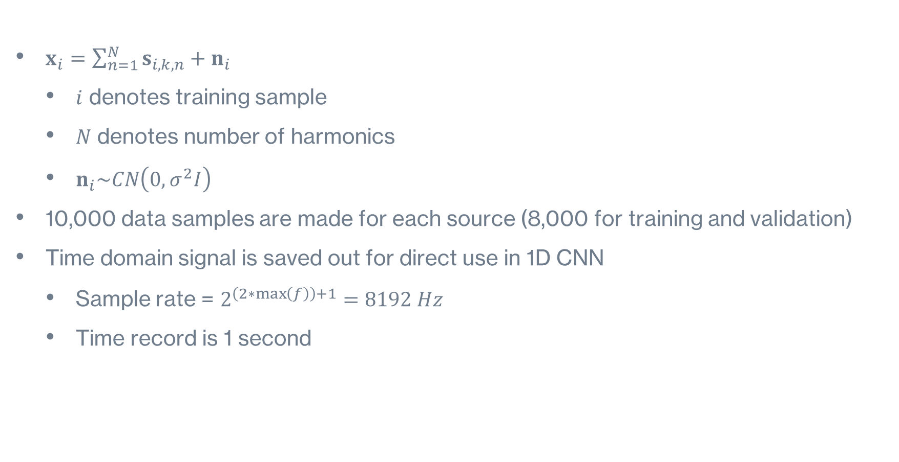
Signal Model (Cont.)
$x_{i}=\sum_{n=1}^{N}{s_{i,k,n}}+n_{i}$
$i$ denotes training sample
$N$ denotes number of harmonics
$n_{i}\sim CN\left(0,σ^{2}I\right)$
10,000 data samples are made for each source (8,000 for training and validation)
Time domain signal is saved out for direct use in 1D CNN
Sample rate = $2^{\left(2∗\max\left(f\right)\right)+1}=8192 Hz$
Time record is 1 second

Slide 9


Signal Model (Cont.)
Fast Fourier transform (FFT) of time domain data is then calculated
No averaging is conducted for FFT
Frequency resolution of 1 Hz
Frequency domain data is used as input to 2D CNN
Frequency domain data is complex
Cannot be converted to a grayscale image for input into the CNN
Solution is to stack the real and imaginary components before conversion to gray scale images
Spectral lines
CNN Input
Spectral lines
$$real(X)$$
$$imag(X)$$

Slide 10
1D Convolutional Neural Network Overview

Slide 11
1D Convolutional Neural Network Overview
Input
1DConv
ReLu
1st Group
Input: Raw time data [1 x samples]
Convolutional Layers:
Filter size: [1 x 8]
Number of filters: 8
Doubles for each successive convolution operation
Pyramidal structure of data size
Normalization Layer
Activation Layers: ReLu
Global Max Pooling Layer
Dropout: 0.5
Optimization Algorithm: Adam
Minibatch size: 48
Number of Epochs: 5
Number of cross validation folds: 5
Normalization
2nd Group
^{3rd} Group
4th Group
MaxPooling
Dropout
Fully Connected

Slide 12
2D Convolutional Neural Network Overview

Slide 13
2D Convolutional Neural Network Overview
Input
2DConv
Input: Stacked frequency domain data [2 x spectral lines]
Convolutional Layers:
Filter size: [8 x 8]
Number of filters: 8
Doubles for each successive convolution operation
Pyramidal structure of data size
Batch Normalization Layers
Activation Layers: ReLu
Pooling Layers: Window [1 x 2], Stride [1 x 2]
Dropout: 0.5
Optimization Algorithm: Adam
Minibatch size: 48
Number of Epochs: 5
Number of cross validation folds: 5
Batch Normalization
1st Group
ReLu
MaxPooling
2nd Group
3rd Group
Dropout
Fully Connected

Slide 14
Results

Slide 15
1D CNN Results
2D CNN Results
Cross Validation (5 folds)
Accuracy: 95.15%
Standard deviation: 0.22%
Significant decrease in accuracy below 2 dB peak SNR
Cross Validation (5 folds)
Accuracy: 97.51%
Standard deviation: 0.24%
Consistent accuracy across all peak SNR

Slide 16
Both networks have acceptable results, however 2D CNN has lower error rates overall
2D CNN has significantly higher accuracy for classes 3 through 8
Class 1 having the lowest accuracy is expected as all other sources are functions of source 1
Error is only correlated with overlapped source and not near sources for 2D CNN results
1D CNN Results
2D CNN Results
Notes:
(compare class 3 and 4) and 6

Slide 17
Conclusions & Next Steps
Conclusions:
Successfully developed two CNNs for classification of signals with common variable dependent tones occurring at random harmonics
Determined that the 2D CNN performed best
Theory: The 1D CNN did not learn a more optimal method compared to the FFT to classify tones
The 2D CNN also performed significantly better at low SNR
Accuracy is correlated with pure tonal overlap
Future work:
Transfer learning to other datasets
Confirm the assumptions that went into the synthetic data
For example, probability of harmonics is not uniform and varies significantly by mechanism
Is equal probability assumption valid for training?
Use on imbalanced datasets
Not all sources occur with equal probability

Slide 18

Questions?

