Slide 1
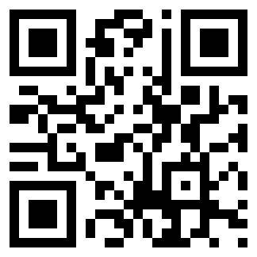
Introducing kohana 3 mvc With Facebook Integration
http://joind.in/2484
1/11/11
Chris Benard
Dallas PHP User Group

Slide 2
IRC
Windows Clients
mIRC
Pidgin
XChat
Mac Clients
Colloquy
Xchat
Linux Clients
Xchat
Web
http://webchat.freenode.net

Slide 4



Who I Am: Chris Benard
Software Developer
Microsoft .Net – 5 years
PHP – 5 years ago
Contact Me
twitter.com/cbenard
linkedin.com/in/chrisbenard
chrisbenard.net

Slide 5
MVC
Stands for Model-View-Controller
Allows clean, standardized URLs
Decouples presentation, business, and application logic
Allows multiple representations of the same backend data easily

Slide 6
MVC - Model
Model
Real-world representation of an object (e.g. User)
Often the Active Record pattern
Contains business logic
User
->id
->name
->email
->save()

Slide 7
MVC - View
PHP Page Template
Standard XHTML with optional PHP
Controller populates with data for display
Only concerned with presentation logic

Slide 8
MVC - Controller
Contains the presentation logic of the application
Gets data in the model and assigns data to the view
Handles user input and modifies model data
Selects a view to render and associates data with it
Can render other actions such as redirects and file downloads

Slide 9
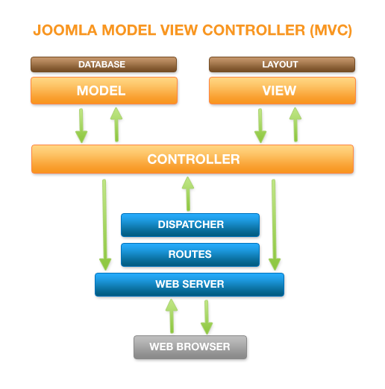
MVC Diagram
http://commons.wikimedia.org/wiki/File:Joomla_mvc-diagram.png

Slide 10
Kohana v3
Rewritten from the ground up to replace v2
Some similarities to v2, but requires PHP 5
Strict OOP
HMVC
Built in templating, ORM, database, form helpers, authentication, many other features
2MB footprint
Easy to set up

Slide 11
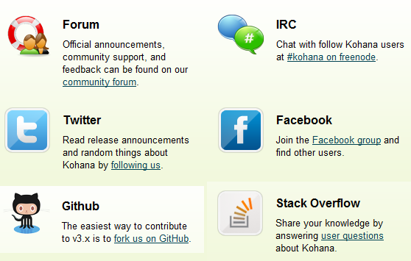
Kohana v3 Support
http://kohanaframework.org/community

Slide 12
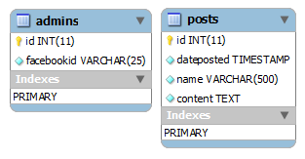
The Database

Slide 13

Teh Codez
http://www.lolgato.com/funny/code-reviews/

Slide 14
Questions and Discussion
Contact Me
twitter.com/cbenard
linkedin.com/in/chrisbenard
ChrisBenard.net
This Talk
http://joind.in/2484

