Slide 1
Water Supply Management System Developed in PHP & MySQL

Slide 2
Introduction
The Water Supply Management System (WSMS) is a web based application that can be accessed over the web. This system can be used to automate the workflow of water supply and their invoices.
The project has been planned to be having the view of distributed architecture, with centralized storage of the database. The application for the storage of the data has been planned. Using the constructs of MySQL Server and all the user interfaces has been designed using the PHP technologies. The database connectivity is planned using the “MySQL Connection” methodology. The standards of security and data protective mechanism have been given a big choice for proper usage. The application takes care of different modules and their associated reports, which are produced as per the applicable strategies and standards that are put forwarded by the administrative staff.

Slide 3
Purpose of the Project
This project is aimed at developing a web based Water Supply management System Tool, which is of importance to either an small water supplier. This is an web based application that can be accessed over the web . This system can be used to automate the workflow of water supply and their invoices. There are features like water bottle booking, tracking,invoice, report generators etc. in this Tool.

Slide 4
Project Modules
In WSMS we use PHP and Mysql database. In this project any person can order drinking water bottle online. It has two modules admin and user.
Admin
User

Slide 5
Admin Module
Dashboard: In this section admin can see all detail in brief like total order, total new order, total accept order, total order deliver, total cancel order, total company and total register user.
Water Bottle info: In this section admin can manage water bottle(Add/Update/delete).
Company Info: In this section admin can manage company(Add/Update/delete).
Pages: In this section admin can update about us and contact us information.
Orders Management: In this section admin can view the order details and they have also right to change order status according to current status.
Latest News/Updates: In this section admin can manage news(Add/Update/Delete).
Reg Users: In this section admin can view register users.
Search: In this section admin can search particular order with the help of order number.
Reports: In this section admin can view order details, order counts and sales report according to dates.
Admin can also update his profile, change password and recover password.

Slide 6
User Module
Water Bottle: In this section user can view which drinking bottle available.
My Accounts: In this section user can change his/her own password , view and update his/her profile and logout from accounts.
My orders: In this section user can view order history after login.
Cart: In this section user can add their drinking bottle which he/her want to order. User has also a facility to download his/her invoice and cancel order if he/her want to cancel.
Brief Information about homepage On this page guest user can only view about us page, contact us page and which drinking bottle is available if anybody want to order the bottle they must registered.

Slide 7
Requirement Specification
Hardware Configuration:
Client Side
Server Side
RAM | 512 MB
Hard Disk | 10GB
Processor | 1.0 GHz
RAM | 1 GB
Hard Disk | 20GB
Processor | 2.0GHz

Slide 8
Continue.....
Software Requirement:
Client Side
Server Side
Web Browser | Google Chrome or any compatible browser
Operating System | Windows or any equivalent OS
Web Server | APACHE
Server side Language | PHP5.6 or above version
Database Server | MySQL
Web Browser | Google Chrome or any compatible browser
Operating System | Windows or any equivalent OS

Slide 9
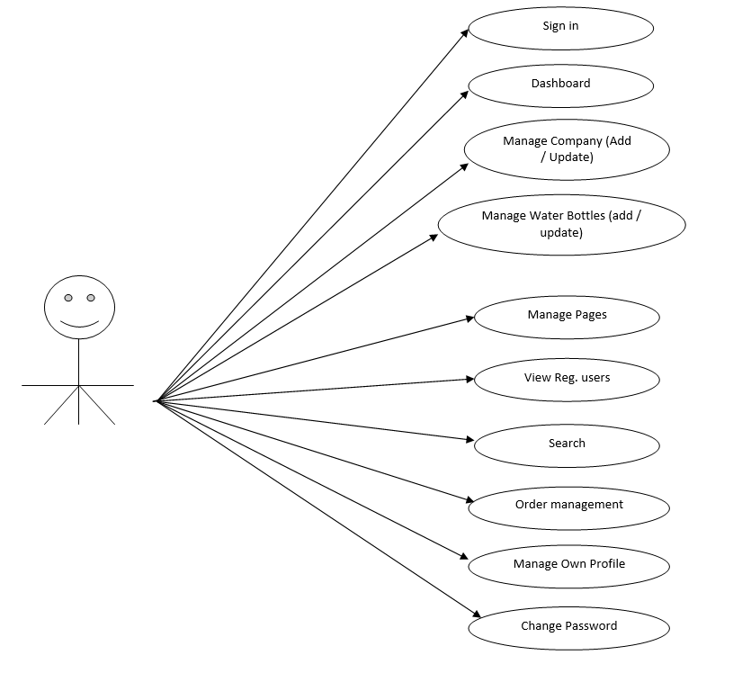
Use Case Diagram
Admin use case Diagram
Notes:
USECASE DIAGRAM: A Use case is a description of set of sequence of actions. Graphically it is rendered as an ellipse with solid line including only its name. Use case diagram is a behavioral diagram that shows a set of use cases and actors and their relationship. It is an association between the use cases and actors. An actor represents a real-world object. Primary Actor – Sender, Secondary Actor Receiver.

Slide 10
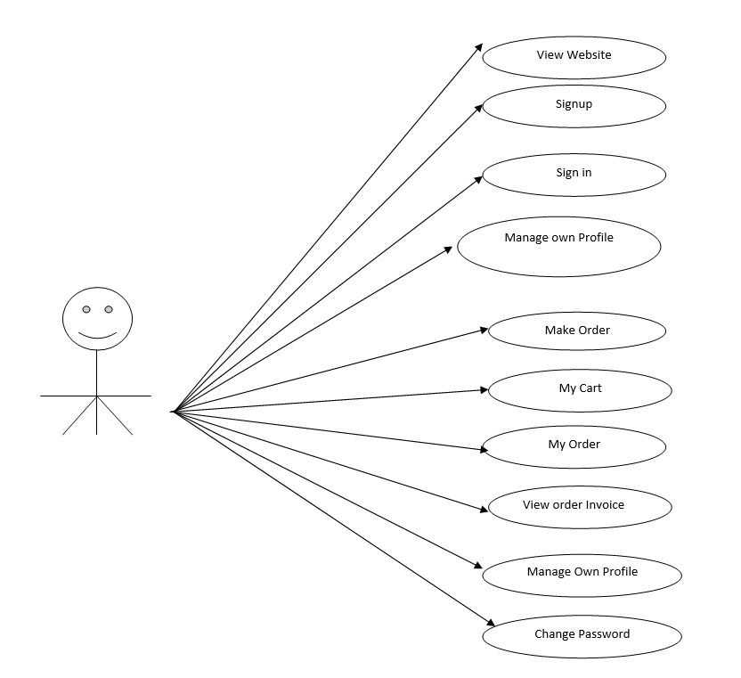
User use case Diagram

Slide 11
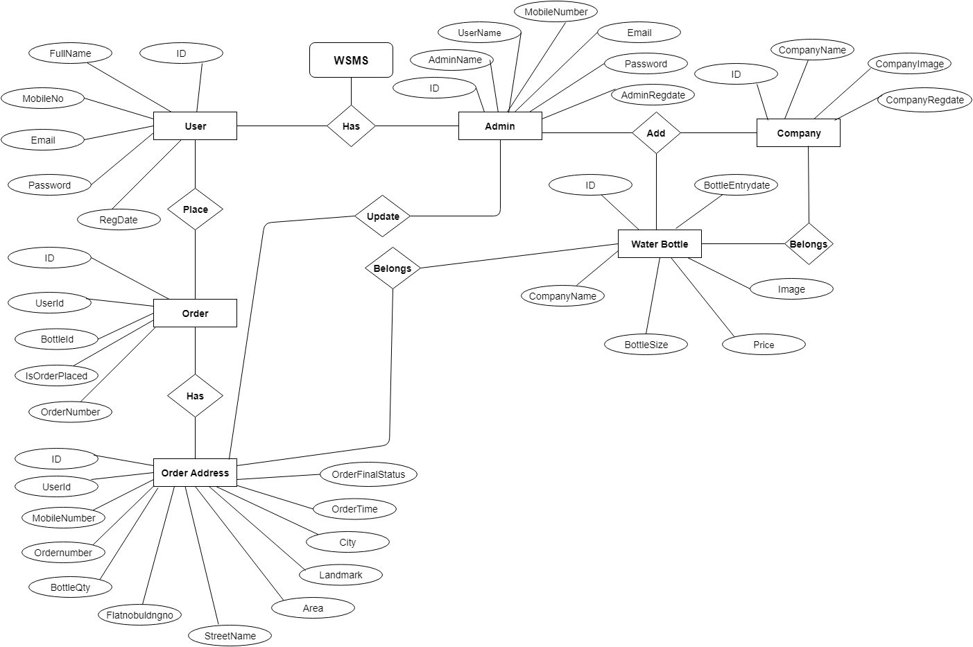
ER Diagram

Slide 12
Dataflow Diagrams (DFDs)
A Data Flow Diagram (DFD) is a traditional visual representation of the information flows within a system. A neat and clear DFD can depict the right amount of the system requirement graphically. It can be manual, automated, or a combination of both.
It shows how data enters and leaves the system, what changes the information, and where data is stored.
The objective of a DFD is to show the scope and boundaries of a system as a whole. It may be used as a communication tool between a system analyst and any person who plays a part in the order that acts as a starting point for redesigning a system. The DFD is also called as a data flow graph or bubble chart.

Slide 13
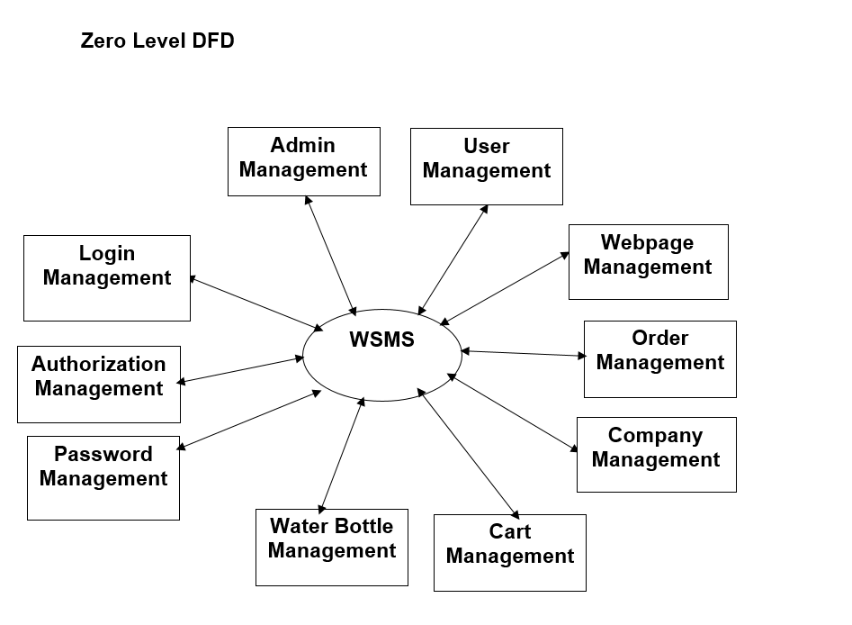

Slide 14
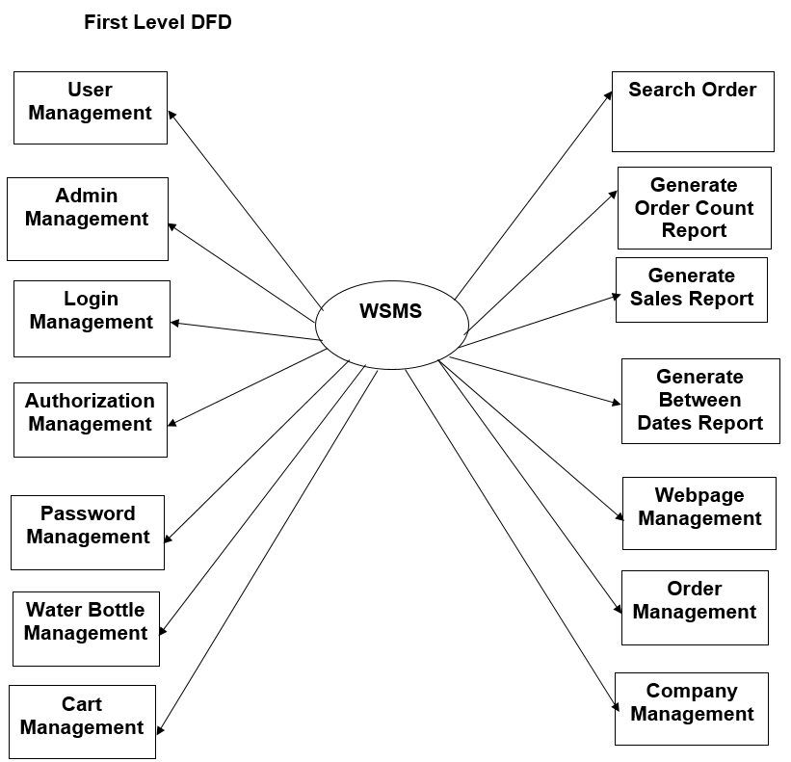

Slide 15
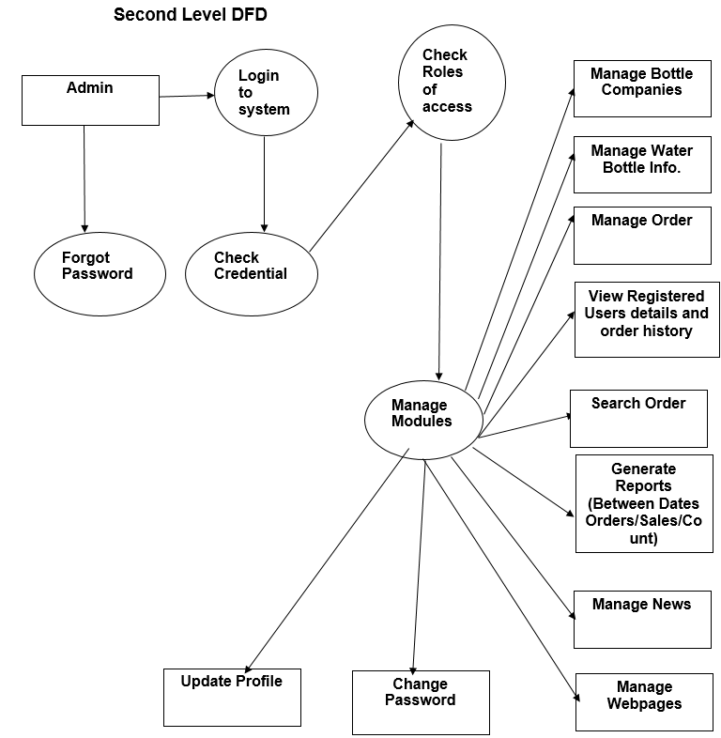

Slide 16
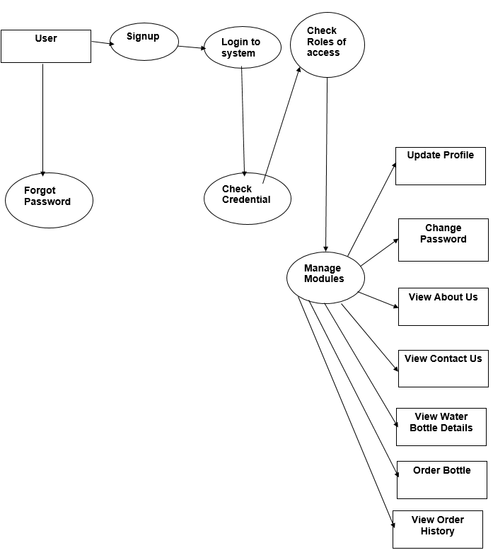

Slide 17
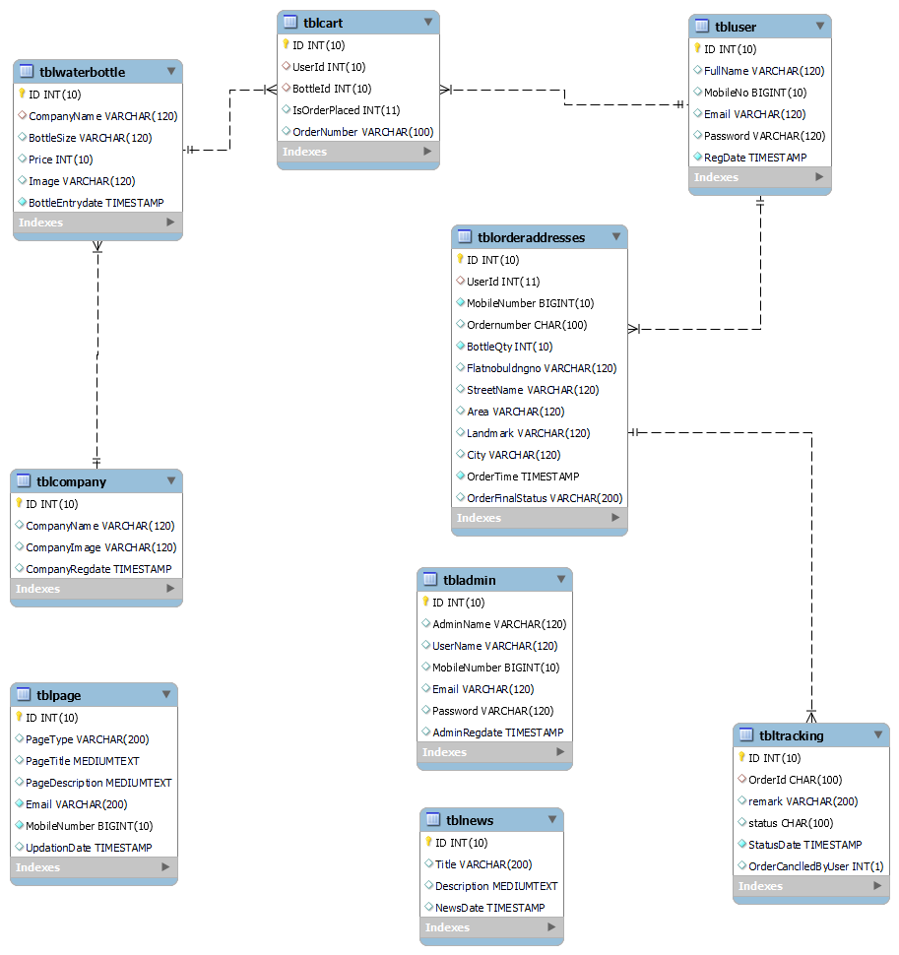
Class Diagram
Notes:
The class diagram shows a set of classes, interfaces, collaborations and their relationships.

Slide 18
Implementation and System Testing
After all phase have been perfectly done, the system will be implemented to the server and the system can be used.
System Testing
The goal of the system testing process was to determine all faults in our project .The program was subjected to a set of test inputs and many explanations were made and based on these explanations it will be decided whether the program behaves as expected or not. Our Project went through two levels of testing
Unit testing
Integration testing

Slide 19
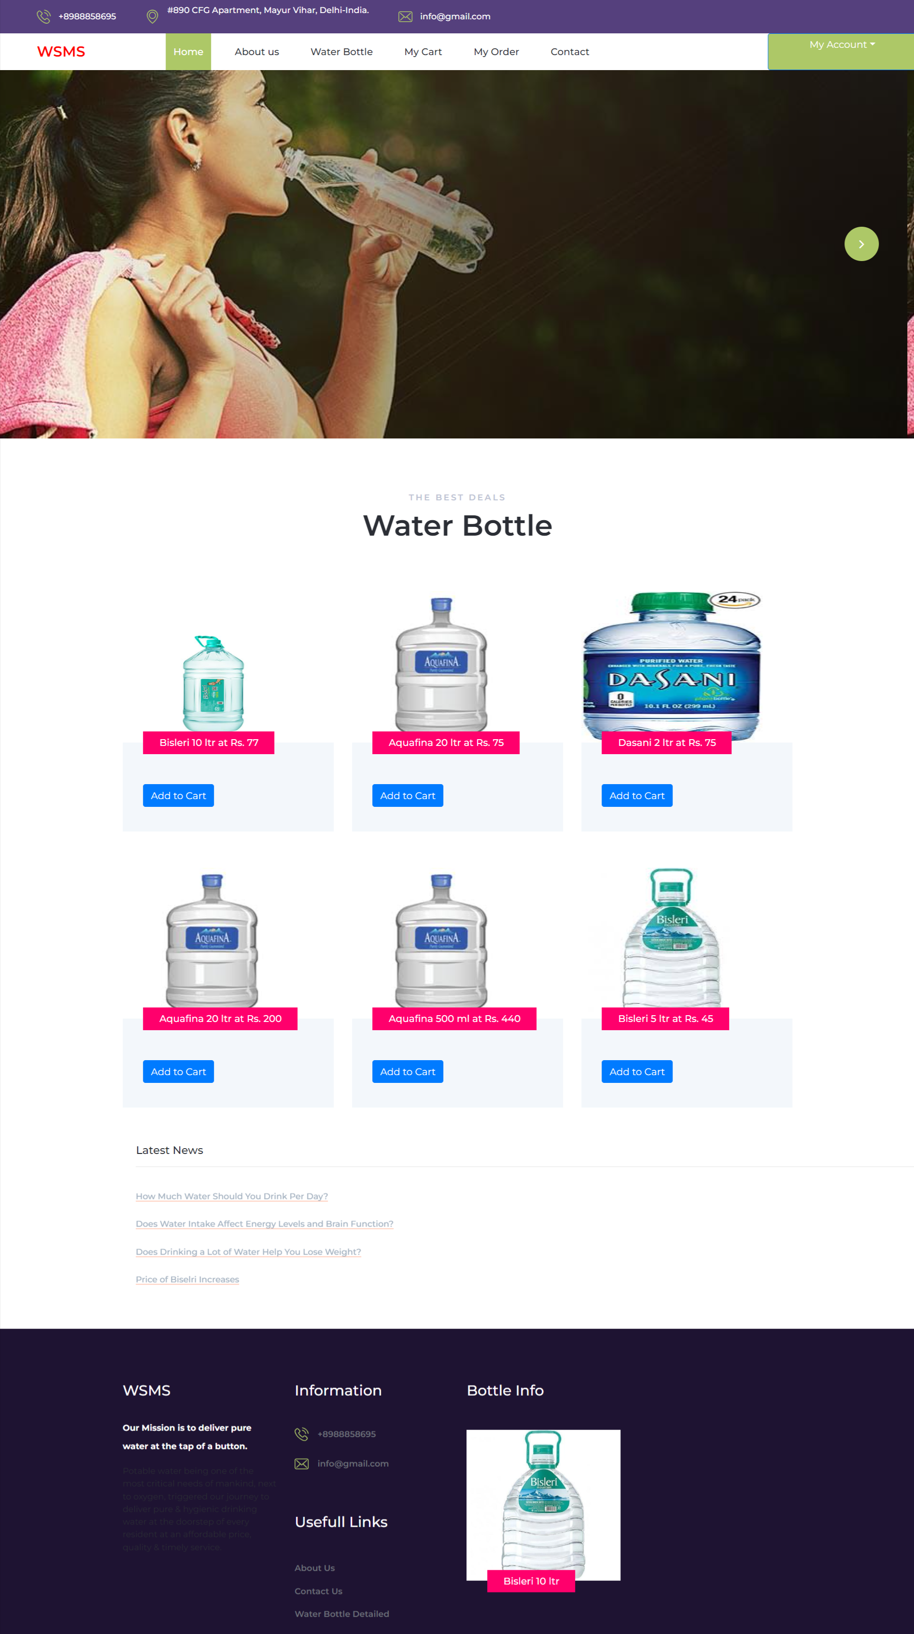
Project Screens

Slide 20
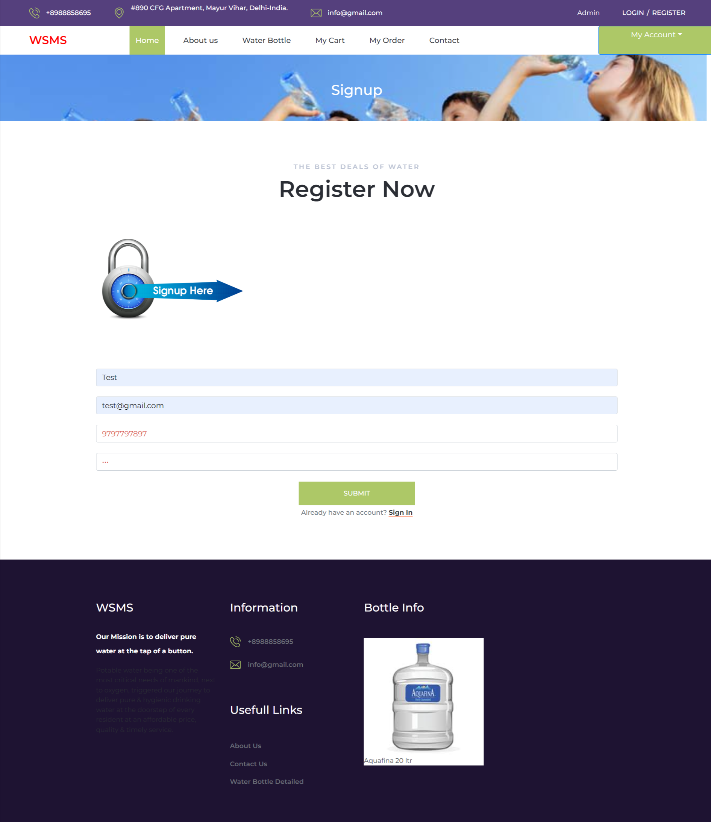

Slide 21
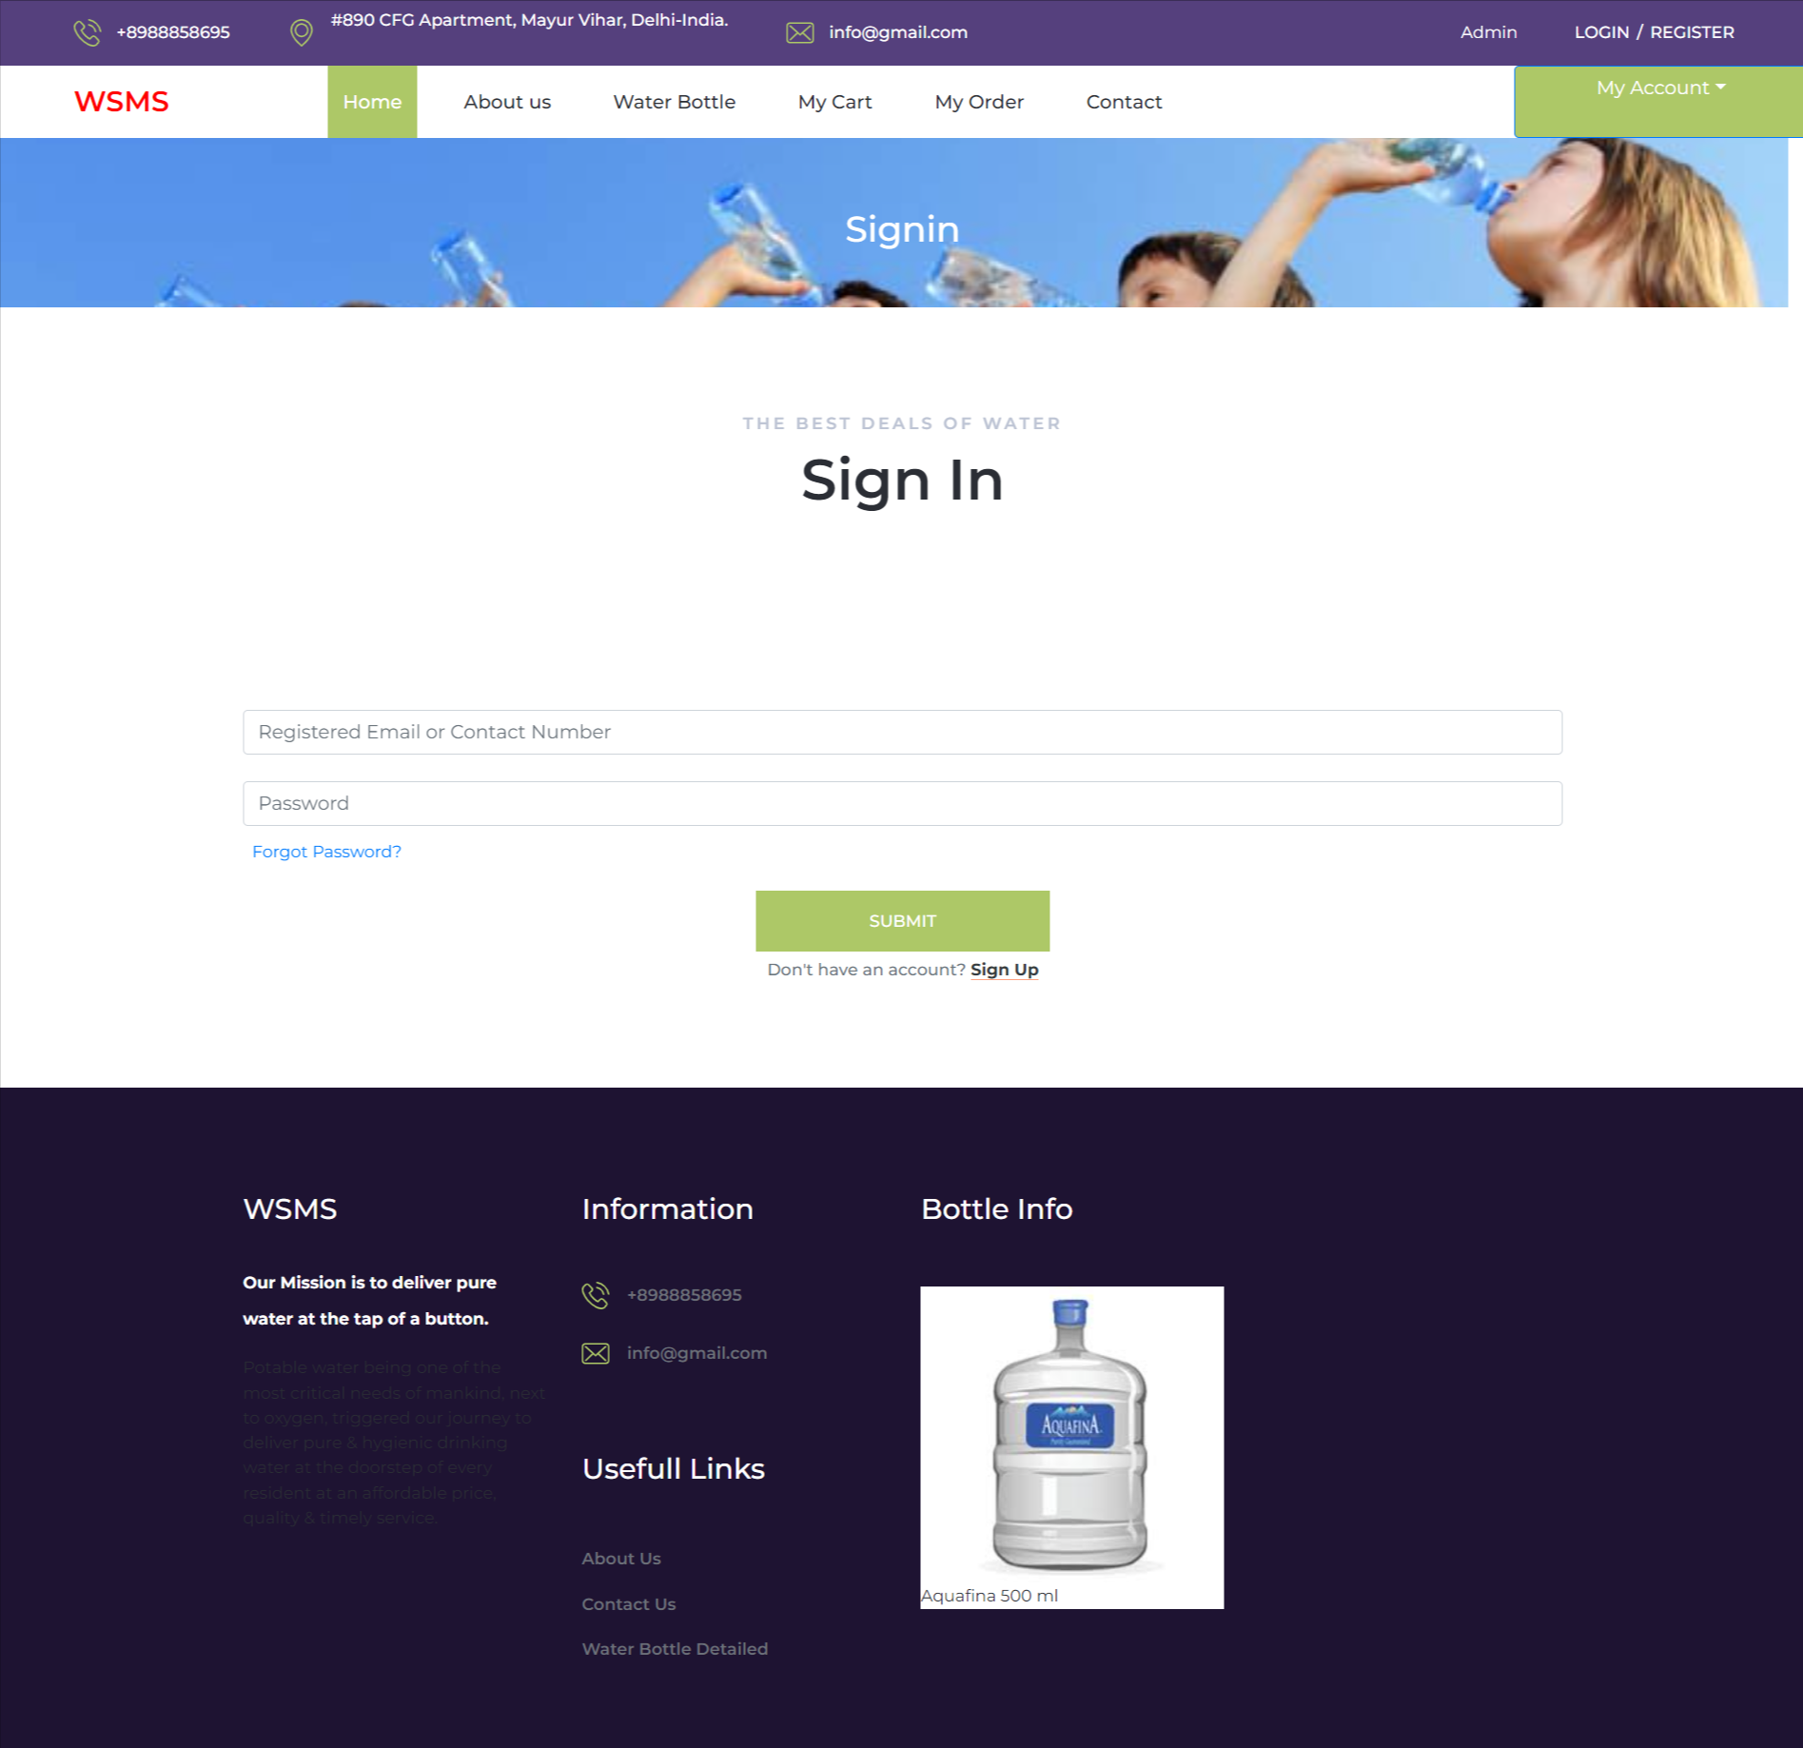

Slide 22
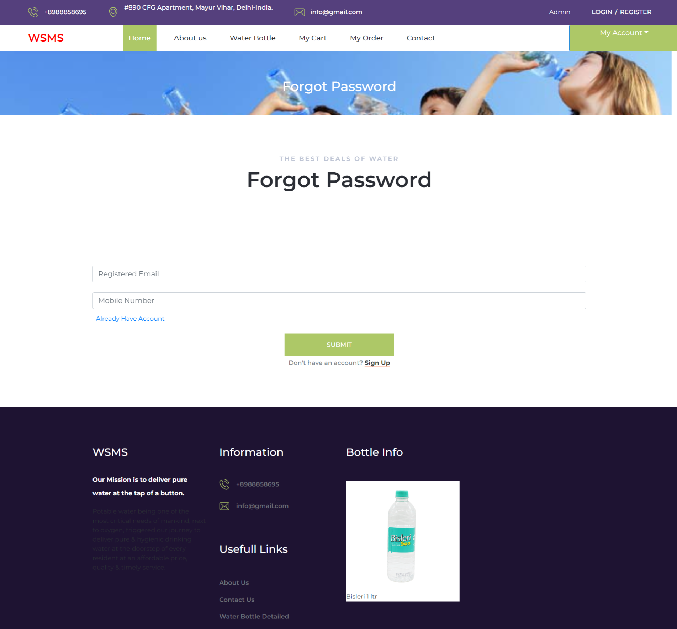
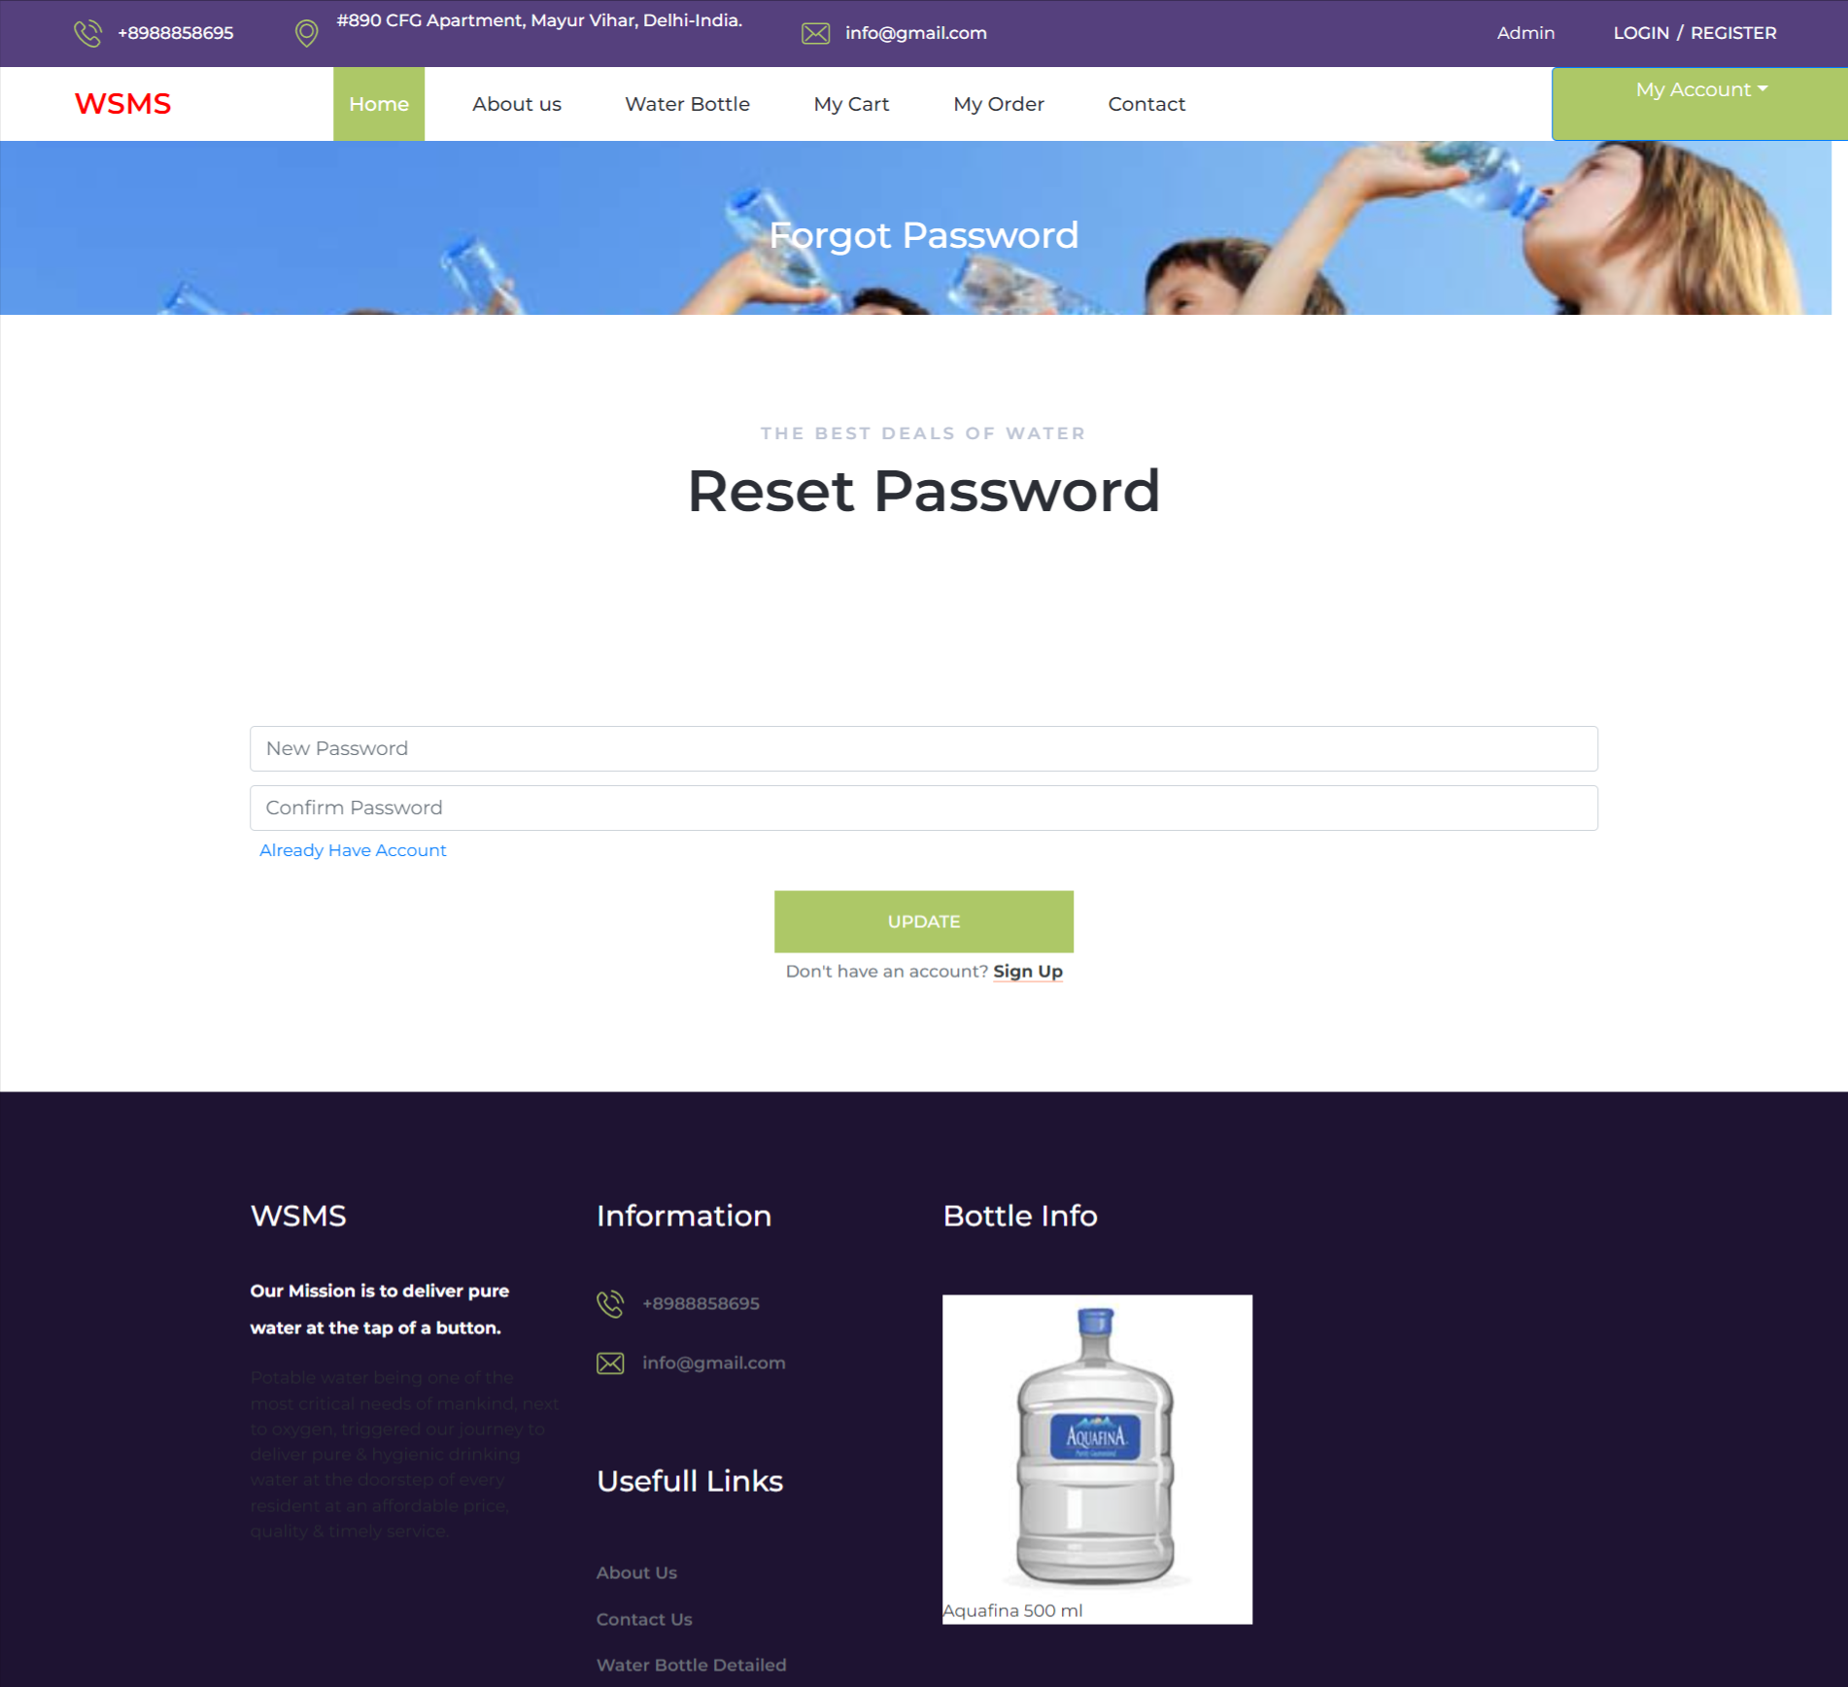

Slide 23
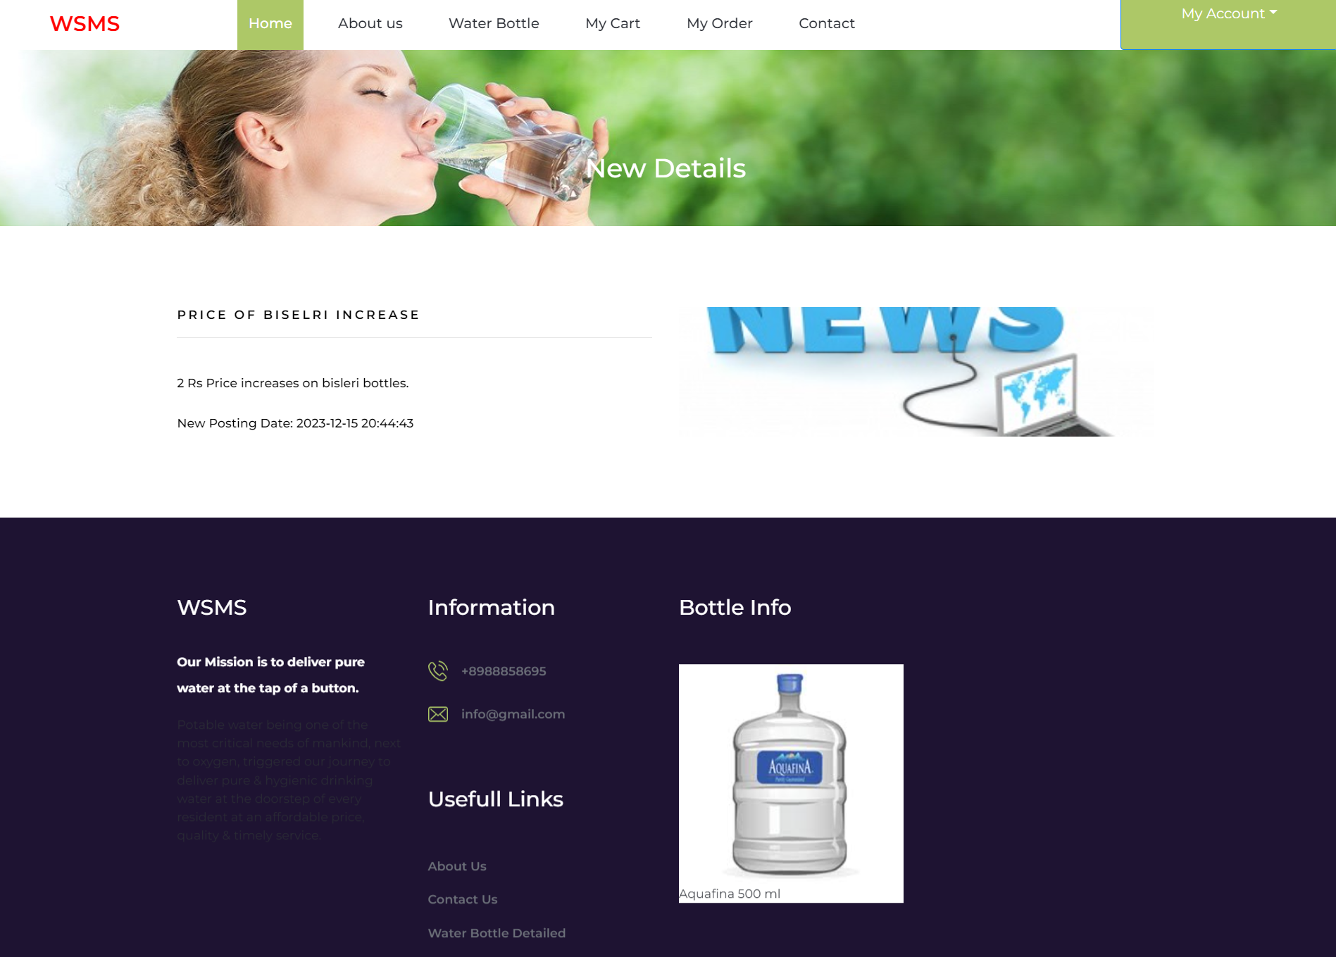
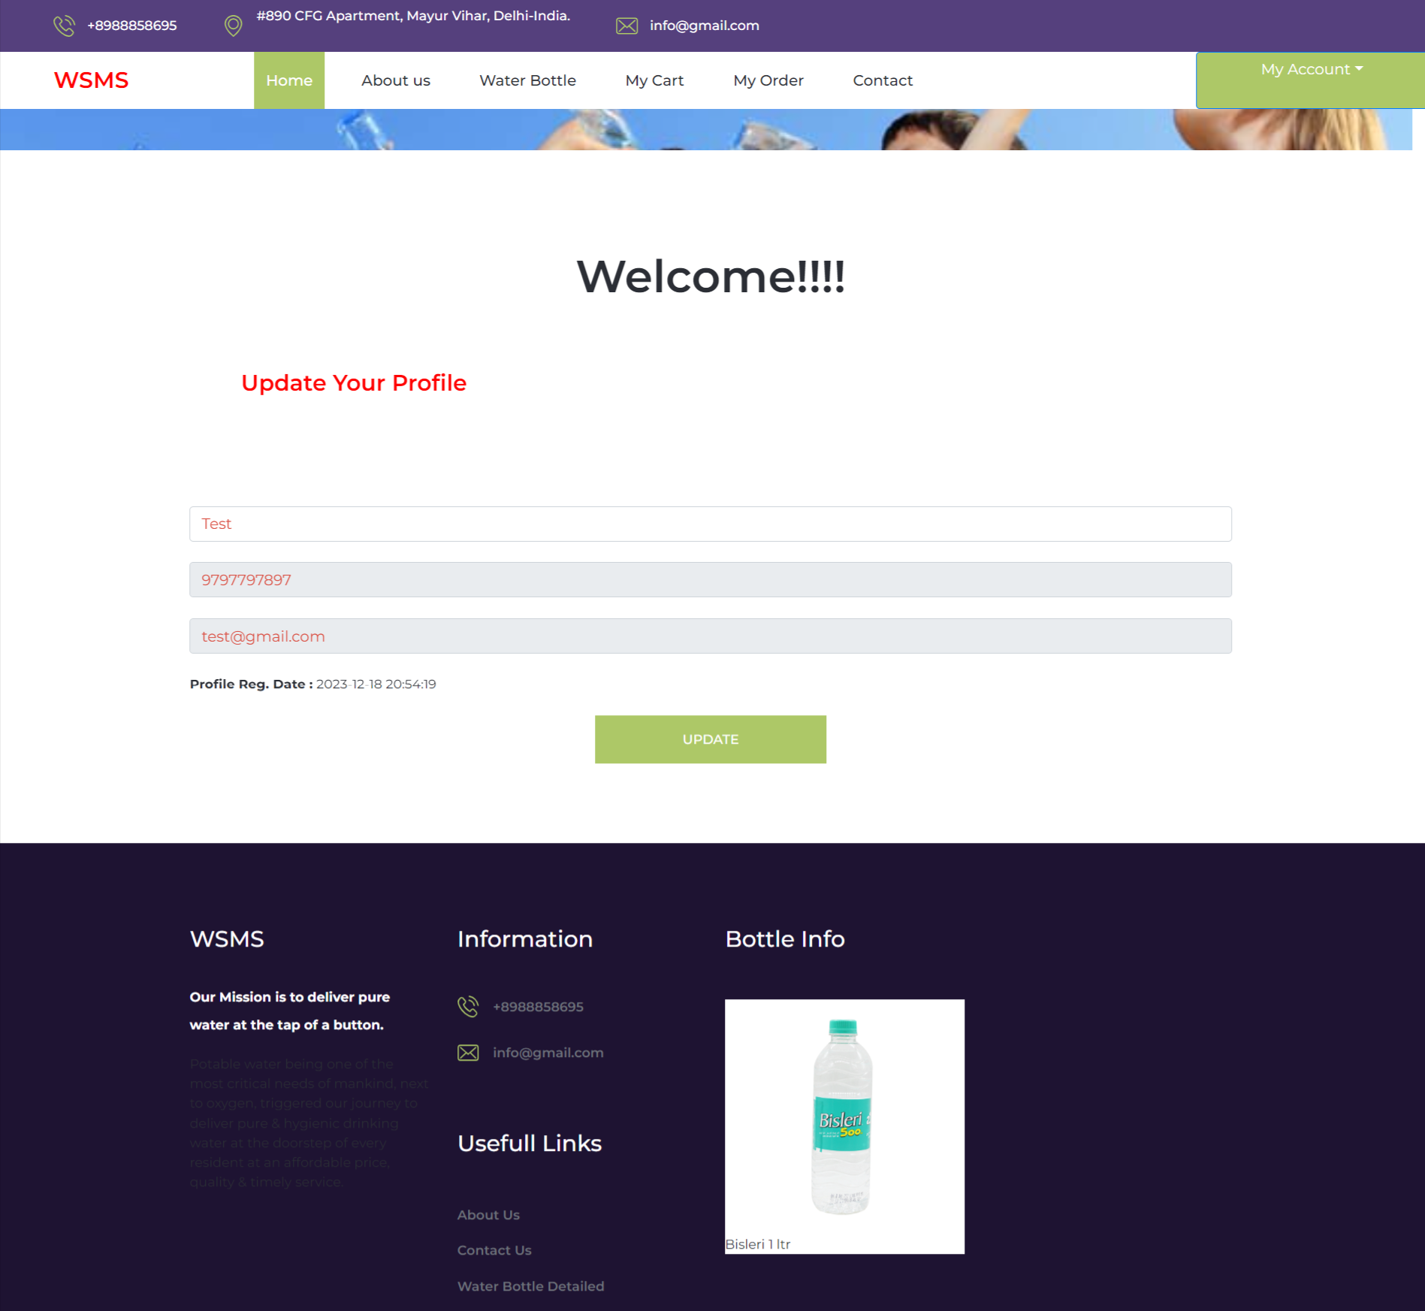

Slide 24
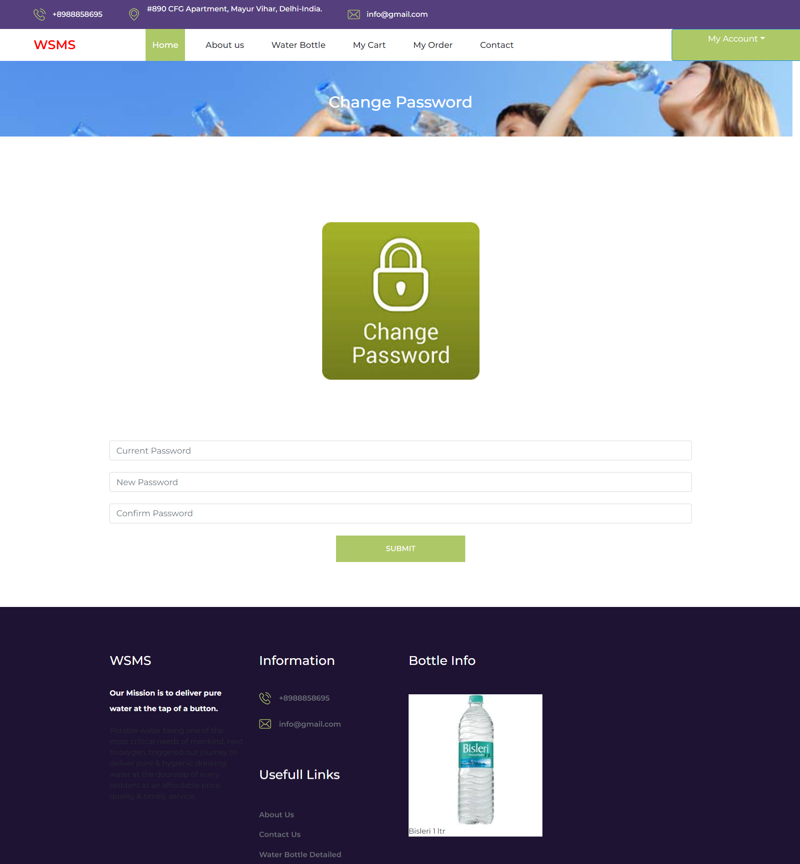

Slide 25
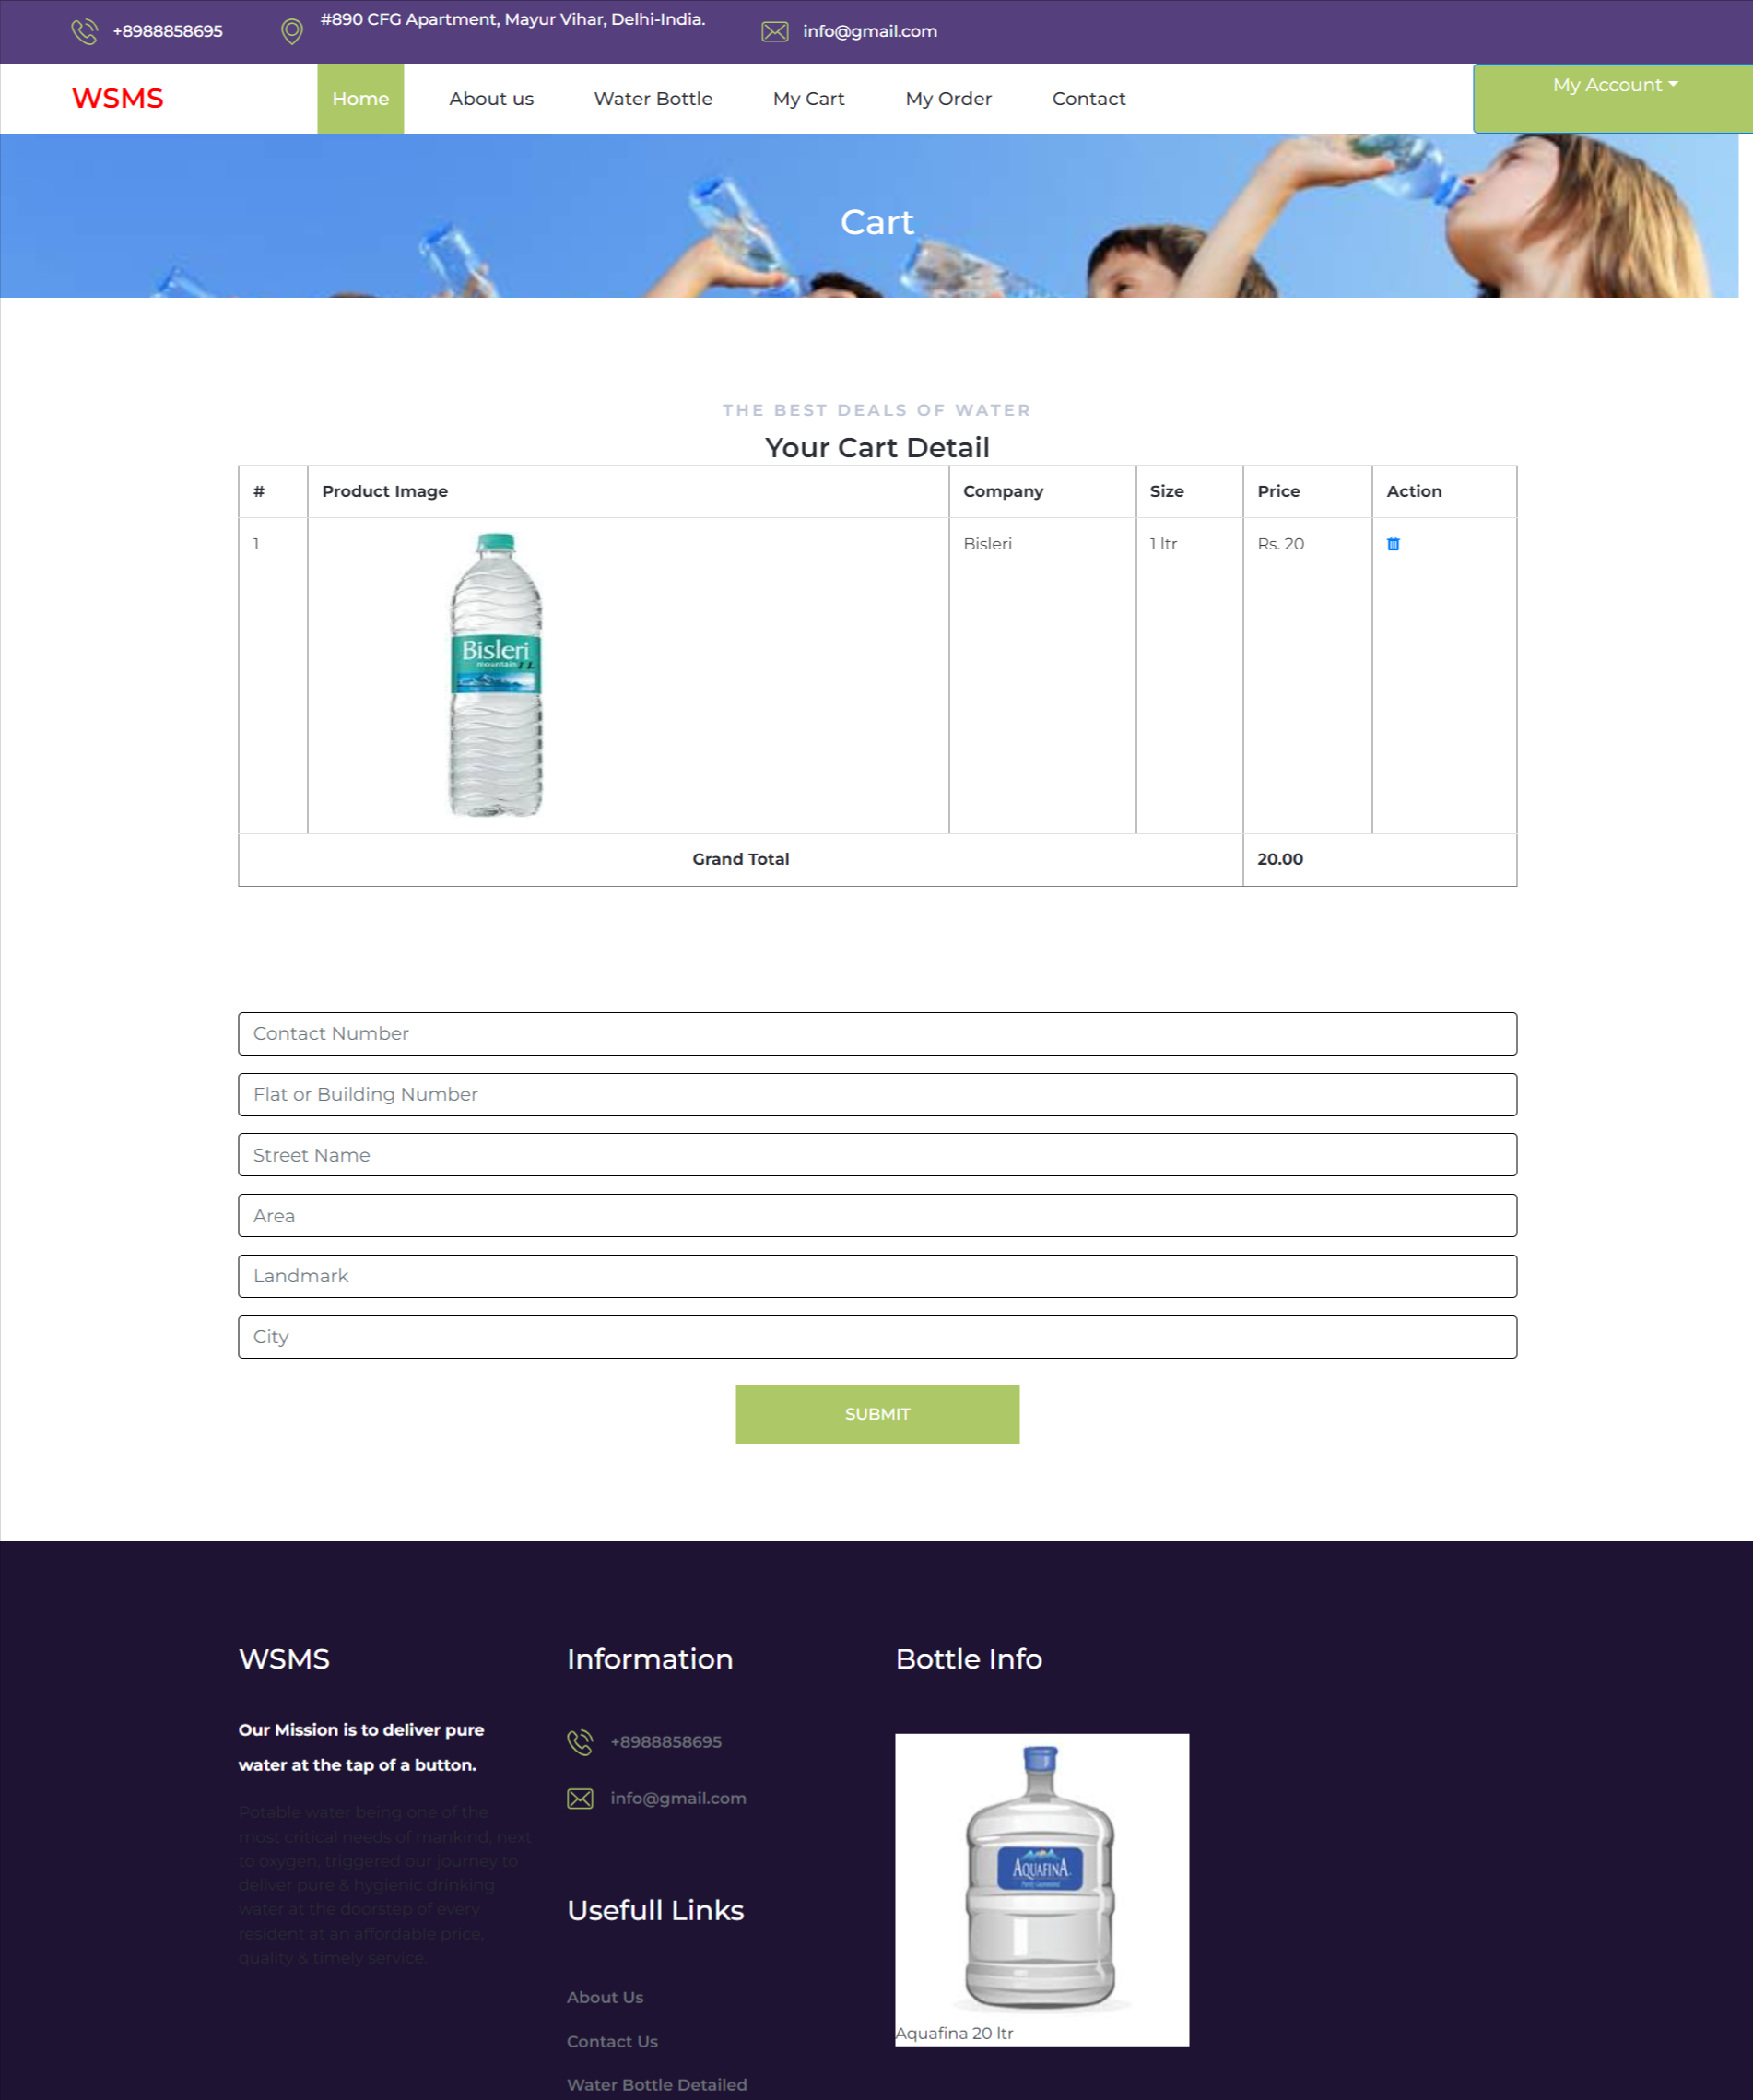

Slide 26
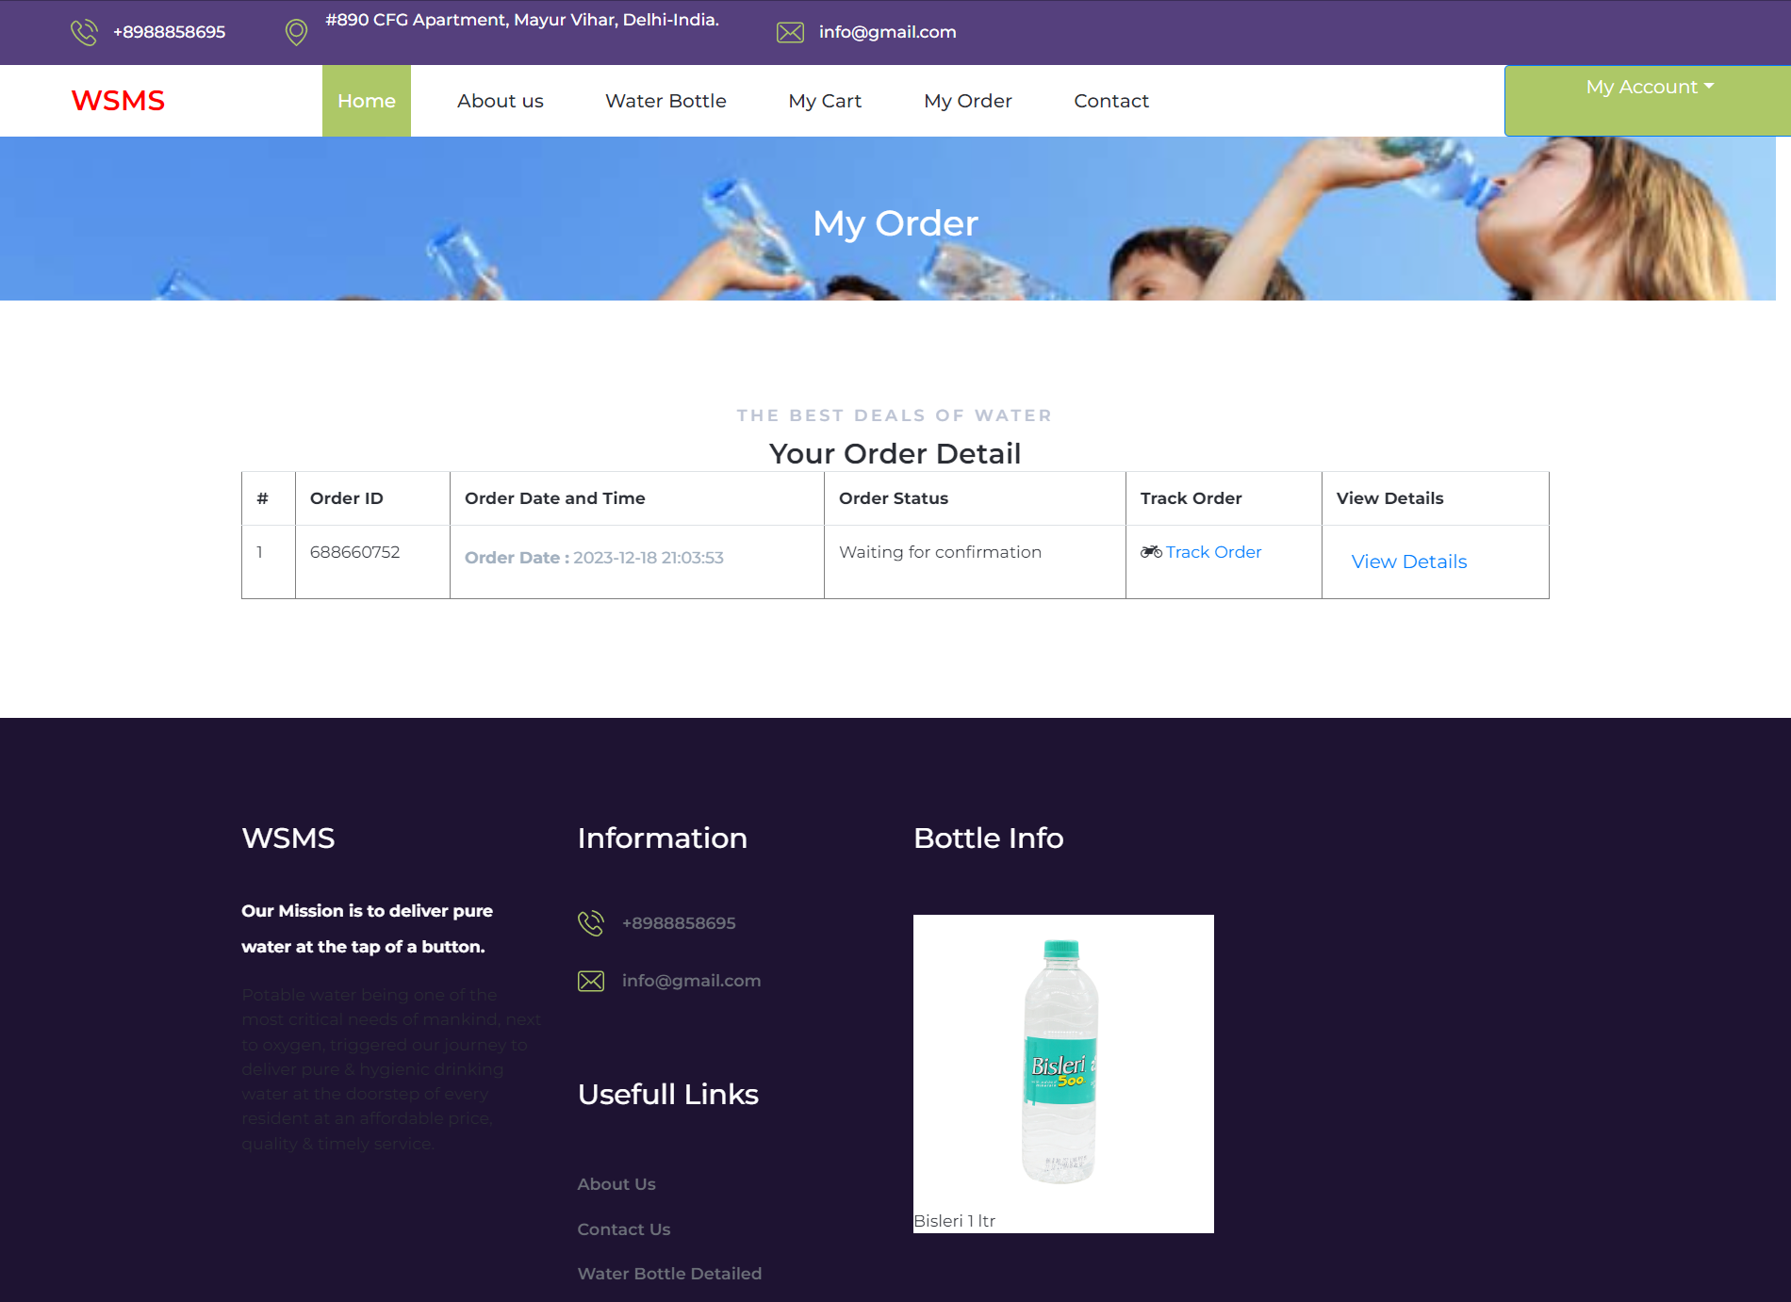

Slide 27
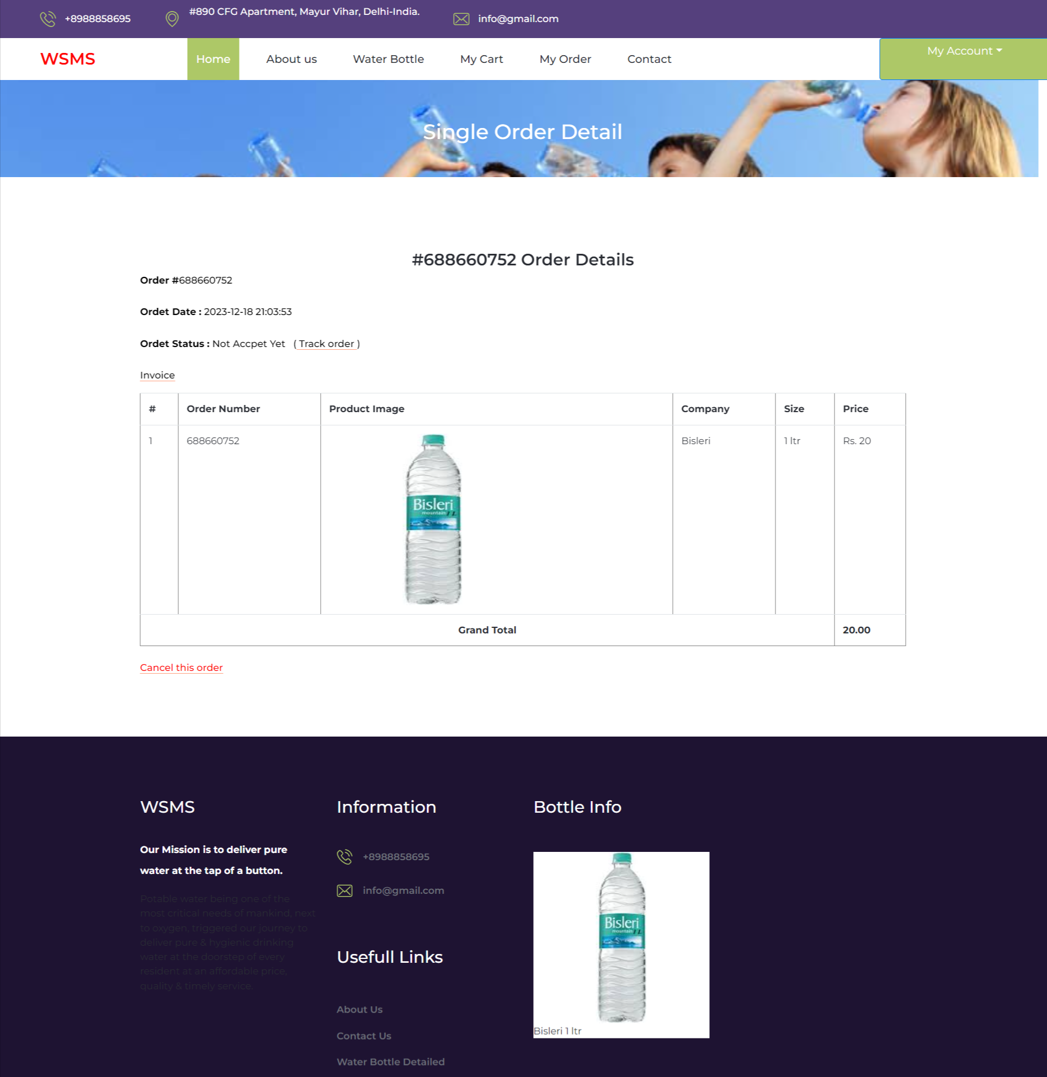
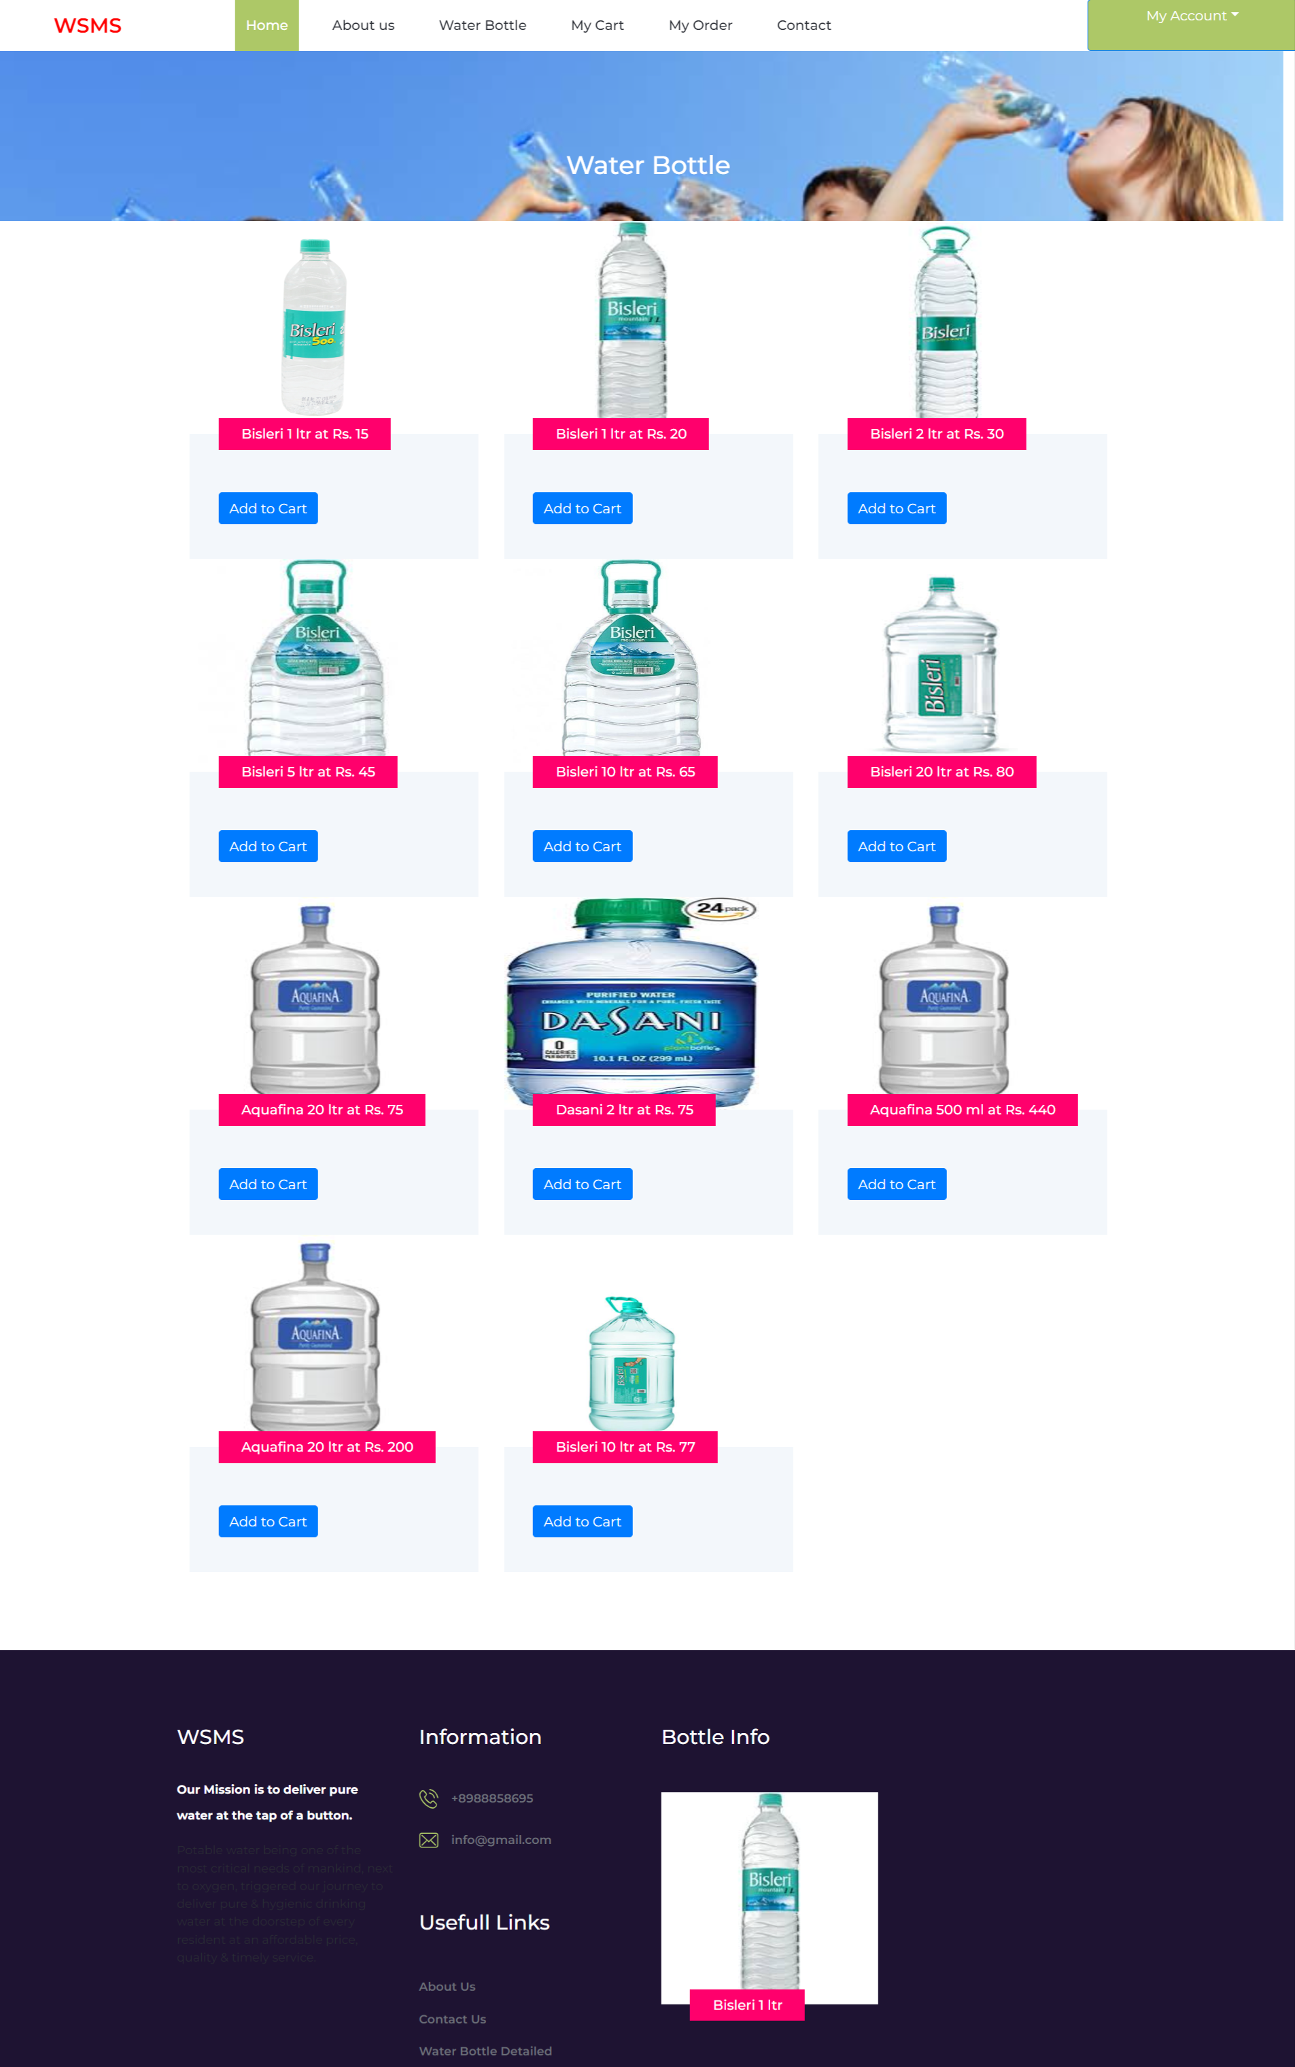

Slide 28
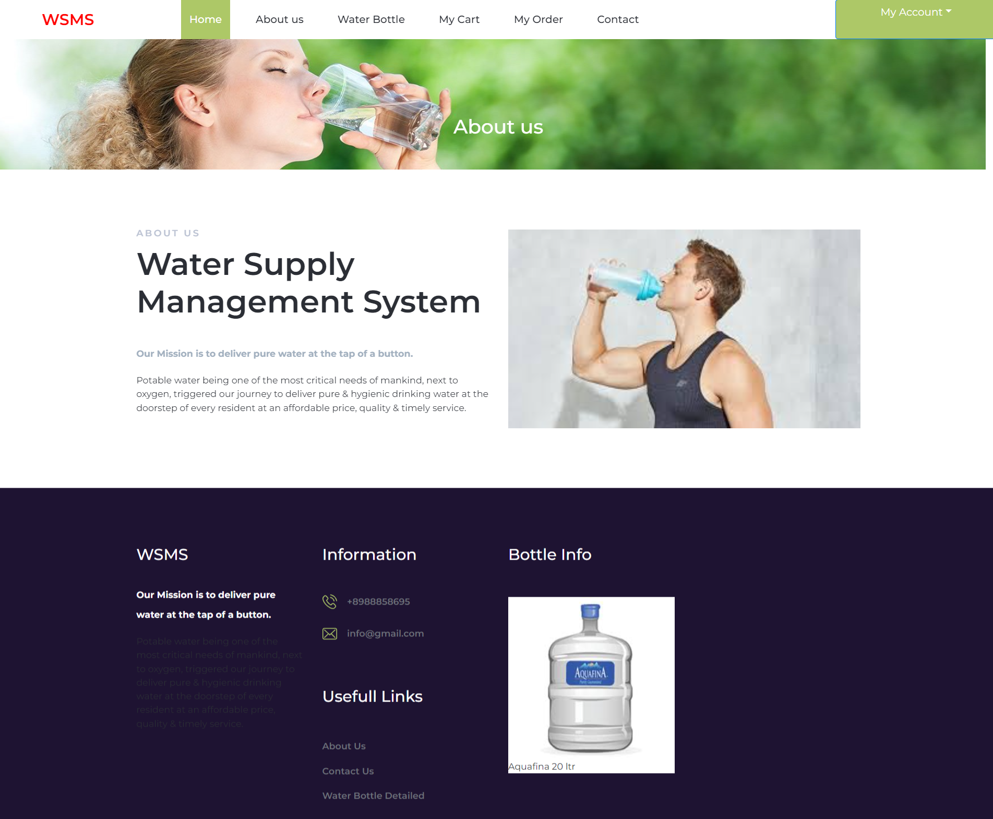
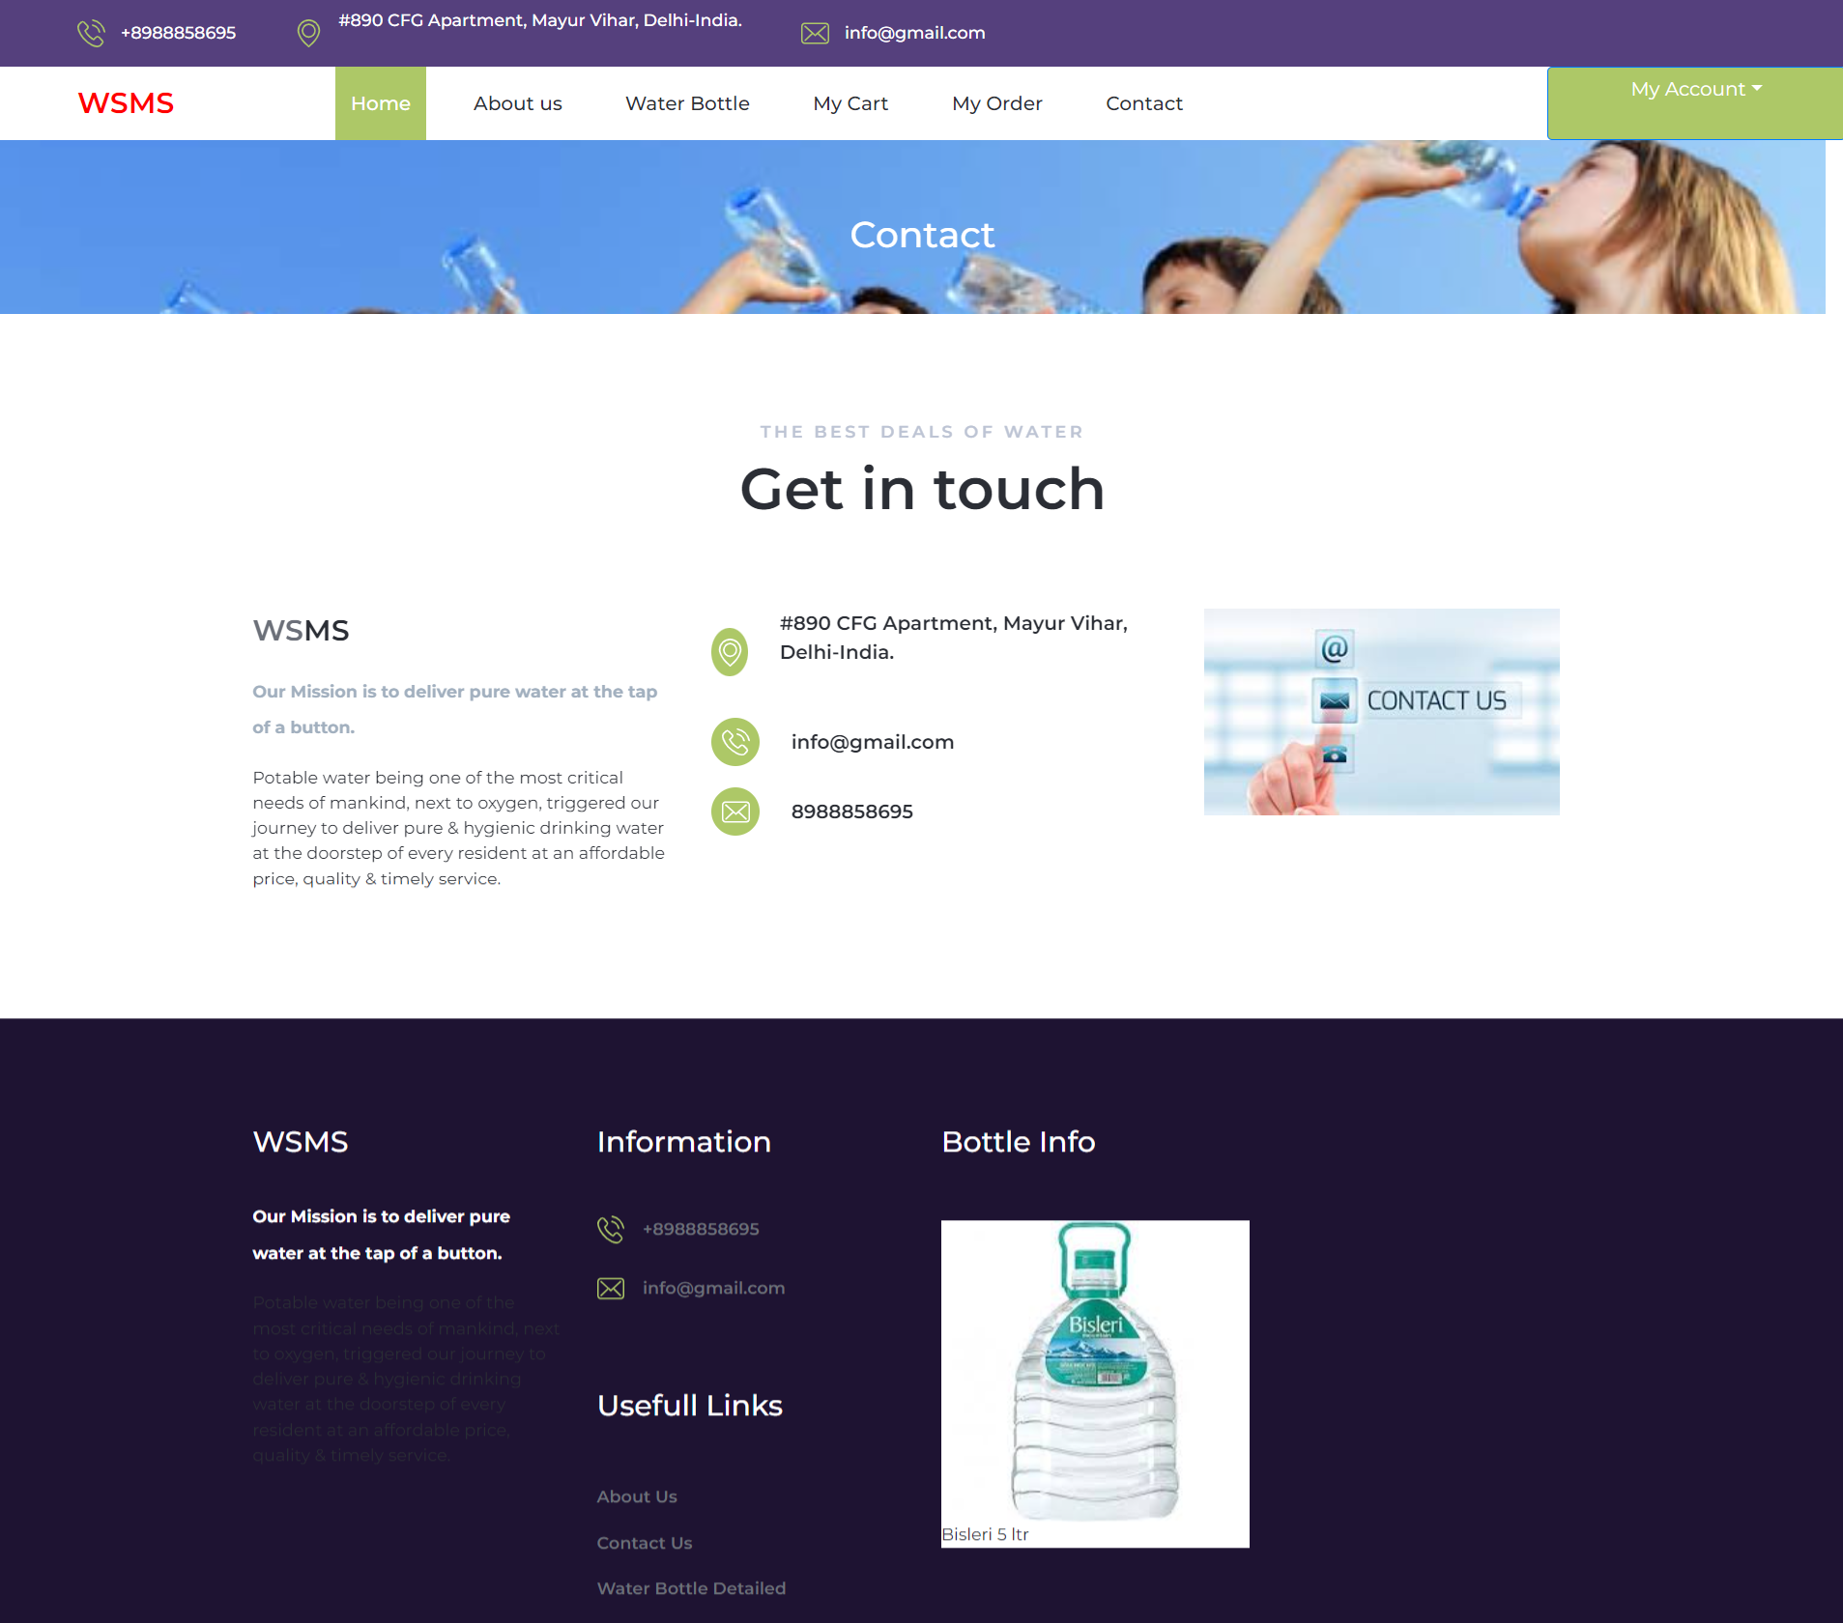

Slide 29
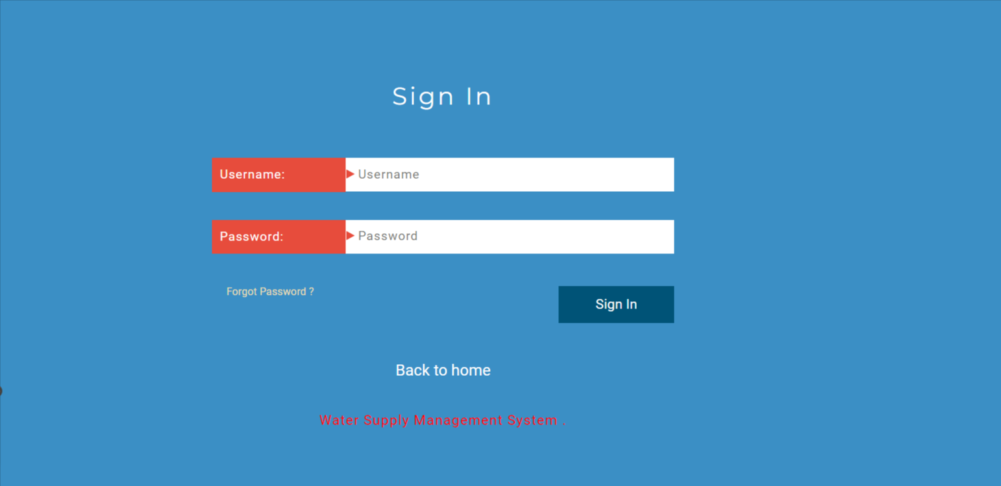
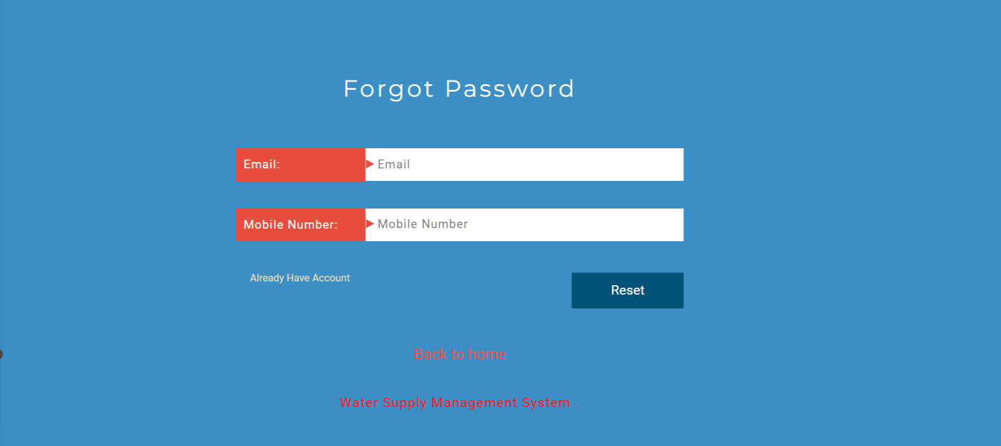

Slide 30
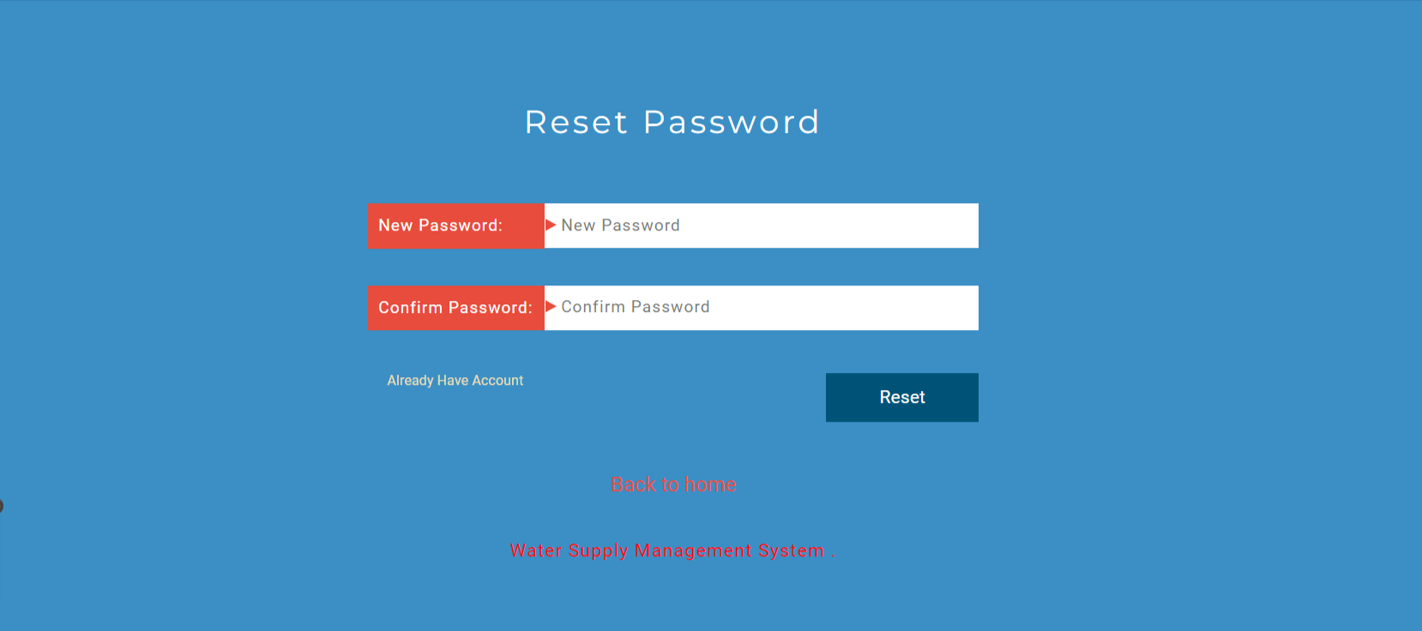
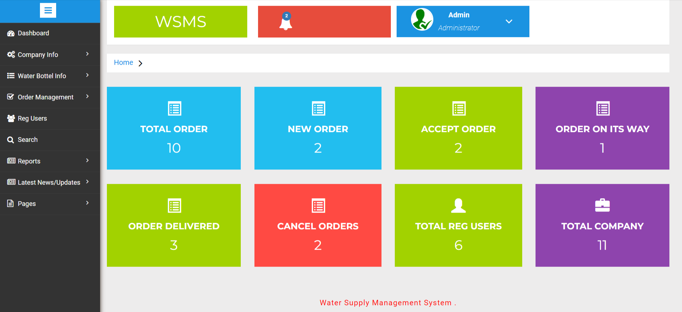

Slide 31
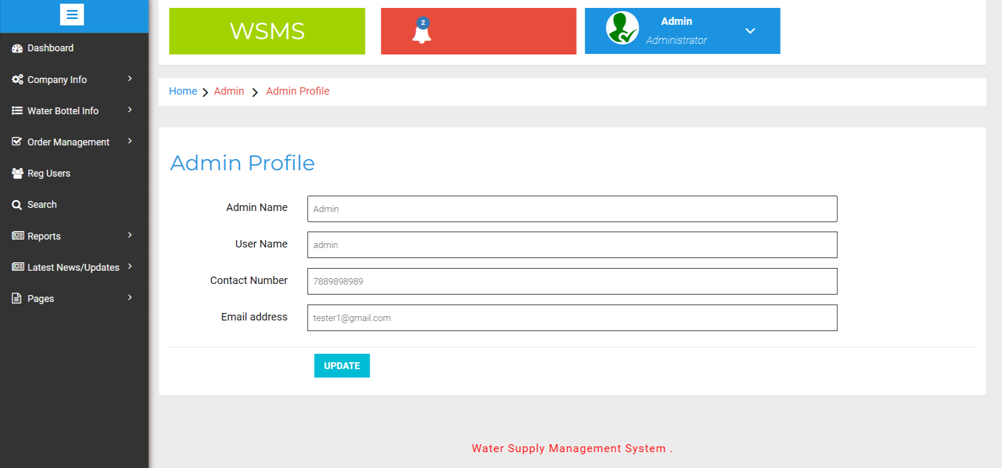
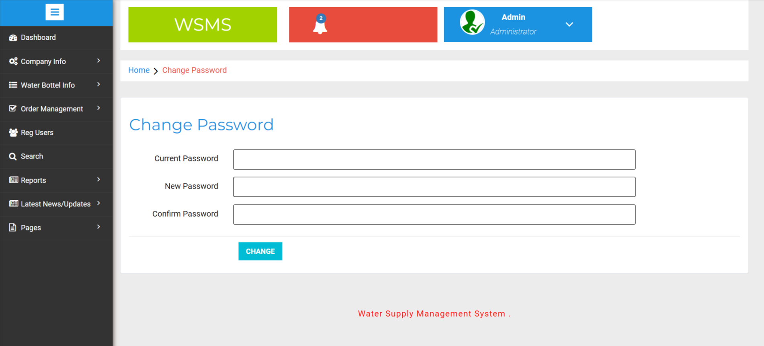

Slide 32
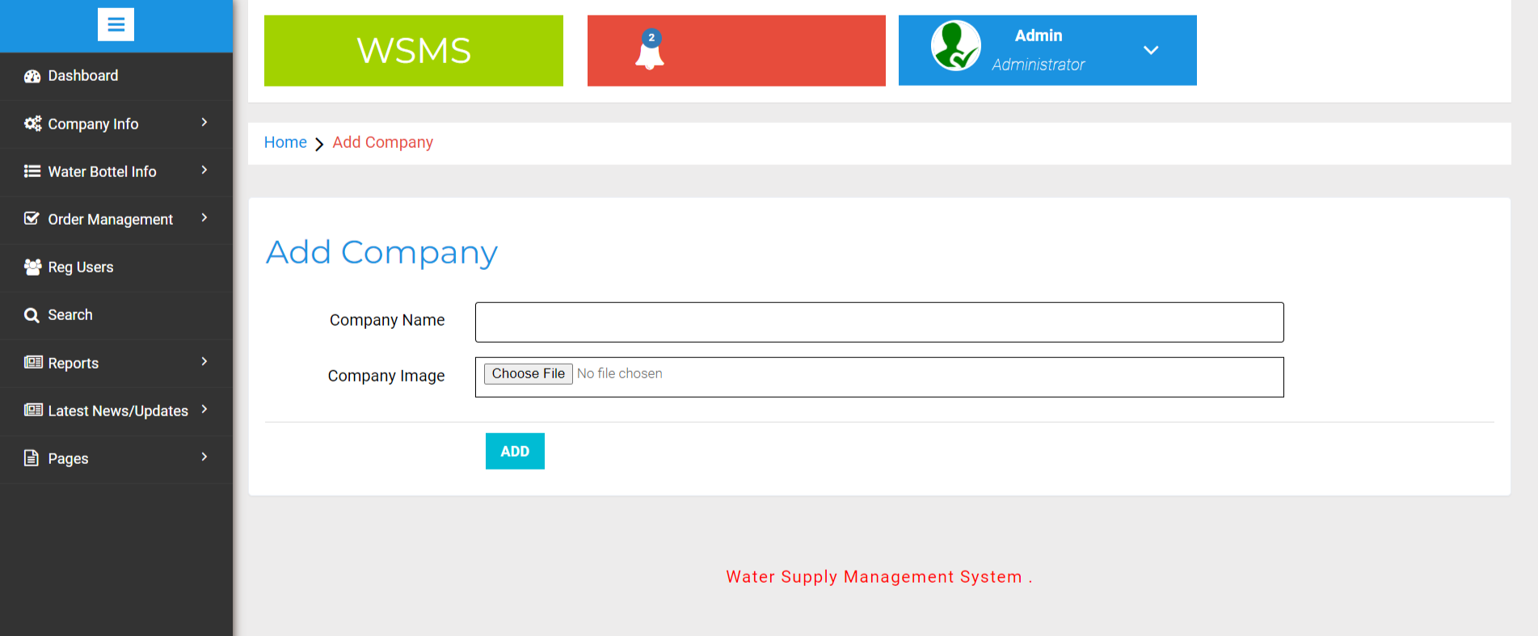
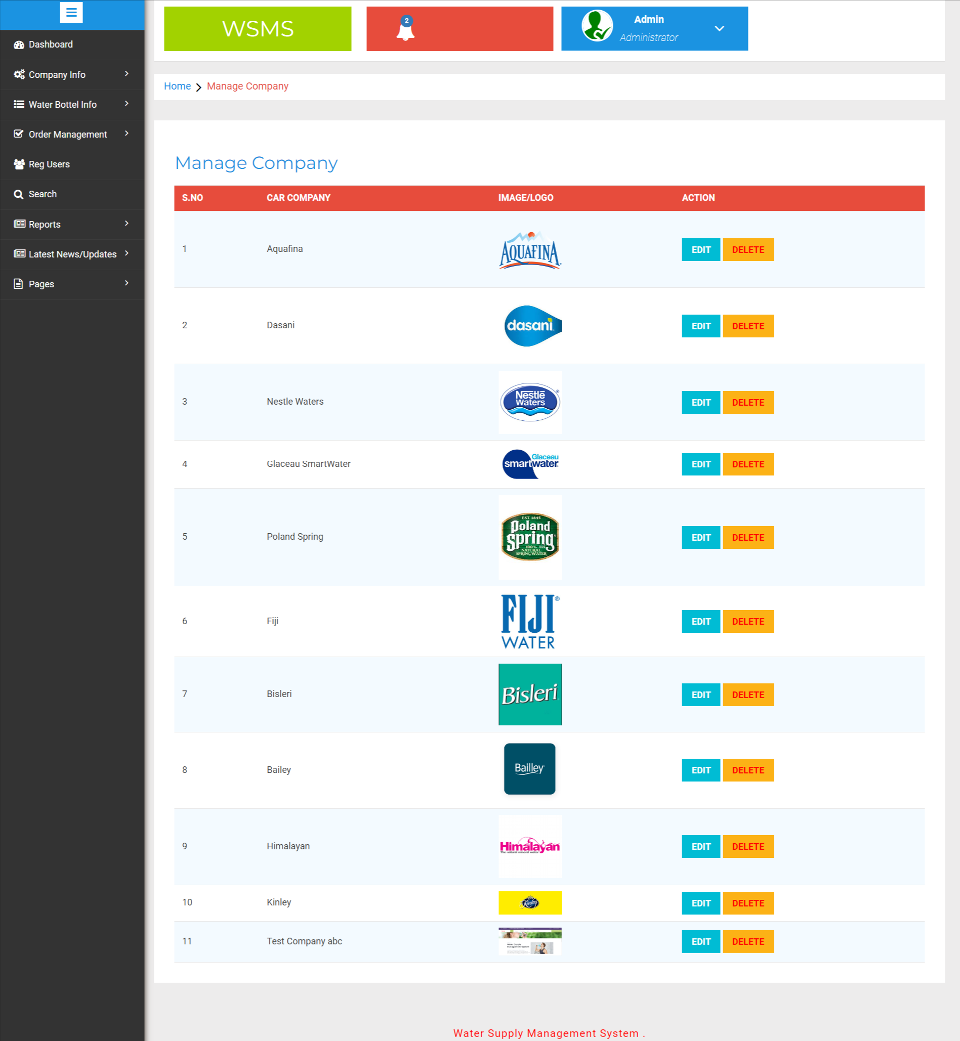

Slide 33
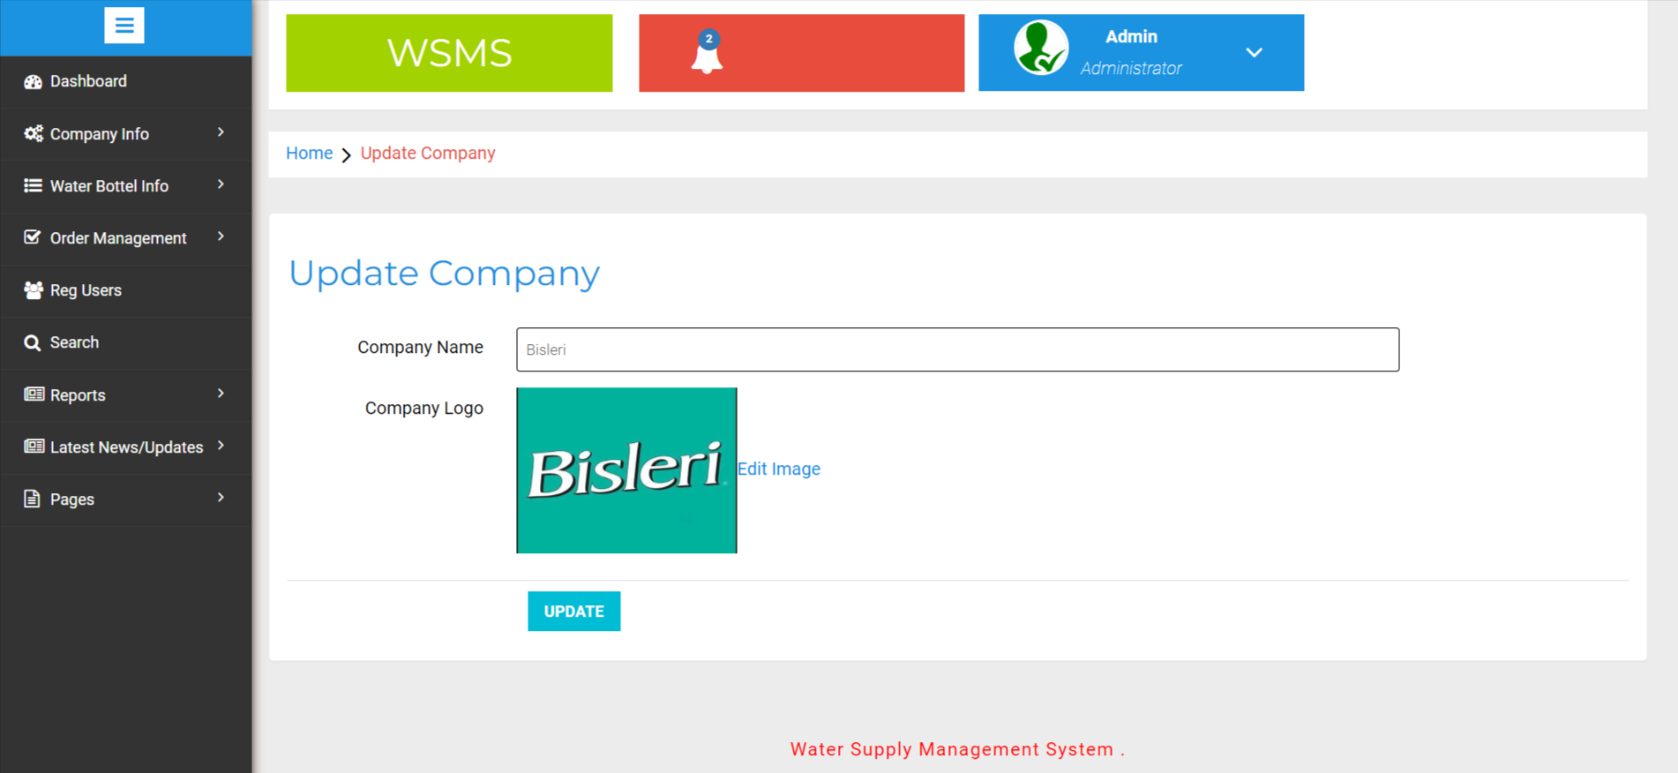
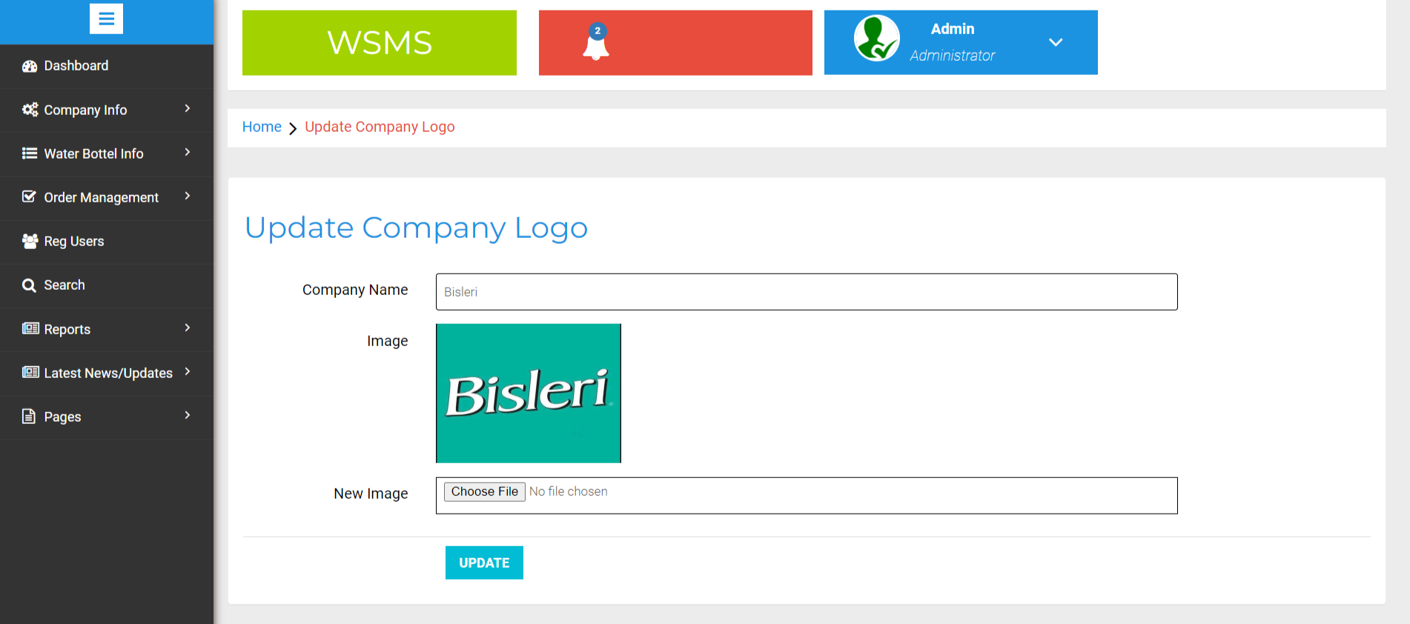

Slide 34
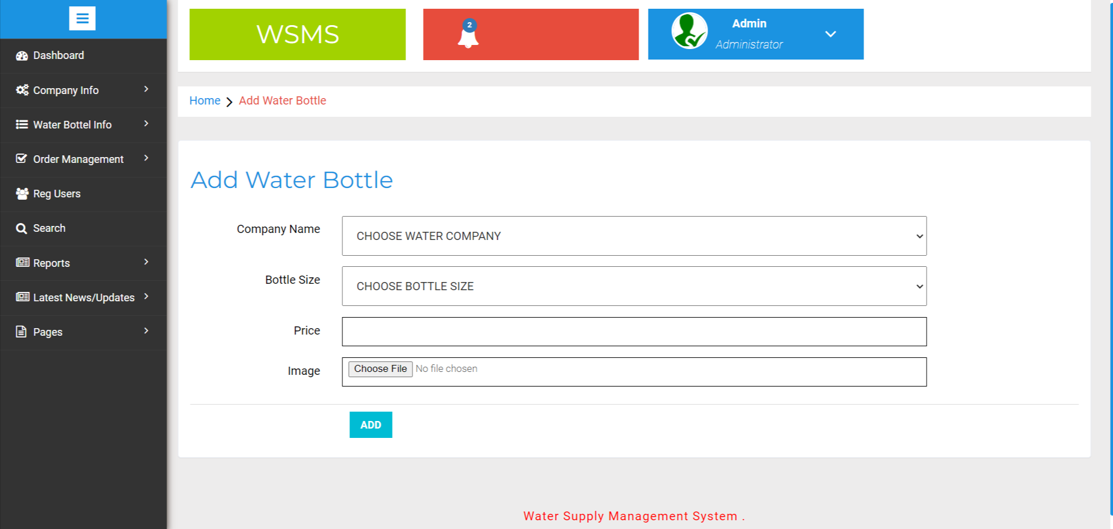
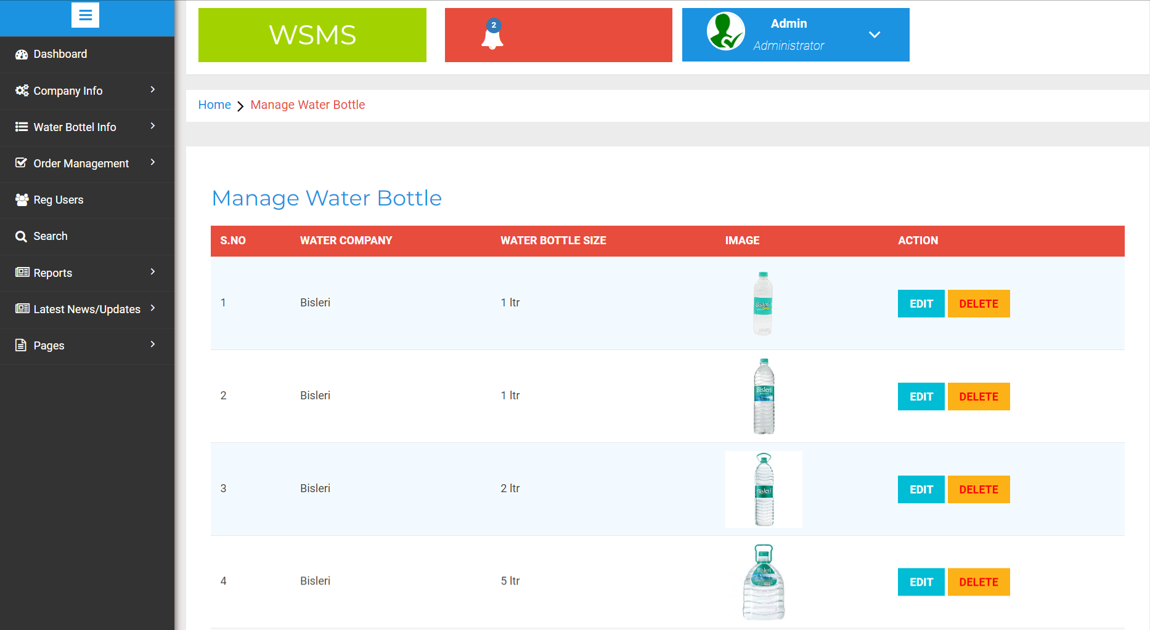

Slide 35
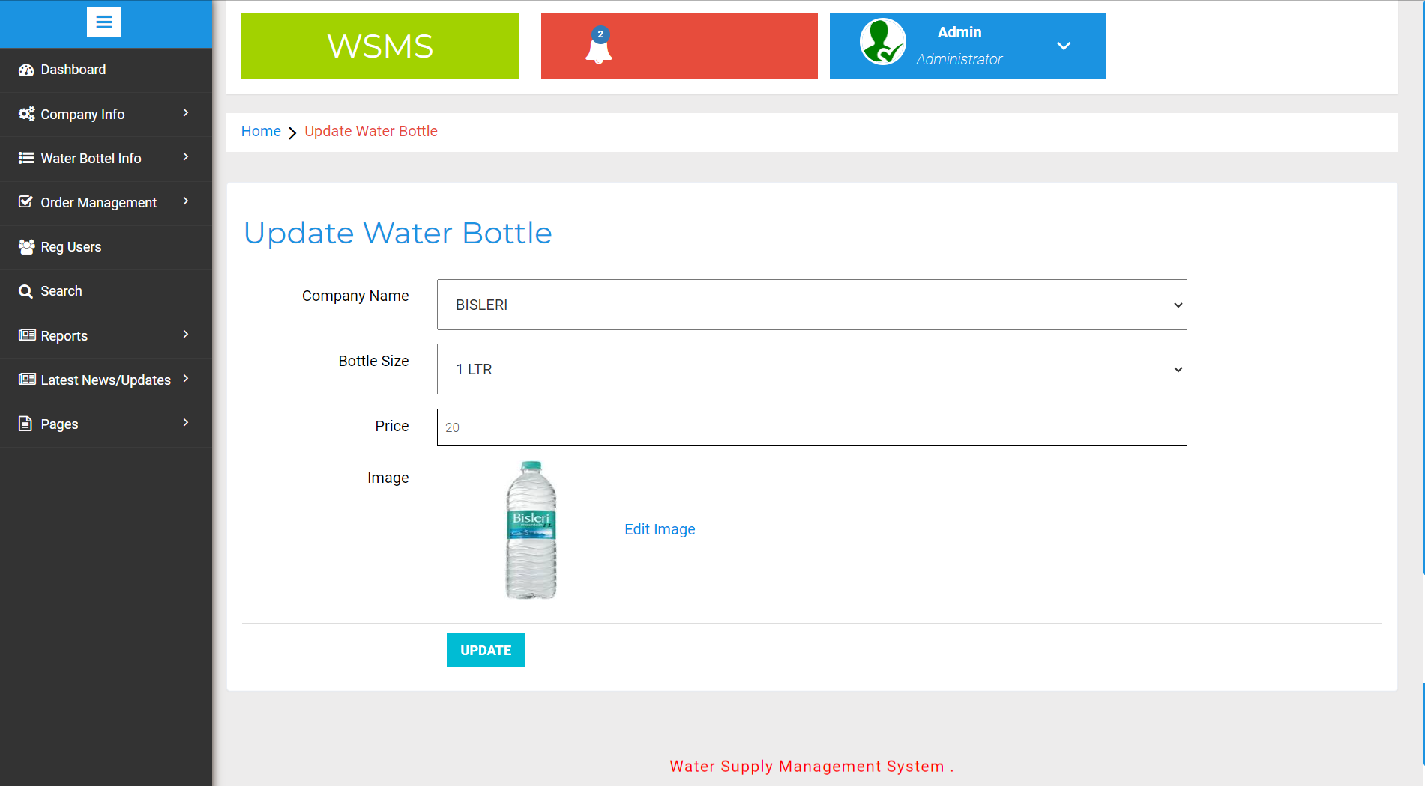
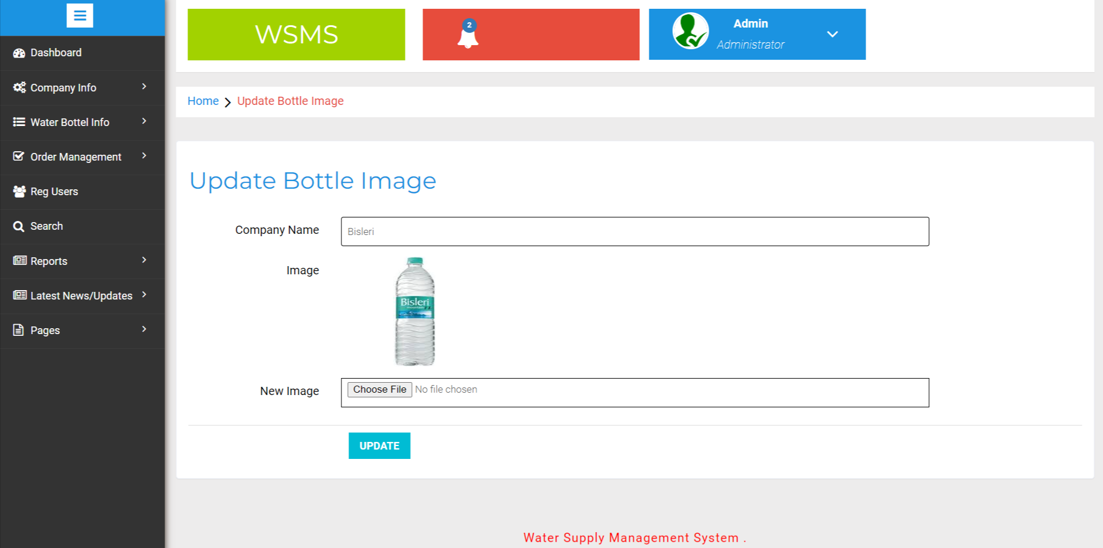

Slide 36
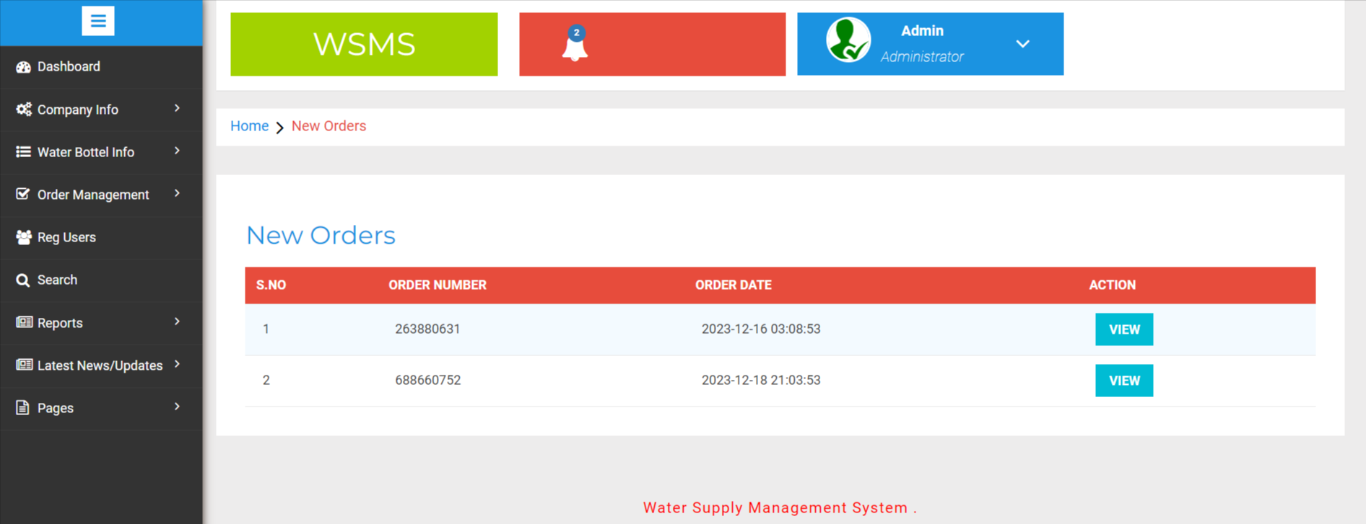
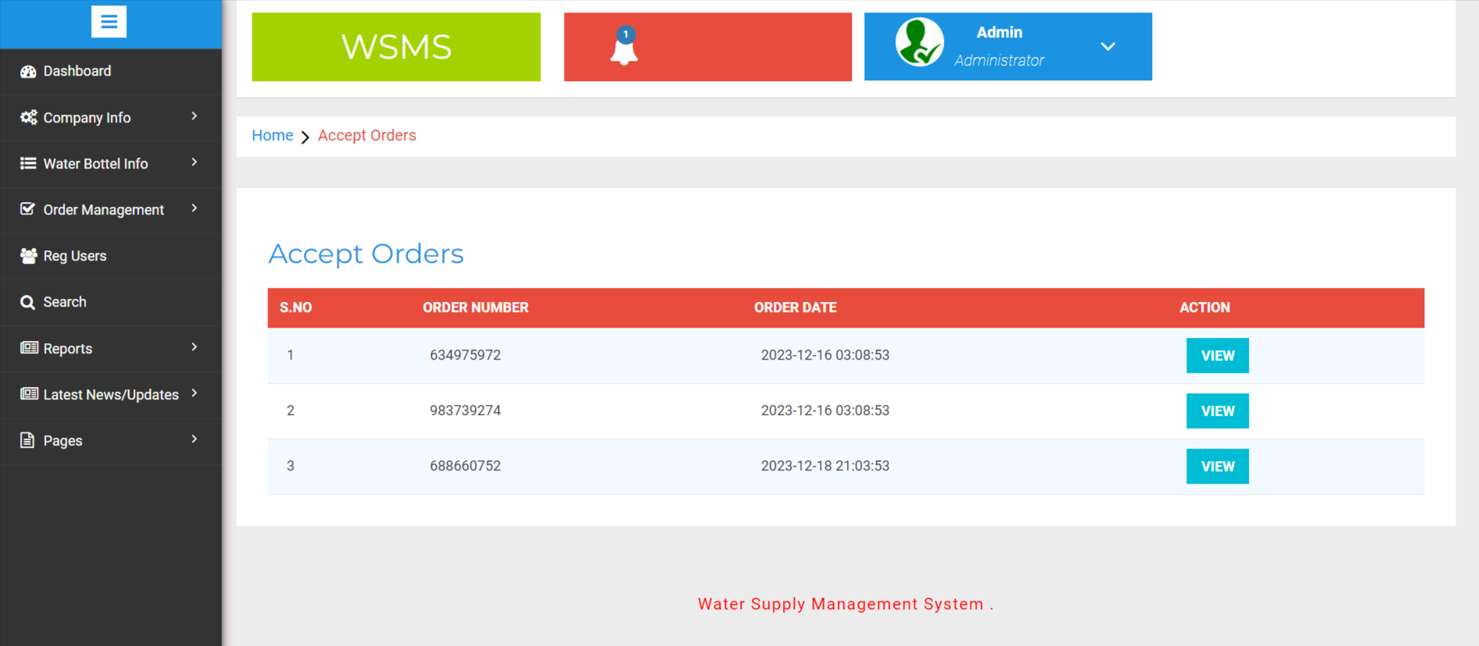

Slide 37
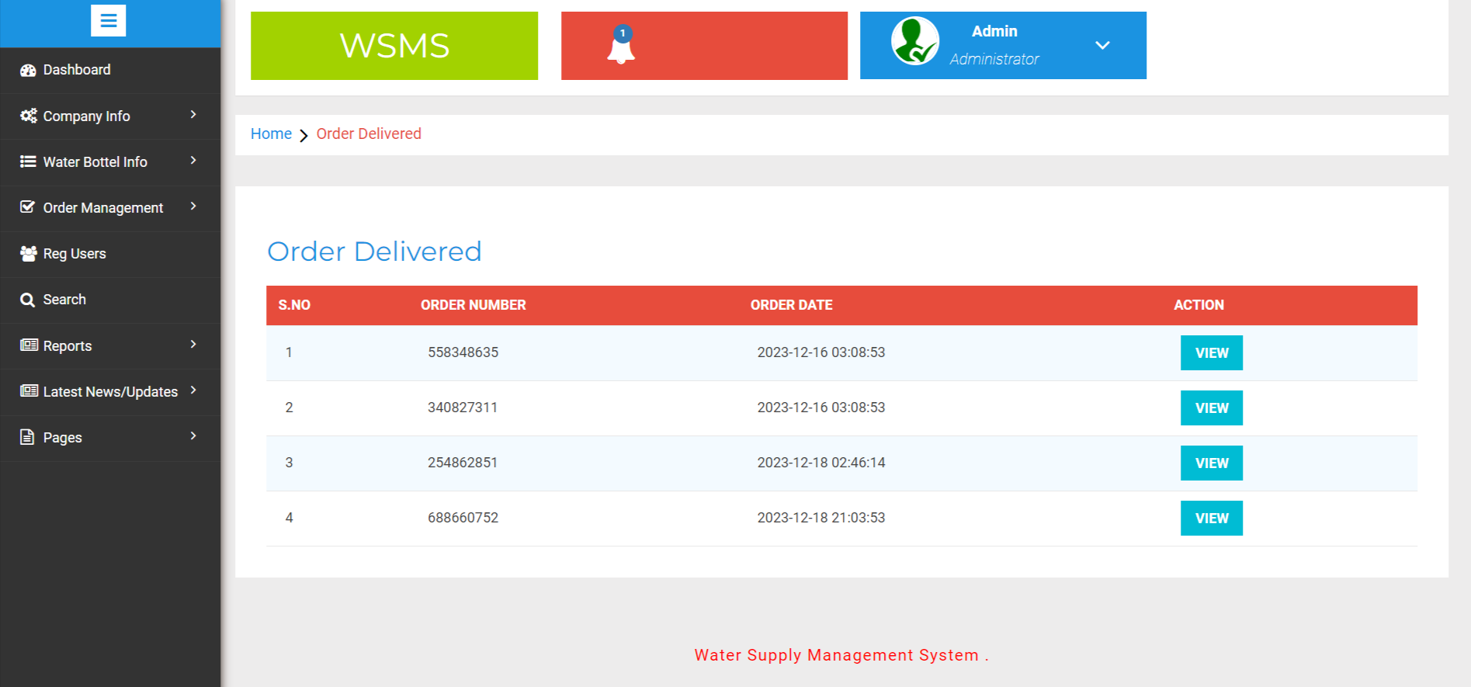

Slide 38
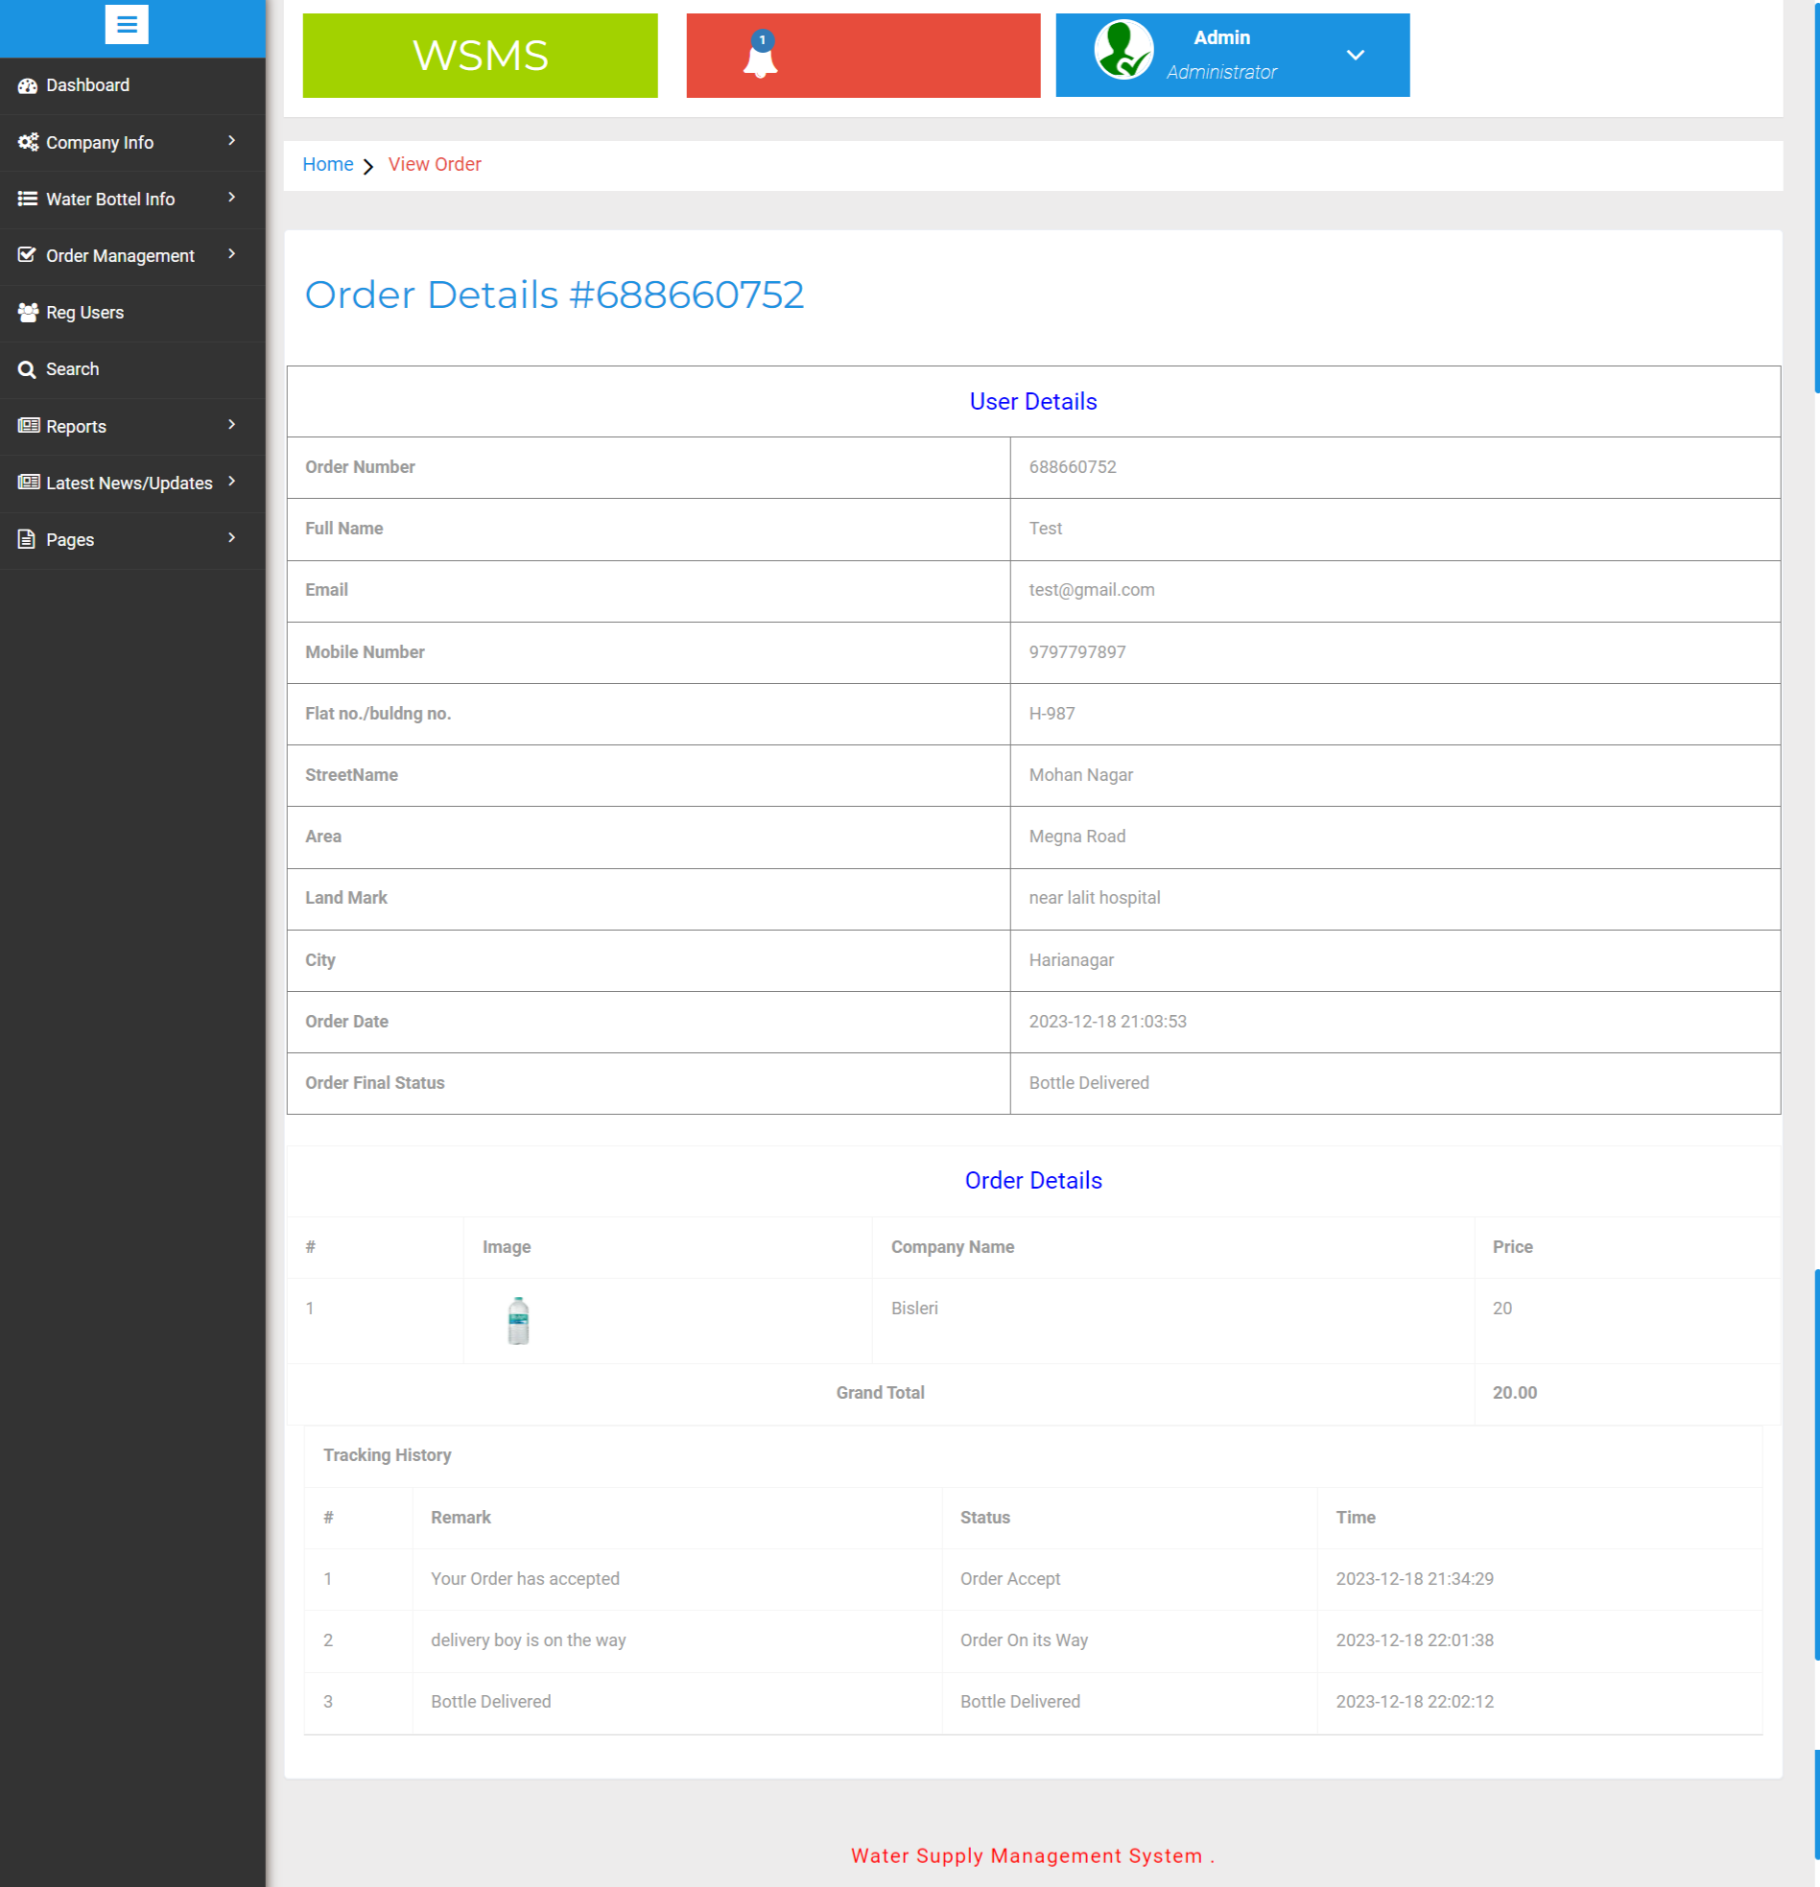

Slide 39
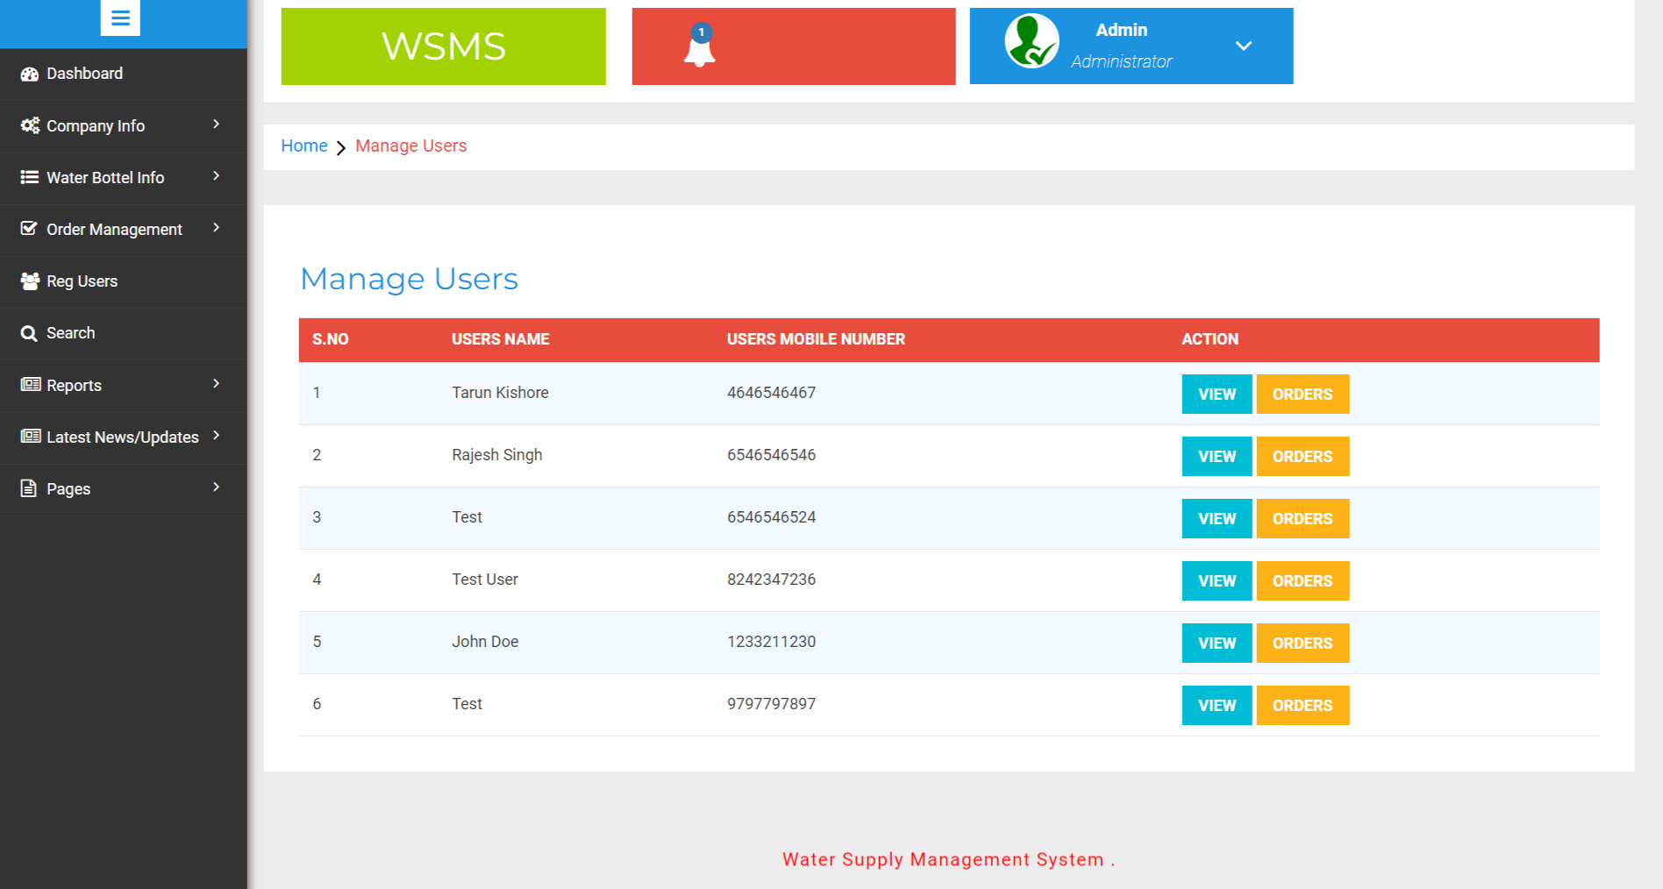
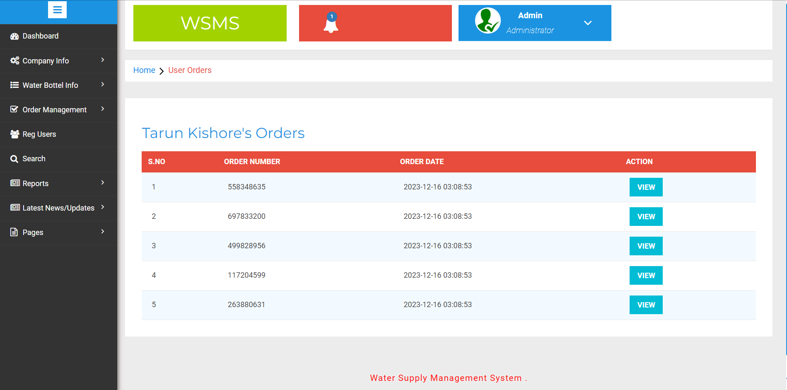

Slide 40
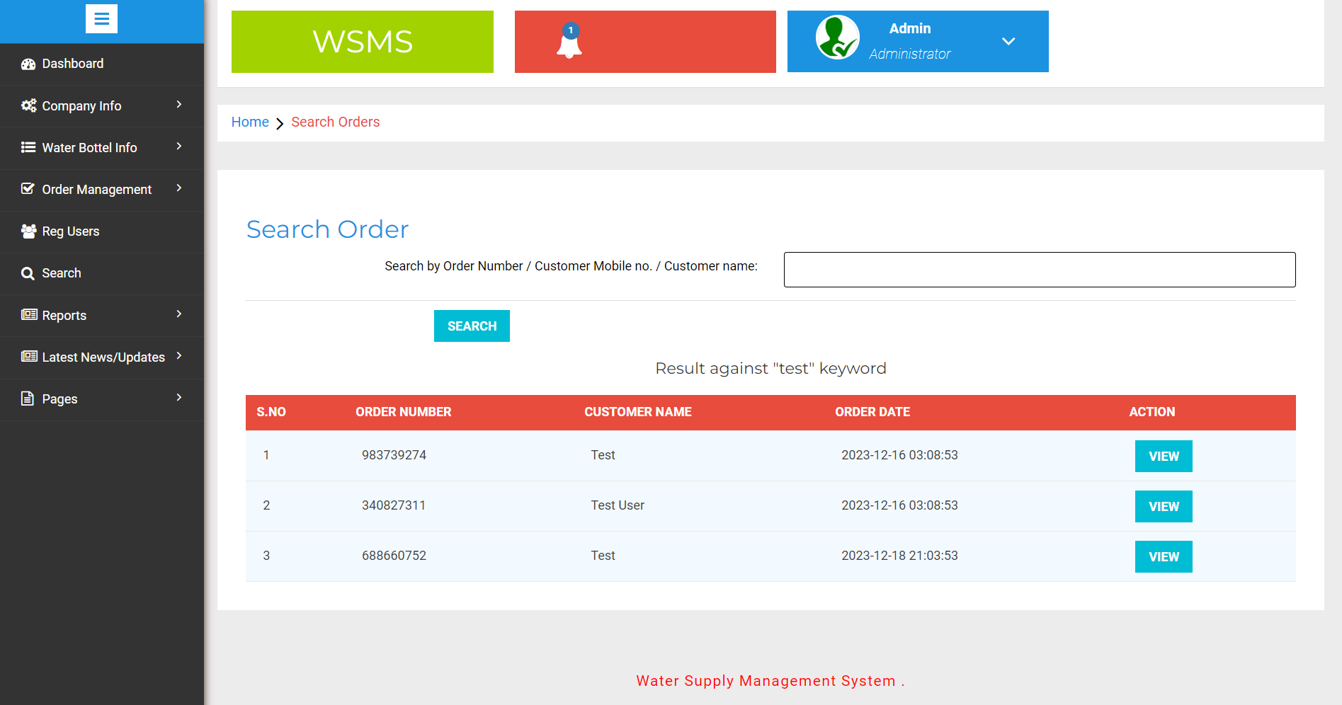
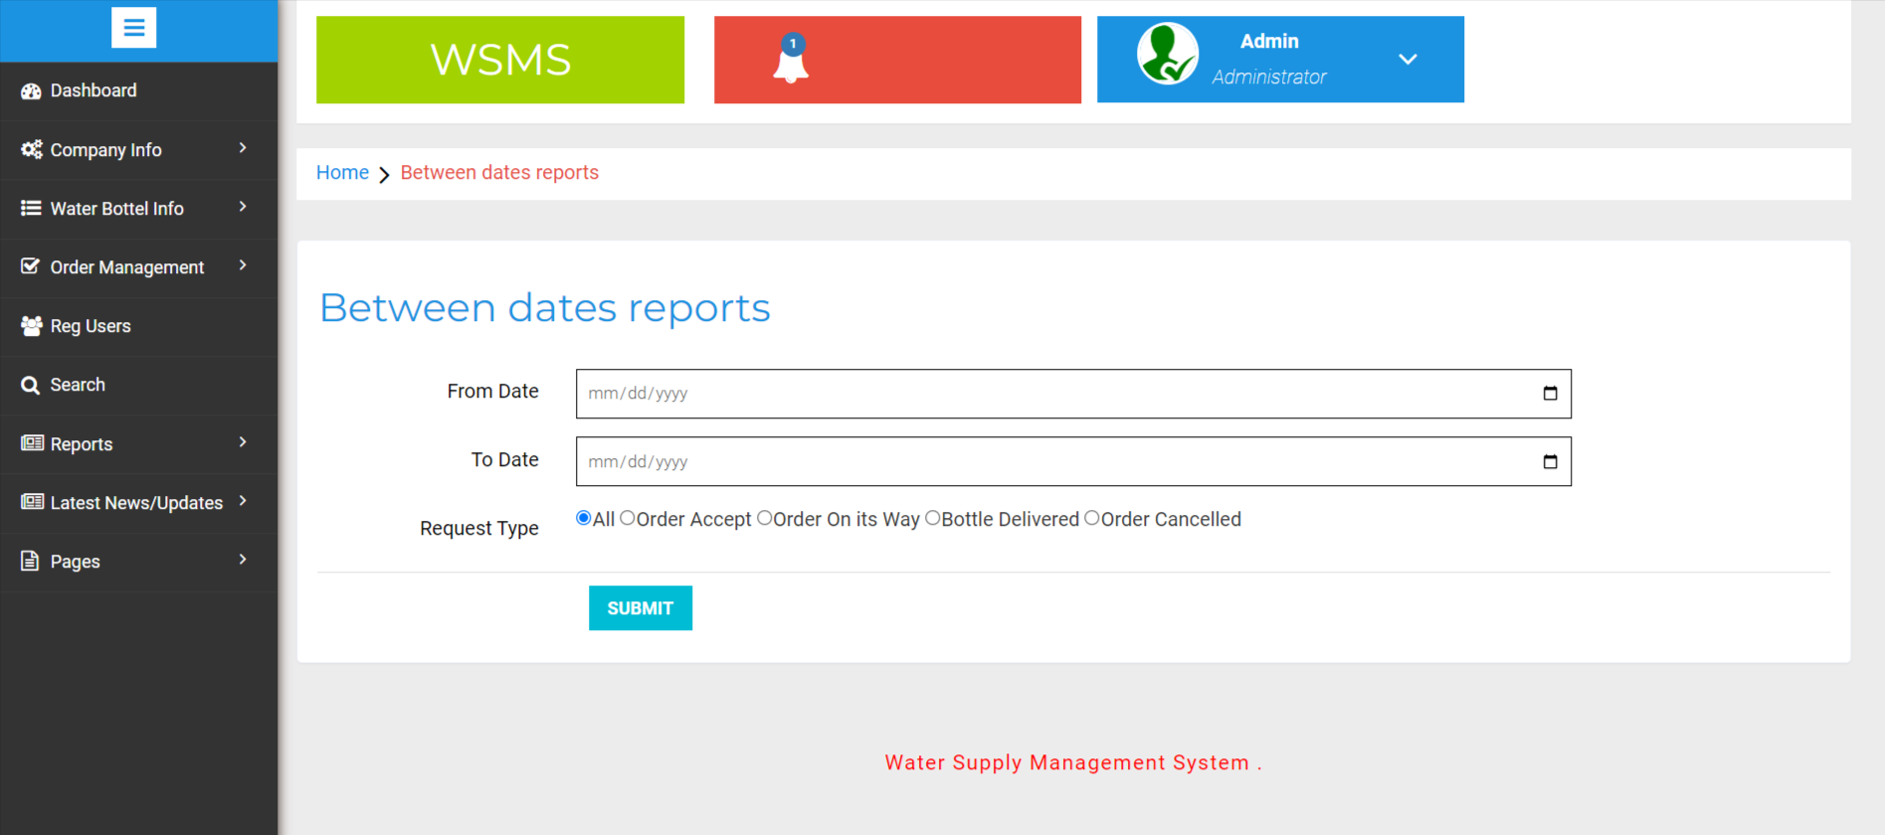

Slide 41
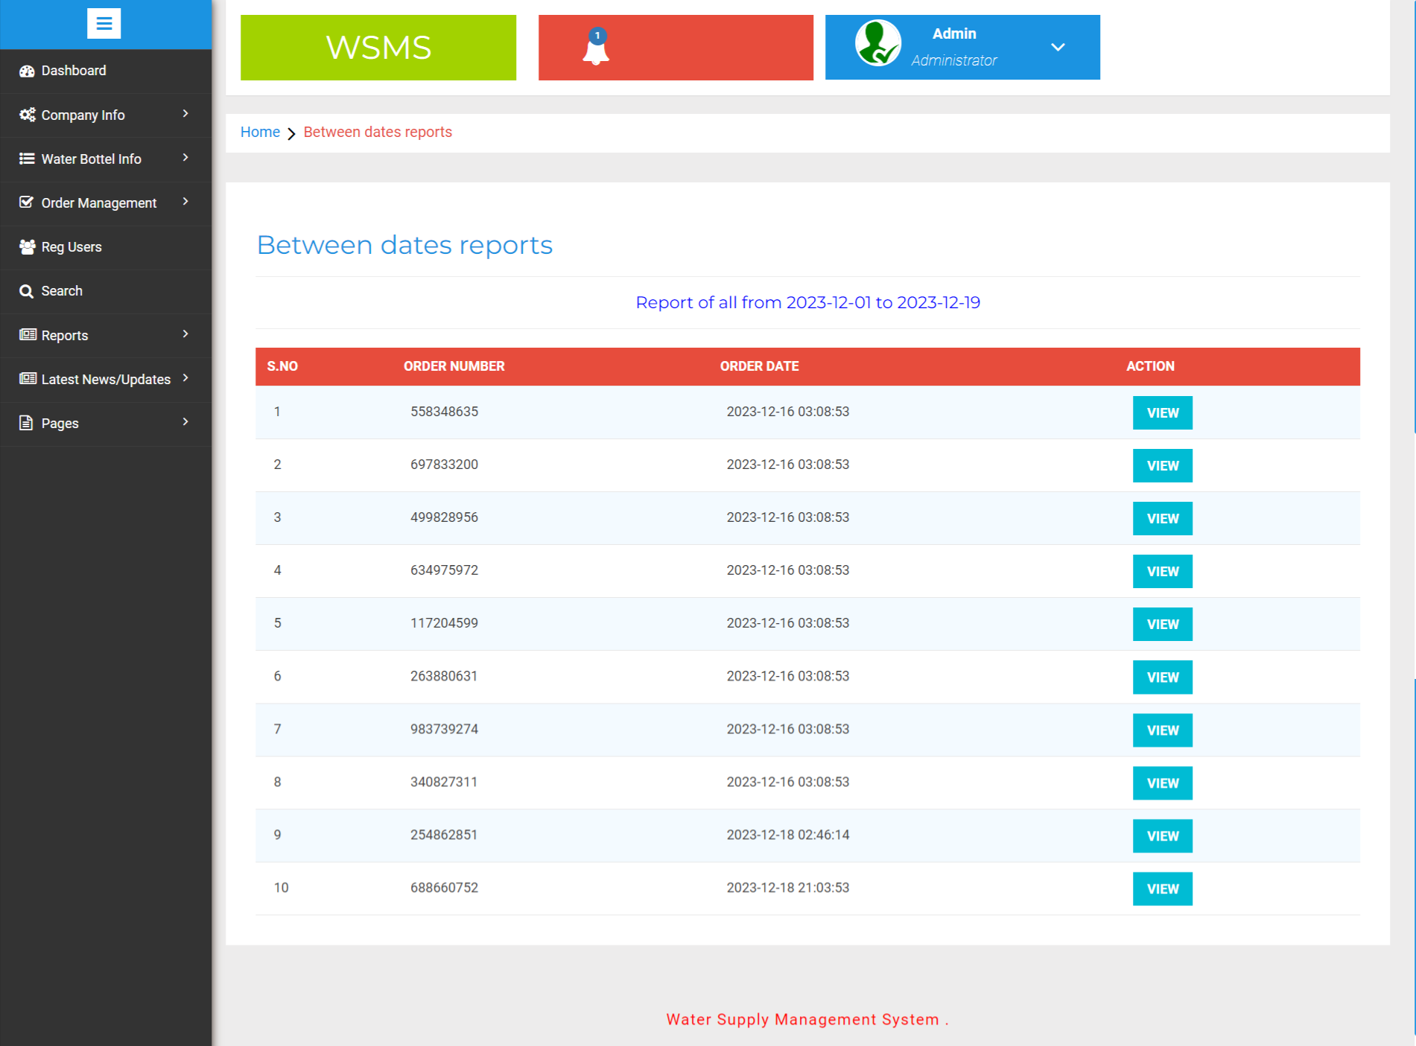

Slide 42
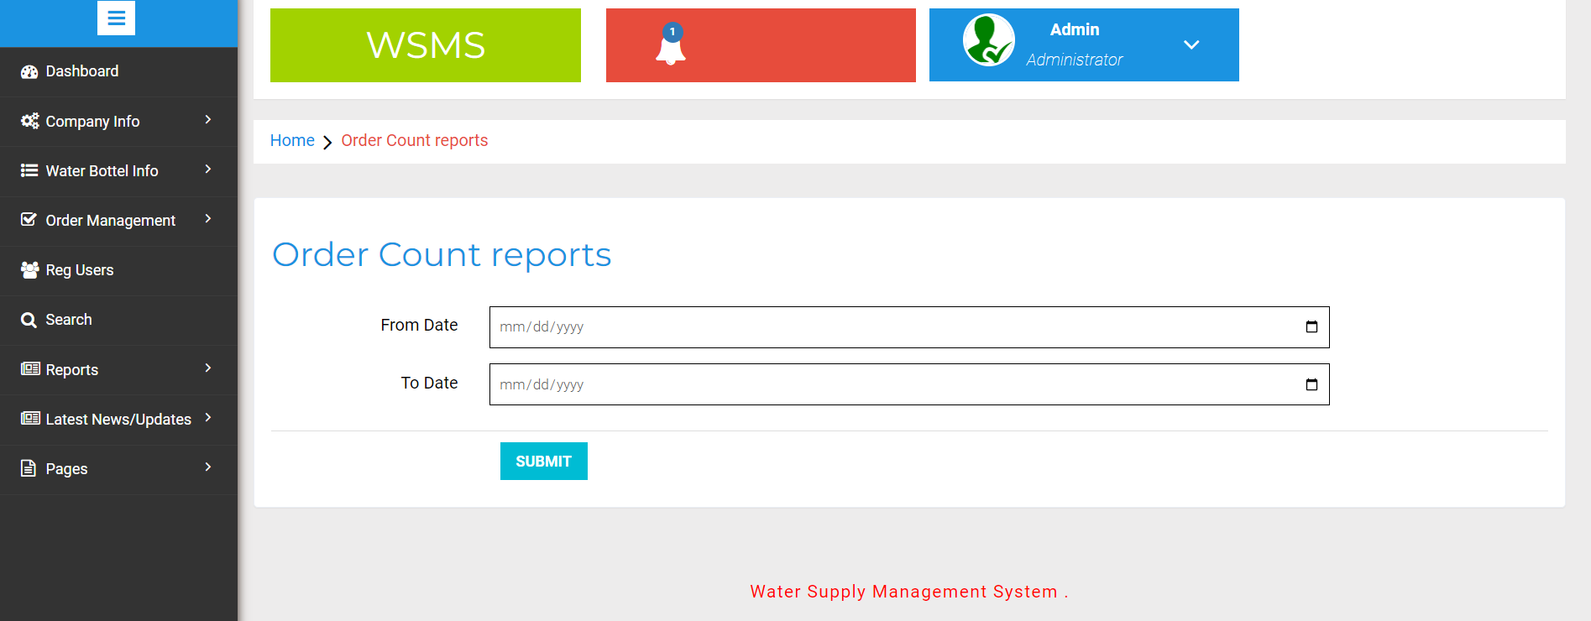
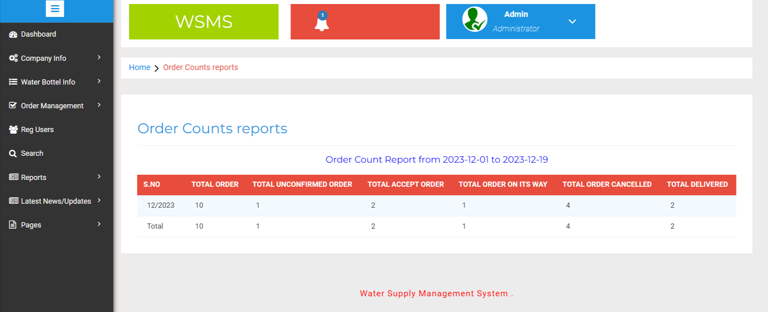

Slide 43
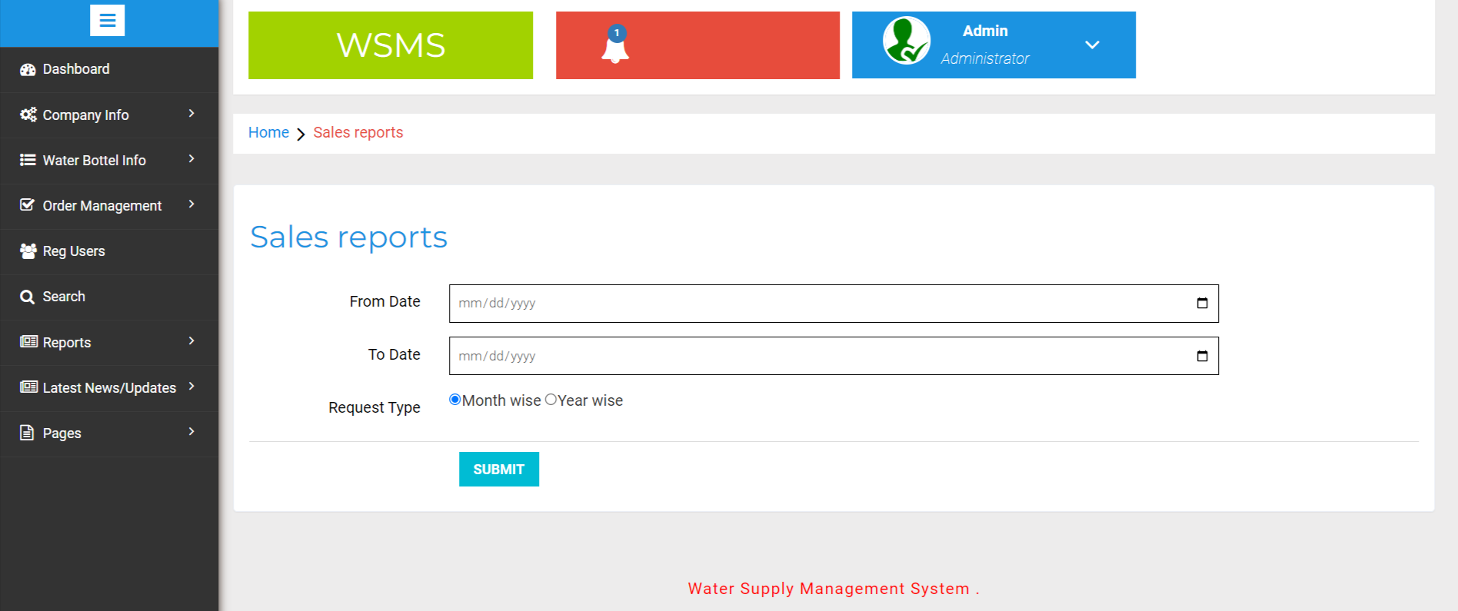
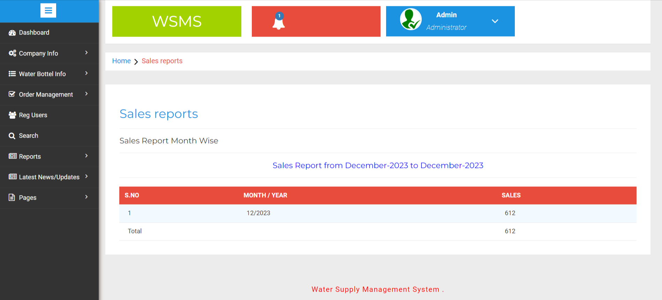

Slide 44

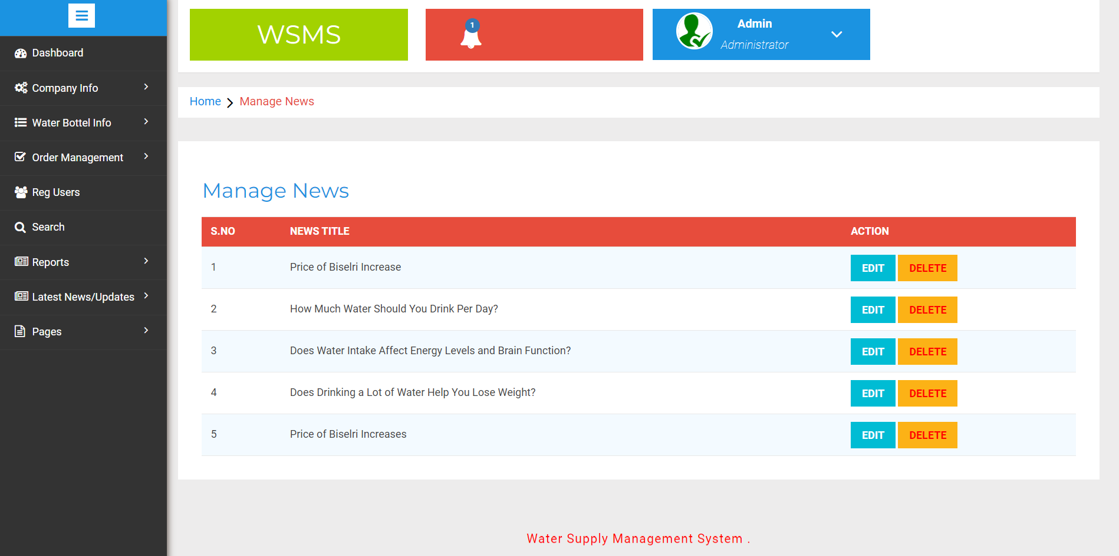

Slide 45



Slide 46


Slide 47
Conclusion
It has been a great pleasure for me to work on this exciting and challenging project. This project proved good for me as it provided practical knowledge of not only programming in PHP and MySQL web based application. It also provides knowledge about the latest technology used in developing web enabled application and client server technology that will be great demand in future. This will provide better opportunities and guidance in future in developing projects independently.
BENEFITS:
The project is identified by the merits of the system offered to the user. The merits of this project are as follows: -
It’s a web-enabled project.
This project offers user to enter the data through simple and interactive forms. This is very helpful for the client to enter the desired information through so much simplicity.
The user is mainly more concerned about the validity of the data, whatever he is entering. There are checks on every stages of any new creation, data entry or updation so that the user cannot enter the invalid data, which can create problems at later date.
Sometimes the user finds in the later stages of using project that he needs to update some of the information that he entered earlier. There are options for him by which he can update the records. Moreover there is restriction for his that he cannot change the primary data field. This keeps the validity of the data to longer extent.
User is provided the option of monitoring the records he entered earlier. He can see the desired records with the variety of options provided by him.
From every part of the project the user is provided with the links through framing so that he can go from one option of the project to other as per the requirement. This is bound to be simple and very friendly as per the user is concerned. That is, we can say that the project is user friendly which is one of the primary concerns of any good project.
Data storage and retrieval will become faster and easier to maintain because data is stored in a systematic manner and in a single database.

Slide 48
Limitation
The size of the database increases day-by-day, increasing the load on the database back up and data maintenance activity.
Training for simple computer operations is necessary for the users working on the system.

Slide 49
References
For PHP
https://www.w3schools.com/php/default.asp
https://www.sitepoint.com/php/
https://www.php.net/
For MySQL
https://www.mysql.com/
http://www.mysqltutorial.org
For XAMPP
https://www.apachefriends.org/download.html

Slide 50
Thank You

