Slide 1

BERT Vision
Improving span annotation and classification task performance using parameter-efficient model architectures trained on BERT’s hidden state activations.
Siduo “Stone” Jiang and William Casey King and Cristopher Benge

Slide 2












BERT Vision
Development Pipeline Components
SQuAD 2.0
DEVELOPMENT
Q&A SPAN ANNOTATION
Notebook
Atom
VS Code
Azure Data Science VM
STORAGE
DATA PROCESSING
BERT Vision Repo
HDF5
(processed dev)
HDF5
(processed train)
Transformers & TensorFlow 2.2
RAW
(JSON)
DATA VISUALIZATION
DOCUMENTATION
IBM GPU VM
BINARY CLASSIFICATION

Slide 3
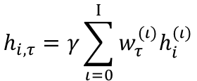
Fine-tuned on SQuAD v2 for span annotation task (Q&A) 1/10th epoch – 9/10th epochs, 1 epoch – 6 epochs.
BERTVision Data Pipeline Span Annotation
BERT_{LARGE}
TRAIN Embeddings (131911, 386, 1024, 25)
Transformer Block₂₄
Learned Pooling Weights (26,)
Embeddings Generated (N, 386, 1024, 25)
Pooled Embeddings (N,386,1024)
Transformer Block₃
Transformer Block₂
Dense(2,386)
Transformer Block₁
$$h_{i,τ}=γ\sum_{ι=0}^{Ι}{w_{τ}^{(ι)}h_{i}^{(ι)}}$$
Input embedding : | (N, 386, 1024, 1)
Layer 1-24 output[0] token : | (N, 386, 1024, 24)
Span Start
input embeddings
DEV Embeddings (12227, 386, 1024, 25)
Span End
Inspired by Tenney et al. 2019

Slide 4
Fine-tuned on SQuAD v2 for binary classification task (Answer / No Answer) 1/10th epoch – 9/10th epochs, 1 epoch – 6 epochs.
BERTVision Data Pipeline Binary Classification
BERT_{LARGE}
TRAIN Embeddings (131911, 1, 1024, 26)
CLS
Transformer Block₂₄
Learned Pooling Weights (26,)
Embeddings Generated (N, 1, 1024, 26)
Pooled Embeddings (N,1,1024)
Transformer Block₃
Transformer Block₂
CLS pooled : | (N, 1, 1024, 1)
Input embedding : | (N, 1, 1024, 1)
Layer 1-24 output[0] token : | (N, 1, 1024, 24)
Dense(2)
Transformer Block₁
$$h_{i,τ}=γ\sum_{ι=0}^{Ι}{w_{τ}^{(ι)}h_{i}^{(ι)}}$$
/
No Answer
DEV Embeddings (12227, 1, 1024, 26)
/
Answer
input embeddings
Inspired by Tenney et al. 2019

Slide 5
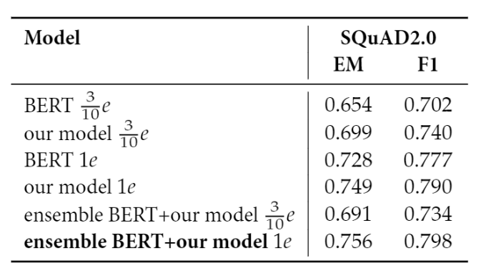
BERTVision Performance Span Annotation
Span Start
Span End
Span Start
Span End
CLS
Transformer Block₂₄
(386, 2)
+
(386, 9650)
Transformer Block₃
(386, 386, 25)
Transformer Block₂
Adapter
Transformer Block₁
Model Input (386, 1024, 25)
input embeddings
BERT
BERTVision

Slide 6
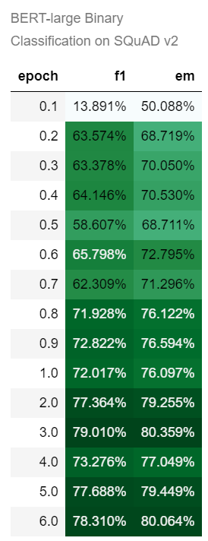
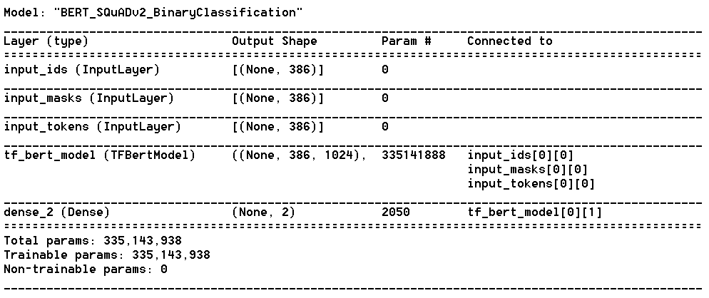
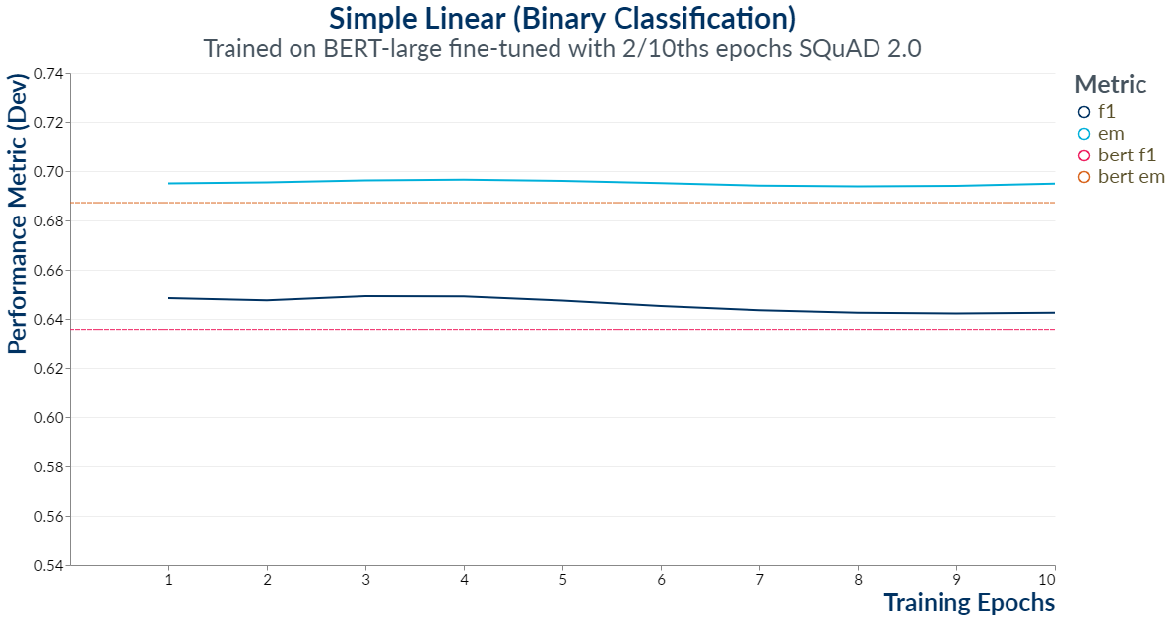
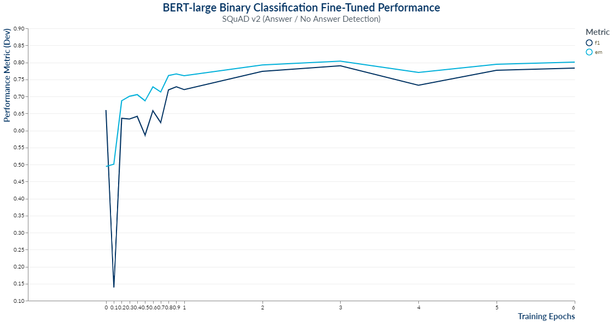
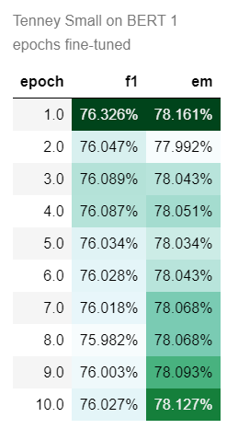
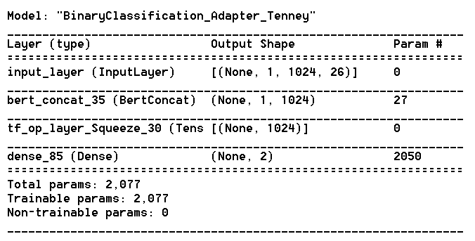
BERT Fine-Tuned Performance
“TS” Model Performance (1 epoch)

