Slide 1
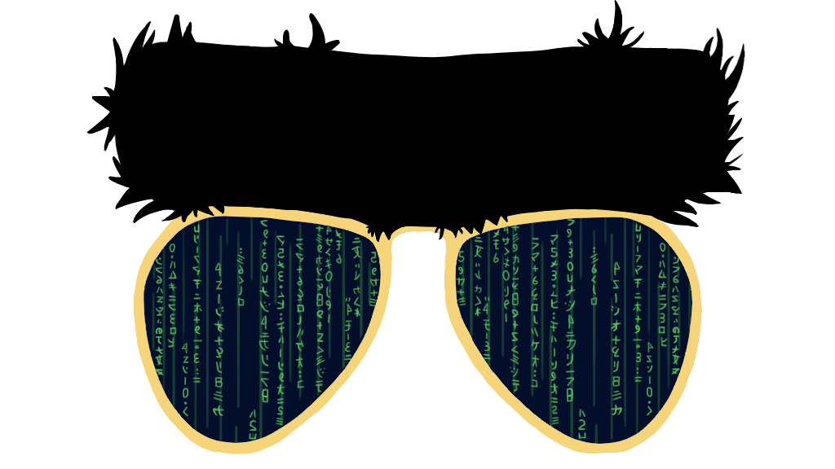
W210
Update Week 7
BERTVision
Paper & Update
Andrew Fogarty and Cristopher Benge and Stone Jiang and William Casey King

Slide 2
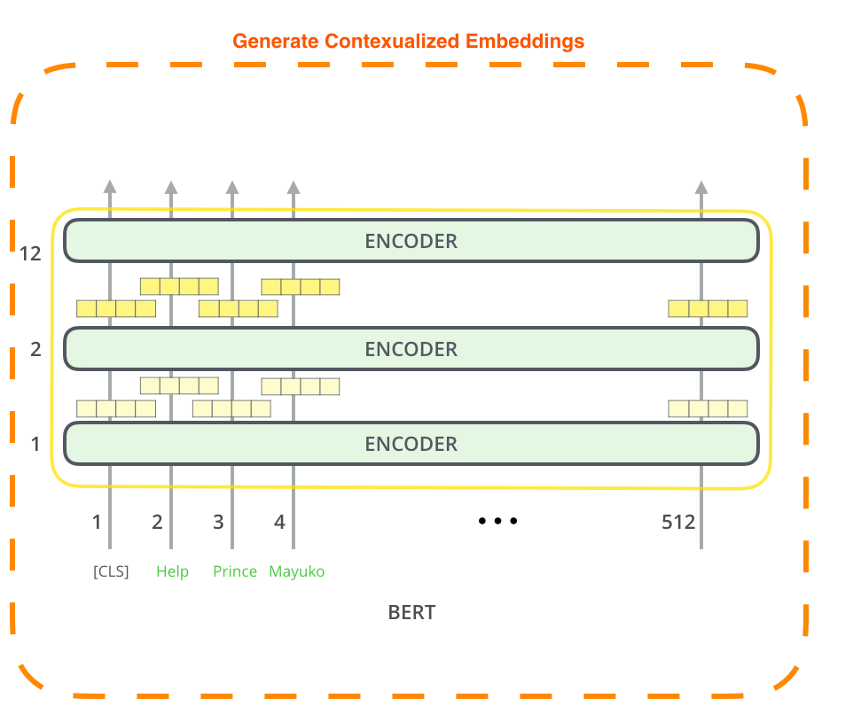
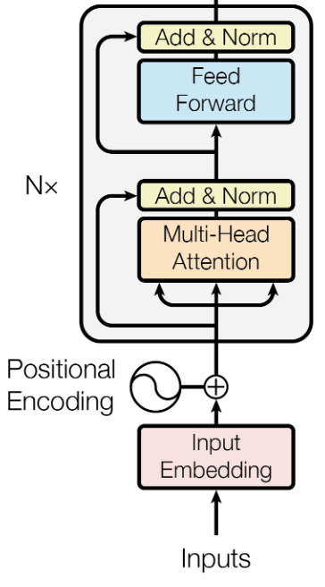
Primer on BERT
BERT is an encoder-only transformer
BERT-base has 12 hidden layers
BERT-large has 24 hidden layers
Final layer of BERT typically used for inference
Transformer Encoder blocks use multi-headed self-attention to allow all tokens to attend to every other token
Positional encodings used as a proxy for location within a sequence
Feed forward layers ensure the output shape at each hidden layer is the same as the input
Not all layers are created equal!
Adapter from http://jalammar.github.io/illustrated-bert/

Slide 3

BERT Rediscovers the Classical NLP Pipeline
Aims to capture linguistic information present within the BERT hidden state layers
BERT represents the steps of training a classical NLP pipeline
Earlier layers does better at syntactic tasks such as POS, parsing, NER
Layer later are better at semantic tasks such as semantic role labeling
BERT can also adjust dynamically based on individual examples
Tenney, Ian, et al. “BERT Rediscovers the Classical NLP Pipeline.” ArXiv.org, 9 Aug. 2019, arxiv.org/abs/1905.05950.

Slide 4
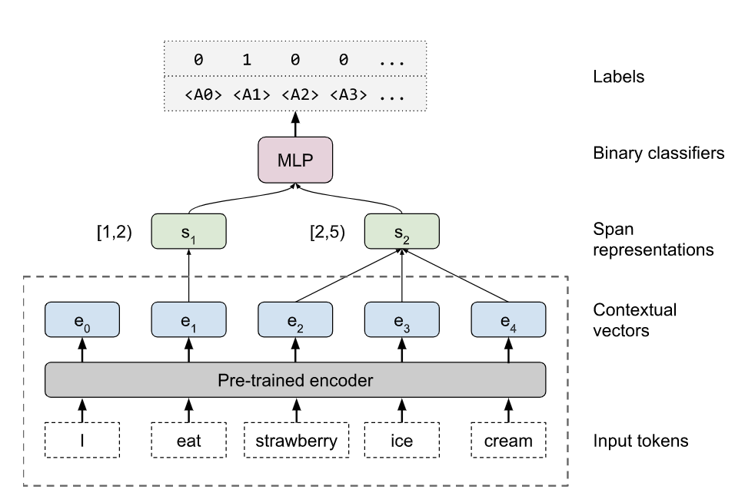
Method:
Edge Probing
Goal of model is to extract information from contextualized embeddings
“Pre-trained encoder” is any of the BERT layers, or combinations of BERT layers
Vectors within spans are pooled together (using a self-attention operator)
Each span cannot access information from other spans – only through contextualized embeddings
Encoder provides information about the relation between these spans
Spans are concatenated and fed to a 2-layer NN for classification

Slide 5
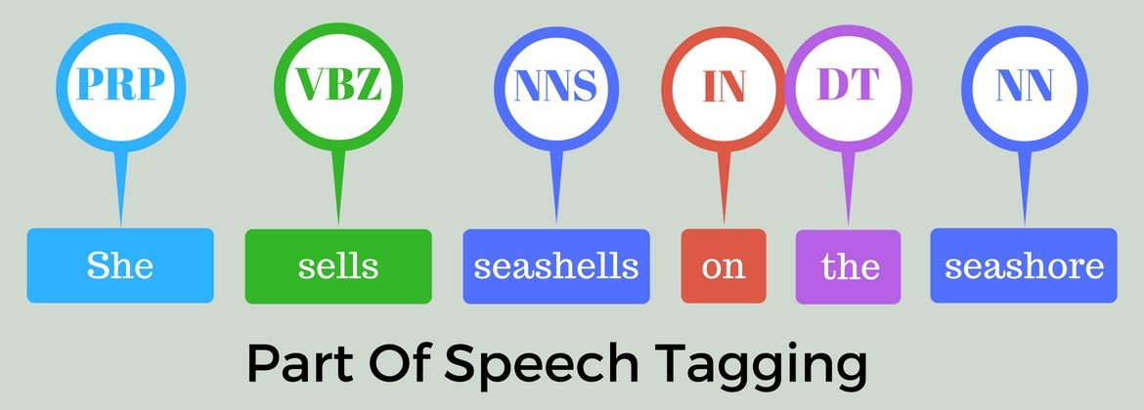
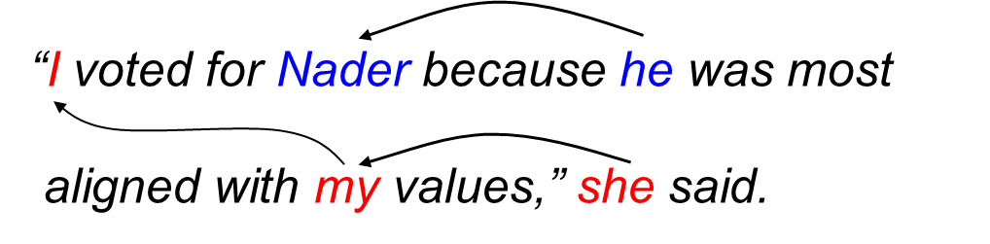
Edge Probing:
CLS tasks
Parts of speech tagging (POS)
Constituents
Dependencies
Entities
Semantic role labeling
Sematic proto-roles
Coreference
These tasks range from syntactic to semantic tasks
All evaluated with micro-averaged F1
Coreference

Slide 6
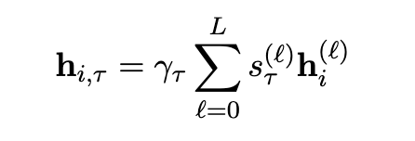
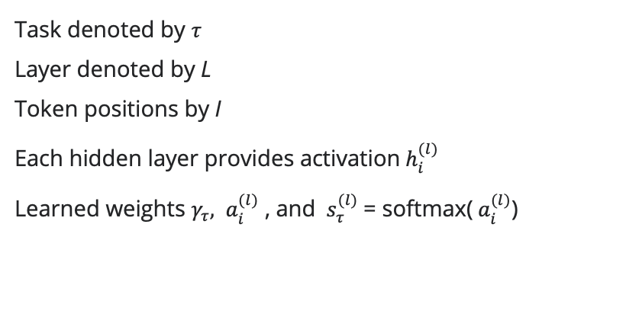
Pooling across layers
Task denoted by $τ$
Layer denoted by L
Token positions by I
Each hidden layer provides activation${ h}_{i}^{(l)}$
Learned weights $γ_{τ},$ ${ a}_{i}^{(l)}$ , and ${ s}_{τ}^{(l)}$= softmax(${ a}_{i}^{(l)}$)
Mixing Layers:
Scalar Mixing
In addition to evaluating each layer at a time, learned pooling technique combines multiple layers together into a single encoding matrix
Higher weights means that that particular layer contains more information related to the task

Slide 7
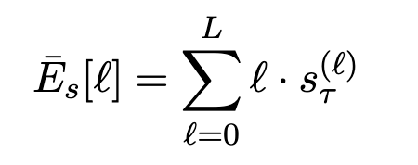
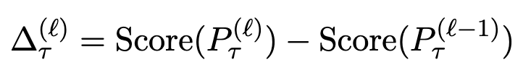
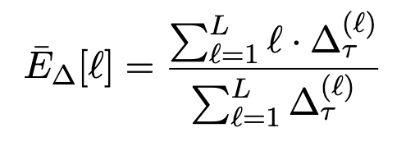
Metrics
Center of Gravity
Cumulative Scoring
Where information is concentrated
Which layer is sufficient
This reflects the average layer attended to for each task
Higher value means that the information needed for that task is captured by higher layers
Which layer in the encoder can a probing task be correctly predicted?
Center of gravity cannot tell us because parameters are learned
Idea: Train scalar mixing to all layers L and all layers previous

Slide 8
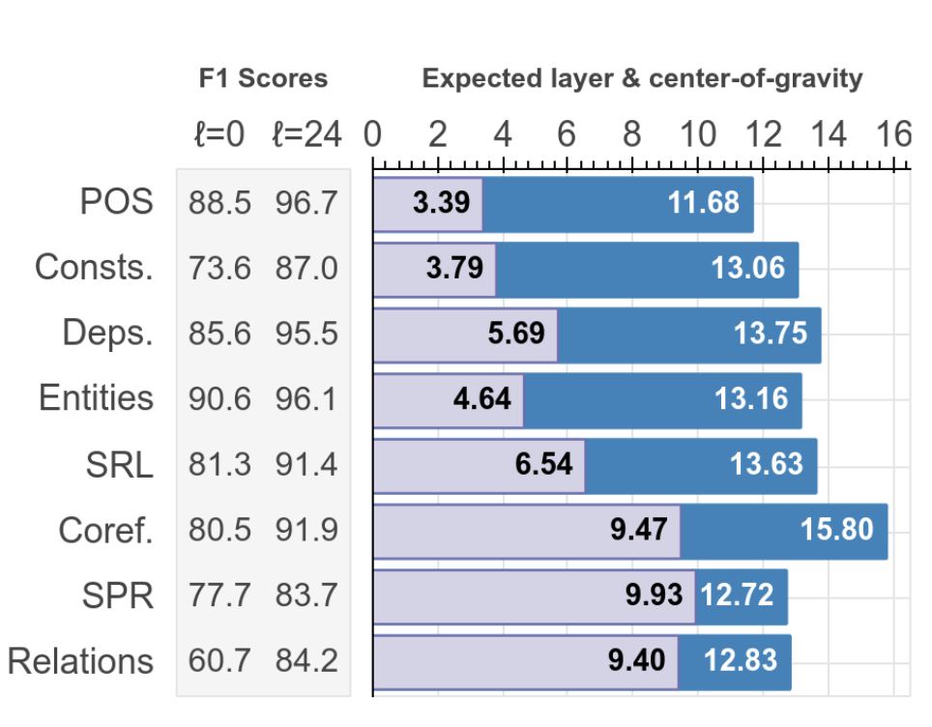
Results:
All tasks
Consistent trend across both metrics
POS earliest
Coreferences latest
First few layers had highest differential in scores
Cumulative score shows continued improvement to higher layers
Holds for BERT-based and BERT-large
Syntactic information localized to first few layers
Cumulative
Expectation
Center of Gravity

Slide 9
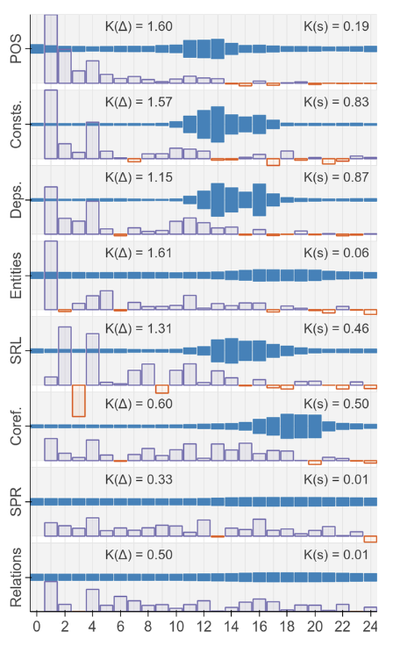
Results:
All layers
Some tasks are highly concentrated in certain layers (POS, Coref)
Others are more spread out (SPR, Relations)
Almost all layers add more information from the cumulative differences
Cumulative
Differences
Mixing weights

Slide 10
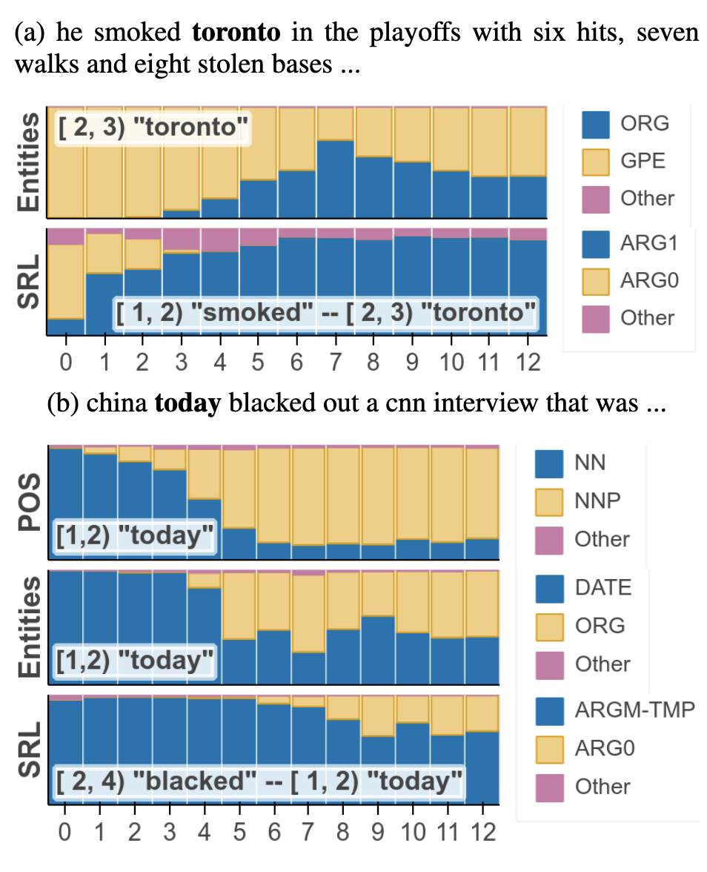
Results:
Examples
Compile predictions of per-layer classifiers for each task and ask: What happens as more layers are added?
First task: Initially, Toronto labeled as a GPE (city) but with more layers added, it correctly labels as ORG (sports team).
Second task: China Today is a proper noun (TV network). “today” is initially labeled as Noun, but with more layers, it is labeled as a Proper Noun.
POS typically works in earlier stages, but at a per example level (difficult ones) later layers are still helpful
Correct Label

Slide 11
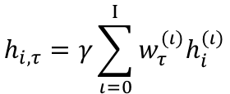
BERT_{LARGE}
TRAIN Embeddings (131911, 386, 1024, 25)
Transformer Block₂₄
Learned Pooling Weights (26,)
Embeddings Generated (N, 386, 1024, 25)
Pooled Embeddings (N,386,1024)
Transformer Block₃
Transformer Block₂
Dense(2,386)
Transformer Block₁
$$h_{i,τ}=γ\sum_{ι=0}^{Ι}{w_{τ}^{(ι)}h_{i}^{(ι)}}$$
Input embedding : | (N, 386, 1024, 1)
Layer 1-24 output[0] token : | (N, 386, 1024, 24)
Span Start
input embeddings
DEV Embeddings (12227, 386, 1024, 25)
Span End
Inspired by Tenney et al. 2019

Slide 12
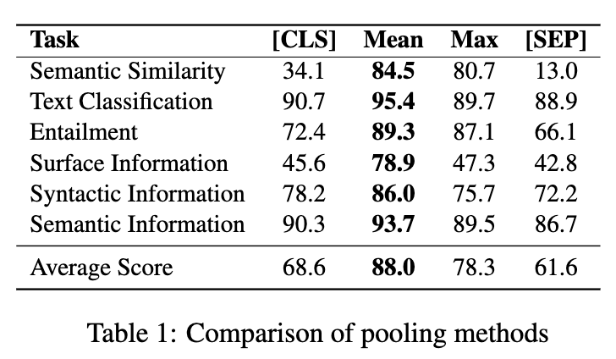
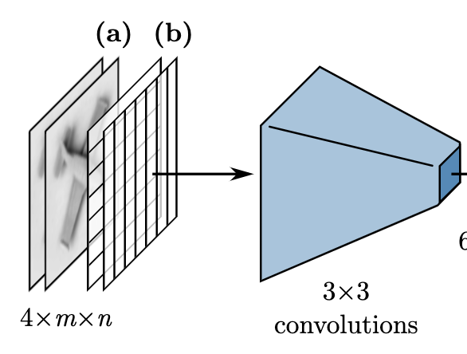
Similar Ideas
Pooling Techniques
Image routers
Compared to Token embeddings
Compression using CNNs
Ma, Xiaofei, et al. “Universal Text Representation from BERT: An Empirical Study.” ArXiv.org, 23 Oct. 2019, arxiv.org/abs/1910.07973.

Slide 13
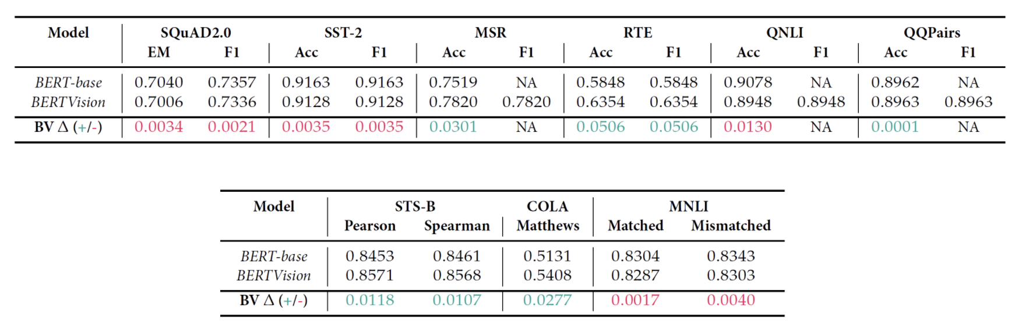
Progress for this week
We’ve completed the test of BERTVision on all of GLUE, using BERT-base and 1 epoch of fine-tuning

Slide 14
THANKS
Questions?

