Slide 1
Random Data Versus csQCA: Building Robustness Assessment for a Promising Method
Ben Gibson

Slide 2
Introduction
One benchmark of many analyses – distinguish from random chance
  Specify procedural steps to check the robustness of configurations returned by QCA
Determine thresholds (consistency, configurational n, and others) where random patterns are unlikely to be returned

Slide 3
QCA: Advantages
Qualitative elements
  complexity of cases
  holistic analysis of cases
Quantitative elements
  production of generalizations
  replicable
Logical/assumptive alternative to mean-based techniques
  Katz, vom Hau, Mahoney (2005)

Slide 4
QCA: Criticisms
Seawright (2004,2005)
  Assumptions:
    1) assumptions about correct form of the relationship
    2) missing variables
    3) inferring causation from association
Lieberson (2004)
  Doubts the analysis can distinguish from random data

Slide 5
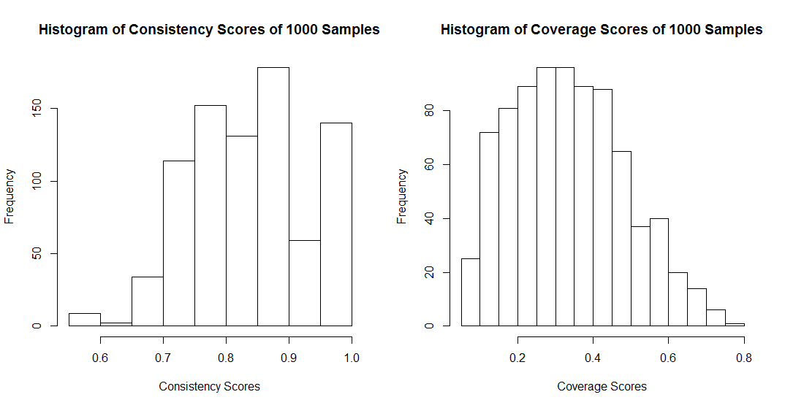
Parsimonious Solution of Random Data
Graph showing the random patterns I found

Slide 6
Researcher Choice and QCA
Hicks (1994)
  Theory-building prior to analysis
  Thorough model specification and resolving of conflicting cases
  “consider results relatively provisional insofar as an inductive-statistical rearticulation of the formulation... is practical”
Skaaning (2011)
  Robustness checks
  Sensitivity of models comparing consistency thresholds, calibration, case frequency

Slide 7
Researcher Knowledge
In general, requires intimacy with the cases
Concrete choices:
  Case selection
  Perceptions of patterns
    causal condition specification
  Choice of parameters
    Consistency, configurational n, etc
Researcher knowledge is thus an important factor in determining the viability of QCA.

Slide 8
Evaluation Work
Much of it has relied on observed data
  or, simulated worlds with a correct model
What about observing the probability of a “random” configuration?

Slide 9
This study
Reduce the probability of observing a pattern where this is none
Discuss possible ways to ensure skeptics that the configuration returned from QCA is not “random”

Slide 10
Simulating Researcher Knowledge
What are some choices we could model?
  Relevant cases.
  Causal conditions.
  Consistency threshold.
  Calibrations.
  N threshold for configurations.
  Complex, parsimonious, and intermediate solutions
    Direction of relationships

Slide 11
“Random” data don't allow analysis of...
Inclusion of Relevant Cases
Selection of Causal Conditions
Calibrations
Direction of Relationships

Slide 12
“Random” data DO allow for analysis of...
Configurational N
Consistency score thresholds
Sample size
Parsimonious versus complex solutions

Slide 13
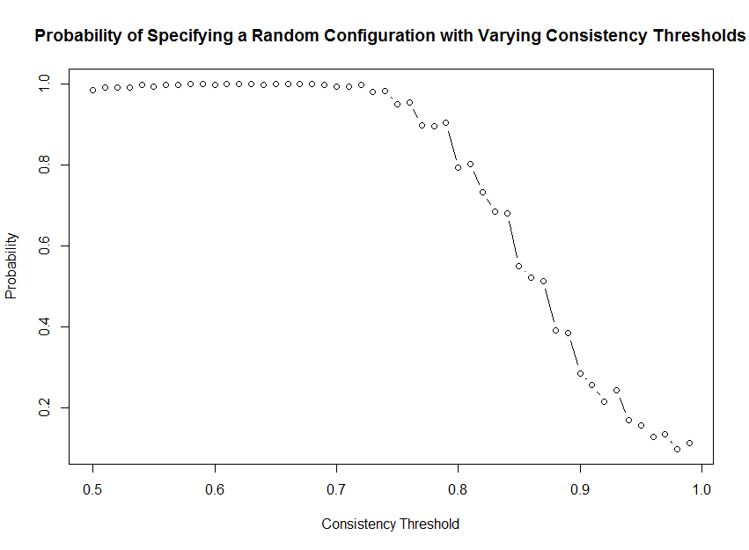
Consistency Threshold

Slide 14
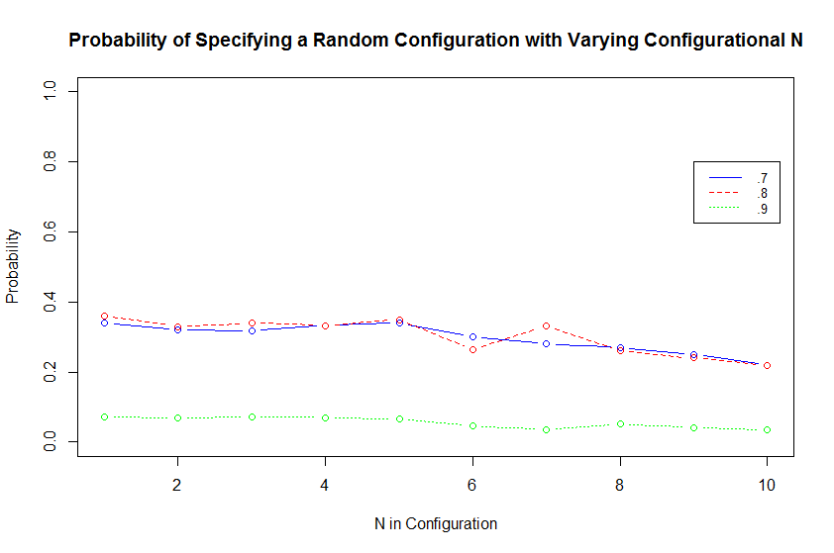
N for configurations

Slide 15
Complex and Parsimonious

Slide 16
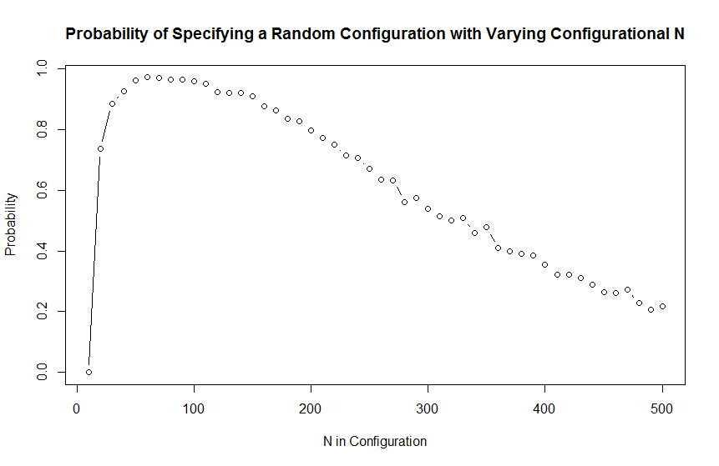
Sample Size

Slide 17
What about combinations of causal conditions?
fsQCA
Outcome: predicting a spurious configuration
Causal conditions:
  consistency threshold
  n configurations
  direction of relationships
  complex and parsimonious solutions

Slide 18
Bivariate Relationships
$`c("CNTH", "CPI")`
0 1
0 0.5 0.5
0.166666666666667 0.5 0.5
0.333333333333333 0.5 0.5
0.5 0.5 0.5
0.625 0.5 0.5
0.75 0.5 0.5
0.875 0.5 0.5
1 0.5 0.5

Slide 19
Researcher choice
Consistency threshold:
  .95
Configurational n threshold:
  5 (number of simulations ran)
Ran both parsimonious and complex solutions

Slide 20
Truth Table
 | CTH | CNTH | CPI | NTH | OUT | n | incl
1 | 0 | 0 | 0 | 0 | 0 | 216 | 0.515
2 | 0 | 0 | 0 | 1 | 0 | 3240 | 0.354
3 | 0 | 0 | 1 | 0 | 1 | 216 | 1
4 | 0 | 0 | 1 | 1 | 0 | 3240 | 0.893
5 | 0 | 1 | 0 | 0 | 0 | 270 | 0.866
6 | 0 | 1 | 0 | 1 | 0 | 4050 | 0.434
7 | 0 | 1 | 1 | 0 | 1 | 270 | 1
8 | 0 | 1 | 1 | 1 | 1 | 4050 | 1
9 | 1 | 0 | 0 | 0 | 0 | 180 | 0.709
10 | 1 | 0 | 0 | 1 | 0 | 2700 | 0.885
11 | 1 | 0 | 1 | 0 | 1 | 180 | 1
12 | 1 | 0 | 1 | 1 | 1 | 2700 | 0.995
13 | 1 | 1 | 0 | 0 | 0 | 225 | 0.945
14 | 1 | 1 | 0 | 1 | 0 | 3375 | 0.946
15 | 1 | 1 | 1 | 0 | 1 | 225 | 1
16 | 1 | 1 | 1 | 1 | 1 | 3375 | 1

Slide 21
fsQCA (complex solution)
S1: CNTH*CPI + CPI*nth + CTH*CPI => out
incl cov.r cov.u
--------------------------------
1 CNTH*COM 1.000 0.338 0.174
2 CPI*nth 1.000 0.052 0.011
3 CTH*COM 0.998 0.248 0.093
--------------------------------
S1 0.999 0.450

Slide 22
fsQCA (parsimonious solution)
S1: CNTH*CPI + CPI*nth + CTH*CPI => out
incl cov.r cov.u
--------------------------------
1 CNTH*COM 1.000 0.338 0.174
2 CPI*nth 1.000 0.052 0.011
3 CTH*COM 0.998 0.248 0.093
--------------------------------
S1 0.999 0.450

Slide 23
Establishing robustness checks?
Configurations of thresholds that make it highly unlikely that random configurations are being returned
  “I am 95% confident this configuration is not due to random chance!”

Slide 24
Conclusions
csQCA is robust, given reasonable consistency score thresholds.
This is for csQCA, fsQCA is likely even more robust.
It is possible to have robustness checks that take into account the:
  sample size
  configurational n

Slide 25
Motivations
New, promising methodology
Given its advantages, it is useful to construct robustness checks of the method

Slide 26
Researcher Choice and Validity
Publication-quality work typically requires justification of choices

Slide 27
Introduction
QCA is mighty promising.
QCA has been criticized.
An important defense is that researcher knowledge defends against many elements of worry from quantitative researchers.

