Slide 1
Approaching a Robustness Assessment for QCA
Ben Gibson

Slide 2
Introduction
One benchmark of many analyses – distinguish from random chance

Slide 3
Introduction
Determine thresholds for analysis – possibly on a case-by-case basis – that reduce the chance that csQCA results are by random chance.

Slide 4
Advantages to QCA
  Qualitative elements
    complexity of cases
    holistic analysis of cases

Slide 5
Advantages to QCA
  Qualitative elements
    complexity of cases
    holistic analysis of cases
  Quantitative elements
    production of generalizations
    replicable

Slide 6
Advantages to QCA
  Assumptive alternative to mean-based approaches!!

Slide 7
Criticisms

Slide 8
Criticisms
Seawright (2004,2005)
  Assumptions:
    1) assumptions about correct form of the relationship
    2) missing variables
    3) inferring causation from association

Slide 9
Criticisms
Lieberson (2004)
  Doubts the analysis can distinguish from random data

Slide 10
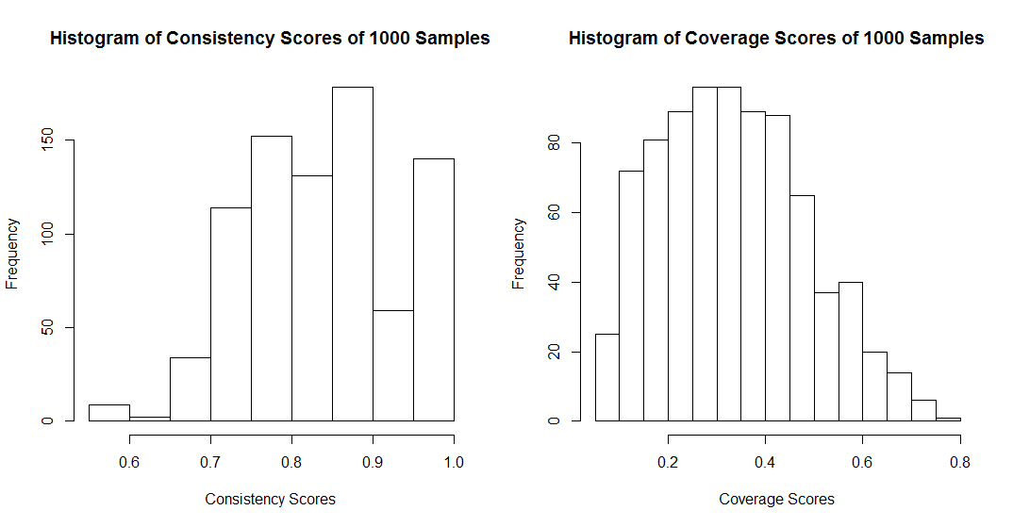
Can it?

Slide 11
Researcher Choice
Hicks (1994)
  Theory-building prior to analysis
  Thorough model specification and resolving of conflicting cases
  “consider results relatively provisional insofar as an inductive-statistical rearticulation of the formulation... is practical”

Slide 12
Researcher Choice
Skaaning (2011)
  Robustness checks
  Sensitivity of models comparing consistency thresholds, calibration, case frequency

Slide 13
Researcher Knowledge
In general, requires intimacy with the cases
  Concrete choices:
    Case selection
    Perceptions of patterns
    causal condition specification
    Choice of parameters
    Consistency, configurational n, etc
Researcher knowledge is thus an important factor in ensuring the viability of QCA.

Slide 14
Evaluation Work
Much of it has relied on observed data
  or, simulated worlds with a correct model
What about observing the probability of a “random” configuration?

Slide 15
This Study
Reduce the probability of observing a pattern where this is none
Discuss possible ways to ensure skeptics that the configuration returned from a csQCA is not “random”

Slide 16
Junctures of Choice
Relevant cases.
Causal conditions.
Calibrations.
Consistency threshold.
N threshold for configurations.
Complex, parsimonious, and intermediate solutions
  Direction of relationships

Slide 17
Random Worlds
Random data don't allow analysis of...
  Inclusion of Relevant Cases
  Selection of Causal Conditions
  Calibrations
  Direction of Relationships

Slide 18
Random Worlds
However, we CAN analyze...
  Configurational N
  Consistency score thresholds
  Sample size
  Parsimonious versus complex solutions

Slide 19
Data
csQCA with four causal conditions and one outcome
All are randomly assigned 0s or 1s (flip-a-coin)
Initial 1000 simulations: sample size 200, consistency threshold .7, configurational n 2, parsimonious solution
(altered later)

Slide 20
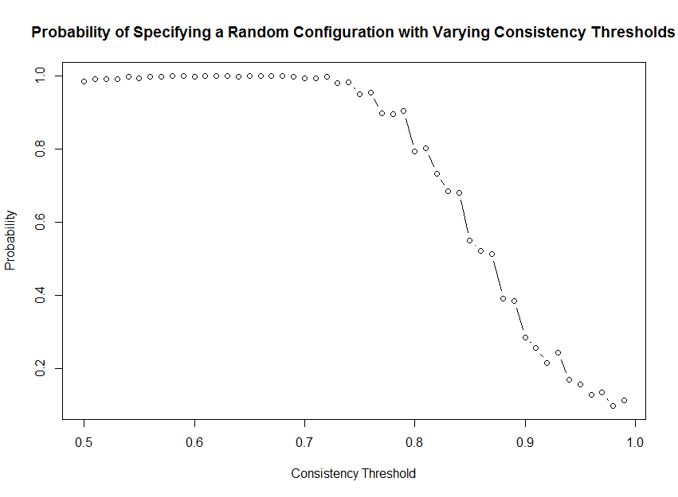
Consistency Thresholds

Slide 21
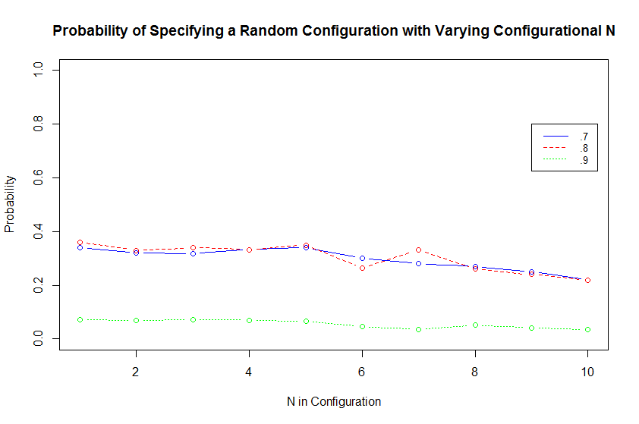
Configuration N Threshold

Slide 22
Parsimonious versus
Complex

Slide 23
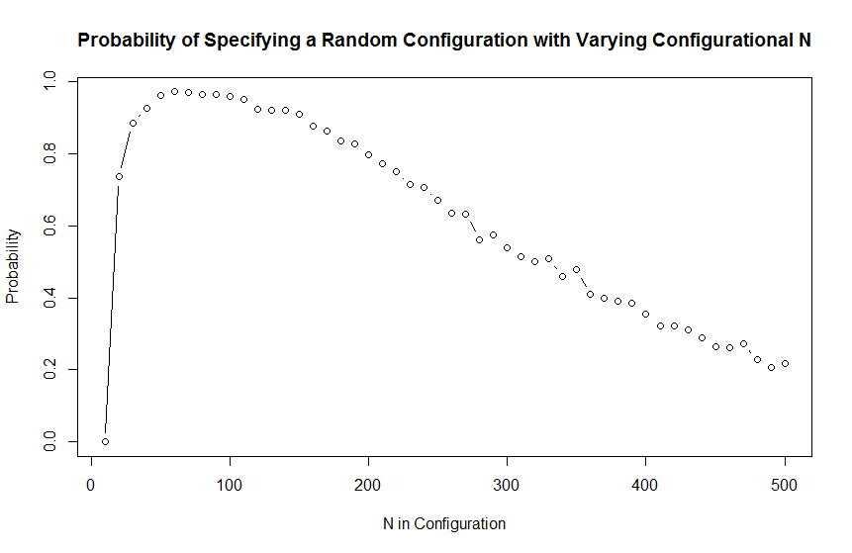
Sample Size

Slide 24
Part 2

Slide 25
Configural Analysis
fsQCA
Outcome: (not) predicting a spurious configuration
Causal conditions:
  consistency threshold
  n configurations
  sample size
  complex and parsimonious solutions

Slide 26
Researcher Choice
Consistency threshold:
  .95
Configurational n threshold:
  5 (number of simulations ran)
Ran both parsimonious and complex solutions

Slide 27
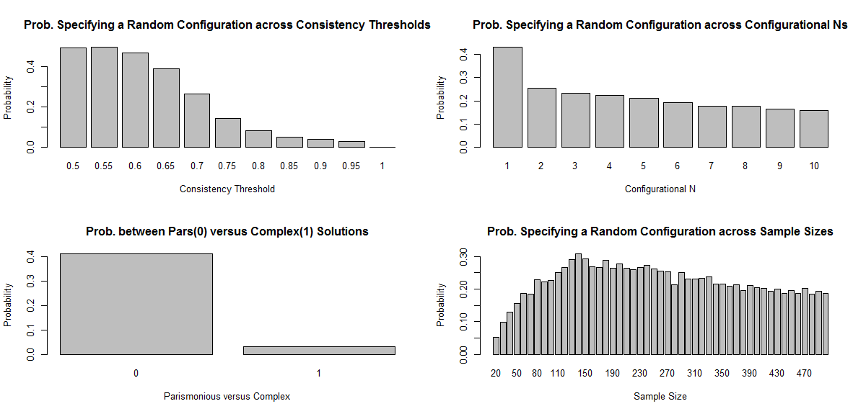

Slide 28
TruthTable
 | CTH | CNTH | COM | NTH | OUT | n | incl
1 | 0 | 0 | 0 | 0 | 0 | 216 | 0.515
2 | 0 | 0 | 0 | 1 | 0 | 3240 | 0.354
3 | 0 | 0 | 1 | 0 | 1 | 216 | 1
4 | 0 | 0 | 1 | 1 | 0 | 3240 | 0.893
5 | 0 | 1 | 0 | 0 | 0 | 270 | 0.866
6 | 0 | 1 | 0 | 1 | 0 | 4050 | 0.434
7 | 0 | 1 | 1 | 0 | 1 | 270 | 1
8 | 0 | 1 | 1 | 1 | 1 | 4050 | 1
9 | 1 | 0 | 0 | 0 | 0 | 180 | 0.709
10 | 1 | 0 | 0 | 1 | 0 | 2700 | 0.885
11 | 1 | 0 | 1 | 0 | 1 | 180 | 1
12 | 1 | 0 | 1 | 1 | 1 | 2700 | 0.995
13 | 1 | 1 | 0 | 0 | 0 | 225 | 0.945
14 | 1 | 1 | 0 | 1 | 0 | 3375 | 0.946
15 | 1 | 1 | 1 | 0 | 1 | 225 | 1
16 | 1 | 1 | 1 | 1 | 1 | 3375 | 1

Slide 29
Solution
S1: CNTH*COM + COM*nth + CTH*COM => out
incl cov.r cov.u
--------------------------------
1 CNTH*COM 1.000 0.338 0.174
2 COM*nth 1.000 0.052 0.011
3 CTH*COM 0.998 0.248 0.093
--------------------------------
S1 0.999 0.450

Slide 30
Approaching Diagnostic Assessment
We can find configurations of thresholds that make it highly unlikely that random configurations are returned
  “I am 95% confident this configuration is not due to random chance!”

Slide 31
Future Approaches
fsQCA
sparsity
constant N
distributional assumptions of causal conditions

Slide 32
Conclusions
In these conditions, csQCA typically rejects random patterns at reasonable thresholds of analysis
(fsQCA is likely even more robust)

Slide 33
Conclusions
It is possible to distinguish any returned configuration with random chance configurations, specific to the data set analyzed.

