Slide 1

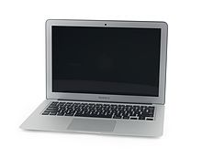
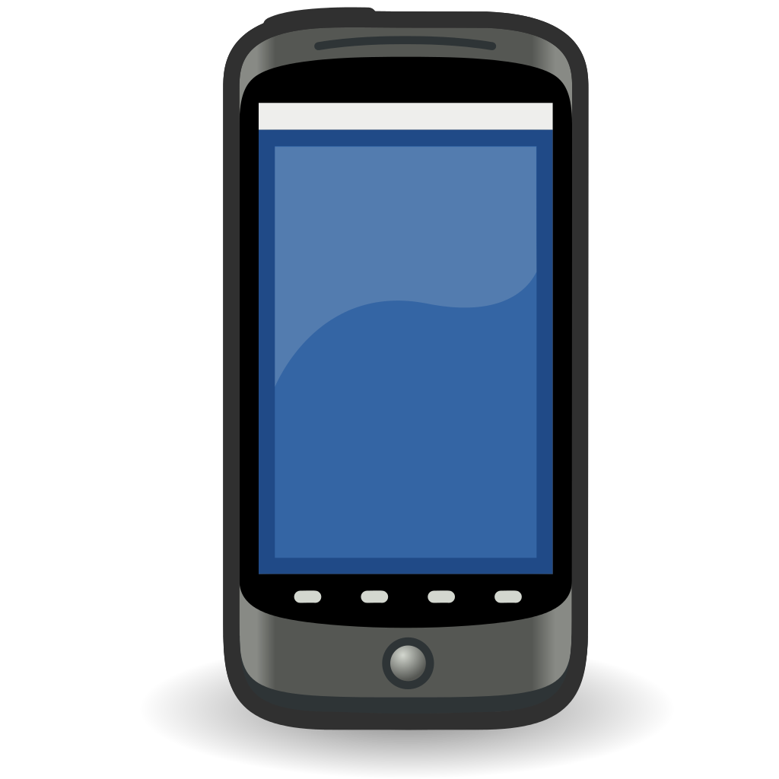
/hv/sensor/voltage/chan1 >
< /hv/switch/chan1 on/off
Gateway
HV
interface
InfluxDB
LV
interface
/lv/*
Telegraf
Grafana
Dashboard
PH2ACF
interface
/ph2acf/*
PH2ACF
interface
user
https
MQTT
Broker
/switch/s1 on
/switch/s1 off
/relay/r1 2
ESP8266
controller
ESP8266
controller
Nodered
~ labview
pushbullet
/sensor/temperature/t1
/sensor/humidity/h1
...
ESP8266
sensor
ESP8266
controller

