Slide 1

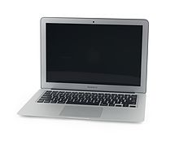
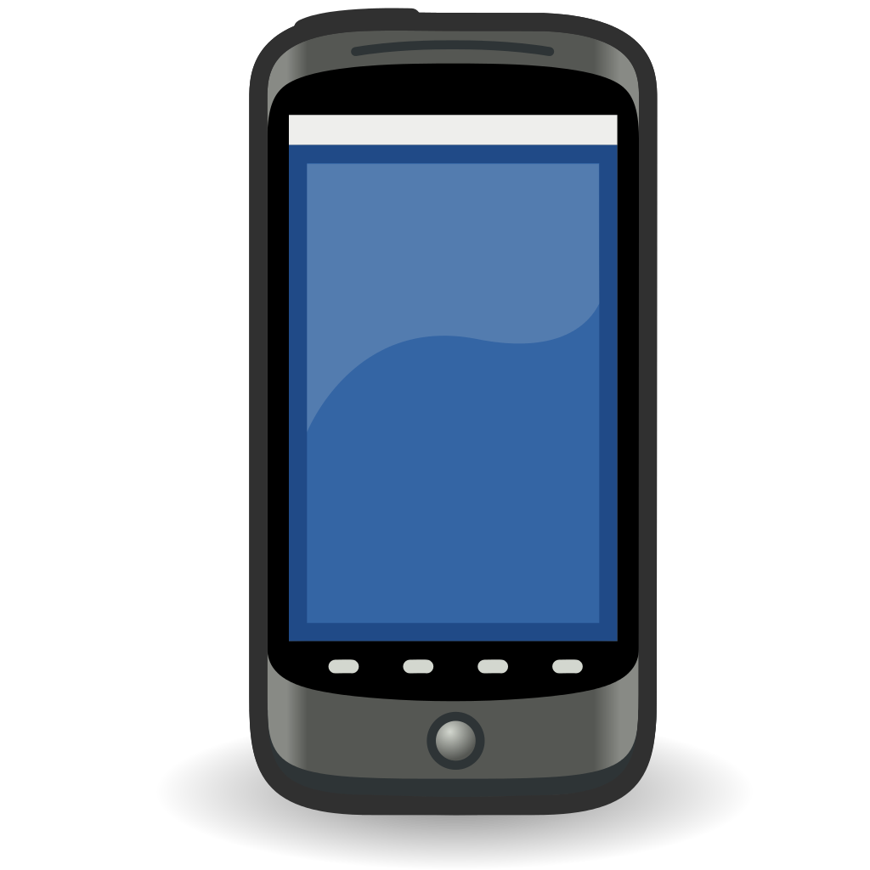
MongoDB
Gateway
PH2ACF
interface
/ph2acf/runcalib
(or whatever)
InfluxDB
/hv/status/voltage/ch1 200. >
< /hv/cmd/switch/ch1 on/off
< /hv/cmd/setv/ch1 200.
HV
interface
Telegraf
Grafana
Dashboard
user
LV
interface
/lv/* (same as HV)
https
MQTT
Broker
/switch/s1 on/off
/relay/r1 2
ESP8266
controller
ESP8266
controller
Nodered
~ labview
pushbullet
/sensor/temperature/t1
/sensor/humidity/h1
...
ESP8266
sensor
ESP8266
controller

