Slide 1
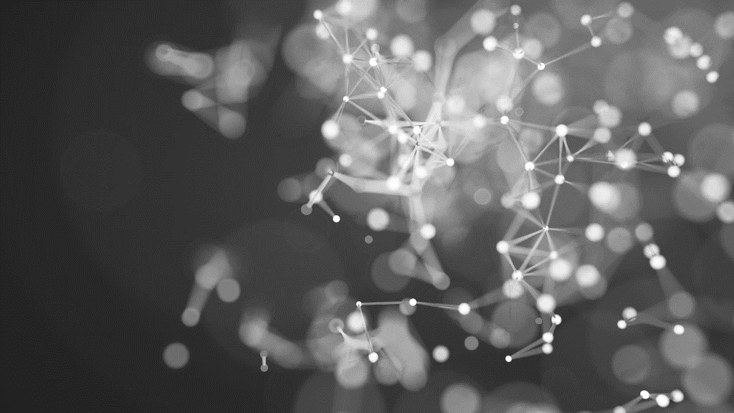
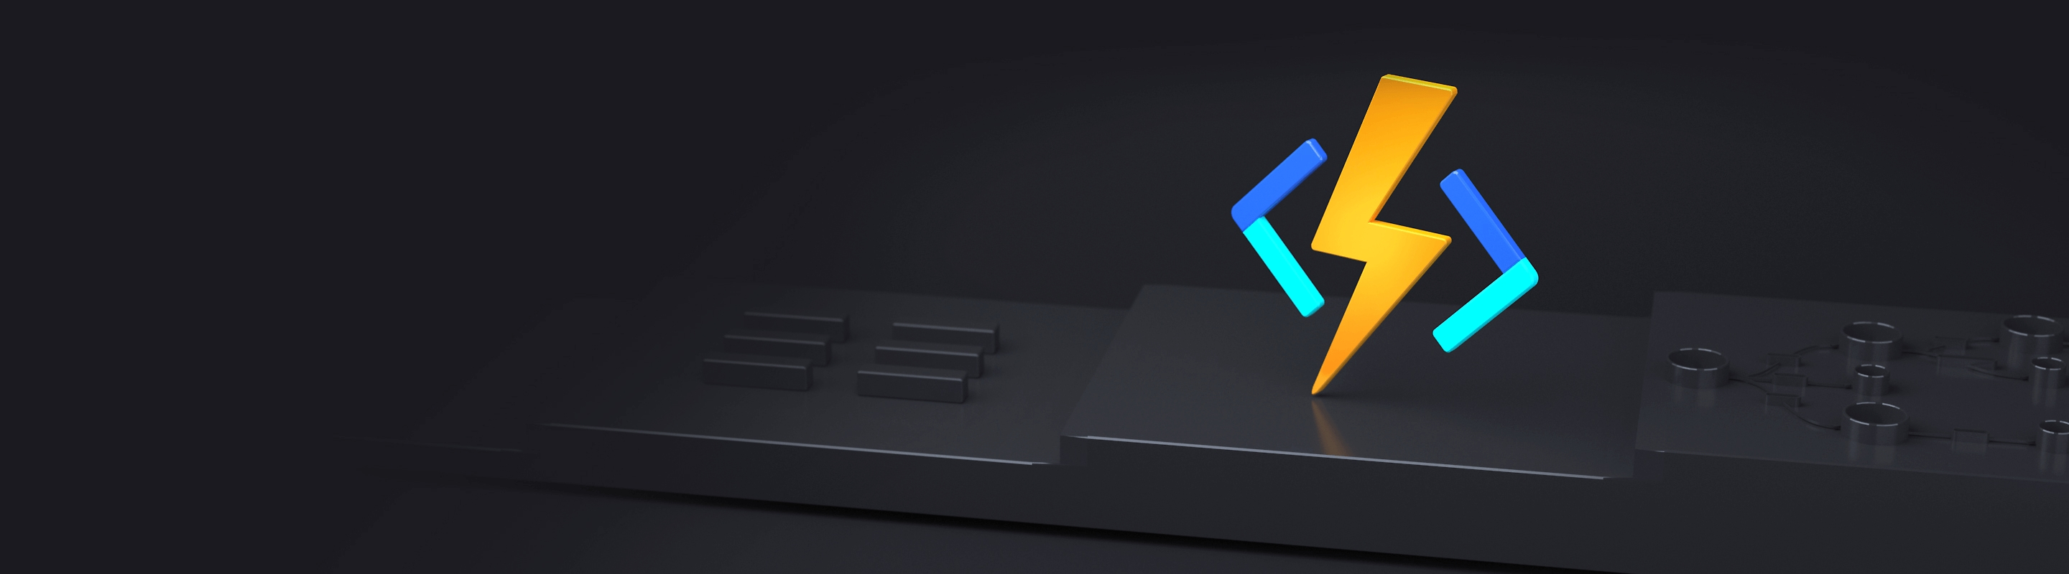
Introduction to durable functions
Presented to swfl coderS
01.11.2024

Slide 2
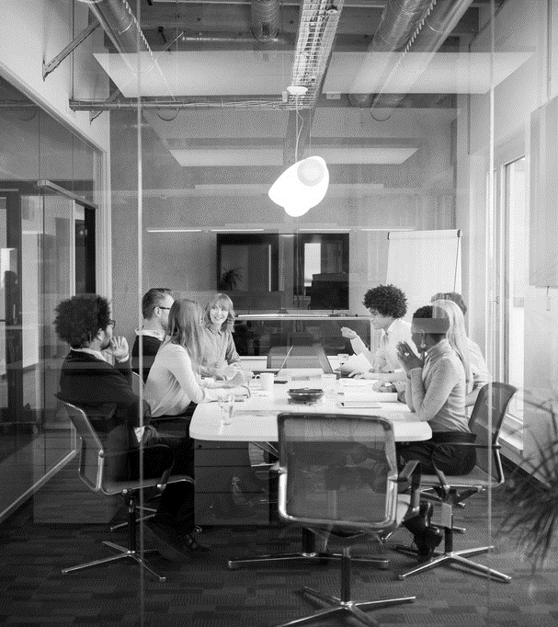
Agenda
INTRODUCTION
BUILD YOUR FIRST ORCHESTRATION
FAN OUT/FAN IN PATTERN
RUNNING LONG WITH EVENTS
CLOSING

Slide 3
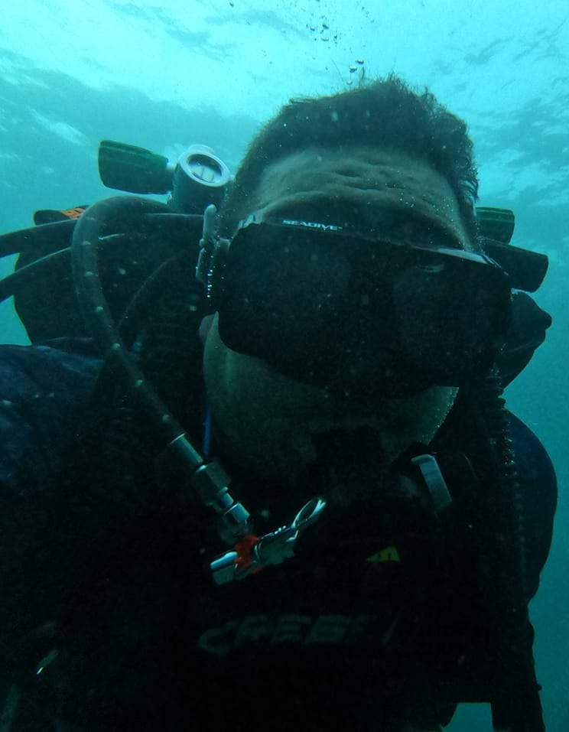
INTRODUCTION
ABOUT ME
Over 25 years of experience in engineering scalable solutions and architecture
Currently a Lead Cloud Solutions Designer at Jackson National Life Insurance NYSE: JXN
Enjoys software architecture, simplifying software design and practical performance in cloud applications
Currently learning Technical Diving Decompression Procedures
Private pilot
https://github.com/cberthold/presentations

Slide 4
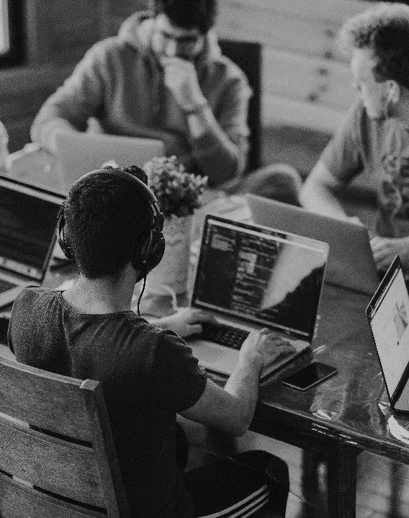
INTRODUCTION
WHAT IS A DURABLE FUNCTION?
Durable Functions is an extension of Azure Functions
Allows writing Stateful Workflows
Orchestrations
Activities for I/O
Extension manages state
Multiple Languages (C#, Java, Python, JS, TS, PS)
More control and easier to test than low-code solutions (Logic Apps)

Slide 5
INTRODUCTION
GLOSSARY
DETERMINISTIC FUNCTION
Always returns the result if given the same inputs
CLIENT
Starts or sends commands to orchestrator - START
ORCHESTRATION
Orchestrates execution of other durable functions – WHAT
ACTIVITY
Executes logic and I/O (API, Storage) - HOW

Slide 6
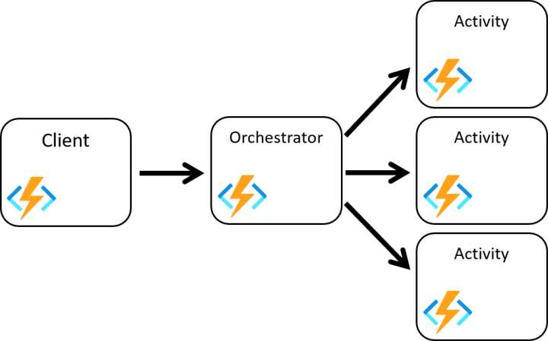
INTRODUCTION
Flow Diagram

Slide 7


INTRODUCTION
Example Orchestration
Customer Places Pizza Order
Send Order to Store
Make Pizza
Wait for Pizza Made
Clicks Pizza Made
Send Customer Notification

Slide 8
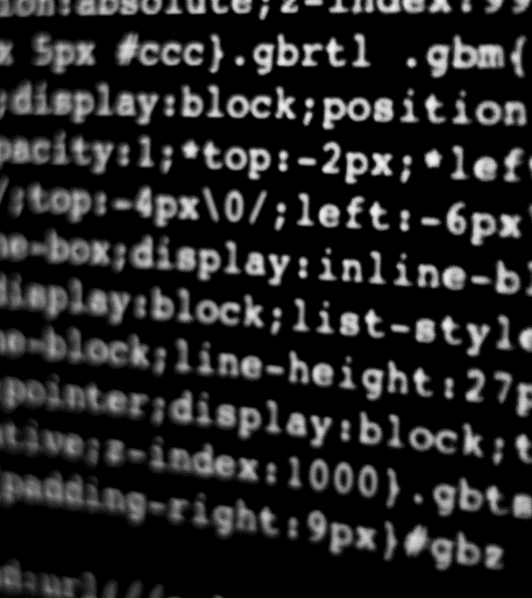
BUILDING YOUR FIRST ORCHESTRATION

Slide 9
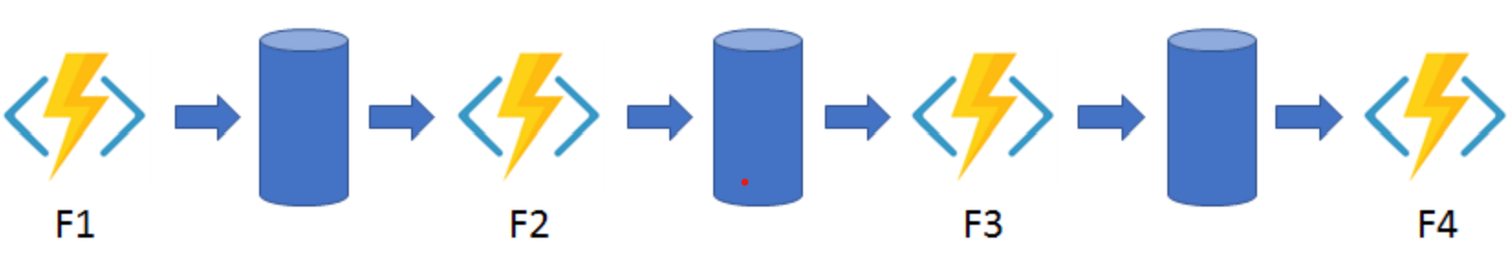
FUNCTION CHAINING

Slide 10
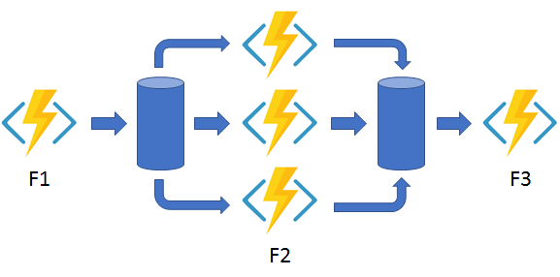
FAN OUT/FAN IN

Slide 11
LONG RUNNING
WAITING FOR EVENTS
Customer Places Pizza Order
Send Order to Store
Make Pizza
Wait for Pizza Made
Clicks Pizza Made
Send Customer Notification

Slide 12
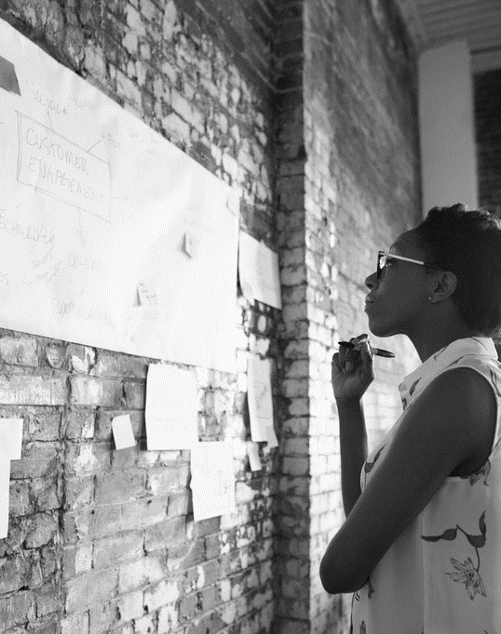
SUMMARY
USE DURABLE FUNCTIONS TO AUTOMATE COMPLEX INTEGRATIONS
USE EVENTS TO MODEL ASYNCHRONOUS PROCESSES AND HUMAN INTERACTIONS
GREAT RESOURCES
https://learn.microsoft.com/en-us/azure/azure-functions/durable/durable-functions-overview
https://github.com/microsoft/DurableFunctionsMonitor

Slide 13



THANK YOU
CHRIS BERTHOLD
@chrisberthold
cberthold@technodotnet.com

