Slide 1

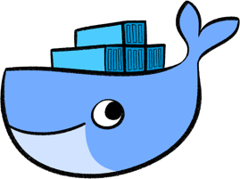

Thinking in Docker
Learn to think in docker and output success

Slide 2
Chris Berthold : Fearless Live Presenter
Over 20 years of development experience developing software and doing DevOps/network administration
10 years of business development in a manufacturing setting
6 years of development as software consultant
5 years with the awesome Product Development Team for Flightdocs
Private pilot
Enjoys software architecture, simplifying software design and practical performance in applications, and engaging others in software architecture
http://github.com/cberthold/presentations

Slide 3
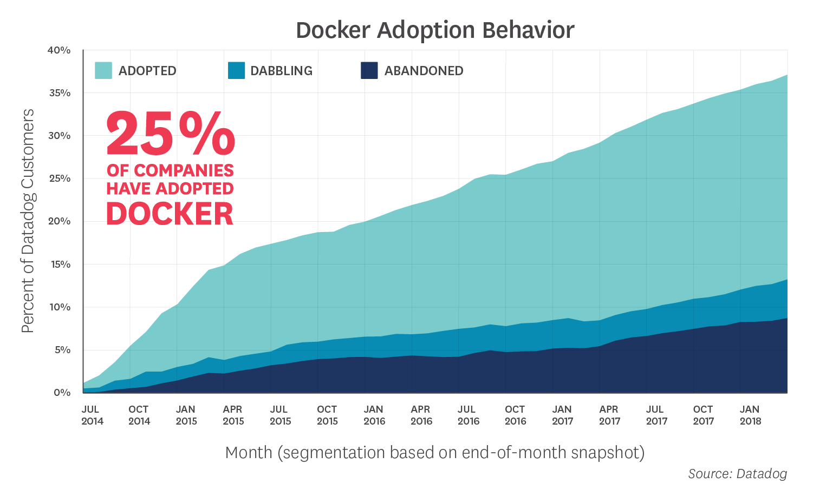
The Rise of Docker
https://www.datadoghq.com/docker-adoption/

Slide 4
The Evolution of Building Units of Computation
1995 – The internet takes rise on the Physical Machine
Weeks or Months to acquire and days to deploy an application
2000 – x86 Virtualization on VMWare
Days to build new Image and hours to deploy
2003 – Xen and Virtual PC
2006-2008 – Open Source/Free VMWare, Virtual PC, Virtual Box, Hyper-V
2014 – Docker starts
2015 – Everyone wants to use Docker
Minutes to build an image and seconds to deploy

Slide 5
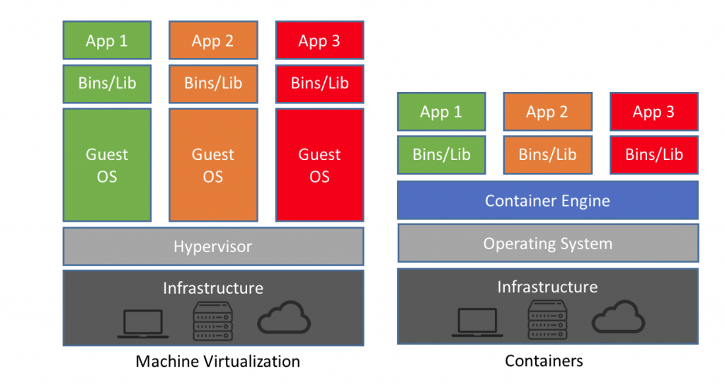
Comparing Virtualization and Containers

Slide 6
Let’s try a simple example
START IT UP!

Slide 7
Docker Workflow
Build
Dockerfile
Build environment variables
Ship
Push Image to Docker Repository
Run
Runtime environment variables
EXPOSE Ports out
Source code
RUN
Persistent VOLUME

Slide 8
Let’s Build our First Dockerfile
Demo time!!!

Slide 9
Ship that Container
Let’s see how we can build CI/CD

Slide 10
Debugging Docker
Demo time!!!

Slide 11
Components to a Good Docker Image
Environment Variables IN
build configuration – changes what builds or runs during build
runtime configuration – changes how the application runs
docker build -> image
Immutable unit of deployment
docker run image -> Ports and /or Process OUT
Port mapping and environment variables added for runtime
These are SOLID principles for building images
Environments IN -> Running Process -> Ports OUT

Slide 12
Working with files
Demo time!!!

Slide 13
Composing Services
Demo time!!!

Slide 14
Problems Docker Solves
Works on my machine!
Running from Docker reduces variables to only being differences in configuration and database state
I can’t run one of those!
Allows running services that are typically hard to run on your own
Do I have all of the same dependencies?
Containers derive their security from the container plus installed dependencies
I want to try x

Slide 15
Tips & Tricks to use Docker
Focus on a single problem at a time
I want to build my application in a container
I then want to deploy my application
I then want to add environment variables for multiple environments
It’s ok not to use Docker for everything
It can solve a lot of problems but solving all problems with Docker can be challenging without experience
Pay attention to your build size
Each command increases the number of incremental images
Build things that change less frequently first

Slide 16
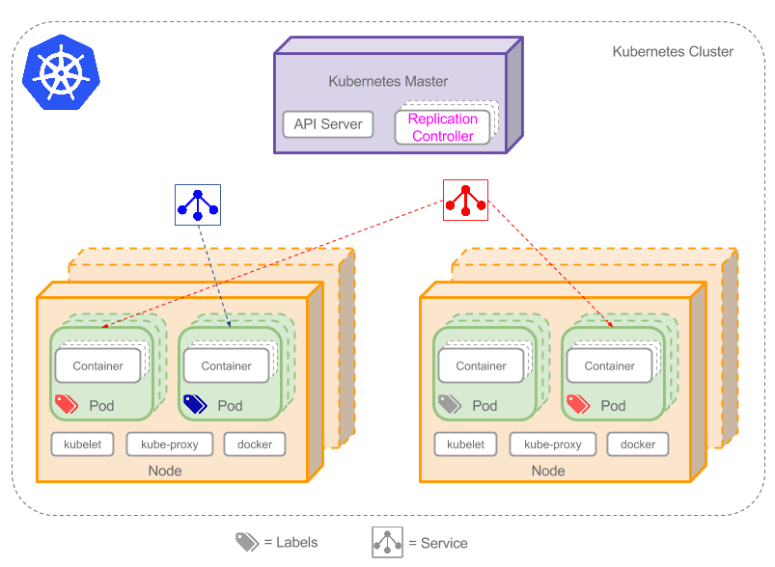
The Future IS Here

Slide 17
Resources
Lots of tips
https://nickjanetakis.com/blog/tag/docker-tips-tricks-and-tutorials
Cheat Sheet
https://github.com/wsargent/docker-cheat-sheet

Slide 18

Thank You
MMMMMMM Beer

