Slide 1
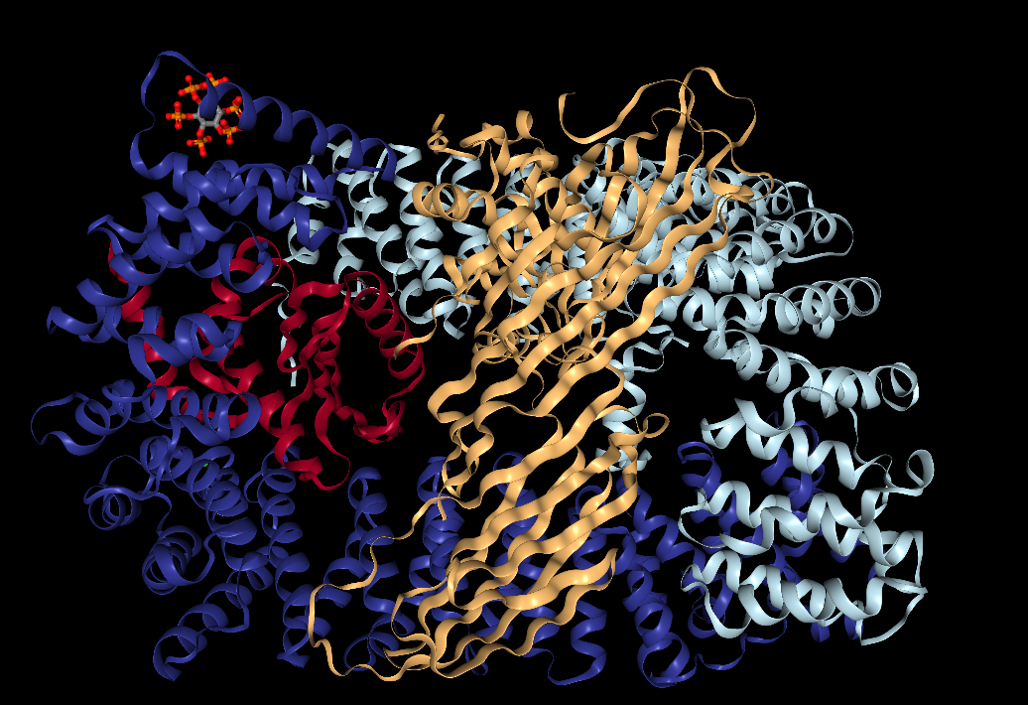
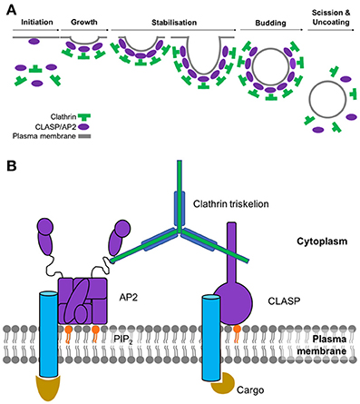
Analysis of Motif Distributions in Regions of Endocytic Proteins
Chante Bethell¹ , Zuzana Kadlecova PhD², and Stephanie J. Spielman, PhD³
¹Bioinformatics Program, Rowan University
² Cambridge Institute for Medical Research, Cambridge University, UK
³Department of Biological Sciences, Rowan University
Abstract
A short linear motif (SLiM) is a recurring pattern of approximately three to ten amino acids found in proteins. SLiMs are important for cellular signaling and the regulating of proteins, often times by acting as binding sites for protein-binding domains. While SLiMs exist both in ordered regions of proteins where there is a tertiary structure and in disordered regions where there is no structure, they are primarily functional in disordered regions. An important example of SLiM-mediated processes and the focus of this study is endocytosis. Endocytosis is the process by which cells engulf molecules from the extracellular environment. There are specific motifs that mediate and trigger endocytosis. However, the short length of motifs means that it is easy to overlook those that may be important to biological functions. The goal of this study is to identify previously unrecognized proteins that may be involved in endocytosis by analyzing the distribution of motifs in the ordered and disordered regions of the human proteome. Using a bioinformatics approach, we systematically searched the entire human proteome for motifs known to be involved in endocytosis. We hypothesize that the proteins we find to be enriched with motifs in disordered regions may be functionally important for endocytosis. These proteins will be targeted for experimental validation.
Figure 2A: Steps of the clathrin-coated pit formation.² Figure 2B: The major players in the initiation of CME. The cargo binds to its respective transmembrane receptor, which AP2 then binds to in order to create a bridge to clathrin.²
Figure 1: The AP2 Protein Adaptor Complex, colored by its subunits: AP2A, AP2B1, AP2S1, AP2M1.¹
Figure 3: This plot shows motif distributions for the known the CME proteins (the five subunits of AP2 and the associated kinase, AAK1).
Distribution of select CME motifs across the human proteome
These plots represent heatmaps of proteins organized by their distribution in the disordered and ordered regions for the several endocytic motifs. Each rectangle (or hexagon) is colored based on the number of proteins that have the respective number of motif instances in the ordered and disordered regions. The rectangles found above the green y=x line on each plot represent the proteins that are enriched for the motif in the disordered regions.
A subset of identified candidate CME proteins
Conclusions
The distribution of motifs in the disordered versus ordered regions are not always enriched in endocytic proteins.
We identify dozens of proteins that are enriched for CME motifs in their disordered regions. These can be targeted for further experimental testing for involvement in the CME pathway.
Many of these identified proteins are not experimentally characterized with functional motifs according to the Eukaryotic Linear Motif database (http://elm.eu.org/).
Protein name⁴ | UNIPROT accession ID | Disordered Region Count | Ordered Region Count | Motif | Select Gene Ontology (GO) terms⁴
Insulin receptor substrate 2 | Q9Y4H2 | 17 | 1 | YXX[LIMFV] | Insulin receptor binding, protein kinase binding, brain development, lipid homeostasis, signal transduction
Insulin receptor substrate 1 | P35568 | 14 | 0 | YXX[LIMFV] | Insulin receptor binding, transmembrane receptor protein tyrosine kinase adaptor activity, glucose homeostasis
Transport protein Sec24B | O95487 | 11 | 2 | YXX[LIMFV] | Coat protein complex II (COPII) vesicle cargo loading, COPII vesicle coating, intracellular protein transport
Protein PRRC2A | P48634 | 10 | 0 | YXX[LIMFV] | RNA binding
Mucin-16 | Q8WXI7 | 10 | 1 | YXX[LIMFV] | Cell adhesion, stimulatory C-type lectin receptor signaling pathway, transmembrane domain
Trichohyalin | Q07283 | 14 | 1 | X[DE]XXXL[LI] | Calcium ion binding, transition metal ion binding, intermediate filament organization
Uncharacterized protein FLJ40521 | Q8N7P7 | 12 | 0 | X[DE]XXXL[LI] | -
Golgin subfamily A member 6-like protein 4 | A6NEF3 | 11 | 0 | X[DE]XXXL[LI] | Cellular component of the Golgi apparatus
Coiled-coil domain-containing protein 136 | Q96JN2 | 11 | 0 | X[DE]XXXL[LI] | Acrosome assembly, single fertilization, spermatogenesis, transmembrane domain
Mucin-17 | E7EPM4 | 9 | 0 | X[DE]XXXL[LI] | Cellular homeostasis, O-glycan processing, stimulatory C-type lectin receptor signaling pathway
Receptor protein-tyrosine kinase | E9PFD7 | 3 | 0 | NPXY | ATP binding, transmembrane receptor protein tyrosine kinase signaling pathway
Transmembrane channel-like protein | F5GYU8 | 3 | 0 | NPXY | Integral component of plasma membrane
Calreticulin | K7EJB9 | 3 | 0 | NPXY | Calcium ion binding, unfolded protein binding, protein folding
Calmegin | O14967 | 3 | 0 | NPXY | Calcium ion binding, protein folding chaperone, unfolded protein binding, binding of sperm to zona pellucida, transmembrane domain
Receptor protein-tyrosine kinase | B4DTR1 | 2 | 0 | NPXY | ATP binding, transmembrane receptor protein tyrosine kinase activity
Mucin-19 | Q7Z5P9 | 119 | 1 | [ST]XXXX[LI] | O-glycan processing, stimulatory C-type lectin receptor signaling pathway
Mucin-17 | E7EPM4 | 114 | 1 | [ST]XXXX[LI] | Cellular homeostasis, O-glycan processing, stimulatory C-type lectin receptor signaling pathway
Mucin-4 | A0A0G2JR46 | 72 | 0 | [ST]XXXX[LI] | Epithelial structure maintenance, regulation of signaling receptor activity
Kruppel-like factor 18 protein | A0A0U1RQI7 | 51 | 1 | [ST]XXXX[LI] | Regulation of transcription by RNA polymerase II, nucleic acid binding
Adenomatous polyposis coli protein | P25054 | 42 | 7 | [ST]XXXX[LI] | Protein kinase regulator activity, cell adhesion, cell migration, cell cycle arrest
Bibliography
RCSB Protein Data Bank. (n.d.). 4UQI. Retrieved April 10, 2019, from https://www.rcsb.org/3d-view/4UQI/1
Smith SM, Baker M, Halebian M and Smith CJ (2017) Weak Molecular Interactions in Clathrin-Mediated Endocytosis. Front. Mol. Biosci. 4:72. doi: 10.3389/fmolb.2017.00072
Tidyverse. (n.d.). Retrieved from https://www.tidyverse.org/
UniProt: A worldwide hub of protein knowledge. (2018). Nucleic Acids Research, 47(D1). doi:10.1093/nar/gky1049
All code and data is available from https://github.com/cbethell/motifs

