Slide 1

Introduction to Probabilistic Machine Learning
Ralf Herbrich, Rainer Schlosser
Tutorial 6 – Recap Theory Unit 6

Slide 2
Overview
Questions and Updates
Recap: Main Concepts of Unit 6
Example: TrueSkill 1 vs 1
Hints for Exercise 3 (to be handed in Monday June 2)

Slide 3
Course Overview
Week | Topic Lecture | Tutorial | Exercises
07.04. & 08.04. | 1 Probability Theory | Intro Julia
14.04. & 15.04. | 2 Inference Methods and Decision-Making | no tutorial | Exercise 1
21.04. & 22.04. | no lecture | Theory Unit 1 & 2 | (14.04. – 08.05.)
28.04. & 29.04. | 3 Graphical Models: Independence | Theory Unit 3
05.05. & 06.05. | 4 Graphical Models: Exact Inference | Theory Unit 4 | Exercise 2
12.05. & 13.05. | 5 Graphical Models: Approximate Inference | Theory Unit 5 | (05.05. – 19.05.)
19.05. & 20.05. | 6 Bayesian Ranking | Theory Unit 6 | Exercise 3
26.05. & 27.05. | 7 Linear Basis Function Models | Theory Unit 7 | (19.05. – 02.06.)
02.06. & 03.06. | 8 Bayesian Regression | Theory Unit 8 | Exercise 4
09.06. & 10.06. | no lecture | 9 Bayesian Classification | (02.06. – 23.06.)
16.06. & 17.06. | 10 Non-Bayesian Classification Learning | Theory Unit 9 & 10
23.06. & 24.06. | 11 Gaussian Processes | Theory Unit 11 | Exercise 5
30.06. & 01.07. | 12 Information Theory | Theory Unit 12 | (23.06. – 07.07.)
07.07. & 08.07. | 13 Real-World Applications

Slide 4
Overview
Questions and Updates
Recap: Main Concepts of Unit 6
Example: TrueSkill 1 vs 1
Hints for Exercise 3 (to be handed in Monday June 2)

Slide 5
Recap Unit 6: Overview of Concepts and Focus
a) Bayesian Ranking: TrueSkill
Gaussian Messages in Factor Graphs
Approximated Messages (Truncated Gaussians)

Slide 6














TrueSkill Factor Graphs (Case 1 vs 1)
Bayesian Network
Factor Graph
$$𝒩\left(s_{i};μ_{i},σ_{i}^{2}\right)$$
$$s_{1}$$
$$s_{2}$$
$$s_{1}$$
$$s_{2}$$
$$p_{1}$$
$$p_{2}$$
$$𝒩\left(p_{i};s_{i},β^{2}\right)$$
$$p_{1}$$
$$p_{2}$$
$$y$$
$$δ\left(d_{1,2}−\left(p_{1}−p_{2}\right)\right)$$
$$d_{1,2}$$
$$𝕀\left(d_{1,2}>0\right)$$

Slide 7


























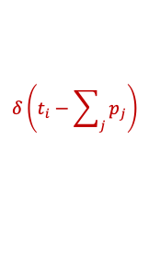
Generalized: TrueSkill Factor Graphs (Case 1 vs 2 vs 1)
Bayesian Network
Factor Graph
$$s_{1}$$
$$s_{2}$$
$$s_{3}$$
$$s_{4}$$
$$𝒩\left(s_{i};μ_{i},σ_{i}^{2}\right)$$
$$t_{1}$$
$$t_{2}$$
$$t_{3}$$
$$s_{1}$$
$$s_{2}$$
$$s_{3}$$
$$s_{4}$$
$$𝒩\left(p_{i};s_{i},β^{2}\right)$$
$$y_{1,2}$$
$$y_{2,3}$$
$$p_{1}$$
$$p_{2}$$
$$p_{3}$$
$$p_{4}$$
$$δ\left(t_{i}−\sum_{j}{p_{j}}\right)$$
$$t_{1}$$
$$t_{2}$$
$$t_{3}$$
$$δ\left(d_{i,j}−\left(t_{i}−t_{j}\right)\right)$$
$$d_{1,2}$$
$$d_{2,3}$$
$$𝕀\left(d_{i,j}>0\right)$$

Slide 8


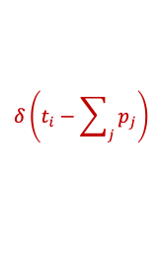















(Approximate) Message Passing in TrueSkill Factor Graphs
TrueSkill Factor Graph
Four Phases
  Pass prior messages (1)
  Pass messages down to the team performances (2 to 3)
  Iterate the approximate messages on the pairwise team differences (4 to 9)
  Pass messages back from up from team performances to player skill (10 – 12)
Since this is a tree, the algorithm is guaranteed to converge!
$$𝒩\left(s_{i};μ_{i},σ_{i}^{2}\right)$$
1
1
1
1
$$s_{1}$$
$$s_{2}$$
$$s_{3}$$
$$s_{4}$$
12
12
12
12
$$𝒩\left(p_{i};s_{i},β^{2}\right)$$
2
2
2
2
$$p_{1}$$
$$p_{2}$$
$$p_{3}$$
$$p_{4}$$
11
11
$$δ\left(t_{i}−\sum_{j}{p_{j}}\right)$$
11
11
3
3
3
$$t_{1}$$
$$t_{2}$$
$$t_{3}$$
$$δ\left(d_{i,j}−\left(t_{i}−t_{j}\right)\right)$$
10
6
9
10
4
7
$$d_{1,2}$$
$$d_{2,3}$$
5
8
$$𝕀\left(d_{i,j}>0\right)$$

Slide 9





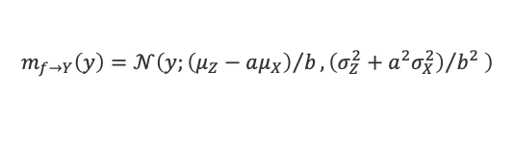


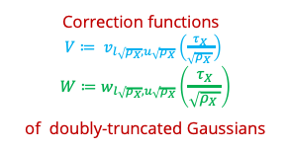




















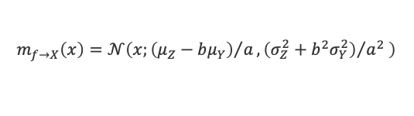
Message Update Equations (2025)
Gaussian Factor $𝒩\left(X;μ,σ^{2}\right)$
Gaussian Mean Factor $𝒩\left(Y;X,β^{2}\right)$
$$m_{f→X}\left(⋅\right)$$
$$𝒩\left(⋅;μ_{X},σ_{X}^{2}\right)$$
$$m_{f→Y}\left(⋅\right)$$
$$X$$
$$X$$
$$Y$$
$$m_{f→X}\left(⋅\right)$$
$$𝒩\left(⋅;μ_{Y},σ_{Y}^{2}\right)$$
$$m_{f→X}\left(x\right)=𝒩\left(x;μ,σ^{2}\right)$$
$$m_{f→Y}\left(y\right)=𝒩\left(y;μ_{X},σ_{X}^{2}+β^{2}\right)$$
$$m_{f→X}\left(x\right)=𝒩\left(x;μ_{Y},σ_{Y}^{2}+β^{2}\right)$$
Correction functions
$V≔ v_{l\sqrt{ρ_{X}},u\sqrt{ρ_{X}}}\left(\frac{τ_{X}}{\sqrt{ρ_{X} }}\right)$
$$W≔w_{l\sqrt{ρ_{X}},u\sqrt{ρ_{X}}}\left(\frac{τ_{X}}{\sqrt{ρ_{X} }}\right)$$
of doubly-truncated Gaussians
Weighted Sum Factor $δ\left(Z−\left(aX+bY\right)\right)$
Between Factor $𝕀\left(l≤X<u\right)$
$$X$$
$$m_{f→Y}\left(⋅\right)$$
$$m_{f→X}\left(⋅\right)$$
$$Y$$
$$𝒩\left(⋅;μ_{X},σ_{X}^{2}\right)$$
$$𝒩\left(⋅;μ_{Y},σ_{Y}^{2}\right)$$
$${\hat{m}}_{f→X}\left(⋅\right)$$
$$X$$
$$𝒩\left(⋅;μ_{Z},σ_{Z}^{2}\right)$$
$$m_{f→Z}\left(⋅\right)$$
$$𝒢\left(⋅;τ_{X},ρ_{X}\right)$$
$$Z$$
$$m_{f→Z}\left(z\right)=𝒩\left(z;aμ_{X}+bμ_{Y},a^{2}σ_{X}^{2}+b^{2}σ_{Y}^{2}\right)$$
$${\hat{m}}_{f→X}\left(x\right)=𝒢\left(x;\sqrt{ρ_{X}}⋅\frac{V}{1−W}+τ_{X}⋅\frac{W}{1−W},ρ_{X}⋅\frac{W}{1−W}\right)$$
$$m_{f→Y}\left(y\right)=𝒩\left(y;{\left(μ_{Z}−aμ_{X}\right)}/b,{\left(σ_{Z}^{2}+a^{2}σ_{X}^{2}\right)}/{b^{2}} \right)$$
$$m_{f→X}\left(x\right)=𝒩\left(x;{\left(μ_{Z}−bμ_{Y}\right)}/a,{\left(σ_{Z}^{2}+b^{2}σ_{Y}^{2}\right)}/{a^{2}} \right)$$

Slide 10
Message Update Equations (2024)
Gaussian Factor
Gaussian Mean Factor
$$m_{f→x}\left(x\right)$$
$$𝒩\left(x;μ,σ^{2}\right)$$
$$m_{f→y}\left(y\right)$$
$$𝒩\left(x;μ,σ^{2}\right)$$
$$x$$
$$x$$
$$y$$
$$𝒩\left(y;x,β^{2}\right)$$
$$m_{f→x}\left(x\right)=𝒩\left(x;μ,σ^{2}\right)$$
$$m_{f→y}\left(y\right)=\int{𝒩\left(y;x,β^{2}\right)⋅𝒩\left(x;μ,σ^{2}\right) dx}=𝒩\left(y;μ,σ^{2}+β^{2}\right)$$
Weighted Sum Factor
Greater-Than Factor
$$x$$
$$y$$
$$δ\left(z−\left(ax+by\right)\right)$$
$${\hat{m}}_{f→x}\left(x\right)$$
$$𝒩\left(x;μ_{x},σ_{x}^{2}\right)$$
$$𝒩\left(y;μ_{y},σ_{y}^{2}\right)$$
$$x$$
$$m_{f→z}\left(z\right)$$
$$𝕀\left(x>0\right)$$
$$𝒩\left(x;μ,σ^{2}\right)$$
$$z$$
Mean and variance of
a truncated Gaussian $𝒩\left(x;μ,σ^{2}\right)$
$$m_{f→z}\left(z\right)=𝒩\left(z;aμ_{x}+bμ_{y},a^{2}σ_{x}^{2}+b^{2}σ_{y}^{2}\right)$$
$${\hat{m}}_{f→x}\left(x\right)=\frac{\hat{p}\left(x\right)}{m_{x→f}\left(x\right)}=\frac{𝒩\left(x;\hat{μ},{\hat{σ}}^{2} \right)}{𝒩\left(x;μ,σ^{2}\right)}$$

Slide 11
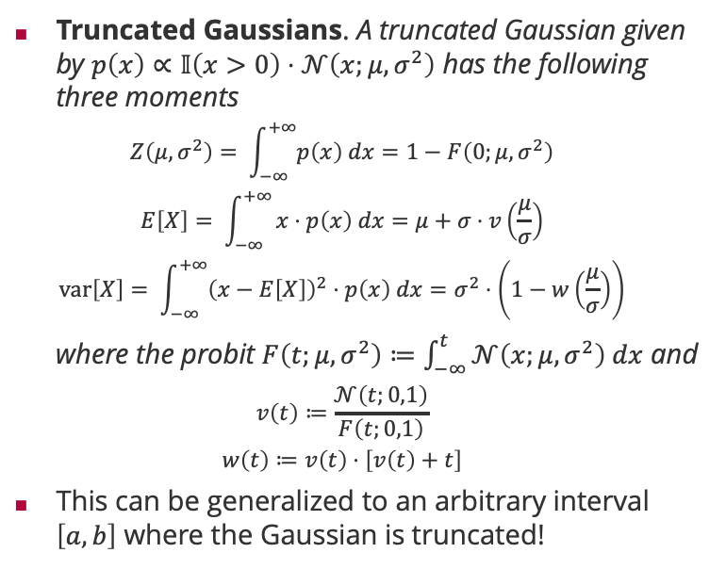
Recap: Truncated Gaussians (2024)
Truncated Gaussians. A truncated Gaussian given by $p\left(x\right)∝𝕀\left(x>0\right)⋅𝒩\left(x;μ,σ^{2}\right)$ has the following three moments
  $$Z\left(μ,σ^{2}\right)= \int_{−∞}^{+∞}{p\left(x\right) dx=1−F\left(0;μ,σ^{2}\right)}$$
  $$E\left[X\right]= \int_{−∞}^{+∞}{x⋅p\left(x\right) dx=μ+σ⋅v\left(\frac{μ}{σ}\right)}$$
  $$var\left[X\right]= \int_{−∞}^{+∞}{{\left(x−E\left[X\right]\right)}^{2}⋅p\left(x\right) dx=σ^{2}⋅\left(1−w\left(\frac{μ}{σ}\right)\right)}$$
  where the probit $F\left(t;μ,σ^{2}\right)≔\int_{−∞}^{t}{𝒩\left(x;μ,σ^{2}\right) dx}$ and
  $$v\left(t\right)≔\frac{𝒩\left(t;0,1\right)}{F\left(t;0,1\right)}$$
  $$w\left(t\right)≔v\left(t\right)⋅\left[v\left(t\right)+t\right]$$
This can be generalized to an arbitrary interval $\left[a,b\right]$ where the Gaussian is truncated!
Follows from definition of $F$
Additive update that
goes to zero as $\frac{μ}{σ}→∞$
Multiplicative update that
goes to 1 as $\frac{μ}{σ}→∞$
Converges to $−t$ as $t→−∞$

Slide 12
Overview
Questions and Updates
Recap: Main Concepts of Unit 5
Example: TrueSkill 1 vs 1
Hints for Exercise 3 (to be handed in Monday June 2)

Slide 13









TrueSkill Factor Graphs (Case 1 vs 1)
Bayesian Network
Factor Graph
$$f_{1}$$
$$f_{3}$$
$$𝒩\left(s_{i};μ_{i},σ_{i}^{2}\right)$$
$$s_{1}$$
$$s_{2}$$
$$s_{1}$$
$$s_{2}$$
$$p_{1}$$
$$p_{2}$$
$$f_{2}$$
$$f_{4}$$
$$𝒩\left(p_{i};s_{i},β^{2}\right)$$
$$p_{1}$$
$$f_{5}$$
$$p_{2}$$
$$y$$
$$δ\left(d−\left(p_{1}−p_{2}\right)\right)$$
$$d$$
$$𝕀\left(d>0\right)$$
$$f_{6}$$

Slide 14














TrueSkill Factor Graphs (Case 1 vs 1): Overall Idea?
Factor Graph
$$f_{1}$$
$$f_{3}$$
$$𝒩\left(s_{i};μ_{i},σ_{i}^{2}\right)$$
$$s_{1}$$
$$s_{2}$$
$$f_{2}$$
$$f_{4}$$
$$𝒩\left(p_{i};s_{i},β^{2}\right)$$
$$p_{1}$$
$$f_{5}$$
$$p_{2}$$
$$δ\left(d−\left(p_{1}−p_{2}\right)\right)$$
$$d$$
$$𝕀\left(d>0\right)$$
$$f_{6}$$

Slide 15
Play 1 Wins: How to Adapt the Skill Beliefs?
Factor Graph
$$f_{1}$$
$$f_{3}$$
$$𝒩\left(s_{i};μ_{i},σ_{i}^{2}\right)$$
$$s_{1}$$
$$s_{2}$$
$$f_{2}$$
$$f_{4}$$
$$𝒩\left(p_{i};s_{i},β^{2}\right)$$
$$p_{1}$$
$$f_{5}$$
$$p_{2}$$
$$δ\left(d−\left(p_{1}−p_{2}\right)\right)$$
$$d$$
$$𝕀\left(d>0\right)$$
$$f_{6}$$

Slide 16
Let’s go Through it: Prior Skill Distributions (Given)
Factor Graph
$$f_{1}$$
$$f_{3}$$
$$𝒩\left(s_{i};μ_{i},σ_{i}^{2}\right)$$
$$s_{1}$$
$$s_{2}$$
$$f_{2}$$
$$f_{4}$$
$$𝒩\left(p_{i};s_{i},β^{2}\right)$$
$$p_{1}$$
$$f_{5}$$
$$p_{2}$$
$$δ\left(d−\left(p_{1}−p_{2}\right)\right)$$
$$d$$
$$𝕀\left(d>0\right)$$
$$f_{6}$$

Slide 17
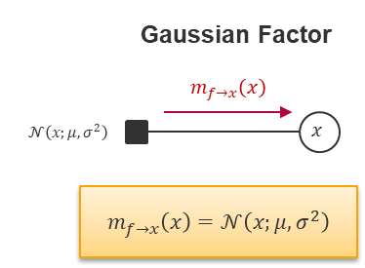
Prior Skill Distributions & Messages (Gaussian Factor)
Factor Graph
$$f_{1}$$
$$f_{3}$$
$$𝒩\left(s_{i};μ_{i},σ_{i}^{2}\right)$$
$$s_{1}$$
$$s_{2}$$
$$f_{2}$$
$$f_{4}$$
$$𝒩\left(p_{i};s_{i},β^{2}\right)$$
$$p_{1}$$
$$f_{5}$$
$$p_{2}$$
$$δ\left(d−\left(p_{1}−p_{2}\right)\right)$$
$$d$$
$$𝕀\left(d>0\right)$$
$$f_{6}$$

Slide 18
Marginals for Skills (Player 1 & 2)
Factor Graph
$$f_{1}$$
$$f_{3}$$
$$𝒩\left(s_{i};μ_{i},σ_{i}^{2}\right)$$
$$s_{1}$$
$$s_{2}$$
$$f_{2}$$
$$f_{4}$$
$$𝒩\left(p_{i};s_{i},β^{2}\right)$$
$$p_{1}$$
$$f_{5}$$
$$p_{2}$$
$$δ\left(d−\left(p_{1}−p_{2}\right)\right)$$
$$d$$
$$𝕀\left(d>0\right)$$
$$f_{6}$$

Slide 19
Factors for Performance (Given)
Factor Graph
$$f_{1}$$
$$f_{3}$$
$$𝒩\left(s_{i};μ_{i},σ_{i}^{2}\right)$$
$$s_{1}$$
$$s_{2}$$
$$f_{2}$$
$$f_{4}$$
$$𝒩\left(p_{i};s_{i},β^{2}\right)$$
$$p_{1}$$
$$f_{5}$$
$$p_{2}$$
$$δ\left(d−\left(p_{1}−p_{2}\right)\right)$$
$$d$$
$$𝕀\left(d>0\right)$$
$$f_{6}$$

Slide 20
Factor for Performance & Messages (Player 1)
Factor Graph
$$f_{1}$$
$$f_{3}$$
$$𝒩\left(s_{i};μ_{i},σ_{i}^{2}\right)$$
$$s_{1}$$
$$s_{2}$$
$$f_{2}$$
$$f_{4}$$
$$𝒩\left(p_{i};s_{i},β^{2}\right)$$
$$p_{1}$$
$$f_{5}$$
$$p_{2}$$
$$δ\left(d−\left(p_{1}−p_{2}\right)\right)$$
$$d$$
$$𝕀\left(d>0\right)$$
$$f_{6}$$

Slide 21
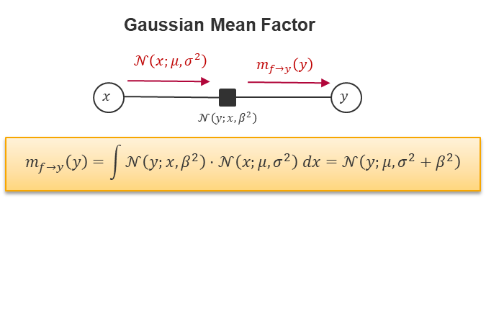
Factor for Performance & Message (Player 1)
Factor Graph
$$f_{1}$$
$$f_{3}$$
$$𝒩\left(s_{i};μ_{i},σ_{i}^{2}\right)$$
$$s_{1}$$
$$s_{2}$$
$$f_{2}$$
$$f_{4}$$
$$𝒩\left(p_{i};s_{i},β^{2}\right)$$
$$p_{1}$$
$$f_{5}$$
$$p_{2}$$
$$δ\left(d−\left(p_{1}−p_{2}\right)\right)$$
$$d$$
$$𝕀\left(d>0\right)$$
$$f_{6}$$

Slide 22
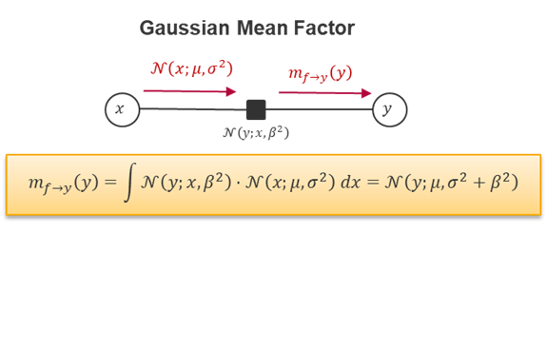
Factor for Performance & Message (Player 2)
Factor Graph
$$f_{1}$$
$$f_{3}$$
$$𝒩\left(s_{i};μ_{i},σ_{i}^{2}\right)$$
$$s_{1}$$
$$s_{2}$$
$$f_{2}$$
$$f_{4}$$
$$𝒩\left(p_{i};s_{i},β^{2}\right)$$
$$p_{1}$$
$$f_{5}$$
$$p_{2}$$
$$δ\left(d−\left(p_{1}−p_{2}\right)\right)$$
$$d$$
$$𝕀\left(d>0\right)$$
$$f_{6}$$

Slide 23
Marginals for Performances (Player 1 & 2)
Factor Graph
$$f_{1}$$
$$f_{3}$$
$$𝒩\left(s_{i};μ_{i},σ_{i}^{2}\right)$$
$$s_{1}$$
$$s_{2}$$
$$f_{2}$$
$$f_{4}$$
$$𝒩\left(p_{i};s_{i},β^{2}\right)$$
$$p_{1}$$
$$f_{5}$$
$$p_{2}$$
$$δ\left(d−\left(p_{1}−p_{2}\right)\right)$$
$$d$$
$$𝕀\left(d>0\right)$$
$$f_{6}$$

Slide 24
The Weighted Sum Factor
Factor Graph
$$f_{1}$$
$$f_{3}$$
$$𝒩\left(s_{i};μ_{i},σ_{i}^{2}\right)$$
$$s_{1}$$
$$s_{2}$$
$$f_{2}$$
$$f_{4}$$
$$𝒩\left(p_{i};s_{i},β^{2}\right)$$
$$p_{1}$$
$$f_{5}$$
$$p_{2}$$
$$δ\left(d−\left(p_{1}−p_{2}\right)\right)$$
$$d$$
$$𝕀\left(d>0\right)$$
$$f_{6}$$

Slide 25
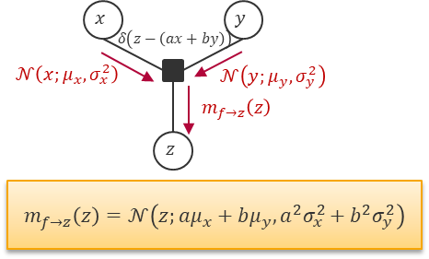
The Weighted Sum Factor
Factor Graph
$$f_{1}$$
$$f_{3}$$
$$𝒩\left(s_{i};μ_{i},σ_{i}^{2}\right)$$
$$s_{1}$$
$$s_{2}$$
$$f_{2}$$
$$f_{4}$$
$$𝒩\left(p_{i};s_{i},β^{2}\right)$$
$$p_{1}$$
$$f_{5}$$
$$p_{2}$$
$$δ\left(d−\left(p_{1}−p_{2}\right)\right)$$
$$d$$
$$𝕀\left(d>0\right)$$
$$f_{6}$$

Slide 26
Marginal for Weighted Sum / Performance Difference
Factor Graph
$$f_{1}$$
$$f_{3}$$
$$𝒩\left(s_{i};μ_{i},σ_{i}^{2}\right)$$
$$s_{1}$$
$$s_{2}$$
$$f_{2}$$
$$f_{4}$$
$$𝒩\left(p_{i};s_{i},β^{2}\right)$$
$$p_{1}$$
$$f_{5}$$
$$p_{2}$$
$$δ\left(d−\left(p_{1}−p_{2}\right)\right)$$
$$d$$
$$𝕀\left(d>0\right)$$
$$f_{6}$$

Slide 27
Marginal for Weighted Sum / Performance Difference
Factor Graph
$$f_{1}$$
$$f_{3}$$
$$𝒩\left(s_{i};μ_{i},σ_{i}^{2}\right)$$
$$s_{1}$$
$$s_{2}$$
$$f_{2}$$
$$f_{4}$$
$$𝒩\left(p_{i};s_{i},β^{2}\right)$$
$$p_{1}$$
$$f_{5}$$
$$p_{2}$$
$$δ\left(d−\left(p_{1}−p_{2}\right)\right)$$
$$d$$
$$𝕀\left(d>0\right)$$
$$f_{6}$$

Slide 28
Factor of Observed Performance Difference (y=1)
Factor Graph
$$f_{1}$$
$$f_{3}$$
$$𝒩\left(s_{i};μ_{i},σ_{i}^{2}\right)$$
$$s_{1}$$
$$s_{2}$$
$$f_{2}$$
$$f_{4}$$
$$𝒩\left(p_{i};s_{i},β^{2}\right)$$
$$p_{1}$$
$$f_{5}$$
$$p_{2}$$
$$δ\left(d−\left(p_{1}−p_{2}\right)\right)$$
$$d$$
$$𝕀\left(d>0\right)$$
$$f_{6}$$

Slide 29
Factor of Observed Performance Difference (y=1)
Factor Graph
$$f_{1}$$
$$f_{3}$$
$$𝒩\left(s_{i};μ_{i},σ_{i}^{2}\right)$$
$$s_{1}$$
$$s_{2}$$
$$f_{2}$$
$$f_{4}$$
$$𝒩\left(p_{i};s_{i},β^{2}\right)$$
$$p_{1}$$
$$f_{5}$$
$$p_{2}$$
$$δ\left(d−\left(p_{1}−p_{2}\right)\right)$$
$$d$$
$$𝕀\left(d>0\right)$$
$$f_{6}$$

Slide 30
Factor of Observed Performance Difference (y=1)
Factor Graph
$$f_{1}$$
$$f_{3}$$
$$𝒩\left(s_{i};μ_{i},σ_{i}^{2}\right)$$
$$s_{1}$$
$$s_{2}$$
$$f_{2}$$
$$f_{4}$$
$$𝒩\left(p_{i};s_{i},β^{2}\right)$$
$$p_{1}$$
$$f_{5}$$
$$p_{2}$$
$$δ\left(d−\left(p_{1}−p_{2}\right)\right)$$
$$d$$
$$𝕀\left(d>0\right)$$
$$f_{6}$$

Slide 31
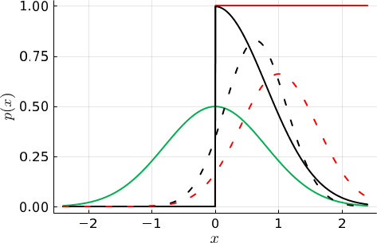
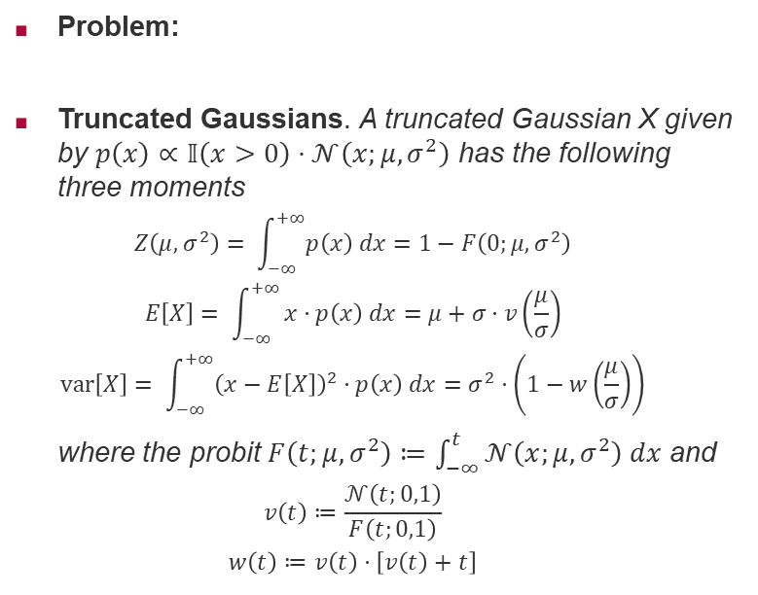
Truncated Gaussian as Approximated Gaussian
Problem:
Truncated Gaussians. A truncated Gaussian X given by $p\left(x\right)∝𝕀\left(x>0\right)⋅𝒩\left(x;μ,σ^{2}\right)$ has the following three moments
  $$Z\left(μ,σ^{2}\right)= \int_{−∞}^{+∞}{p\left(x\right) dx=1−F\left(0;μ,σ^{2}\right)}$$
  $$E\left[X\right]= \int_{−∞}^{+∞}{x⋅p\left(x\right) dx=μ+σ⋅v\left(\frac{μ}{σ}\right)}$$
  $$var\left[X\right]= \int_{−∞}^{+∞}{{\left(x−E\left[X\right]\right)}^{2}⋅p\left(x\right) dx=σ^{2}⋅\left(1−w\left(\frac{μ}{σ}\right)\right)}$$
  where the probit $F\left(t;μ,σ^{2}\right)≔\int_{−∞}^{t}{𝒩\left(x;μ,σ^{2}\right) dx}$ and
  $$v\left(t\right)≔\frac{𝒩\left(t;0,1\right)}{F\left(t;0,1\right)}$$
  $$w\left(t\right)≔v\left(t\right)⋅\left[v\left(t\right)+t\right]$$

Slide 32
Truncated Gaussian as Approximated Gaussian
Problem:
Truncated Gaussians. A truncated Gaussian X given by $p\left(x\right)∝𝕀\left(x>0\right)⋅𝒩\left(x;μ,σ^{2}\right)$ has the following three moments
  $$Z\left(μ,σ^{2}\right)= \int_{−∞}^{+∞}{p\left(x\right) dx=1−F\left(0;μ,σ^{2}\right)}$$
  $$E\left[X\right]= \int_{−∞}^{+∞}{x⋅p\left(x\right) dx=μ+σ⋅v\left(\frac{μ}{σ}\right)}$$
  $$var\left[X\right]= \int_{−∞}^{+∞}{{\left(x−E\left[X\right]\right)}^{2}⋅p\left(x\right) dx=σ^{2}⋅\left(1−w\left(\frac{μ}{σ}\right)\right)}$$
  where the probit $F\left(t;μ,σ^{2}\right)≔\int_{−∞}^{t}{𝒩\left(x;μ,σ^{2}\right) dx}$ and
  $$v\left(t\right)≔\frac{𝒩\left(t;0,1\right)}{F\left(t;0,1\right)}$$
  $$w\left(t\right)≔v\left(t\right)⋅\left[v\left(t\right)+t\right]$$

Slide 33

Recap: Convergence of v(t) and w(t) for small t
Problem:
Truncated Gaussians. A truncated Gaussian X given by $p\left(x\right)∝𝕀\left(x>0\right)⋅𝒩\left(x;μ,σ^{2}\right)$ has the following three moments
  $$Z\left(μ,σ^{2}\right)= \int_{−∞}^{+∞}{p\left(x\right) dx=1−F\left(0;μ,σ^{2}\right)}$$
  $$E\left[X\right]= \int_{−∞}^{+∞}{x⋅p\left(x\right) dx=μ+σ⋅v\left(\frac{μ}{σ}\right)}$$
  $$var\left[X\right]= \int_{−∞}^{+∞}{{\left(x−E\left[X\right]\right)}^{2}⋅p\left(x\right) dx=σ^{2}⋅\left(1−w\left(\frac{μ}{σ}\right)\right)}$$
  where the probit $F\left(t;μ,σ^{2}\right)≔\int_{−∞}^{t}{𝒩\left(x;μ,σ^{2}\right) dx}$ and
  $$v\left(t\right)≔\frac{𝒩\left(t;0,1\right)}{F\left(t;0,1\right)}$$
  $$w\left(t\right)≔v\left(t\right)⋅\left[v\left(t\right)+t\right]$$

Slide 34

Recap: Convergence of v(t) and w(t) for small t
Problem:
Truncated Gaussians. A truncated Gaussian X given by $p\left(x\right)∝𝕀\left(x>0\right)⋅𝒩\left(x;μ,σ^{2}\right)$ has the following three moments
  $$Z\left(μ,σ^{2}\right)= \int_{−∞}^{+∞}{p\left(x\right) dx=1−F\left(0;μ,σ^{2}\right)}$$
  $$E\left[X\right]= \int_{−∞}^{+∞}{x⋅p\left(x\right) dx=μ+σ⋅v\left(\frac{μ}{σ}\right)}$$
  $$var\left[X\right]= \int_{−∞}^{+∞}{{\left(x−E\left[X\right]\right)}^{2}⋅p\left(x\right) dx=σ^{2}⋅\left(1−w\left(\frac{μ}{σ}\right)\right)}$$
  where the probit $F\left(t;μ,σ^{2}\right)≔\int_{−∞}^{t}{𝒩\left(x;μ,σ^{2}\right) dx}$ and
  $$v\left(t\right)≔\frac{𝒩\left(t;0,1\right)}{F\left(t;0,1\right)}$$
  $$w\left(t\right)≔v\left(t\right)⋅\left[v\left(t\right)+t\right]$$
Converges to $−t$ as $t→−∞$
Converges to $1$ as $t→−∞$

Slide 35
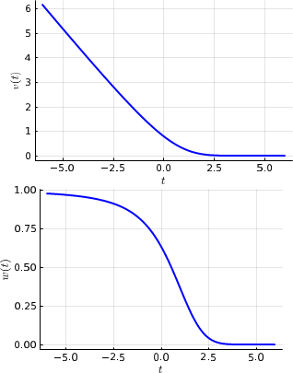
Recap: Convergence of v(t) and w(t) for small t
Problem:
Truncated Gaussians. A truncated Gaussian X given by $p\left(x\right)∝𝕀\left(x>0\right)⋅𝒩\left(x;μ,σ^{2}\right)$ has the following three moments
  $$Z\left(μ,σ^{2}\right)= \int_{−∞}^{+∞}{p\left(x\right) dx=1−F\left(0;μ,σ^{2}\right)}$$
  $$E\left[X\right]= \int_{−∞}^{+∞}{x⋅p\left(x\right) dx=μ+σ⋅v\left(\frac{μ}{σ}\right)}$$
  $$var\left[X\right]= \int_{−∞}^{+∞}{{\left(x−E\left[X\right]\right)}^{2}⋅p\left(x\right) dx=σ^{2}⋅\left(1−w\left(\frac{μ}{σ}\right)\right)}$$
  where the probit $F\left(t;μ,σ^{2}\right)≔\int_{−∞}^{t}{𝒩\left(x;μ,σ^{2}\right) dx}$ and
  $$v\left(t\right)≔\frac{𝒩\left(t;0,1\right)}{F\left(t;0,1\right)}$$
  $$w\left(t\right)≔v\left(t\right)⋅\left[v\left(t\right)+t\right]$$
Converges to $−t$ as $t→−∞$
Converges to $1$ as $t→−∞$

Slide 36
Backwards with Approximated Gaussian Message
Factor Graph
$$f_{1}$$
$$f_{3}$$
$$𝒩\left(s_{i};μ_{i},σ_{i}^{2}\right)$$
$$s_{1}$$
$$s_{2}$$
$$f_{2}$$
$$f_{4}$$
$$𝒩\left(p_{i};s_{i},β^{2}\right)$$
$$p_{1}$$
$$f_{5}$$
$$p_{2}$$
$$δ\left(d−\left(p_{1}−p_{2}\right)\right)$$
$$d$$
$$𝕀\left(d>0\right)$$
$$f_{6}$$

Slide 37
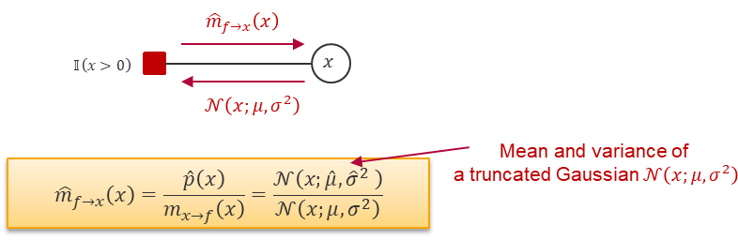
Backwards with Approximated Gaussian Message
Factor Graph
$$f_{1}$$
$$f_{3}$$
$$𝒩\left(s_{i};μ_{i},σ_{i}^{2}\right)$$
$$s_{1}$$
$$s_{2}$$
$$f_{2}$$
$$f_{4}$$
$$𝒩\left(p_{i};s_{i},β^{2}\right)$$
$$p_{1}$$
$$f_{5}$$
$$p_{2}$$
$$δ\left(d−\left(p_{1}−p_{2}\right)\right)$$
$$d$$
$$𝕀\left(d>0\right)$$
$$f_{6}$$

Slide 38
Backwards with Approximated Gaussian Message
Factor Graph
$$f_{1}$$
$$f_{3}$$
$$𝒩\left(s_{i};μ_{i},σ_{i}^{2}\right)$$
$$s_{1}$$
$$s_{2}$$
$$f_{2}$$
$$f_{4}$$
$$𝒩\left(p_{i};s_{i},β^{2}\right)$$
$$p_{1}$$
$$f_{5}$$
$$p_{2}$$
$$δ\left(d−\left(p_{1}−p_{2}\right)\right)$$
$$d$$
$$𝕀\left(d>0\right)$$
$$f_{6}$$

Slide 39
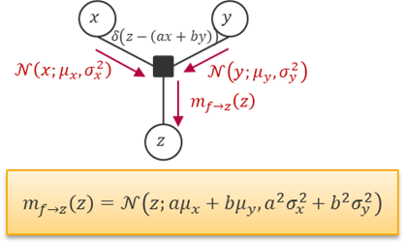
Backwards: The Weighted Sum (Any Ideas?)
Factor Graph
$$f_{1}$$
$$f_{3}$$
$$𝒩\left(s_{i};μ_{i},σ_{i}^{2}\right)$$
$$s_{1}$$
$$s_{2}$$
$$f_{2}$$
$$f_{4}$$
$$𝒩\left(p_{i};s_{i},β^{2}\right)$$
$$p_{1}$$
$$f_{5}$$
$$p_{2}$$
$$δ\left(d−\left(p_{1}−p_{2}\right)\right)$$
$$d$$
$$𝕀\left(d>0\right)$$
$$f_{6}$$

Slide 40
Backwards: The Weighted Sum (Approach 1)
Factor Graph
$$f_{1}$$
$$f_{3}$$
$$𝒩\left(s_{i};μ_{i},σ_{i}^{2}\right)$$
$$s_{1}$$
$$s_{2}$$
$$f_{2}$$
$$f_{4}$$
$$𝒩\left(p_{i};s_{i},β^{2}\right)$$
$$p_{1}$$
$$f_{5}$$
$$p_{2}$$
$$δ\left(d−\left(p_{1}−p_{2}\right)\right)$$
$$d$$
$$𝕀\left(d>0\right)$$
$$f_{6}$$

Slide 41

Backwards: The Weighted Sum (Approach 1)
Factor Graph
$$f_{1}$$
$$f_{3}$$
$$𝒩\left(s_{i};μ_{i},σ_{i}^{2}\right)$$
$$s_{1}$$
$$s_{2}$$
$$f_{2}$$
$$f_{4}$$
$$𝒩\left(p_{i};s_{i},β^{2}\right)$$
$$p_{1}$$
$$f_{5}$$
$$p_{2}$$
$$δ\left(d−\left(p_{1}−p_{2}\right)\right)$$
$$d$$
$$𝕀\left(d>0\right)$$
$$f_{6}$$

Slide 42
Backwards: The Weighted Sum (Approach 2)
Factor Graph
$$f_{1}$$
$$f_{3}$$
$$𝒩\left(s_{i};μ_{i},σ_{i}^{2}\right)$$
$$s_{1}$$
$$s_{2}$$
$$f_{2}$$
$$f_{4}$$
$$𝒩\left(p_{i};s_{i},β^{2}\right)$$
$$p_{1}$$
$$f_{5}$$
$$p_{2}$$
$$δ\left(d−\left(p_{1}−p_{2}\right)\right)$$
$$d$$
$$𝕀\left(d>0\right)$$
$$f_{6}$$

Slide 43
Backwards: The Weighted Sum (Approach 2)
Factor Graph
$$f_{1}$$
$$f_{3}$$
$$𝒩\left(s_{i};μ_{i},σ_{i}^{2}\right)$$
$$s_{1}$$
$$s_{2}$$
$$f_{2}$$
$$f_{4}$$
$$𝒩\left(p_{i};s_{i},β^{2}\right)$$
$$p_{1}$$
$$f_{5}$$
$$p_{2}$$
$$δ\left(d−\left(p_{1}−p_{2}\right)\right)$$
$$d$$
$$𝕀\left(d>0\right)$$
$$f_{6}$$

Slide 44
Backwards: The Weighted Sum (Application)
Factor Graph
$$f_{1}$$
$$f_{3}$$
$$𝒩\left(s_{i};μ_{i},σ_{i}^{2}\right)$$
$$s_{1}$$
$$s_{2}$$
$$f_{2}$$
$$f_{4}$$
$$𝒩\left(p_{i};s_{i},β^{2}\right)$$
$$p_{1}$$
$$f_{5}$$
$$p_{2}$$
$$δ\left(d−\left(p_{1}−p_{2}\right)\right)$$
$$d$$
$$𝕀\left(d>0\right)$$
$$f_{6}$$

Slide 45
Backwards: Marginals of Performances (Player 1 & 2)
Factor Graph
$$f_{1}$$
$$f_{3}$$
$$𝒩\left(s_{i};μ_{i},σ_{i}^{2}\right)$$
$$s_{1}$$
$$s_{2}$$
$$f_{2}$$
$$f_{4}$$
$$𝒩\left(p_{i};s_{i},β^{2}\right)$$
$$p_{1}$$
$$f_{5}$$
$$p_{2}$$
$$δ\left(d−\left(p_{1}−p_{2}\right)\right)$$
$$d$$
$$𝕀\left(d>0\right)$$
$$f_{6}$$

Slide 46
Backwards: Message to Skill (Player 1)
Factor Graph
$$f_{1}$$
$$f_{3}$$
$$𝒩\left(s_{i};μ_{i},σ_{i}^{2}\right)$$
$$s_{1}$$
$$s_{2}$$
$$f_{2}$$
$$f_{4}$$
$$𝒩\left(p_{i};s_{i},β^{2}\right)$$
$$p_{1}$$
$$f_{5}$$
$$p_{2}$$
$$δ\left(d−\left(p_{1}−p_{2}\right)\right)$$
$$d$$
$$𝕀\left(d>0\right)$$
$$f_{6}$$

Slide 47
Backwards: Message to Skill (Player 2)
Factor Graph
$$f_{1}$$
$$f_{3}$$
$$𝒩\left(s_{i};μ_{i},σ_{i}^{2}\right)$$
$$s_{1}$$
$$s_{2}$$
$$f_{2}$$
$$f_{4}$$
$$𝒩\left(p_{i};s_{i},β^{2}\right)$$
$$p_{1}$$
$$f_{5}$$
$$p_{2}$$
$$δ\left(d−\left(p_{1}−p_{2}\right)\right)$$
$$d$$
$$𝕀\left(d>0\right)$$
$$f_{6}$$

Slide 48
Backwards: Marginals of Skills (Player 1 & 2)
Factor Graph
$$f_{1}$$
$$f_{3}$$
$$𝒩\left(s_{i};μ_{i},σ_{i}^{2}\right)$$
$$s_{1}$$
$$s_{2}$$
$$f_{2}$$
$$f_{4}$$
$$𝒩\left(p_{i};s_{i},β^{2}\right)$$
$$p_{1}$$
$$f_{5}$$
$$p_{2}$$
$$δ\left(d−\left(p_{1}−p_{2}\right)\right)$$
$$d$$
$$𝕀\left(d>0\right)$$
$$f_{6}$$

Slide 49
Backwards: Marginals of Skills (Player 1 & 2)
Factor Graph
$$f_{1}$$
$$f_{3}$$
$$𝒩\left(s_{i};μ_{i},σ_{i}^{2}\right)$$
$$s_{1}$$
$$s_{2}$$
$$f_{2}$$
$$f_{4}$$
$$𝒩\left(p_{i};s_{i},β^{2}\right)$$
$$p_{1}$$
$$f_{5}$$
$$p_{2}$$
$$δ\left(d−\left(p_{1}−p_{2}\right)\right)$$
$$d$$
$$𝕀\left(d>0\right)$$
$$f_{6}$$

Slide 50
Recap: Multiplication & Division of Gaussians
Factor Graph
$$f_{1}$$
$$f_{3}$$
$$𝒩\left(s_{i};μ_{i},σ_{i}^{2}\right)$$
$$s_{1}$$
$$s_{2}$$
$$f_{2}$$
$$f_{4}$$
$$𝒩\left(p_{i};s_{i},β^{2}\right)$$
$$p_{1}$$
$$f_{5}$$
$$p_{2}$$
$$δ\left(d−\left(p_{1}−p_{2}\right)\right)$$
$$d$$
$$𝕀\left(d>0\right)$$
$$f_{6}$$

Slide 51
Numerical Example for Comparison
Factor Graph
$$f_{1}$$
$$f_{3}$$
$$s_{1}$$
$$s_{2}$$
$$f_{2}$$
$$f_{4}$$
$$p_{1}$$
$$f_{5}$$
$$p_{2}$$
$$d$$
$$f_{6}$$

Slide 52
Numerical Example for Comparison
Factor Graph
$$f_{1}$$
$$f_{3}$$
$$s_{1}$$
$$s_{2}$$
$$f_{2}$$
$$f_{4}$$
$$p_{1}$$
$$f_{5}$$
$$p_{2}$$
$$d$$
$$f_{6}$$

Slide 53
Overview
Questions and Updates
Recap: Main Concepts of Unit 5
Example: TrueSkill 1 vs 1
Hints for Exercise 3 (to be handed in Monday June 2)

Slide 54
Exercise 3 (until May 27)
Part I: TrueSkill Models (1 vs 1 + Similar Extensions)
Part II: Integral of a Product of 2 Gaussian Densities
(Gaussian Mean Factor)

Slide 55














Bonus Exercise 3 (Factor Graph Part I*, +1 Point)
Factor Graph
$$f_{1}$$
$$f_{3}$$
$$f_{7}$$
$$𝒩\left(s_{i};μ_{i},σ_{i}^{2}\right)$$
$$s_{1}$$
$$s_{2}$$
$$s_{3}$$
$$f_{2}$$
$$f_{4}$$
$$f_{8}$$
$$𝒩\left(p_{i};s_{i},β^{2}\right)$$
$$p_{1}$$
$$f_{5}$$
$$p_{2}$$
$$f_{9}$$
$$p_{3}$$
$$δ\left(d−\left(p_{i}−p_{j}\right)\right)$$
$$d_{1,2}$$
$$d_{2,3}$$
$$𝕀\left(d_{i,j}>0\right)$$
$$f_{6}$$
$$f_{10}$$

Slide 56
Summary
Recap I: TrueSkill Factor Graph (1 vs 1)
Recap II: Messages & Marginals (Forward)
Recap III: Messages & Marginals (Backward)

Slide 57
See you next Week!

