Slide 1

Introduction to Probabilistic Machine Learning
Ralf Herbrich, Rainer Schlosser
Tutorial 7 – Recap Theory Unit 7

Slide 2
Overview
Questions and Updates
Recap: Unit 7, Linear Algebra, and the Inverse of a Matrix
Recap: Cholesky Decomposition
Recap: Linear Regression in Matrix Notation

Slide 3
Course Overview
Week | Topic Lecture | Tutorial | Exercises
07.04. & 08.04. | 1 Probability Theory | Intro Julia
14.04. & 15.04. | 2 Inference Methods and Decision-Making | no tutorial | Exercise 1
21.04. & 22.04. | no lecture | Theory Unit 1 & 2 | (14.04. – 08.05.)
28.04. & 29.04. | 3 Graphical Models: Independence | Theory Unit 3
05.05. & 06.05. | 4 Graphical Models: Exact Inference | Theory Unit 4 | Exercise 2
12.05. & 13.05. | 5 Graphical Models: Approximate Inference | Theory Unit 5 | (05.05. – 19.05.)
19.05. & 20.05. | 6 Bayesian Ranking | Theory Unit 6 | Exercise 3
26.05. & 27.05. | 7 Linear Basis Function Models | Theory Unit 7 | (19.05. – 05.06.)
02.06. & 03.06. | 8 Bayesian Regression | Theory Unit 8 | Exercise 4
09.06. & 10.06. | no lecture | 9 Bayesian Classification | (02.06. – 23.06.)
16.06. & 17.06. | 10 Non-Bayesian Classification Learning | Theory Unit 9 & 10
23.06. & 24.06. | 11 Gaussian Processes | Theory Unit 11 | Exercise 5
30.06. & 01.07. | 12 Information Theory | Theory Unit 12 | (23.06. – 07.07.)
07.07. & 08.07. | 13 Real-World Applications

Slide 4
Overview
Questions and Updates
Recap: Unit 7, Linear Algebra, and the Inverse of a Matrix
Recap: Cholesky Decomposition
Recap: Linear Regression in Matrix Notation

Slide 5
Recap Unit 7: Overview of Concepts and Focus
a) Linear Basis Function Models
Modelling Data (Text and Images)
Linear Mappings and Matrices
Singular Value Decomposition

Slide 6
Matrix-Multiplication
Vector: An n-dimensional vector x is a column , is a row
Matrix: An nxm matrix has n rows and m columns

Slide 7
Matrix-Multiplication
Vector: An n-dimensional vector x is a column , is a row
Matrix: An nxm matrix has n rows and m columns
Product: An nxm matrix times an mxk matrix is of ??? Format
Does the order matter? Is AxB = BxA ?

Slide 8
Matrix-Multiplication
Vector: An n-dimensional vector x is a column , is a row
Matrix: An nxm matrix has n rows and m columns
Product: An nxm matrix times an mxk matrix is of nxk format
Examples:

Slide 9
Recap: Inverse of a Matrix
Existence: An nxn matrix A is regular, i.e., has an inverse if, e.g.,
- A has full rank
- det(A)<>0
Property:
Solves:

Slide 10
To Solve Ax=b: Compute the Inverse of a Matrix
Computation 1: Given a regular nxn matrix A, the inverse
can be computed as follows ??

Slide 11
To Solve Ax=b: Compute the Inverse of a Matrix
Computation 1: Given a regular nxn matrix A, the inverse
can be computed as follows:
Allowed: (i) switch rows, (ii) multiply row with nonzero scalars, (iii) add rows

Slide 12
To Solve Ax=b: Compute the Inverse of a Matrix
Computation 2: Given a regular nxn matrix A, the inverse
can be computed as follows:
Solve a Linear Program (LP) with ??

Slide 13
To Solve Ax=b: Compute the Inverse of a Matrix
Computation 2: Given a regular nxn matrix A, the inverse
can be computed as follows:
Solve a Linear Program (LP) with nxn variables (cf. X) and nxn constraints:

Slide 14
To Solve Ax=b: Compute the Inverse of a Matrix
Computation 3: Given a regular nxn matrix A, the inverse
can be computed as follows:
Use Singular Value Decomposition (U, V orthogonal, diagonal):

Slide 15
To Solve Ax=b: Compute the Inverse of a Matrix
Computation 3: Given a regular nxn matrix A, the inverse
can be computed as follows:
Use Singular Value Decomposition (U, V orthogonal, diagonal):
Note:

Slide 16
Overview
Questions and Updates
Recap: Unit 7, Linear Algebra, and the Inverse of a Matrix
Recap: Cholesky Decomposition
Recap: Linear Regression in Matrix Notation

Slide 17
To Solve Ax=b: Cholesky Decomposition
Computation 4: Given a nxn matrix A (symmetric, positive-semidefinite)
we can compute a lower triangular matrix L such that:
Then (Outlook): (fast & stable!)
How to get L? Note, again the ~nxn/2 constraints determine L:

Slide 18
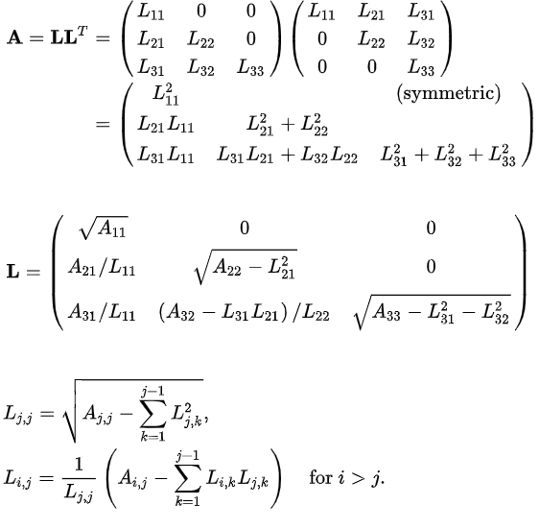
To Solve Ax=b: Cholesky Decomposition

Slide 19
To Solve Ax=b: Cholesky Decomposition

Slide 20
To Solve Ax=b: Cholesky Decomposition

Slide 21
To Solve Ax=b: Cholesky Decomposition

Slide 22
To Solve Ax=b: Cholesky Decomposition

Slide 23
To Solve Ax=b: Cholesky Decomposition

Slide 24
To Solve Ax=b: Cholesky Decomposition

Slide 25
To Solve Ax=b: Cholesky Decomposition

Slide 26
To Solve Ax=b: Cholesky Decomposition

Slide 27
To Solve Ax=b: Cholesky Decomposition

Slide 28
To Solve Ax=b: Cholesky Decomposition

Slide 29
To Solve Ax=b: Cholesky Decomposition
General formula to compute L ??

Slide 30
To Solve Ax=b: Cholesky Decomposition
General formula to compute L:

Slide 31
Overview
Questions and Updates
Recap: Unit 7, Linear Algebra, and the Inverse of a Matrix
Recap: Cholesky Decomposition
Recap: Linear Regression in Matrix Notation

Slide 32
Recap: Regression & Linear Basis Function Models
Dependent variable y
Explanatory variables x0, x1, …, xK
Model: Find weights such that

Slide 33
Recap: Regression & Linear Basis Function Models
Dependent variable y
Explanatory variables x0, x1, …, xK
Model: Find weights such that
Data (Example):
Basis Functions: (i)
(ii)
(iii)

Slide 34
Recap: Regression & Linear Basis Function Models
Dependent variable y
Explanatory variables x0, x1, …, xK
Model: Find weights such that
Data (Example):
Basis Functions: (i)
(ii)
(iii)

Slide 35
Recap: Regression & Linear Basis Function Models
Dependent variable y
Explanatory variables x0, x1, …, xK
Model: Find weights such that
Data (Example):
Basis Functions: (i)
(ii)
(iii)

Slide 36
Recap: Regression & Linear Basis Function Models
Dependent variable y
Explanatory variables x0, x1, …, xK
Model: Find weights such that
Data (Example):
Basis Functions: (i)
(ii)
(iii)

Slide 37
Recap: Linear Regression
Dependent variable y
Explanatory variables x0, x1, …, xK (cf. Basis function models)
Model: Find weights such that
Objective of the Regression? What are the variables?

Slide 38
Recap: Linear Regression
Dependent variable y
Explanatory variables x0, x1, …, xK (cf. Basis function models)
Model: Find weights such that
Minimize the Sum of Squared Errors:

Slide 39
Let‘s take a Look: Residuals and Matrix Notation
Consider the errors:
What is happening here in Matrix Notation?

Slide 40
Let‘s take a Look: Residuals and Matrix Notation
Consider the errors:
What is happening here in Matrix Notation?
We have:
Or just ??

Slide 41
Let‘s take a Look: Residuals and Matrix Notation
Consider the errors:
What is happening here in Matrix Notation?
We have:
Or just:

Slide 42
Sum of Squared Errors
Consider the errors:
Sum of squared errors in Matrix notation?

Slide 43
Sum of Squared Errors
Consider the errors:
Sum of squared errors:
Great! What now?

Slide 44
Sum of Squared Errors
Consider the errors:
Sum of squared errors:
We have:

Slide 45
Sum of Squared Errors
Consider the errors:
Sum of squared errors:
We have:

Slide 46
Sum of Squared Errors
Consider the errors:
Sum of squared errors:
We have:

Slide 47
Transposed Terms
Consider:
Then:

Slide 48
Transposed Terms
Consider:
Then:

Slide 49
Transposed Terms
Consider:
We have:

Slide 50
Transposed Terms
Consider:
We have:
Note: Switch the order!

Slide 51
Sum of Squared Errors
Consider the errors:
Sum of squared errors:
We have:

Slide 52
Sum of Squared Errors
Consider the errors:
Sum of squared errors:
We have:

Slide 53
Sum of Squared Errors
Consider the errors:
Sum of squared errors:
We have:

Slide 54
Minimizing the Sum of Squared Errors
Sum of squared errors:
Derivatives/FOC??

Slide 55
Minimizing the Sum of Squared Errors
Sum of squared errors:
Derivatives/FOC:
Hence:

Slide 56
Minimizing the Sum of Squared Errors
Sum of squared errors:
Derivatives/FOC:
Hence:

Slide 57
Minimizing the Sum of Squared Errors
Sum of squared errors:
Derivatives/FOC:
Hence:

Slide 58
Minimizing the Sum of Squared Errors
Sum of squared errors:
Derivatives/FOC:
Hence:

Slide 59
Minimizing the Sum of Squared Errors
Sum of squared errors:
Derivatives/FOC:
Hence:

Slide 60
Minimizing the Sum of Squared Errors
Sum of squared errors:
Derivatives/FOC:
Hence:

Slide 61
Minimizing the Sum of Squared Errors
Sum of squared errors:
Derivatives/FOC:
Hence:

Slide 62
Minimizing the Sum of Squared Errors
Hence:

Slide 63
Minimizing the Sum of Squared Errors
Hence:

Slide 64
Minimizing the Sum of Squared Errors
Hence:

Slide 65
Minimizing the Sum of Squared Errors
Hence:

Slide 66
Minimizing the Sum of Squared Errors
Hence:

Slide 67
Minimizing the Sum of Squared Errors
Sum of squared errors:
Derivatives/FOC:
Hence:

Slide 68
Minimizing the Sum of Squared Errors
Sum of squared errors:
Derivatives/FOC:
Hence:
What do we want again?

Slide 69
Minimizing the Sum of Squared Errors
Optimality condition:
How to get the optimal weights ?
Any ideas?

Slide 70
Minimizing the Sum of Squared Errors
Optimality condition:
How to get the optimal weights ?
If has full rank, then the inverse exists and we get:

Slide 71
Minimizing the Sum of Squared Errors
Optimality condition:
How to get the optimal weights ?
If has full rank, then the inverse exists and we get:

Slide 72
Minimizing the Sum of Squared Errors
Optimality condition: Other ideas to get ??
How to get the optimal weights ?
If has full rank, then the inverse exists and we get:

Slide 73
Minimizing the Sum of Squared Errors
Optimality condition:
How to get the optimal weights ?
If has full rank, then the inverse exists and we get:

Slide 74
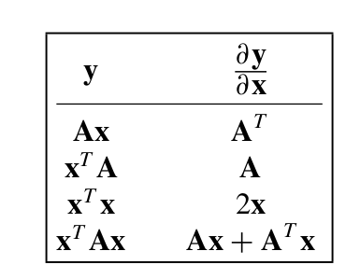
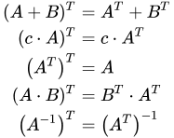
Summary
Recap I: Cholesky Decomposition
Recap II: Linear Basis Function Models
Recap III: Linear Regression & Matrix Algebra

Slide 75
See you next Week!

