Slide 1

Introduction to Probabilistic Machine Learning
Ralf Herbrich, Rainer Schlosser
Tutorial 3 – Recap Theory Unit 3

Slide 2
Overview
Questions and Updates
Recap: Main Concepts of Unit 3
Example: Conditional Independence & D-Separation
Simulating 1 vs 1 TrueSkill (discrete)

Slide 3
Course Overview
Week | Topic Lecture | Tutorial | Exercises
07.04. & 08.04. | 1 Probability Theory | Intro Julia
14.04. & 15.04. | 2 Inference Methods and Decision-Making | no tutorial | Exercise 1
21.04. & 22.04. | no lecture | Theory Unit 1 & 2 | (14.04. – 05.05.)
28.04. & 29.04. | 3 Graphical Models: Independence | Theory Unit 3
05.05. & 06.05. | 4 Graphical Models: Exact Inference | Theory Unit 4 | Exercise 2
12.05. & 13.05. | 5 Graphical Models: Approximate Inference | Theory Unit 5 | (05.05. – 19.05.)
19.05. & 20.05. | 6 Bayesian Ranking | Theory Unit 6 | Exercise 3
26.05. & 27.05. | 7 Linear Basis Function Models | Theory Unit 7 | (19.05. – 02.06.)
02.06. & 03.06. | 8 Bayesian Regression | Theory Unit 8 | Exercise 4
09.06. & 10.06. | no lecture | 9 Bayesian Classification | (02.06. – 23.06.)
16.06. & 11.06. | 10 Non-Bayesian Classification Learning | Theory Unit 9 & 10
23.06. & 24.06. | 11 Gaussian Processes | Theory Unit 11 | Exercise 5
30.06. & 01.07. | 12 Information Theory | Theory Unit 12 | (23.06. – 07.07.)
07.07. & 08.07. | 13 Real-World Applications

Slide 4
Overview
Questions and Updates
Recap: Main Concepts of Unit 3
Example: Conditional Independence & D-Separation
Simulating 1 vs 1 TrueSkill (discrete)

Slide 5
Recap Unit 3: Overview of Concepts and Focus
a) Graphical Models & Bayesian Networks
Conditional Probabilities & Chain Rule
c) Conditional Independence
d) D-Separation

Slide 6

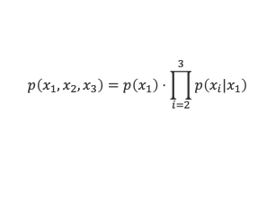





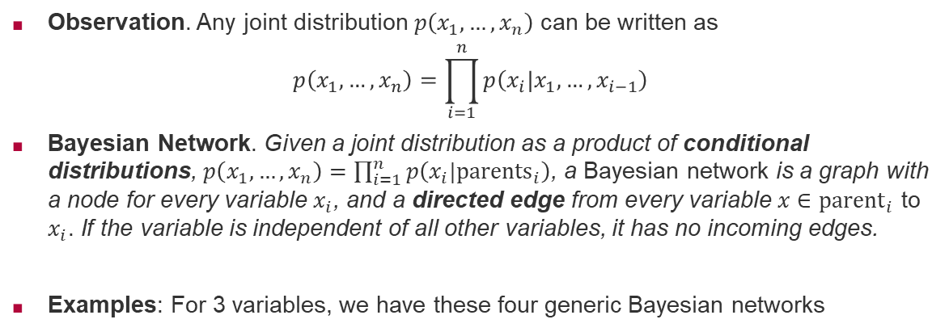




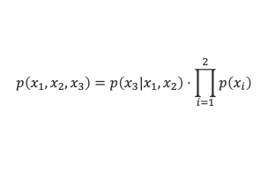



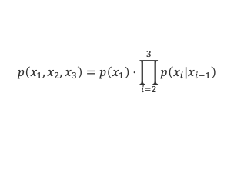
Recap: Conditional Probabilities in Bayesian Networks
Observation. Any joint distribution $p\left(x_{1},…,x_{n}\right)$ can be written as
$$p\left(x_{1},…,x_{n}\right)=\prod_{i=1}^{n}{p\left(x_{i}|x_{1},…,x_{i−1}\right)}$$
Bayesian Network. Given a joint distribution as a product of conditional distributions, $p\left(x_{1},…,x_{n}\right)=\prod_{i=1}^{n}{p\left(x_{i}|{parents}_{i}\right)}$, a Bayesian network is a graph with a node for every variable $x_{i}$, and a directed edge from every variable $x∈{parent}_{i}$ to $x_{i}$. If the variable is independent of all other variables, it has no incoming edges.
Examples: For 3 variables, we have these four generic Bayesian networks
$$x_{1}$$
$$x_{2}$$
$$x_{1}$$
$$x_{2}$$
$$x_{1}$$
$$x_{2}$$
$$x_{1}$$
$$x_{2}$$
$$x_{3}$$
$$x_{3}$$
$$x_{3}$$
$$x_{3}$$
$$p\left(x_{1},x_{2},x_{3}\right)=p\left(x_{1}\right)⋅p\left(x_{2}|x_{1}\right)⋅p\left(x_{3}|x_{1},x_{2}\right)$$
$$p\left(x_{1},x_{2},x_{3}\right)=p\left(x_{1}\right)⋅\prod_{i=2}^{3}{p\left(x_{i}|x_{1}\right)}$$
$$p\left(x_{1},x_{2},x_{3}\right)=p\left(x_{1}\right)⋅\prod_{i=2}^{3}{p\left(x_{i}|x_{i−1}\right)}$$
$$p\left(x_{1},x_{2},x_{3}\right)=p\left(x_{3}|x_{1},x_{2}\right)⋅\prod_{i=1}^{2}{p\left(x_{i}\right)}$$
full mesh
star
chain
sink

Slide 7
Joint Probabilities vs Conditional Probabilities
Joint Probabilities and short-hand notation:

Slide 8
Joint Probabilities vs Conditional Probabilities
Joint Probabilities and short-hand notation:
Representation as Conditional Probabilities via Chain Rule in some „Order“

Slide 9
Joint Probabilities vs Conditional Probabilities
Joint Probabilities and short-hand notation:
Representation as Conditional Probabilities via Chain Rule in some „Order“
Norm Identities:

Slide 10
Joint Probabilities vs Conditional Probabilities (Variants!)
Joint Probabilities and short-hand notation:
Representation as Conditional Probabilities via Chain Rule in some „Order“
Norm Identities:

Slide 11

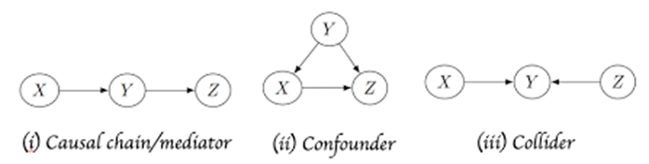
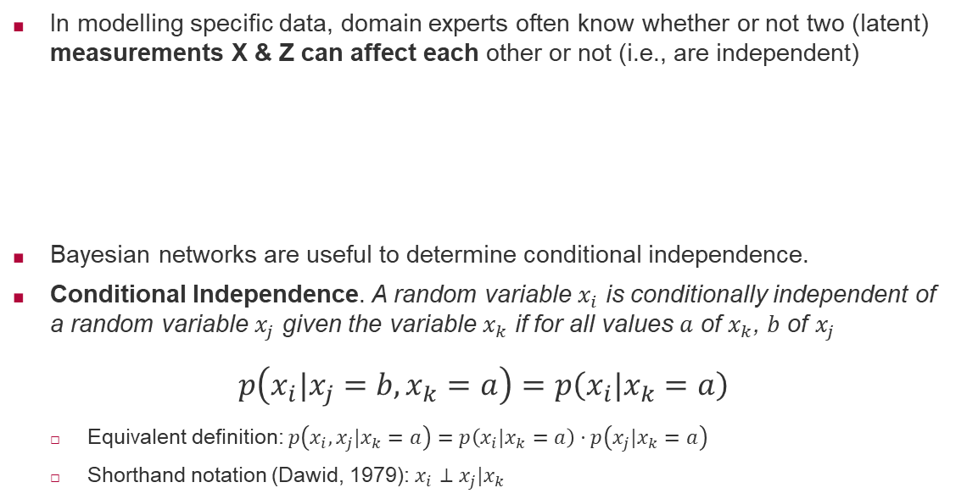
Recap: Conditional Independence
In modelling specific data, domain experts often know whether or not two (latent) measurements X & Z can affect each other or not (i.e., are independent)
Bayesian networks are useful to determine conditional independence.
Conditional Independence. A random variable $x_{i}$ is conditionally independent of a random variable $x_{j}$ given the variable $x_{k}$ if for all values $a$ of $x_{k}$, $b$ of $x_{j}$
$$p\left(x_{i}|x_{j}=b,x_{k}=a\right)=p\left(x_{i}|x_{k}=a\right)$$
Equivalent definition: $p\left(x_{i},x_{j}|x_{k}=a\right)=p\left(x_{i}|x_{k}=a\right)⋅p\left(x_{j}|x_{k}=a\right)$
Shorthand notation (Dawid, 1979): $x_{i}⊥x_{j}|x_{k}$
Philip Dawid (1946– )

Slide 12
Conditional Independence
Question: Does one variable X affect another variable Y?
Or: When does observing Y change the distribution of X?
Problem: Influence of third variables (e.g. Confounder/Collider)
Helping Concept: Conditional Independence (CI)
Involves: Compares the probabilities of two variables X and Y
conditioned on the observation of a third variable Z

Slide 13
Conditional Independence
Question: Does one variable X affect another variable Y?
Or: When does observing Y change the distribution of X?
Problem: Influence of third variables (e.g. Confounder/Collider)
Helping Concept: Conditional Independence (CI)
Involves: Compares the probabilities of two variables X and Y
conditioned on the observation of a third variable Z
Question: Relation to usual Independence of 2 variables?

Slide 14
Conditional Independence
Question: Does one variable X affect another variable Y?
Or: When does observing Y change the distribution of X?
Problem: Influence of third variables (e.g. Confounder/Collider)
Helping Concept: Conditional Independence (CI)
Involves: Compares the probabilities of two variables X and Y
conditioned on the observation of a third variable Z
Different from: Independence (I) of 2 Random Variables!

Slide 15
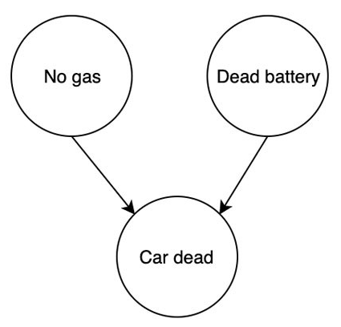
Conditional Independence
Question: Does one variable X affect another variable Y?
Or: When does observing Y change the distribution of X?
Problem: Influence of third variables (e.g. Confounder)
Helping Concept: Conditional Independence (CI)
Example: Are Gas (X) and Battery (Y)
independent conditioned on
observations of Car Dead (Z)?

Slide 16
Checking for Conditional Independence
Question: Are two variables X & Y conditionally independent?
(for a given set of other observed variables)!
Idea: Look for paths/connections between them
To confirm CI: (1)
(2)
(3)

Slide 17
Checking for Conditional Independence
Question: Are two variables X & Y conditionally independent?
(for a given set of other observed variables)!
Idea: Look for paths/connections between them
To confirm CI: (1) determine all „paths“
(2) check all paths whether they have a „blocked node“
(3)

Slide 18
Checking for Conditional Independence
Question: Are two variables X & Y conditionally independent?
(for a given set of other observed variables)!
Idea: Look for paths/connections between them
To confirm CI: (1) determine all „paths“
(2) check all paths whether they have a „blocked node“
(3) Does every path have a blocked node?
If yes: then X & Y are CI If no: then X & Y are not CI

Slide 19
Checking for Conditional Independence
Question: Are two variables X & Y conditionally independent?
(for a given set of other observed variables)!
Idea: Look for paths/connections between them
To confirm CI: (1) determine all „paths“
(2) check all paths whether they have a „blocked node“
(3) Does every path have a blocked node?
If yes: then X & Y are CI If no: then X & Y are not CI
Left to understand: a) What is a path?
b) What is a blocked node?

Slide 20
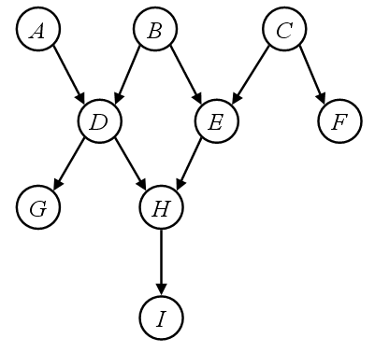
a) What is a Path?
Look for: Connections from a node X to a node Y (all directions allowed)
Consider: Single routes with directed edges (without forks)
Example: Paths from G to E ??

Slide 21
a) What is a Path?
Look for: Connections from a node X to a node Y (all directions allowed)
Consider: Single routes with directed edges (without forks)
Example: From G to E (path 1: GDBE, path 2: GDHE)

Slide 22
b) What is a Blocked Node?
Blocked Node: A node Z that – e.g. when observed – is such that
a considered path in the graph is such that
the distribution of X does not change if Y is observed

Slide 23
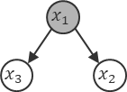
b) What is a Blocked Node?
Blocked Node: A node Z that – e.g. when observed – is such that
a considered path in the graph is such that
the distribution of X does not change if Y is observed
When this is the case on a route of edges? Consider 3 nodes in a row (triples):
Tail-to-Tail (Fork) x1 (obs.) is a blocking node
Head-to-Tail (Chain)
Head-to-Head (Sink)

Slide 24

b) What is a Blocked Node?
Blocked Node: A node Z that – e.g. when observed – is such that
a considered path in the graph is such that
the distribution of X does not change if Y is observed
When this is the case on a route of edges? Consider 3 nodes in a row (triples):
Tail-to-Tail (Fork)
Head-to-Tail (Chain) x2 (obs.) is a blocking node
Head-to-Head (Sink)

Slide 25
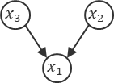
b) What is a Blocked Node?
Blocked Node: A node Z that – e.g. when observed – is such that
a considered path in the graph is such that
the distribution of X does not change if Y is observed
When this is the case on a route of edges? Consider 3 nodes in a row (triples):
Tail-to-Tail (Fork)
Head-to-Tail (Chain)
Head-to-Head (Sink) x1 (free) is a blocking node

Slide 26
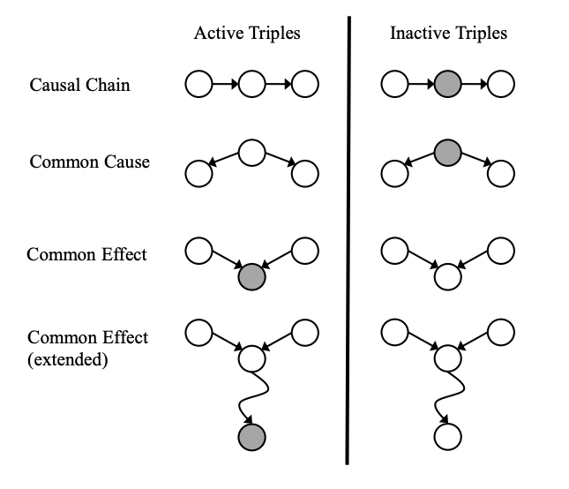
Putting it together: D-Separation
Check: Are X & Y CI „for a given set of observed variables“?
X & Y are CI if: All paths contain at least one inactive triple

Slide 27
Putting it together: D-Separation
Check: Are X & Y CI „for a given set of observed variables“?
X & Y are CI if: All paths contain at least one inactive triple
(1) Tail-to-Tail (Fork with root observation)
(2) Head-to-Tail (Chain with middle observation)
(3) Head-to-Head (Merge with clean sink)
X & Y not CI if: If there is an active path between them (without any blocking node)
e.g., if they are neighbors (child/parent)

Slide 28
Overview
Questions and Updates
Recap: Main Concepts of Unit 3
Example: Conditional Independence & D-Separation
Recap: Main Concepts of Unit 4
Example: Message Passing in Factor Graphs
Hints for Exercise 2 (to be handed in Monday May 13, 7:00)

Slide 29
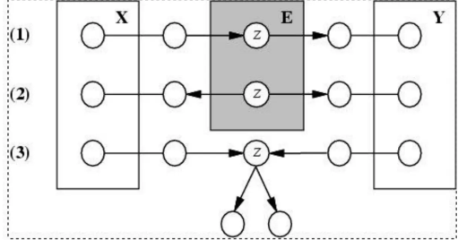
Conditional Independence: Examples & Generalizations
Look for: (1) Head-to-Tail (Chain with middle obs.)
(2) Tail-to-Tail (Fork with root observation)
(3) Head-to-Head (Merge with clean sink)

Slide 30
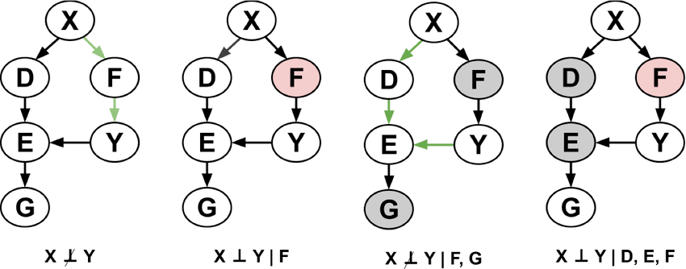
Conditional Independence: Examples & Generalizations
Look for: (1) Head-to-Tail (Chain with middle obs.)
(2) Tail-to-Tail (Fork with root observation)
(3) Head-to-Head (Merge with clean sink)

Slide 31

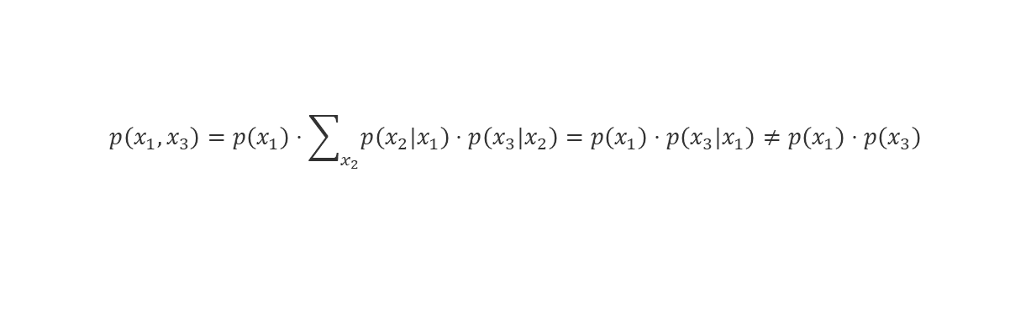
Recap: Proof for Case H2T (Unit 3, slide 12)
Proof for Chain Graph (Head-to-Tail):
$$p\left(x_{1},x_{3}\right)=p\left(x_{1}\right)⋅\sum_{x_{2}}{p\left(x_{2}|x_{1}\right)⋅p\left(x_{3}|x_{2}\right)}=p\left(x_{1}\right)⋅p\left(x_{3}|x_{1}\right)≠p\left(x_{1}\right)⋅p\left(x_{3}\right)$$

Slide 32
Recap: Proof for Case H2T (Unit 3, slide 12)
Proof for Chain Graph (Head-to-Tail):
Note (1)

Slide 33
Recap: Proof for Case H2T (Unit 3, slide 12)
Proof for Chain Graph (Head-to-Tail):
Note (1)
Note (2) Does this also hold in
the world „given x1“?

Slide 34
Recap: Proof for Case H2T (Unit 3, slide 12)
Proof for Chain Graph (Head-to-Tail):
Note (1)
Note (2) This also holds in
the world „given x1“!

Slide 35
Recap: Proof for Case H2T (Unit 3, slide 12)
Proof for Chain Graph (Head-to-Tail):
Note (1)
Note (2) This also holds in
the world „given x1“!
Hence:

Slide 36
Recap: Proof for Case H2T (Unit 3, slide 12)
Proof for Chain Graph (Head-to-Tail):
Note (1)
Note (2) This also holds in
the world „given x1“!
Hence:

Slide 37
Overview
Questions and Updates
Recap: Main Concepts of Unit 3
Example: Conditional Independence & D-Separation
Simulating 1 vs 1 TrueSkill (discrete)

Slide 38
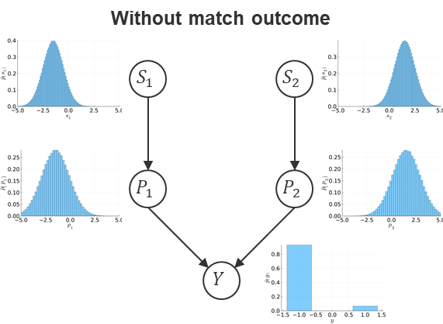
Simulating TrueSkill (cp. Unit 2, slide 11-12)
Consider TrueSkill 1 vs 1 with discrete variables!
Simulate Skills:
Simulate Performances:
Evaluate Differences:
Evaluate Outcomes:
(a) Simulate e.g. 1000 vectors

Slide 39
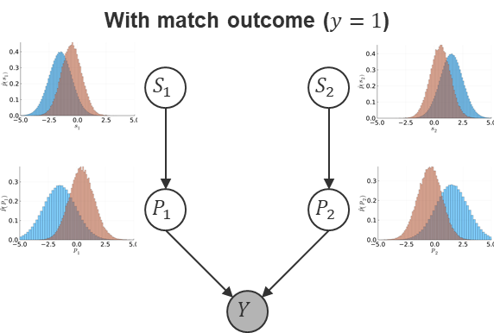
Simulating TrueSkill (cp. Unit 2, slide 11-12)
Consider TrueSkill 1 vs 1 with discrete variables!
Simulate Skills:
Simulate Performances:
Evaluate Differences:
Evaluate Outcomes:
(b) Evaluate Skills & Performances conditioned on y=1! Doable?

Slide 40
Summary
Recap I: Conditional Probabilities
Recap II: Conditional Independence in Bayesian Networks
Recap III: Simulation of Networks

Slide 41
See you next Week!

