Slide 1

Introduction to Probabilistic Machine Learning
Ralf Herbrich, Rainer Schlosser
Tutorial 4 – Recap Theory Unit 4

Slide 2
Overview
Questions and Updates
Recap: Main Concepts of Unit 4
Example: Message Passing in Factor Graphs
Hints for Exercise 2 (to be handed in May 19)

Slide 3
Course Overview
Week | Topic Lecture | Tutorial | Exercises
07.04. & 08.04. | 1 Probability Theory | Intro Julia
14.04. & 15.04. | 2 Inference Methods and Decision-Making | no tutorial | Exercise 1
21.04. & 22.04. | no lecture | Theory Unit 1 & 2 | (14.04. – 08.05.)
28.04. & 29.04. | 3 Graphical Models: Independence | Theory Unit 3
05.05. & 06.05. | 4 Graphical Models: Exact Inference | Theory Unit 4 | Exercise 2
12.05. & 13.05. | 5 Graphical Models: Approximate Inference | Theory Unit 5 | (05.05. – 19.05.)
19.05. & 20.05. | 6 Bayesian Ranking | Theory Unit 6 | Exercise 3
26.05. & 27.05. | 7 Linear Basis Function Models | Theory Unit 7 | (19.05. – 02.06.)
02.06. & 03.06. | 8 Bayesian Regression | Theory Unit 8 | Exercise 4
09.06. & 10.06. | no lecture | 9 Bayesian Classification | (02.06. – 23.06.)
16.06. & 17.06. | 10 Non-Bayesian Classification Learning | Theory Unit 9 & 10
23.06. & 24.06. | 11 Gaussian Processes | Theory Unit 11 | Exercise 5
30.06. & 01.07. | 12 Information Theory | Theory Unit 12 | (23.06. – 07.07.)
07.07. & 08.07. | 13 Real-World Applications

Slide 4
Overview
Questions and Updates
Recap: Main Concepts of Unit 4
Example: Message Passing in Factor Graphs
Hints for Exercise 2 (to be handed in Monday May 19)

Slide 5





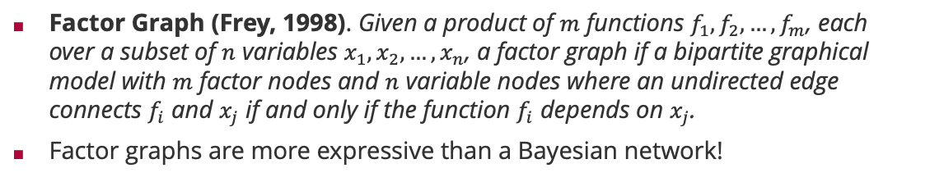








Factor Graphs
Factor Graph (Frey, 1998). Given a product of $m$ functions $f_{1},f_{2},…,f_{m}$, each over a subset of $n$ variables $x_{1},x_{2},…,x_{n}$, a factor graph if a bipartite graphical model with $m$ factor nodes and $n$ variable nodes where an undirected edge connects $f_{i}$ and $x_{j}$ if and only if the function $f_{i}$ depends on $x_{j}$.
Factor graphs are more expressive than a Bayesian network!
Brendan Frey (1968 – )
Bayesian network
Corresponding factor graph
Factor graph with more structure
$$x_{1}$$
$$x_{2}$$
$$x_{1}$$
$$x_{2}$$
$$x_{1}$$
$$x_{2}$$
$$x_{3}$$
$$x_{3}$$
$$x_{3}$$
$$p\left(x_{1},x_{2},x_{3}\right)=p\left(x_{1}\right)⋅p\left(x_{2}\right)⋅p\left(x_{3}|x_{1},x_{2}\right)$$
$$p\left(x_{1},x_{2},x_{3}\right)=f_{1}\left(x_{1}\right)⋅f_{2}\left(x_{2}\right)⋅f_{3}\left(x_{3},x_{1},x_{2}\right)$$
$$p\left(x_{1},x_{2},x_{3}\right)=f_{1}\left(x_{1}\right)⋅f_{2}\left(x_{2}\right)⋅f_{3}\left(x_{1},x_{3}\right)⋅f_{4}\left(x_{2},x_{3}\right)$$
Structure in $p\left(x_{3}|x_{1},x_{2}\right)$

Slide 6
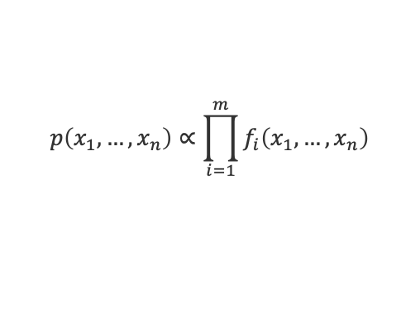
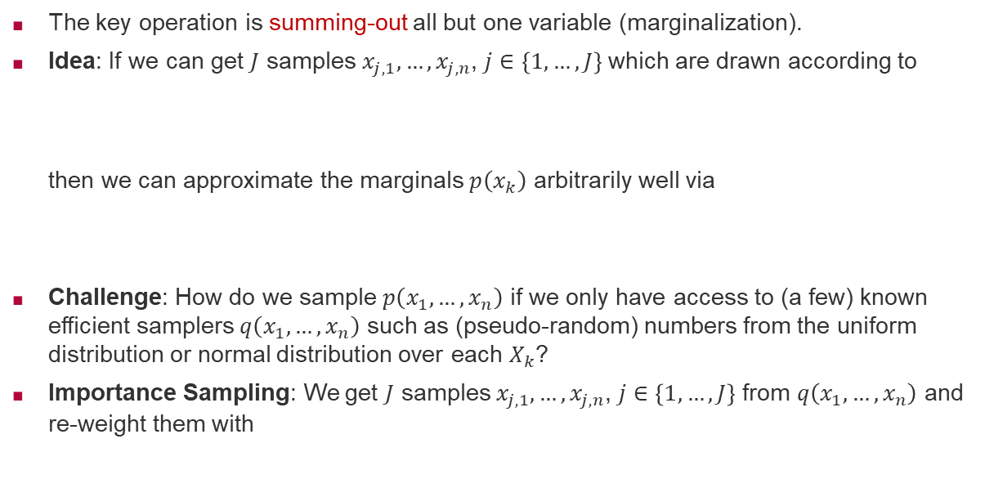
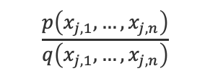
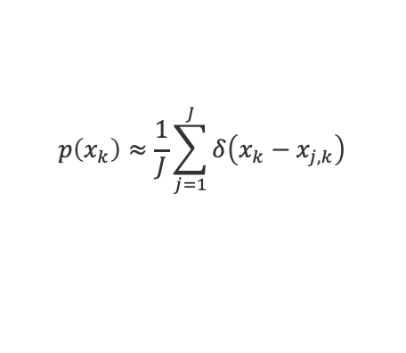
Inference by Importance Sampling
The key operation is summing-out all but one variable (marginalization).
Idea: If we can get $J$ samples $x_{j,1},…,x_{j,n}$, $j∈\left\{1,…,J\right\}$ which are drawn according to
then we can approximate the marginals $p\left(x_{k}\right)$ arbitrarily well via
Challenge: How do we sample $p\left(x_{1},…,x_{n}\right)$ if we only have access to (a few) known efficient samplers $q\left(x_{1},…,x_{n}\right)$ such as (pseudo-random) numbers from the uniform distribution or normal distribution over each $X_{k}$?
Importance Sampling: We get $J$ samples $x_{j,1},…,x_{j,n}$, $j∈\left\{1,…,J\right\}$ from $q\left(x_{1},…,x_{n}\right)$ and re-weight them with
$$p\left(x_{1},…,x_{n}\right)∝\prod_{i=1}^{m}{f_{i}\left(x_{1},…,x_{n}\right)}$$
$$p\left(x_{k}\right)≈\frac{1}{J}\sum_{j=1}^{J}{δ\left(x_{k}−x_{j,k}\right)}$$
$$\frac{p\left(x_{j,1},…,x_{j,n}\right)}{q\left(x_{j,1},…,x_{j,n}\right)}$$
Importance weight

Slide 7
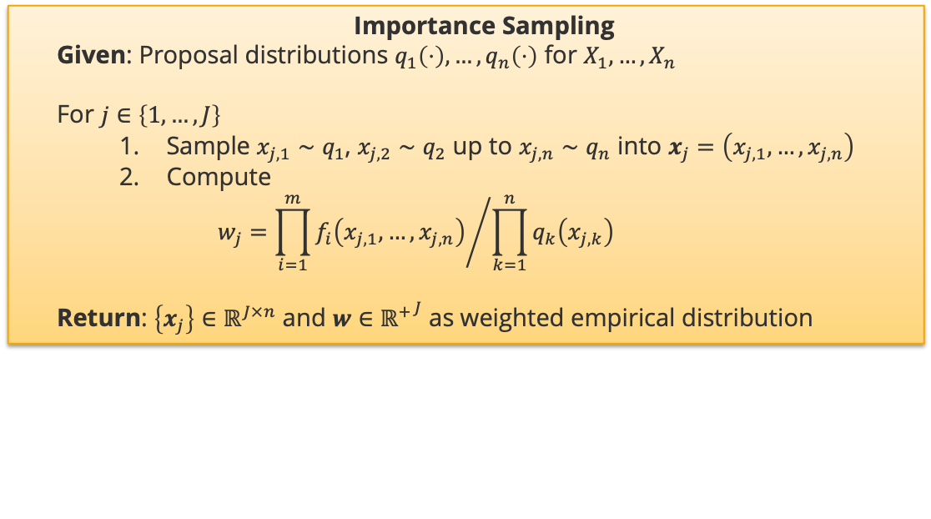
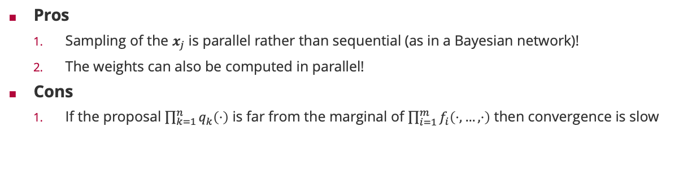
Marginalization by Sampling a Factor Graph
Importance Sampling
Given: Proposal distributions $q_{1}\left(⋅\right),…,q_{n}\left(⋅\right)$ for $X_{1},…,X_{n}$
For $j∈\left\{1,…,J\right\}$
Sample $x_{j,1}∼q_{1}$, $x_{j,2}∼q_{2}$ up to $x_{j,n}∼q_{n}$ into $x_{j}=\left(x_{j,1},…,x_{j,n}\right)$
Compute
$$w_{j}={\prod_{i=1}^{m}{f_{i}\left(x_{j,1},…,x_{j,n}\right)}}/{\prod_{k=1}^{n}{q_{k}\left(x_{j,k}\right)}}$$
Return: $\left\{x_{j}\right\}∈ℝ^{J×n}$ and $w∈{ℝ^{+}}^{J}$ as weighted empirical distribution
Pros
Sampling of the $x_{j}$ is parallel rather than sequential (as in a Bayesian network)!
The weights can also be computed in parallel!
Cons
If the proposal $\prod_{k=1}^{n}{q_{k}\left(⋅\right)}$ is far from the marginal of $\prod_{i=1}^{m}{f_{i}\left(⋅,…,⋅\right)}$ then convergence is slow

Slide 8





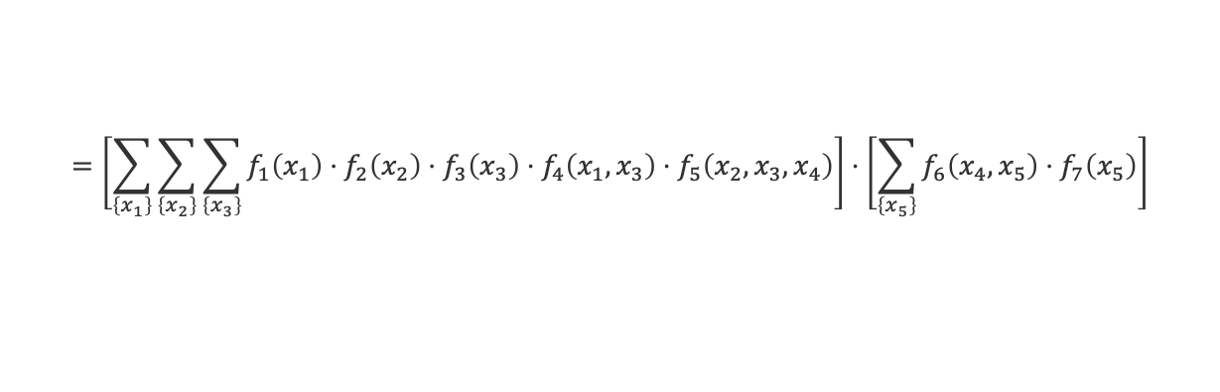



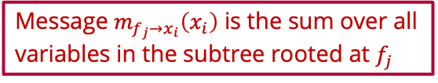









Sum-Product Algorithm: Marginals
$$f_{3}$$
$$f_{1}$$
$$f_{4}$$
$$x_{3}$$
$$x_{1}$$
$$f_{5}$$
$$f_{6}$$
$$f_{7}$$
$$x_{4}$$
$$x_{5}$$
$$f_{2}$$
$$m_{f_{5}→x_{4}}\left(x_{4}\right)$$
$$m_{f_{6}→x_{4}}\left(x_{4}\right)$$
$$x_{2}$$
Message $m_{f_{j}→x_{i}}\left(x_{i}\right)$ is the sum over all variables in the subtree rooted at $f_{j}$
$$p\left(x_{4}\right)=\sum_{\left\{x_{1}\right\}}{\sum_{\left\{x_{2}\right\}}{\sum_{\left\{x_{3}\right\}}{\sum_{\left\{x_{5}\right\}}{f_{1}\left(x_{1}\right)⋅f_{2}\left(x_{2}\right)⋅f_{3}\left(x_{2}\right)⋅f_{4}\left(x_{1},x_{3}\right)⋅f_{5}\left(x_{2},x_{3},x_{4}\right)⋅f_{6}\left(x_{4},x_{5}\right)⋅f_{7}\left(x_{5}\right)}}}}$$
$$=\left[\sum_{\left\{x_{1}\right\}}{\sum_{\left\{x_{2}\right\}}{\sum_{\left\{x_{3}\right\}}{f_{1}\left(x_{1}\right)⋅f_{2}\left(x_{2}\right)⋅f_{3}\left(x_{3}\right)⋅f_{4}\left(x_{1},x_{3}\right)⋅f_{5}\left(x_{2},x_{3},x_{4}\right)}}}\right]⋅\left[\sum_{\left\{x_{5}\right\}}{f_{6}\left(x_{4},x_{5}\right)⋅f_{7}\left(x_{5}\right)}\right]$$
$$m_{f_{5}→x_{4}}\left(x_{4}\right)$$
$$m_{f_{6}→x_{4}}\left(x_{4}\right)$$
Marginals are the product of all incoming messages from neighbouring factors!

Slide 9

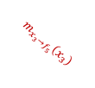
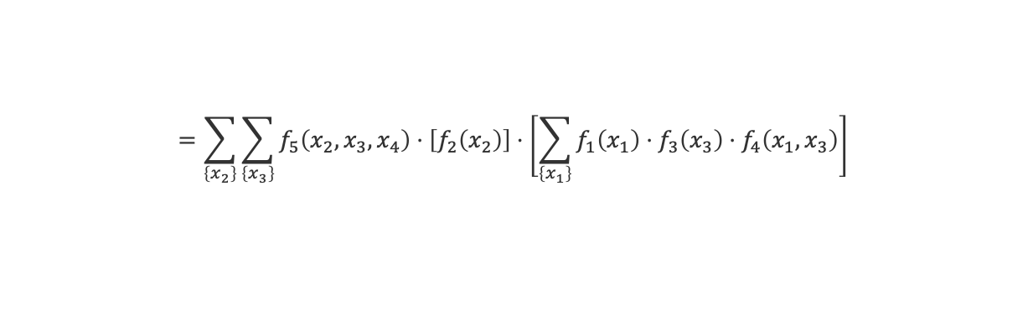

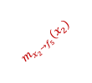





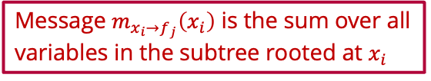
Sum-Product Algorithm: Message from Factor to Variable
$$f_{3}$$
$$f_{1}$$
$$f_{4}$$
$$x_{3}$$
$$m_{x_{3}→f_{5}}\left(x_{3}\right)$$
$$x_{1}$$
$$f_{5}$$
$$f_{6}$$
$$f_{7}$$
$$x_{4}$$
$$x_{5}$$
$$f_{2}$$
$$m_{f_{5}→x_{4}}\left(x_{4}\right)$$
$$m_{f_{6}→x_{4}}\left(x_{4}\right)$$
$$x_{2}$$
$$m_{x_{2}→f_{5}}\left(x_{2}\right)$$
Message $m_{x_{i}→f_{j}}\left(x_{i}\right)$ is the sum over all variables in the subtree rooted at $x_{i}$
$$m_{f_{5}→x_{4}}\left(x_{4}\right)=\sum_{\left\{x_{1}\right\}}{\sum_{\left\{x_{2}\right\}}{\sum_{\left\{x_{3}\right\}}{f_{1}\left(x_{1}\right)⋅f_{2}\left(x_{2}\right)⋅f_{3}\left(x_{3}\right)⋅f_{4}\left(x_{1},x_{3}\right)⋅f_{5}\left(x_{2},x_{3},x_{4}\right)}}}$$
$$=\sum_{\left\{x_{2}\right\}}{\sum_{\left\{x_{3}\right\}}{f_{5}\left(x_{2},x_{3},x_{4}\right)⋅\left[f_{2}\left(x_{2}\right)\right]⋅\left[\sum_{\left\{x_{1}\right\}}{f_{1}\left(x_{1}\right)⋅f_{3}\left(x_{3}\right)⋅f_{4}\left(x_{1},x_{3}\right)}\right]}}$$
$$m_{x_{2}→f_{5}}\left(x_{2}\right)$$
$$m_{x_{3}→f_{5}}\left(x_{3}\right)$$
Messages from a factor to a variable sum out all neighboring variables weighted by their incoming message

Slide 10





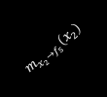






Sum-Product Algorithm: Message from Variable to Factor
$$f_{3}$$
$$m_{f_{3}→x_{3}}\left(x_{3}\right)$$
$$f_{1}$$
$$f_{4}$$
$$x_{3}$$
$$m_{x_{3}→f_{5}}\left(x_{3}\right)$$
$$x_{1}$$
$$f_{5}$$
$$f_{6}$$
$$f_{7}$$
$$m_{f_{4}→x_{3}}\left(x_{3}\right)$$
$$x_{4}$$
$$x_{5}$$
$$f_{2}$$
$$m_{f_{5}→x_{4}}\left(x_{4}\right)$$
$$m_{f_{6}→x_{4}}\left(x_{4}\right)$$
$$x_{2}$$
$$m_{x_{2}→f_{5}}\left(x_{2}\right)$$
$$m_{x_{3}→f_{5}}\left(x_{3}\right)=\sum_{\left\{x_{1}\right\}}{f_{1}\left(x_{1}\right)⋅f_{3}\left(x_{3}\right)⋅f_{4}\left(x_{1},x_{3}\right)}$$
$$=\left[f_{3}\left(x_{3}\right)\right]⋅\left[\sum_{\left\{x_{1}\right\}}{f_{1}\left(x_{1}\right)⋅f_{4}\left(x_{1},x_{3}\right)}\right]$$
$$m_{f_{3}→x_{3}}\left(x_{3}\right)$$
$$m_{f_{4}→x_{3}}\left(x_{3}\right)$$
Messages from a variable to a factor multiply incoming message from neighboring factors

Slide 11
Overview
Questions and Updates
Recap: Main Concepts of Unit 4
Example: Message Passing in Factor Graphs
Hints for Exercise 2 (to be handed in Monday May 19)

Slide 12
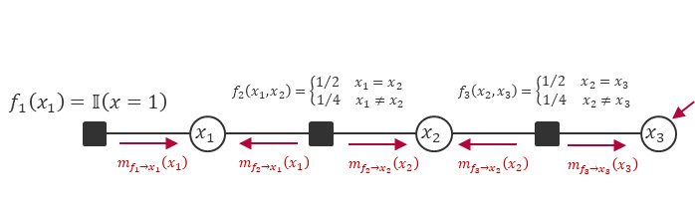
Example Chain (Slide 13): Model & Dynamics
Chain Graph:

Slide 13
Example Chain (Slide 13): Model & Dynamics
Chain Graph:
Initial Probability:
Transition Probability:

Slide 14
Example Chain (Slide 13): Computing Marginals as Usual
Chain Graph:
Initial Probability:
Transition Probability:
Marginal x1:
Marginal x2:
Marginal x3:

Slide 15
Example Chain (Slide 13): Computing Marginals as Usual
Chain Graph:
Initial Probability:
Transition Probability:
Marginal x1:
Marginal x2:
Marginal x3:

Slide 16
Example Chain (Slide 13): Computing Marginals as Usual
Chain Graph:
Initial Probability:
Transition Probability:
Marginal x1:
Marginal x2:
Marginal x3:

Slide 17
Example Chain (Slide 13): Results for Marginals
Chain Graph:
Initial Probability:
Transition Probability:
Marginal x1:
Marginal x2:

Slide 18
Example Chain (Slide 13): Results for Marginals
Chain Graph:
Initial Probability:
Transition Probability:
Marginal x1:
Marginal x2:

Slide 19
Example Chain (Slide 13): Computing Probabilities as Usual
Chain Graph:
Initial Probability:
Transition Probability:
Marginal x3:

Slide 20
Example Chain (Slide 13): Computing Probabilities as Usual
Chain Graph:
Initial Probability:
Transition Probability:
Marginal x3:

Slide 21
Example Chain (Slide 13): Impact of Observations (x3=2)
Chain Graph:
Marginals (conditioned on x3=2): ??

Slide 22
Example Chain (Slide 13): Impact of Observations (x3=2)
Chain Graph:
Marginals (conditioned):

Slide 23
Example Chain (Slide 13): Impact of Observations (x3=2)
Chain Graph:
Marginals (conditioned):

Slide 24
Example Chain (Slide 13): Impact of Observations (x3=2)
Chain Graph:
Marginals (conditioned):

Slide 25
Example Chain (Slide 13): Are Longer Chains Tractable?
Chain with K nodes:
Initial Probability:
Transition Probability:
Marginals: ??
Marginals (conditioned): ??

Slide 26
Example Chain (Slide 13): Are Longer Chains Tractable?
Chain with K nodes:
Initial Probability:
Transition Probability:
Marginals:
Marginals (conditioned):

Slide 27
Towards Alternatives: Sums & Products of Probabilities
Discrete events:
Expected Value:

Slide 28
Towards Alternatives: Sums & Products of Probabilities
Discrete events:
Expected Value:
Joint Probability:
Cond. Probability:

Slide 29
Towards Alternatives: Sums & Products of Probabilities
Discrete events:
Expected Value:
Joint Probability:
Cond. Probability:
Likelihood x Prior:

Slide 30
Towards Alternatives: Sums & Products of Probabilities
Discrete events:
Expected Value:
Joint Probability:
Cond. Probability:
Likelihood x Prior:

Slide 31
Towards Alternatives: Sums & Products of Probabilities
Discrete events:
Expected Value:
Joint Probability:
Cond. Probability:
Likelihood x Prior:
Product of Probabilities:

Slide 32
Towards Alternatives: Sums & Products of Probabilities
Discrete events:
Expected Value:
Joint Probability:
Cond. Probability:
Likelihood x Prior:
Product of Probabilities:

Slide 33
Example Chain (Slide 13): Marginal & Messages (Plan)
Chain Graph:
1. Initialize
2. Start at leaf x1
Initial message f1 to x1:
then marginal x1:

Slide 34
Example Chain (Slide 13): Marginal & Messages (Plan)
Chain Graph:
1. Initialize
2. Start at leaf x1
Initial message f1 to x1:
then marginal x1:
message from f2 to x2:
then marginal x2:
message from f3 to x3:
then marginal x3:

Slide 35
Example Chain (Slide 13): Marginal & Messages (Plan)
Chain Graph:
1. Initialize
2. Start at leaf x1
Initial message f1 to x1:
then marginal x1:
message from f2 to x2:
then marginal x2:
message from f3 to x3:
then marginal x3:

Slide 36
Example Chain (Slide 13): Marginal & Messages (Plan)
Chain Graph:
1. Initialize
2. Start at leaf x1
Initial message f1 to x1:
then marginal x1:
message from f2 to x2:
then marginal x2:
message from f3 to x3:
then marginal x3:

Slide 37
Example Chain (Slide 13): Marginal & Messages (Plan)
Chain Graph:
1. Initialize
2. Start at leaf x1
Initial message f1 to x1:
then marginal x1:
message from f2 to x2:
then marginal x2:
message from f3 to x3:
then marginal x3:

Slide 38
Example Chain (Slide 13): Computing Marginal & Messages
Chain Graph:
1. Initialize (Uniform!):
2. Start at leaf x1
Initial message f1 to x1:
then marginal x1:
message from f2 to x2:
then marginal x2:
message from f3 to x3:
then marginal x3:

Slide 39
Example Chain (Slide 13): Computing Marginal & Messages
Chain Graph:
1. Initialize (Uniform!):
2. Start at leaf x1
Initial message f1 to x1:
then marginal x1:
message from f2 to x2:
then marginal x2:
message from f3 to x3:
then marginal x3:

Slide 40
Example Chain (Slide 13): Computing Marginal & Messages
Chain Graph:
1. Initialize (Uniform!):
2. Start at leaf x1
Initial message f1 to x1:
then marginal x1:
message from f2 to x2:
then marginal x2:
message from f3 to x3:
then marginal x3:

Slide 41
Example Chain (Slide 13): Forward Results
Chain Graph:
initial message from f1 to x1:
then marginal x1:
then message from f2 to x2:
then marginal x2: should be ??
then message from f3 to x3:
then marginal x3: should be ??

Slide 42
Example Chain (Slide 13): Forward Results (Confirmed)
Chain Graph:
initial message from f1 to x1:
then marginal x1:
then message from f2 to x2:
then marginal x2:
then message from f3 to x3:
then marginal x3:

Slide 43
Example Chain (Slide 13): Impact of Observations (x3=2)
Chain Graph:
3. Observation:
4. What now?

Slide 44
Example Chain (Slide 13): Impact of Observations (x3=2)
Chain Graph:
3. Observation:
4. New factor f4 to x3:
Now messages backwards:
then marginal x3:
message from f3 to x2:
then marginal x2:
message from f2 to x1:
then marginal x1:

Slide 45
Example Chain (Slide 13): Impact of Observations (x3=2)
Chain Graph:
3. Observation:
4. New factor f4 to x3:
Now messages backwards:
then marginal x3:
message from f3 to x2:
then marginal x2:
message from f2 to x1:
then marginal x1:

Slide 46
Example Chain (Slide 13): Impact of Observations (x3=2)
Chain Graph:
3. Observation:
4. New factor f4 to x3:
Now messages backwards:
then marginal x3:
message from f3 to x2:
then marginal x2:
message from f2 to x1:
then marginal x1:

Slide 47
Example Chain (Slide 13): Impact of Observations (x3=2)
Chain Graph:
3. Observation:
4. New factor f4 to x3:
Now messages backwards:
then marginal x3:
message from f3 to x2:
then marginal x2:
message from f2 to x1:
then marginal x1:

Slide 48
Example Chain (Slide 13): Impact of Observations (x3=2)
Chain Graph:
3. Observation:
4. New factor f4 to x3:
Now messages backwards:
then marginal x3:
message from f3 to x2:
then marginal x2:
message from f2 to x1:
then marginal x1:

Slide 49
Example Chain (Slide 13): Impact of Observations (x3=2)
Chain Graph:
3. Observation:
4. New factor f4 to x3:
Now messages backwards:
then marginal x3:
message from f3 to x2:
then marginal x2:
message from f2 to x1:
then marginal x1:

Slide 50
Example Chain (Slide 13): Backward Results (x3=2)
Chain Graph:
initial message:
then marginal x3:
then message from x3 to x2:
then marginal x2: should be ??
then message from x2 to x1:
then marginal x1:

Slide 51
Example Chain (Slide 13): Backward Results (x3=2)
Chain Graph:
initial message:
then marginal x3:
then message from x3 to x2:
then marginal x2:
then message from x2 to x1:
then marginal x1:

Slide 52
Chains: Generalizations (More Nodes & Any Dynamics)
Chain (K nodes):

Slide 53
Chains: Generalizations (More Nodes & Any Dynamics)
Chain (K nodes):

Slide 54
Chains: Generalizations (More Nodes & Any Dynamics)
Chain (K nodes):
1. Initialize via Uniform
2. Update initial message:

Slide 55
Chains: Generalizations (More Nodes & Any Dynamics)
Chain (K nodes):
1. Initialize via Uniform
2. Update initial message:
3. Update marginal xk:

Slide 56
Chains: Generalizations (More Nodes & Any Dynamics)
Chain (K nodes):
1. Initialize via Uniform
2. Update initial message:
3. Update marginal xk:
Forward message from fk to xk:

Slide 57
Chains: Generalizations (More Nodes & Any Dynamics)
Chain (K nodes):
1. Initialize via Uniform
2. Update initial message:
3. Update marginal xk:
Forward message from fk to xk:
4. Backward message from fk to xk-1:

Slide 58
Chains: Are Longer Chains Tractable? Yes!
Chain (K nodes):
1. Initialize via Uniform
2. Start again at leaf x1
3. Forward Updates: messages & marginals from k=1 to k=K
4. Backward Updates: messages & marginals from k=K to k=1
Do you think you can do that?

Slide 59
Chains: Are Longer Chains Tractable? Yes!
Chain (K nodes):
1. Initialize via Uniform
2. Start again at leaf x1
3. Forward Updates: messages & marginals from k=1 to k=K
4. Backward Updates: messages & marginals from k=K to k=1
Test it: It easily works for K=100.
Note: This has not been possible by using standard summations!

Slide 60
Overview
Questions and Updates
Recap: Main Concepts of Unit 4
Example: Message Passing in Factor Graphs
Hints for Exercise 2 (to be handed in May 19)

Slide 61
Exercise 2 (until May 19)
Part I: Sums & Products of Gaussians & Distributions
Part II: Conditional Independence & D-separation
Part III: TrueSkill (discrete) via Message Passing

Slide 62
Summary
Recap I: Conditional Probabilities
Recap II: Conditional Independence in Bayesian Networks
Recap III: Messages & Marginals in Factor Graphs (Chain)

Slide 63
See you next Week!

