Slide 1
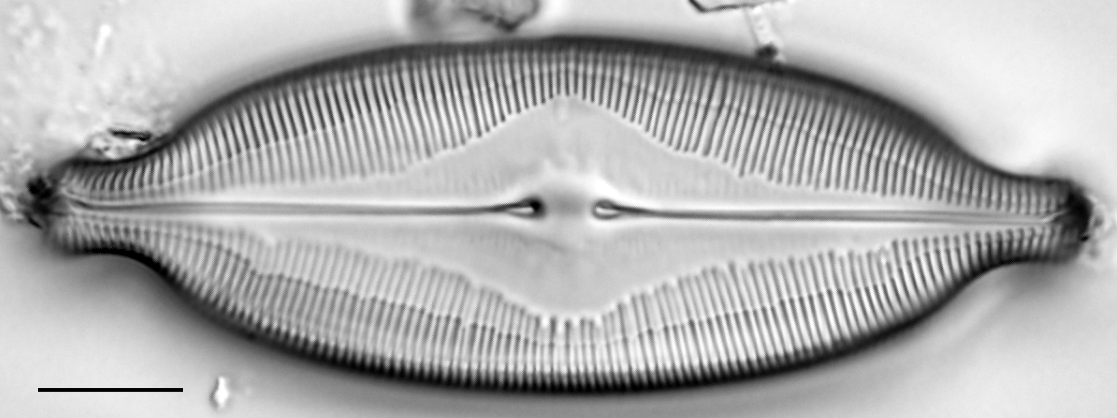
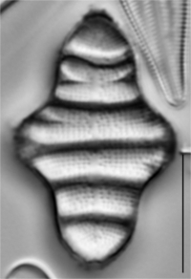
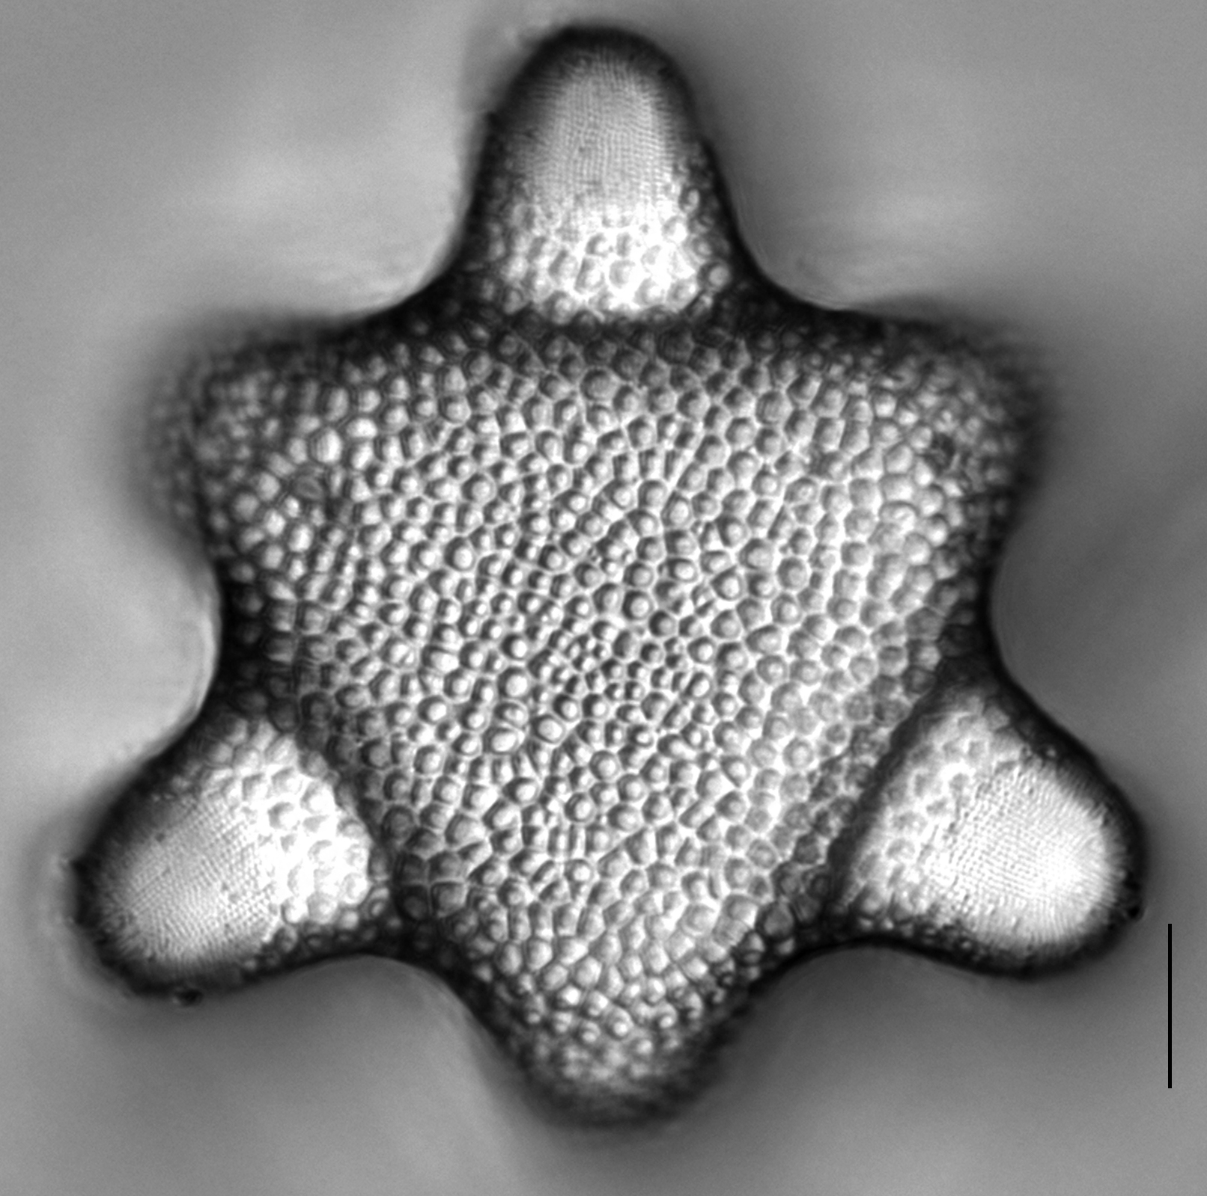
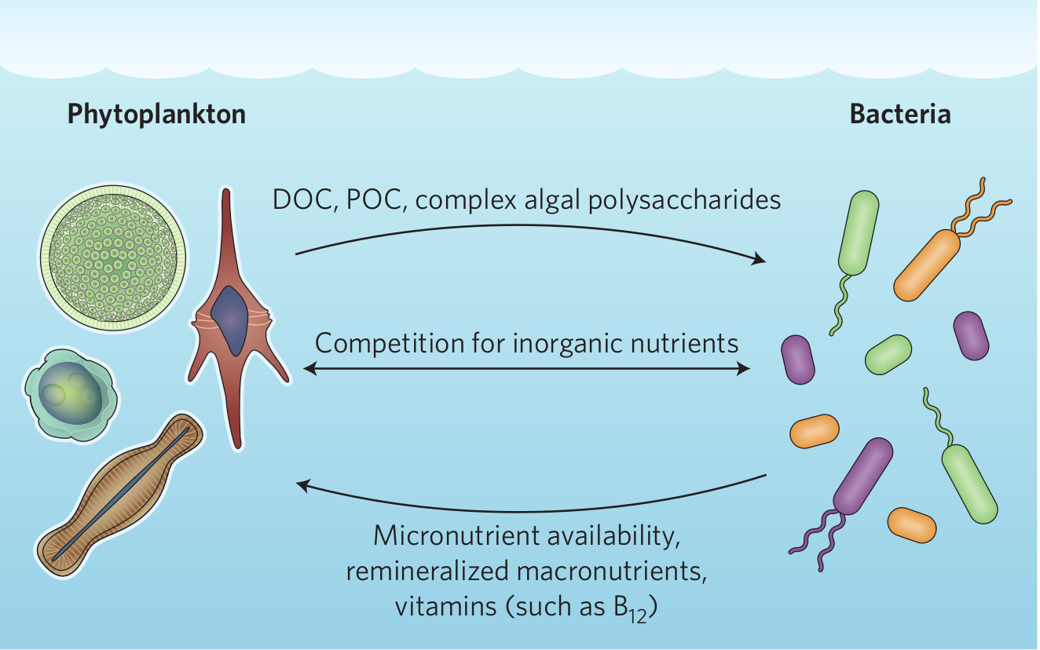
Cory Gargas – OTU sorting, clustering, and assignment
Overview:
Prokaryotic 16s sequences scavenged from ~132 diatom transcriptomes.
Need to infer taxonomy for these ‘unknown’ prokaryote 16s sequences.
Tasks:
Sort unknown 16s sequences by Domain.
Remove sequences ≤250bp in length.
OTU clustering to remove duplicate sequences.
Reformat Silva LTP reference files make them parse-able and to make names in FASTA file match those of tree file.
Use raxml to place our unknown 16s sequences onto LTP reference phylogeny.
Top right: www.diatoms.org; Bottom right: Figure 1, Seymour et al. 2017

Slide 2
Cory Gargas – workflow
Poorly formatted Silva
LTP reference files -
FASTA & tree files
unknown 16s
Sequences -
Archaea: 67
Bacteria: 18385
SSU-ALIGN - seqs > 250bp
Archaea: 57
Bacteria: 11,865
Custom python script -
Reformat FASTA alignment
& tree files
SSU-ALIGN -
sequence alignment
CD-hit - 97%
Archaea: 19
Bacteria: 5,604
Reformatted
FASTA alignment
RAxML -
Taxonomic placement of
unknowns onto
reference tree
MUSCLE -
Profile
alignment
Reformatted
Tree

