Slide 1
Death rates for suicide, by sex, race,Hispanic origin, and age:United States
U.S. Department of Health and Human Services 2019

Slide 2
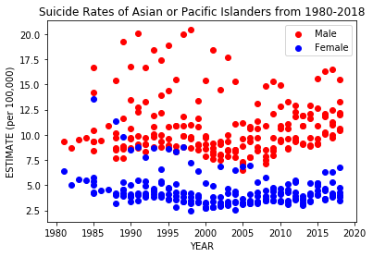
Difference Between Male and Female
Males are represented in red
Females are represented in blue
Males tend to have the idea that they need to provide (Pressure?)
Females tend to seek help and willing to talk unlike most males

Slide 3
90’s scare
Things that could have contributed but not limited to an increase during this decade:
Drug use
Immigrating to a new country
Y2K
Deaths reports listing suicides instead another cause of death

Slide 4
Trend
Slight leveling out going in 2000’s
An increase in the trend after the start of 2000’s
Less outliers

Slide 5
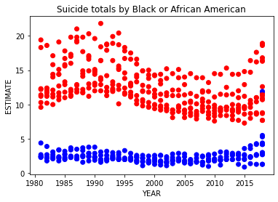
African American Suicide Rates

Slide 6
In conclusion
Wild ride
Men> Female
Increase later years

Slide 7
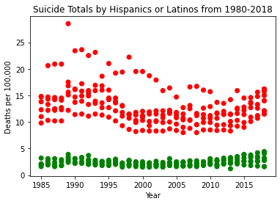
Visualization

Slide 8
Work in Progress
Unique information
Male > Female
Age group
More comparisons

Slide 9
Conclusions
Male > Female (Time Period)
Various datasets
Coding matters
Know what to code

Slide 10
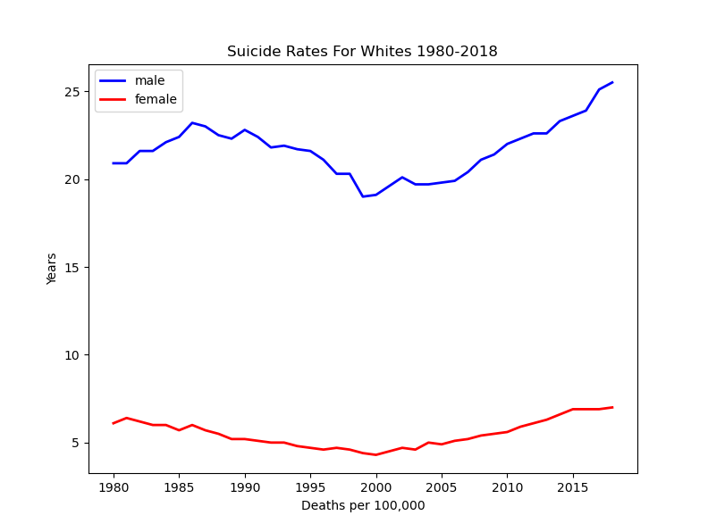
White Suicides 1980-2018

Slide 11
White Suicides Conclusion
Increase in white suicides
Male suicides higher than women
Small dip in 2000s
How much more often men kill themselves
Would like to compare to visual of total suicides over time

Slide 12
Conclusion
No matter race, male suicides > female suicides
Suicide rates are increasing
Suicide methods = suicide success?
Splitting Data
Simple lines of code can be hard to debug

