Slide 1
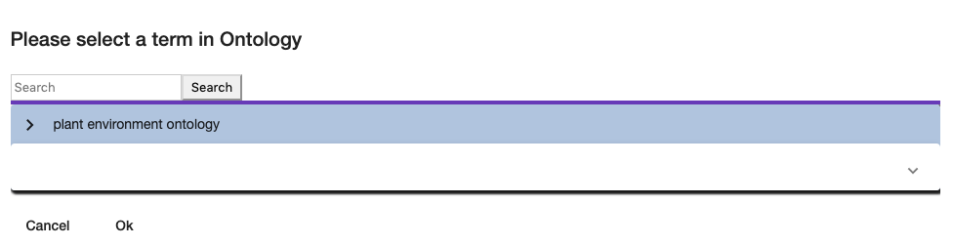
click here
to expand

Slide 2
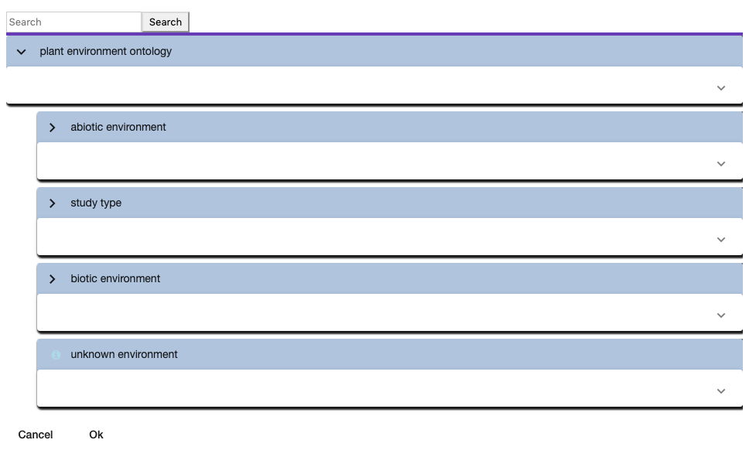

Slide 3
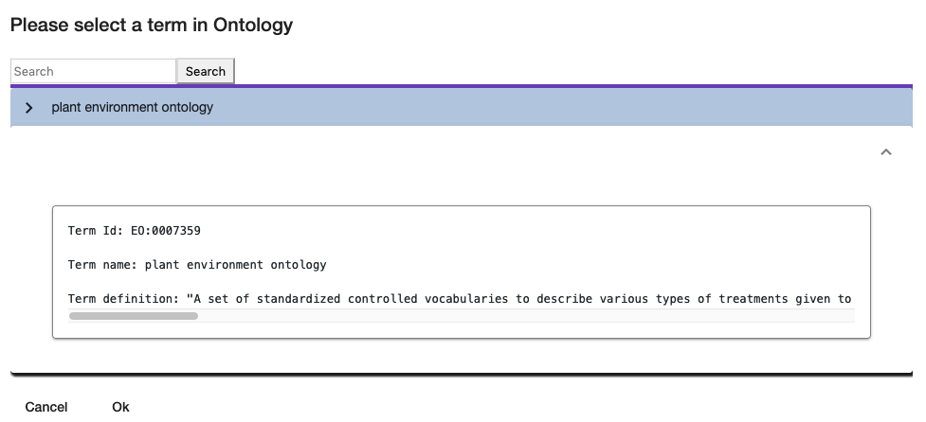
click here to display

Slide 5
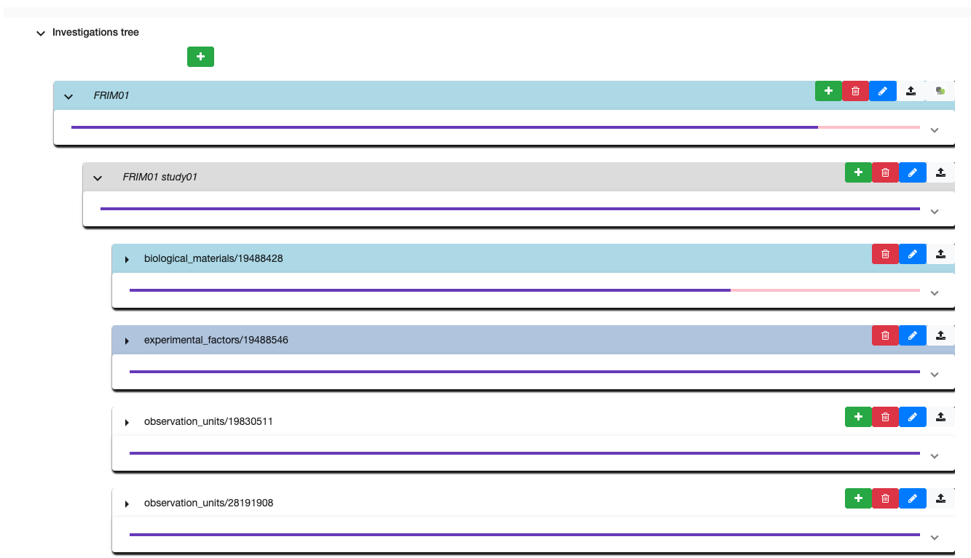
1 - DESIGN YOUR EXPERIMENT IN A VERY SIMPLE WAY
Duration, start and end date
Biological Material and material source
Experimental factor and observed variable
Describes observation unit and climatic events
And many more …

Slide 6
Terrain
10 m
Azote -- /water --
Azote -- /water ++
Azote ++ /water --
Azote ++ /water ++
Sunny
5 m
Shady
Parcelle

Slide 7
Azote -- /water --
Azote -- /water ++
Azote ++ /water --
Azote ++ /water ++
Sunny
Shady

Slide 8

1,80 m
parcelle
1,80 m

