Slide 1
Problems with the current approach
Repetitive tasks:
Especially many of the pre- and post-processing tasks with GIS (data conversion, aggregation, alignment) need to be repeated many times for a varying number of features
A set of Zonation analysis typically includes many variants
Analysis may need to be repeated as data is updated

Slide 2
Problems with the current approach
Manual work
Data layers are processed in GIS → converted to ASCII files
Zonation setup constitutes of several different configuration (text) files and varying number of input files (new features → new files…)
Keeping track of data and analysis details is hard
Propagating changes is even harder

Slide 3
Problems with the current approach
Complex (error prone) configuration
Changing one thing in the analysis may involve changes in several places
Configuration is done by hand in text/batch files
GIS-processing dependes on who’s doing it and with what tools

Slide 4
Why a new framework?
Bind together consecutive steps in the analysis setup
→ easy to adjust analysis setup, update data and repeat the analysis
Provide a protocol for the analysis
→ consistent description of the data, analysis setup and the workflow
Provide an extendable plug-in framework
→ new features/tools can be accommodated

Slide 5









Development stack
GUI
Framework
lxml
Tools (plug-ins)

Slide 6
Implementation
The language of choice: Python 2.6
fast development
wrappers for many external tools
easy to learn
All the features in the standard library
Execution speed is not an issue

Slide 7
lxml
Description language
Markup language: XML
describes the data files, data flow, tools and parameters, and associated meta data
all components use well defined XML schema + schema validation (XSD)
all stages recorded → history and documentation
Python package: lxml
efficient parsing (C-implementation)
ElementTree compliant API → pythonic usage

Slide 8
Core
Traits
Initialization
Validation
Delegation
Notification
Visualization
TraitsUI + TraitsGUI
automatic generation of UI, or MVC on objects
PyQt4 or wxPython backend

Slide 9
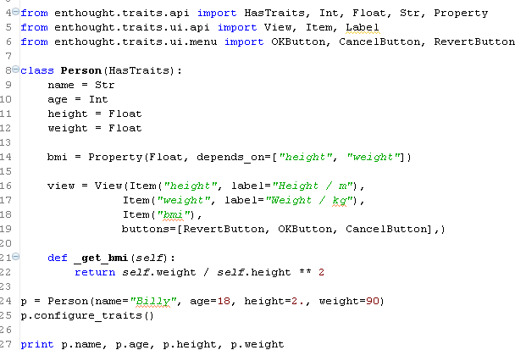
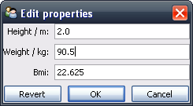
Traits example
With 18 lines of code you get:
Static typing (initialization + validation)
Cross-dependencies and automatic
updates
Custom graphical view and actions

Slide 10
Core
Envisage - extensible application framework
Plug-ins that can:
Advertise where and how it can be extended (its "extension points")
Contribute extensions to the extension points offered by other plug-ins
Create and share the objects that perform the real work of the application ("services")
EnvisagePlugins
Workbench, Action, Single project, Text editor, Python shell, Debug

Slide 11



Plug-ins
A plug-in: Python wrapper for a given tool
knows how to handle the tool
fits into an extension point of the main framework
Services (plug-in functionalities) kept in the framework’s registry
Framework keeps account about operations and data modification (via XML)

Slide 12

GUI
Implemented mostly through TraitsGUI with ’qt4’-backend
Main GUI / editor with separate PyQt4-application?
Matplotlib (for plotting) also has a ’qt4’-backend

Slide 13
Tools
Plugins
Framework
GUI
GIS
plugin
Zonation
plugin
R
plugin

Slide 14
Structure
Input data
GIS
Z
GIS
Output data
FILESYS
LOG
Data description
XX
Plug-in
Operations description

Slide 15
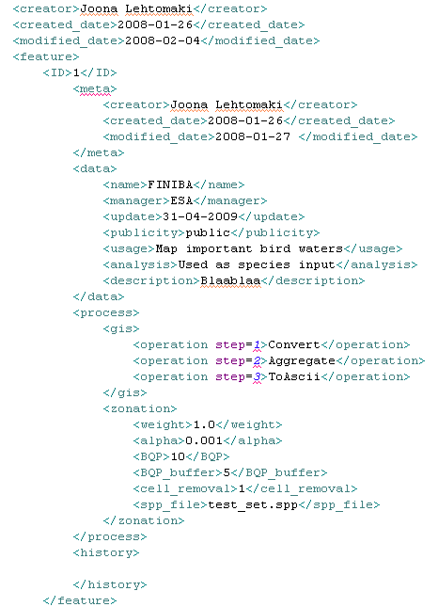
Description language – xml
General metadata
Data metadata
Different operations on the data
History
Notes:
Projects?g

Slide 16
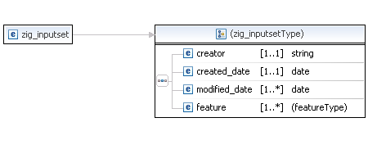
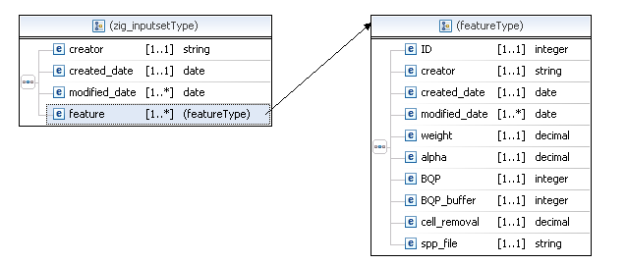
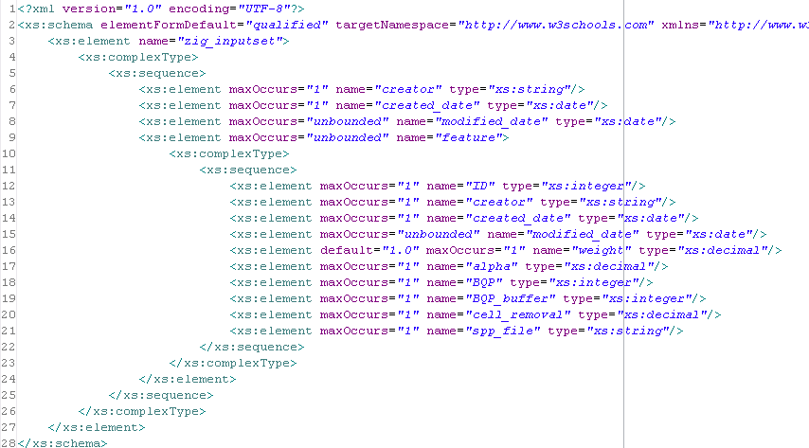
Description language – validation(xsd)

Slide 17
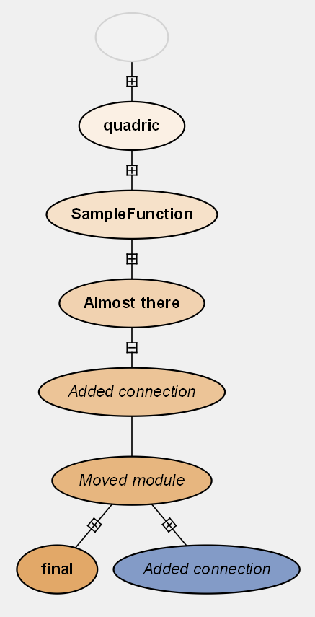
Description language - history
Inspiration: VisiTrails
History will be saved in xml automatically → visualization
Plotting?
Networkx + Matplotlib

Slide 18
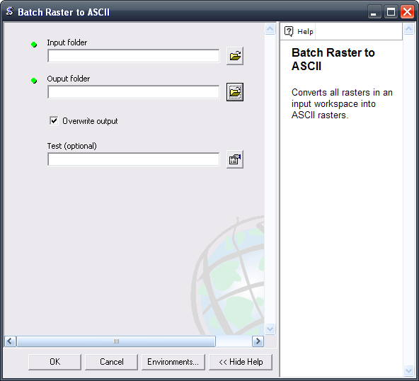
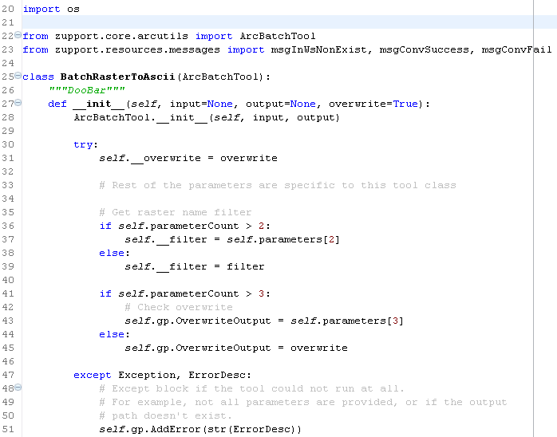
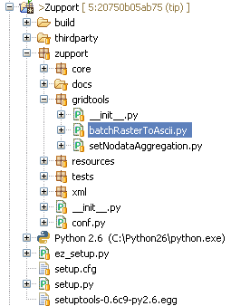
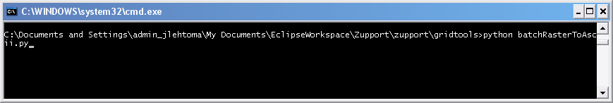
ArcGIS integration
ArcToolbox
Same codebase
Programatically
Command line

Slide 19
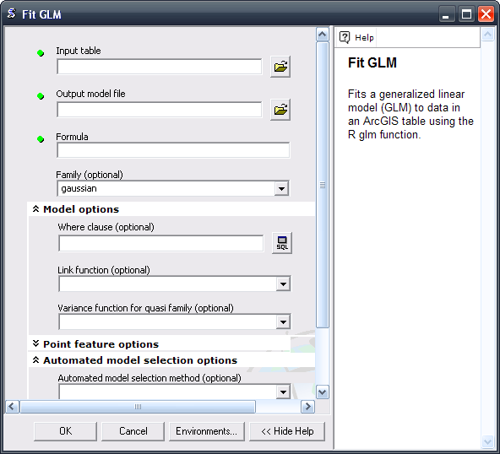
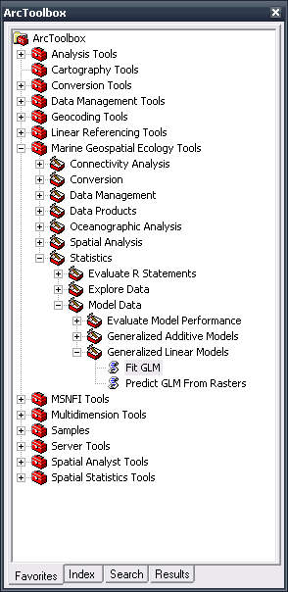
Additional tools - R
Inspiration: Marine Geospatial Ecology Tools → connection to R via Rpy2

