Slide 1
Re-distributing Biased Pseudo Labels for Semi-supervised Semantic Segmentation: A Baseline Investigation
Ryhan Moghe

Slide 2
Problem
Recently, DCNNs have been successful for semantic segmentation, but require lots of data with accurate pixel-by-pixel human annotations
Self-training, by using semi-supervised learning with a small amount of labeled data to create pseudo-labels, then training on the pseudo-labeled data has achieved excellent results
But most previous self-training approaches assume class-balanced data distribution, and use a single confidence scheme to create pseudo-labels, whereas most real-world datasets have long-tail class distributions (few categories make up majority of pixels)
DCCNs trained on such a distribution will be biased towards the dominant categories

Slide 3
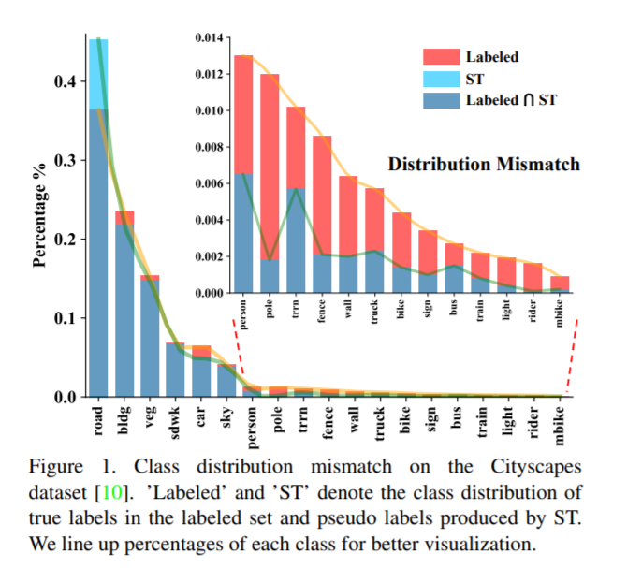
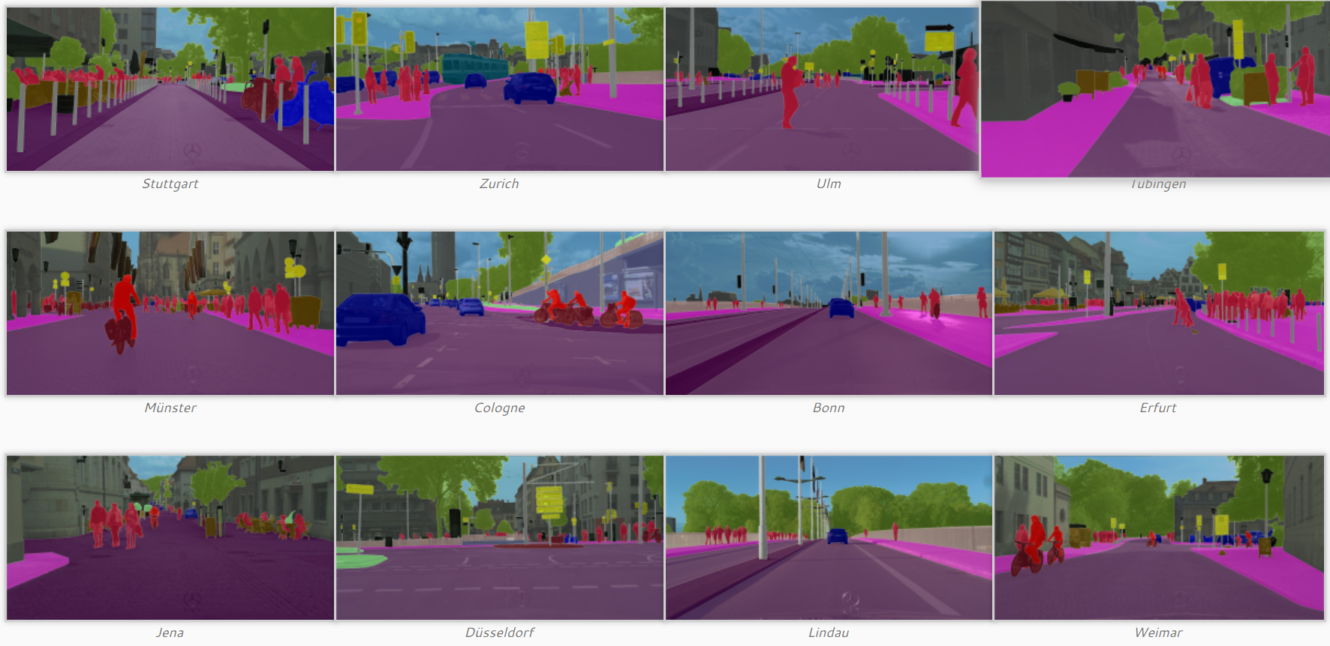
Data Sample Example
Cityscapes dataset samples

Slide 4
Related Efforts
Recent efforts attempt to address this issue by sampling the same % of pixels in each category based on predicted results, as opposed to a single confidence threshold
But, the prediction class distribution will already deviate from true class distribution, thus pseudo labels will suffer the same bias
Summary: Related works do not exploit bias in pseudo-labeling, and use ST for all classes or samples based on biased predictions, whereas this method explicitly processes the bias in pseudo-labeling

Slide 5
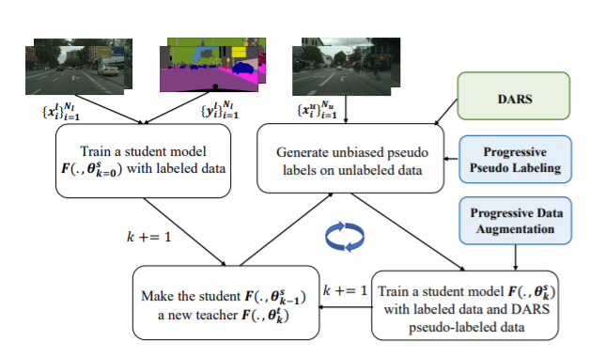
Method
Step 1: Train student model F with labeled data, minimizing cross-entropy loss
Step 2: Use student model F as teacher model to produce predictions for unlabeled samples
Using predictions and labels, generate pseudo labels using DARS method
Step 3: Use labeled data and pseudo-labeled data to train F, minimizing cross-entropy loss for both labeled and unlabeled data
Self-training iterates Steps 2 and 3 until no more performance gains

Slide 6
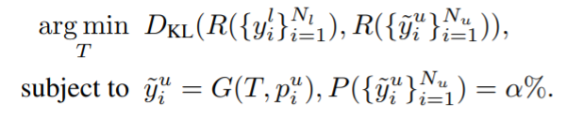
Unbiased Pseudo Label Generation
Aim to obtain pseudo labels that occupy α% of all pixels (labeling ratio)
Adopt category-specific confidence thresholds to derive pseudo-labels
Confidence thresholds derived by finding thresholds that minimize KL-divergence of frequency of labels and pseudo-labels of each category:
R: Frequency function, outputs labeled/pseudo-labeled pixel % of each category
G: Generates pseudo-label for pixel if confidence value >= category threshold, otherwise assign ignore label
P: Returns percentage of pseudo-labeled pixels
*Pixels with ignore label will not contribute to training

Slide 7
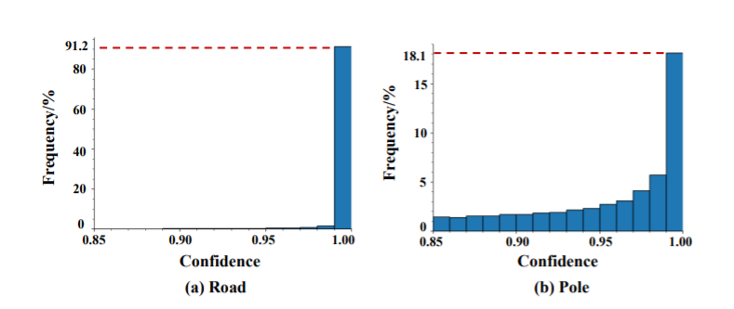
Confidence Overlapping Issue
In semantic segmentation, many pixels have similar/indistinguishable confidence values
DCCNs are prone to producing over-confident prediction values, especially for head categories, causes these confidence overlaps
This results in number of pixels after thresholding being larger/much larger than desired

Slide 8
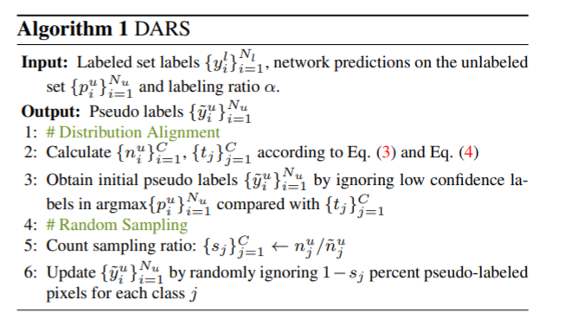
Distribution Alignment and Random Sampling (DARS)
Assume no confidence overlapping, and perform distribution alignment
For categories that do not suffer serious confidence overlapping, we can derive the desirable number of pixels for each category j, by ignoring all pixels for category j with confidence lower than t_j

Slide 9
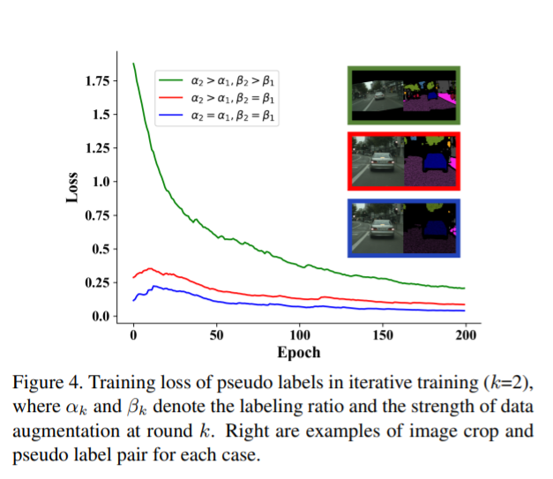
Progressive Data Augmentation and Labeling
If we keep the labeling ratio and data augmentation magnitude the same, training loss starts low
Increasing labeling ratio allows model to evaluate new data samples, but alone changes loss very little
We further introduce new samples to our model by increasing magnitude of data augmentation

Slide 10
Experiment
Dataset:
Cityscapes
5k fine annotated images
2975, 500, 1525 three image sets for training, validation, and testing
19 urban-scene semantic classes defined for semantic segmentation
⅛ and ¼ of training set are randomly sampled for labeled set, and remaining are used for unlabeled set
VOC12
20 semantic classes, 1 background class
1464 training set used as labeled data, 9k augmented set used as unlabeled data
Architecture:
PSPNet:
Used instead of SOTA methods often contain heavy engineering and parameter tuning
Best trade off between reproducibility, performance, and costs

Slide 11
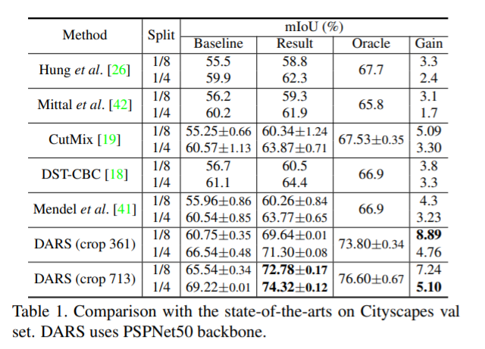
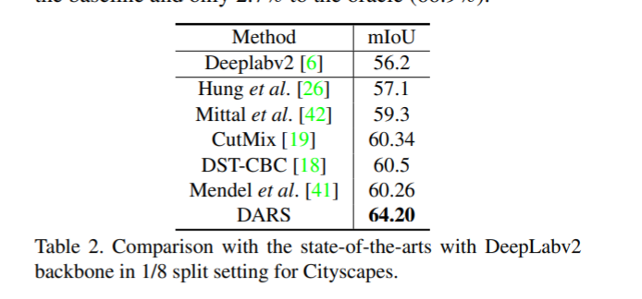
Comparison: DARS vs SOTA methods on Cityscapes

Slide 12
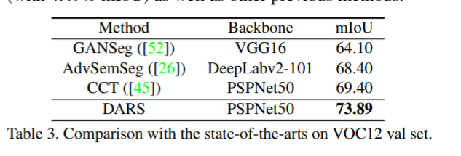
Comparison: DARS vs SOTA methods on VOC12

Slide 13
Ablation Studies
Methods Tested:
ST (baseline): single confidence thresholding method
CBST (SOTA) : class balanced confidence thresholding method, based on prediction results
DA: proposed distribution aligning method without random sampling
TS: temperature scaling, incorporating with DA, CBST, or ST to facilitate distribution alignment by calibrating model predictions

Slide 14
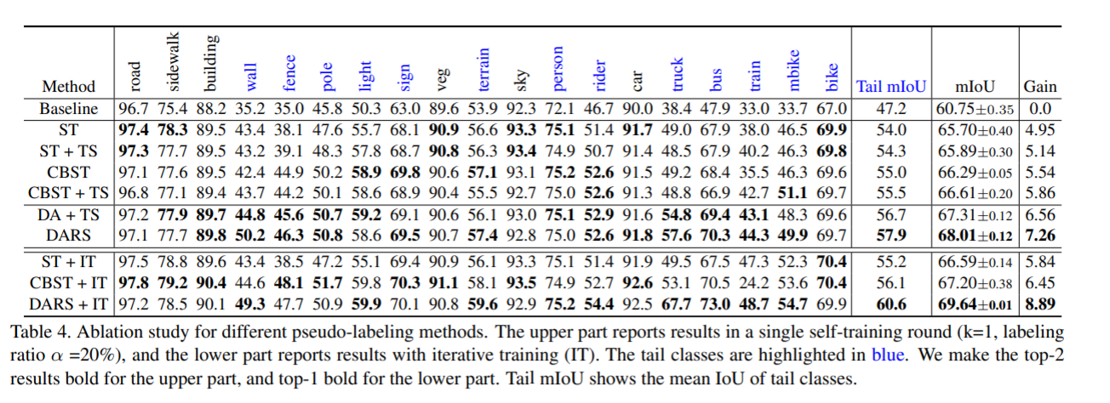
Ablation Study Results

