Slide 1
Axis 1
Genome assembly

Slide 2
Genome assembly project
Context: New advances in the field of genomic sequencing
Aims:
1. Identify the best practice to obtain the highest quality assembly at a specific price
2. Development of new methods for de novo assembly
Data: Oxford Nanopore, Pacific Bioscience, Hi-C, 10x Chromium, Bionano optical mapping …
Species: Cattle, Maize, Pig, Quail, Goat, Sheep, …

Slide 3
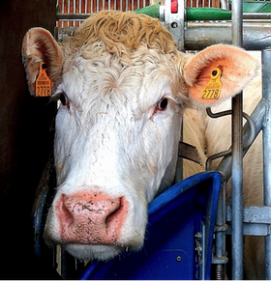
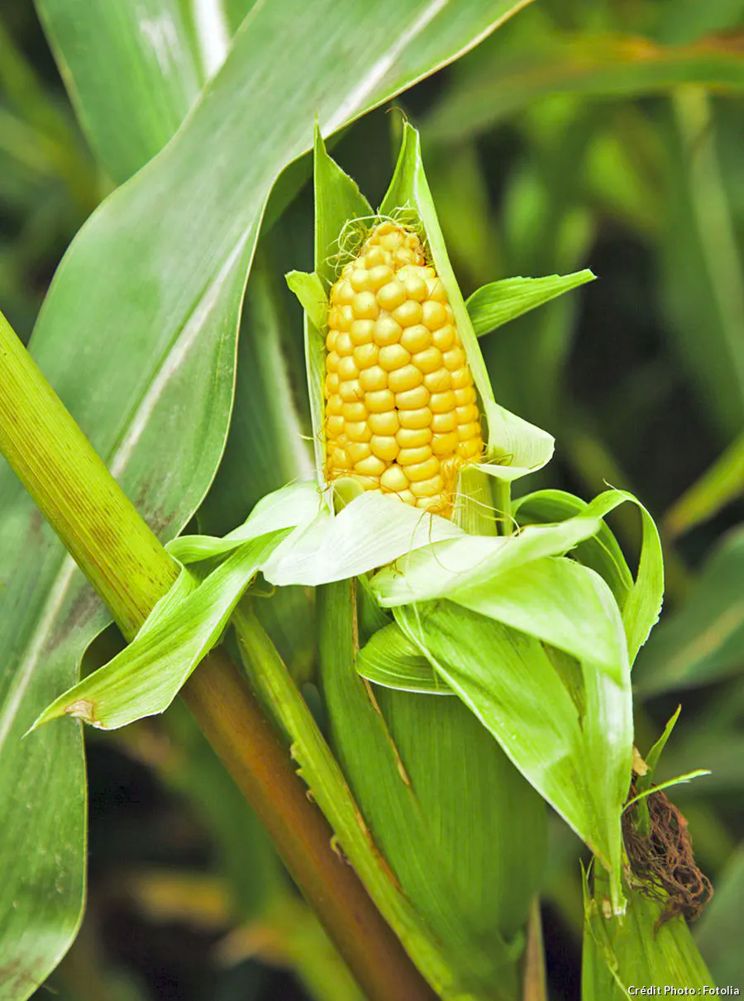
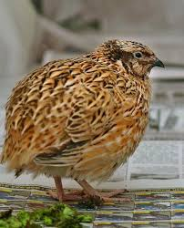
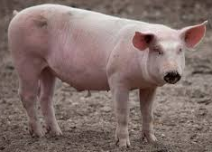
Genomes specificities
- 2.7 Gb genome length
- 30 Chromosomes
- 40 % Repetitive regions
- 2 Trio (6 Animals)
- 2.4 Gb genome length
- 10 Chromosomes
- 85 % Repetitive regions
- 4 Strains
- 2.8 Gb genome length
- 38 Chromosomes
- 35 % Repetitive regions
- 1 Animal
- 0.93 Gb genome length
- 33 Chromosomes
- 15 % Repetitive regions
- 1 Animal

Slide 4
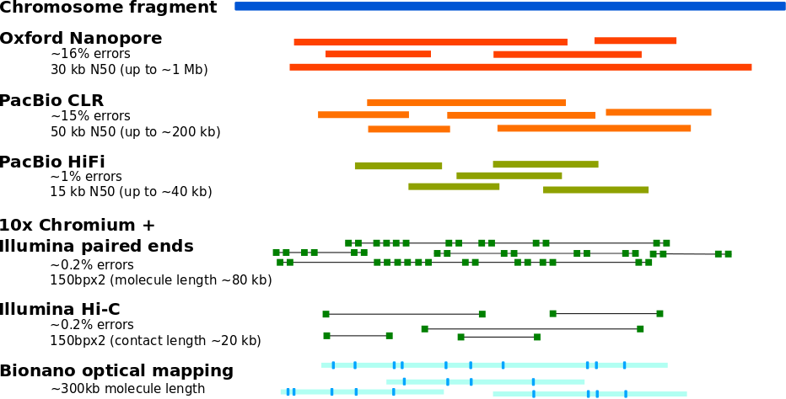
Available data

Slide 5
Current assembly pipeline
Hi-C read
fastq
Linked read
fastq
Long read
fasta
Contig assembly
Error correction
Scaffolding
Finishing
Polishing
Splitting
Gap filling
Polishing

Slide 6
Contig assembly
Construction of long chromosomial parts without N’s based on overlapping reads
Assemblers tested: - wtdbg2 - best ratio between contigs quality, run time and memory required
- flye - similar results to wtdbg2 but longer run time
- shasta - requires very long reads
- canu - requires high coverage and large disk space
- ...

Slide 7
Assembly evaluation
N50: defines assembly quality in terms of contiguity. Given a set of contigs, the N50 is defined as
the sequence length of the shortest contig at 50% of the total genome length.
BUSCO score: assesses genome assembly completeness by finding a particular set of near-universal
single copy orthologs
C: complete (S : single-copy and D : duplicated)
F: fragmented
M: missing
Contigs N50: 20-25 Mb
Contig’s BUSCO score: C:67.9%[S:67.4%,D:0.5%],F:11.7%,M:20.4%

Slide 8
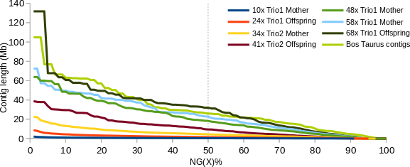
Coverage impact on female bovine assembly

Slide 9
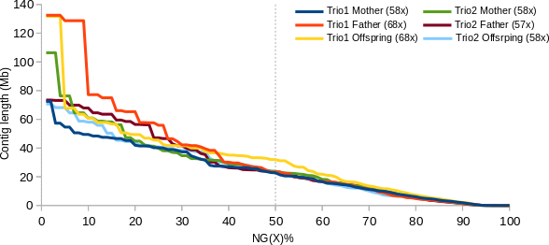
Maximum coverage results

Slide 10
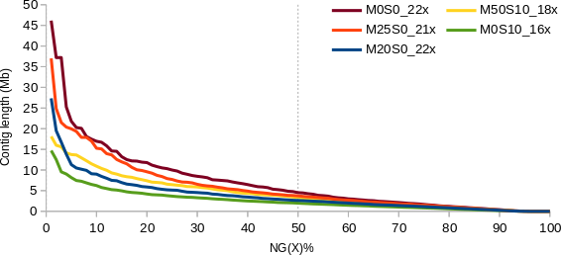
Protocol impact on contig length

Slide 11
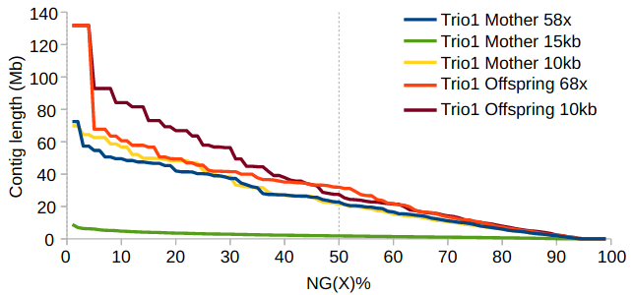
Bioinformatic read length filter

Slide 12
Error correction
Two types of errors in contigs :
- sequence errors due to sequencing => corrected through polishing
- connection errors due to assembler choices => corrected through splitting
Steps in the error correction pipeline:
1. Polishing based on long reads – align long reads to contigs and build consensus
2. Splitting based on long reads – remove contigs regions covered by less than 4 reads
remove sequence extension errors made by polisher
3. Polishing based on short reads – align short reads to contigs and build consensus

Slide 13

Long read polishing
Long reads
Mini
map2
Alignment
Assembly
Racon
Medaka
Loop and
polish again
Busco
Kat
Splitting
OR
Short reads
polishing
Quast
Assembly

Slide 14
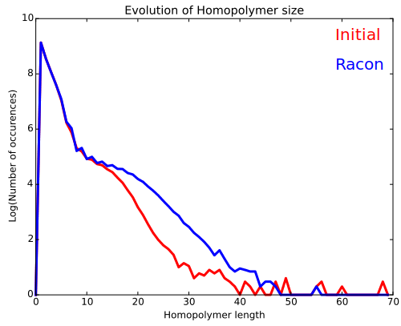
Long read polishing
BUSCO score after contig assembly:
C:67.9% [S:67.4%,D:0.5%],F:11.7%,M:20.4%
BUSCO score after long read polishing:
C:83 % [S:82.1%,D:0.9%],F:9.8%,M:7.1%
Contigs N50 after contig assembly:
20 / 25 Mb
Contigs N50 after long read polishing:
22 / 26 Mb

Slide 15
Long read splitting
Long reads
Mini
map2
Alignment
Assembly
Samtools
Mpileup
Samtools
depth
Reads stats file
Depth file
Splitter.py
Assembly
corrected

Slide 16
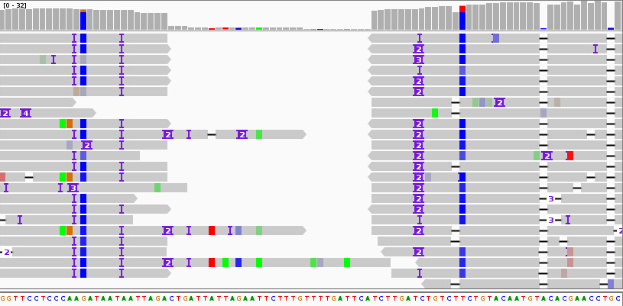
Long read splitting
High coverage area
(>4X)
High coverage area
(>4X)
Low coverage area
(<4X)
BUSCO score:
C:82.6%[S:81.7%,D:0.9%],F:9.9%,M:7.5%
Contigs N50:
22 / 26 Mb

Slide 17
Short read polishing
Short reads
Bwa
Longranger
Alignment
Assembly
Pilon
FreeBayes
VCFTools
Loop and
polish again
Busco
Kat
Quast
Assembly
BUSCO score before short read polishing:
C:82.6%[S:81.7%,D:0.9%],F:9.9%,M:7.5%
BUSCO score after short read polishing:
C:95 %[S:93.9%,D:1.1%],F:3.0%,M:2.1%

Slide 18
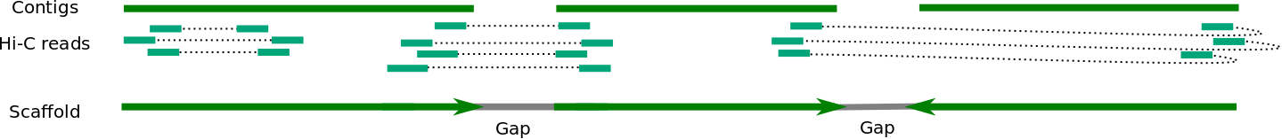
Scaffolding
Align Hi-C reads and connect contigs into scaffolds/chromosomes based on contacts
Scaffolders tested: - 3d-dna - allows easy manual correction of scaffolds)
- Salsa - similar results to 3d-dna on high coverage (>10x)
but better results with very low coverage (<7x)
- ...
BUSCO score after scaffolding:
C:95 %[S:93.9%,D:1.1%],F:3.0%,M:2.1%
Scaffold N50:
95 / 110Mb

Slide 19
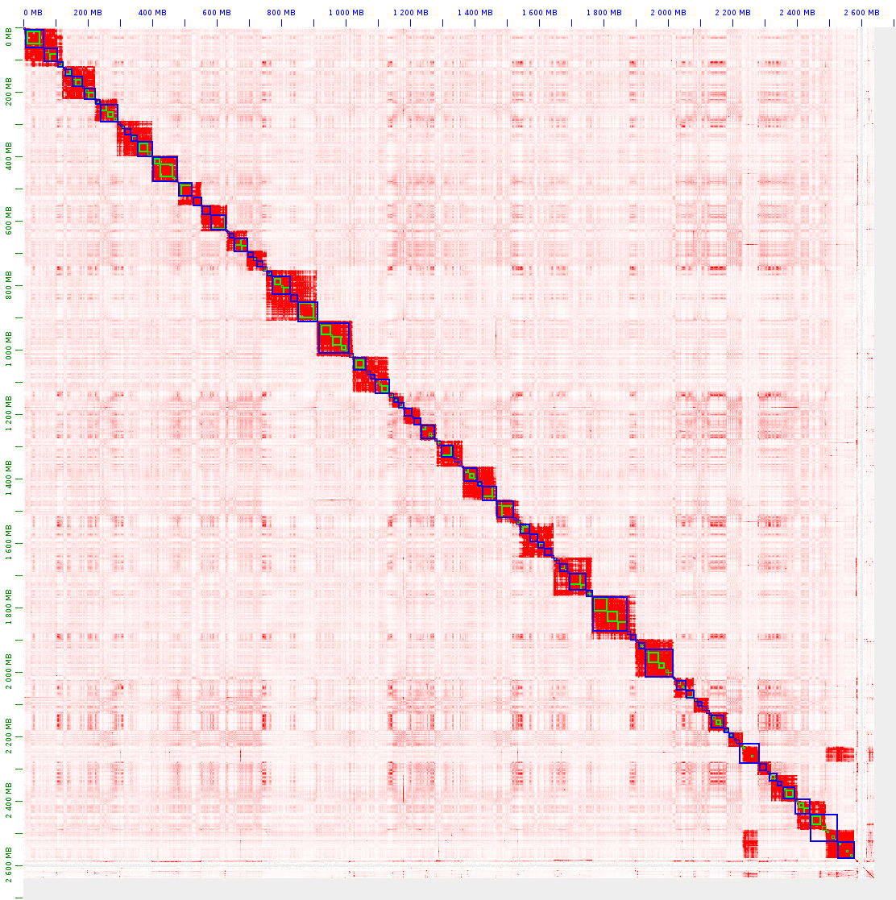
Hi-C contact map
0
Mother Trio1 – 14x Hi-C coverage

Slide 20
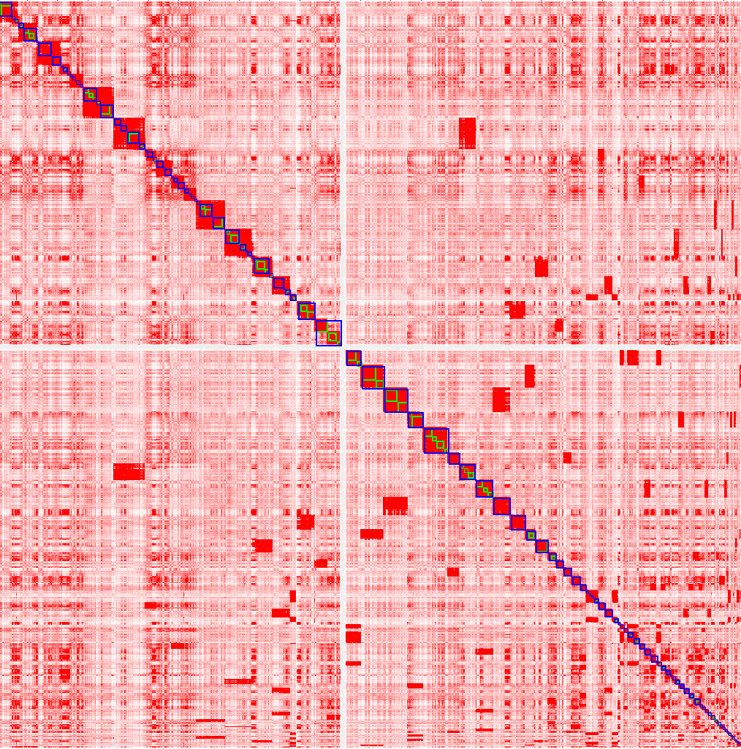
Coverage impact on Hi-C maps
Mother Trio1 – 11x Hi-C coverage

Slide 21
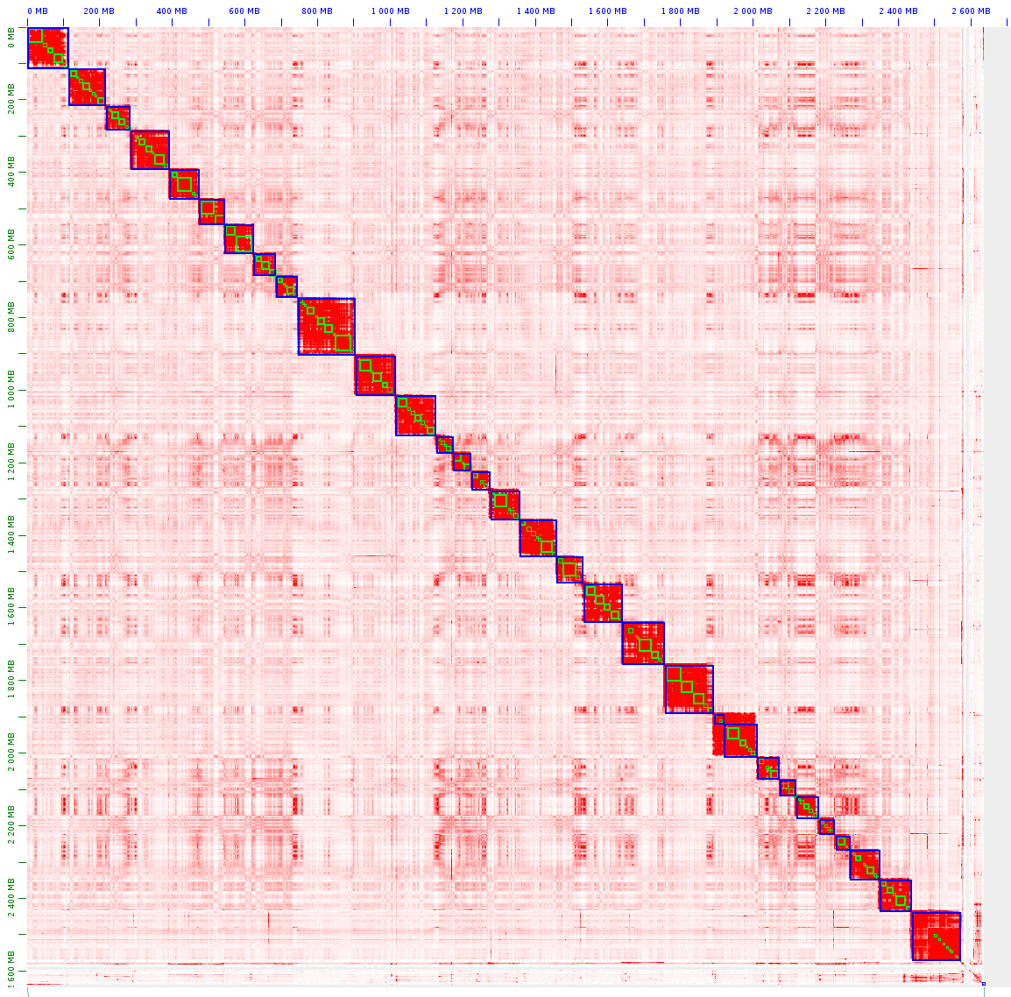
Manual correction
0
Mother Trio1 – 14x after 3d-dna
Mother Trio1 – 14x after manual correction

Slide 22
Completion time
Hi-C read
fastq
Linked read
fastq
Long read
fasta
Contig assembly
Error correction
Scaffolding
Finishing
Polishing
Splitting
Gap filling
Polishing
CPU hours :
≈ 2500h
≈ 1600h + 2600h + 50h
≈ 1500h
+
≈ 4h manual
correction
≈ 2000h + 2600h

Slide 23
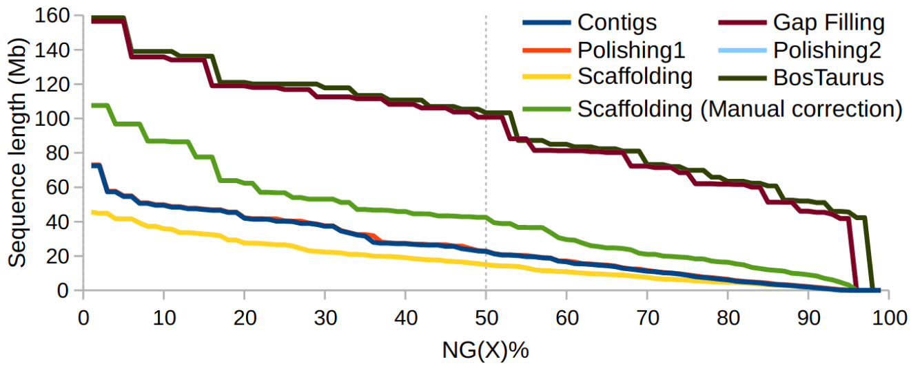
N50 evolution

Slide 24
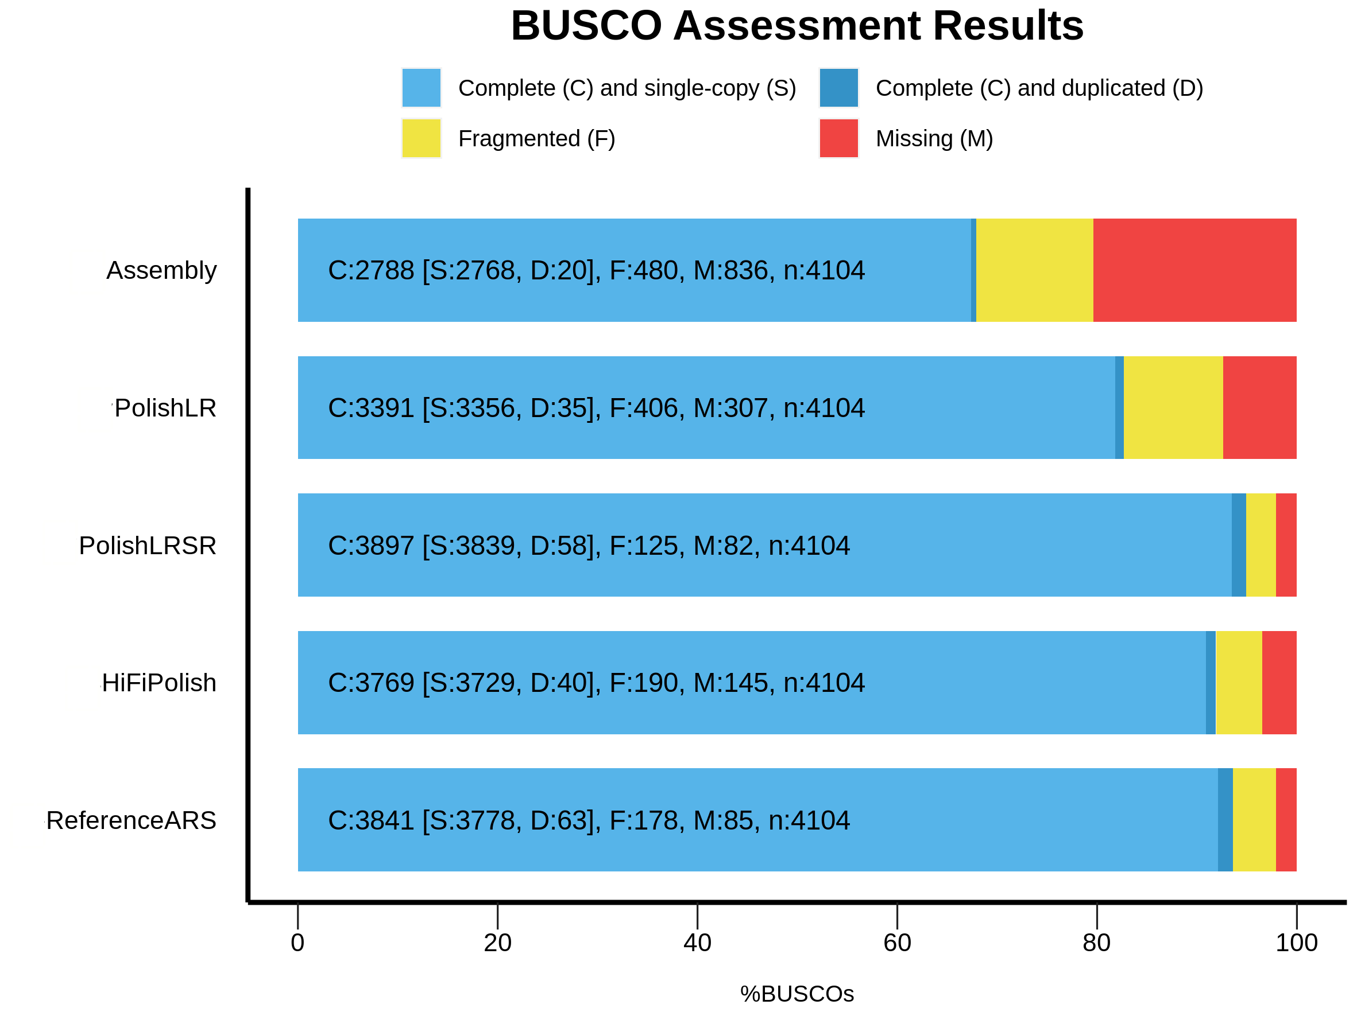
Busco score evolution

Slide 25
Supernova – 10x Chromium based pipeline
« Push-button » pipeline that generates phased, whole-genome de novo
assemblies (contigs and scaffolds) from a 10x Chromium-prepared library:
- Contigs build with a classical paired-end approach (problem: very short)
- Contigs phased and connected into scaffolds based on barcode information
Completion time
≈ 4000h
BUSCO score:
C:95% [S:93.7%,D:1.3%],F:2.9%,M:2.1%
Scaffold N50:
40 / 45Mb

Slide 26
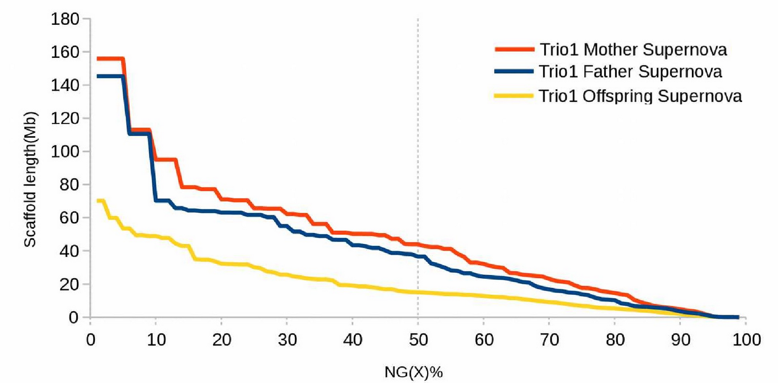
Supernova – 10x Chromium based pipeline

Slide 27
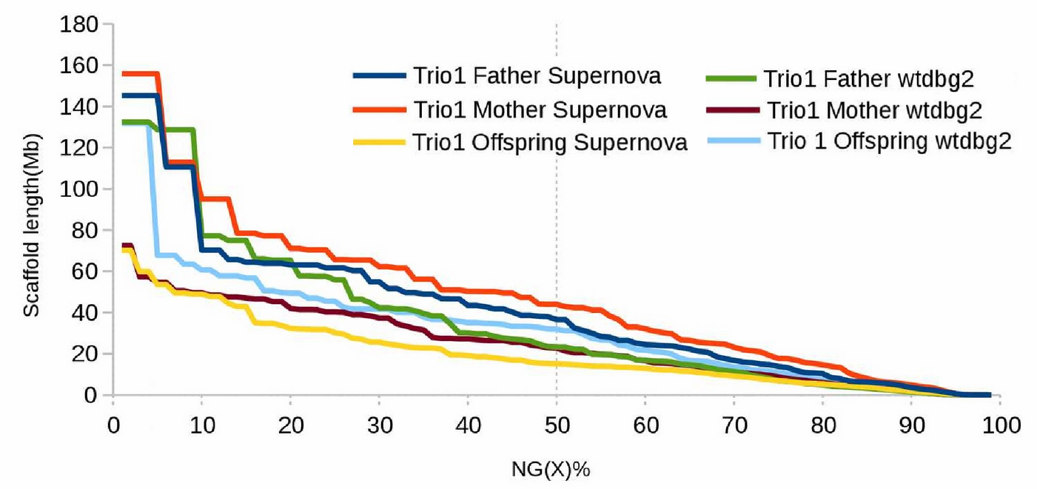
Supernova – 10x Chromium based pipeline

Slide 28
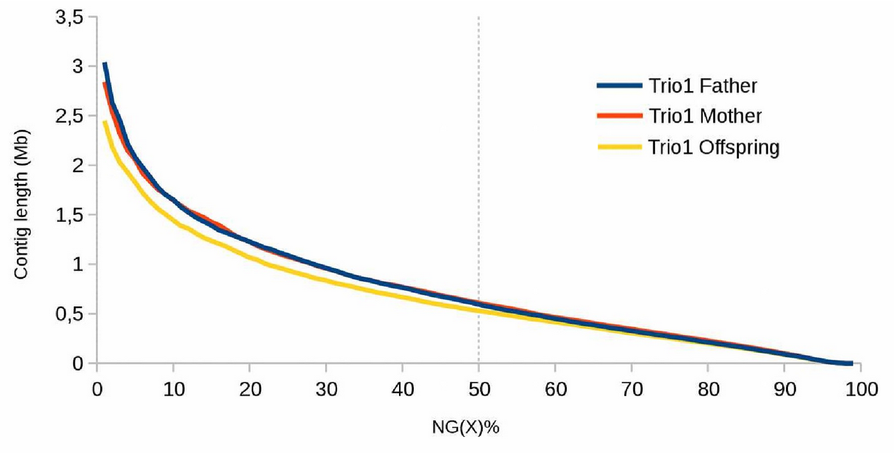
Supernova – 10x Chromium based pipeline

Slide 29
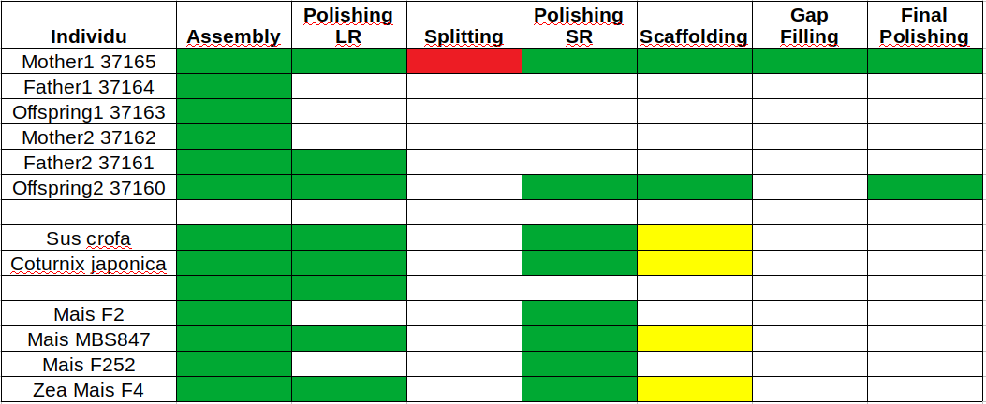
Work in progress

