Slide 1
SeqOccIn 2021
Axis 1
Assembly Results
Clément Birbes

Slide 2
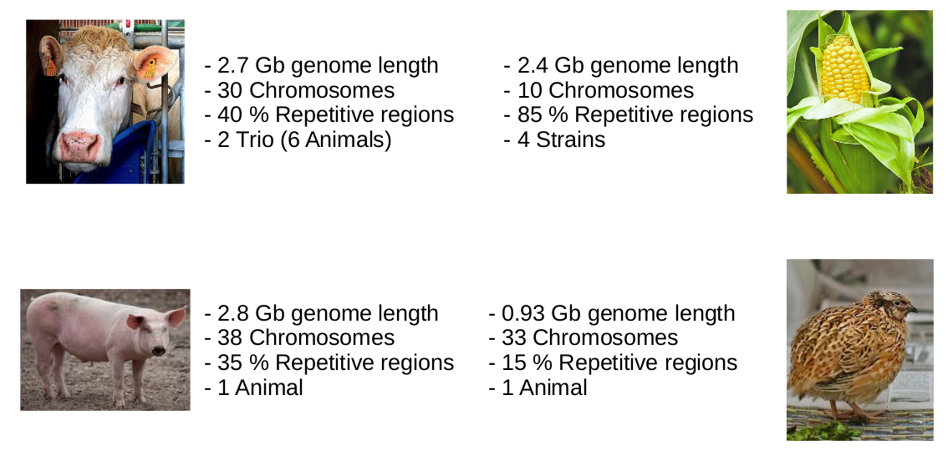
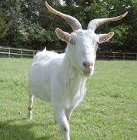
Species
- 2.7 Gb genome length
- 30 Chromosomes
- 40 % Repetitive regions
- 2.4 Gb genome length
- 10 Chromosomes
- 85 % Repetitive regions
- 2.8 Gb genome length
- 20 Chromosomes
- 35 % Repetitive regions
- 0.93 Gb genome length
- 39 Chromosomes
- 15 % Repetitive regions
- 3.1 Gb genome length
- 30 Chromosomes
- 35 % Repetitive regions

Slide 3
Bovine results - Contigs
CLR Pipeline
 | Reference ARS | Offspring2 37160 - ONT 58X | Offspring2 37160 - CLR 108X | Offspring2 37160 - CCS 31X
Number of contigs | 2 596 | 7 226 | 2 937 | 2175
Total size (Gb) | 2.715 | 2.701 | 2.643 | 3.147
Longest contigs (Mb) | 104.8 | 70.6 | 73.1 | 159.5
N50 contigs length (Mb) | 25.8 | 23.6 | 22.4 | 82.3
CCS Pipeline
ONT Pipeline

Slide 4
Bovine results - Contigs
CLR Pipeline
 | Reference ARS | Offspring2 37160 - ONT 58X | Offspring2 37160 - CLR 108X | Offspring2 37160 - CCS 31X
Number of contigs | 2 596 | 7 226 | 2 937 | 2175
Total size (Gb) | 2.715 | 2.701 | 2.643 | 3.147
Longest contigs (Mb) | 104.8 | 70.6 | 73.1 | 159.5
N50 contigs length (Mb) | 25.8 | 23.6 | 22.4 | 82.3
CCS Pipeline
ONT Pipeline

Slide 5
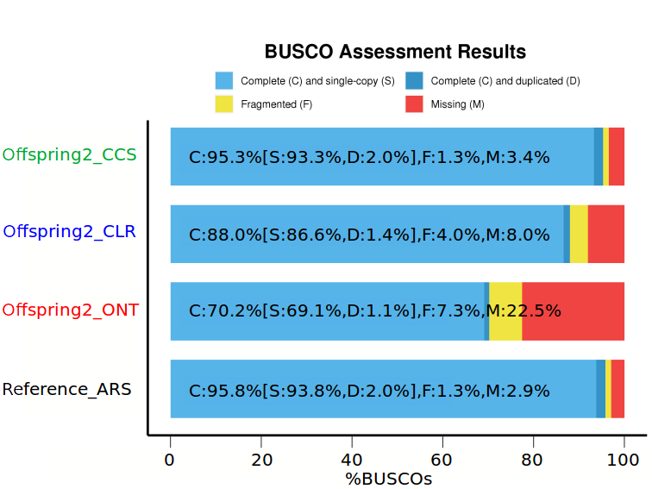
Bovine results - Contigs
CLR Pipeline
 | Reference ARS | Offspring2 37160 - ONT 58X | Offspring2 37160 - CLR 108X | Offspring2 37160 - CCS 31X
Number of contigs | 2 596 | 7 226 | 2 937 | 2175
Total size (Gb) | 2.715 | 2.701 | 2.643 | 3.147
Longest contigs (Mb) | 104.8 | 70.6 | 73.1 | 159.5
N50 contigs length (Mb) | 25.8 | 23.6 | 22.4 | 82.3
CCS Pipeline
ONT Pipeline

Slide 6
Bovine results - Finished
CLR Pipeline
CCS Pipeline
 | Reference ARS | Offspring2 37160 - ONT 58X | Offspring2 37160 - CCS 31X
Number of scaffolds | 2 211 | 4 600 | 3 131
Total size (Gb) | 2.715 | 2.705 | 3.128
Longest scaffolds (Mb) | 158.5 | 156.4 | 158.7
N50 scaffolds length (Mb) | 103.3 | 100.9 | 103.2
ONT Pipeline

Slide 7
Bovine results - Finished
CLR Pipeline
CCS Pipeline
 | Reference ARS | Offspring2 37160 - ONT 58X | Offspring2 37160 - CCS 31X
Number of scaffolds | 2 211 | 4 600 | 3 131
Total size (Gb) | 2.715 | 2.705 | 3.128
Longest scaffolds (Mb) | 158.5 | 156.4 | 158.7
N50 scaffolds length (Mb) | 103.3 | 100.9 | 103.2
ONT Pipeline

Slide 8
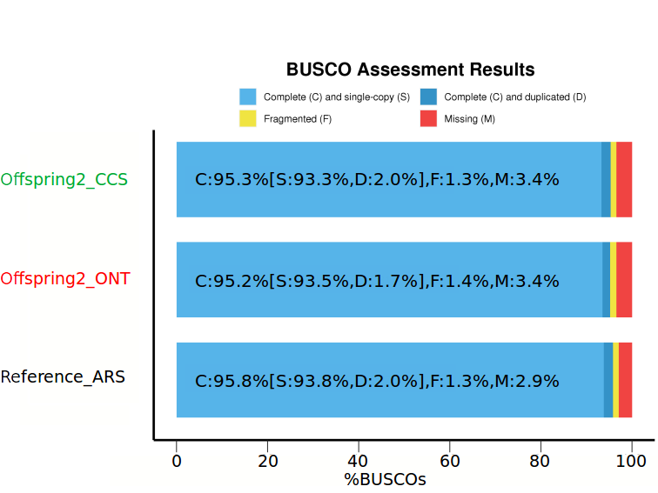
Bovine results - Finished
CLR Pipeline
CCS Pipeline
 | Reference ARS | Offspring2 37160 - ONT 58X | Offspring2 37160 - CCS 31X
Number of scaffolds | 2 211 | 4 600 | 3 131
Total size (Gb) | 2.715 | 2.705 | 3.128
Longest scaffolds (Mb) | 158.5 | 156.4 | 158.7
N50 scaffolds length (Mb) | 103.3 | 100.9 | 103.2
ONT Pipeline

Slide 9
Bovine – State of assemblies
Done
 | Individu | Assembly | Polishing | Scaffolding | Final Polishing | Completed Assemblies
A1P1a | 37165 | ONT
 | 37164 | ONT
 | 37163 | ONT/HiFi
 | 37162 | ONT
 | 37161 | ONT
 | 37160 | ONT
A1P1b | Holstein / Normande | HiFi / hap
 | Yack / Montbeliard | HiFi / hap
A1P2 | 40740 | CLR
 | 40610 | CLR
 | 40619 | CLR
 | 40753 | CLR
In progress

Slide 10
Bovine – Conclusion
3 Pipelines producing good results on bovine genome
Hifi assembly size 10 % longer than reference
2 / 6 Bovine assemblies done for Phase1. 4 to finalize
4 / 4 Assemblies done for Phase 2
Phased assemblies done for Phase 1b
Working on the best CLR polishing tool

Slide 11
Porcine assemblies - Contigs
CLR Pipeline
 | Reference | 227 31X CLR | 564 33X CLR | 735 44X CLR | 811 28X CLR | 259 41X CCS | Axe2 61X ONT
Number of contigs | 1118 | 3 919 | 3 916 | 4 782 | 4 544 | 423 | 2562
Total size (Gb) | 2.472 | 2.429 | 2.454 | 2.435 | 2.468 | 2.715 | 2.436
Longest contigs (Mb) | 133.6 | 75.6 | 131.5 | 73.2 | 47.9 | 191.4 | 159.1
N50 contigs length (Mb) | 48.2 | 18.8 | 27.5 | 13.5 | 14.2 | 95.4 | 33.5
CCS Pipeline
ONT Pipeline

Slide 12
Porcine assemblies - Contigs
CLR Pipeline
 | Reference | 227 31X CLR | 564 33X CLR | 735 44X CLR | 811 28X CLR | 259 41X CCS | Axe2 61X ONT
Number of contigs | 1118 | 3 919 | 3 916 | 4 782 | 4 544 | 423 | 2562
Total size (Gb) | 2.472 | 2.429 | 2.454 | 2.435 | 2.468 | 2.715 | 2.436
Longest contigs (Mb) | 133.6 | 75.6 | 131.5 | 73.2 | 47.9 | 191.4 | 159.1
N50 contigs length (Mb) | 48.2 | 18.8 | 27.5 | 13.5 | 14.2 | 95.4 | 33.5
CCS Pipeline
ONT Pipeline

Slide 13
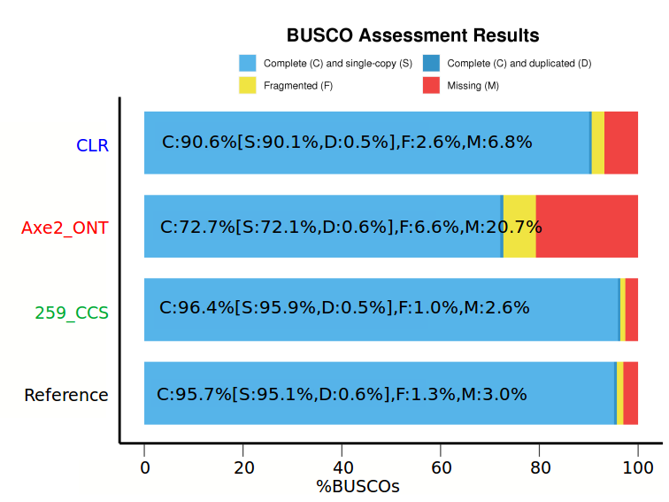
Porcine assemblies - Contigs
CLR Pipeline
 | Reference | 227 31X CLR | 564 33X CLR | 735 44X CLR | 811 28X CLR | 259 41X CCS | Axe2 61X ONT
Number of contigs | 1118 | 3 919 | 3 916 | 4 782 | 4 544 | 423 | 2562
Total size (Gb) | 2.472 | 2.429 | 2.454 | 2.435 | 2.468 | 2.715 | 2.436
Longest contigs (Mb) | 133.6 | 75.6 | 131.5 | 73.2 | 47.9 | 191.4 | 159.1
N50 contigs length (Mb) | 48.2 | 18.8 | 27.5 | 13.5 | 14.2 | 95.4 | 33.5
CCS Pipeline
ONT Pipeline

Slide 14
Porcine - Conclusion
Good CLR assemblies with ~30X coverage
Longer reads greatly improve N50 and contigs size
High coverage ONT produce contiguous assemblies
Hifi assembly size 12 % longer than reference
Assemblies can be scaffolded according to the reference
Assemblies quality can be improved with polishing
6 / 6 Assemblies done for Phase 2 and Axis 2

Slide 15
Goat assemblies - Contigs
CLR Pipeline
CCS Pipeline
 | Reference | Pyrénéenne 109X CLR | Poitevine 47X | Provençale 35X
Number of scaffolds | 30399 | 4 729 | 4 751 | 6 696
Total size (Gb) | 2.922 | 2.720 | 2.681 | 2.701
Longest scaffolds (Mb) | 113.5 | 136.9 | 136.9 | 70.9
N50 scaffolds length (Mb) | 26.2 | 36.9 | 38.1 | 17.1
ONT Pipeline

Slide 16
Goat assemblies - Contigs
CLR Pipeline
CCS Pipeline
 | Reference | Pyrénéenne 109X CLR | Poitevine 47X | Provençale 35X
Number of scaffolds | 30399 | 4 729 | 4 751 | 6 696
Total size (Gb) | 2.922 | 2.720 | 2.681 | 2.701
Longest scaffolds (Mb) | 113.5 | 136.9 | 136.9 | 70.9
N50 scaffolds length (Mb) | 26.2 | 36.9 | 38.1 | 17.1
ONT Pipeline

Slide 17
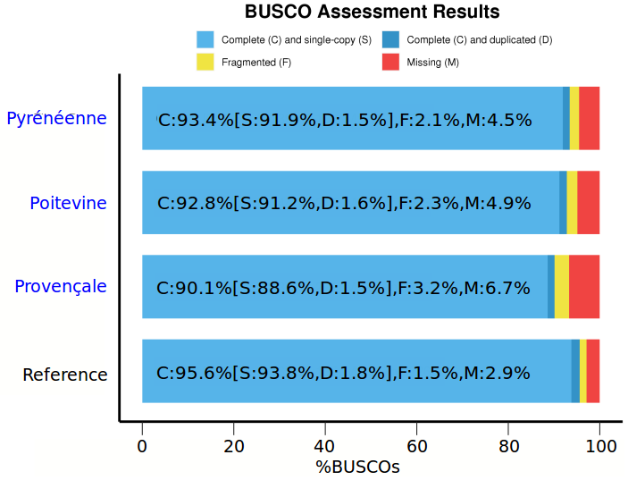
Goat assemblies - Contigs
CLR Pipeline
CCS Pipeline
 | Reference | Pyrénéenne 109X CLR | Poitevine 47X | Provençale 35X
Number of scaffolds | 30399 | 4 729 | 4 751 | 6 696
Total size (Gb) | 2.922 | 2.720 | 2.681 | 2.701
Longest scaffolds (Mb) | 113.5 | 136.9 | 136.9 | 70.9
N50 scaffolds length (Mb) | 26.2 | 36.9 | 38.1 | 17.1
ONT Pipeline

Slide 18
Goat - Conclusion
Good CLR assemblies with low coverage
Good read quality improve assemblies BUSCO score
Assemblies can be polished to improve general quality
Assemblies can be scaffolded according to the reference
3 / 3 Assemblies done for Phase 1

Slide 19
Coturnix Results - Finished
CLR Pipeline
CCS Pipeline
 | Reference | SeqOccIn 28X CCS | SeqOccIn 80X ONT
Number of scaffolds | 2 011 | 1 241 | 1 781
Total size (Mb) | 927.640 | 1 282.206 | 979.279
Longest scaffolds (Mb) | 175.6 | 179.2 | 173.1
N50 scaffolds length (Mb) | 82.2 | 83.8 | 63.9
ONT Pipeline

Slide 20
Coturnix Results - Finished
CLR Pipeline
CCS Pipeline
 | Reference | SeqOccIn 28X CCS | SeqOccIn 80X ONT
Number of scaffolds | 2 011 | 1 241 | 1 781
Total size (Mb) | 927.640 | 1 282.206 | 979.279
Longest scaffolds (Mb) | 175.6 | 179.2 | 173.1
N50 scaffolds length (Mb) | 82.2 | 83.8 | 63.9
ONT Pipeline

Slide 21
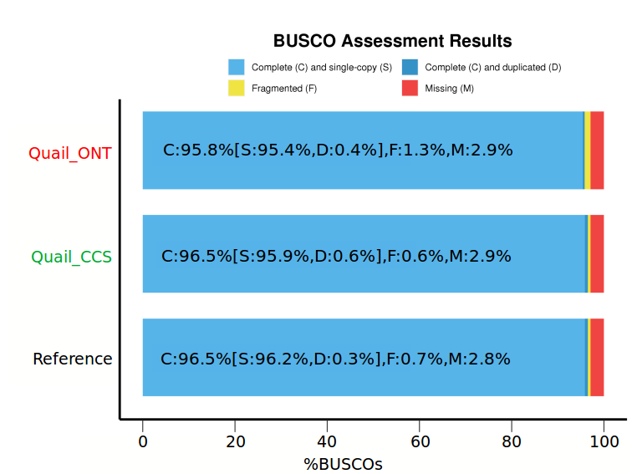
Coturnix Results - Finished
CLR Pipeline
CCS Pipeline
 | Reference | SeqOccIn 28X CCS | SeqOccIn 80X ONT
Number of scaffolds | 2 011 | 1 241 | 1 781
Total size (Mb) | 927.640 | 1 282.206 | 979.279
Longest scaffolds (Mb) | 175.6 | 179.2 | 173.1
N50 scaffolds length (Mb) | 82.2 | 83.8 | 63.9
ONT Pipeline

Slide 22
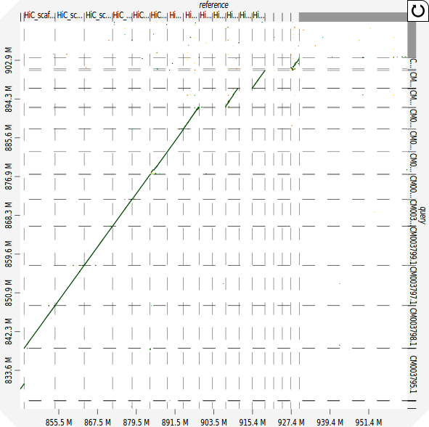
Coturnix - Conclusion
CCS assemblies 30% larger than reference
Well aligned to reference
6 New chromosome find
8 Assemblies done to find
missing micro-chromosomes

Slide 23
Maize Results - contigs
CLR Pipeline
CCS Pipeline
 | Reference B73 | MBS847 67X CLR | MBS847 61X ONT | MBS847 28X CCS
Number of contigs | 2 787 | 78 089 | 84 963 | 2619
Total size (Gb) | 2.104 | 3.757 | 3.886 | 2.281
Longest contigs (Mb) | 7.3 | 4.2 | 4.3 | 153.7
N50 contigs length (Mb) | 1.3 | 0.8 | 0.8 | 58.1
ONT Pipeline

Slide 24
Maize Results - contigs
CLR Pipeline
CCS Pipeline
 | Reference B73 | MBS847 67X CLR | MBS847 61X ONT | MBS847 28X CCS
Number of contigs | 2 787 | 78 089 | 84 963 | 2619
Total size (Gb) | 2.104 | 3.757 | 3.886 | 2.281
Longest contigs (Mb) | 7.3 | 4.2 | 4.3 | 153.7
N50 contigs length (Mb) | 1.3 | 0.8 | 0.8 | 58.1
ONT Pipeline

Slide 25
Maize Results - finished
CLR Pipeline
 | Reference B73 | MBS847 28X CCS | F4 36X CCS | F4 NRGene
Number of scaffolds | 267 | 2 564 | 2 535 | 11
Total size (Gb) | 2.135 | 2.282 | 2.224 | 2.264
Longest scaffolds (Mb) | 307.0 | 317.3 | 303.0 | 321.8
N50 scaffolds length (Mb) | 223.9 | 219.8 | 221.8 | 229.5
CCS Pipeline
ONT Pipeline

Slide 26
Maize Results - finished
CLR Pipeline
 | Reference B73 | MBS847 28X CCS | F4 36X CCS | F4 NRGene
Number of scaffolds | 267 | 2 564 | 2 535 | 11
Total size (Gb) | 2.135 | 2.282 | 2.224 | 2.264
Longest scaffolds (Mb) | 307.0 | 317.3 | 303.0 | 321.8
N50 scaffolds length (Mb) | 223.9 | 219.8 | 221.8 | 229.5
CCS Pipeline
ONT Pipeline

Slide 27
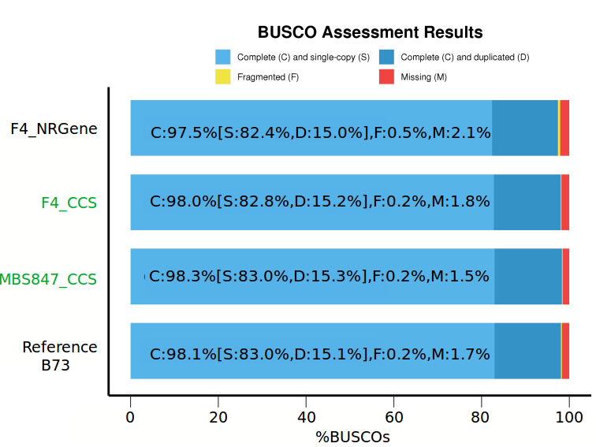
Maize Results - finished
CLR Pipeline
 | Reference B73 | MBS847 28X CCS | F4 36X CCS | F4 NRGene
Number of scaffolds | 267 | 2 564 | 2 535 | 11
Total size (Gb) | 2.135 | 2.282 | 2.224 | 2.264
Longest scaffolds (Mb) | 307.0 | 317.3 | 303.0 | 321.8
N50 scaffolds length (Mb) | 223.9 | 219.8 | 221.8 | 229.5
CCS Pipeline
ONT Pipeline

Slide 28
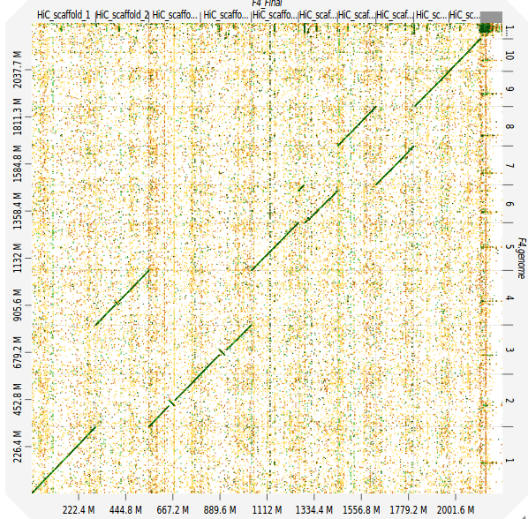
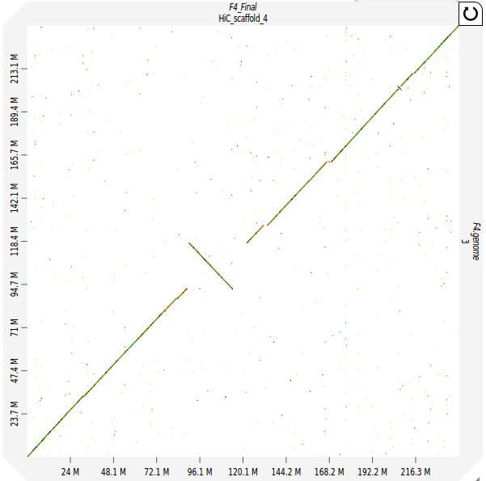
Maize F4 Vs NRGene – alignment error

Slide 29
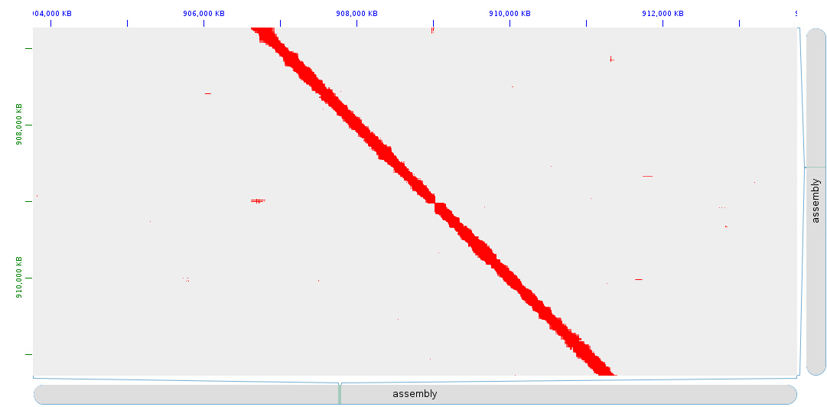
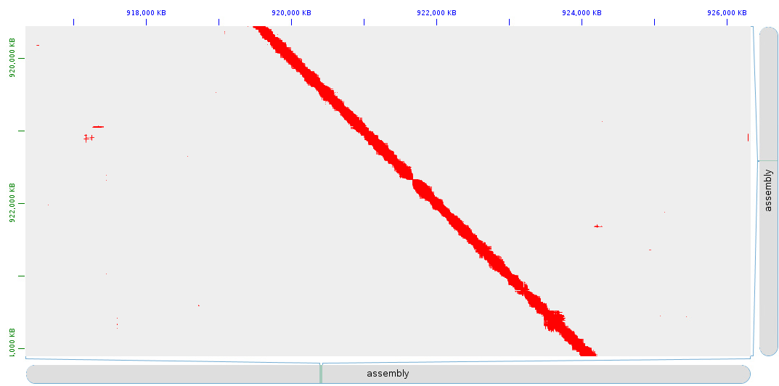
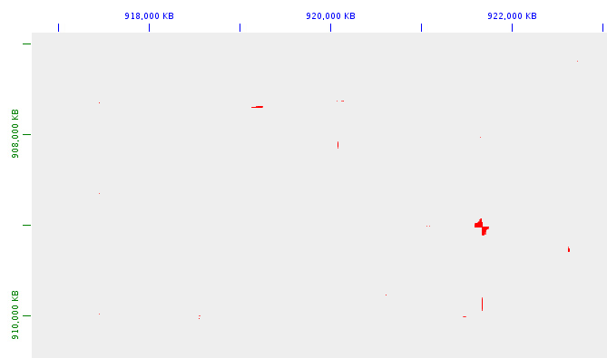
Maize F4 Vs NRGene – 10X focus
- Align SeqOccIn 10X chromium
vs NRGene F4
- Find connection lost in F4
- SeqOccIn assembly have better
scaffolding

Slide 30
Maize - Conclusion
Complex genome, hard to assemble with CLR or ONT
Slightly better than reference
Less error than already assembled genomes
4/4 Assemblies done for Phase 1
1/2 Assemblies done for Phase 2

