Slide 1
Juicer statistics

Slide 2
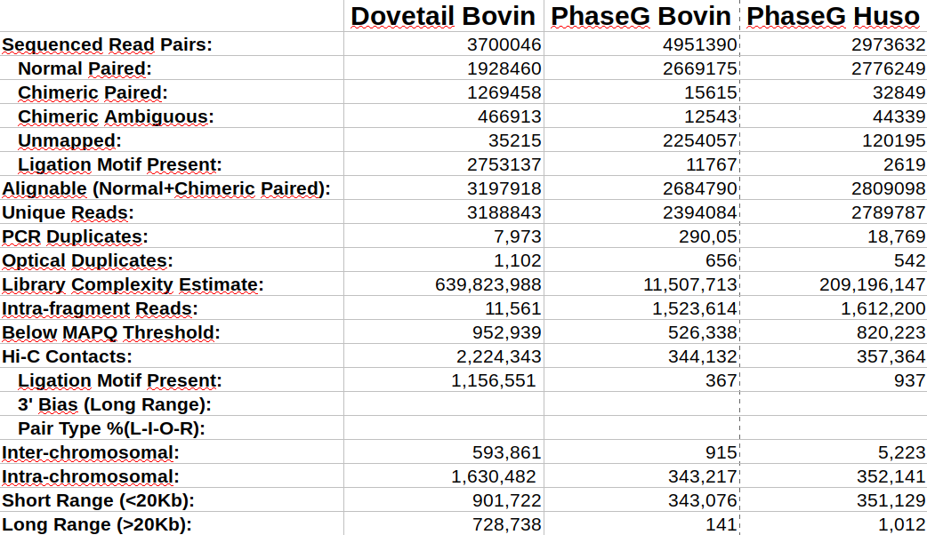

Slide 3
Normal Paired :
Ligation junction
Hi-C Molecule
Position of Mapped Reads
Locus A
Locus B

Slide 4
Chimeric Paired :
Ligation junction
Hi-C Molecule
Position of Mapped Reads
Locus A
Locus B

Slide 5
Chimeric Ambiguous Paired :
Ligation junction
Breakpoint
Hi-C Molecule
Position of Mapped Reads
Locus A
Locus C
Locus B
Hi-C Molecule
Position of Mapped Reads
Locus X
Locus B
Locus A

Slide 6
Intra-fragment :
Ligation junction
Hi-C Molecule
Position of Mapped Reads
Locus A
Locus A

Slide 7
