Slide 1
Zea_mays
MBS847

Slide 2
Contig assembly
Wtdbg2 assembly
73X ONT
Flye assembly
73X ONT
3 886 168 405
161.9 %
81 093
2 182 167 593
90.9 %
3 122 117
Total size :
% of assumed genome size :
N50 contig length :
Total size :
% of assumed genome size :
N50 contig length :

Slide 3
Polishing
73X ONT
65X 10X Chromium
10X HiFi
(1e smrtCell)
2 184 316 260
90.9 %
3 571 534
94.0%[S:83.3%,D:10.7%]
F:1.9%,M:4.1%
2 184 399 715
91 %
3 125 047
97.3%[S:91.7%,D:5.6%]
F:1.1%,M:1.6%
Total size :
% of assumed genome size :
N50 contig length :
Busco :
Total size :
% of assumed genome size :
N50 contig length :
Busco :

Slide 4
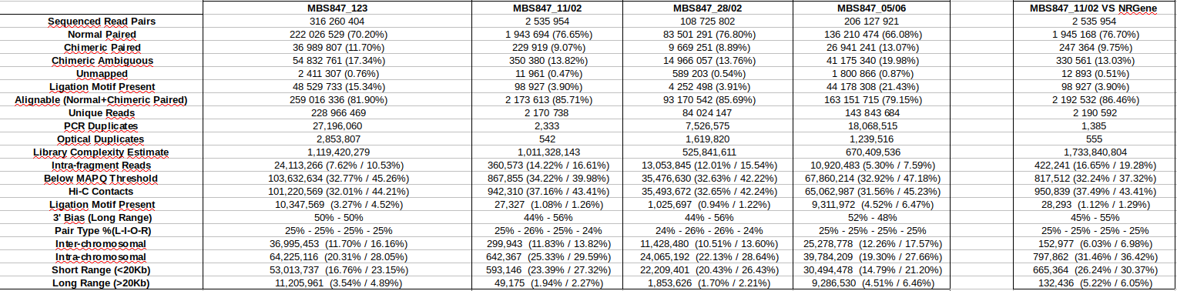
Juicer stats
- Around 80% reads alignable
- Low HiC contact due to repetitive regions
- Low Intra chromosomal and Long Range
- Fragmented assembly

Slide 5
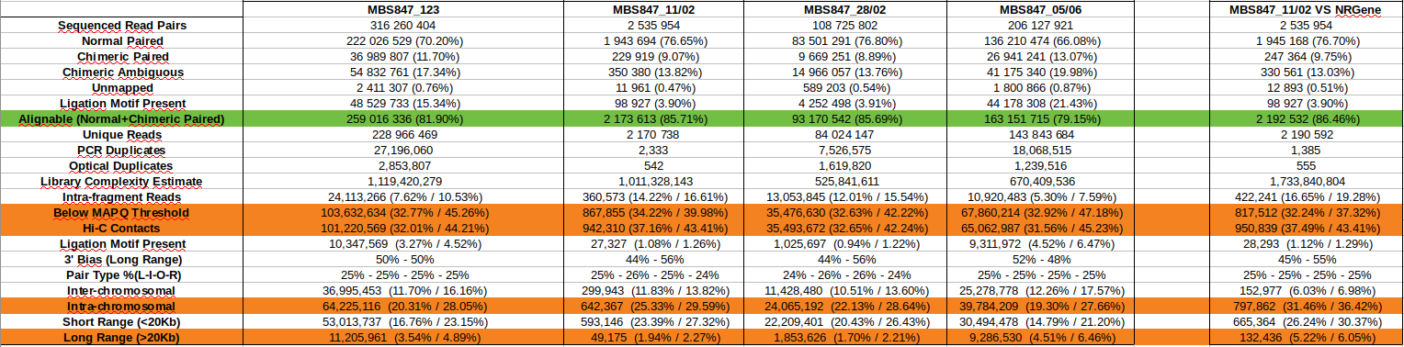
Juicer stats
- Around 80% reads alignable
- Low HiC contact due to repetitive regions
- Low Intra chromosomal and Long Range
- Fragmented assembly

Slide 6
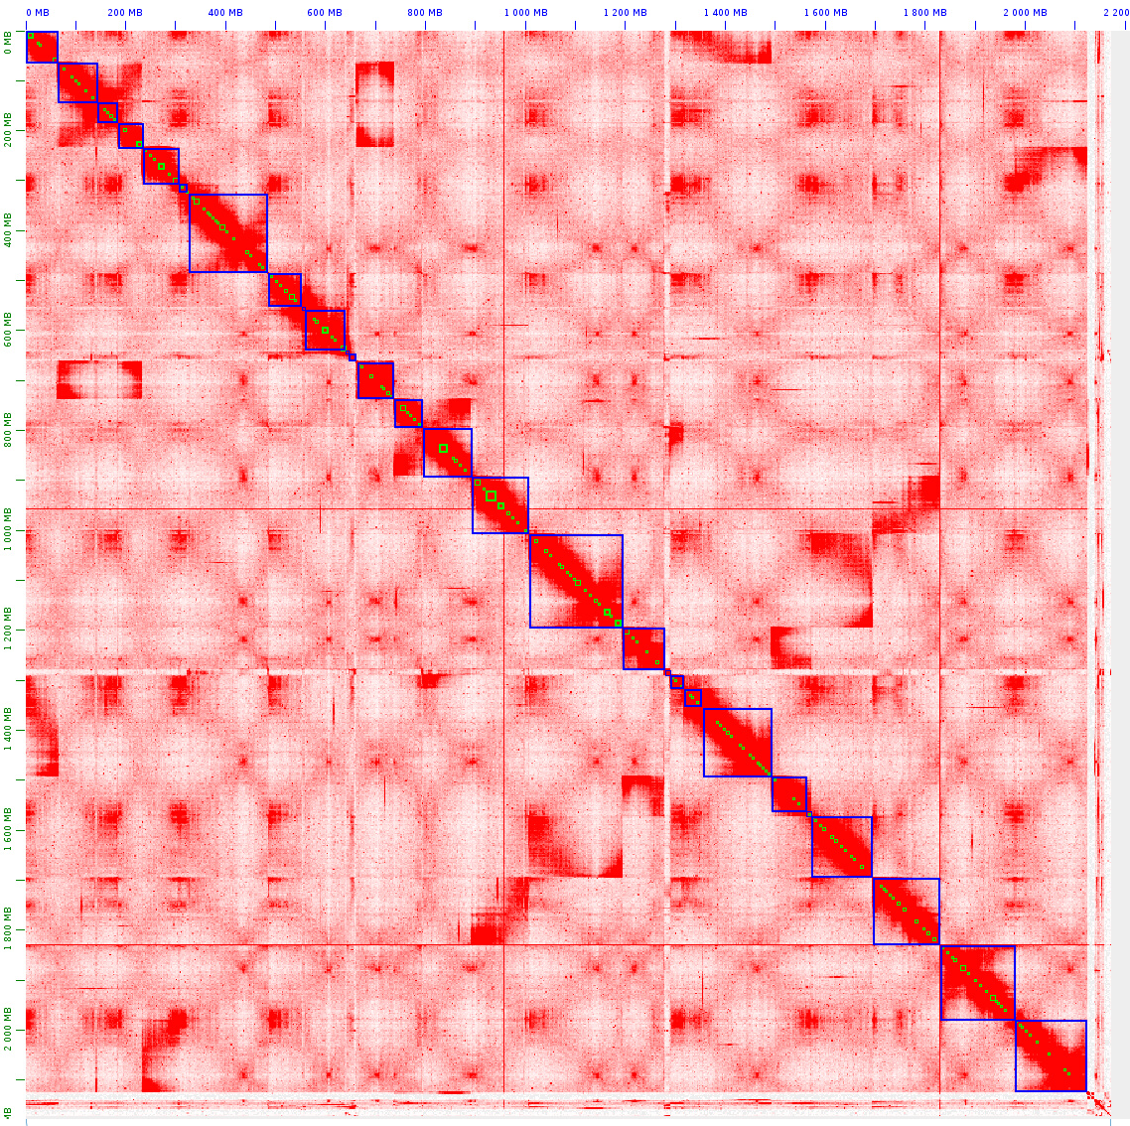
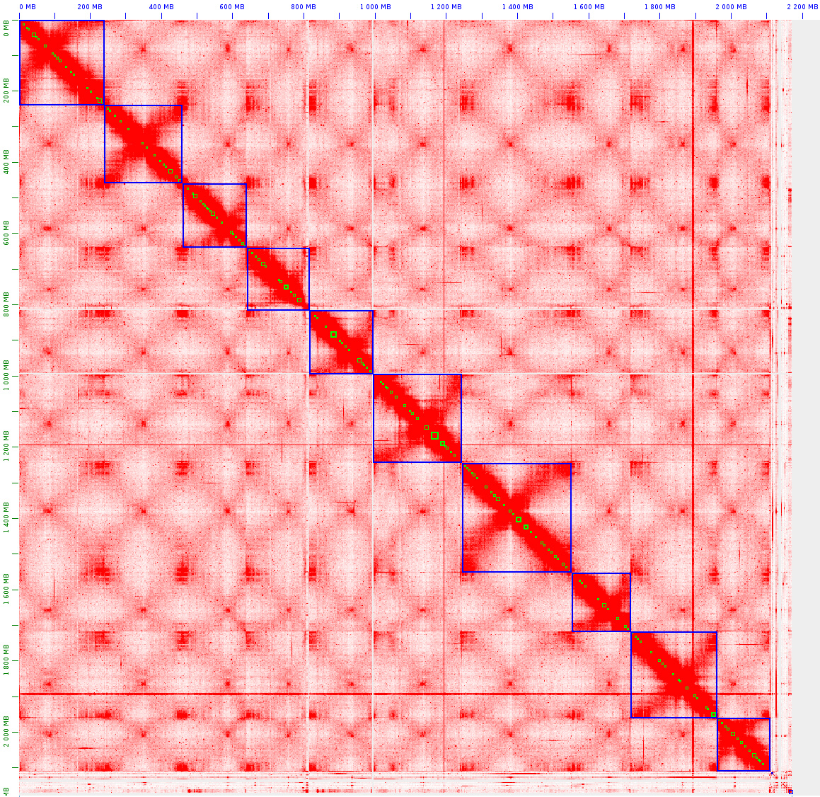
Run 05/06

Slide 7
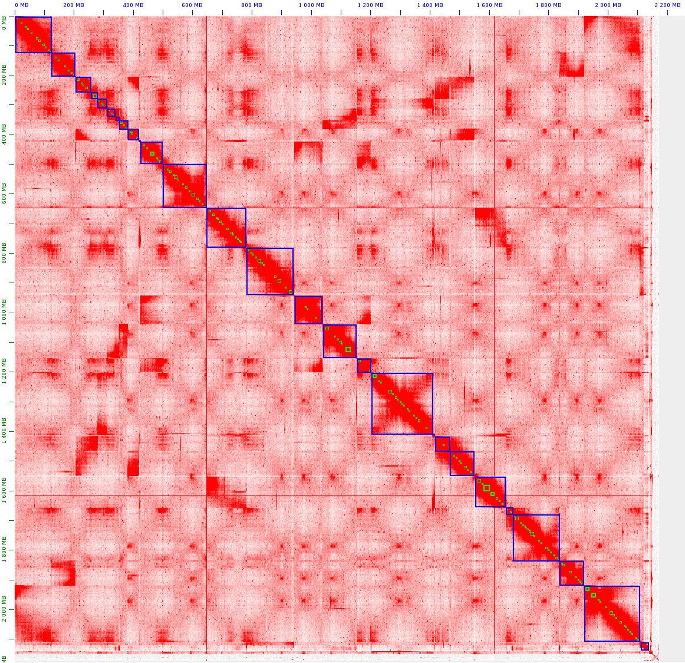
All runs

Slide 8
Offspring 2 – 37160

Slide 9
Assembly protocol
1- Wtdbg2 contig assembly with 58X ONT reads
2- Polishing Racon with 58X ONT reads
3- Polishing Pilon with 102X 10X reads
4- 3Ddna scaffolding with 28X HiC reads (Maison)
5- Manual modification of HiC map
6- Polishing Pilon with 102X 10X reads

Slide 10
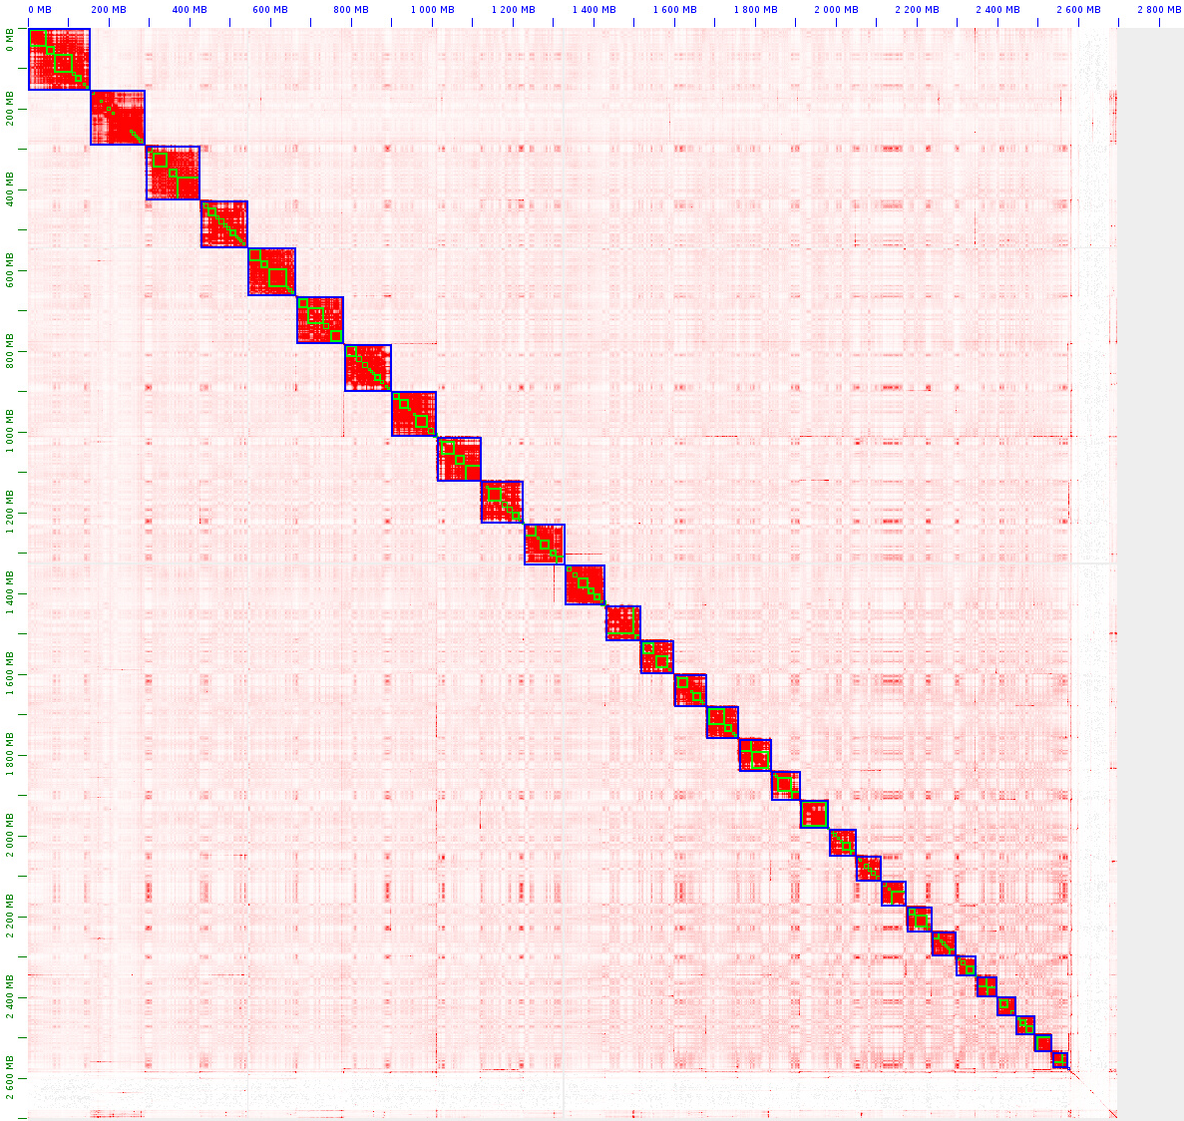
HiC Map

Slide 11
Final stats
Total size of scaffolds | Longest scaffold | N50/NG50 scaffold length | Busco
2 702 956 655 | 156 379 558 | 101 146 902 101 146 902 | C:94.2%[S:93.0%,D:1.2%] F:3.1% M:2.7%

Slide 12
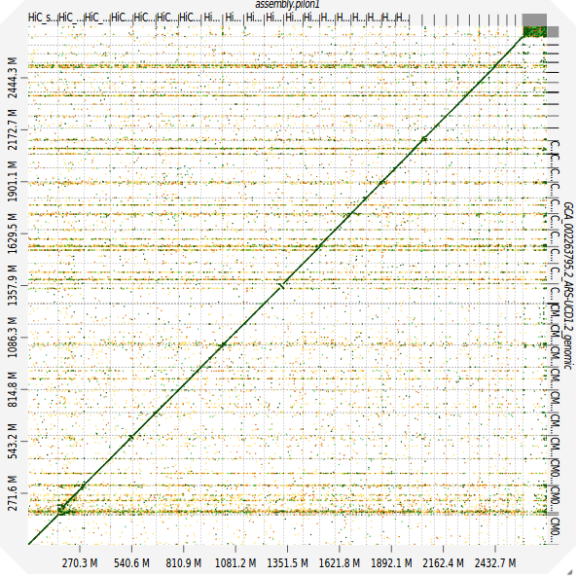
Alignment vs Bovine reference

Slide 13
Mother 1 – 37165

Slide 14
Assembly protocol
1- Wtdbg2 contig assembly with 58X ONT reads
2- Polishing Racon with 58X ONT reads
3- Polishing Pilon with 84X 10X reads
4- 3Ddna scaffolding with 15X HiC reads (Maison)
5- Manual modification of HiC map
6- Gap-Filling TGSGapFiller with 58X ONT reads
7- Polishing Pilon with 84X 10X reads

Slide 15
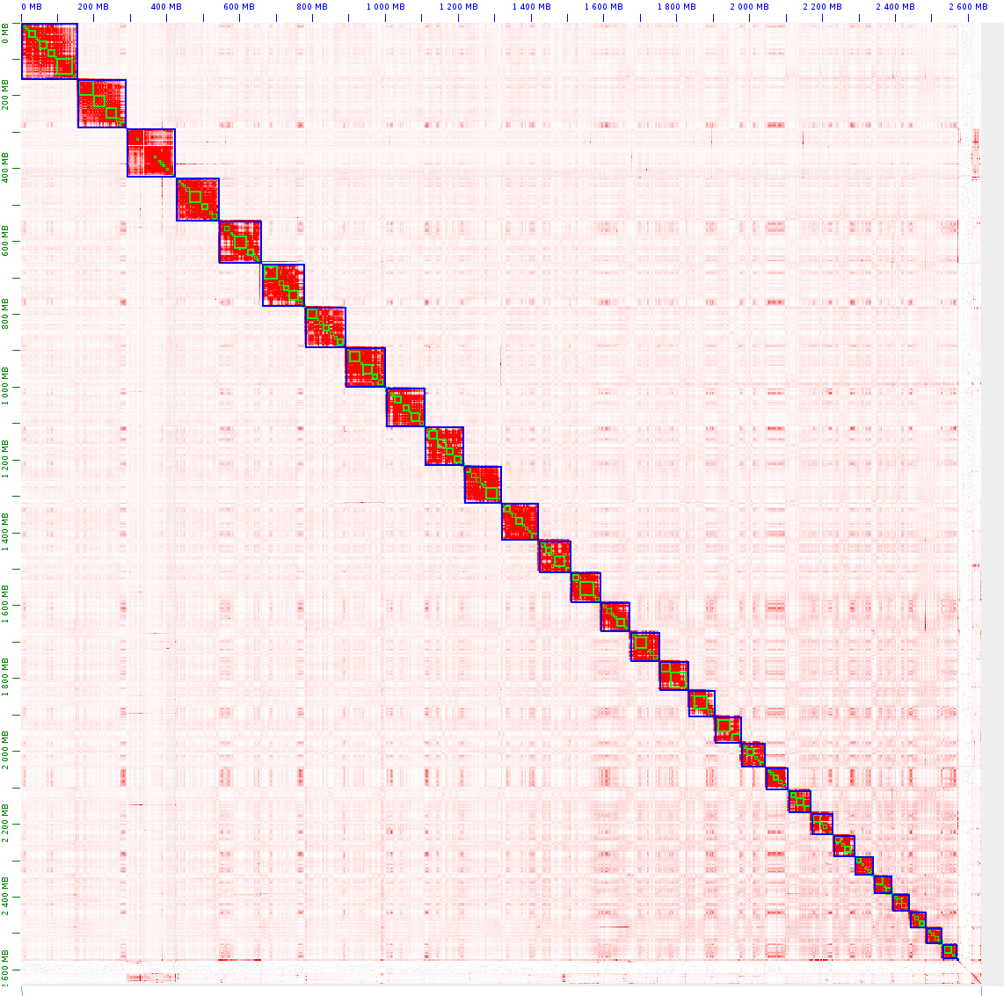
HiC Map

Slide 16
Final stats
Total size of scaffolds | Longest scaffold | N50/NG50 scaffold length | Busco
2 642 056 172 | 156 510 258 | 103 769 945 100 772 962 | C:94.5%[S:93.3%,D:1.2%] F:3.1% M:2.4%

Slide 17
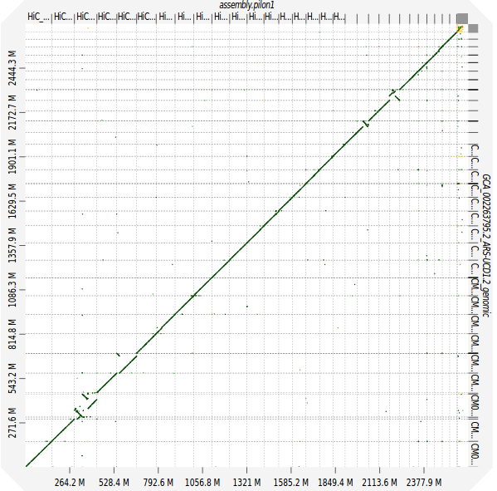
Alignment vs Bovine reference

Slide 18
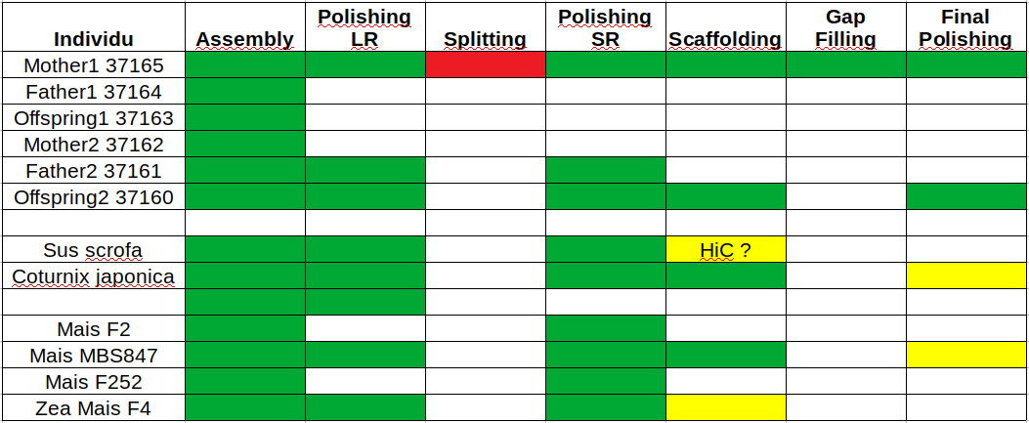

Slide 19
HiFi
Zea_mays :
MBS847 – 20X
F252 – 33 X
Data :
Bos_taurus :
Offspring2 – 15 X
Results :
Polishing MBS847 – 10X
- 7,4 time faster
- BUSCO 97.3%
Polishing – 8X
- 12.3 time faster
- BUSCO 94.3%
In progress :
Polishing – 15X
Assembly - 15 X
Polishing MBS847 – 20X
Polishing F252 – 33X
Assembly MBS847 – 20X
Assembly F252 – 33X

Slide 21
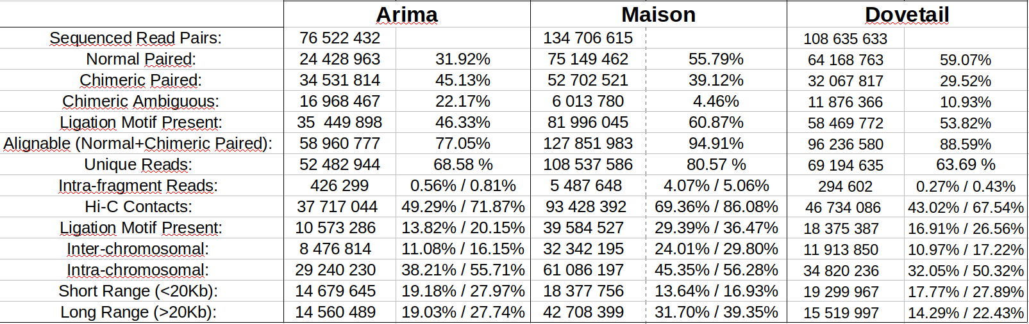
Juicer stats

