Slide 1

Genome polishing
Pipeline

Slide 2
Long reads polishing
Long reads
Minimap2
Alignment
Assembly
Racon
Wtdbg2
Medaka
Pilon
Loop and
polish again
Assembly
Polish with short reads

Slide 3
Short reads polishing
Short reads
BWA
/
Longranger
Alignment
Assembly
Pilon
Wtdbg2
FreeBayes
VCFTools
Racon
Changes
(Optional)
Loop and
polish again
Busco
Assembly

Slide 4
Use of the pipeline
Nextflow run main.nf --longReads Path to long reads fasta or fastq .gz file
or/and
--shortReads Path to short reads fasta or fastq .gz file
--assembly Fasta file of genome assembly to polish
(Optional)
--LRPolish Polisher to use for long reads: wtdbg2, racon,
pilon, medaka (default : racon)
--LRNum Number of long reads polishing (default: 2)
--SRPolish Polisher to use for short reads: pilon, racon,
freebayes or wtdbg2 (default : pilon)
--SRNum Number of short reads polishing (default: 2)
--NoChanges Short reads polishing with pilon until no more
changes (default : false)
--chunck Size for pilon parallelization (default : 10000000)
--lineage Lineage dataset used for BUSCO
--species Reference species for BUSCO (default: generic)
--outdir The output directory where the results will be
saved (default: ./results/)

Slide 5
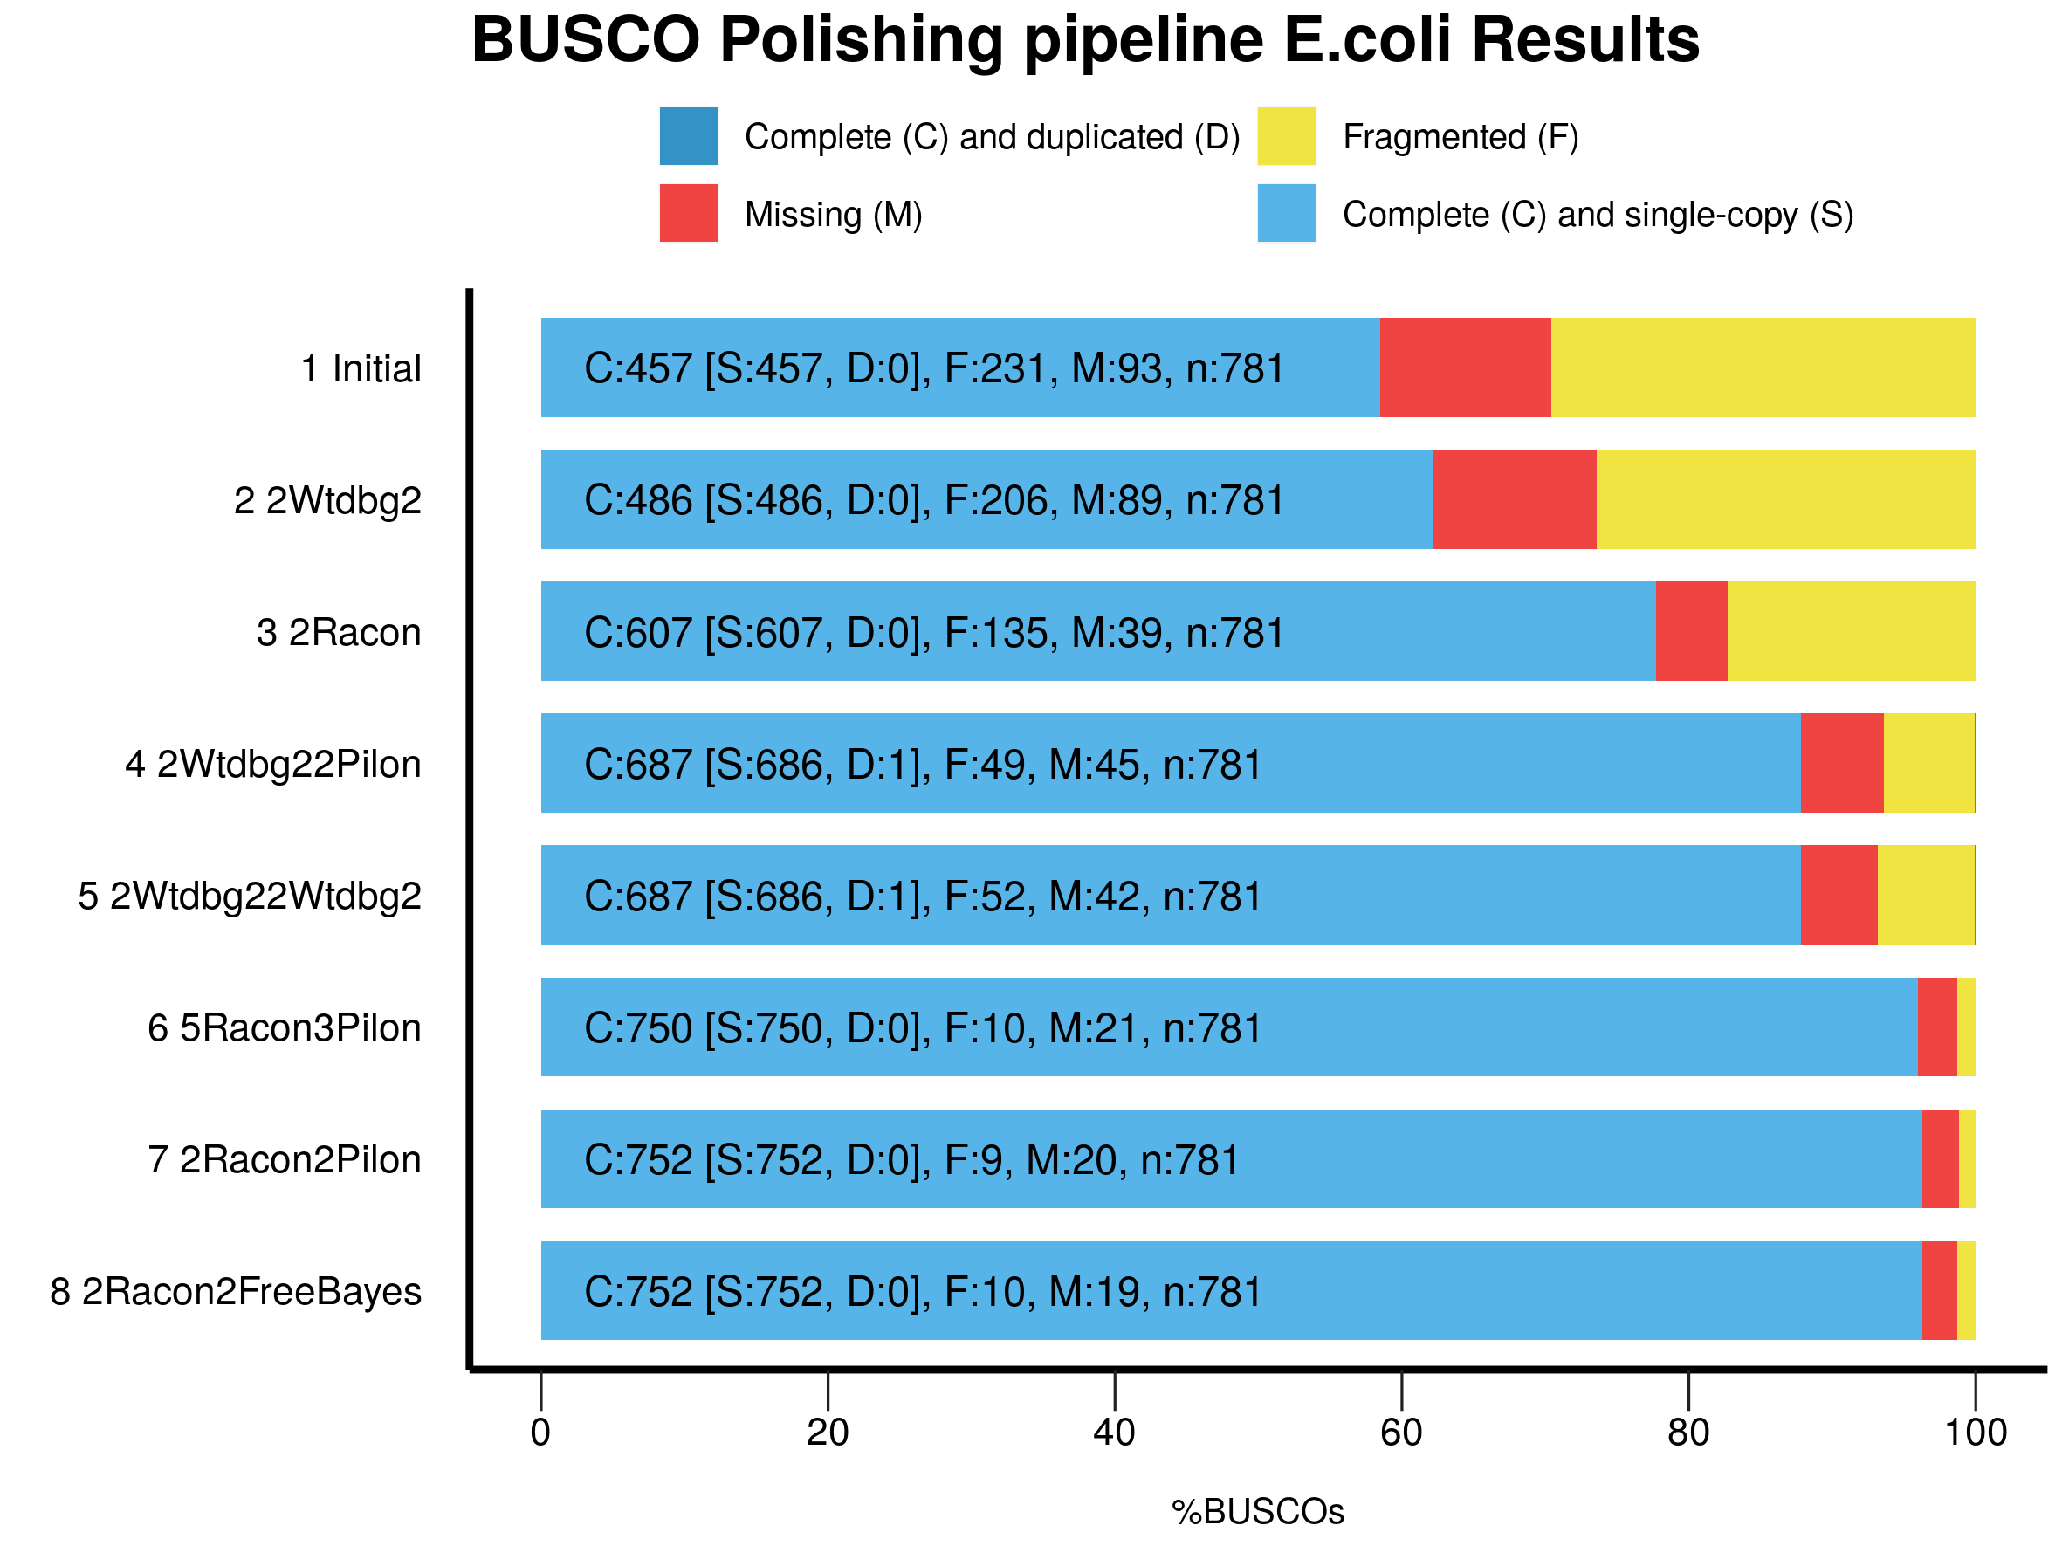
Duration : 11m 30s
Duration : 6m 17s
Duration : 52m 21s
Duration : 37m 47s
Duration : 1h 10m 1s
Duration : 48m 15s
Duration : 3h 14m 29s

Slide 7
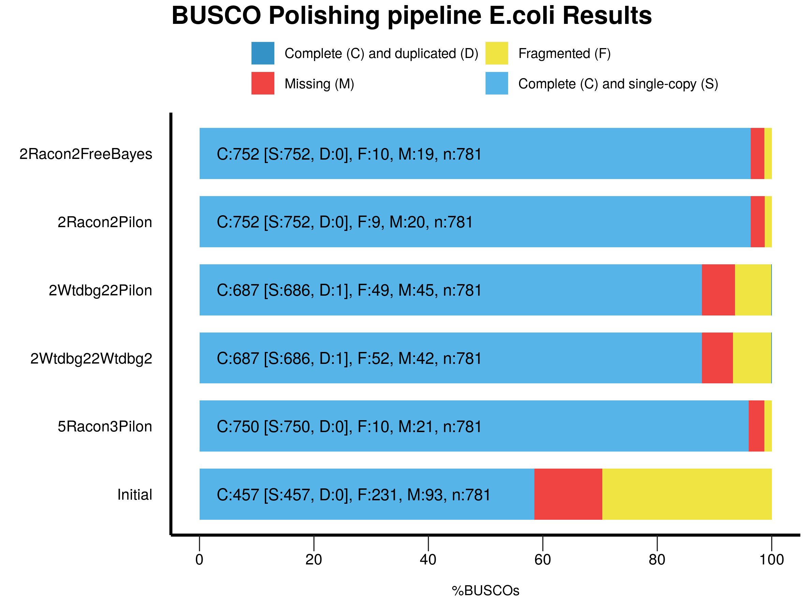
Diapo Supp
Duration : 3h 14m 29s
CPU hours : 24.0
Duration : 48m 15s
CPU hours : 5.7
Duration : 52m 21s
CPU hours : 6.5
Duration : 37m 47s
CPU hours : 4.1
Duration : 1h 10m 1s
CPU hours : 8.6

