Slide 1
SeqOccIn 2021
Axis 1 – Diploid Assembly
Arnaud Di Franco
Clément Birbes

Slide 2
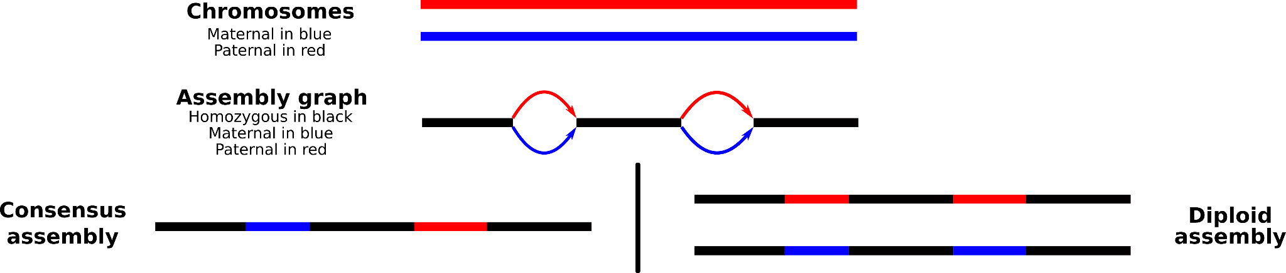
Diploid Assembly
A diploid assembly is an assembly in which the maternal and paternal haplotypes are separated to create 2 sets of chromosomes.
Different methods exists to create a diploid assembly.
1 Method using distant connection to separate haplotypes
1 Method resolving haplotype based on parental K-mer
1 Method using long reads only

Slide 3
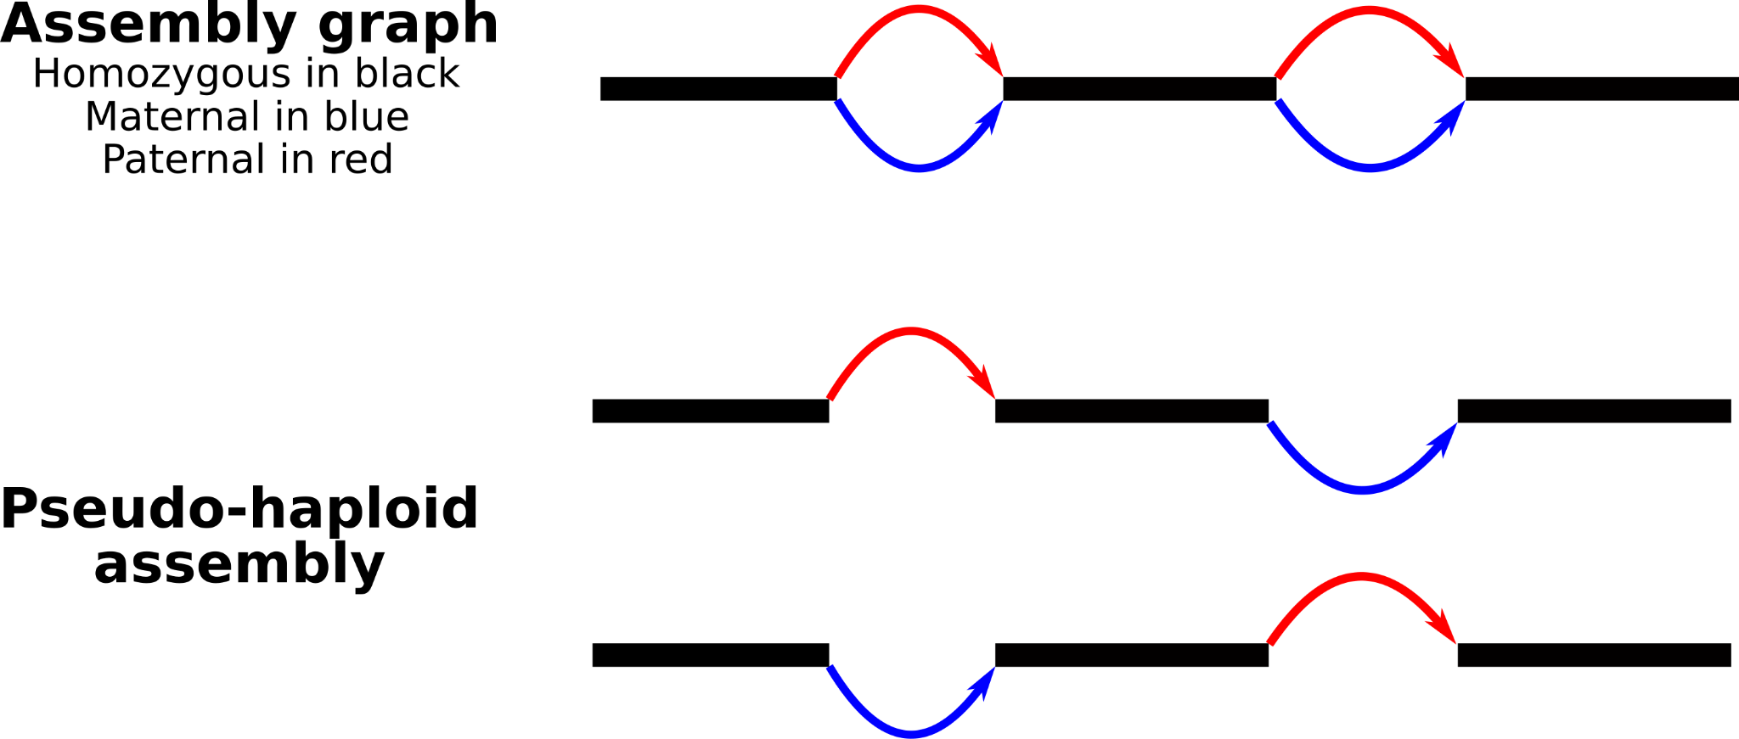
Hifiasm-HiC Diploid Assembly
Produce diploid assembly using HiFi reads (long reads with low error rate) and Hi-C connection information to separate haplotypes
HiFi
Offspring
Hi-C
Offspring
HiFiasm
Haplotype1
Haplotype2
This method produces chimeric assemblies due to the lack of Hi-C contact in some intra-chromosome areas but also between chromosomes

Slide 4
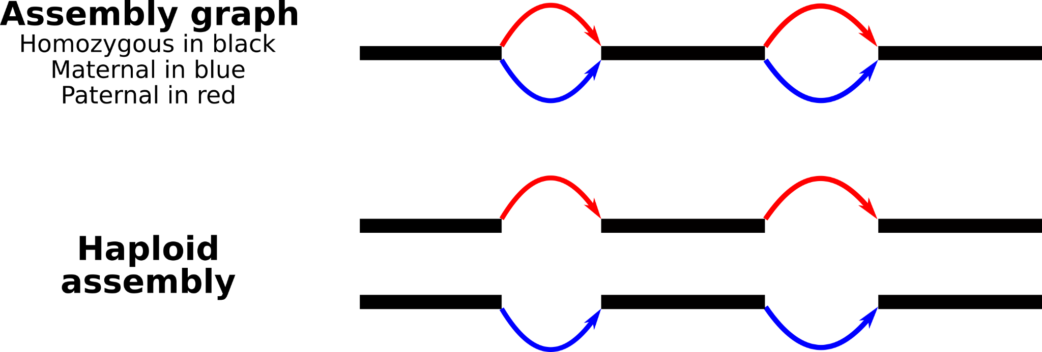
Hifiasm-Kmer Haplotyping
Produce diploid assembly using HiFi reads (long reads with low error rate) and parental short reads to separate haplotypes
Mother
Short reads
Father
Short reads
HiFi
Offspring
K-mer
Mother
K-mer
Father
HiFiasm
This method produces better diploid assemblies with fewer haplotyping errors through the use of parental kmers
Mother
Haplotype
Father
Haplotype

Slide 5
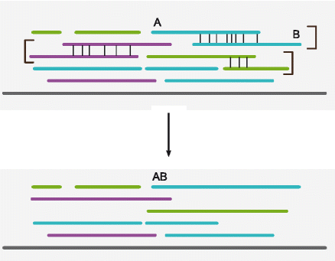
Long Reads phasing
A third way to separate haplotypes is through phasing, using SNPs
+
No parental information needed
No supplementary sequencing
-
Affected by numerous factors
  SNP density
  Reads length distribution
  Reads quality
  ...
Long reads are particularly useful as their size allow for large phased blocks
SNPs sharing between reads allow to stretch phased block size
adapted from Abou Saada et al. 2021

Slide 6
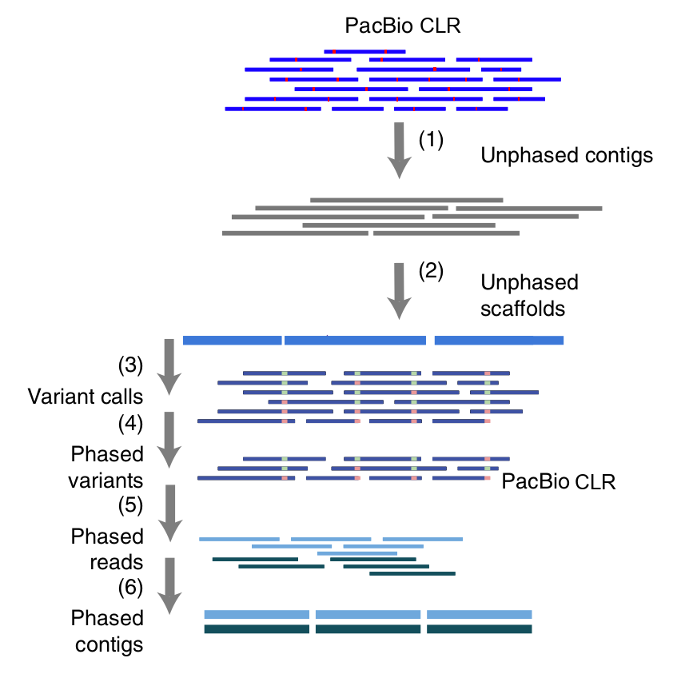
Long Reads phasing
Protocol based on DipAsm proof of concept (Garg et al. 2020) and adapted for long reads only
( )
LongShot (HapCut2 ML)
HapCut2 (&& WhatsHap phase)
WhatsHap haplotag
WTDBG2

Slide 7
Haplotype separation from SNPs - test protocol on Porc
Individual | Type | Cov | CIGAR Cov | Reads MQ0 | AVG reads length | Max Reads length | SNPs | SNPs PASS | SNPs dn | SV | SV PASS DP10
Porc735 | CLR | 42.64 | 38.06 | 14 731 | 22 921 | 173 050 | 10 706 993 | 7 199 444 | 3 507 549 | 116 565 | 110 441
Various protocols:
Phasing: Keep Longshot phasing or add WhatsHap phasing
SNPs: Keep all variants or filter them
Reads Haplotype splitting: Aligned portion or full length
5 tests on Porc735
simple : Longshot only, no filter, aligned portion
WH: WhatsHap phasing, no filter, aligned portion
WHMQ20: WhatsHap phasing, filter PASS SNPs with 100% MQ20 reads, aligned portion
Extract: Longshot only, no filter, full length reads
EWHMQ20: WhatsHap phasing, filter PASS SNPs with 100% MQ20 reads, full length reads

Slide 8
Haplotype separation from SNPs - Porc CLR results
Separate reads between phased and unphased in a ~ ¾ , ¼ ratio
Each haplotype having similar coverage
Assembly size are slightly larger with filtering but no drastic differences between protocol
Using full length reads gives smaller values of N50 and smaller longest reads
 | assembly | simple |  | WH |  | WHMQ20 |  | Extract |  | EWHMQ20
735 |  | 1 | 2 | 1 | 2 | 1 | 2 | 1 | 2 | 1 | 2
Cov |  | 16x | 16x | 16x | 16x | 15x | 15x | 16x | 16x | 15x | 15x
 | ~44x | 10x |  | 10x |  | 13x |  | 10x |  | 13x
Total size | 2.44G | 2.45G | 2.47G | 2.46G | 2.44G | 2.49G | 2.48G | 2.48G | 2.46G | 2.47G | 2.48G
N50 | 13.5M | 16.8M | 17M | 16.2M | 13M | 19.9M | 16.3M | 13M | 12.7M | 13M | 11.2M
Longest | 73.2M | 48M | 71M | 64M | 58.3M | 60.9M | 55.8M | 44.6M | 45.2M | 42.9M | 35.6M

Slide 9
Haplotype separation from SNPs - Porc CLR results
Assemblies quality will vary with coverage, SNPs density and reads length distribution
Individual | Type | Cov | CIGAR Cov | Reads MQ0 | AVG reads length | Max Reads length | SNPs | SNPs PASS | SNPs dn | SV | SV PASS DP10
Porc735 | CLR | 42.64 | 38.06 | 14 731 | 22 921 | 173 050 | 10 706 993 | 7 199 444 | 3 507 549 | 116 565 | 110 441
Porc227 | CLR | 28.71 | 23.24 | 16 713 | 16 256 | 207 909 | 10 542 377 | 7 486 493 | 3 055 884 | 116 804 | 109 774
 | Porc 735 |  |  | Porc 227
 | assembly | WHMQ20 |  | assembly | WHMQ20
 |  | 1 | 2 |  | 1 | 2
Cov |  | 15x | 15x |  | 11x | 11x
Total | ~44x | 28x |  | ~30x | 18x
Total size | 2.44G | 2.49G | 2.48G | 2.43G | 2.44G | 2.43G
N50 | 13.5M | 19.9M | 16.3M | 18.8M | 2.1M | 2.2M
Longest | 73.2M | 60.9M | 55.8M | 75.7M | 13.7M | 12.1M
BUSCO | 89.7% | 90.7% | 91.7% | 86.4% | 72.3% | 71.6%

Slide 10
Hifiasm Results - Bovine Offspring 2
 | 37160 Offspring2 Classique | 37160 Offspring2 HiC |  | 37160 Offspring2 Kmer |  | 37160 Offspring2 Haplotag
Data | CCS | CCS_HiC |  | CCS_Parental |  | CCS_Haplotag_WHGQ10 |  | CCS_Haplotag_WHGQ10_Split
Quantity | 31X | 31X + 28X |  | 31X + 2x80X |  | 31x |  | 31x
 | Consensus | Hap1 | Hap2 | Hap1 | Hap2 | Hap1 | Hap2 | Hap1 | Hap2
Number of contigs | 2175 | 4418 | 3553 | 4632 | 3250 | 2582 | 2701 | 3773 | 3009
Total size (Gb) | 3.146 | 3.145 | 3.124 | 3.125 | 3.071 | 3.213 | 3.208 | 3.455 | 3.361
Longest contigs (Mb) | 159.6 | 157.2 | 120.5 | 157.2 | 119.6 | 132.5 | 159.1 | 159.6 | 158.3
N50 contigs length (Mb) | 82.3 | 30.9 | 38.3 | 38.2 | 36.9 | 43.1 | 46.2 | 63.2 | 68.5
Busco V5 |  | 95.4% | 95.5% | 95.4% | 95.4% | 95.4% | 95.5% | 95.8% | 95.7%

Slide 11
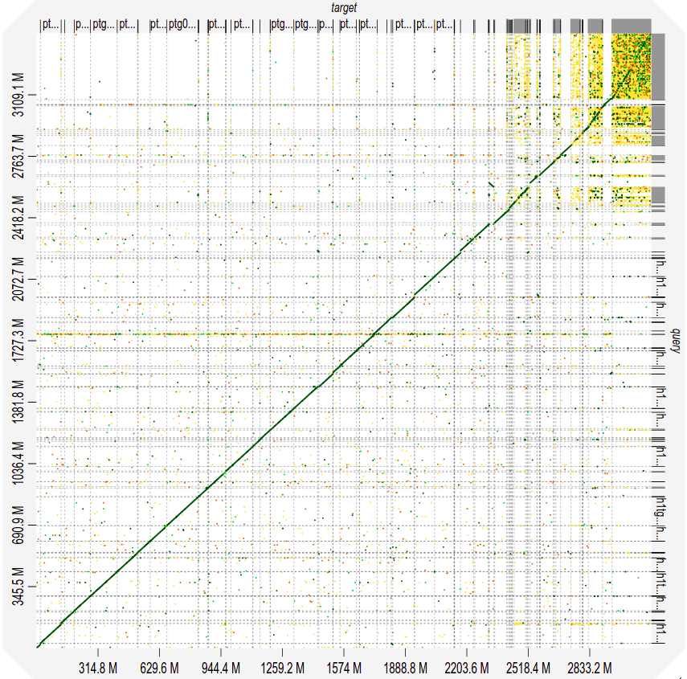
Hifiasm Results - Consensus Vs Split Hap 1

Slide 12
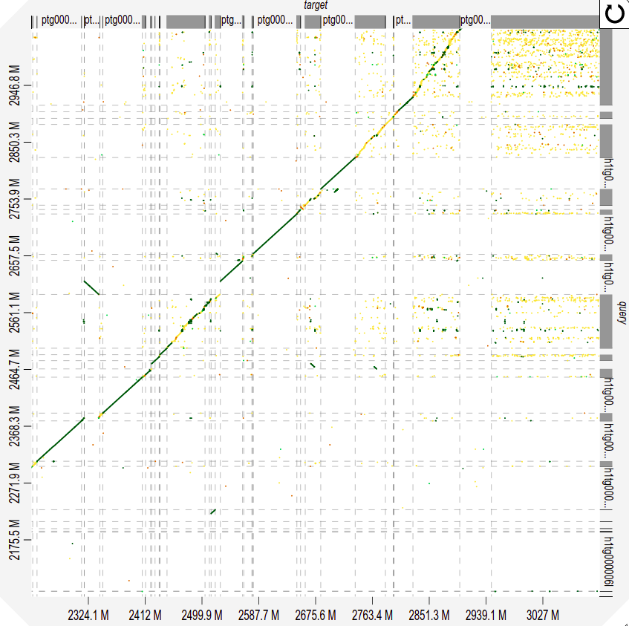
Hifiasm Results - Consensus Vs Split Hap 1

Slide 13
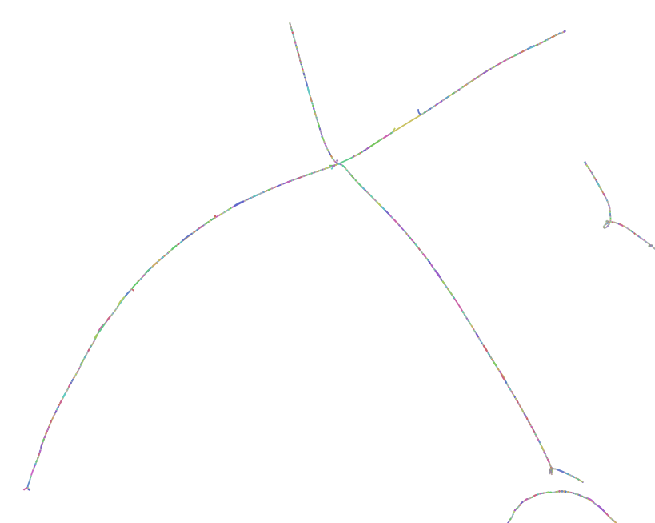
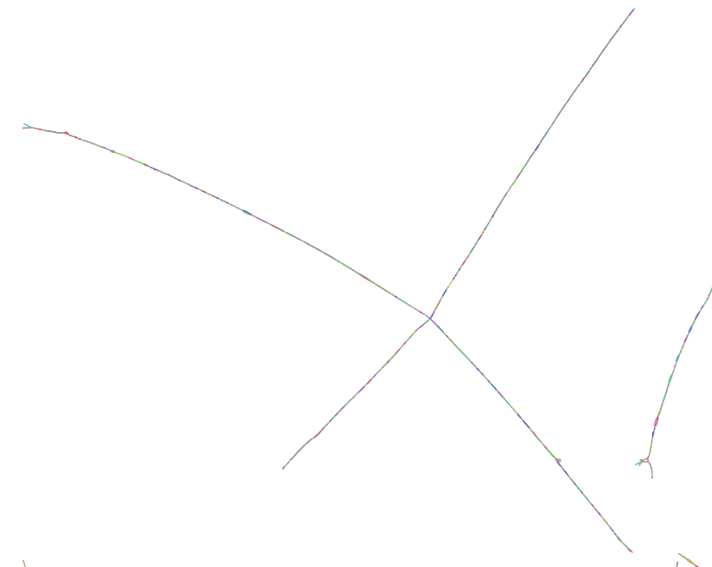
Hifiasm Results - Consensus Vs Split Hap 1
 | Consensus | HiC | Kmer | Haplotag split
Nodes | 49 073 | 49 073 | 223 780 | 80 954
Edges | 60 417 | 60 417 | 332 014 | 113 915
Total Length (Gb) | 6.3 | 6.3 | 8.9 | 7.0

Slide 14
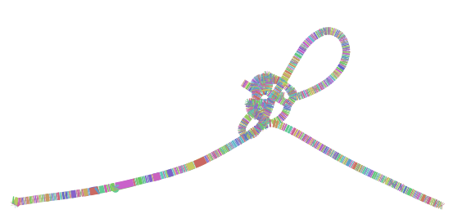
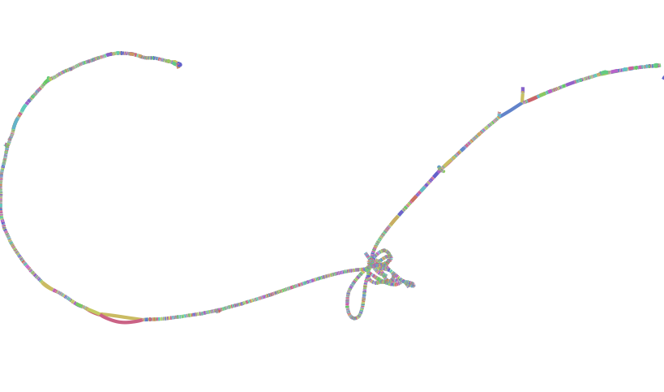
Hifiasm Results - Consensus Vs Split Hap 1
 | Consensus | HiC | Kmer | Haplotag split
Nodes | 49 073 | 49 073 | 223 780 | 80 954
Edges | 60 417 | 60 417 | 332 014 | 113 915
Total Length (Gb) | 6.3 | 6.3 | 8.9 | 7.0

Slide 15
Conclusion
With proper long reads coverage,
there is always a diploid assembly solution !
Haplotypes separation is generally better with added sequencing (Hi-C or Parental Illumina data)
Parental information allow to identify the haplotype origin and gives the best results
Separation based on phasing is still in development but show promising results
SNPs/Reads phasing was thought to be a “B” plan method but show competitive results
We need to find better methods/metrics to estimate haplotype separation quality
What about genome size ? Assembly Errors or unveiled genomic elements
  Need to investigate non reference matching portion

