Slide 1
Axis 1
Assembly
Assembly – Polishing - Scaffolding

Slide 2
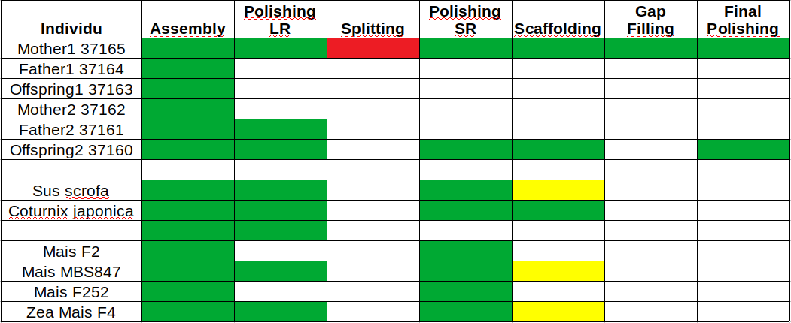
Axis goal
- Finding the best way to assemble genome
- Optimize and automate existing tools
- Must work for maximum genomes

Slide 3


Pipeline improvement
Long reads
Mini
map2
Alignment
Assembly
V20.04.1
Racon
Medaka
Busco
Kat
Loop and
polish again
Quast
Assembly
(Splitting)
Short reads
Bwa
Longranger
H.E.L.E.N
MarginPolish
Pepper
Alignment
Assembly
Pilon
FreeBayes
VCFTools
Busco
Kat
Loop and
polish again
Quast
Assembly

Slide 4
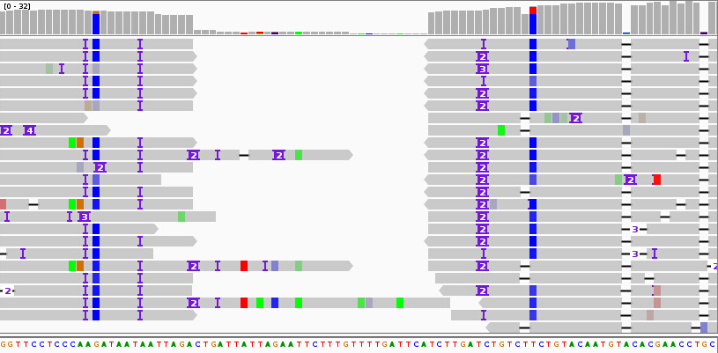
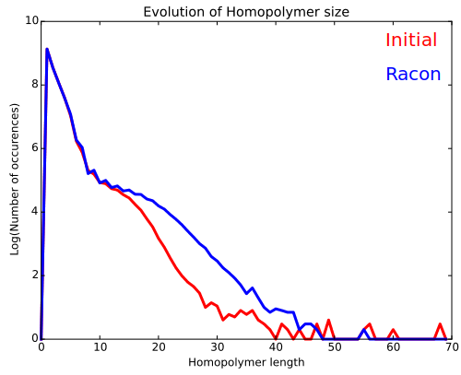
Splitting step
High coverage area
(>4X)
Low coverage area
(<4X)
High coverage area
(>4X)
Long reads
Mini
map2
Alignment
Assembly
Samtools
Mpileup
Splitter.py
Assembly
corrected

Slide 5
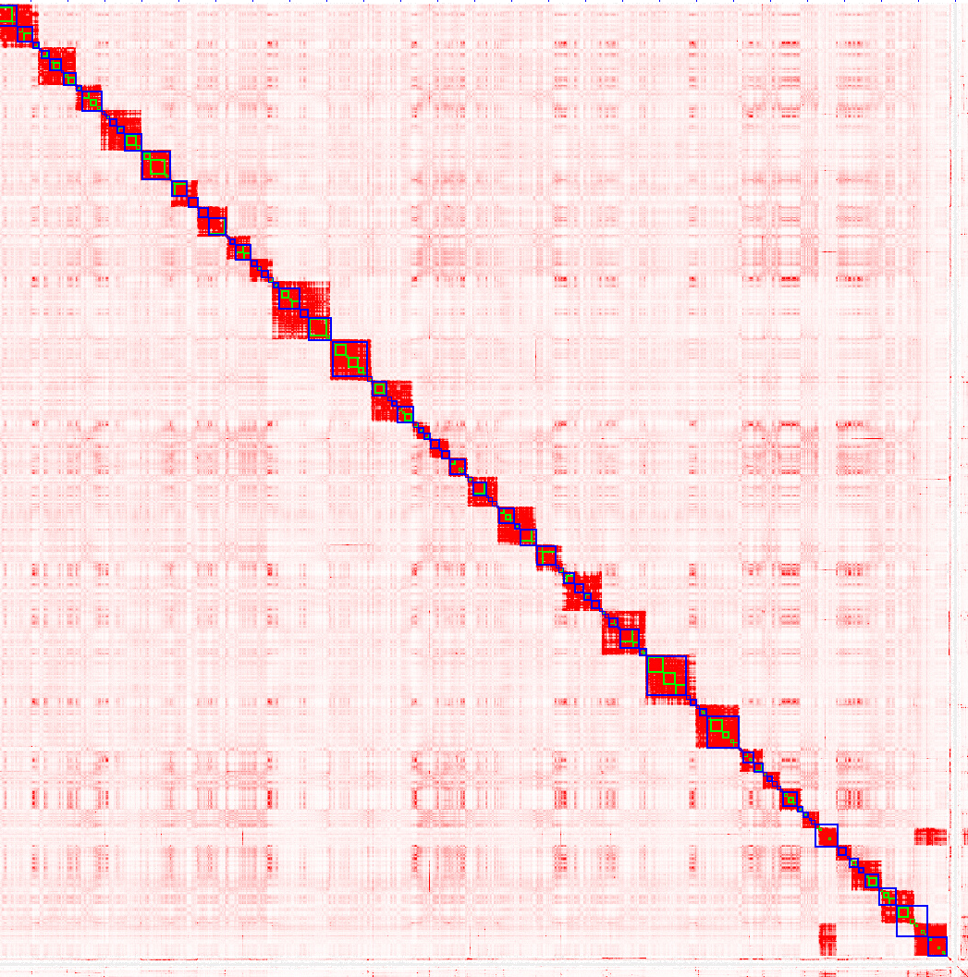
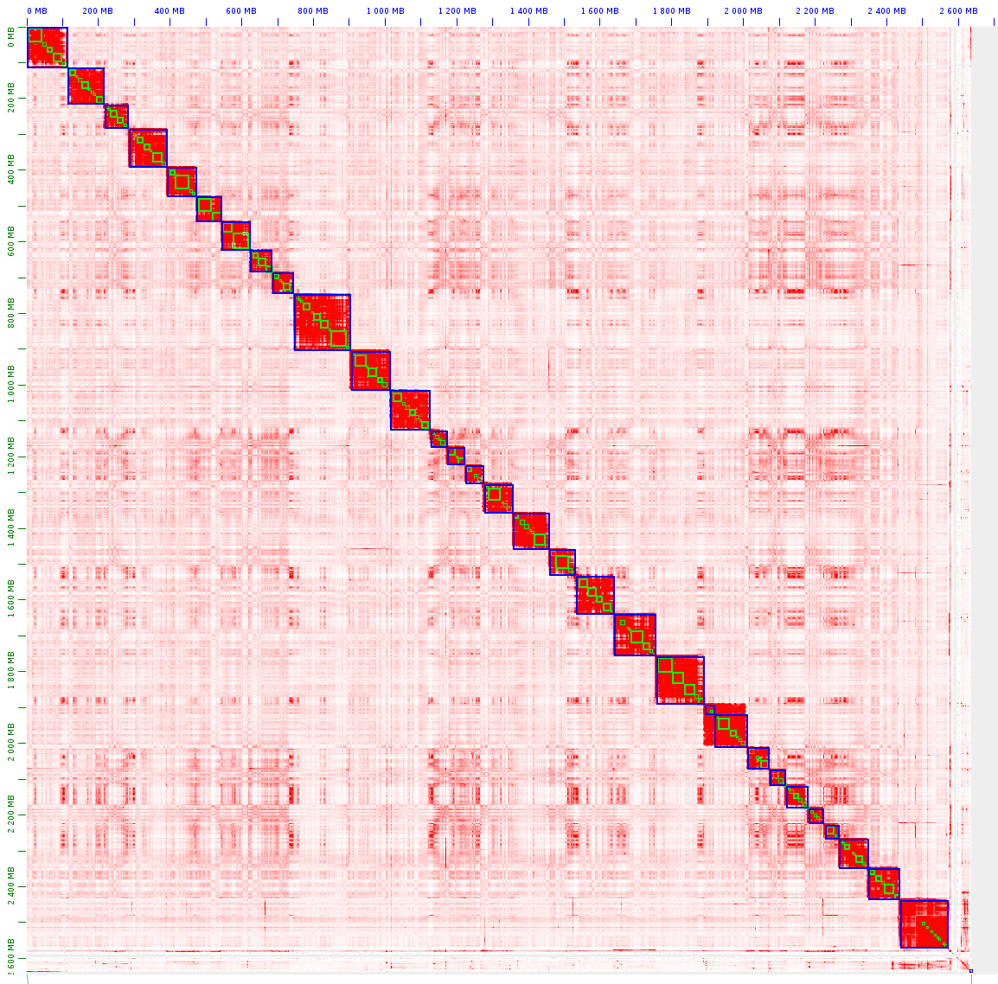
Other current jobs
- Run polishing pipeline on all the genomes of the project
- Find the best way to use PacBio HiFi reads
- Find the ideal coverage thresholds for assembly / polishing / scaffolding
- Scaffold and manual modification

Slide 6
Polishing
Long reads
Long reads
Mini
map2
Alignment
Assembly
Racon
Medaka
Busco
Kat
Loop and
polish again
Quast
Assembly
Split and Correct
Long reads
Long reads
Mini
map2
Alignment
Assembly
Splitter.py
Assembly
Polishing
Short reads
Short reads
Bwa
Longranger
Alignment
Assembly
Pilon
FreeBayes
VCFTools
Busco
Kat
Loop and
polish again
Quast
Assembly

