Slide 1
Error Rate Calculation Script
Martin French

Slide 2
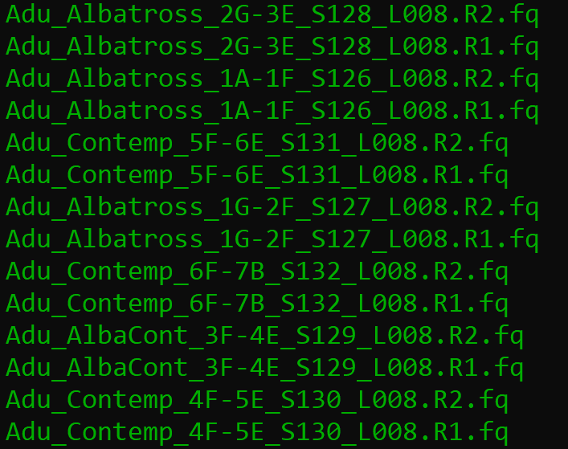
Working Directory
.fq files
Bash Script
R Script

Slide 3
sbatch ErrorCalc12_2_19.bash

Slide 4
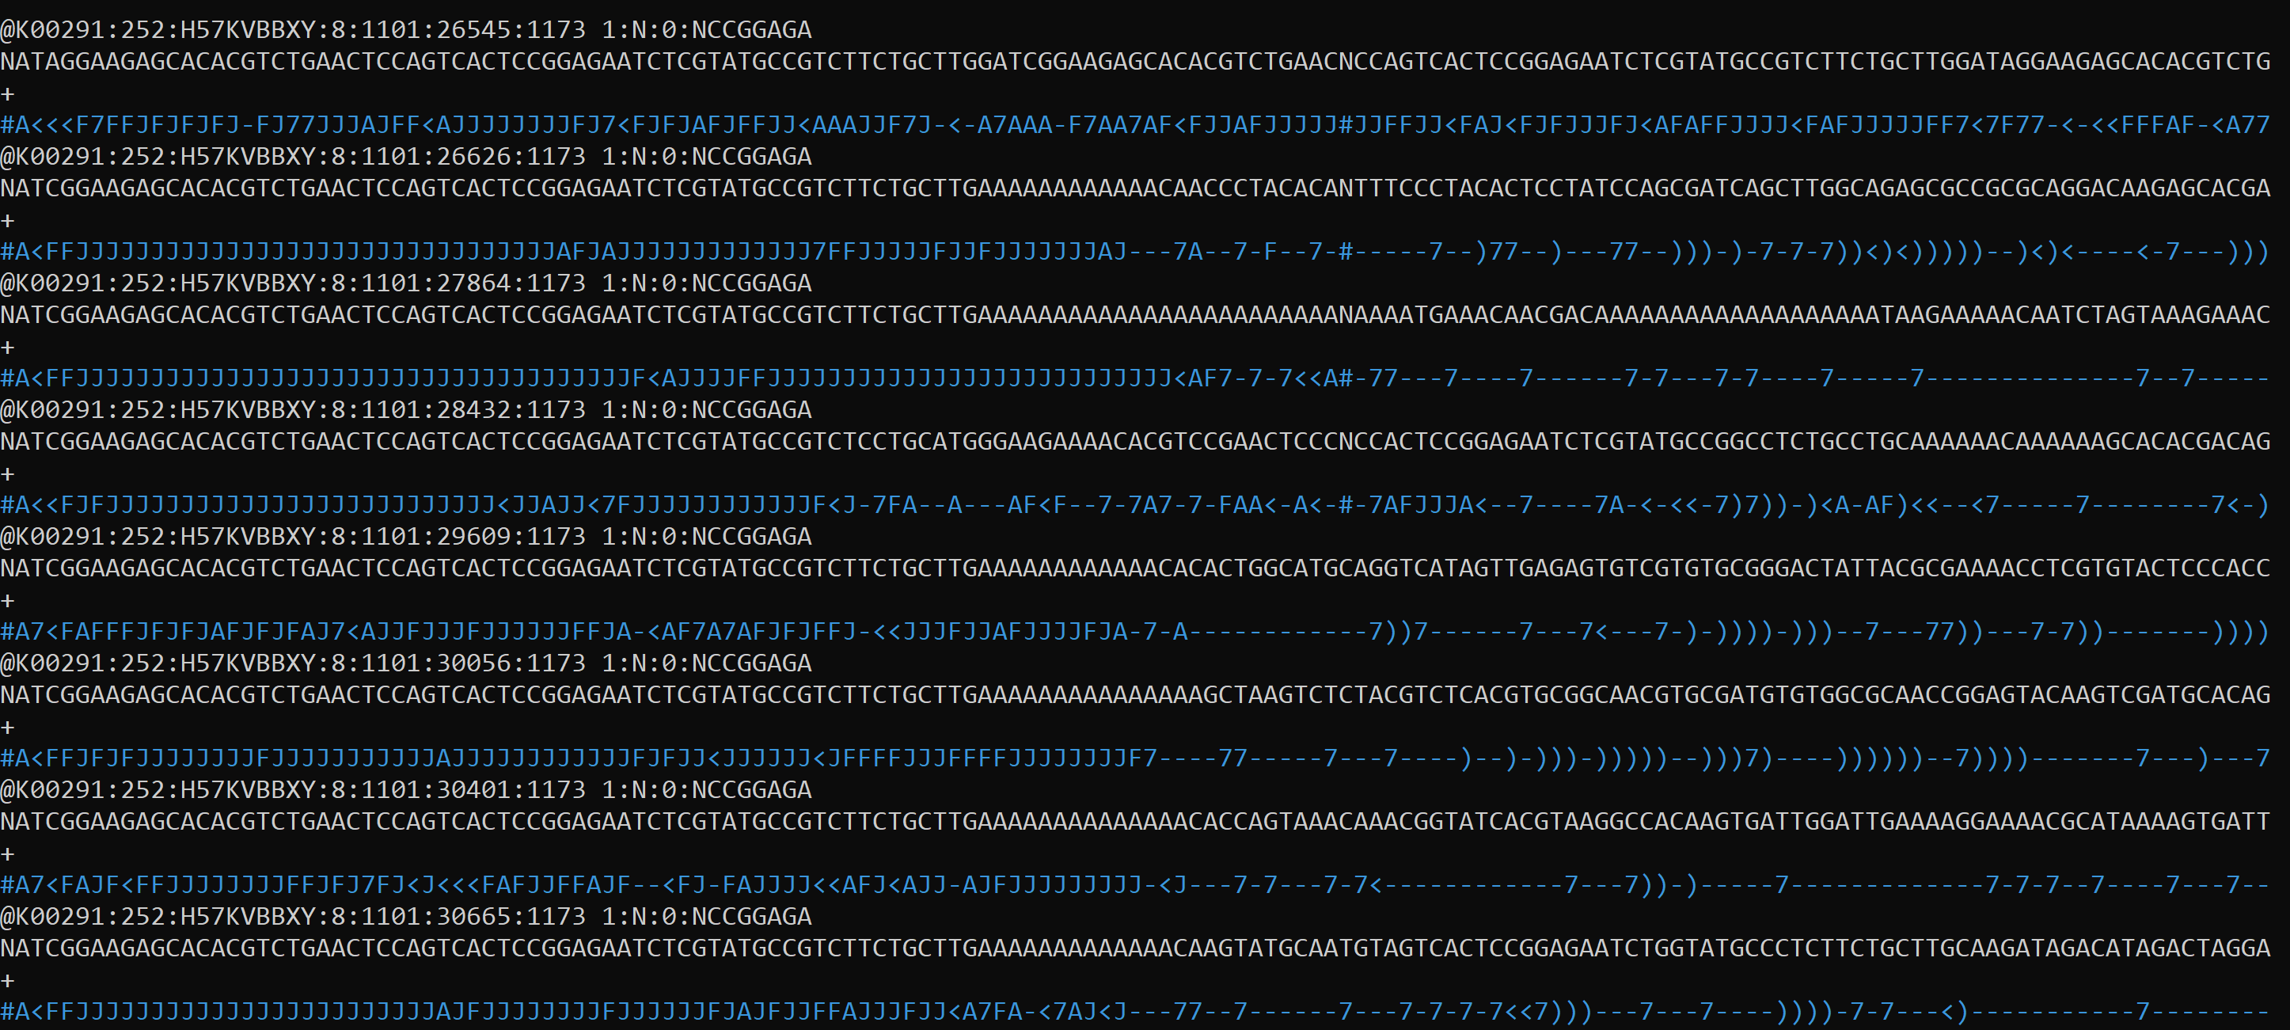
.fq files

Slide 5
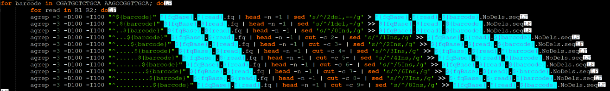
.fq files
${fqBase}${read}${barcode}.NoDels.seq
A “fuzzy” grep (agrep) is used to search for barcode sequences within “.fq” files
-Variable starting position to allow for indels.
-Three mistakes allowed within barcode sequence.

Slide 6
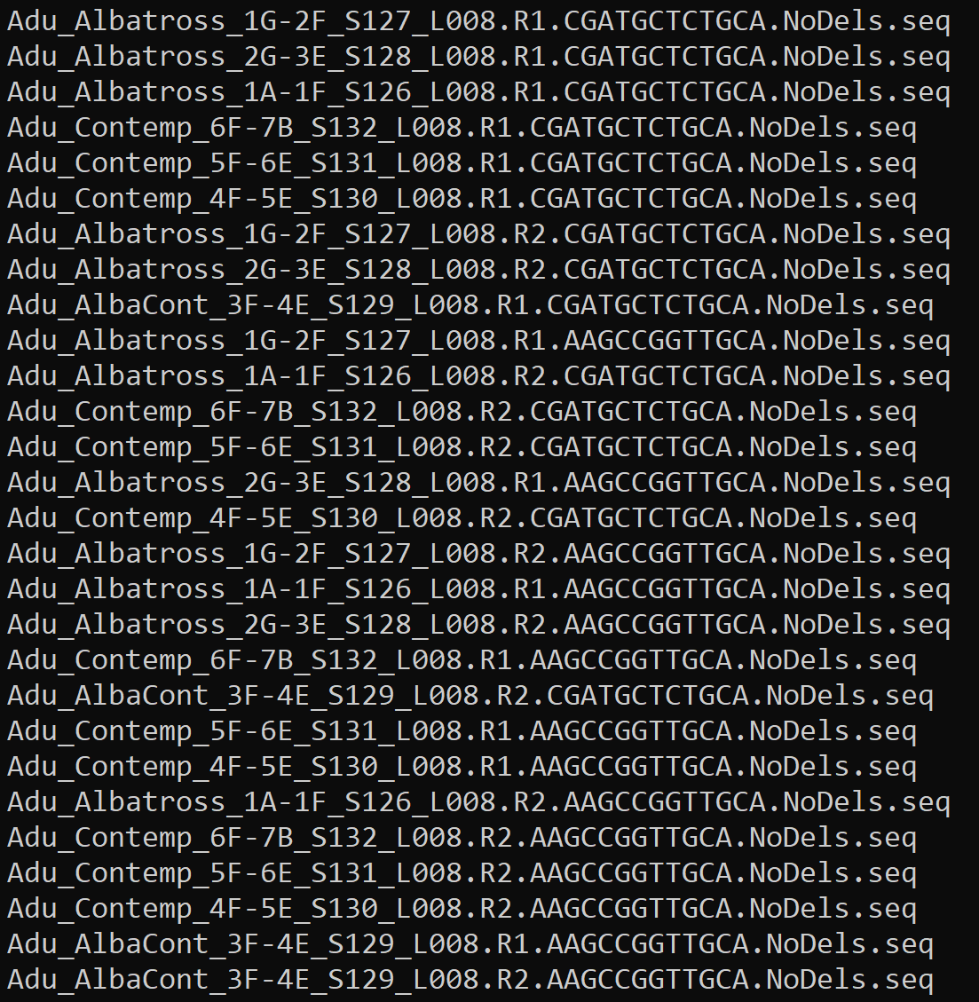
.fq files
“.seq” files
Bash Script
R Script

Slide 7
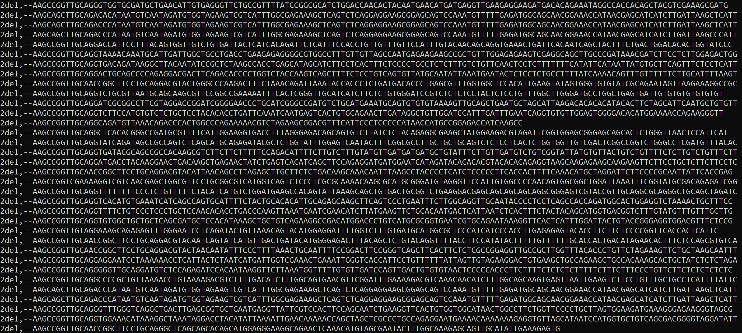
${fqBase}${read}${barcode}.NoDels.seq

Slide 8
.fq files
${fqBase}${read}${barcode}.NoDels.seq
The first 21 characters are cut from each “.seq” file
and put into “.csv” files. (Indels + 16bp)
${fqBase}${read}${barcode}.csv

Slide 9
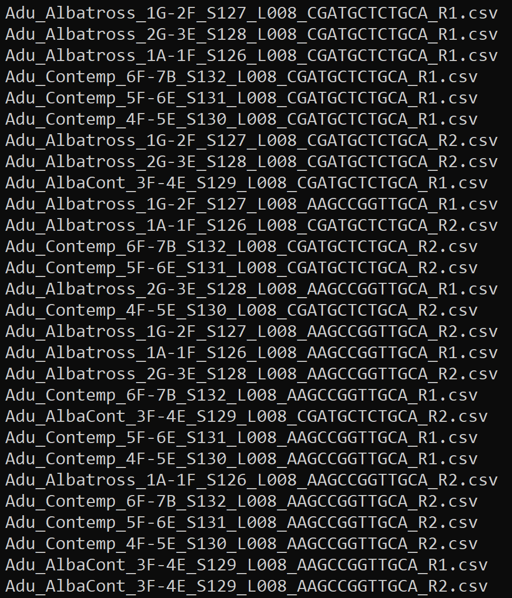
.fq files
“.seq” files
“.csv” files
Bash Script
R Script

Slide 10
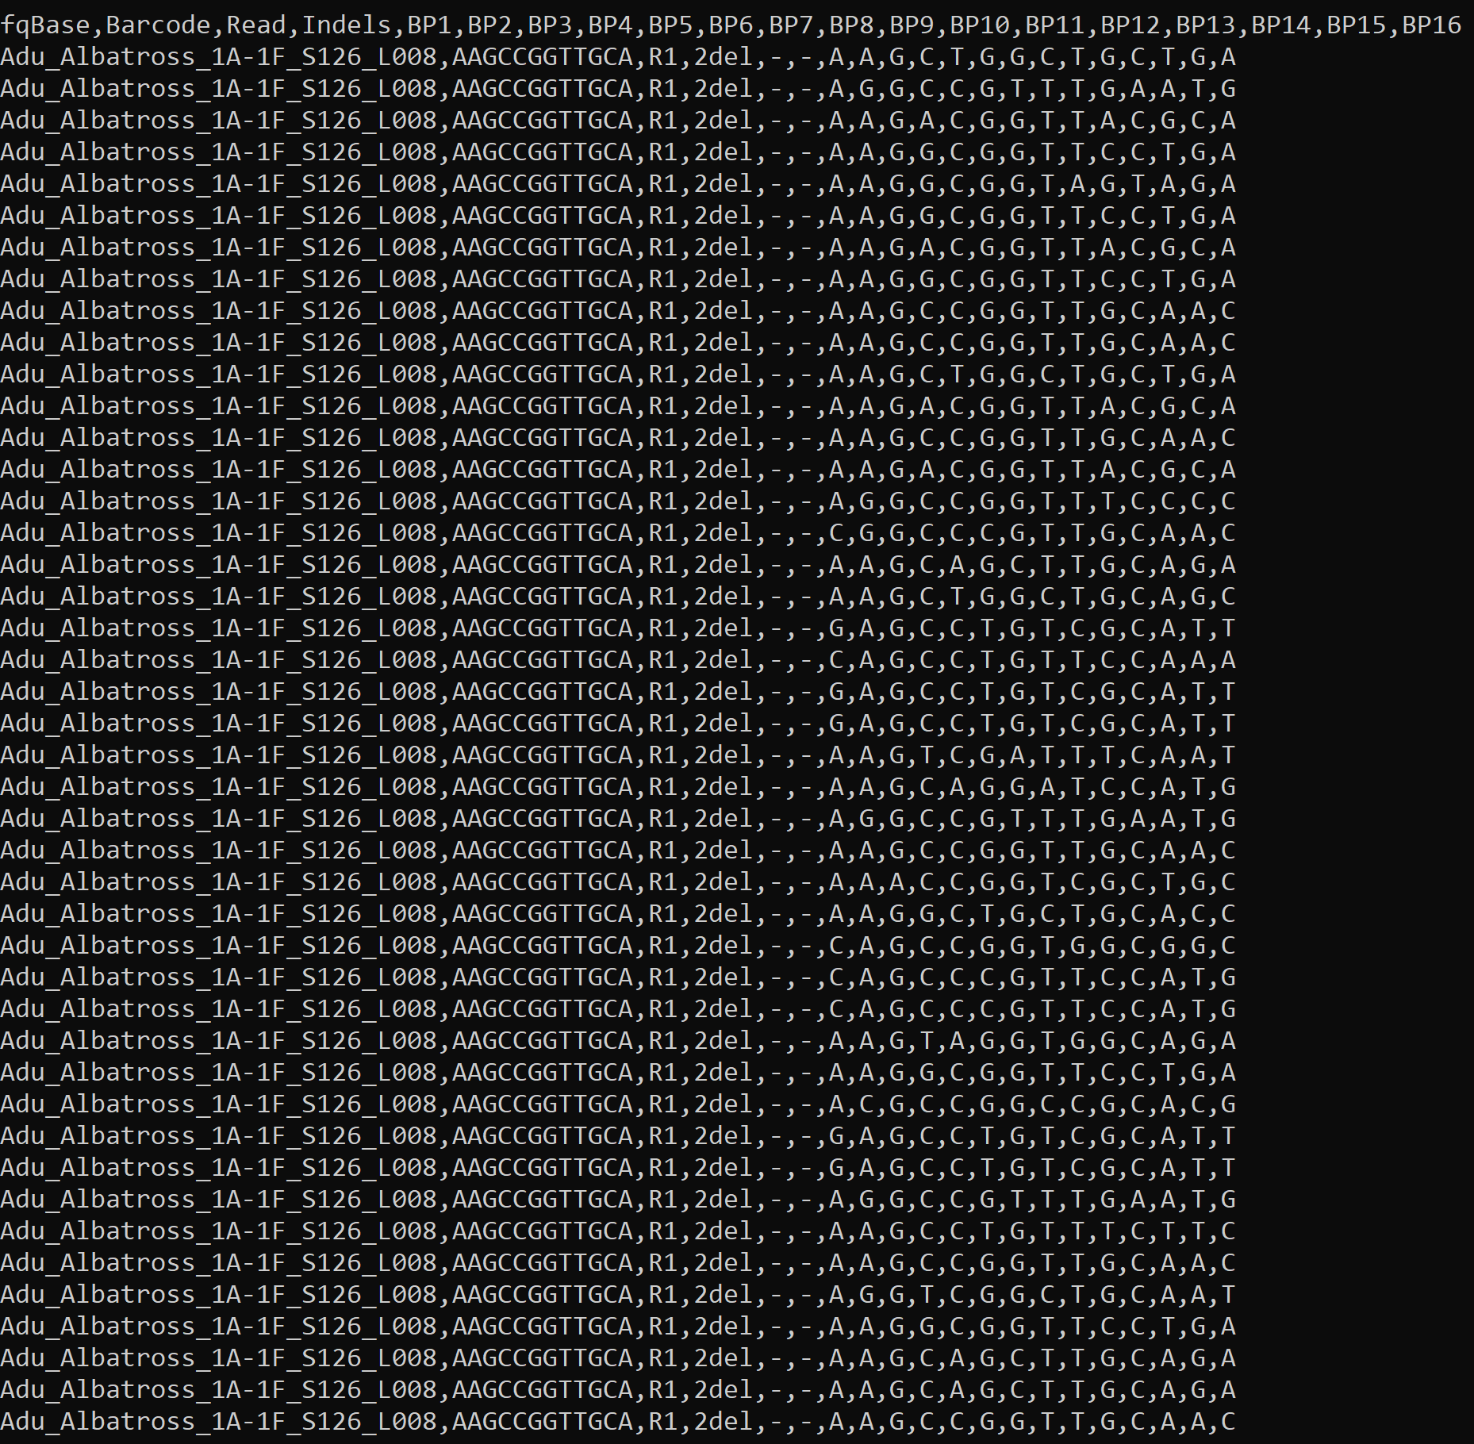
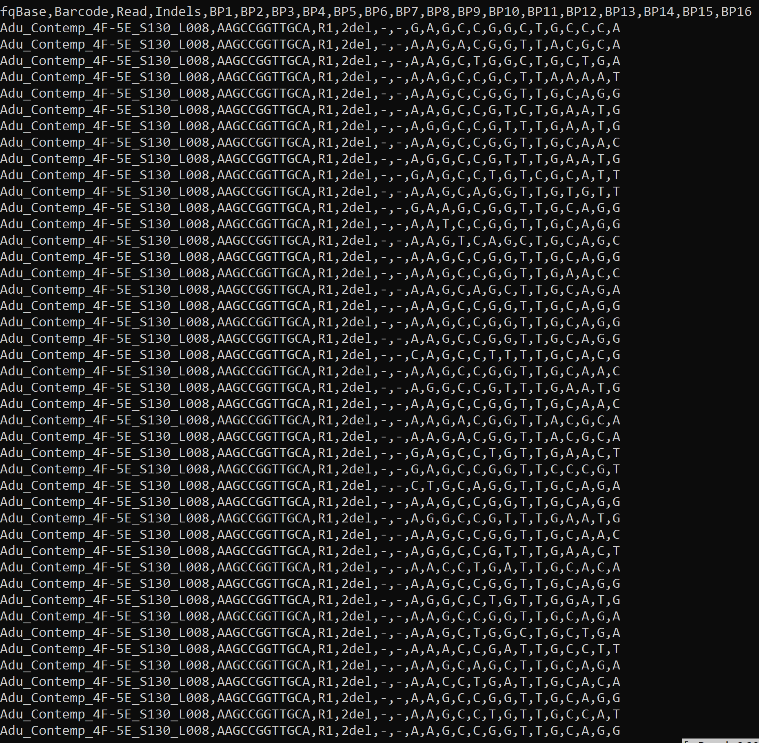
${fqBase}${read}${barcode}.csv

Slide 11
.fq files
${fqBase}${read}${barcode}.NoDels.seq
${fqBase}${read}${barcode}.csv
“Albatross” and “Contemp” .csv files are combined into respective barcode files.
AlbatrossBarcodes.csv
ContempBarcodes.csv

Slide 12

.fq files
“.seq” files
Combined “.csv” files
Bash Script
“.csv” files
R Script

Slide 13
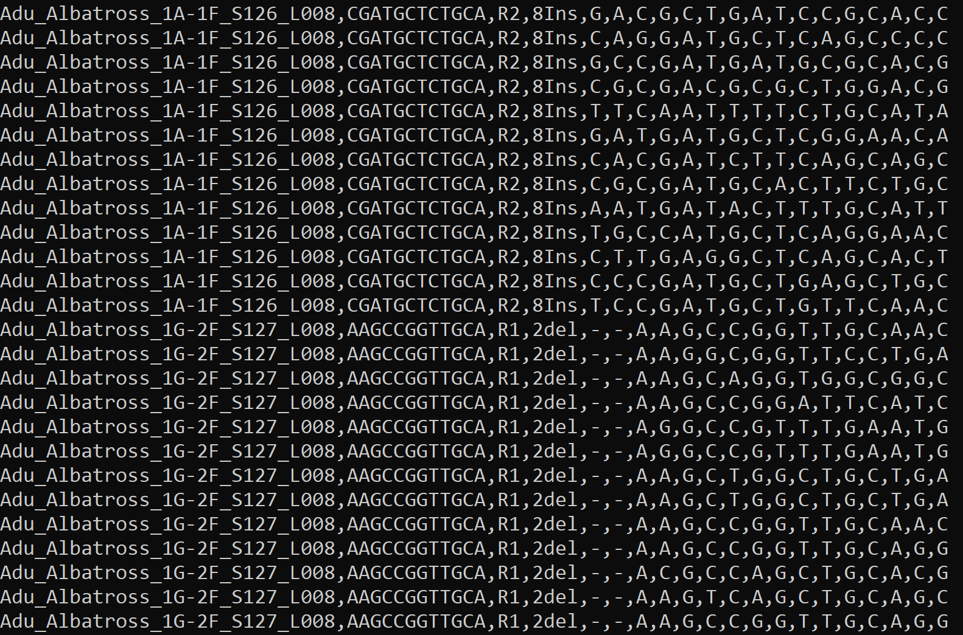
AlbatrossBarcodes.csv
ContempBarcodes.csv

Slide 14

.fq files
${fqBase}${read}${barcode}.NoDels.seq
${fqBase}${read}${barcode}.csv
AlbatrossBarcodes.csv
ContempBarcodes.csv
[Albatross/Contemp]Barcodes.csv files are called in R script.
PIRE_Aduo_Stats_forR_12_2_19.R

Slide 15
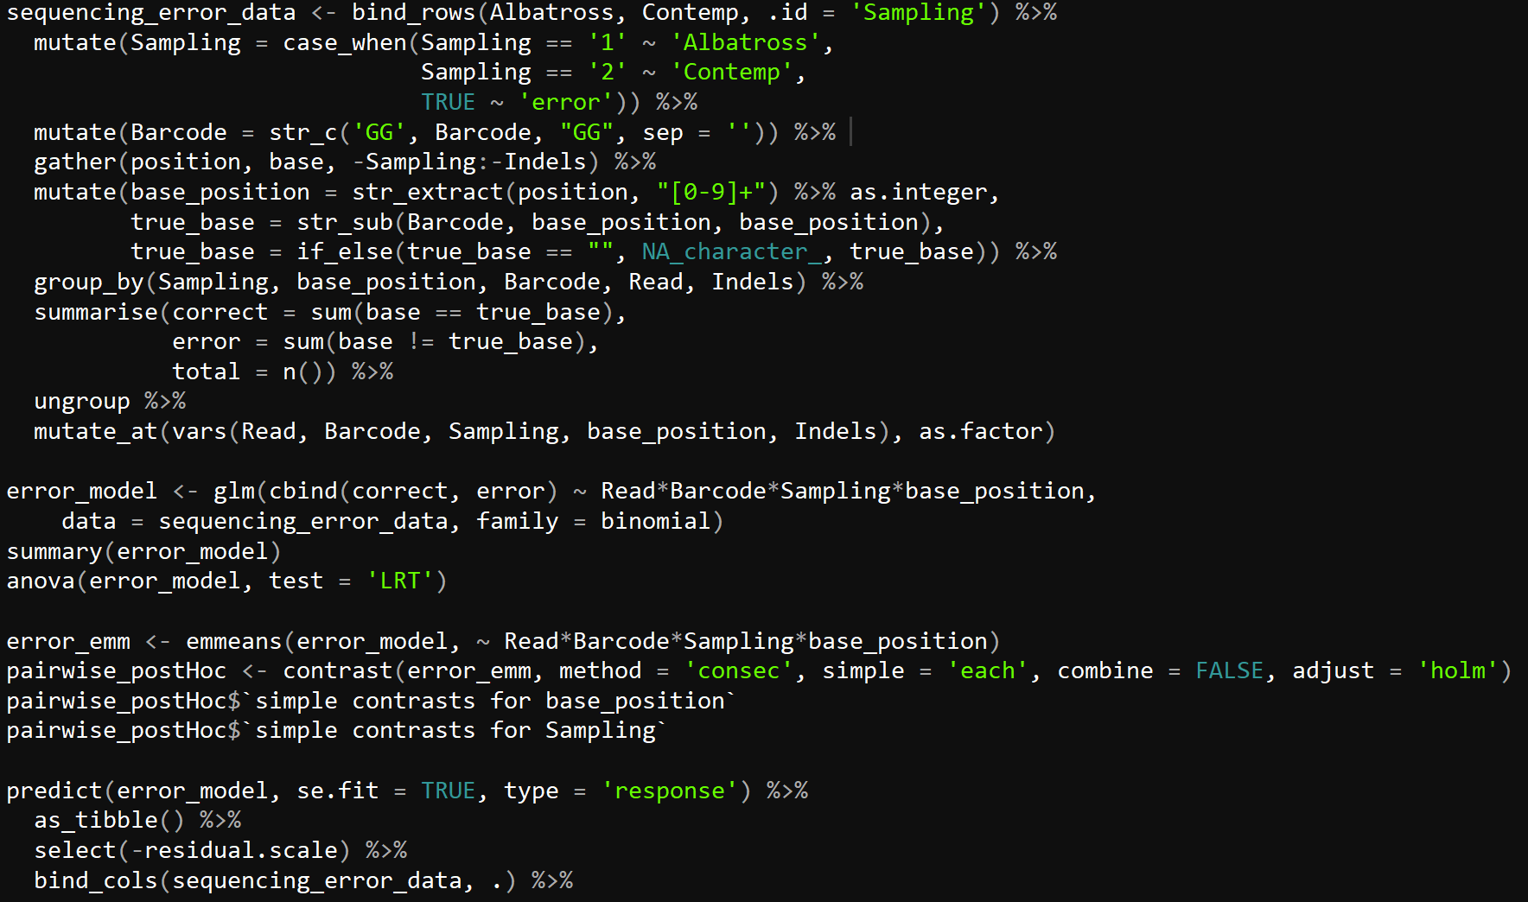
PIRE_Aduo_Stats_forR_12_2_19.R

Slide 16
.fq files
${fqBase}${read}${barcode}.NoDels.seq
${fqBase}${read}${barcode}.csv
AlbatrossBarcodes.csv
ContempBarcodes.csv
PIRE_Aduo_Stats_forR_12_2_19.R
Statistics
“.pdf” figures

Slide 17
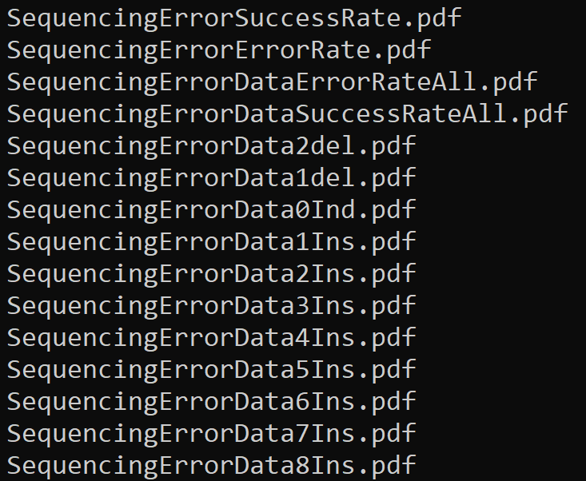
.fq files
“.seq” files
Combined “.csv” files
Statistics
“.pdf” files
Bash Script
“.csv” files
R Script

Slide 18
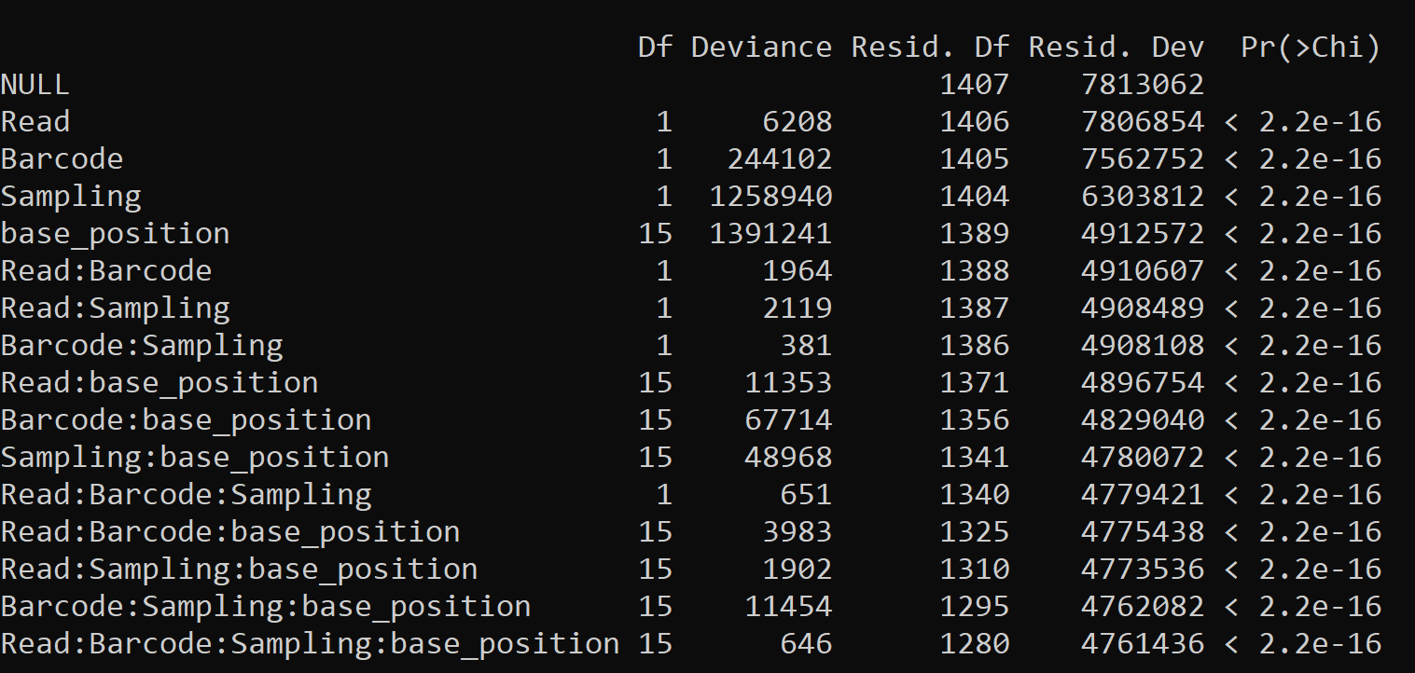
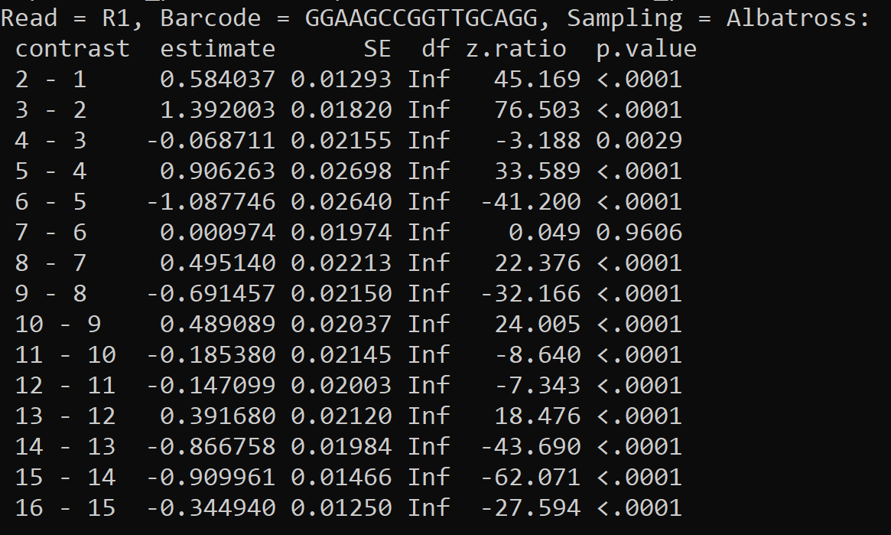
Statistics

Slide 19
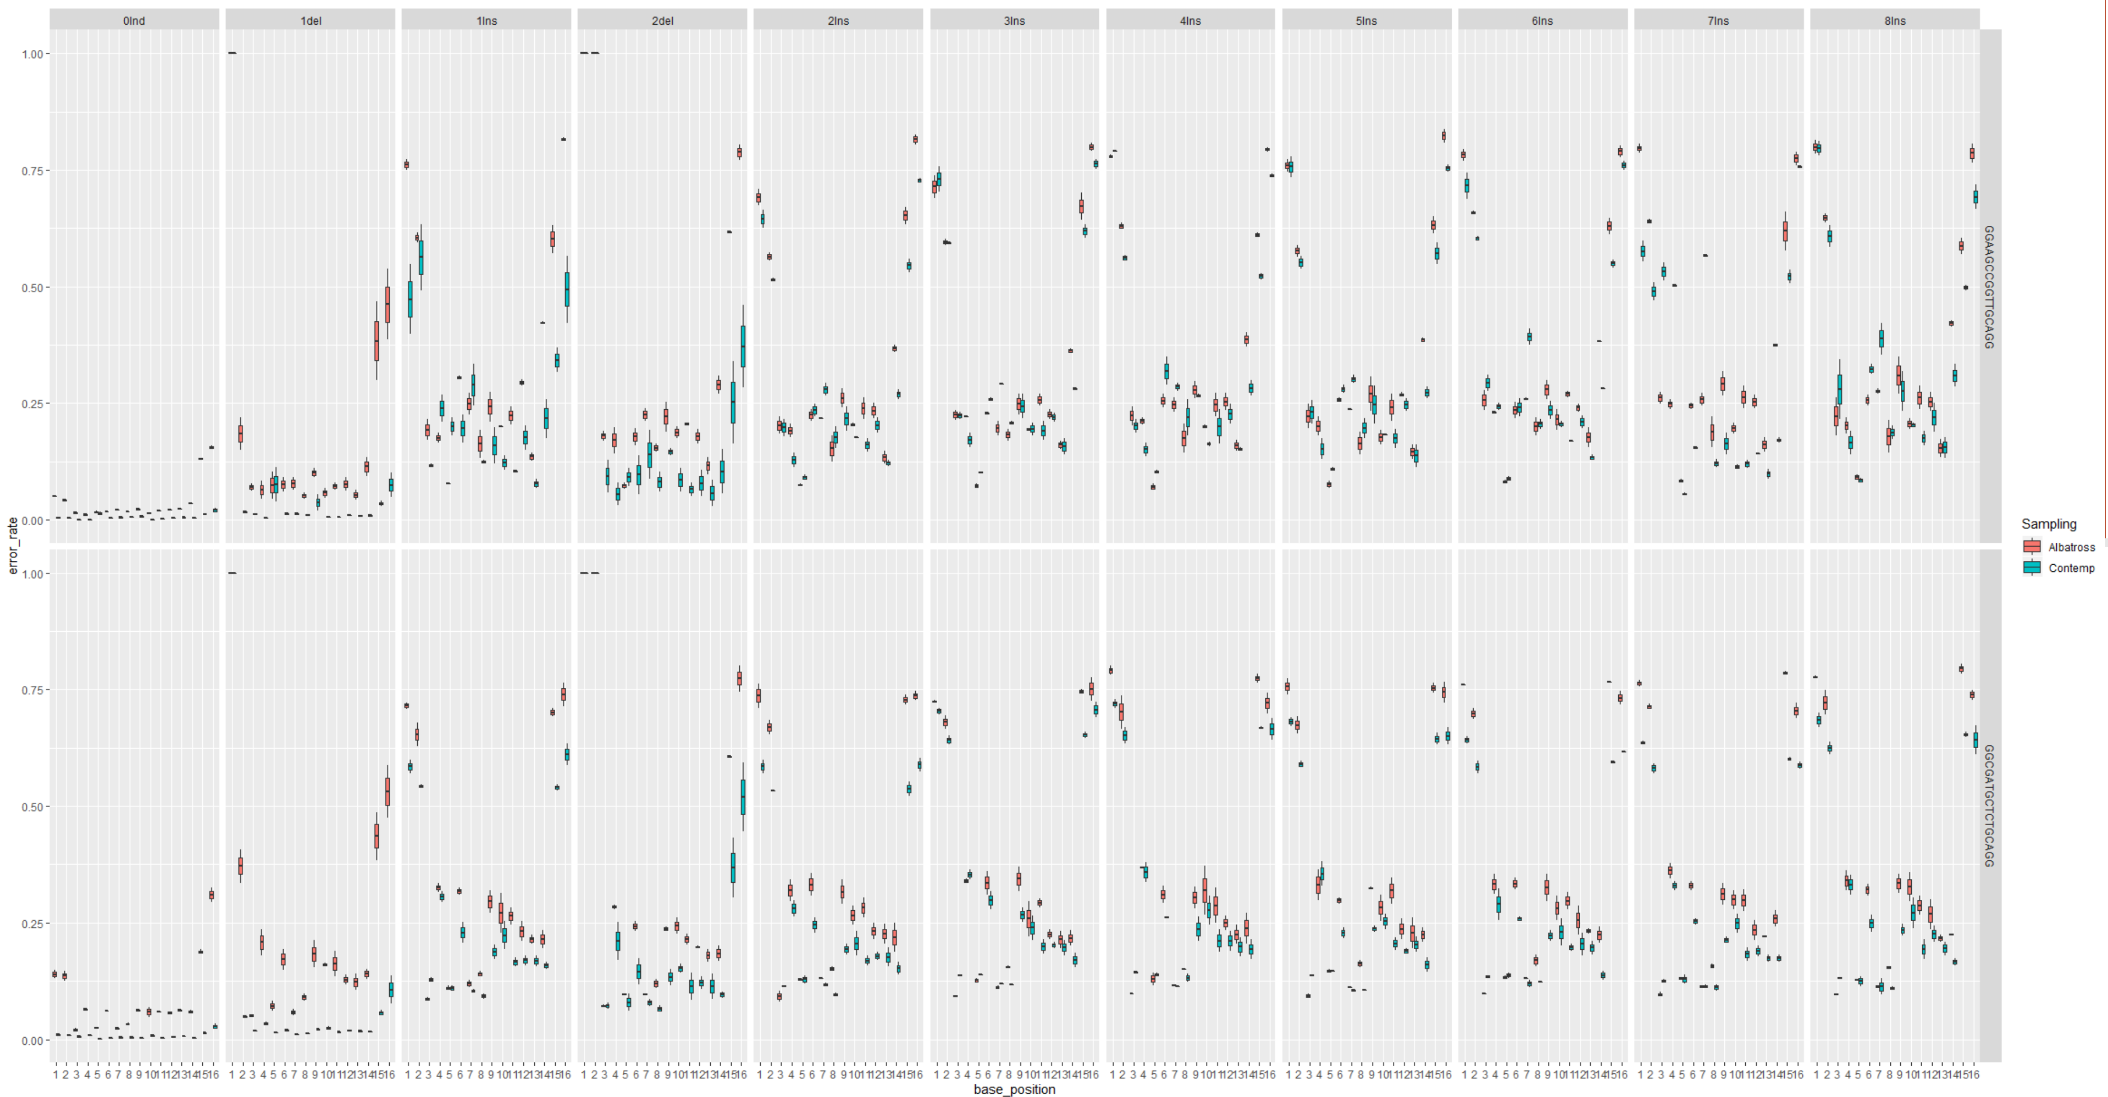
“.pdf” figures

Slide 20
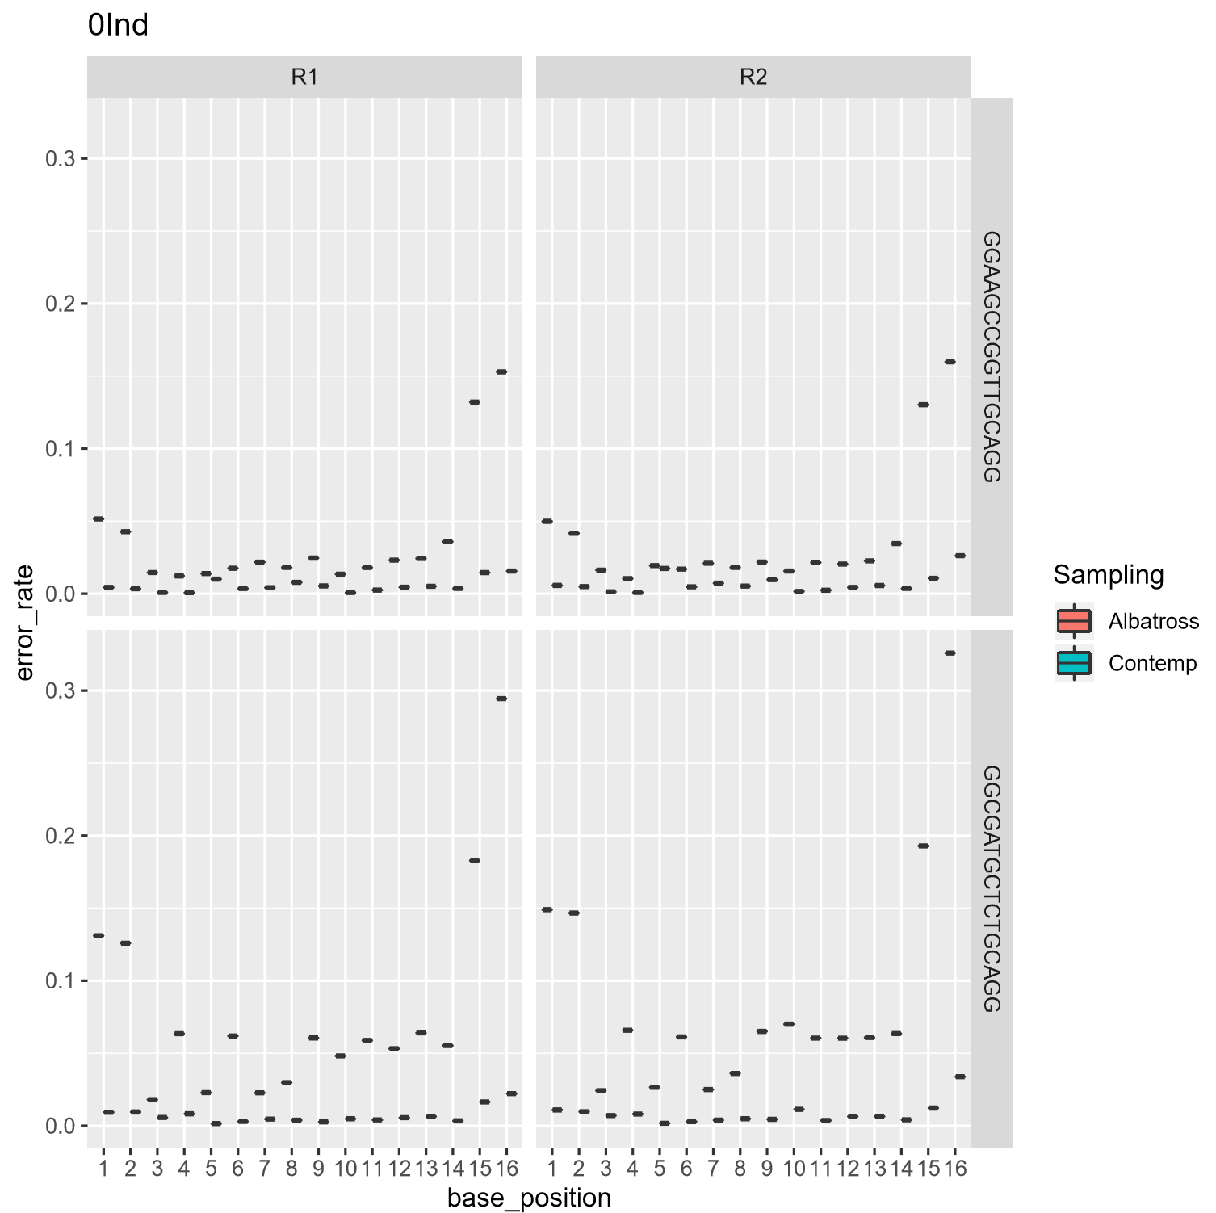
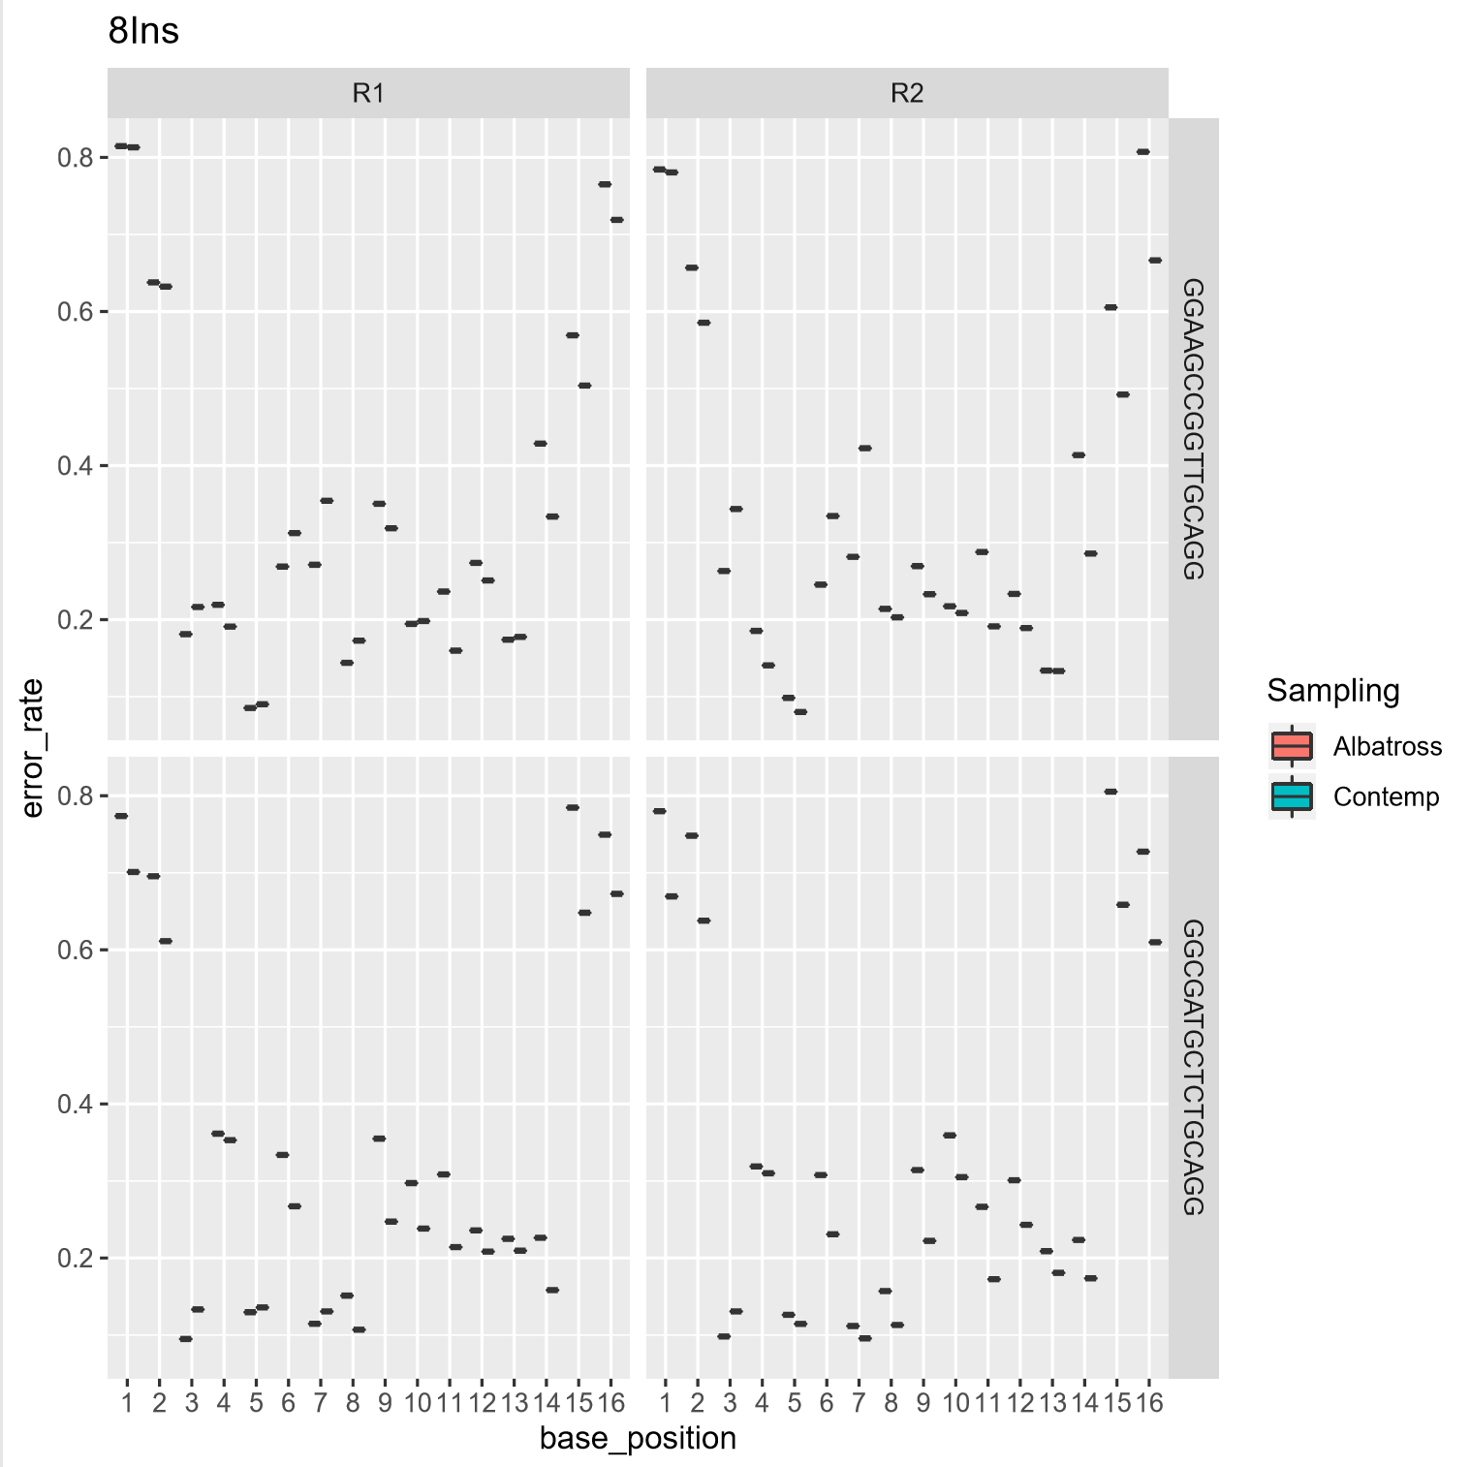
“.pdf” figures

