Slide 1
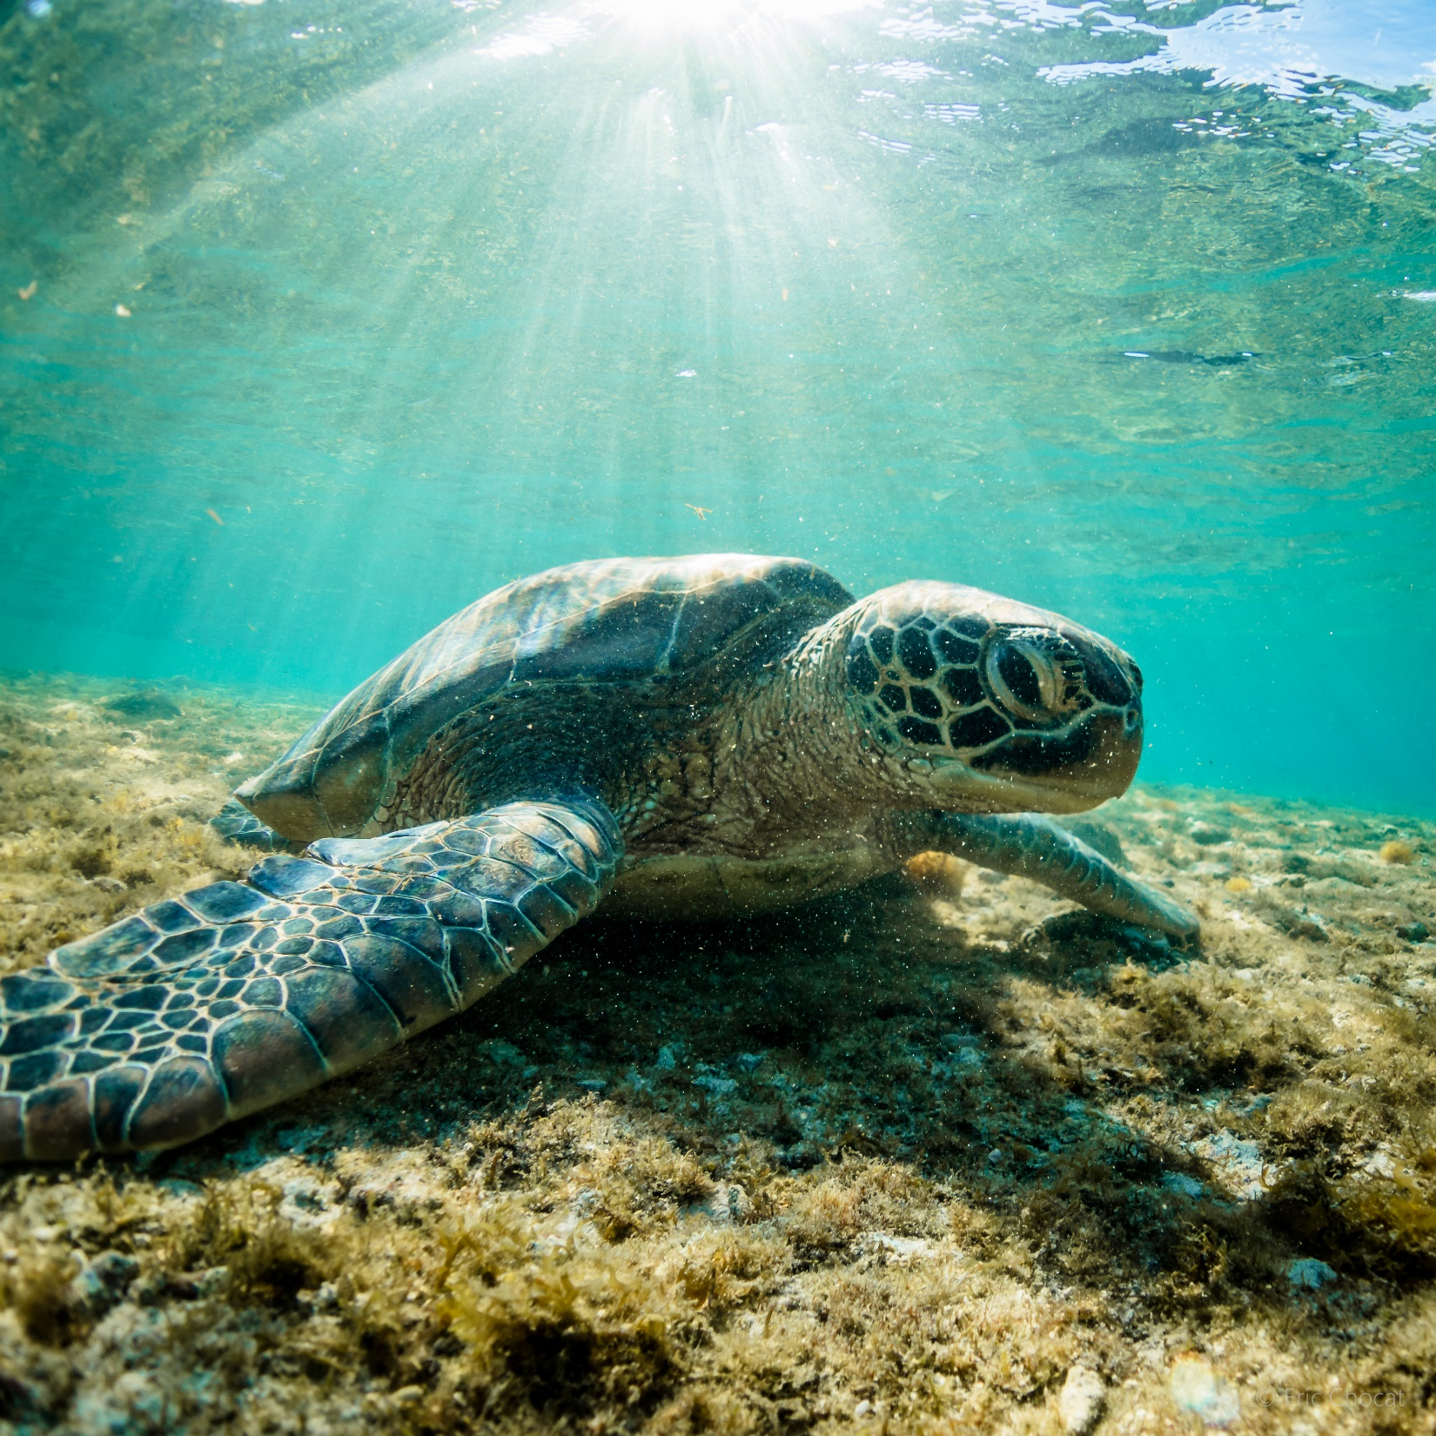
Understanding a complex relationship:
An assessment of marine wildlife tourism with endangered marine turtles at Apo Island Protected landscape and Seascape
Jia Dollano
Total Flight-initiation-Distance Surveys: 102

Slide 2
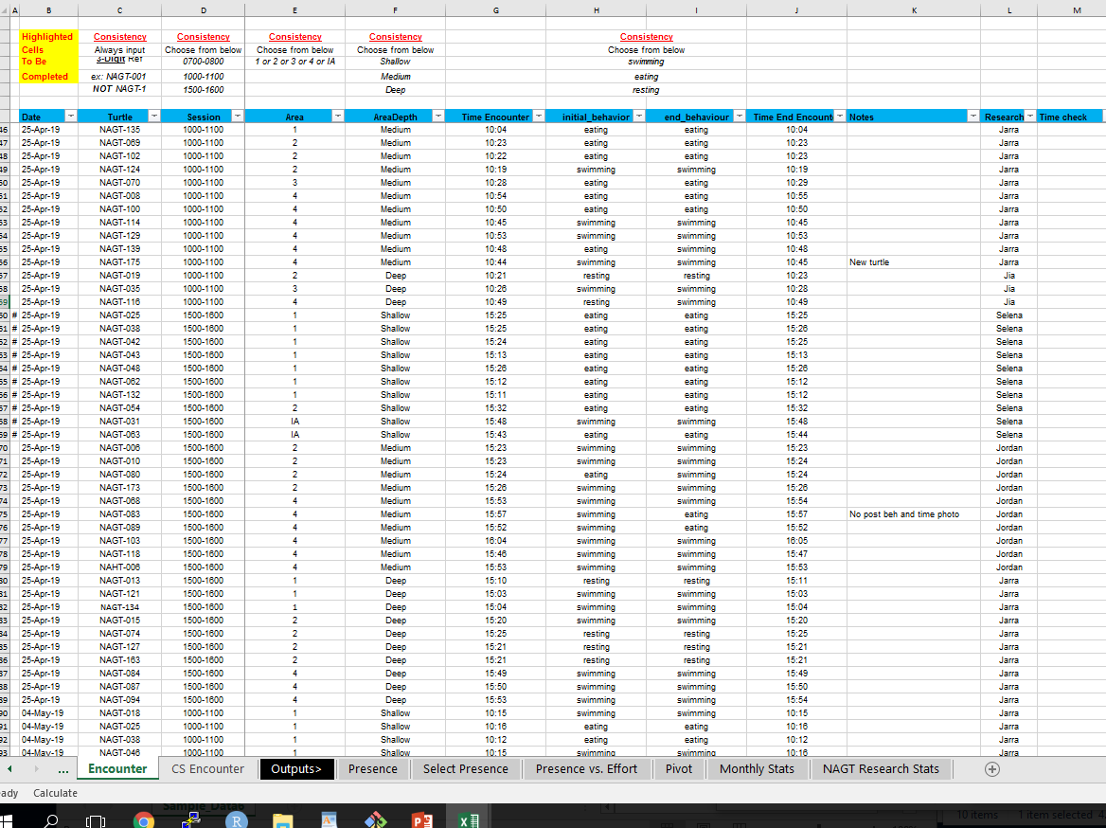

Slide 3
Legend
X
Behavior
SS – Slow Swimming
FS – Fast Swimming
BR - Breathing
Y
Distance
1m
1.5 m
2.0 m
5.0 m
10 m
Legend
X
Area
1
2
3
4
Y – Individual Count

Slide 4
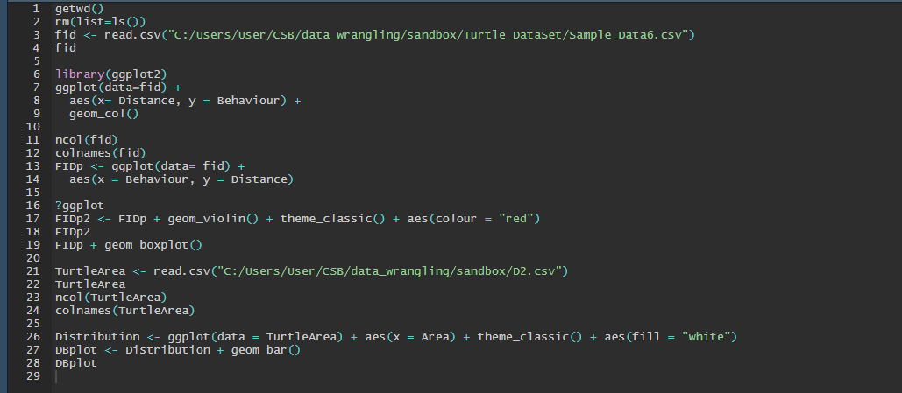

Slide 5
