Slide 1
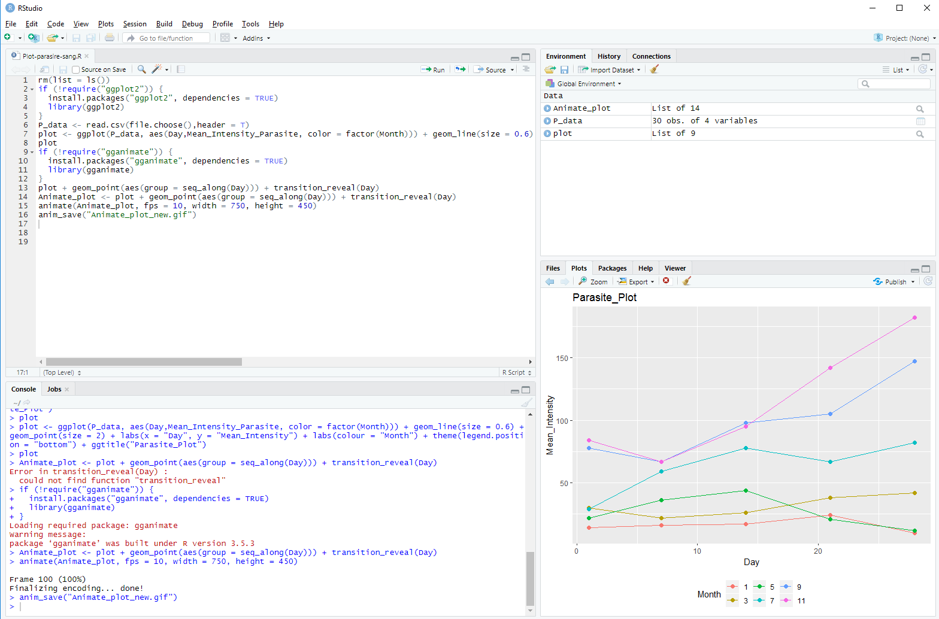
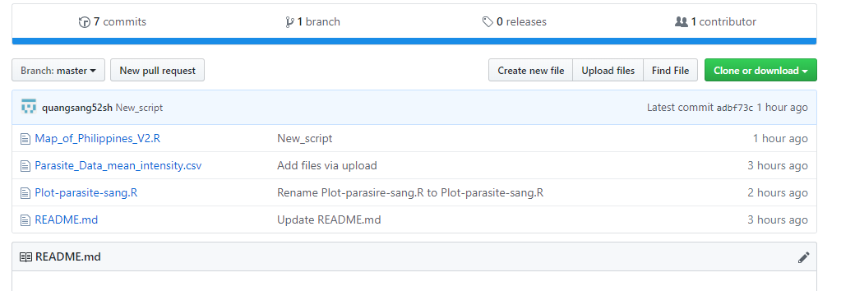
Parasite diversity on catfish in Khanh Hoa Province, Vietnam
TRAN QUANG SANG
NHA TRANG UNIVERSITY
KHANH HOA PROVINCE
VIETNAM

Slide 2
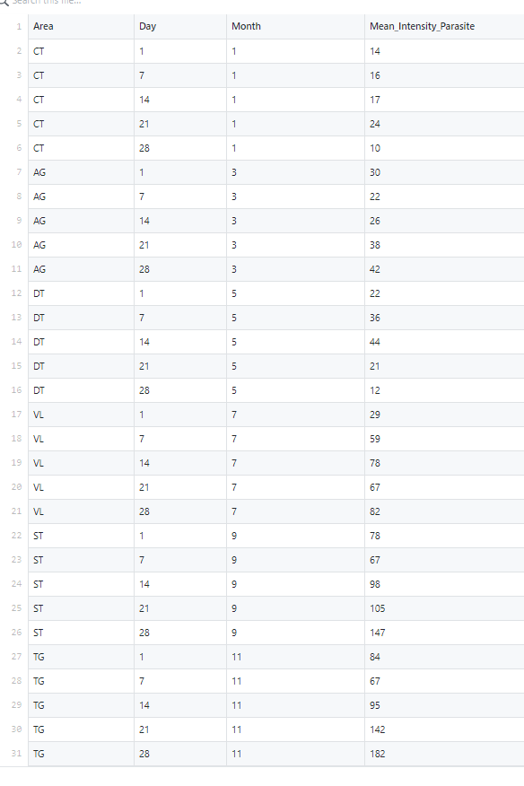
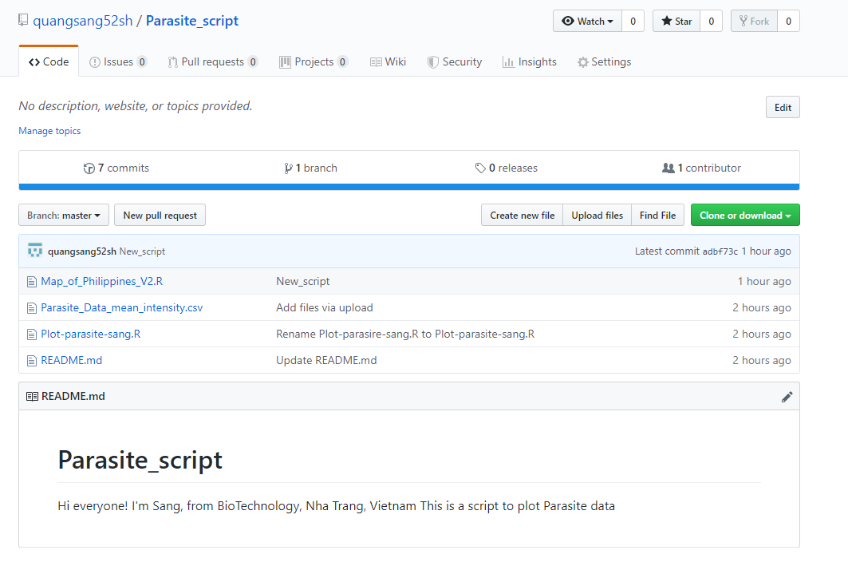
https://github.com/quangsang52sh/Parasite_script
My Data
My Script

Slide 3
Make sure all old data is cleared
rm(list = ls())
if (!require("ggplot2")) {
install.packages("ggplot2", dependencies = TRUE)
library(ggplot2)
}
P_data <- read.csv(file.choose(),header = T)
plot <- ggplot(P_data, aes(Day,Mean_Intensity_Parasite, color = factor(Month))) + geom_line(size = 0.6) +geom_point(size = 2) + labs(x = "Day", y = "Mean_Intensity") + labs(colour = "Month") + theme(legend.position = "bottom") + ggtitle("Parasite_Plot")
plot
if (!require("gganimate")) {
install.packages("gganimate", dependencies = TRUE)
library(gganimate)
}
plot + geom_point(aes(group = seq_along(Day))) + transition_reveal(Day)
Animate_plot <- plot + geom_point(aes(group = seq_along(Day))) + transition_reveal(Day)
animate(Animate_plot, fps = 10, width = 750, height = 450)
anim_save("Animate_plot_new.gif")
Install the data packets
Input data with csv file
Performing data based on Day and Mean Intensity
The print graph on the interface screen
Install the data packets
Make an animation of graph
Save an animation graph based on GIF file

Slide 4
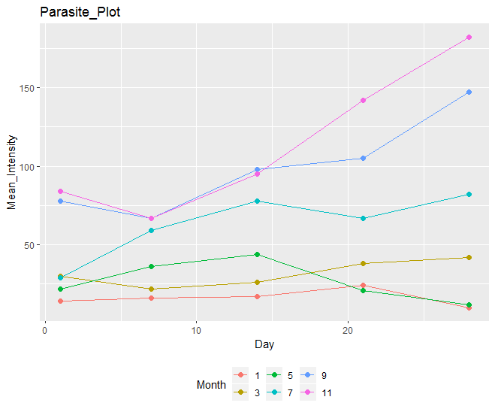
labs(y = "Mean_Intensity")
ggtitle("Parasite_Plot")
geom_point(size = 2)
geom_line(size = 0.6)
labs(x = "Day“)
labs(colour = "Month")

Slide 5
Animate_plot
transition_reveal(Day): lines gradually appearing
aes(group = seq_along(Day)): Point and line groups

Slide 6




