Slide 1
Coral Population in Lian, Batangas in 2009 and 2017
Kathryn R. Jadloc

Slide 2
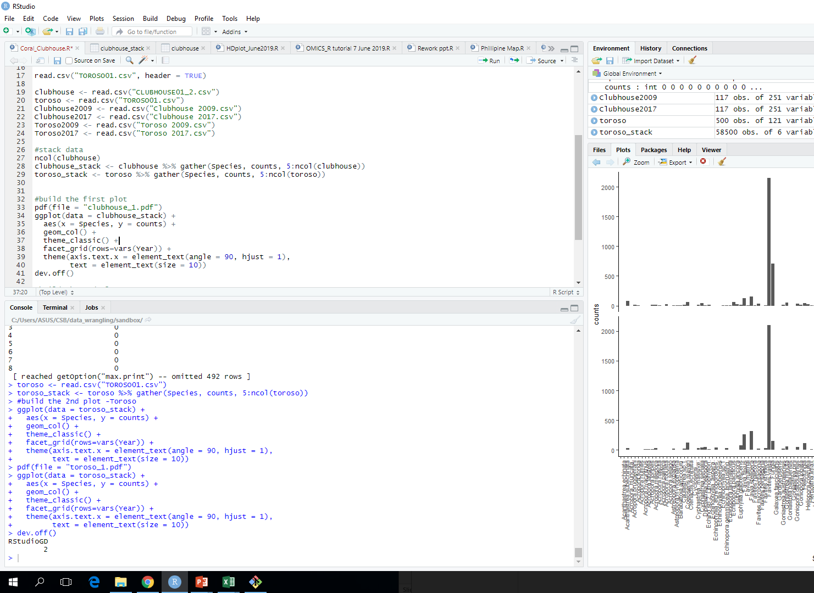

Slide 3
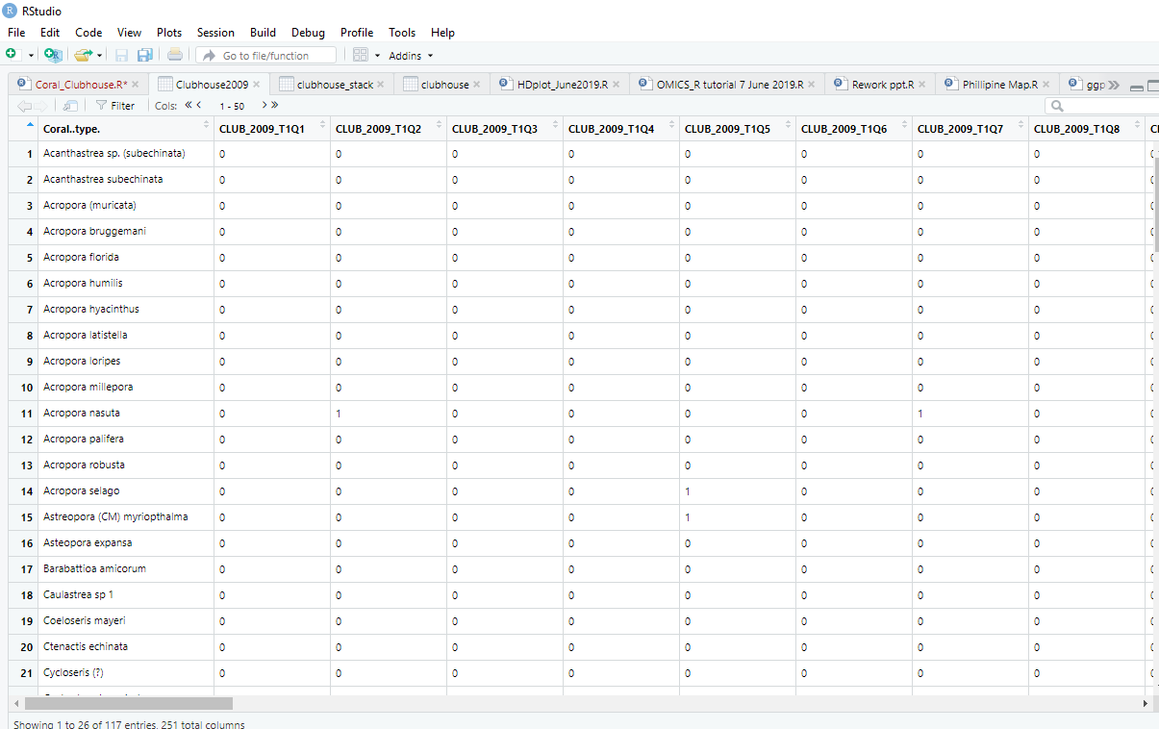

Slide 4
