Slide 1
Stingray Biomarker Data- Enzymatic Reactions from Liver and Bile
Biological Question:
Is there significant correlation among stingray biomarkers?
Hypothesis:
There is significant correlation between stingray biomarkers
Michaela, Rain, & Nichole

Slide 2
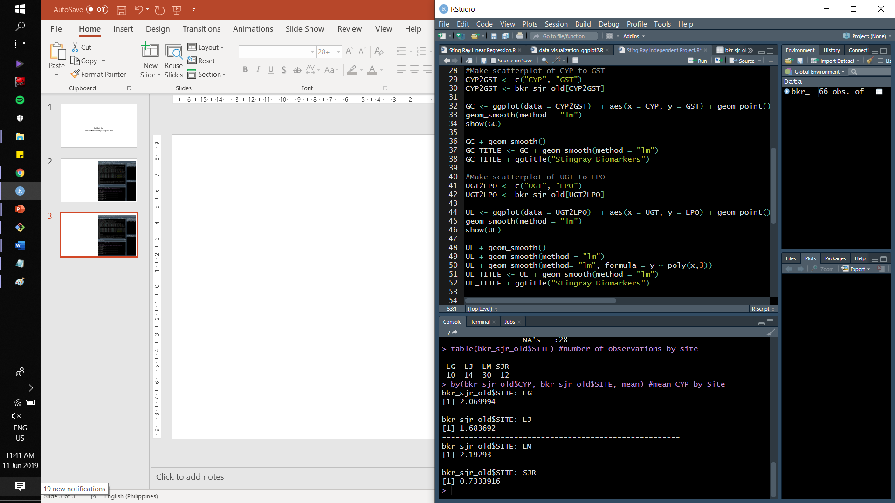
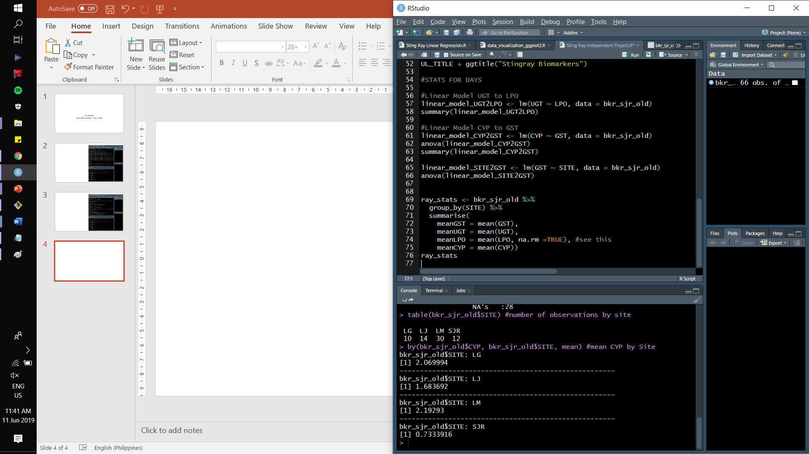
Notes:
Liver detoxification enzymes: CYP, GST, and UGT
Liver cell damage- LPO

Slide 3
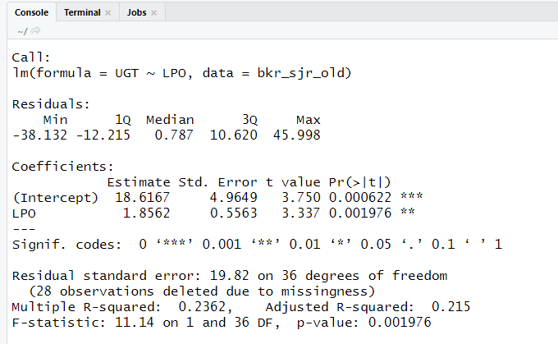
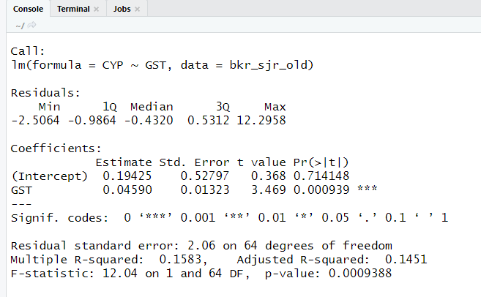




Determining Significance using Linear Regression/ ANOVA
Notes:
P-value is significant (the P-value indicates that there is only a 0.01976% chance that the relationship we found (via the stats function and the graphs) is just coincidental. This means that there is a (1 – 0.01976)% chance that the correlation is real (not by chance). A P-value smaller than 0.05 (there’s a 95% chance the relationship is real and not coincidental) is significant , and 0.001976 is definitely less than 0.05.

Slide 4
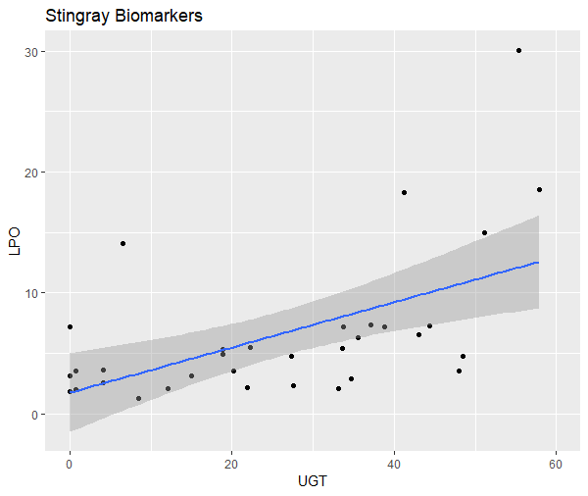
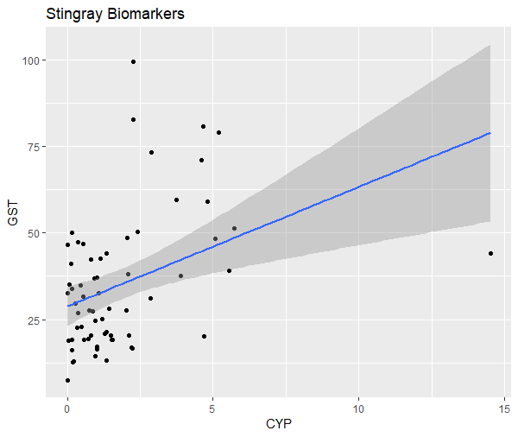


Slide 5
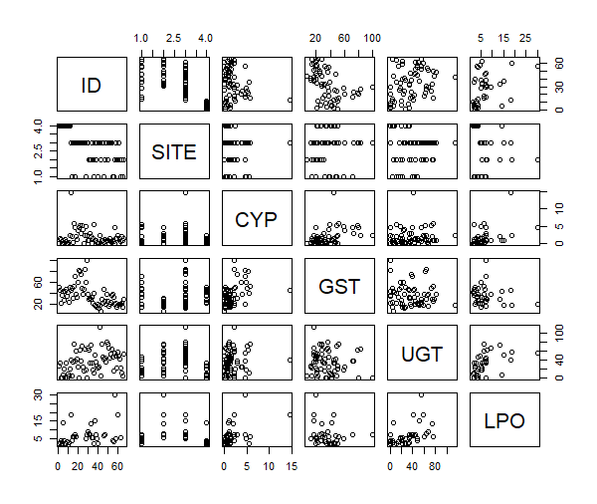
# forfunsies

Slide 6
The End

