Slide 1
Zooxanthellae diversity in Philippine corals: Biogeographic variability in the Pocilloporidae
Andrew F. Torres, Darryl Anthony M. Valino, Rachel Ravago-Gotanco
Marine Science Insitute
University of the Philippines Diliman

Slide 2
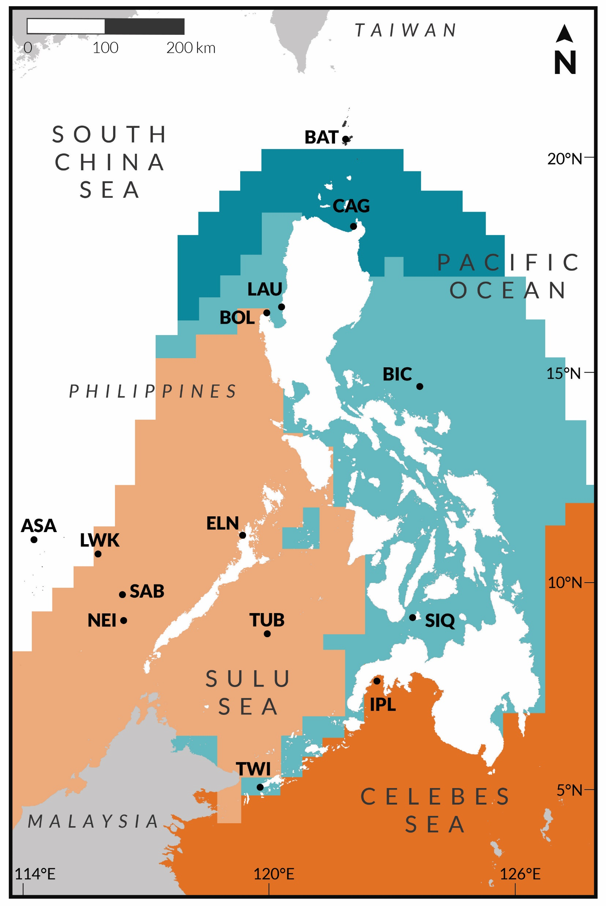
PHL thermal regimes
Peñaflor et al. (2008)
1986-2006 SST data
0.5deg (~50 km) pixels

Slide 3
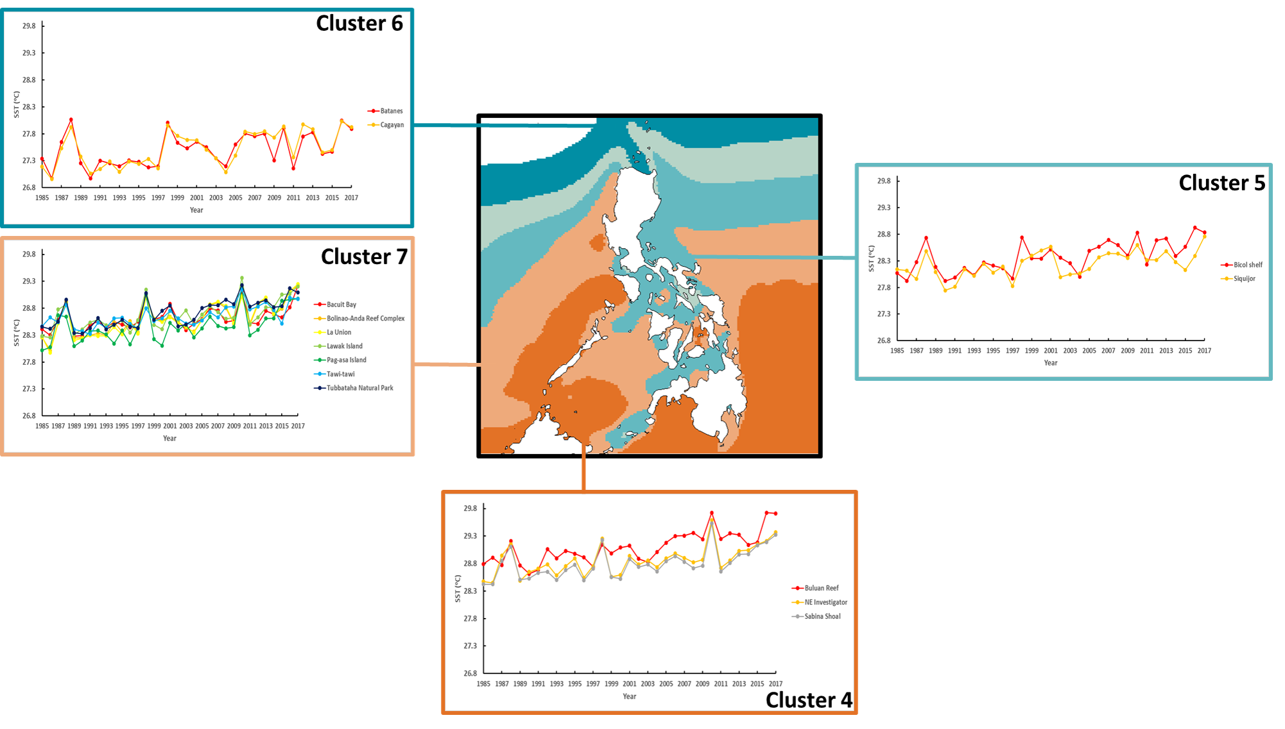
Updated: 1985-2017 5km pixels

Slide 4
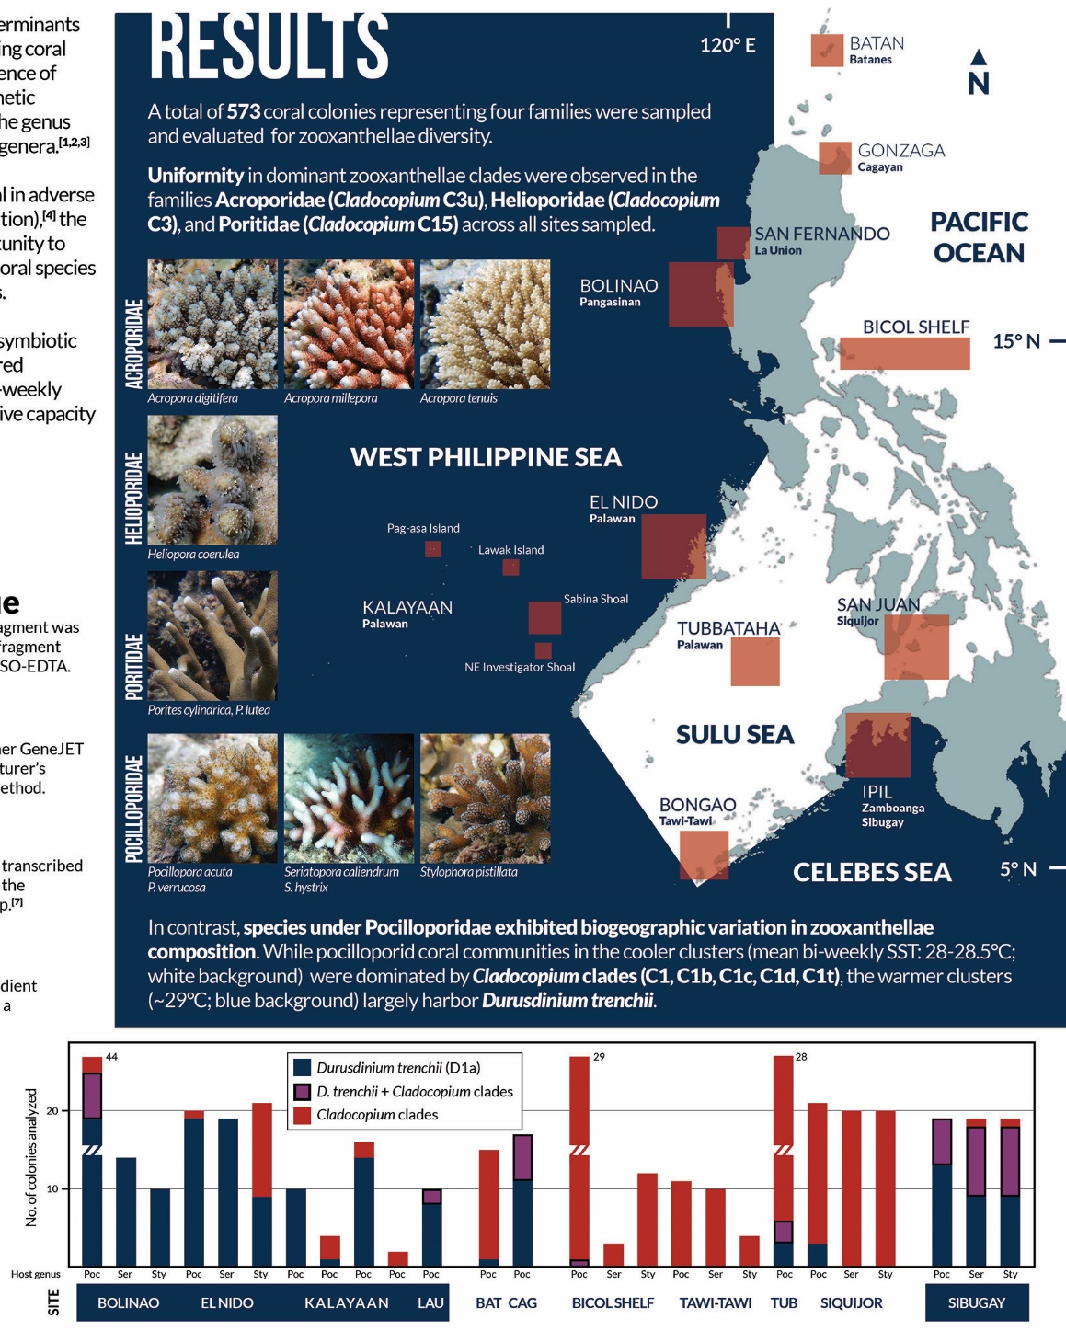
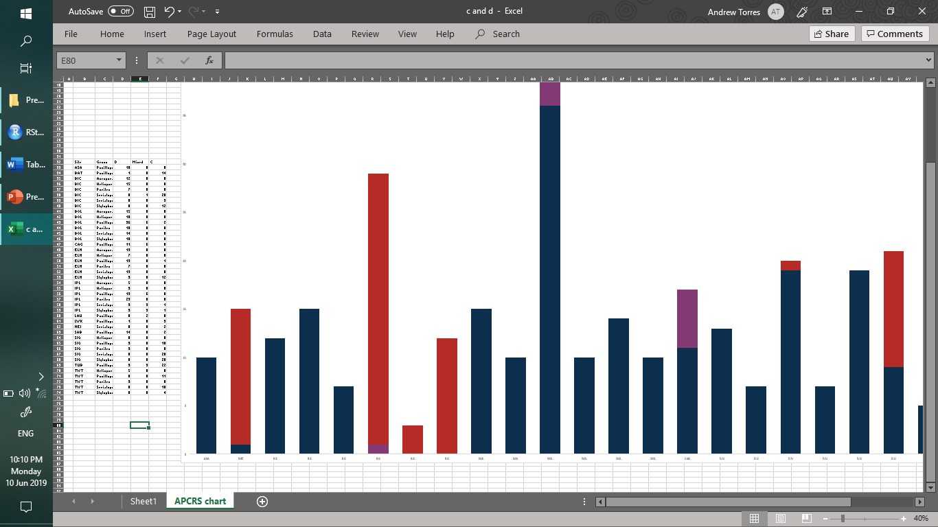
endosymbiotic zooxanthellae diversity across coral families across biogeographic regions

Slide 5
Dataset
Site
Coral family
Coral genus
Zoox species/clades

Slide 6
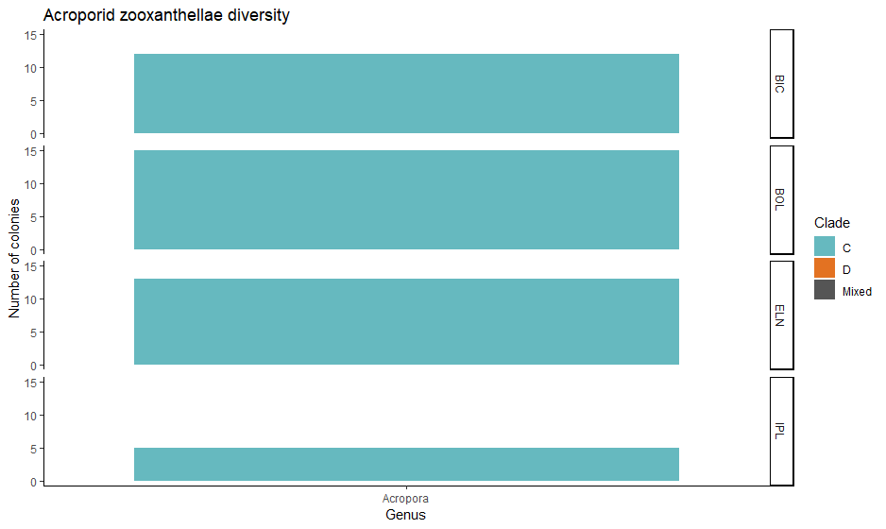
General plot structure

Slide 7
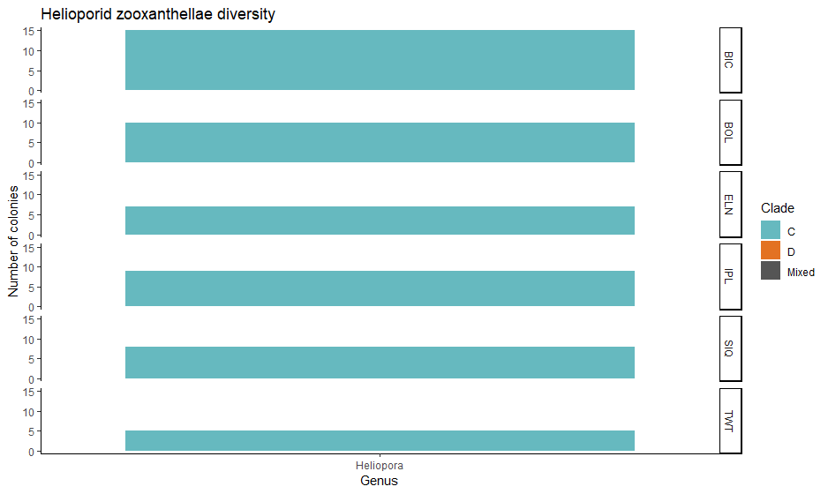
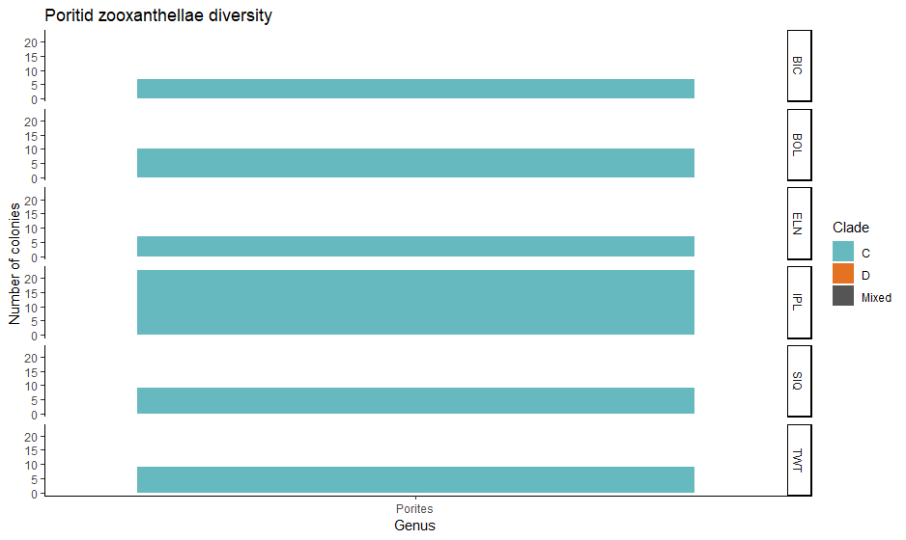
Acroporids Helioporids Poritids

Slide 8
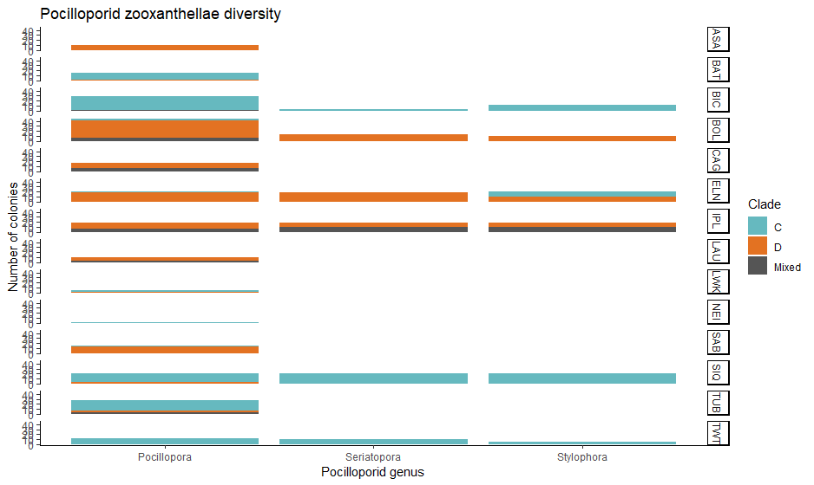
Pocilloporids

