Slide 1
Export data (PSA, 2016)
Year : 1995 -1996
Description: Sea urchin, Scallops, Sea cucumbers,
gK : Gross volume in kilograms
Fob: free on board (USD)

Slide 2
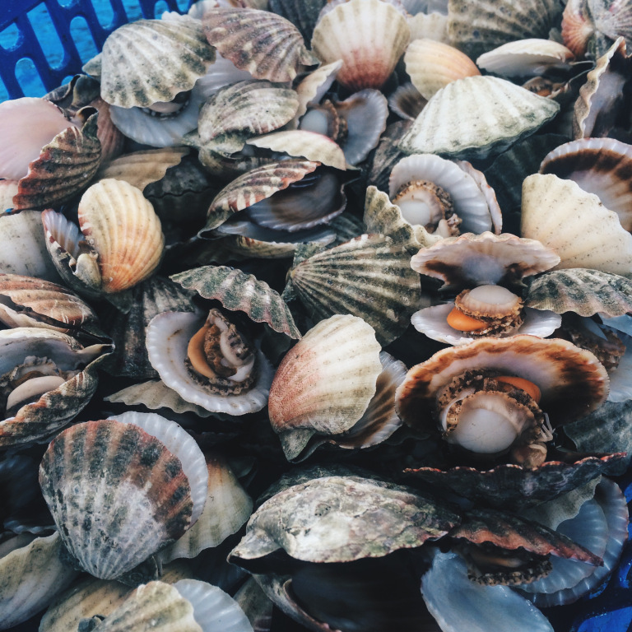
Questions:
What is the total export of scallops over time in the Philippines?
Is there a trend (i.e. increasing/decreasing) over time?

Slide 3
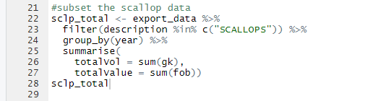
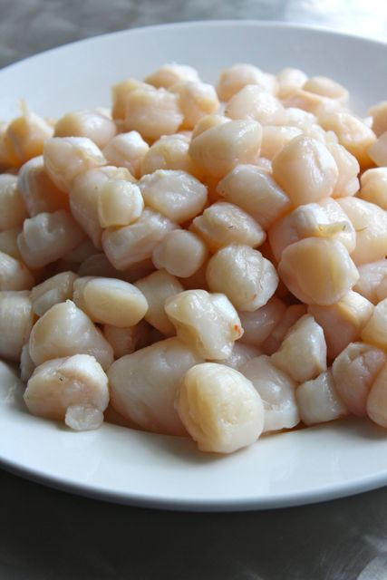
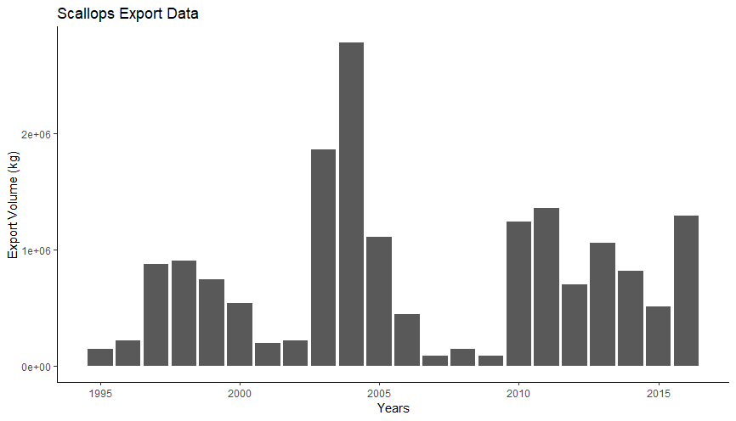

Slide 4
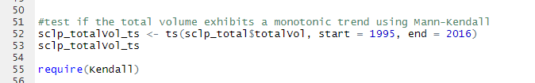
Mann-Kendall Trend Test
Package: Kendall
Kendall’s Tau statistics
“Ho : no trend”
“Ha: monotonic trend”

Slide 5
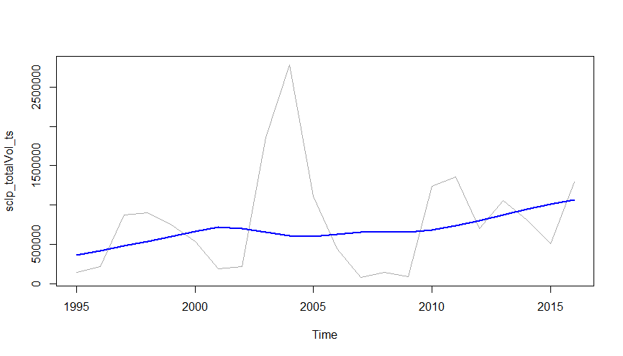
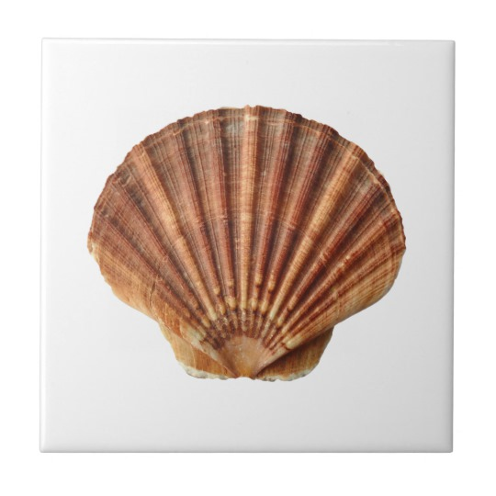
Volume over time…
Kendall’s Tau statistics
“Ho : no trend”
“Ha: monotonic trend”
MannKendall(sclp_totalVol_ts)
tau = 0.134, 2-sided pvalue =0.39759

Slide 6
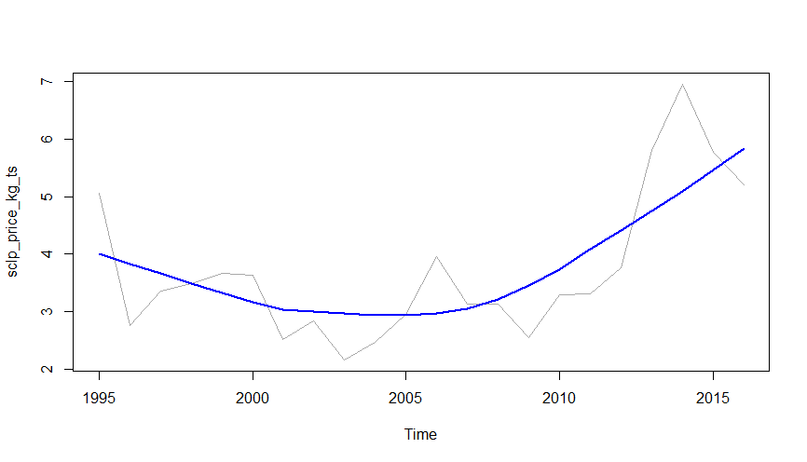
Price over time…
Scallops
MannKendall(sclp_price_kg_ts)
tau = 0.299, 2-sided pvalue =0.05518

Slide 7
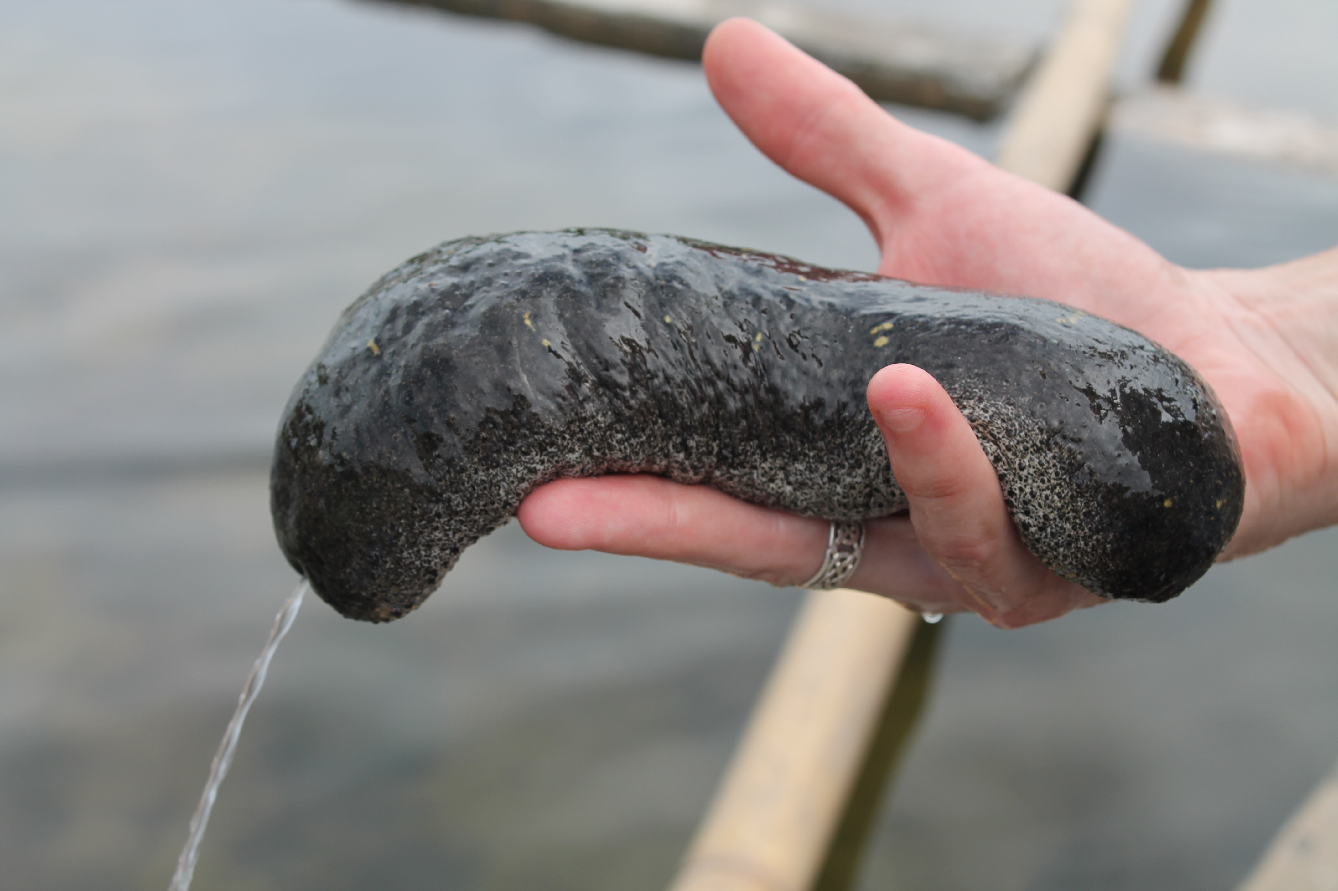
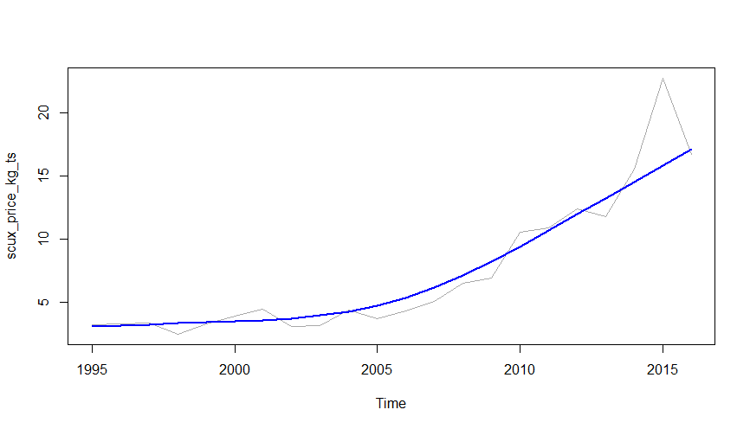
Price over time…
Sea cucumbers
MannKendall(scux_price_kg_ts)
tau = 0.784, 2-sided pvalue =3.5763e-07

