Slide 1
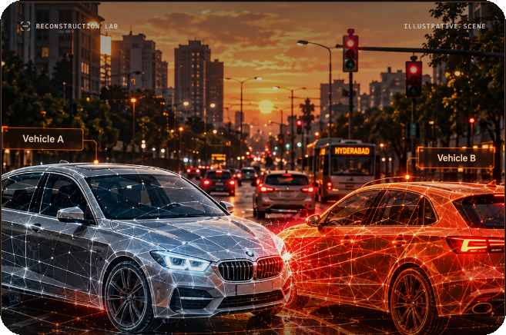
TRACEDRIVE / ROAD ACCIDENT FORENSICS
AI-powered timeline
ILLUSTRATIVE RECONSTRUCTION
reconstruction
for road accident forensics
PROBLEM STATEMENT
Road accident investigations often involve incomplete dashcam footage, conflicting witness statements, and limited information about vehicle movement. Develop a tool that combines multiple sources of evidence to construct a timeline of an incident, identify inconsistencies, and present a traceable reconstruction of what may have happened.
FROM FRAGMENTED EVIDENCE
One clear incident sequence.
VIDEO
+
WITNESS
+
OPTIONAL SENSOR
→
TRACEABLE TIMELINE
A reconstruction that shows what is supported — and what is still unknown.
Evidence first. Every finding traceable.
TRACEDRIVE / EVIDENCE-LED RECONSTRUCTION
01 / 08

Slide 2
WHY THIS MATTERS
Accident evidence is fragmented.
Each source captures only part of the incident — and each has its own limits.
“ ”
01
02
03
VIDEO FOOTAGE
WITNESS ACCOUNTS
SENSOR RECORDS
Partial camera views
Different perspectives
Optional measurements
Occlusion, missing frames and camera angles can hide key moments.
Accounts may disagree and often describe time approximately.
Speed, braking or GPS data may be absent, incomplete or misaligned.
FRAME / VISIBILITY
CLAIM / QUOTE
TIME / VALUE
THE INVESTIGATION GAP
No single source gives the complete, reviewable sequence.
TRACEDRIVE / EVIDENCE-LED RECONSTRUCTION
02 / 08

Slide 3
WHAT WE ARE BUILDING
Five requirements. One connected workflow.
TraceDrive maps each point in the problem statement to a clear product capability.
01
MULTI-SOURCE INGEST
Accept video clips, written witness accounts and optional simulated sensor records.
UPLOAD
02
EVENT & MOVEMENT EXTRACTION
Extract timestamps, visible road users, movement cues and witness claims.
EXTRACT
03
CHRONOLOGICAL TIMELINE
Arrange supported events in incident time while preserving uncertainty.
RECONSTRUCT
04
CONTRADICTIONS & GAPS
Flag comparable disagreements, missing coverage and unverified claims.
COMPARE
05
EVIDENCE TRACEABILITY
Link findings to sources; separate observations, claims, estimates and inferences.
VERIFY
BONUS
Annotated vehicle trajectories — synchronized to the selected incident timestamp.
TRACEDRIVE / EVIDENCE-LED RECONSTRUCTION
03 / 08

Slide 4
LIVE WEBSITE WALKTHROUGH
From case creation to reconstruction.
Follow this sequence while navigating the TraceDrive website.
01
›
02
›
03
›
04
›
05
›
06
CREATE CASE
UPLOAD
PROCESS
TIMELINE
ANALYZE
RECONSTRUCT
Incident details
+ case ID
Video, witness
text, optional CSV
Detect, extract
and parse
Review events
in case-time order
Inspect conflicts
and evidence gaps
Explore paths
and export report
DEMO TIP
Show the same case moving through upload → processing → timeline → findings → 3D replay.
TRACEDRIVE / EVIDENCE-LED RECONSTRUCTION
04 / 08

Slide 5
AI + ENGINEERING
Three engines turn evidence into structure.
YOLO handles object detection; Featherless AI supports frame interpretation and witness-claim extraction.
01
02
03
YOLO
FEATHERLESS AI
RECONSTRUCTION LAYER
OBJECT DETECTION + TRACKING
›
VISION + LANGUAGE MODELS
›
TIME + EVIDENCE LOGIC
Detects vehicles and other road users in sampled video frames, then follows visible objects across frames.
Vision-capable model: selected frames. Language model: witness claims, entities, actions and time expressions.
Aligns source timestamps, compares compatible events, identifies gaps and links findings to original evidence.
VIDEO FRAMES → OBJECT TRACKS
FRAMES / TEXT → STRUCTURED OUTPUT
EVENTS → TIMELINE + FINDINGS
SUPPORTING PIPELINE
FFmpeg / OpenCV
→
Frame extraction
→
Time alignment + rule checks
→
Evidence-linked output
The specification does not name exact Featherless model IDs; use the selected models that explicitly support image or text input.
TRACEDRIVE / EVIDENCE-LED RECONSTRUCTION
05 / 08

Slide 6
CORE EXPERIENCE
The timeline makes every event reviewable.
Choose an event, inspect the source, then compare it with other available evidence.
ILLUSTRATIVE CASE TIMELINE
CASE TIME / APPROXIMATE
FINDING PREVIEW
10:02:10
Vehicle A approaches junction
APPARENT CONFLICT / REVIEW
OBSERVATION
CCTV / frame reference
Entry-order
disagreement
~10:02:11
Witness 1 says Vehicle A entered first
WITNESS CLAIM
Statement / quoted passage
The two witness accounts describe a different order of entry.
10:02:12
Camera view is partly obstructed
COVERAGE GAP
CCTV / visibility warning
~10:02:13
Witness 2 says Vehicle B entered first
WHY IT NEEDS REVIEW
WITNESS CLAIM
Statement / quoted passage
Check vehicle identity, camera visibility and time alignment before calling this a direct contradiction.
Every item links to a frame, quote or sensor row.
TRACEDRIVE / EVIDENCE-LED RECONSTRUCTION
06 / 08

Slide 7
BONUS FEATURE
Vehicle movement — visual, synchronized, qualified.
The reconstruction follows incident time while showing which path segments are observed or estimated.
ANNOTATED VEHICLE TRAJECTORIES
SYNCHRONIZED REPLAY
01
SCROLL OR SELECT
Moves the shared incident timestamp.
02
OBSERVED / ESTIMATED
Dashed segments identify inferred movement.
?
POSSIBLE CONTACT REGION
03
EVIDENCE SUPPORT
Detection, tracking, time and path quality.
A
B
04
SOURCE LINKS
Jump from a segment to its supporting evidence.
OBSERVED
ESTIMATED
SCHEMATIC VIEW / NOT TO SCALE
No calibration? Show relative movement — not invented speed or distance.
TRACEDRIVE / EVIDENCE-LED RECONSTRUCTION
07 / 08

Slide 8
THE OUTCOME
A clearer view of
01
SUPPORTED SEQUENCE
Chronological events with source references.
what happened.
02
CONFLICTS & GAPS
TraceDrive turns fragmented road-accident evidence into a source-linked timeline and an uncertainty-aware reconstruction.
Disagreements, missing coverage and open questions.
03
ALTERNATIVE HYPOTHESES
More than one scenario when evidence is incomplete.
OUR PRINCIPLE
Evidence first. Every finding traceable.
04
INVESTIGATION REPORT
Evidence inventory, limits and unresolved items.
OBSERVATIONS ≠ CLAIMS
CONFIDENCE ≠ FAULT PROBABILITY
NO INVENTED SENSOR DATA
INVESTIGATION SUPPORT — NOT A LEGAL VERDICT.
What is supported. What conflicts. What remains unknown.
TRACEDRIVE / EVIDENCE-LED RECONSTRUCTION
08 / 08

