Slide 1
CBIT HACKTOBERFEST '26 • OFFICIAL PITCH DECK
ResuArchitect AI
Local-First ATS Resume Architect & Deterministic Tailoring Studio
A zero-database, privacy-preserving resume engineering platform featuring sub-2ms deterministic match scoring, an algorithmic Truth Guard against hallucinations, and certified dual OpenXML/PDF exports.
100% LOCAL-FIRST
Candidate profile data lives in localStorage. Zero cloud DB, zero server data retention.
SUB-2MS MATCH SCORING
Deterministic 500-skill taxonomy. Mathematical evidence model (1.0x bullet vs 0.6x skills).
ALGORITHMIC TRUTH GUARD
Deterministic static regex & set-difference linter. Catches metric drift, sign flips & fake tools.
DUAL ATS EXPORTS
One-click native Word .docx (Heading 1/2, tab stops, 0 tables) + searchable vector A4 PDF.
Team Red flowers (TEAM-4) | Registration ID: HFEST26-2P5XJ82R | IIIT Hyderabad (IIIT-H)
Lead: Nawander Raghavendra (rnn.2777@gmail.com) • Nara Lakshmi Sankeerth • Navneet

Slide 2
01 / PROBLEM STATEMENT
Over 75% of Qualified Candidates Are Silently Filtered Out
Applicant Tracking Systems (Workday, Taleo, Greenhouse, Lever, Ashby) fail candidates across three technical bottlenecks.
1. THE PARSING TRAP
CSS Tables & Floating Canvases
Resumes generated on Canva or graphic builders use CSS columns, nested tables, and SVG badges.
When processed by linear ATS extractors, words are read across columns, scrambling chronological job history, contact info, and bullet points into unreadable character soup.
2. THE KEYWORD GAP
Blind Alignment & Missing Taxonomy
Candidates fail to match the exact canonical terminology and priority tiers demanded by recruiters.
Must-Have requirements and Preferred qualifications are indistinguishable to applicants, causing automated filter rejection despite real-world competence.
3. THE HALLUCINATION HAZARD
Unbounded Generative AI
Generic chatbots (ChatGPT wrappers) hallucinate accomplishments, inflate metrics (e.g. 'boosted revenue by $10M'), and invent unused tools.
Candidates are disqualified during technical interviews for claims they cannot defend, while candidate PII is leaked to cloud databases.
RESUARCHITECT AI • TEAM RED FLOWERS (TEAM-4) • CBIT HACKTOBERFEST '26
SLIDE 02 / 12

Slide 3
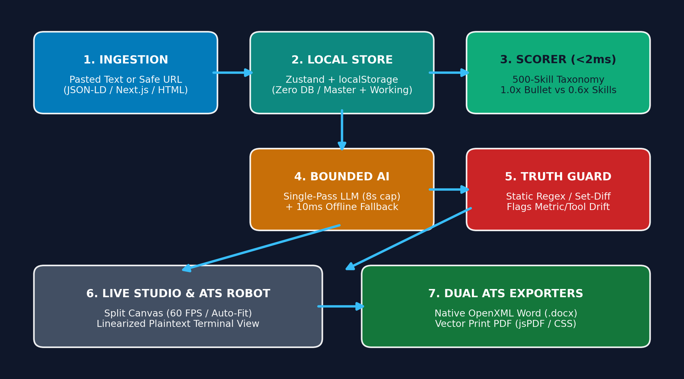
02 / SYSTEM ARCHITECTURE
End-to-End System Topology & Data Flowchart
A local-first browser core orchestrated with a bounded, stateless serverless proxy.
LOCAL STATE & ZERO DB
Candidate Master Profile resides 100% in browser localStorage. No database setup, no data leaks, complete client-side data residency.
BOUNDED GENERATIVE CO-PILOT
Single-turn LLM call capped at 8s. Contact info (email/phone/links) stripped before transit. Automatic 10ms offline heuristic fallback.
DUAL AST COMPILERS
Generates true OpenXML .docx with Heading 1/2 & right-aligned tab stops (0 tables) and vector print A4 PDF with selectable text.
RESUARCHITECT AI • TEAM RED FLOWERS (TEAM-4) • CBIT HACKTOBERFEST '26
SLIDE 03 / 12

Slide 4
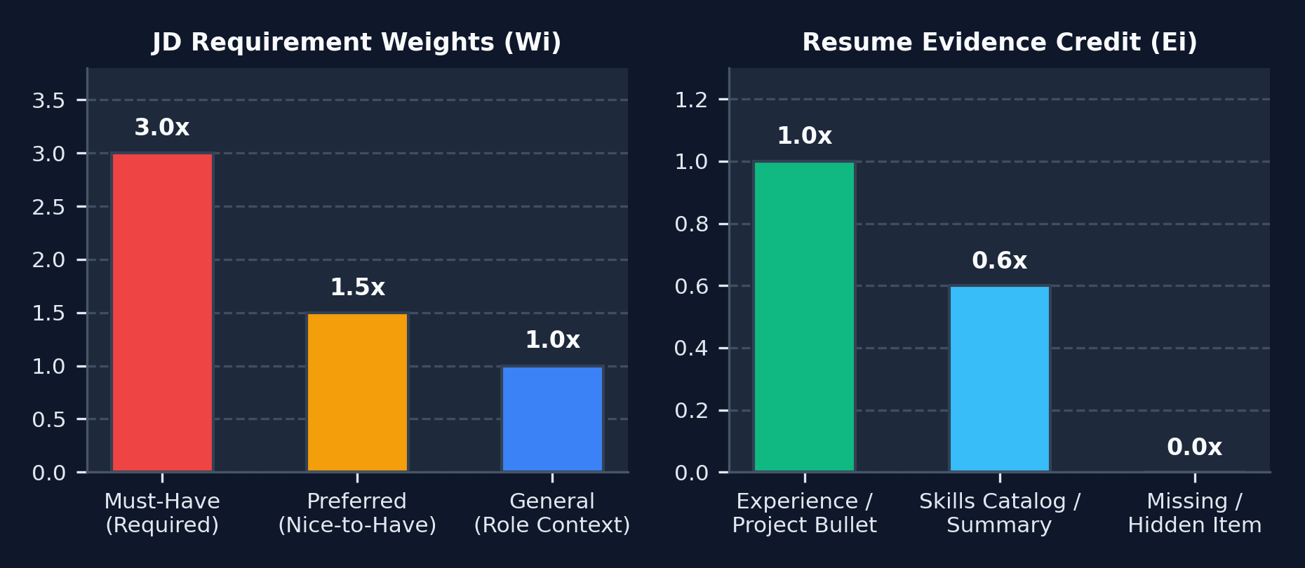
03 / MATHEMATICAL SCORING
Sub-2ms Deterministic Scorer: Math Replaces LLM Drift
100% reproducible, explainable coverage calculation based on evidence placement and priority weights.
EMPIRICAL COVERAGE FORMULA
Score (%) = min( 100, round( [ Σ (Wi × Ei) / Σ Wi ] × 100 ) )
Where:
• Wi = Requirement Priority Weight (Must-Have = 3.0, Preferred = 1.5, General = 1.0)
• Ei = Evidence Credit Score achieved by the candidate for skill i
Evidence Placement Tiers:
• 1.0x Full Credit: Skill demonstrated in Experience / Project bullets.
• 0.6x Partial Credit: Skill listed only in Skills catalog or Summary.
• 0.0x Zero Credit: Missing keyword gap or hidden bullet.
Greedy Span Subsumption:
Longest skill phrases match first. Matches are tracked by character range [start, end] so compound skills ('Spring Boot') never trigger false substring matches ('Spring').
BENCHMARK PERFORMANCE VERIFICATION
• Client-Side Execution Latency: < 2.0 ms (Node / V8 engine benchmark: p50 = 0.28ms, p95 = 0.43ms)
• Zero API Costs: Runs locally as candidate types at 60 FPS ($0.00 token cost)
• Strictly Idempotent: f(f(x)) === f(x) with zero scoring drift across runs
• Labeled 'JD Coverage Estimate' — not a deceptive ATS pass guarantee
RESUARCHITECT AI • TEAM RED FLOWERS (TEAM-4) • CBIT HACKTOBERFEST '26
SLIDE 04 / 12

Slide 5
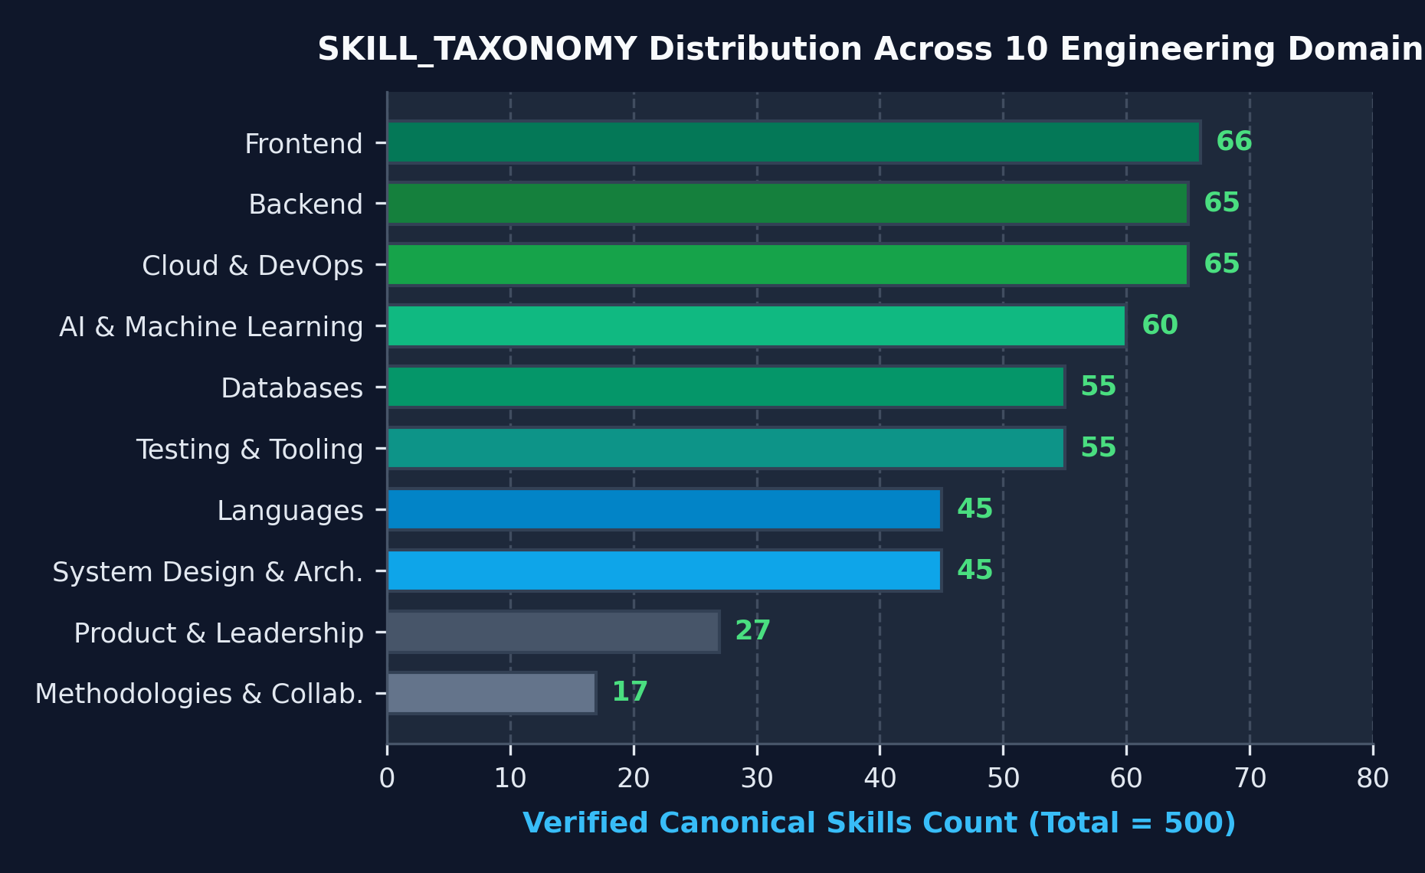
04 / TAXONOMY & ALIASES
500 Curated Tech Skills Across 10 Engineering Domains
Built-in bidirectional alias dictionary normalizes abbreviations, acronyms, and frameworks.
BIDIRECTIONAL ALIAS MAPPINGS
150+ Industry Shorthands Normalized to Canonical Form:
• K8s, kube, k8 ➔ Kubernetes
• postgres, pgsql, postgres db ➔ PostgreSQL
• js, ecmascript, es6, es6+ ➔ JavaScript
• ts, typed javascript ➔ TypeScript
• aws, amazon web services ➔ AWS
• gcp, google cloud platform ➔ Google Cloud Platform
• reactjs, react.js, react js ➔ React
• golang, go-lang ➔ Go
• cplusplus, cpp ➔ C++
• csharp, c-sharp ➔ C#
Edge-Case Token Boundaries:
Enforces lookaround assertions so 'C' doesn't trigger on 'C++', and 'Go' doesn't match normal English verbs unless capitalized in technical context.
RESUARCHITECT AI • TEAM RED FLOWERS (TEAM-4) • CBIT HACKTOBERFEST '26
SLIDE 05 / 12

Slide 6
05 / ANTI-HALLUCINATION GATE
Algorithmic Truth Guard: Deterministic Code Intercepts AI
Static analysis pipeline audits all AI suggestions against Master Profile facts before user review.
1. GROUNDED FACT HARVESTING
Master Profile Fact Vectors
Extracts complete Sets of canonical tools (facts.tools), numbers (facts.numbers), and exact normalized metrics (facts.metricsExact) from the candidate's verified profile.
2. SIGN-FLIP & DECIMAL LINTER
Precision Drift Detection
Regex isolates signed numeric tokens (/[+-]?$?_x0008_\d+(\.\d+)?%/gi). Detects sign inversions (20% to -20%) and decimal precision tampering (99.9% to 99.99%).
3. TOOL WHITELIST AUDIT
Set-Difference Detection
Extracts technical skills from proposed rewrite. If any detected tool does NOT exist in Master Profile, it is immediately flagged as an unverified tool claim.
4. QUALITATIVE CLAIM LINTER
Unbacked Seniority Guard
Scans for 'architecture', 'reliability', 'test coverage', and 'proven track record'. Verifies supporting evidence exists in candidate history before approval.
TRUTH GUARD CLASSIFICATION STATES & UI BADGING
• [VERIFIED GROUNDED] (Green Shield): All tools, metrics, and numbers match verified master profile history. Safe to apply.
• [NEEDS CONFIRMATION] (Amber Shield): Injected JD keyword or altered metric not found in Master Profile. Explicit candidate confirmation required.
• [BREVITY ALERT]: Proposed text exceeds 180 characters, risking page-2 overflow. Flagged for concise editing.
RESUARCHITECT AI • TEAM RED FLOWERS (TEAM-4) • CBIT HACKTOBERFEST '26
SLIDE 06 / 12

Slide 7
06 / GENERATIVE CO-PILOT
Bounded AI Tailoring & Single-Bullet Google XYZ Co-Pilot
Combines single-pass LLM prompts with a 10ms offline heuristic fallback engine.
BOUNDED AI EXECUTION MODEL
Single-Turn Bounded Inference (/api/tailor):
• 8-second hard timeout guard (AbortSignal.timeout(8000))
• PII Anonymization: Strips name, email, phone, location & social links before prompt serialization
• Temperature 0.2 with strict JSON-mode schema validation
• Drops hallucinated bullet IDs that do not exist in Master Profile
Single-Bullet Co-Pilot (/api/optimize-bullet):
• Dedicated per-bullet optimization with 7-second timeout
• 409 Conflict Stale-Edit Protection: Rejects rewrites if bullet was modified in editor during generation
100% Offline Heuristic Fallback (heuristicTailor.ts):
• Zero API key requirement — works 100% offline out-of-the-box
• Sharpens weak verbs ('helped with' ➔ 'Architected', 'Engineered')
• Weaves verified role technologies naturally into bullet endings
• Returns structured diffs with Truth Guard badges in <10ms
GOOGLE XYZ FORMULA & REAL SCORE DELTA
Formula: 'Accomplished [X], as measured by [Y], by doing [Z]'
[X] Accomplished: Strong action verb + core engineering outcome
[Y] Measured By: Quantifiable scale, latency drop, or efficiency gain
[Z] By Doing: Technical implementation & verified tool stack
Before (Weak passive bullet):
'Worked on customer dashboard and helped with database speed.'
After (Optimized Google XYZ):
'Architected real-time customer analytics dashboard, cutting p95 query latency from 320ms to 95ms by indexing PostgreSQL tables and implementing Redis caching.'
Dynamic Real Score-Delta Calculation:
Constructs hypothetical resume in-memory with rewritten bullet, computes:
Δ = max( 0, Score(hypothetical) - Score(current) )
Diff Card displays real mathematical bump: '+6% Coverage'.
RESUARCHITECT AI • TEAM RED FLOWERS (TEAM-4) • CBIT HACKTOBERFEST '26
SLIDE 07 / 12

Slide 8
07 / DOCUMENT GENERATION
Dual ATS Export Pipeline: Native OpenXML & Vector PDF
Structural document compilers eliminate nested tables, unparseable frames, and image rasterization.
NATIVE OPENXML WORD (.DOCX)
Compiled via 'docx' npm Library directly from AST:
• True Semantic Hierarchy:
- Candidate Name: HeadingLevel.HEADING_1
- Section Titles: HeadingLevel.HEADING_2 with single bottom border
• Right-Aligned Tab Stops (TabStopPosition.MAX / 9000 twips):
Aligns dates and locations flush-right on the same line as job titles without using a single HTML or Word table.
• Native Bullet Runs (bullet: { level: 0 }):
Uses standard Word bullet nodes rather than asterisks or unicode symbol hacks.
• Clickable ExternalHyperlink Nodes:
Preserves complete destination URLs for GitHub, LinkedIn, and live project demos.
• Zero Tables, Zero Text Boxes: 100% ATS parser compliant.
NATIVE VECTOR PRINT PDF (.PDF)
Compiled via 'jsPDF' & Isolated @media print CSS:
• Selectable Vector Text Layer:
Writes character streams directly into PDF (%PDF-) using standard Helvetica/Times. Text is 100% searchable, copyable, and readable by commercial ATS.
• 1-Page Auto-Fit Dynamic Constraint Engine:
Measures scrollHeight against standard A4 height (297mm ≈ 1122.5px at 96 DPI). When 1-Page Fit is active:
- Font scale clamped dynamically (9.5pt to 11.5pt)
- Margins compressed (19.0mm ➔ 12.7mm compact)
- CSS variables clamp --section-gap (1rem ➔ 0.5rem) and --bullet-gap (0.35rem ➔ 0.2rem)
• Automatic Multi-Page Overflow Protection:
If content exceeds 297mm, clean page breaks (break-inside: avoid) add page 2 instead of clipping bullets.
RESUARCHITECT AI • TEAM RED FLOWERS (TEAM-4) • CBIT HACKTOBERFEST '26
SLIDE 08 / 12

Slide 9
08 / SECURITY & SCRAPER
Enterprise Job Scraper with 5-Layer SSRF Protection
Safely parses complex career portals (Microsoft, Workday, Greenhouse, Lever) without security risks.
TIER 1: JSON-LD JOBPOSTING
Structured Schema Extractor
Extracts <script type='application/ld+json'> objects with @type: 'JobPosting'. Bypasses all DOM clutter, tracking scripts, and cookie banners to retrieve title, company, location, and clean requirements.
TIER 2: NEXT.JS HYDRATION
State Props Extractor
Extracts job descriptions embedded inside <script id='__NEXT_DATA__'> pageProps on modern React/Next.js career boards before client-side hydration occurs.
TIER 3: SEMANTIC DOM REPAIR
Structural Header Repair
Converts <strong> and <h1>-<h6> headings to markdown ('### Heading') and <li> to '• ' before stripping tags. Runs repairExtractedText() to rescue glued headers.
5-LAYER SERVER-SIDE REQUEST FORGERY (SSRF) SHIELD
1. Protocol & Port Whitelist: Restricts to HTTP/HTTPS on ports 80, 443, 8080, 8443 (blocks file://, ftp://, gopher://).
2. Credential Stripping: Rejects URLs containing embedded user authentication (user:pass@host).
3. Hostname & Wildcard DNS Blacklist: Blocks localhost, internal TLDs (.local, .internal), cloud metadata (169.254.169.254), and wildcard DNS aliases (.nip.io, .sslip.io, .localtest.me).
4. Deep IPv6 Tunneling Defense: Parses 8 16-bit groups to block 6to4 (2002::/16), NAT64 (64:ff9b::/96), and Teredo (2001:0000::/32).
5. DNS Pinning Socket Transport (fetchPinned): Resolves DNS once via dns.promises.lookup, validates public IP, and hard-pins socket connection to prevent Time-of-Check to Time-of-Use DNS rebinding race conditions. Strict 5-second timeout and 1MB stream cap.
RESUARCHITECT AI • TEAM RED FLOWERS (TEAM-4) • CBIT HACKTOBERFEST '26
SLIDE 09 / 12

Slide 10
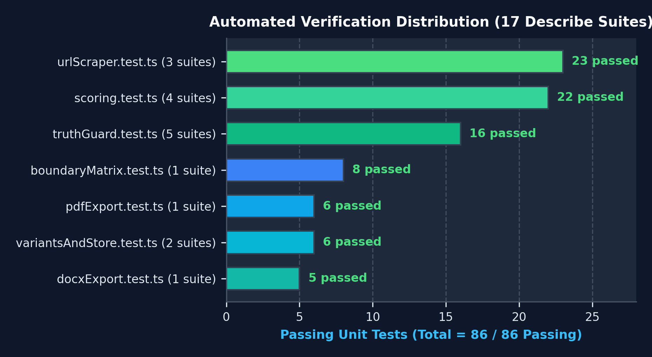
09 / PRODUCTION VERIFICATION
Autonomous Test Suite: 86 / 86 Tests Passing (100%)
Comprehensive test harness verifies mathematical boundaries, security, and document generation.
TEST SUITE BREAKDOWN (17 DESCRIBE BLOCKS)
• urlScraper.test.ts (23 tests)
SSRF IPv4/IPv6 blocks, 6to4/NAT64, DNS pinning, JSON-LD, anti-bot detection.
• scoring.test.ts (22 tests)
500-skill taxonomy, alias mapping, span subsumption, 1.0x vs 0.6x weighting.
• truthGuard.test.ts (16 tests)
Tool whitelists, metric precision, sign-flips (-20%), qualitative claim rules.
• boundaryMatrix.test.ts (8 tests)
Null bytes, 25,000 char strings, empty resumes, unicode/emojis in PDF/DOCX.
• pdfExport.test.ts (6 tests)
Vector %PDF- headers, A4 page margins, multi-page overflow page addition.
• variantsAndStore.test.ts (6 tests)
Section normalization, bullet/item hiding, 20-variant storage limits.
• docxExport.test.ts (5 tests)
OpenXML binary PK headers, Heading 1/2, tab stop twips, zero nested tables.
Execution Time: < 600ms via tsx / vitest • 0 Failures • Clean Next.js 14 Build
RESUARCHITECT AI • TEAM RED FLOWERS (TEAM-4) • CBIT HACKTOBERFEST '26
SLIDE 10 / 12

Slide 11
10 / COMPETITIVE ANALYSIS
Competitive Advantage: ResuArchitect AI vs Existing Market
Why existing resume generators and chatbot wrappers fail modern job seekers.
Evaluation Dimension | ResuArchitect AI (Ours) | Traditional Builders (Canva/Novo) | Generic AI (ChatGPT Wrappers)
Match Scoring Engine | Deterministic TypeScript (<2ms) 1.0x Bullet vs 0.6x Skills math | None (Blind keyword guessing) or opaque percentages | Flaky LLM prompt evaluation (±20% drift across identical runs)
Anti-Hallucination Gate | Algorithmic Code Truth Guard Flags metric drift & ungrounded tools | N/A (Manual human entry only) | Unbounded hallucinations (Fabricates tools, metrics & titles)
ATS Export Compliance | Certified Single-Column OpenXML .docx (tab stops) + Vector PDF | Fails ATS (Multi-column CSS, tables, text boxes, canvas rasters) | Broken exports or locked behind $29/month subscription paywalls
Data Privacy & Storage | 100% Local-First (Zero DB) Candidate PII redacted before AI call | Sells candidate resume data to recruiter databases and aggregators | Full candidate PII transmitted to and stored in cloud databases
Offline Resilience | 100% Offline Heuristic Engine (Never crashes if API key missing) | Requires active internet session | Complete failure / 500 error if external LLM API limits or drops
RESUARCHITECT AI • TEAM RED FLOWERS (TEAM-4) • CBIT HACKTOBERFEST '26
SLIDE 11 / 12

Slide 12
CONCLUSION & SUBMISSION
Tailor for the role. Keep the evidence.
ResuArchitect AI delivers mathematical certainty, certified ATS compliance, and privacy by design.
LOCAL-FIRST PLATFORM
Next.js 14 App Router, Zustand, Tailwind CSS. Zero cloud database, zero candidate PII ingress.
DETERMINISTIC ENGINE
500-skill taxonomy, 150+ aliases, <2ms greedy span subsumption, empirical evidence weighting.
ALGORITHMIC TRUTH GUARD
Deterministic static analysis intercepting fabricated numbers, precision drift, and unverified tools.
CERTIFIED DUAL EXPORTS
Native OpenXML Word .docx (Heading 1/2, right tabs, 0 tables) + searchable vector A4 PDF.
TEAM RED FLOWERS (TEAM-4) • CBIT HACKTOBERFEST '26 SUBMISSION
• Repository: github.com/rnn27/HFT26-TEAM-4 ➔ cbitosc/HFT26-TEAM-4
• Team Members: Nawander Raghavendra (Lead), Nara Lakshmi Sankeerth, Navneet | IIIT Hyderabad (IIIT-H)
• Verification Status: 86 / 86 tests passing (100% pass rate) | Clean Next.js 14 production build
• Included Documentation: docs/ARCHITECTURE.md, docs/ResuArchitect_AI_Project_Guide.pdf, docs/presentation.marp.md

