Slide 1
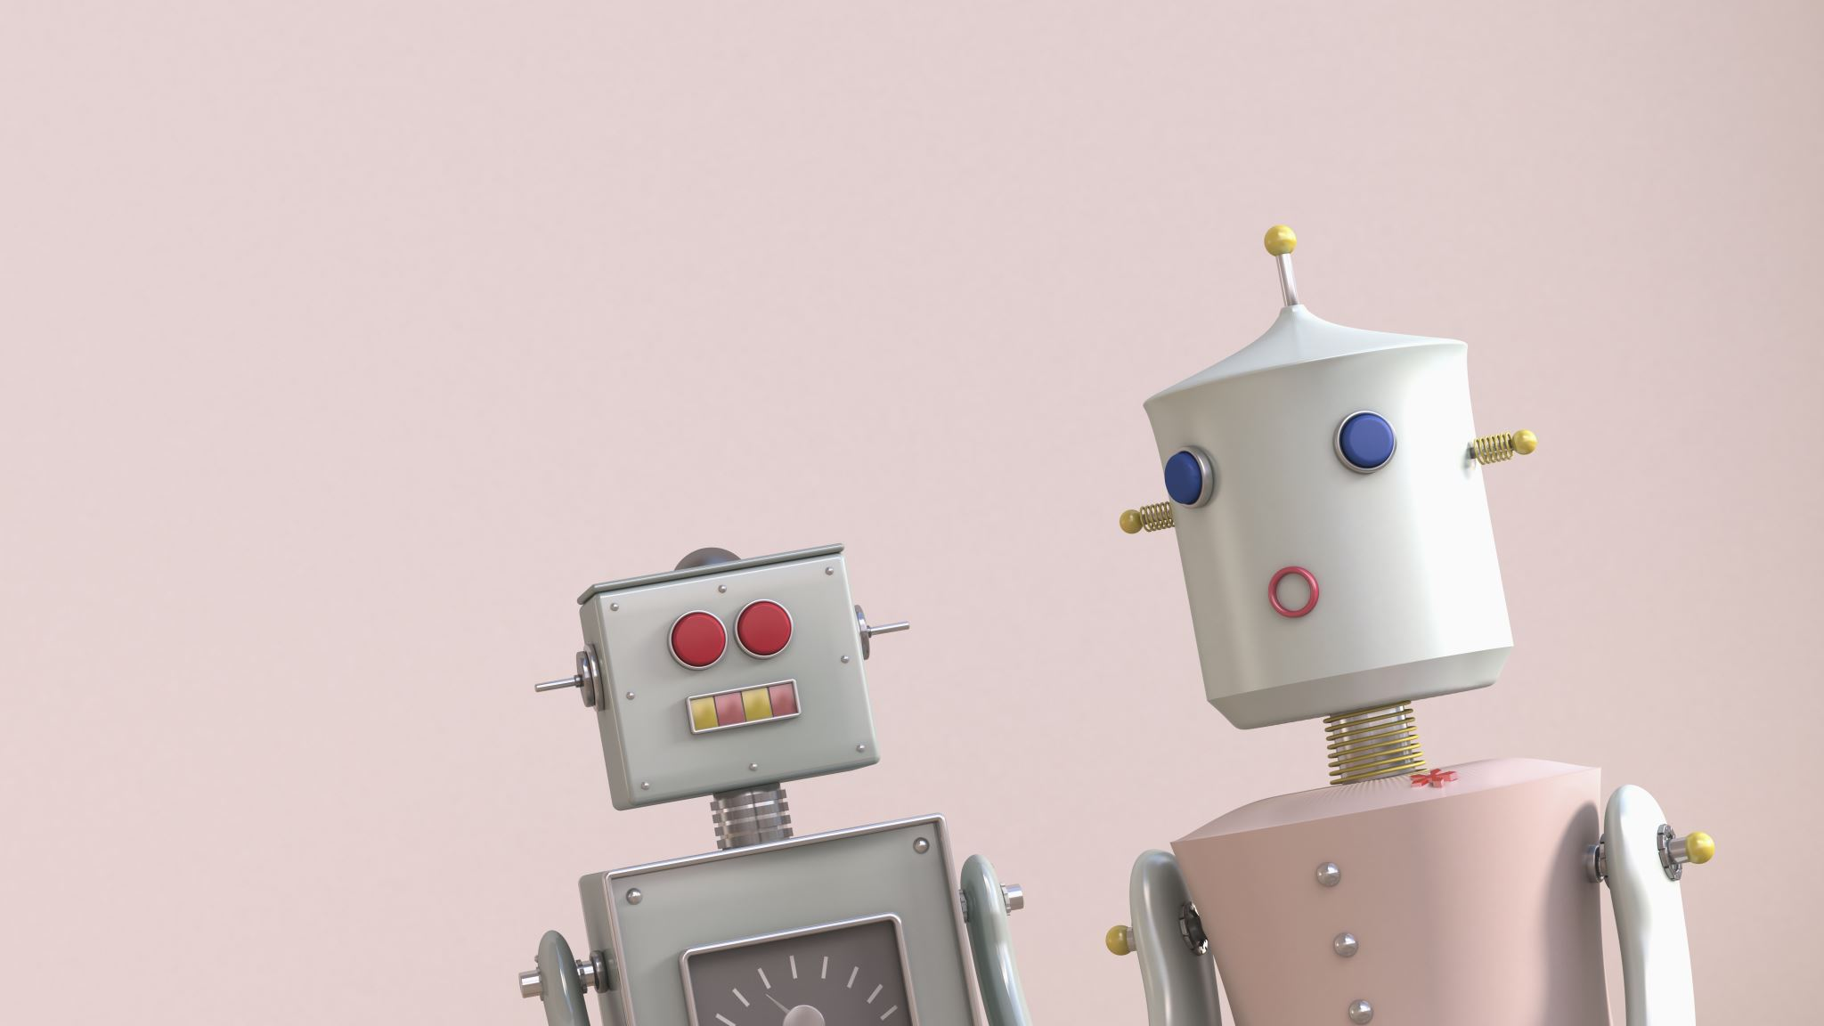
CBIT ChatBot

Slide 2

What is ChatBot?
Chat Robot, a computer program that simulates human conversation, or chat.
Typically, a chat bot will communicate with a real person.

Slide 3
Why ChatBot in CBIT?
👉 The student or visitor has lots of queries which can be easily answered by CHATBOT.
👉 The CHATBOT helps to save the time of the student or the visitor.
👉 The CHATBOT provides a user friendly platform, where the people can directly ask the questions.

Slide 4
What is NLTK?
Natural Language Toolkit
is a leading platform for building Python programs to work with human language data.
NLTK has been called “a wonderful tool for teaching and working in, computational linguistics using Python,” and “an amazing library to play with natural language.”

Slide 5
Role of NLTK in ChatBot?
If your chatbot is facing a significant amount of questions, and responding poorly, NLP can serve as an outstanding method for delivering superior answers more consistently.

Slide 6
Thank you

