Slide 1


Slide 2
Description
An application which maintains a centralized database of the location, time and casualties when an accident has occurred.
From this database, nearby hospitals, police stations, and ambulances are notified about the same.

Slide 3

Alert360
Notes:
Ss of app
logo

Slide 4
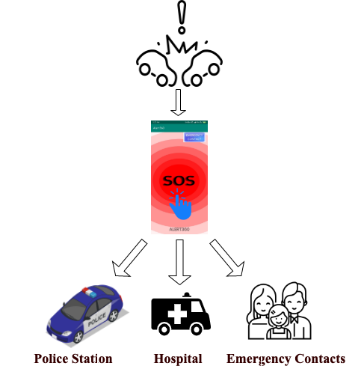
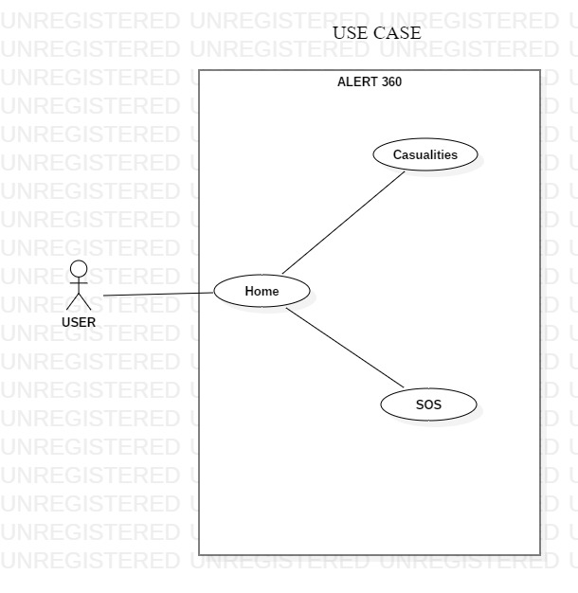
ALERT360

Slide 5
Solution
We are developing an android application which sends alerts when an unexpected casualty occurs.
If the user hits the SOS button, an alert will be sent to the nearby hospitals, police stations, and emergency contacts.
The user can also specify if there are more than one casualties.
The application can store emergency contacts given by the user.

Slide 6


Tech Stacks
Android studio
Firebase

Slide 7
Use Cases
Casualty
The user can enter the number of casualties and those casualties are stored in the database.
SOS
When the user hits the SOS button- based on the casualty- nearby hospitals, ambulances, fire stations, and police stations are alerted.

Slide 8
Alert360
Arsalan | Tejaswini | Amogha | Annanya | Viswatej | Hussain
HTF19- App Monsters
Thank You!
Notes:
Ss of app
logo

